Slide 1
Software Implementation of ECC2-131
刘志杰

Slide 2
Catalog
ECC2-131 Finite Field Construction
ECC2-131 Addition
ECC2-131 Reduction
ECC2-131 Square
ECC2-131 Multiplication
ECC2-131 Inversion
ECC2-131 Square Root
ECC2-131 Solving the Quadratic Equation

Slide 3
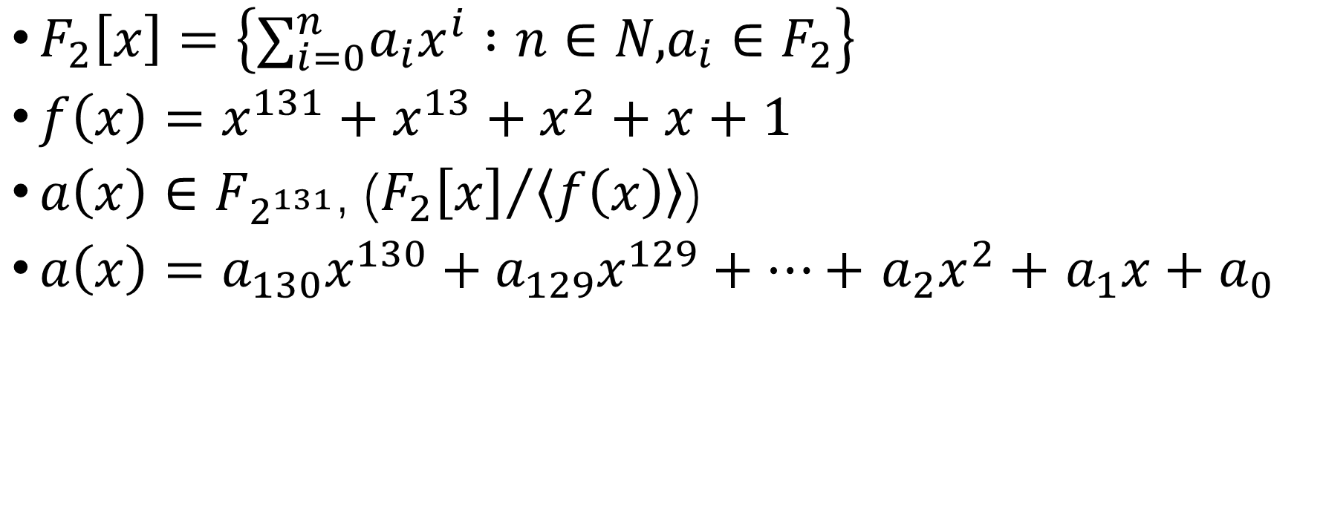
ECC2-131 Finite Field Construction
$F_{2}\left[x\right]=\left\{∑_{i=0}^{n}a_{i}x^{i} :n∈N\text{,}{a_{i}∈F}_{2}\right\}$
$f\left(x\right)=x^{131}+x^{13}+x^{2}+x+1$
$a\left(x\right)∈F_{2^{131}}$, (${F_{2}\left[x\right]}/{\left\langle f\left(x\right)\right\rangle }$)
$a\left(x\right)=a_{130}x^{130}+a_{129}x^{129}+⋯+$ $a_{2}x^{2}+$ $a_{1}x+a_{0}$

Slide 4
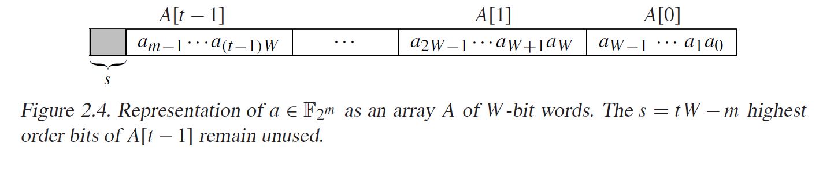

We assume that the implementation platform has a W-bit architecture where W is a multiple of 64. The bits of a W-bit word U are numbered from 0 to W −1, with the rightmost bit of U designated as bit 0.
The following standard notation is used to denote operations on words U and V :
U ⊕V bitwise exclusive-or
U &V bitwise AND
U >> i right shift of U by i positions with the i high-order bits set to 0
U << i left shift of U by i positions with the i low-order bits set to 0.
Let f (x) be an irreducible binary polynomial of degree m, and write $f\left(x\right)=x^{m}+r\left(x\right)$ The elements of $F_{2^{m}}$ are the binary polynomials of degree at most m −1.
Addition of field elements is the usual addition of binary polynomials. Multiplication is performed modulo f (x). A field element$a\left(x\right)=a_{m−1}x^{m−1}+⋯+a_{2}x^{2}+a_{1}x+a_{0}$ is associated with the binary vector $a=\left(a_{m−1},⋯,a_{2},a_{1},a_{0}\right)$ of length m.
In software, a may be stored in an array of t W-bit words: A = (A[t −1], . . ., A[2], A[1], A[0]), where the rightmost bit of A[0] is a0, and the leftmost s bits of A[t −1] are unused (always set to 0).

Slide 5
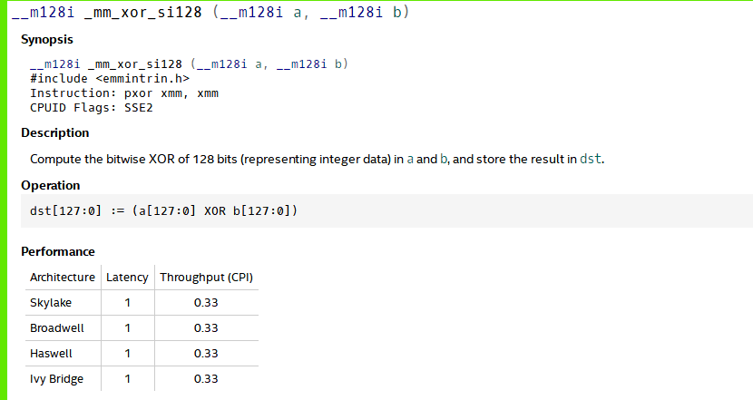
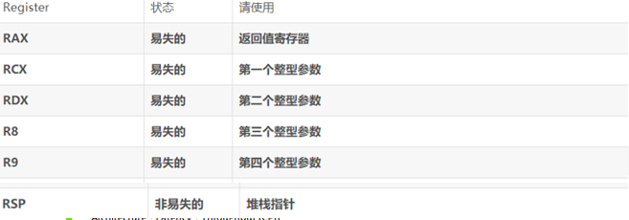
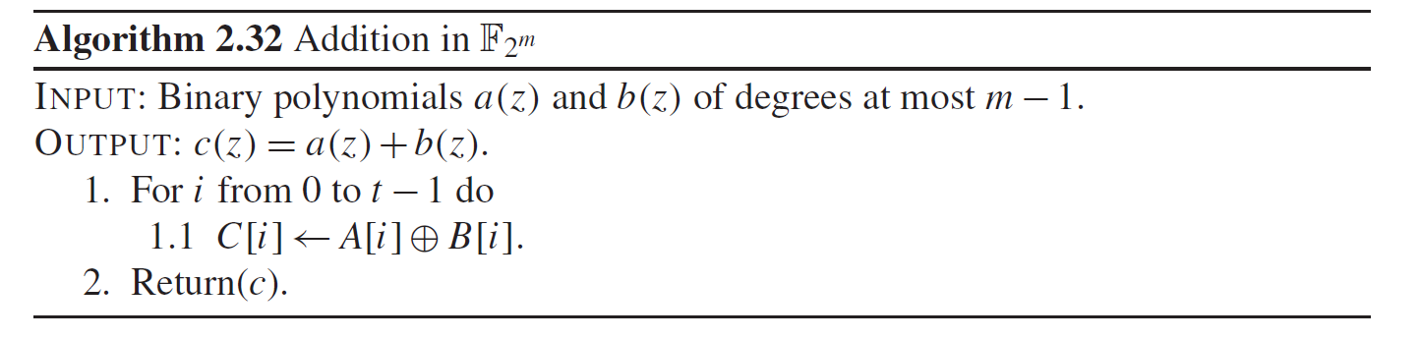
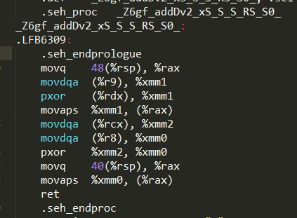
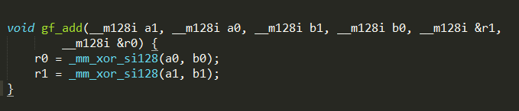
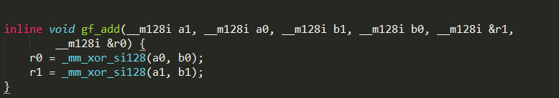
ECC2-131 Addition
算法实现：
⊕ bitwise exclusive-or
Notes:
R9 是 第四个 b0; rdx 是 a0
Rcx 是第一个 a1 r8 是b1
加入inline

Slide 6
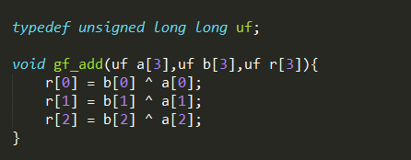
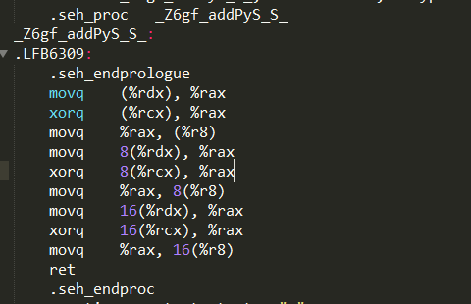
Common
Notes:
0.328 ns

Slide 7
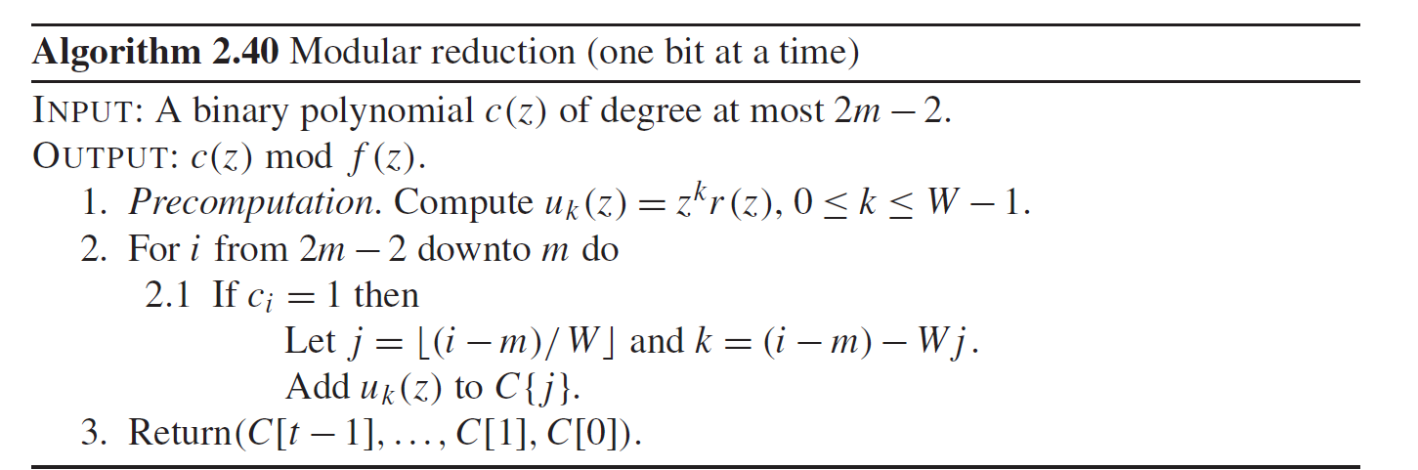

ECC2-131 Reduction
Recall that$f\left(x\right)=x^{m}+r\left(x\right)$ ,where r (x) is a binary polynomial of degree at most m −1. Algorithm 2.40 reduces c(x) modulo f (x) one bit at a time, starting with the leftmost bit. It is based on the observation that
$$c\left(x\right)=c_{2m−2}x^{2m−2}+⋯+c_{m}x^{m}+c_{m−1}x^{m−1}+⋯+c_{2}x^{2}+c_{1}x+c_{0}$$
$$≡\left(c_{2m−2}x^{2m−2}+⋯+c_{m}x^{m}\right)r\left(x\right)+c_{m−1}x^{m−1}+⋯+c_{2}x^{2}+c_{1}x+c_{0} \left(mod f\left(x\right)\right)$$
The reduction is accelerated by precomputing the polynomials $x^{k}r\left(x\right)$, 0 ≤ k ≤ W −1.
If r (x) is a low-degree polynomial, or if f (x) is a trinomial, then the space requirements
are smaller, and furthermore the additions involving $x^{k}r\left(x\right)$in step 2.1 are faster. The
following notation is used: if C = (C[n], . . .,C[2],C[1],C[0]) is an array, then C{ j }
denotes the truncated array (C[n], . . .,C[ j +1],C[ j ]).

Slide 8
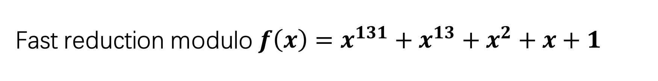
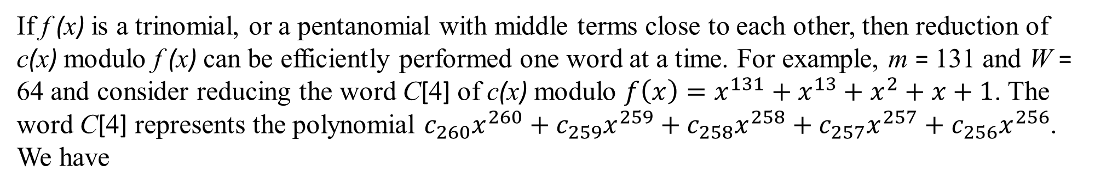
Fast reduction modulo $f\left(x\right)=x^{131}+x^{13}+x^{2}+x+1$
If f (x) is a trinomial, or a pentanomial with middle terms close to each other, then reduction of c(x) modulo f (x) can be efficiently performed one word at a time. For example, m = 131 and W = 64 and consider reducing the word C[4] of c(x) modulo $f\left(x\right)=x^{131}+x^{13}+x^{2}+x+1$. The word C[4] represents the polynomial $c_{260}x^{260}+c_{259}x^{259}+c_{258}x^{258}+c_{257}x^{257}+c_{256}x^{256}$. We have
$$x^{256}≡x^{138}+x^{127}+x^{126}+x^{125} \left(mod f\left(x\right)\right)$$
$$x^{257}≡x^{139}+x^{128}+x^{127}+x^{126} \left(mod f\left(x\right)\right)$$
$$x^{258}≡x^{140}+x^{129}+x^{128}+x^{127} \left(mod f\left(x\right)\right)$$
$$x^{259}≡x^{141}+x^{130}+x^{129}+x^{128} \left(mod f\left(x\right)\right)$$
$$x^{260}≡x^{142}+x^{131}+x^{130}+x^{129} \left(mod f\left(x\right)\right)$$
By considering the four columns on the right side of the above congruences, we see that reduction of C[4] can be performed by adding C[4] four times to C, with the rightmost bit of C[4] added to bits 138, 127, 126 and 125 of C;

Slide 9
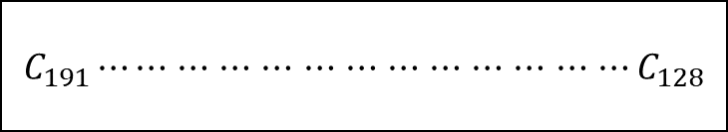
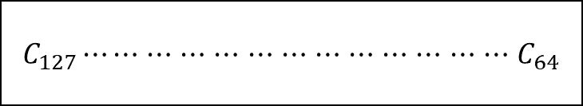
C[2]
C[1]
$C_{191}⋯⋯$ $⋯$ $⋯$ $⋯$ $⋯$ $⋯$ $⋯$ $⋯$ $⋯$ $⋯$ $⋯$ $⋯C_{128}$
$C_{127}⋯⋯$ $⋯$ $⋯$ $⋯$ $⋯$ $⋯$ $⋯$ $⋯$ $⋯$ $⋯$ $⋯$ $⋯$ $C_{64}$
⊕
C[4]
10
1
C[4]
⊕
2
C[4]
⊕
⊕
3
C[4]

Slide 10
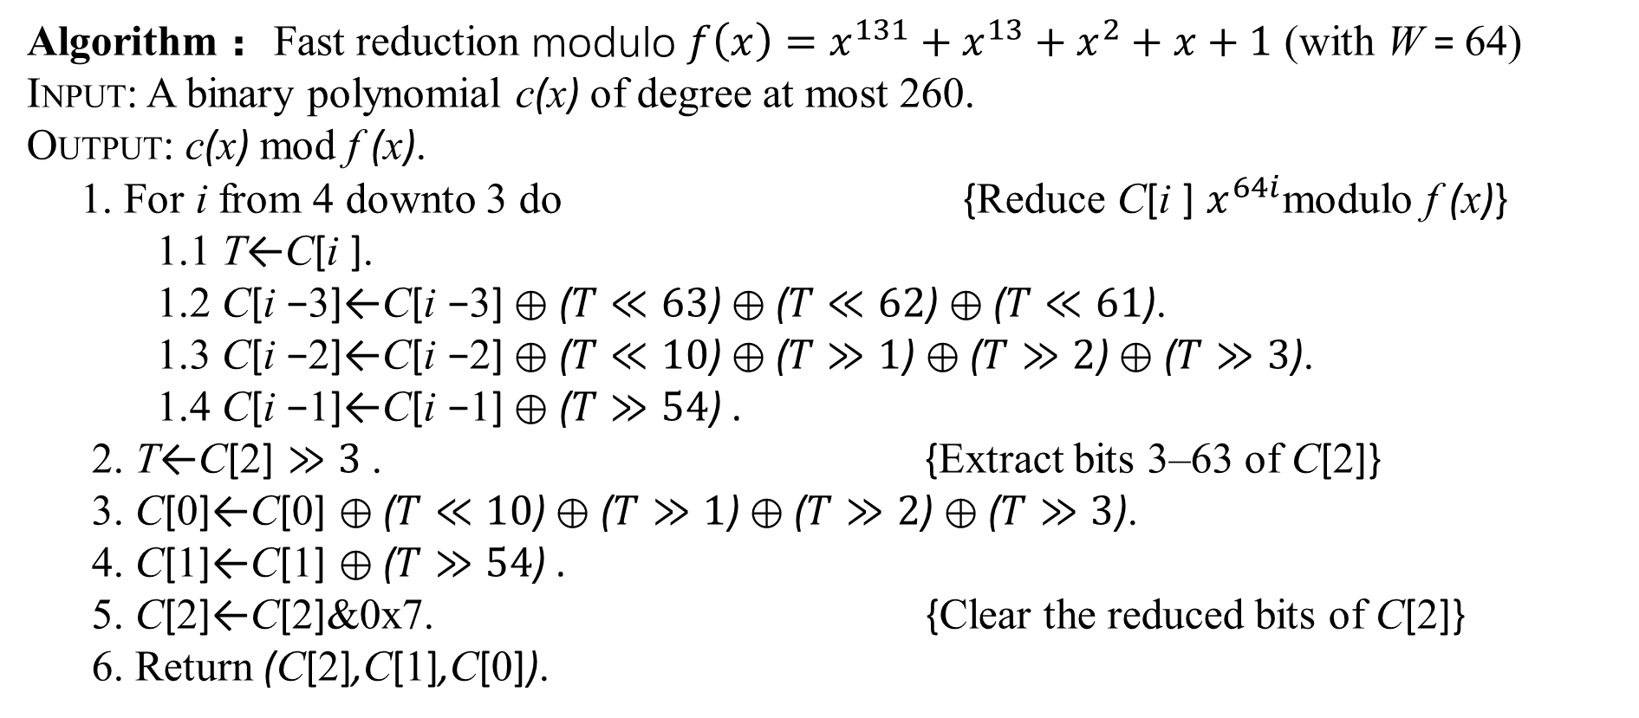
Algorithm： Fast reduction modulo $f\left(x\right)=x^{131}+x^{13}+x^{2}+x+1$ (with W = 64)
INPUT: A binary polynomial c(x) of degree at most 260.
OUTPUT: c(x) mod f (x).
1. For i from 4 downto 3 do {Reduce C[i ] $x^{64i}$modulo f (x)}
1.1 T←C[i ].
1.2 C[i −3]←C[i −3] ⊕ ($T≪63$) ⊕ ($T≪62$) ⊕ ($T≪61$).
1.3 C[i −2]←C[i −2] ⊕ ($T≪10$) ⊕ ($T≫1$) ⊕ ($T≫2$) ⊕ ($T≫3$).
1.4 C[i −1]←C[i −1] ⊕ ($T≫54$) .
2. T←C[2] $≫3$ . {Extract bits 3–63 of C[2]}
3. C[0]←C[0] ⊕ ($T≪10$) ⊕ ($T≫1$) ⊕ ($T≫2$) ⊕ ($T≫3$).
4. C[1]←C[1] ⊕ ($T≫54$) .
5. C[2]←C[2]&0x7. {Clear the reduced bits of C[2]}
6. Return (C[2],C[1],C[0]).

Slide 11
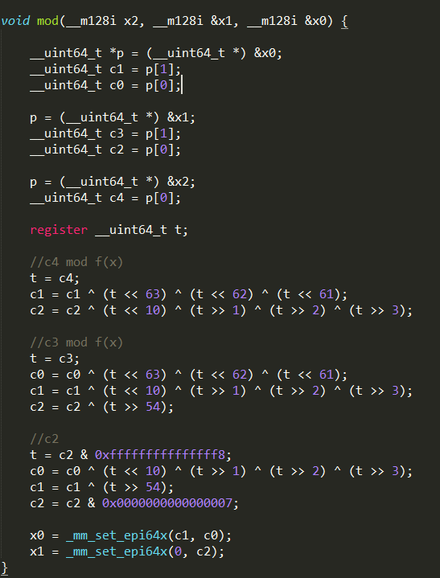
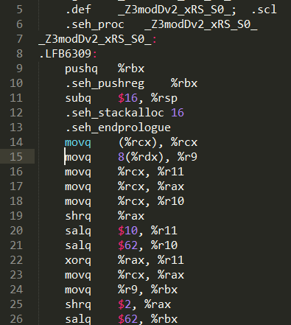
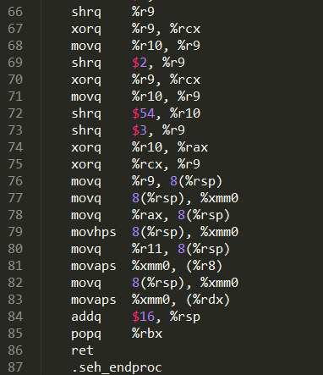

Slide 12
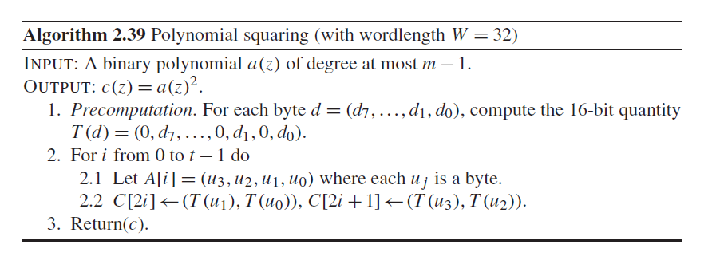
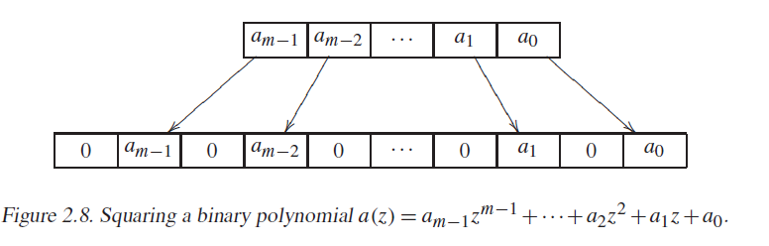

ECC2-131 Square
Since squaring a binary polynomial is a linear operation, it is much faster than multiplying
two arbitrary polynomials; i.e., if $a\left(x\right)=a_{m−1}x^{m−1}+⋯+$ $a_{2}x^{2}+$ $a_{1}x+a_{0}$
then
${a\left(x\right)}^{2}=a_{m−1}x^{2m−2}+⋯+$ $a_{2}x^{4}+a_{1}x^{2}+a_{0}$
The binary representation of ${a\left(x\right)}^{2}$is obtained by inserting a 0 bit between consecutive
bits of the binary representation of $a\left(x\right)$as shown in below. To facilitate this process,
a table T of size 512 bytes can be precomputed for converting 8-bit polynomials
into their expanded 16-bit counterparts. Algorithm 2.39 describes this procedure for
the parameter W = 32.

Slide 13
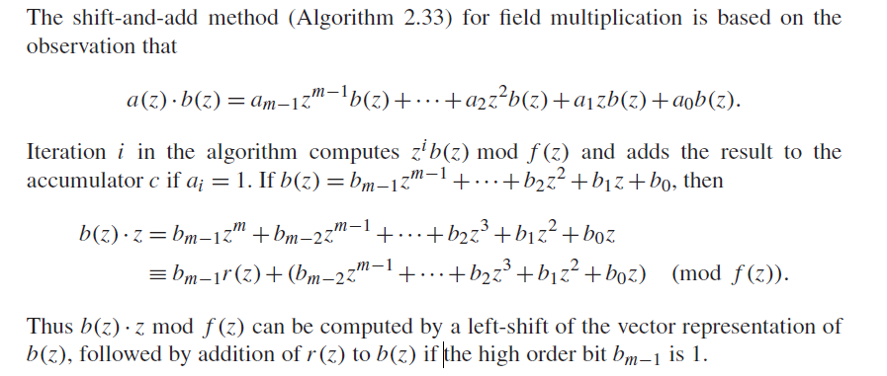
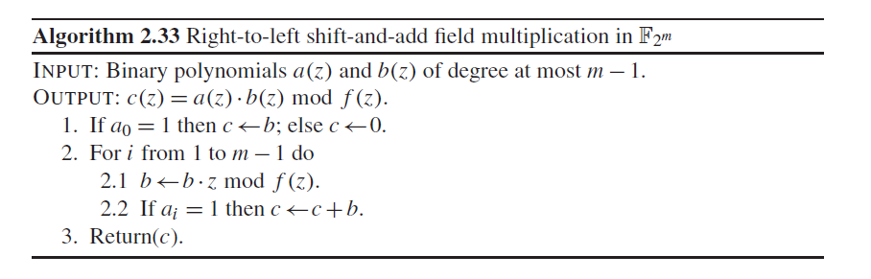
ECC2-131 Multiplication

Slide 14
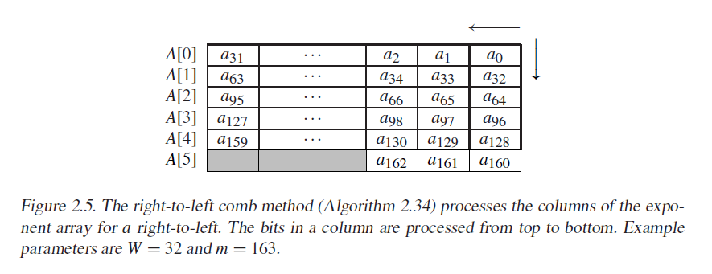
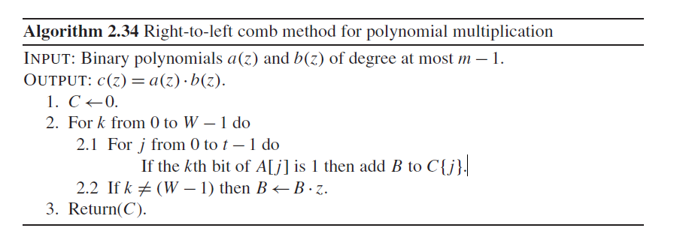

Slide 15
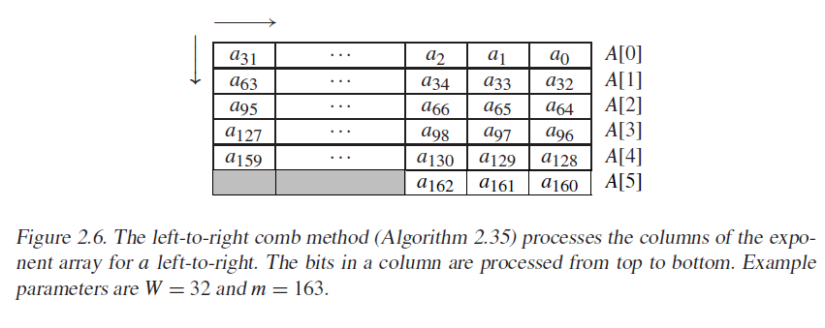
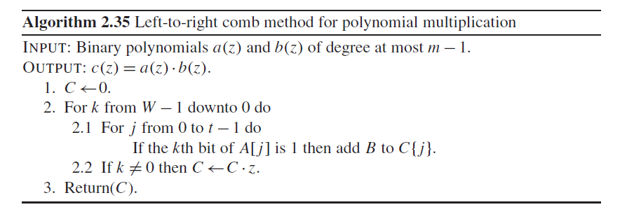

Slide 16
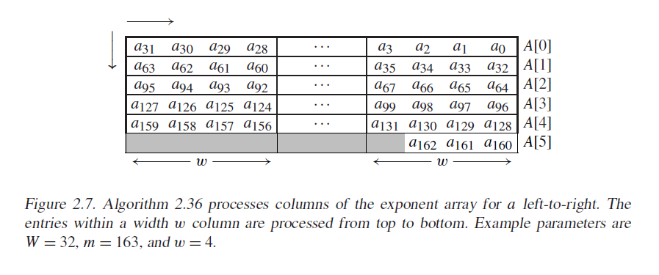
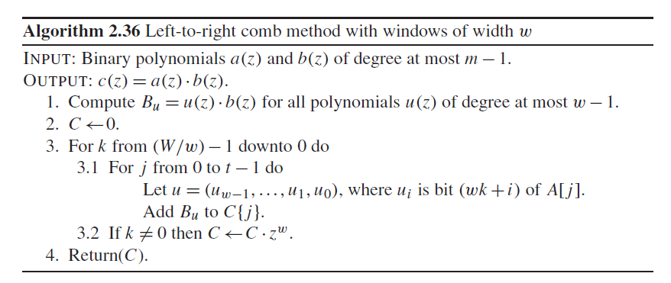

Slide 17
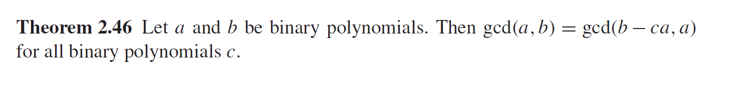
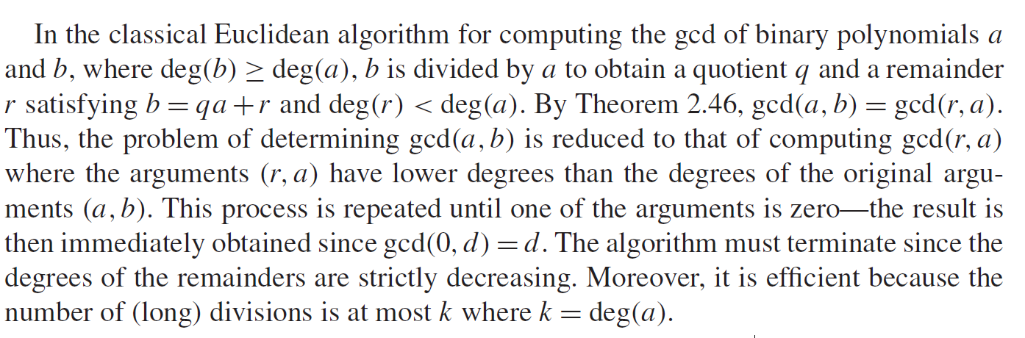
ECC2-131 Inversion
Notes:
17 10
17=10 +7 7=17-7 1=7-2*3
10 = 7+ 3 3=10-7 =7-2*(10-7)
7=2*3 +1 1=7-2*3 =(-2)*10 +3*7
=(-2)*10+3*(17-10)
=(-5)*10+3*17

Slide 18
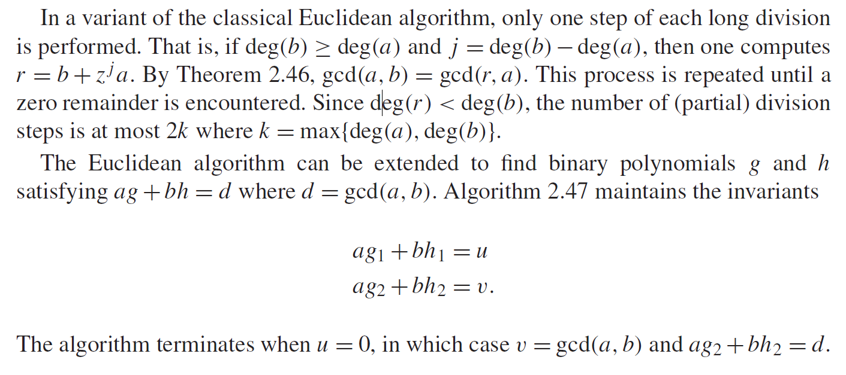

Slide 19
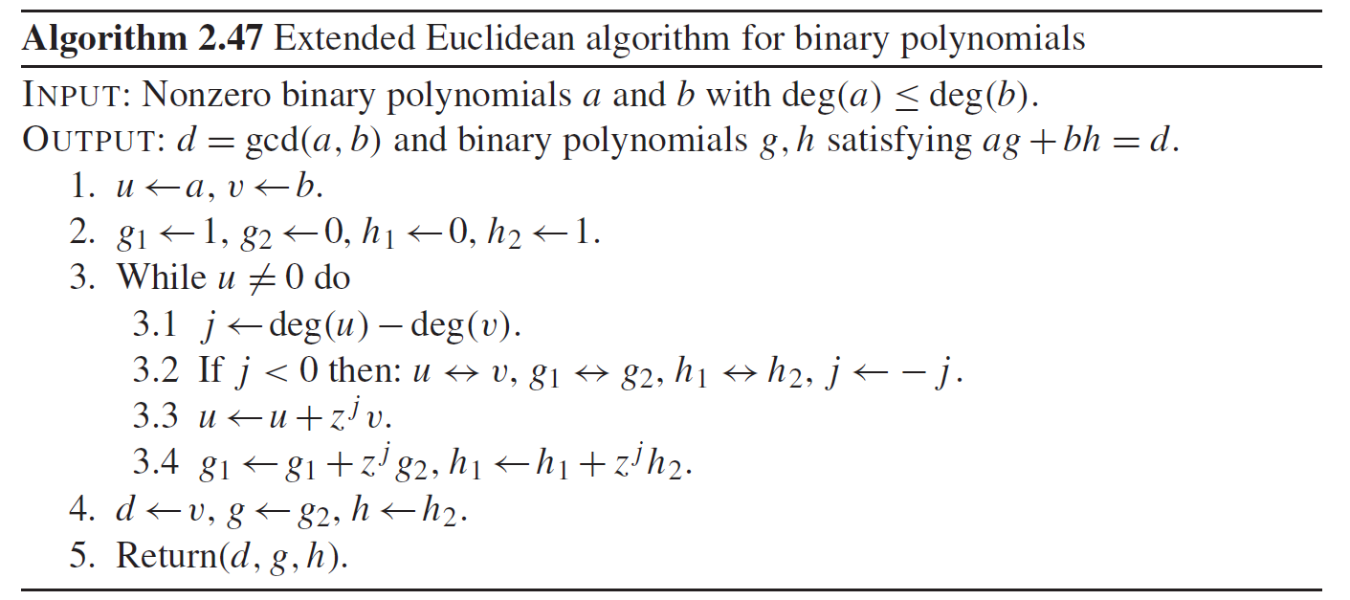

Slide 20
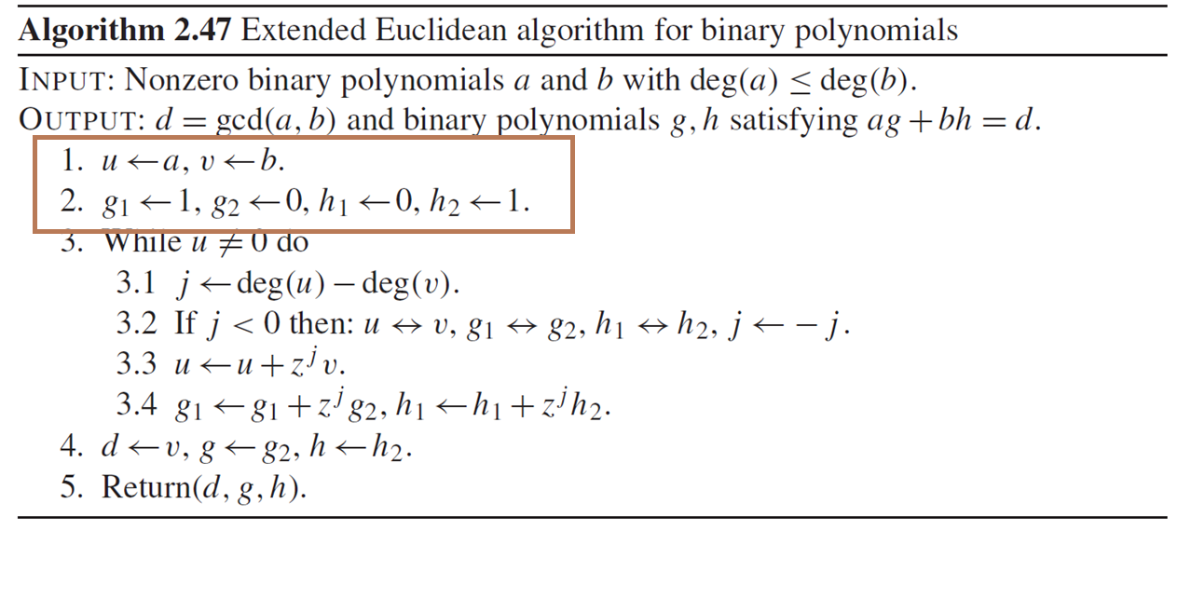

$$a∗1+b∗0=u$$
$$a∗0+b∗1=v$$

Slide 21
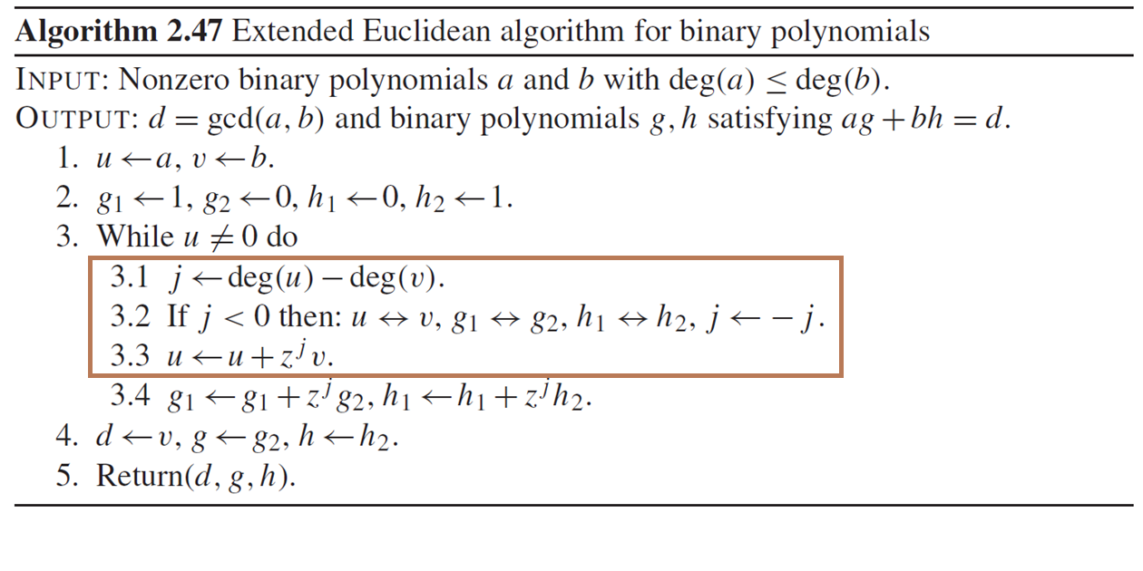
Make sure that deg(u) ≥ deg(v) and j = deg(u)−deg(v), then one computes
$r=u+z^{j}v$. By Theorem 2.46, gcd(u,v) = gcd(r,v).
Notes:
一次不一定是 deg(u)<deg(v).多次之后，就会是
实质就是 r = a – z*b;

Slide 22
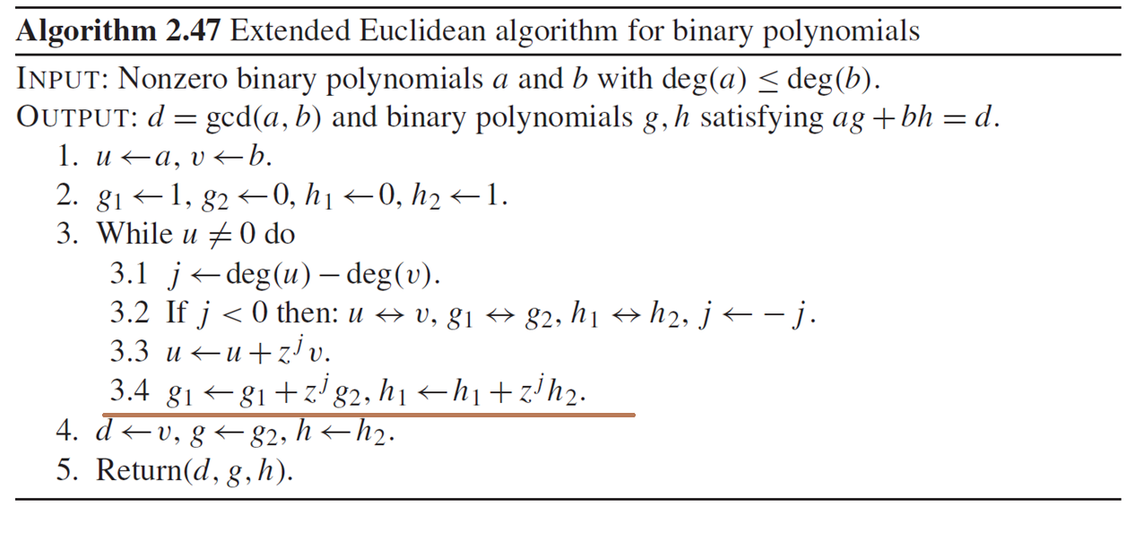
$$a\left(g_{1}+z^{j}g_{2}\right)+b\left(h_{1}+z^{j}h_{2}\right)=u+z^{j}v$$
Notes:
然后，a 和 b 以及余数要写出 ad + bc的形式

Slide 23
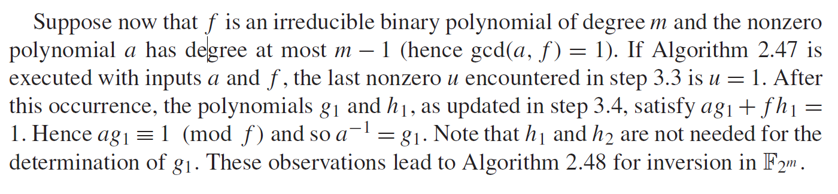
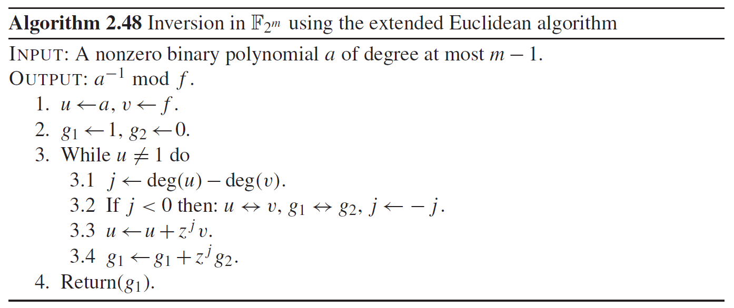
Notes:
Ag+fh=1 mod f >>> ag mod f + fh mod f = 1mod f >>> ag mod f ==1 因为 fh mod f =0

Slide 25
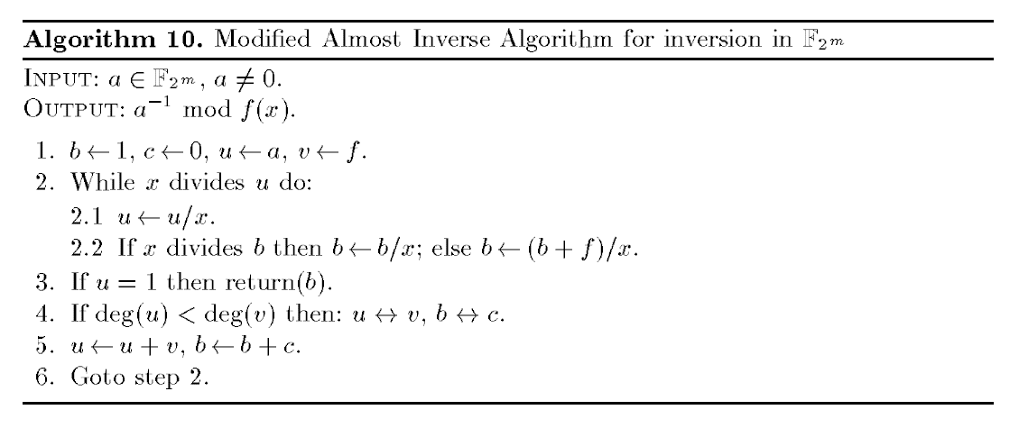

Slide 26
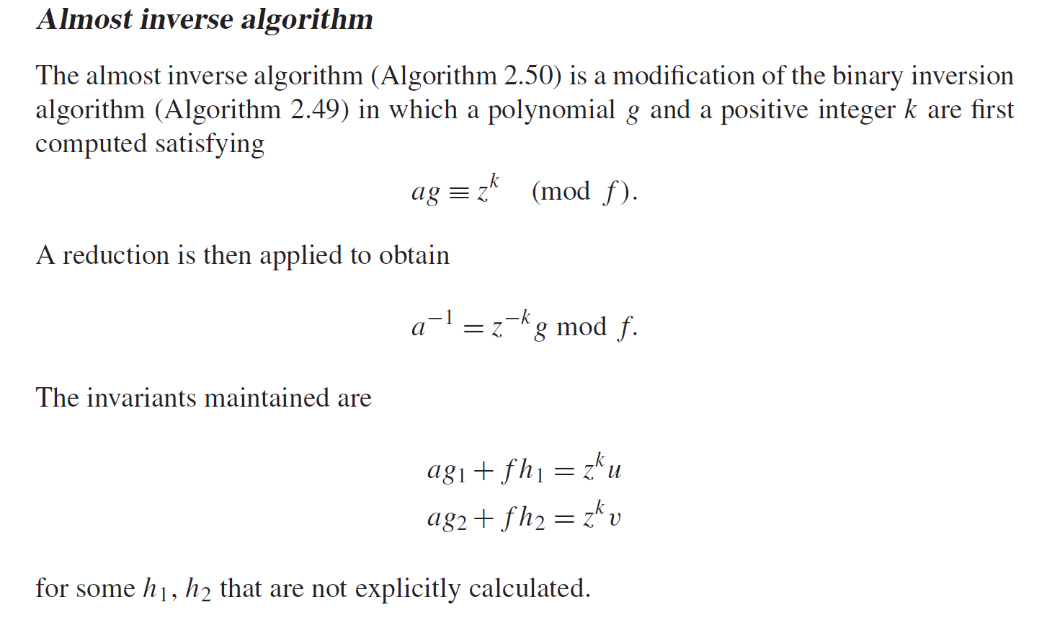

Slide 27
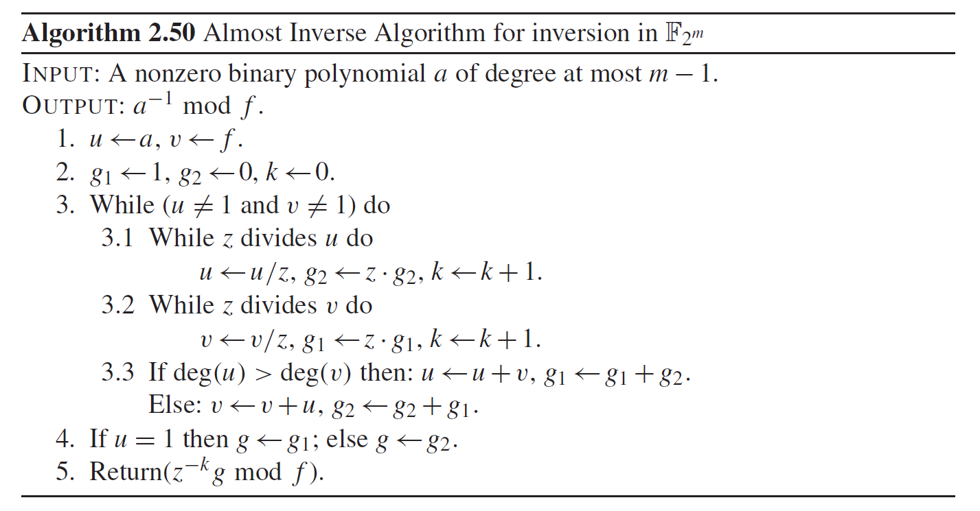

Slide 28
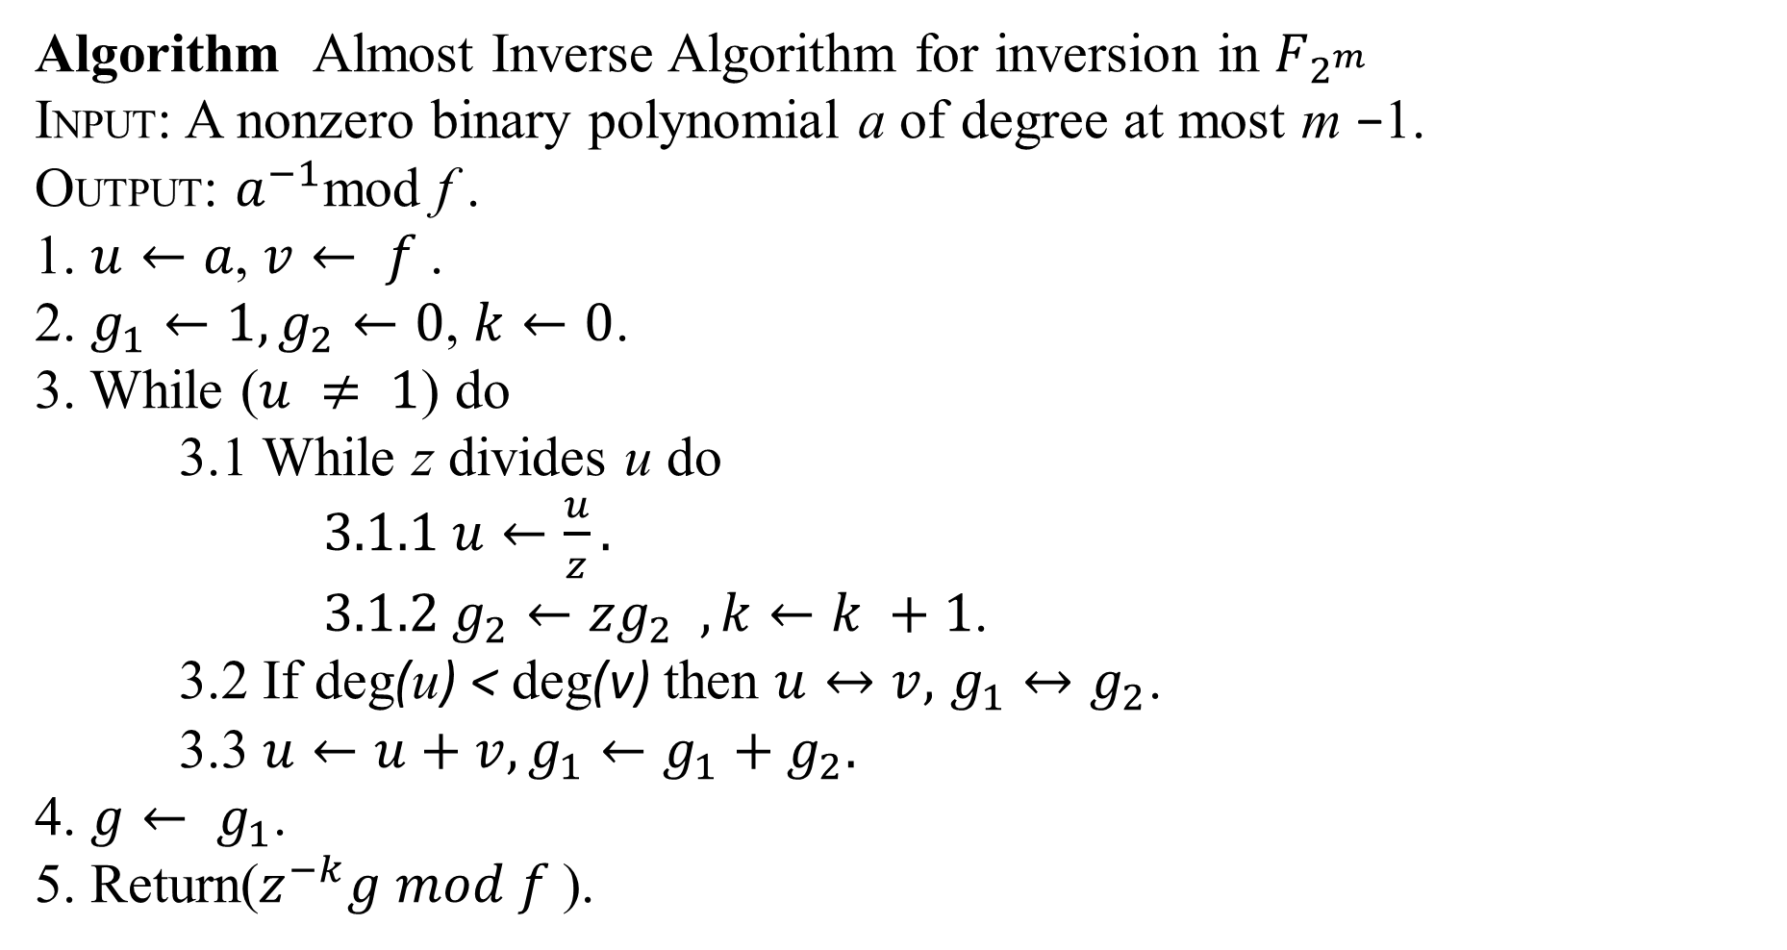
Algorithm Almost Inverse Algorithm for inversion in $F_{2^{m}}$
INPUT: A nonzero binary polynomial a of degree at most m −1.
OUTPUT: $a^{−1}$mod f .
1. $u←a$, $v← f$.
2. $g_{1}←1,g_{2}←0$, $k←0$.
3. While ($u ≠ 1$) do
3.1 While z divides u do
$3.1.1 u←\frac{u}{z}.$
$3.1.2 g_{2}←zg_{2} , k←k +1$.
3.2 If deg(u) < deg(v) then $u↔v,$ $g_{1}↔g_{2}$.
3.3 $u←u+v,g_{1}←g_{1}+g_{2}.$
4. $g← g_{1}$.
5. Return($z^{−k}g mod f$).

