Slide 1
Recreating flowdroid report
Johanthan Lemon

Slide 2
problem
I did not solve a problem, but instead aimed to replicate a tool that aimed to solve the problem of testing security vulnerabilities and created a powerful tool for call graph generation in the process.

Slide 3
The initial problem
The initial problem was testing security vulnerabilities inside android applications. To do this, they implemented call graph generation inside the tool. A side effect of this was a call graph that was so in depth other tools started using the tool solely for getting it.

Slide 4
Aims
I wanted to do two things researching the tool. Check the simplicity of integration and check how in depth the call graph generated was. I went to run the tool on some android and run it locally to find these things.

Slide 5
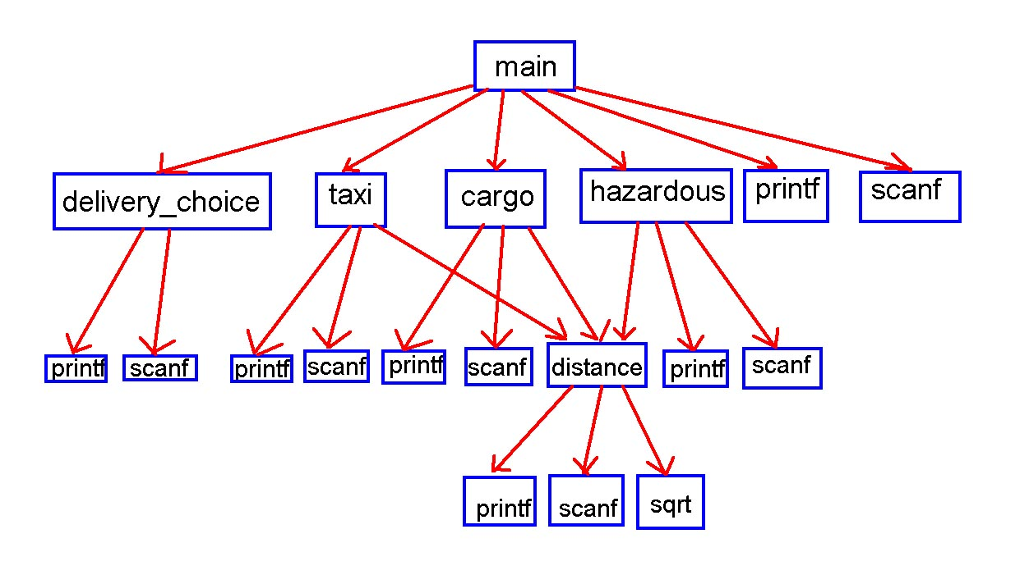
Example call graph

Slide 6
Technique
Since I was replicating and investigating a tool, I used the implementation of the tool. I chose to do the command line version of the flowdroid that can be found on their github page. The command line version simply needed to run the jar with three things: an android jdk jar directory, the apk file of the desired app to test, and a sourcesink that details what counts as a leak.

Slide 7
Running the tool locally
Running the tool locally was a very simple process. Their documentation was clear and lacked confusion. They had multiple options for running the tool and I decided that running in the command line would be the easiest. It ran fine and fast, and would generate a call graph, but it would not seem to appear anywhere. They had an output folder, but locally it would not report anything there.

Slide 8
Findings
Simplicity of use: the tool is very easy to use. It was very well documented, did not have many moving pieces, and only required an apk to analyze. Comparative to other tools, it was much more streamlined.
Usefulness of call graph: I was unable to find a meaningful answer to this question as, while the tool appeared to be generating them, I could not find where it would output to.

Slide 9
Threats to validity
My implementation may have missed a step in generating and that may have led to issues with the lack of output.
I used the command line version. The results may have been different if I implemented it in a different way such as through eclipse.

