Slide 1
PathSense
Adaptive Path Planning & Collision Avoidance for Autonomous Vehicles on Unstructured Indian Roads
Smart India Hackathon 2026 · Problem Statement SIH26037

Slide 2
The Problem: Roads That Don't Follow the Textbook
• Indian roads are unstructured: lanes, rules and geometry are negotiated in real time.
• Cows, goats and pedestrians cross anywhere, anytime.
• Carts, parked vehicles and potholes shrink the drivable corridor.
• Wrong-side traffic and occluded bends hide threats until the last second.
•
• Standard AD planners assume lane markings, structured traffic and predictable agents - they fail here.
• Sound often arrives before sight: horns and sirens around occlusions are invisible to cameras.
PathSense · SIH26037

Slide 3
Our Solution: A Full Autonomy Stack Built for Chaos
• Perception
  – Ground-truth / noisy sensor simulation + synthetic camera vision pipeline (Sprint 2+)
  – Acoustic attention: horn/siren cues with direction-of-arrival (occluded threats)
• Mapping
  – Local costmap with inflation on a road-network prior
• Global planning
  – A* on the costmap with dynamic replanning when the route blocks
• Local planning & collision avoidance
  – Time-aware DWA: predicts dynamic obstacles forward in time, respects steering/braking limits
  – OBB (oriented bounding box) collision geometry - no inflated-circle cheats
• Control & safety
  – Pure Pursuit + kinematic bicycle model
  – Independent envelope safety monitor: physical-limit enforcement as a last line of defence
PathSense · SIH26037

Slide 4
What Makes This Different
• Time-aware obstacle prediction - DWA scores trajectories against where animals WILL be, not where they are.
• Audio-visual fusion - a mic-array 'acoustic attention' module hears horns/sirens around occlusions and couples them to speed capping (creep-and-yield).
• Independent safety envelope - a monitor outside the planner physically vetoes impossible commands.
• Honest metrics - collision counts, TTC, path efficiency, jerk and planning latency auto-reported for every scenario run.
• Deterministic, testable pipeline - 7 scripted Indian-road scenarios, one command, reproducible results.
PathSense · SIH26037

Slide 5
Results: 7 / 7 Scenarios PASS, Zero Collisions
Scenario | Status | Path Eff. | Min Clearance | E-Stops | Min TTC
Static Obstacle | PASS | 94.09% | 2.79 | 0.00 | -
Crossing Animal | PASS | 98.49% | 6.00 | 0.00 | 1.89
Multi Animal | PASS | 100.00% | 1.40 | 0.00 | -
Indian Road | PASS | 99.53% | 0.38 | 0.00 | 4.84
City Roads | PASS | 80.60% | 1.51 | 0.00 | 0.88
Sensor Noise | PASS | 95.54% | 2.83 | 0.00 | -
Occluded Siren | PASS | 97.47% | 0.37 | 0.00 | 0.93
Full details: metrics_report.md (auto-generated)

Slide 6
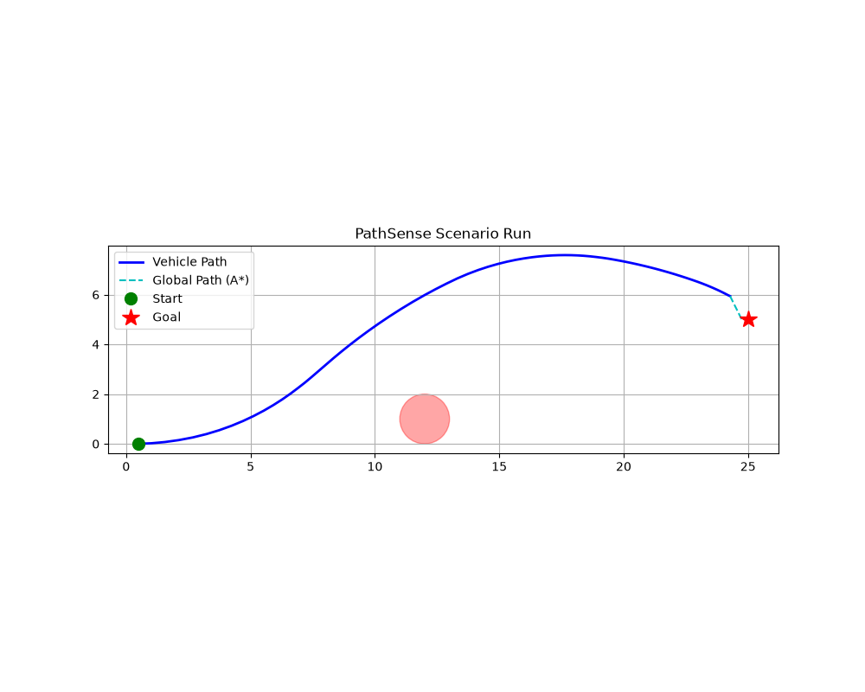
Static Obstacle
A* reroutes around a blocked lane; DWA keeps a safe margin.
Status: PASS
Min Clearance M: 2.79
Path Efficiency: 94.09%
PathSense · SIH26037

Slide 7
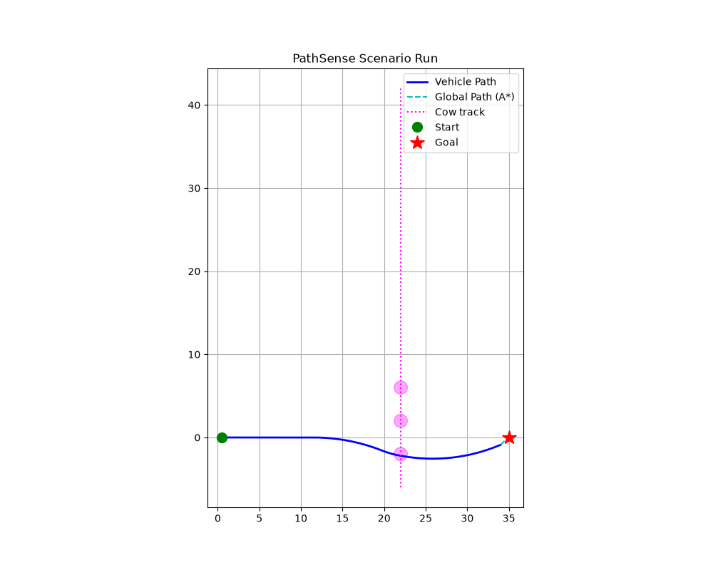
Crossing Animal
Sudden goat crossing: time-aware DWA predicts motion and swerves within dynamic limits.
Status: PASS
Min Ttc S: 1.89
Path Efficiency: 98.49%
Rejoin T S: 10.30
PathSense · SIH26037

Slide 8
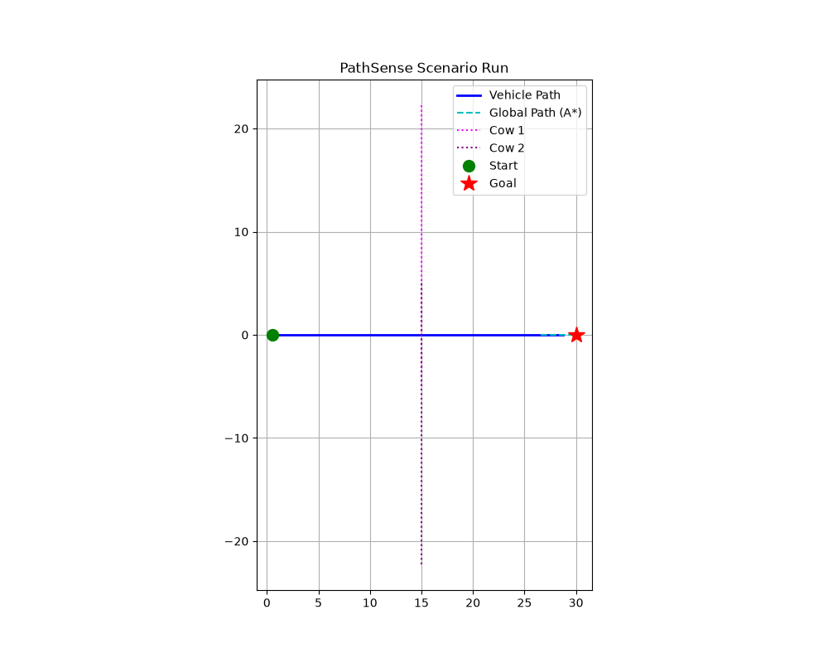
Multi Animal
Simultaneous dynamic obstacles handled with zero emergency stops.
Status: PASS
Min Clearance M: 1.40
Emergency Stops: 0.00
PathSense · SIH26037

Slide 9
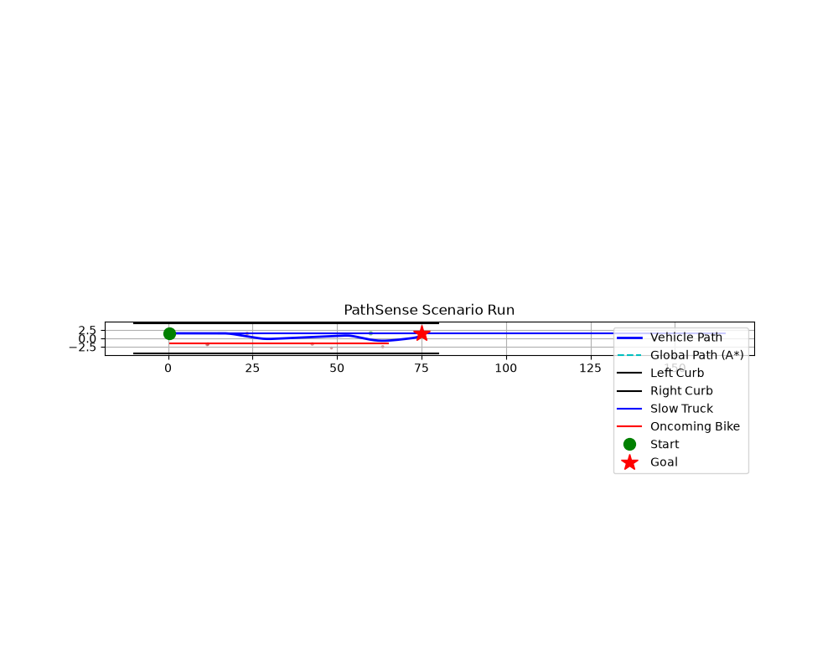
Indian Road
Encroaching carts, wrong-side traffic and potholes on a single route.
Status: PASS
Path Efficiency: 99.53%
Min Clearance M: 0.38
PathSense · SIH26037

Slide 10
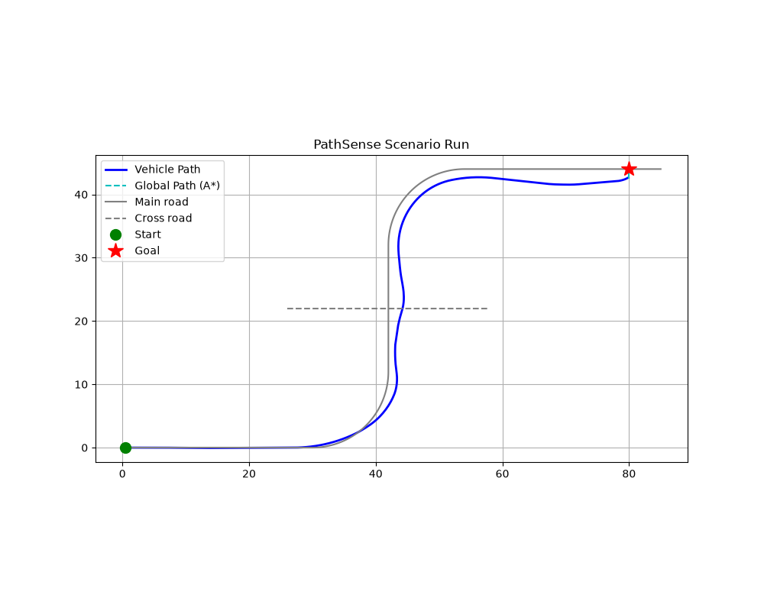
City Roads
Dense urban traffic; emergency stops used, zero collisions.
Status: PASS
Emergency Stops: 0.00
Path Efficiency: 80.60%
PathSense · SIH26037

Slide 11
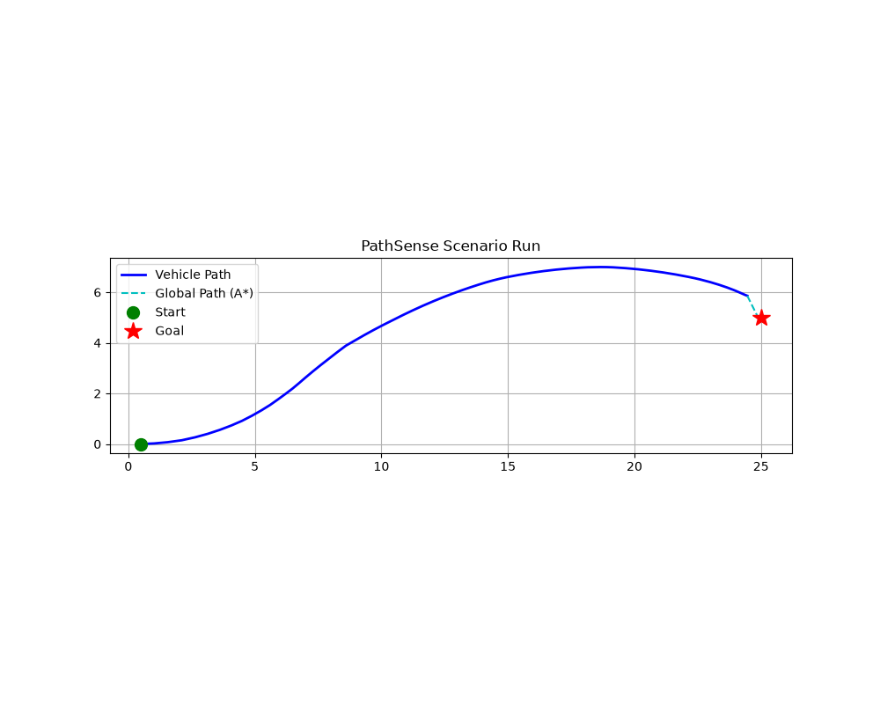
Sensor Noise
Noisy detections still yield a stable, collision-free path.
Status: PASS
Min Clearance M: 2.83
Path Efficiency: 95.54%
PathSense · SIH26037

Slide 12
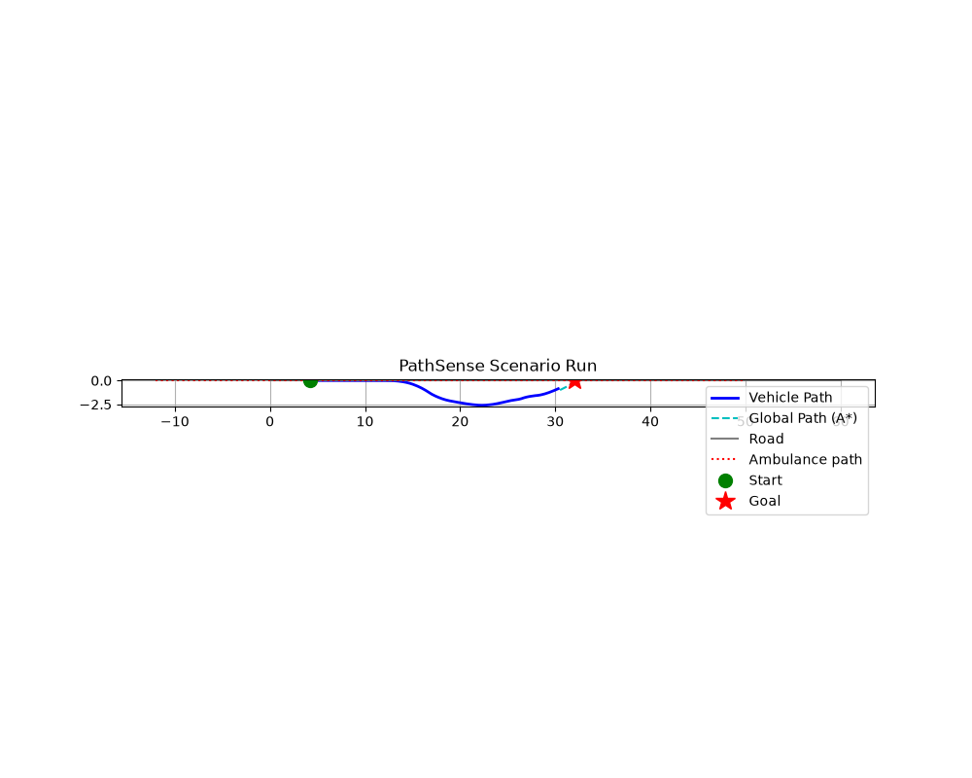
Occluded Siren
Acoustic attention: the vehicle hears the siren it cannot see and creeps cautiously.
Status: PASS
Max Hold Speed Mps: 0.14
Post Siren Progress M: 17.20
Emergency Stops: 0.00
PathSense · SIH26037

Slide 13
Honest Limitations
• Vision pipeline uses a synthetic camera model - no trained detector weights yet; detection is geometry-driven.
• Acoustic module runs on synthetic event injection, not live mic hardware.
• City-roads scenario needs 5 emergency stops - comfort tuning is open.
• Single ego vehicle; no multi-agent negotiation yet.
• Simulation-first: hardware port is a stretch goal.
PathSense · SIH26037

Slide 14
Road to Submission (30 Sep)
• Sprint 3 (23-27 Sep): full-suite hardening, dashboard polish, stress tests.
• Sprint 4 (28-30 Sep): demo video, final PPT with these results, dry runs.
• Stretch: small-scale hardware rig + live audio capture.
PathSense · SIH26037

