Slide 1

Sprint 1: Quantum Computing Simulator
EC601 Product Design in Electrical and Computer Engineering
Department of Electrical and Computer Engineering
Christopher Lemus
lemusc@bu.edu
2026 October 13

Slide 2
Mission Statement
For students who need a GUI-based quantum circuit simulator, the Quantum Circuit Simulation Tool will support learning quantum material. Unlike the SDK Qiskit, it provides an additional layer of abstraction to make simulating quantum circuits intuitive along with useful examples

Slide 3
User Stories
As a beginner student, I want to select a simple quantum circuit template, so that I can run a simulation without writing code and learn what it does
As a student, I want to see the equivalent Qiskit code, so that I can connect the visual circuit to programming syntax
As a student, I want explanations at different difficulty levels, so that I can follow along even without prior background
As a non-English speaking student, I want core interface labels translated, so that I can navigate the tool and learn the material
As a student, I want results to be clearly labeled as simulator or real-time hardware output, so classical simulation is not confused with real quantum hardware behavior

Slide 4
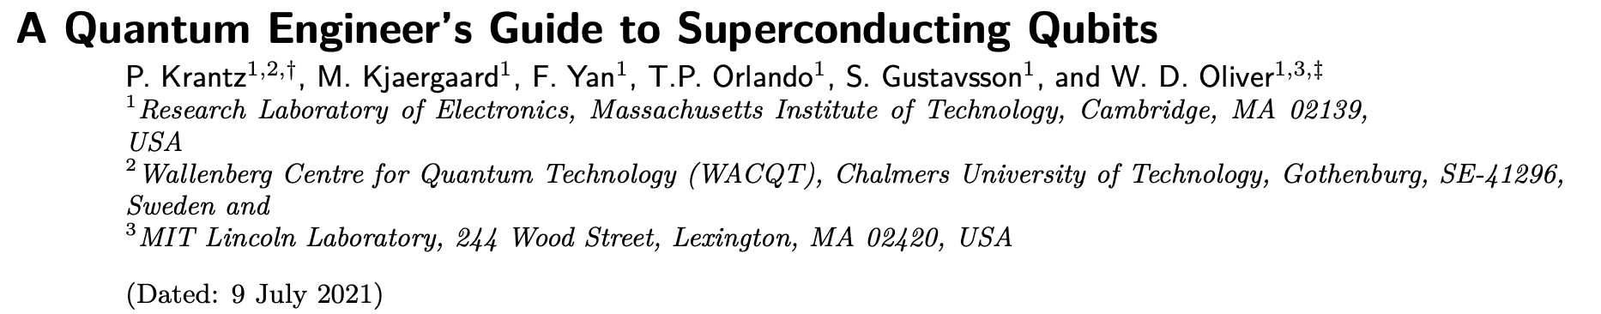
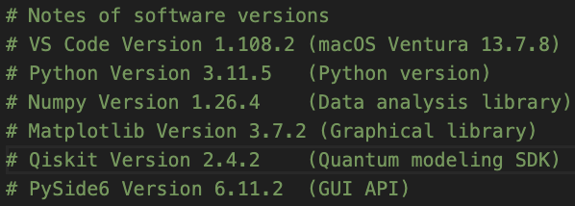
Tools

Slide 5
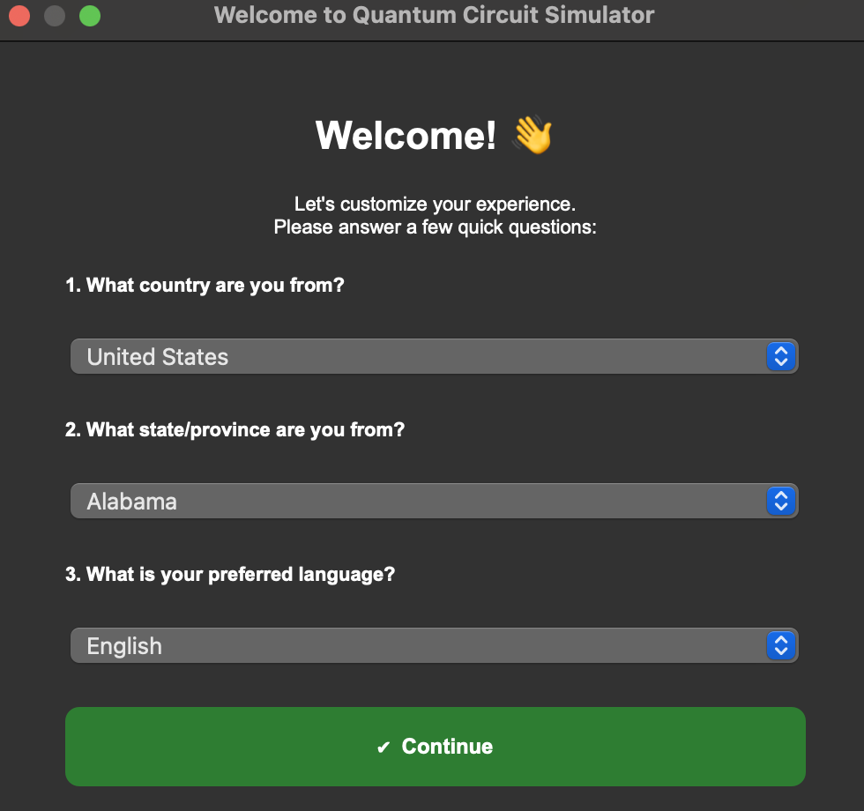
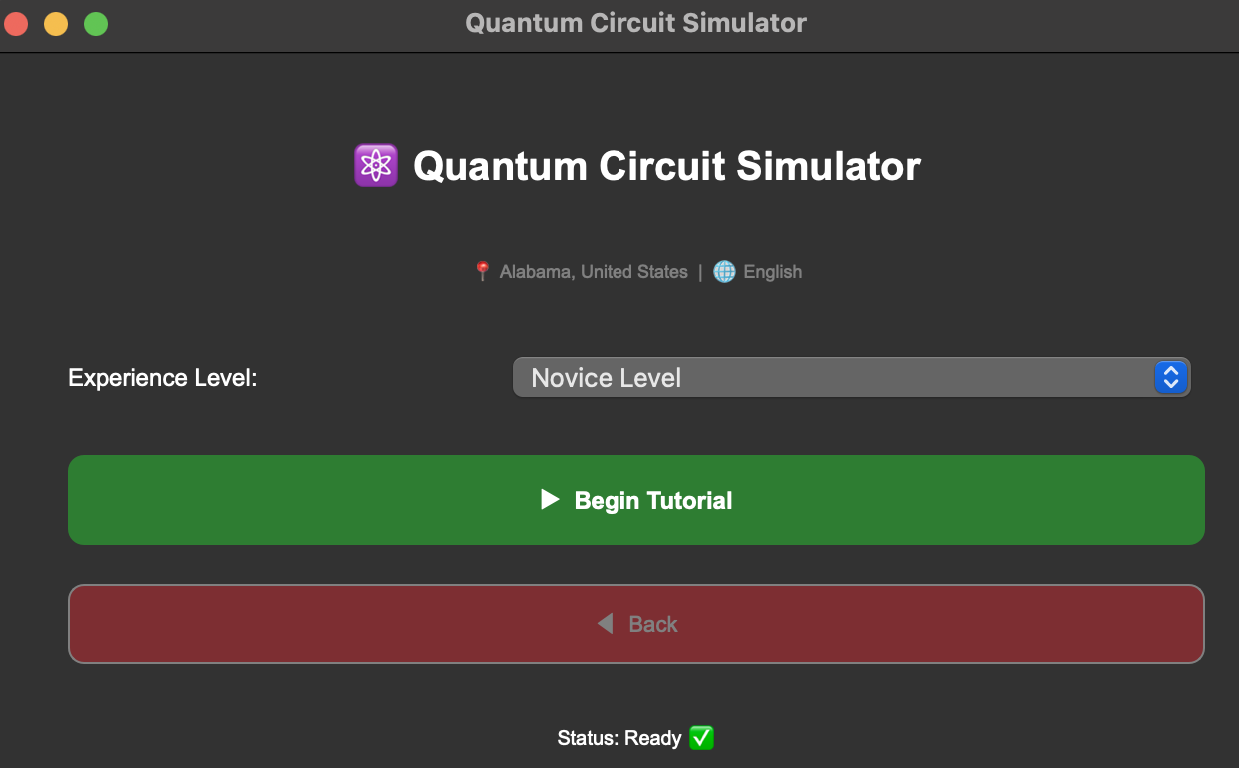
Progress

Slide 6
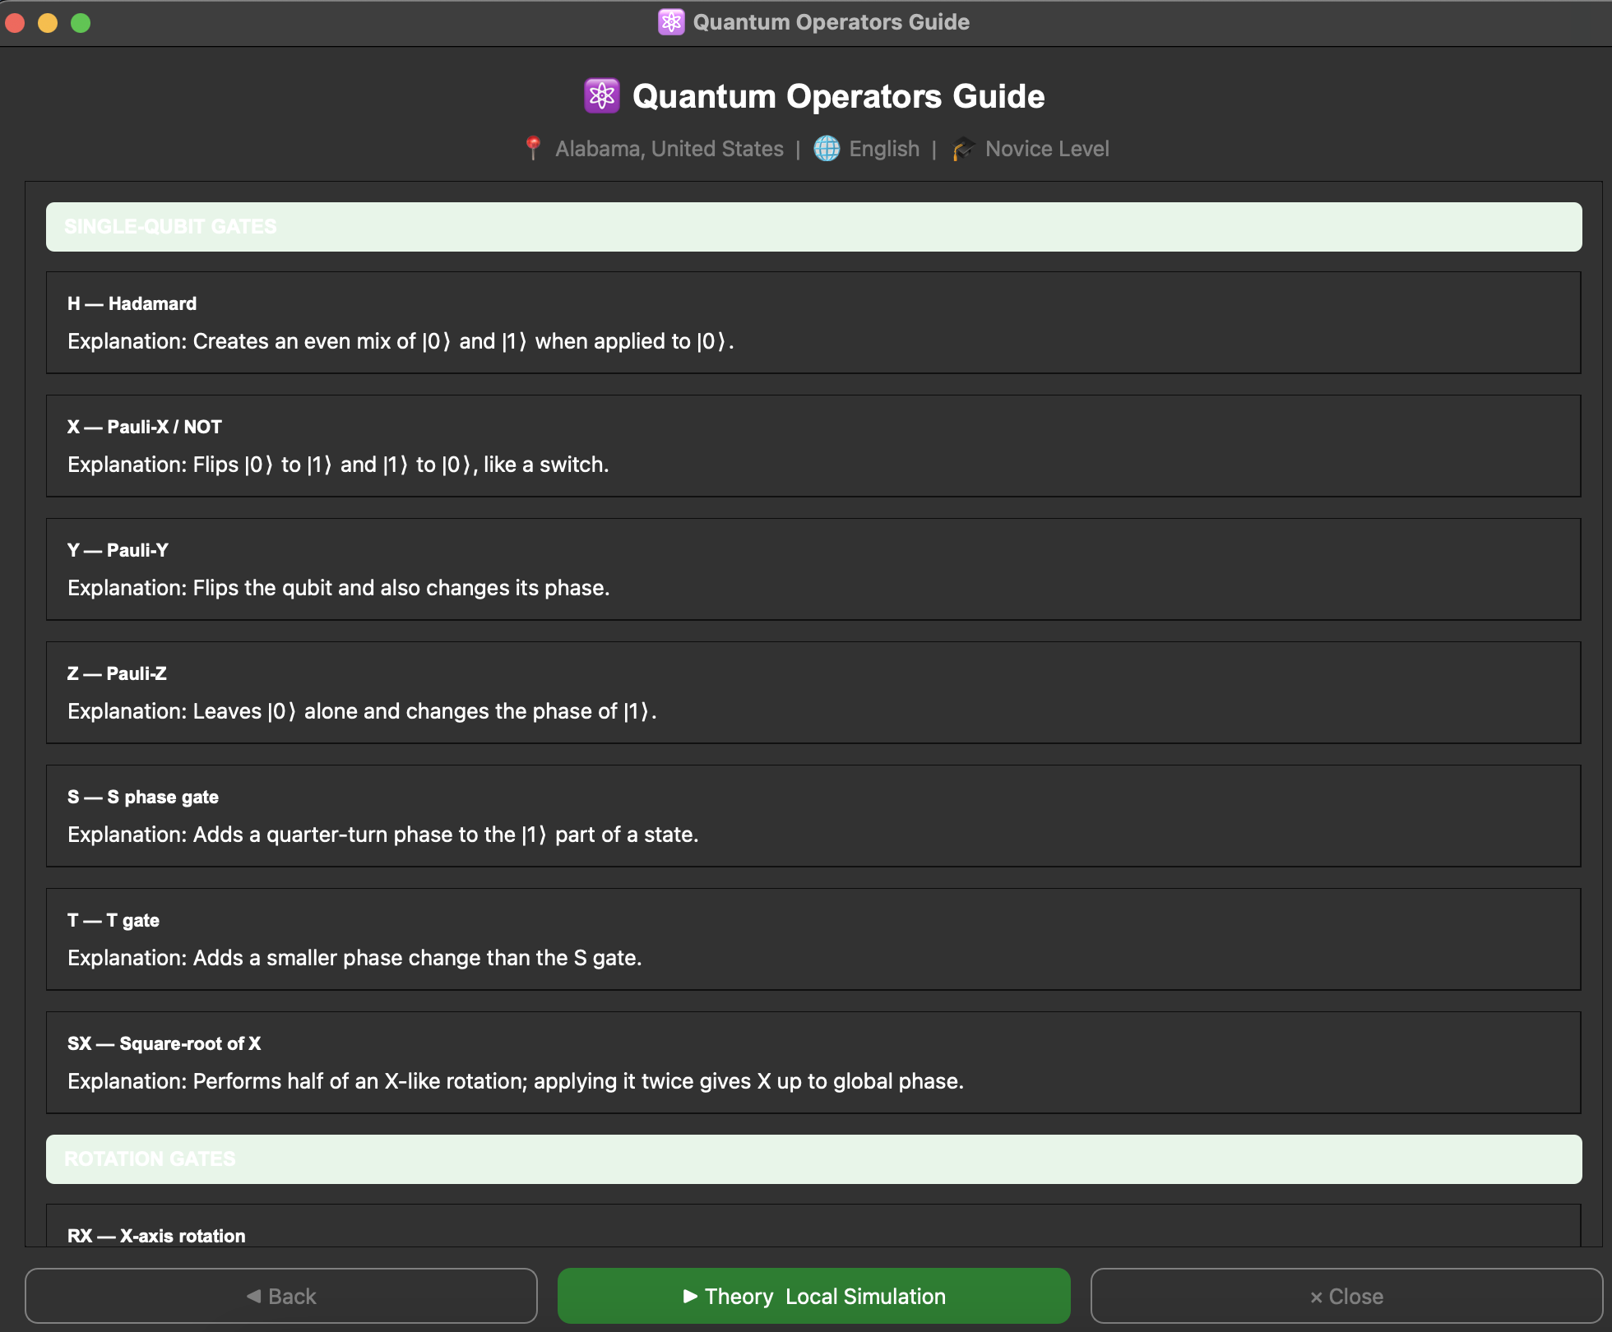
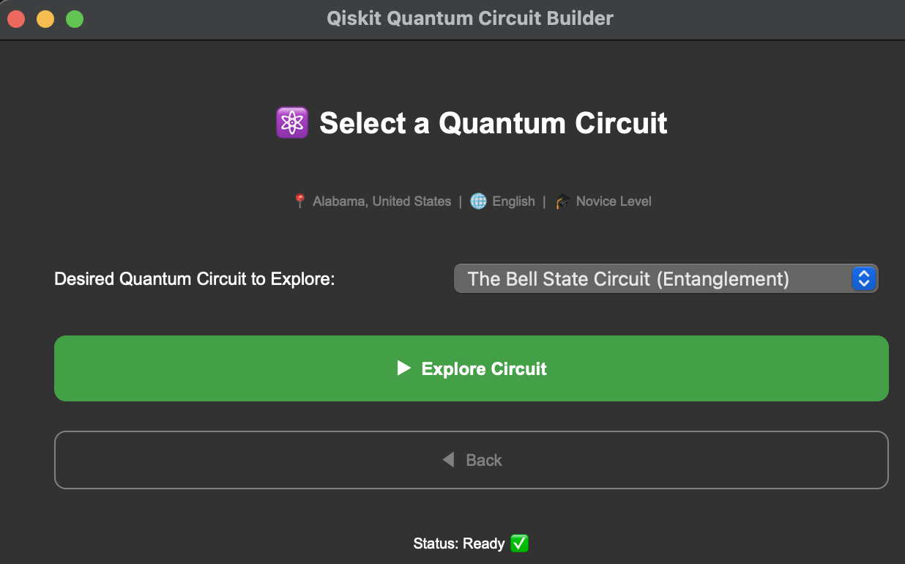
Progress

Slide 7
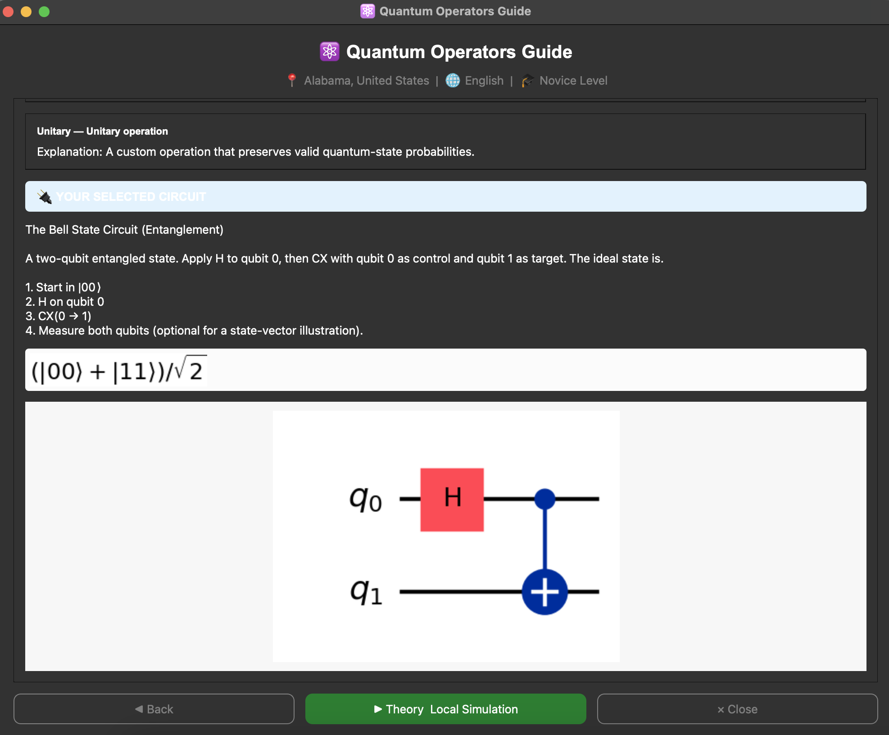
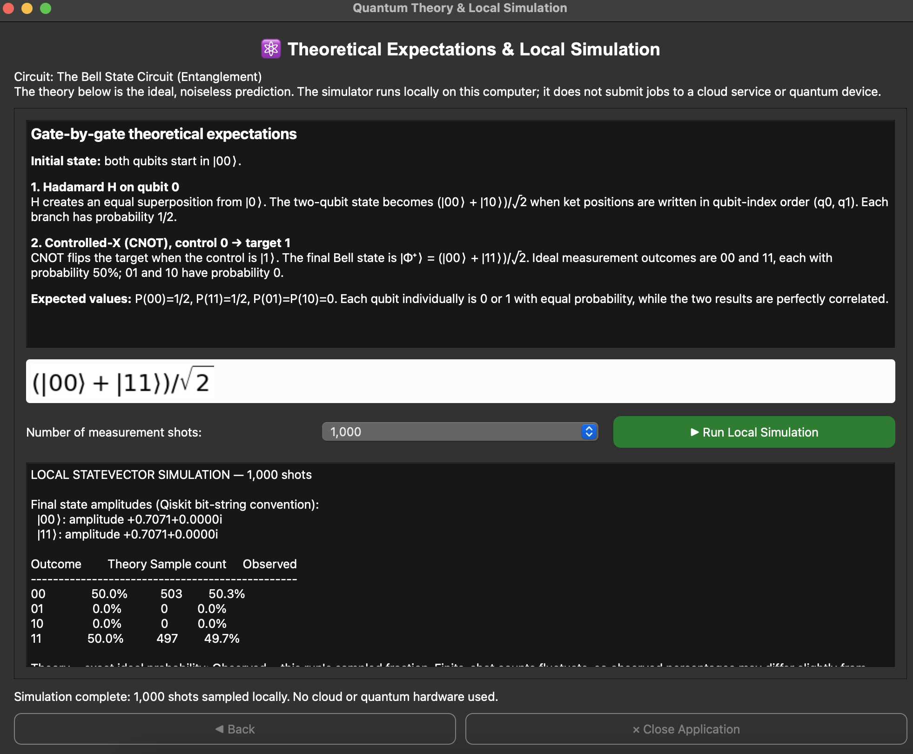
Progress

Slide 8
Lessons Learned
Keep the interfaces easy to navigate so they are less overwhelming
Less is more
Make it pretty later, get it working first with a solid base

Slide 9
Sprint 2 Goals + Demo Statement
By the end of sprint 2 we will have different circuits available which are first explained in theory (depth depending on difficulty) and then simulated with results printed as well
Things to think about
Make it easier on the eyes
  Colors
  Fewer blocks of text
  Better structured
How to convey any audio feedback to the user
Make explanations clear based on the level of experience

