Slide 1

Sprint 2: Quantum Computing Simulator
EC601 Product Design in Electrical and Computer Engineering
Department of Electrical and Computer Engineering
Christopher Lemus
lemusc@bu.edu
2026 November 02-04

Slide 2
Mission Statement + Sprint 1 recap
For students who need a GUI-based quantum circuit simulator, the Quantum Circuit Simulation Tool will support learning quantum material. Unlike the SDK Qiskit, it provides an additional layer of abstraction to make simulating quantum circuits intuitive along with useful examples
Sprint 1 Recap
Proof of concept formed
  Software components
  Can test classically

Slide 3
User Stories
As a beginner student, I want to select a simple quantum circuit template, so that I can run a simulation without writing code
As a student, I want explanations at different difficulty levels, so that I can follow along, learn, even without prior background
As a non-English speaking student, I want core interface labels translated, so that I can navigate the tool and learn the material
As a student, I want results to be clearly labeled as classical or quantum to avoid ambiguity
As a student, I want to see the equivalent Qiskit code, so that I can connect the visual circuit to programming syntax
As a student, I want to see the simulation results line up with the theory

Slide 4
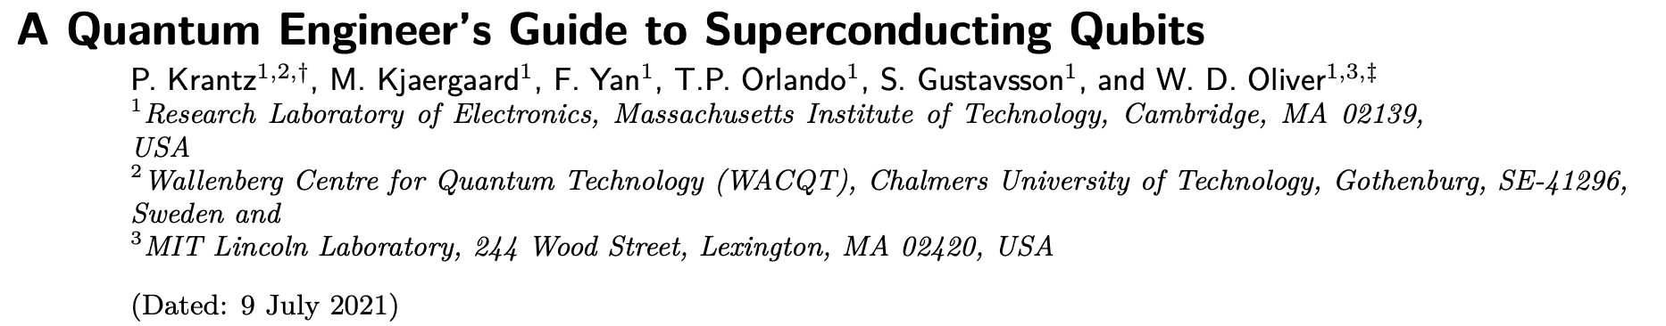
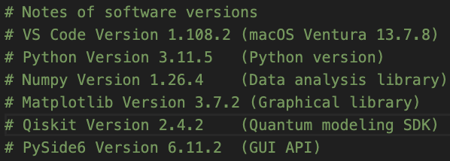
Tools (Sprint 1)

Slide 5

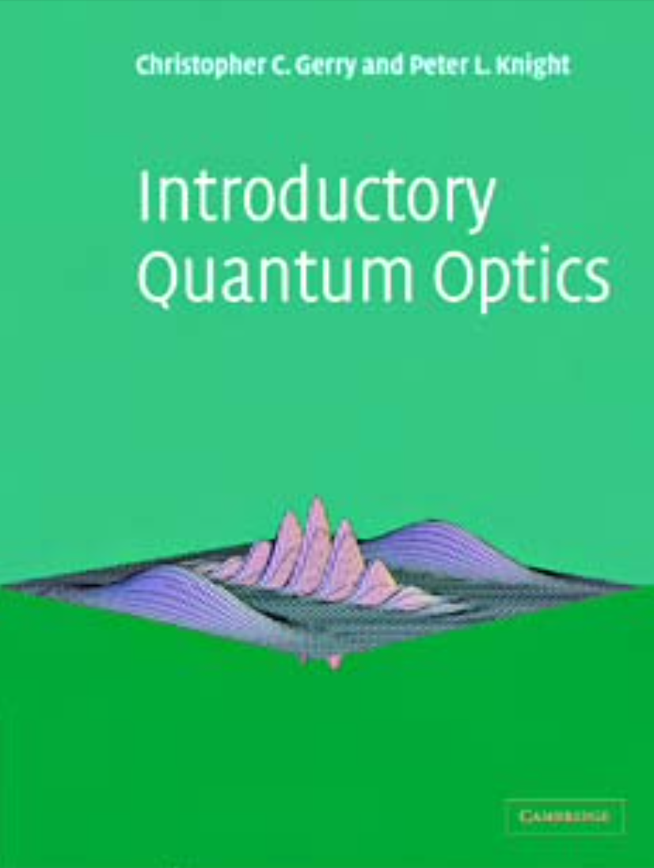
Tools (Sprint 2)
New additions
  Node.js
  OpenAI Codex

Slide 6
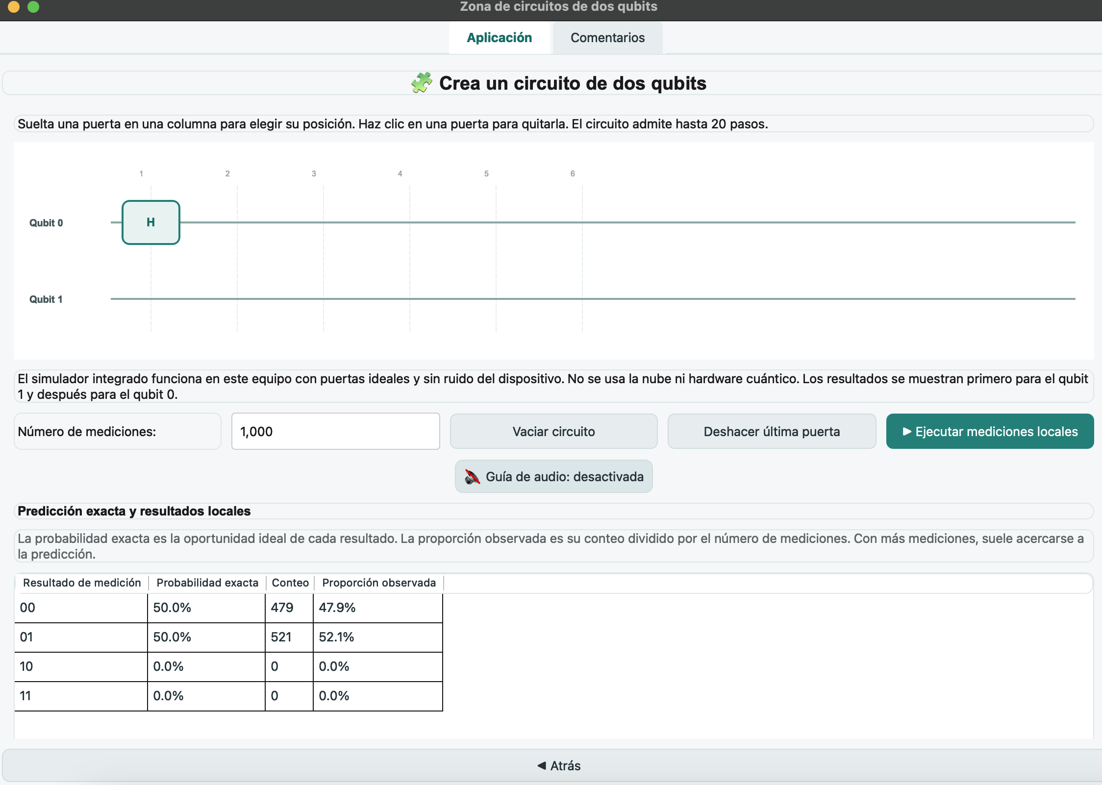
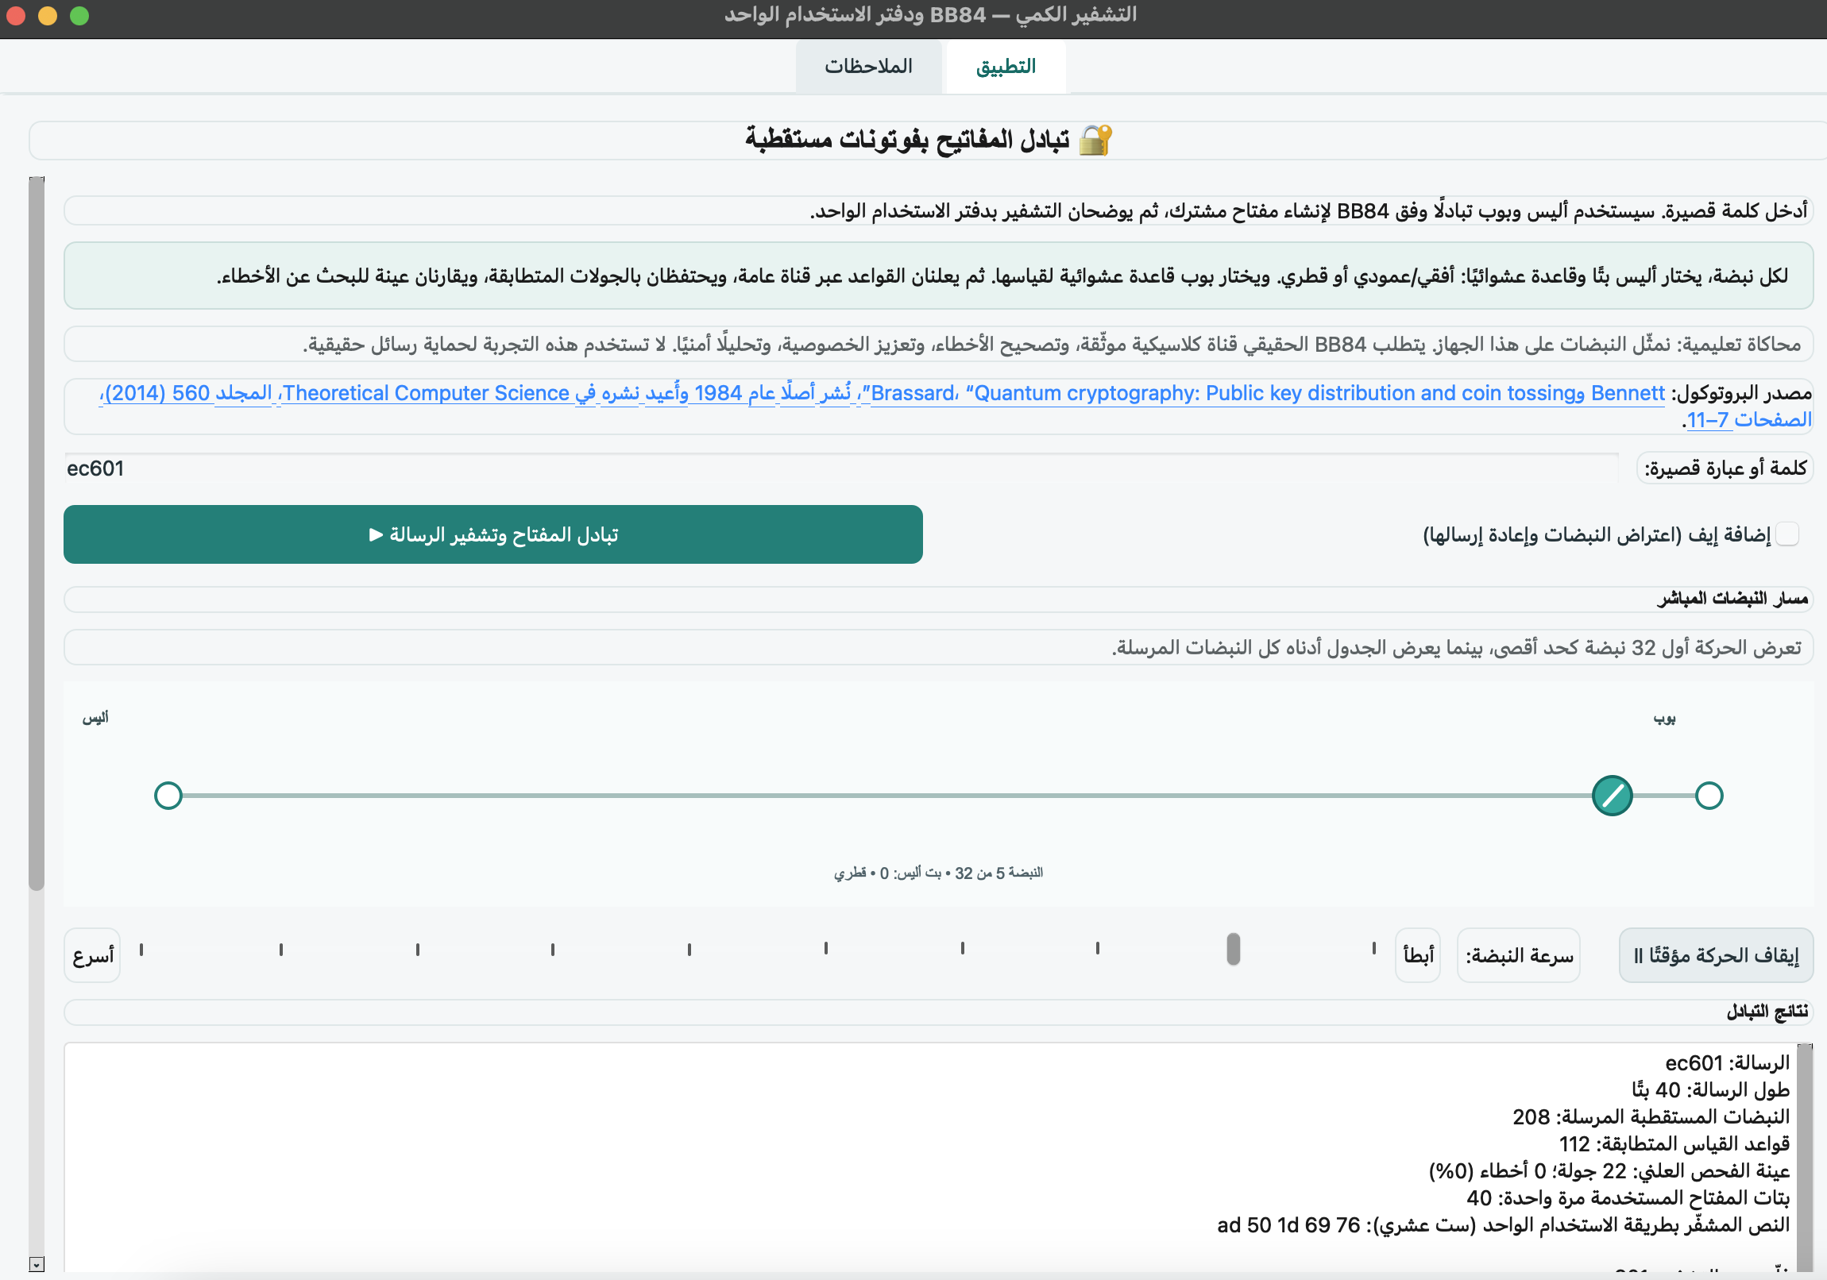
Progress
Support for few languages + audio

Slide 7
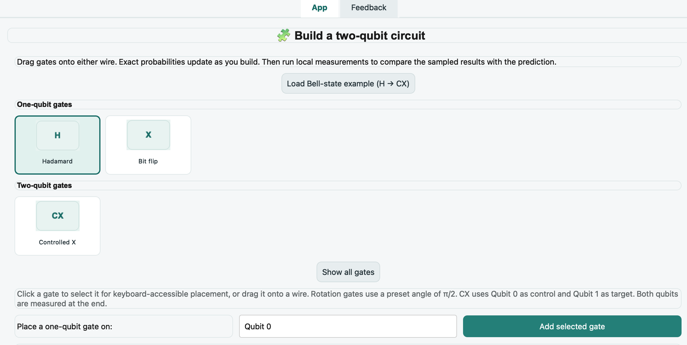
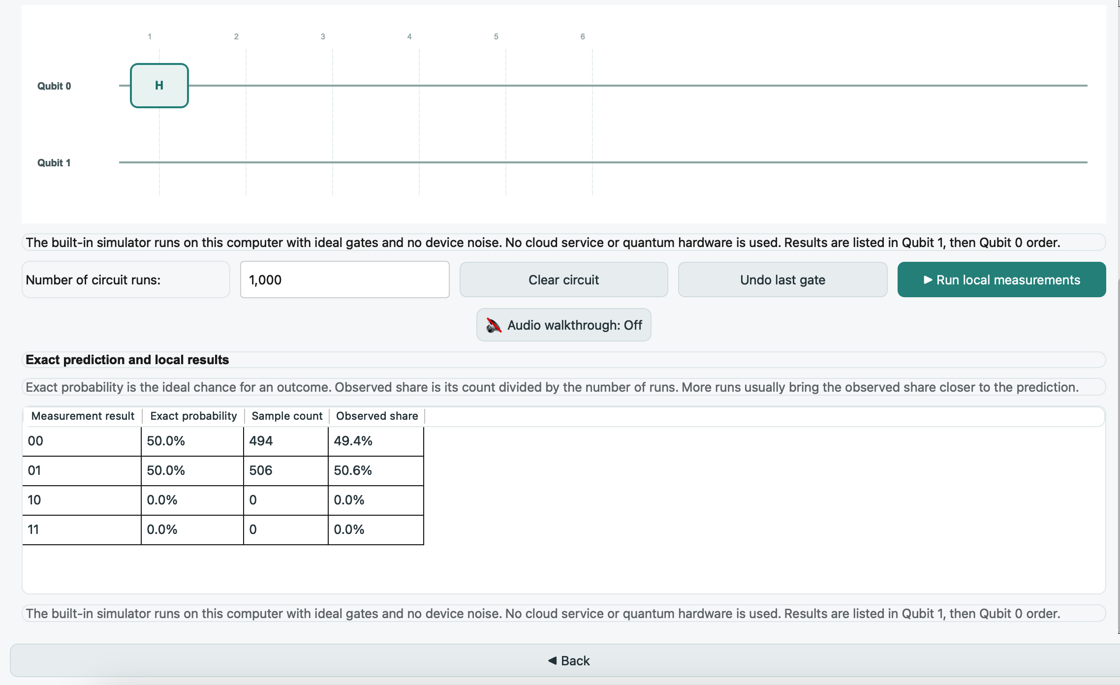
Progress
Sandbox for building quantum circuit using operators + results (theory vs. execution)

Slide 8
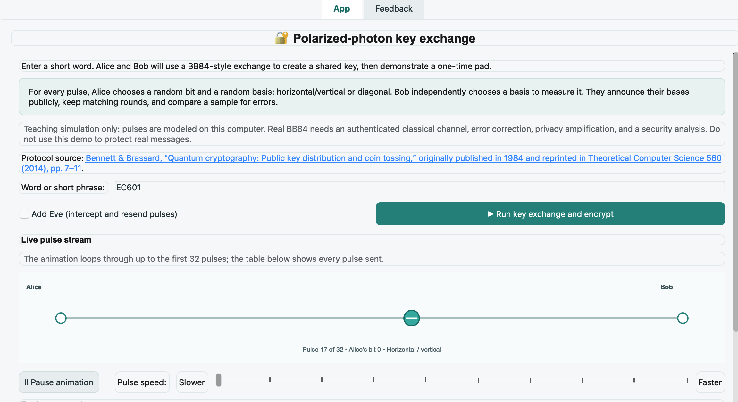
Progress
Concepts of quantum cryptography implemented

Slide 9
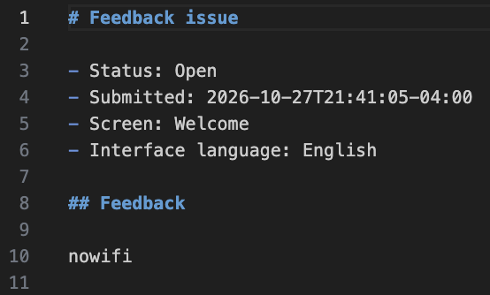
Progress
Feedback mechanism
- How to handle wifi/no wifi?

Slide 10
Lessons Learned
Use LLM to drive the effort for you
  Great at a laundry list of things and checking its work
  Maximize limited time with LLM by giving it a laundry list to iterate over at night

Slide 11
Sprint 3 Goals + Demo Statement
By the end of sprint 3 we will incorporate algorithms improve yield of a circuit, audio tones to denote what is happening at each stage in circuit. If time permits, consolidate into a deployable exe for possible
Things to think about
How can I maximize free LLM time
Are more visuals easier for students to understand material
Best way to use navigate + use the tool

