Slide 1

Horus: A Fully-Digital Dual-Polarimetric Phased Array Radar
EC707: Radar Remote Sensing
Department of Electrical and Computer Engineering
Christopher Lemus
lemusc@bu.edu
April 30, 2026

Slide 2
Motivation & Goals
Motive – Justify why this class of radar can be the successor to Weather Surveillance Radar –1988 Doppler class (WSD-88D) in NEXRAD network
Goals
Some history
Horus overview
Verification of design specs through simulation
Verification of claims of expansion
Closing remarks

Slide 3
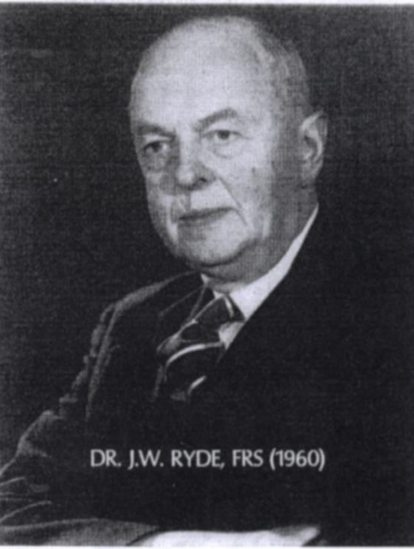
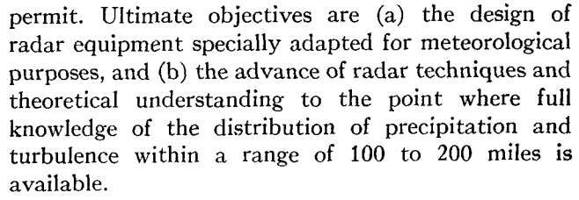
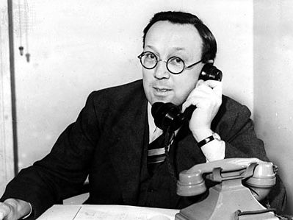
Origins of WSRs
Scottish physicist & meteorologist (1892-1973) played major role in radar development in the United Kingdom pre-WWII
1940, GE operated a 10 cm wave radar that would return reflections thought to be false target returns
  Asked Dr. J. W. Ryde to report attenuation and backscatting properties of clouds & rain to characterize the clutter returns they were observing
  Similar work done by Arthur E. Bent at MIT and characterized using 3 cm – 10 cm waves
Sir Robert Alexander Watson-Watt
Dr. J. W. Ryde
From Radar detection of precipitation [3]

Slide 4
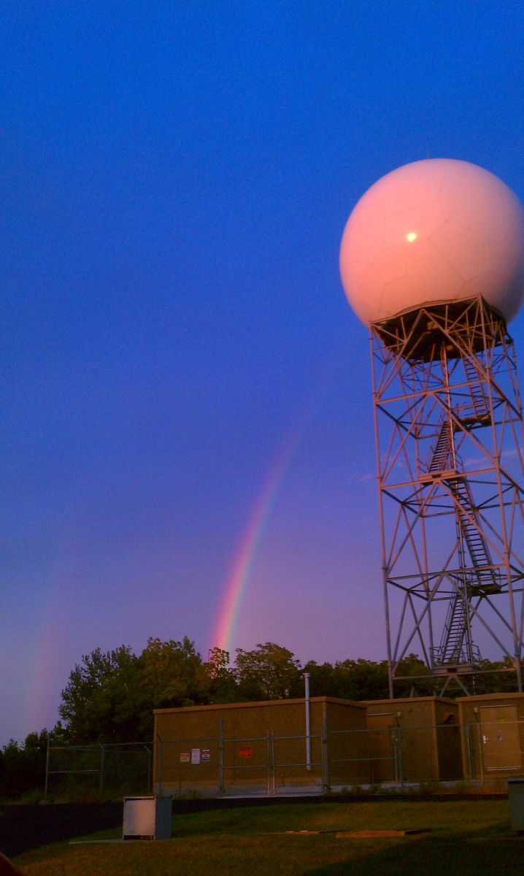
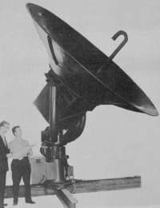
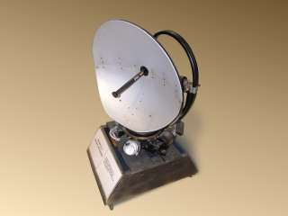
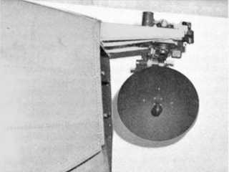
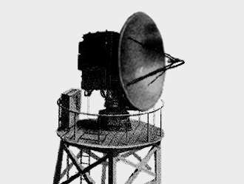
Post WWII to Present WSRs
1945, while development of strict weather radars under weigh, standard military issued radars deployed [1, pg. 222]
  AN/APQ-13 and AN/APS-10 (Airborne Pulse Search/Bombing Gunnery, Airborne Pulse Search)
  60 in operation around the world
  1977 the last AN/APQ-13 was decommissioned from Fort Sill, OK. Go see it at the Air Force Museum @ Wright-Patterson AFB, Ohio (:
1946, NWS also received 25 AN/APS-2F radars from AF for free (maybe free)
  At a rate of 5 radars per year, these S band radars were upgraded for meteorological use and fielded, then named WSR-1, so on
1954, first dedicated weather radar delivered. CPS-9
1957 WSR-57, 1976 WSR-74C/S, 1988 WSR-88D
AN/APQ-13
AN/APS-10
AN/CPS-9
WSR-57
WSR-88D

Slide 5
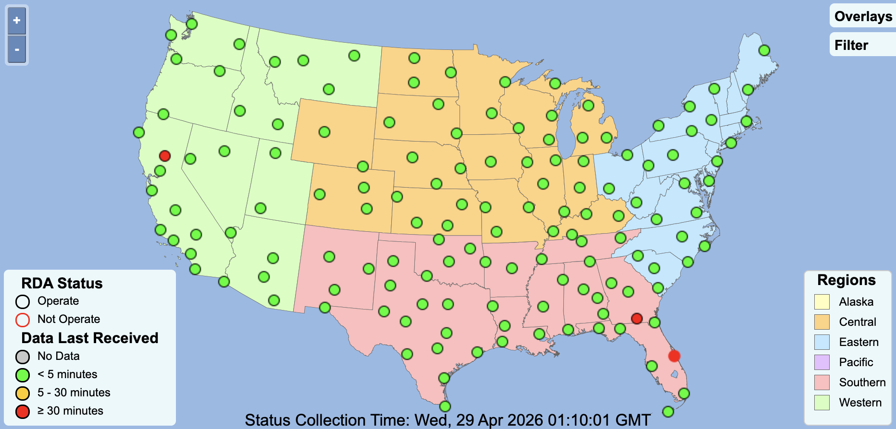
NEXRAD Network
https://www.weather.gov/nl2/NEXRADView

Slide 6
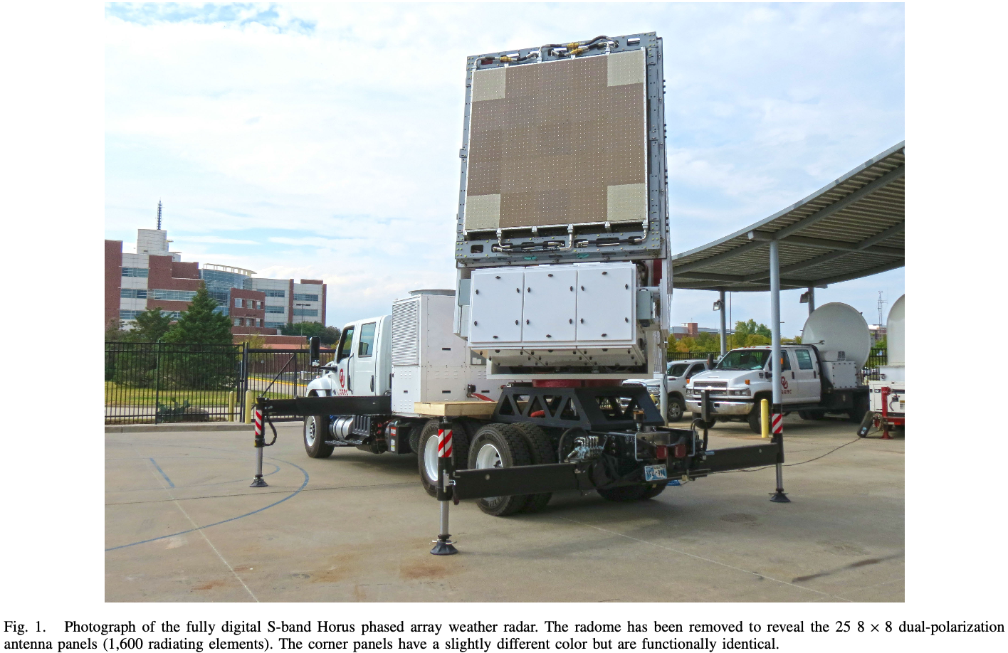
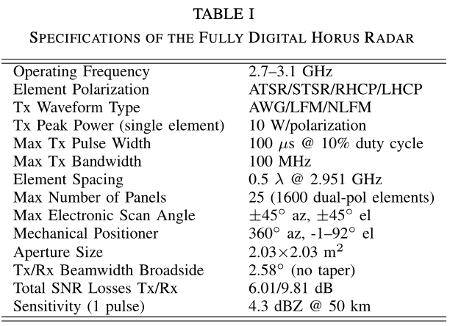
The Horus PAR
HORUS—A FULLY DIGITAL POLARIMETRIC PAR [4]

Slide 7
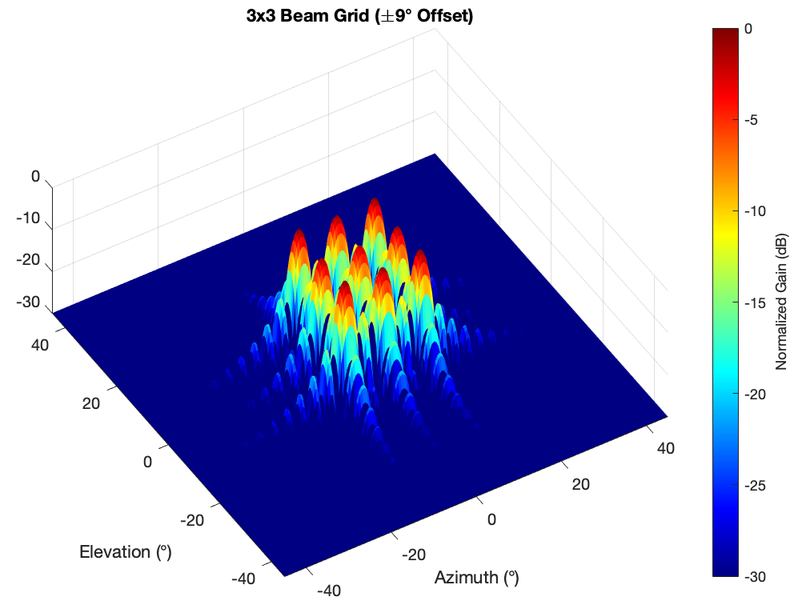
Horus PAR Pros & Cons
Pros | Cons
Line replaceable units | External generator needed for power (potential non-issue)
Fully digital architecture + sw defined | Complex calibration
Unique beamforming ability

Slide 8
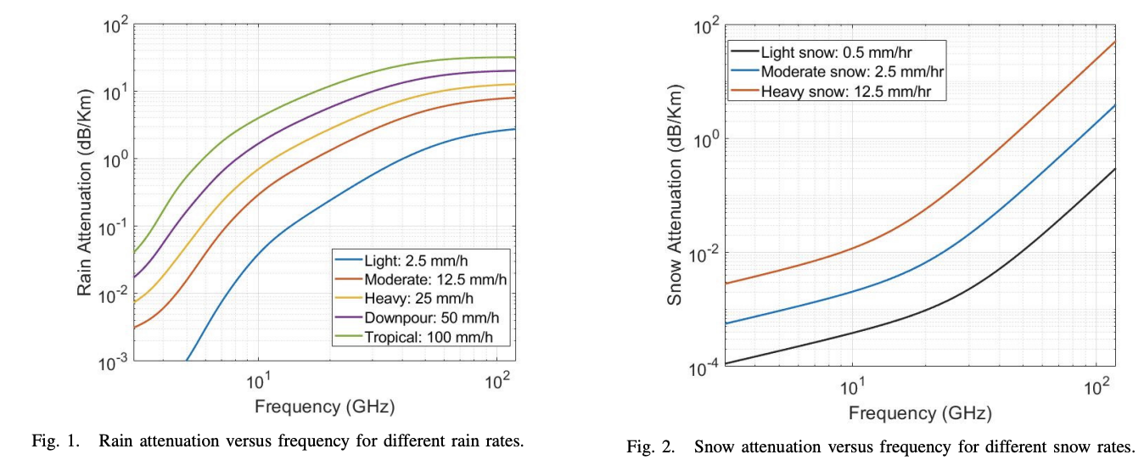
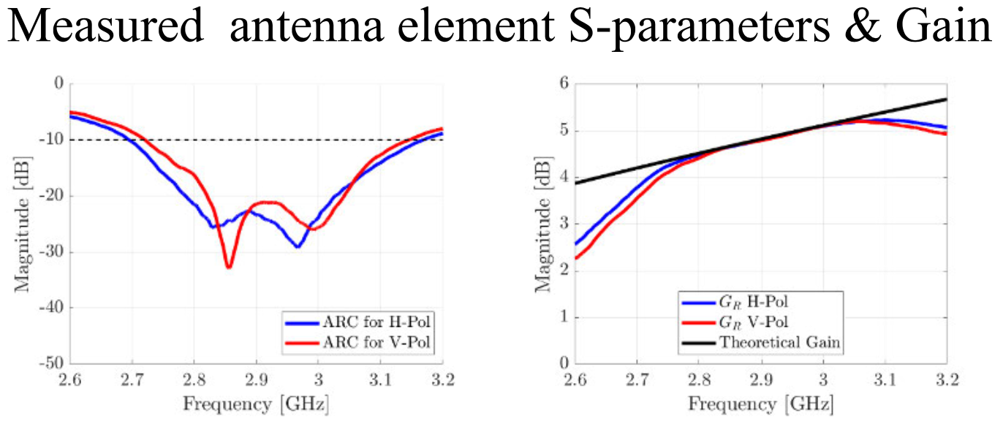
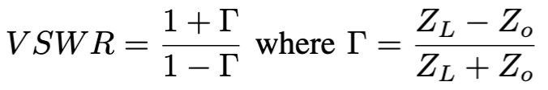
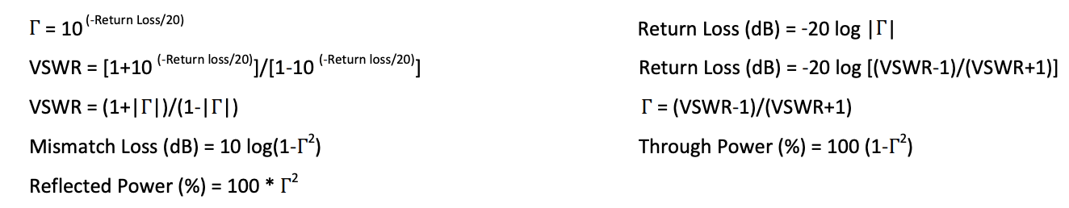
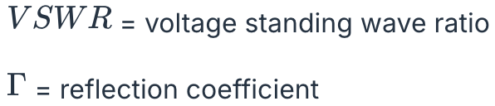
Why S-band?
HORUS—A FULLY DIGITAL POLARIMETRIC PAR [4]
Attenuation correction in weather radars for snow[6]
2:1 VSWR & nice linear regime
Maury Microwave

Slide 9
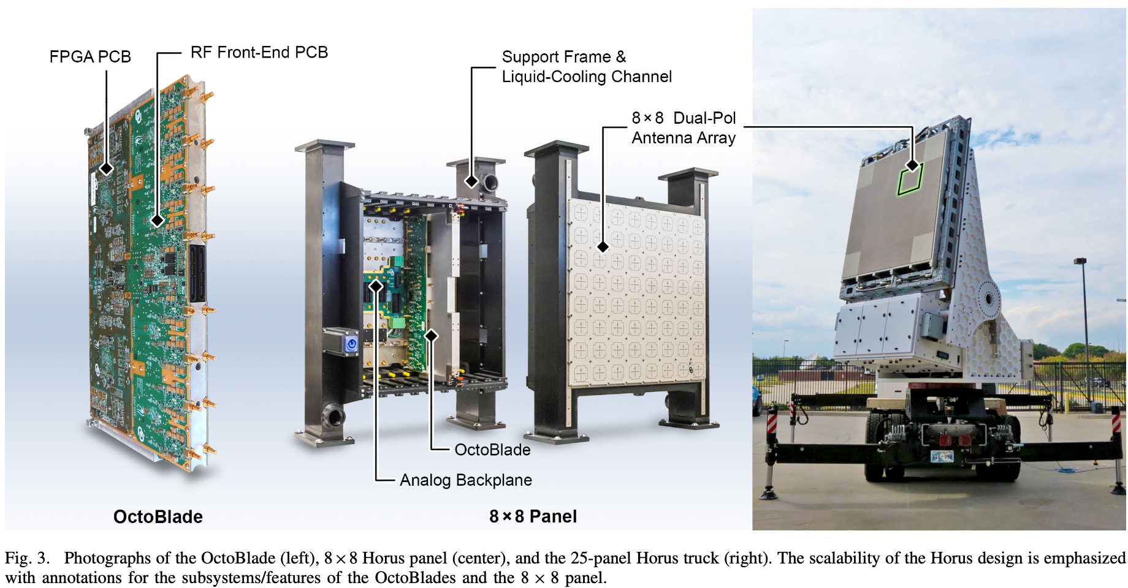
Architecture overview
-
HORUS—A FULLY DIGITAL POLARIMETRIC PAR [4]

Slide 10
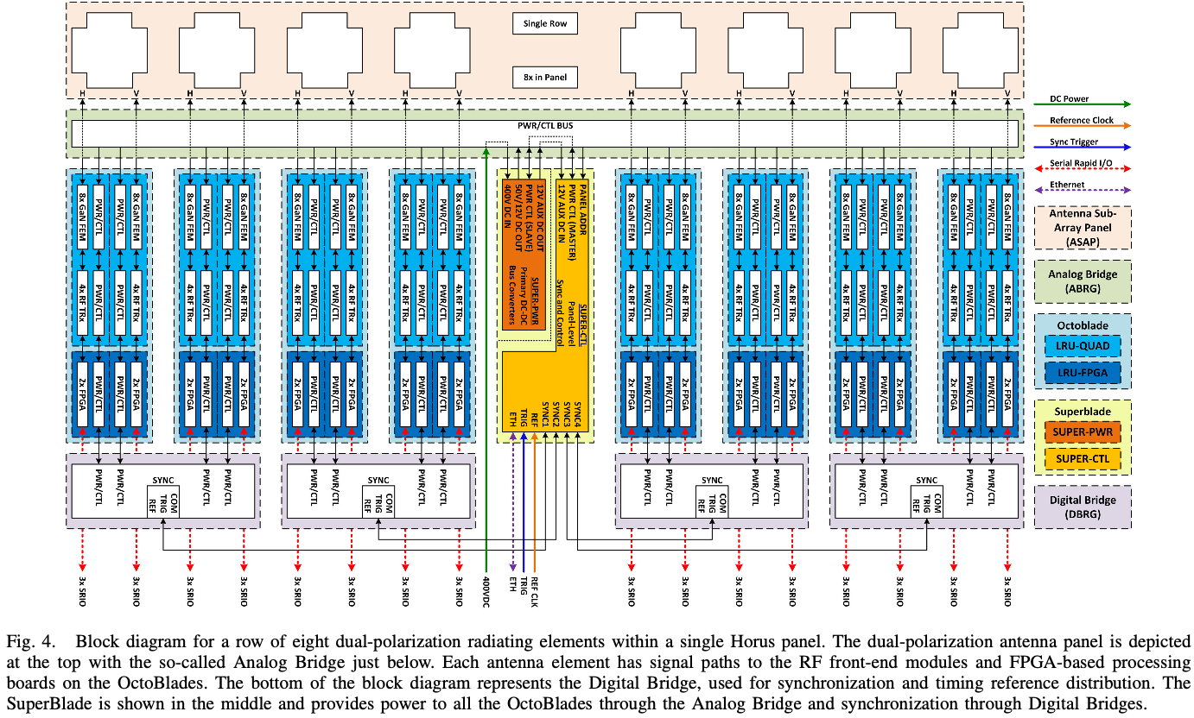
Subsystem overview
-
HORUS—A FULLY DIGITAL POLARIMETRIC PAR [4]

Slide 11


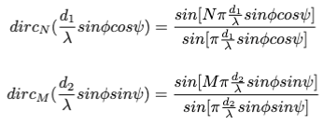




Beam Formulas
The Journal claims beamwidth of 13 degrees in Az, 3.1 degrees in El for 5x1
claim 2.53 degrees for 5x5 design, approximately 1 degree for an ~10,000 element array
Element Beampattern
Array Beampattern
Blahut[7], pg. 154-161

Slide 12

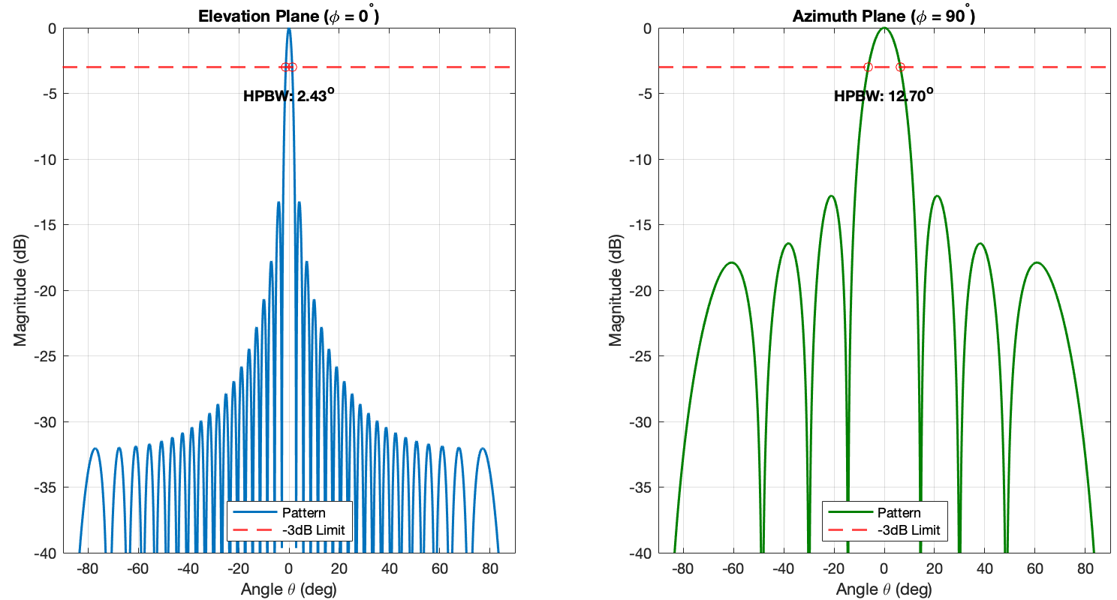
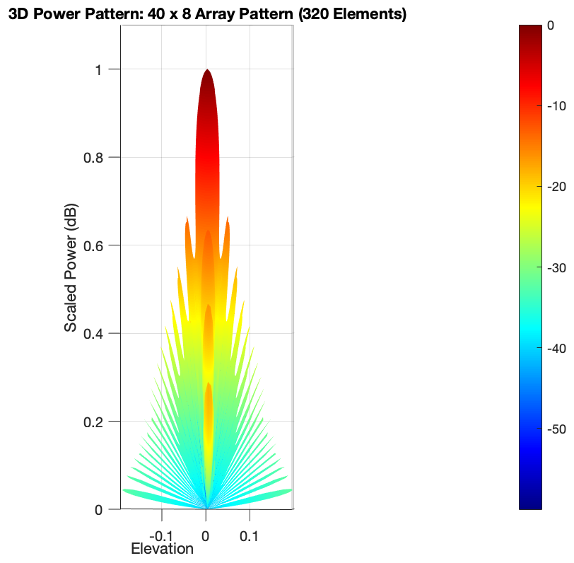
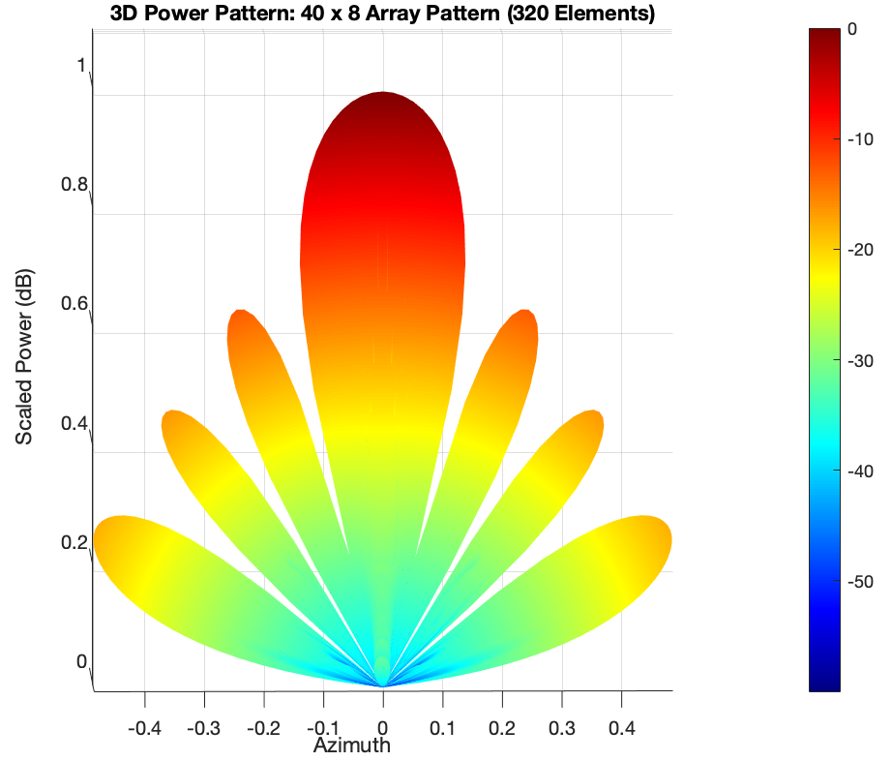
Confirming 5 x 1 via Simulation
Claim: 13 degrees in Az, 3.1 degrees in El

Slide 13
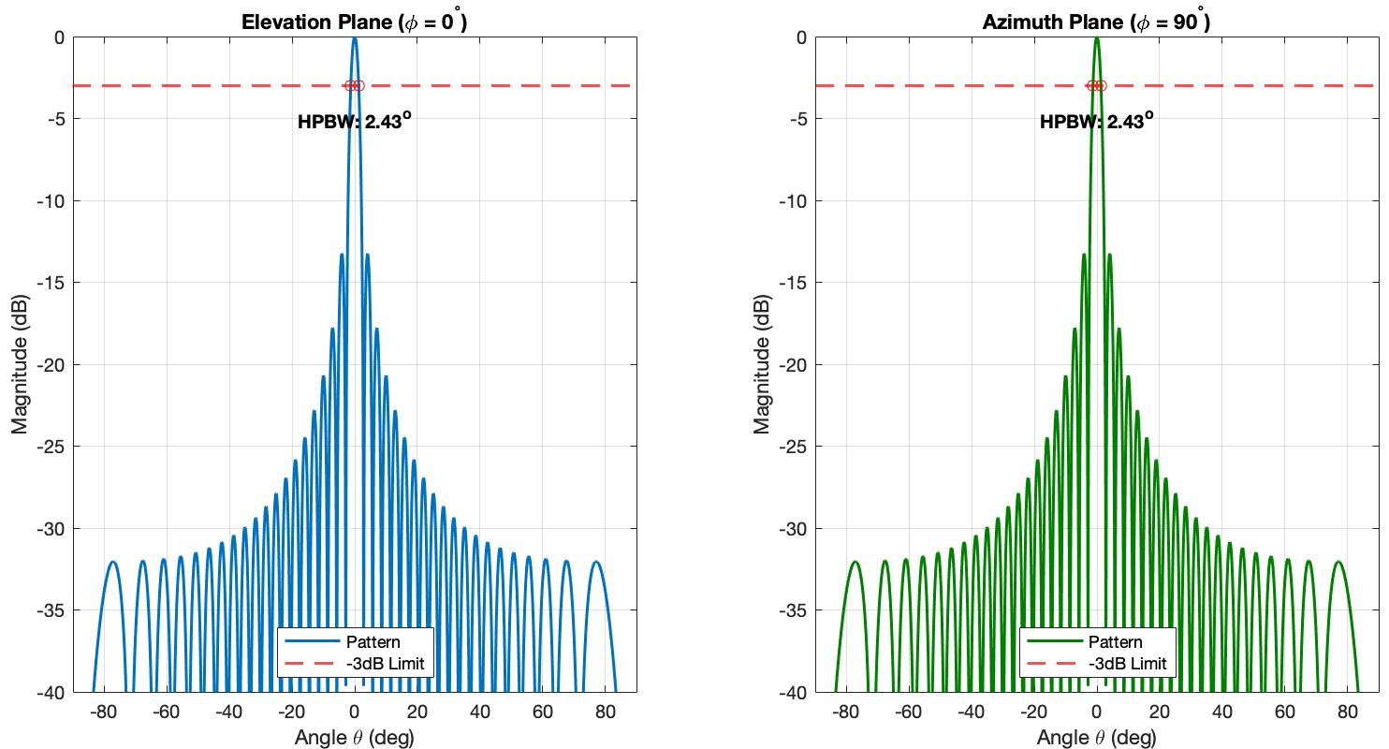
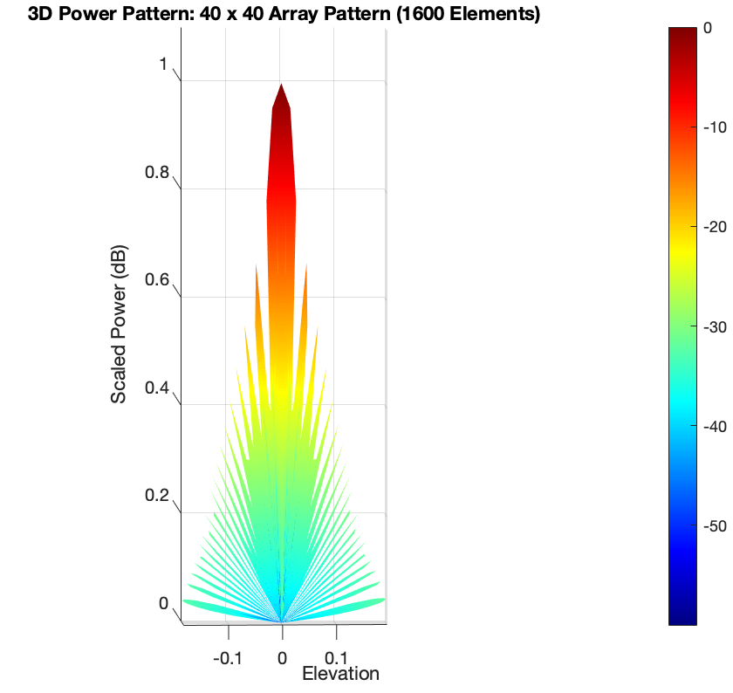
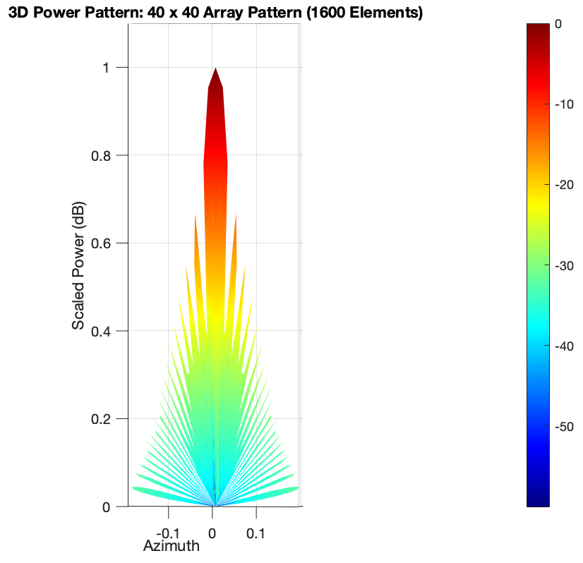
Confirming 5 x 5 via Simulation
Claim: 2.53 degrees in Az, 2.53 degrees in El

Slide 14

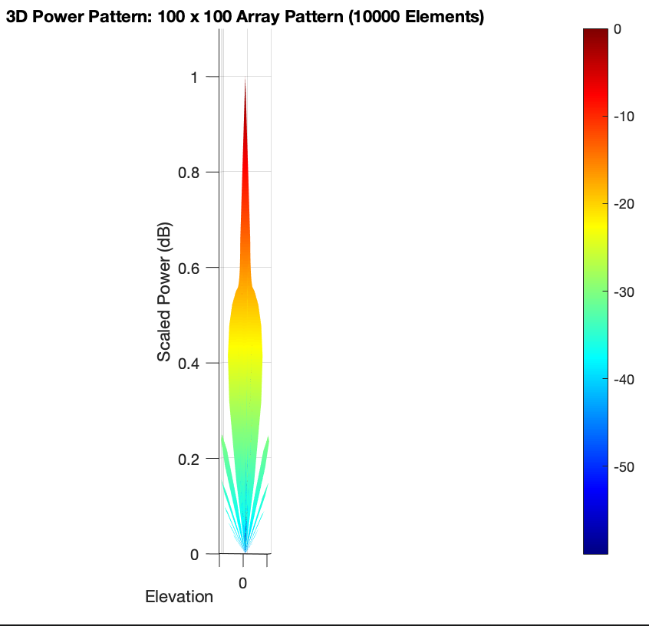

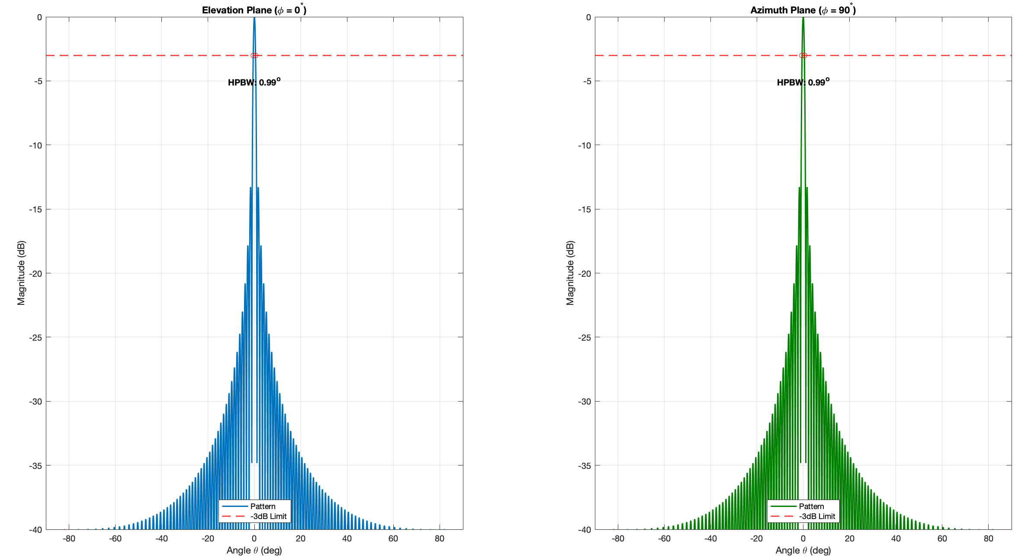
Confirming 10,000 Elements
Claim: ~1 degree in Az, ~1 degree in El

Slide 15

Antenna Gain
The antenna gain should compared to WSR-88D, which is 48 dB and radius of 4.2 m or area of 55.43 sq. m
Assume wavelength of 0.1 m
Gain of 37.15 and 45.1 dB respectively
Mahafza [9], sh 38
For the 10,000 element case, A = 25.756 sq. m
For the 1,600 element case, A = 4.12 sq. m

Slide 16
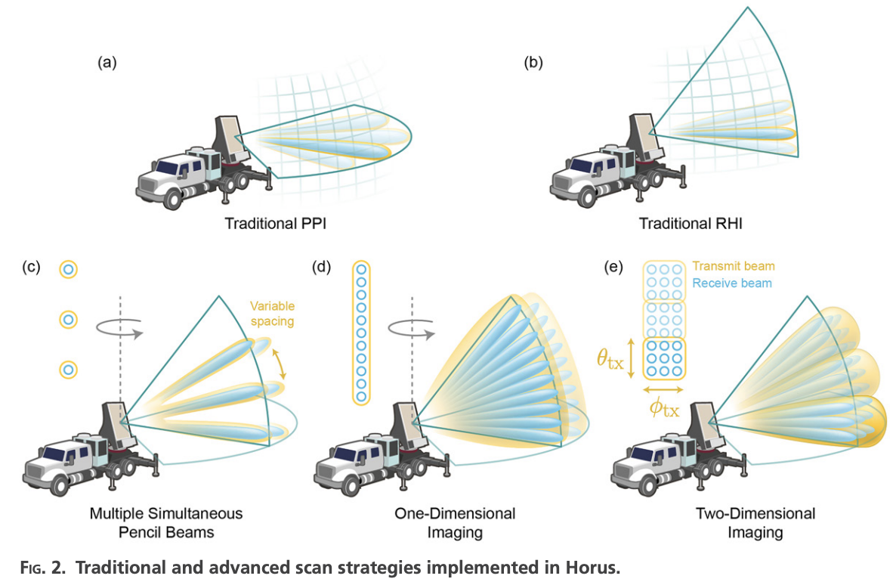
Scanning Modes
Plan Position Indicator (PPI)
Range Height Indicator (RHI)
Digital Beamforming (DBF)
Advanced weather surveillance capabilities of the fully Digital Horus Phased Array Radar[8]

Slide 17

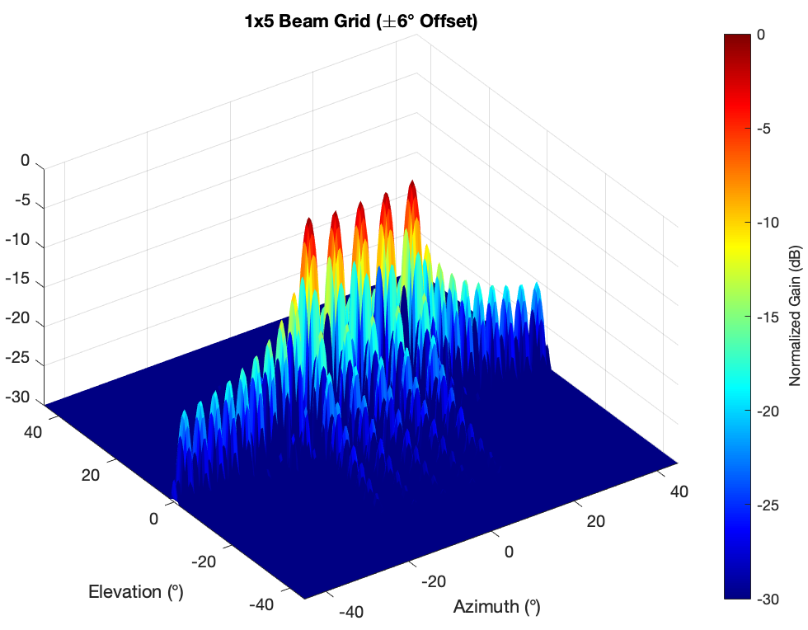
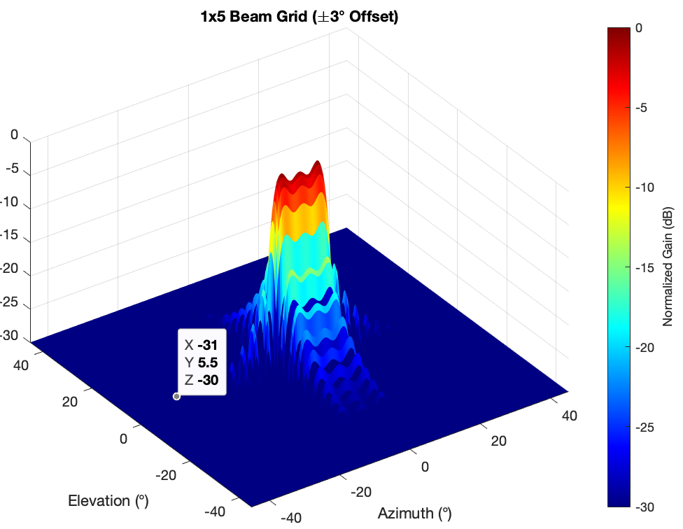
“Spoiling” (Broadening)
-Caused by having the beam offsets too close
-Additional loss term that gets carried over

Slide 18
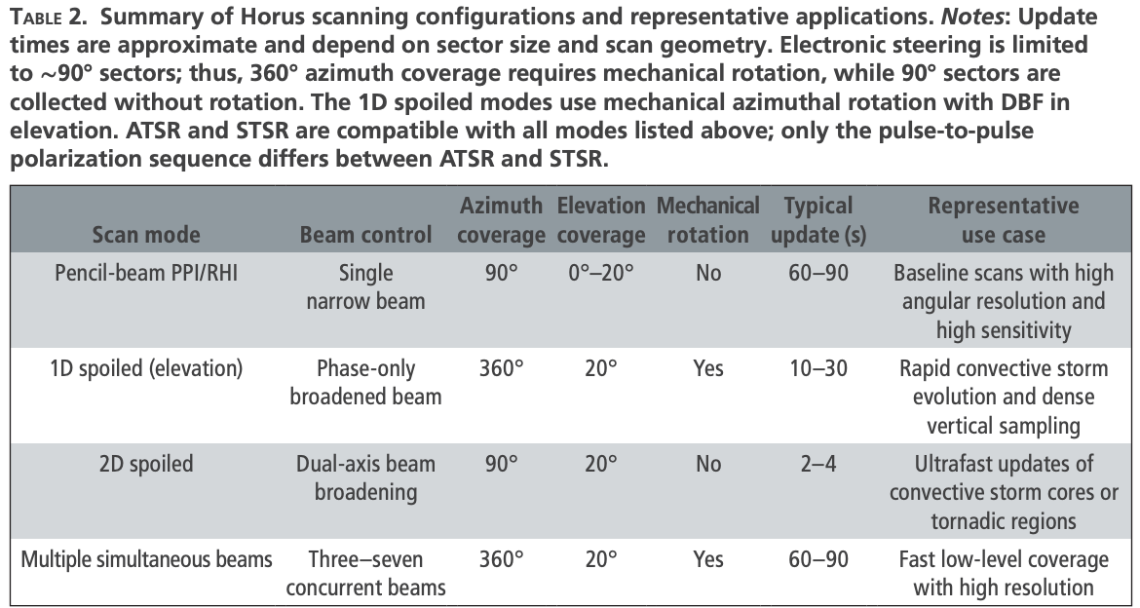
Horus Scan Times
Advanced weather surveillance capabilities of the fully Digital Horus Phased Array Radar[8]

Slide 19
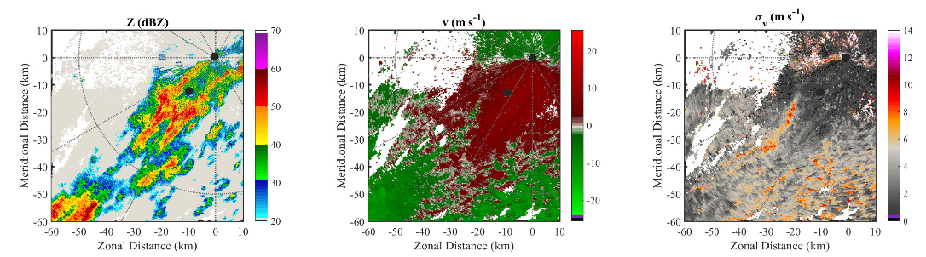
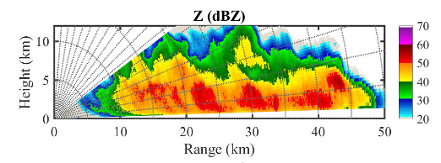
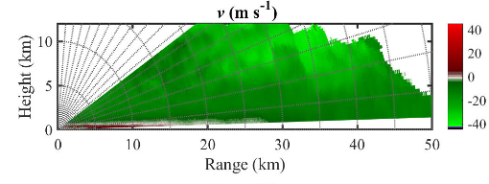
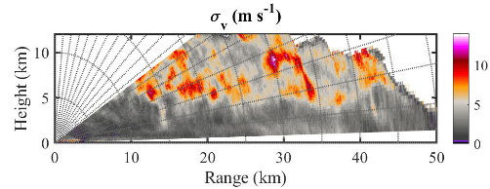
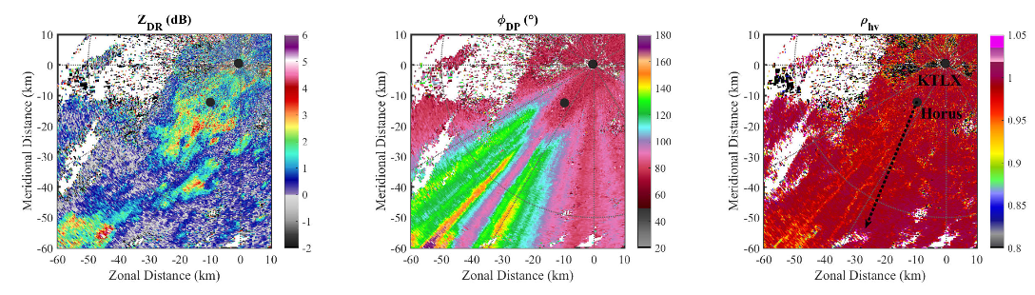
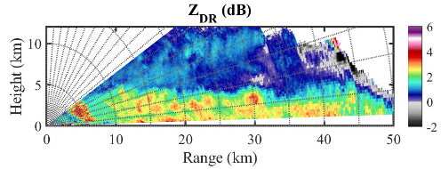
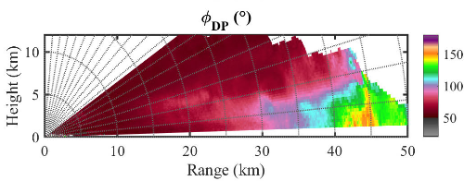
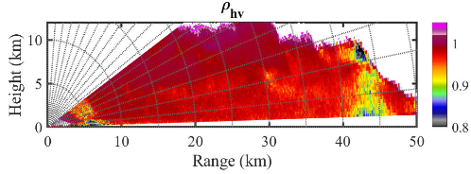
Journal Data results
Reflectivity
Doppler Vel
Spectrum width
WSR-88D
20% PAR
Differential reflectivity
Differential phase
Correlation coefficient
WSR-88D
20% PAR

Slide 20
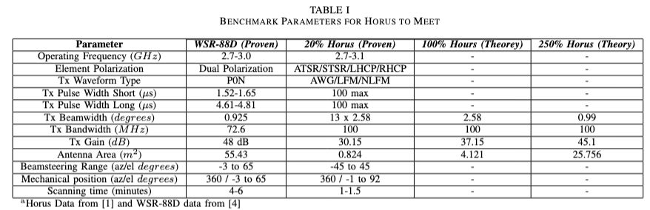
Conclusion
Fully-digital, dual-polarization, software-defined radar of this class has all the potential
Why?
- At the proper scale, they offer competitive radar specifications that are in par to the latest WSD-88D radars
- The ability to digitally beamform and digitally control beams is a major benefit
- Very easy to scale and incredibly modular
- The government will pay

Slide 21
References
[1] Whiton, Roger C., et al. “History of operational use of weather radar by U.S. Weather Services. part I: The pre-NEXRAD era.” Weather and Forecasting, vol. 13, no. 2, June 1998, pp. 219–243, https://doi.org/10.1175/1520-0434(1998)013&lt;0219:hoouow&gt;2.0.co;2.
[2] [PDF] the History of the First Twenty-Five Years of Radar Meteorology in the United Kingdom | Semantic Scholar, www.semanticscholar.org/paper/THE-HISTORY-OF-THE-FIRST-TWENTY-FIVE-YEARS-OF-RADAR-Probert-Jones/7f6ac819caaa86a99034620a074d9177882cdda6. Accessed 28 Apr. 2026.
[3] Bent, Arthur E. “Radar detection of precipitation.” Weather, vol. 3, no. 2, Feb. 1948, pp. 37–41, https://doi.org/10.1002/j.1477-8696.1948.tb06717.x.
[4] Palmer, Robert D., et al. “Horus—a fully digital polarimetric phased array radar for next-generation weather observations.” IEEE Transactions on Radar Systems, vol. 1, 2023, pp. 96–117, https://doi.org/10.1109/trs.2023.3280033.
[5] Deirmendjian, D. “Far-infrared and submillimeter wave attenuation by clouds and rain.” Journal of Applied Meteorology, vol. 14, no. 8, Dec. 1975, pp. 1584–1593, https://doi.org/10.1175/1520-0450(1975)014&lt;1584:fiaswa&gt;2.0.co;2.
[6] Joshil, Shashank S., and V. Chandrasekar. “Attenuation correction in weather radars for snow.” IEEE Transactions on Geoscience and Remote Sensing, vol. 61, 2023, pp. 1–14, https://doi.org/10.1109/tgrs.2023.3254555.
[7] “Antenna Systems.” Theory of Remote Image Formation, 18 Nov. 2004, pp. 153–185, https://doi.org/10.1017/cbo9780511543418.006.
[8] Schvartzman, David, et al. “Advanced weather surveillance capabilities of the fully Digital Horus Phased Array Radar.” Bulletin of the American Meteorological Society, vol. 107, no. 1, Jan. 2026, https://doi.org/10.1175/bams-d-24-0296.1.
[9] Mahafza, Bassem R. Radar Systems Analysis and Design Using MATLAB. CRC Press, 2000.

