Slide 1

Synthetic Aperture Radar (SAR)
EC717: Image Reconstruction and Restoration
Department of Electrical and Computer Engineering
Christopher Lemus
lemusc@bu.edu
April 09, 2026

Slide 2
Motivation & Goals
Motive – provide context about radars, real world sources of error and explain how regularization can be used to compensate for these sources
Goals
Radar overview
Who SAR and Why?
Noise

Slide 3
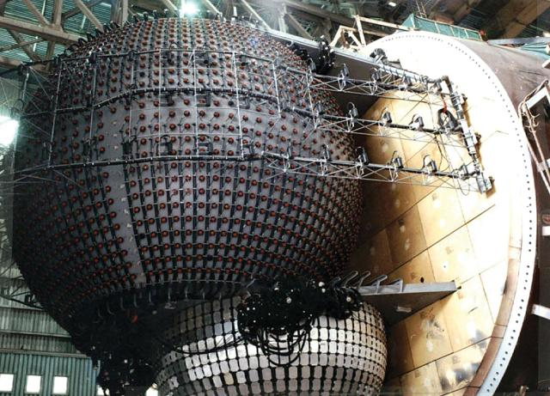
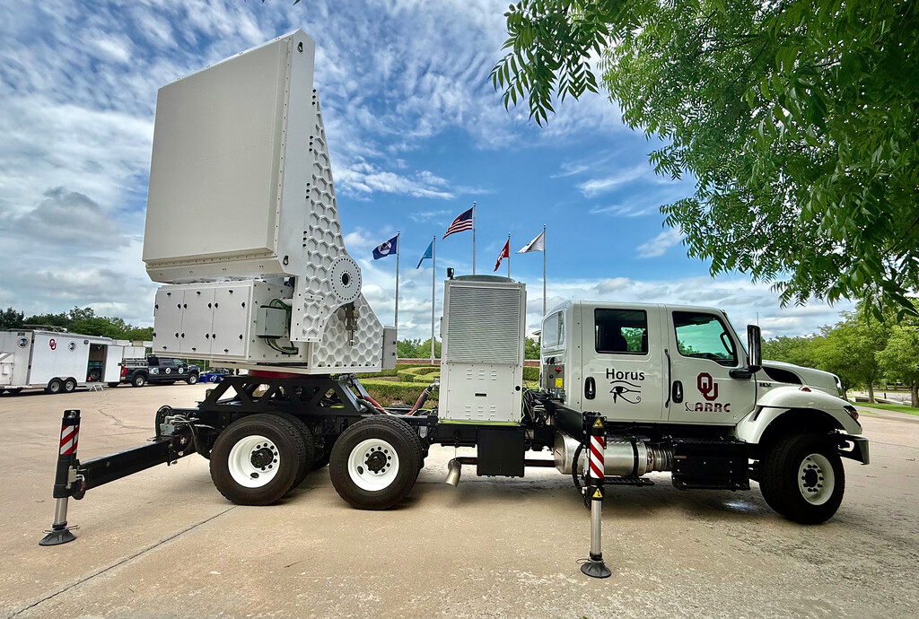
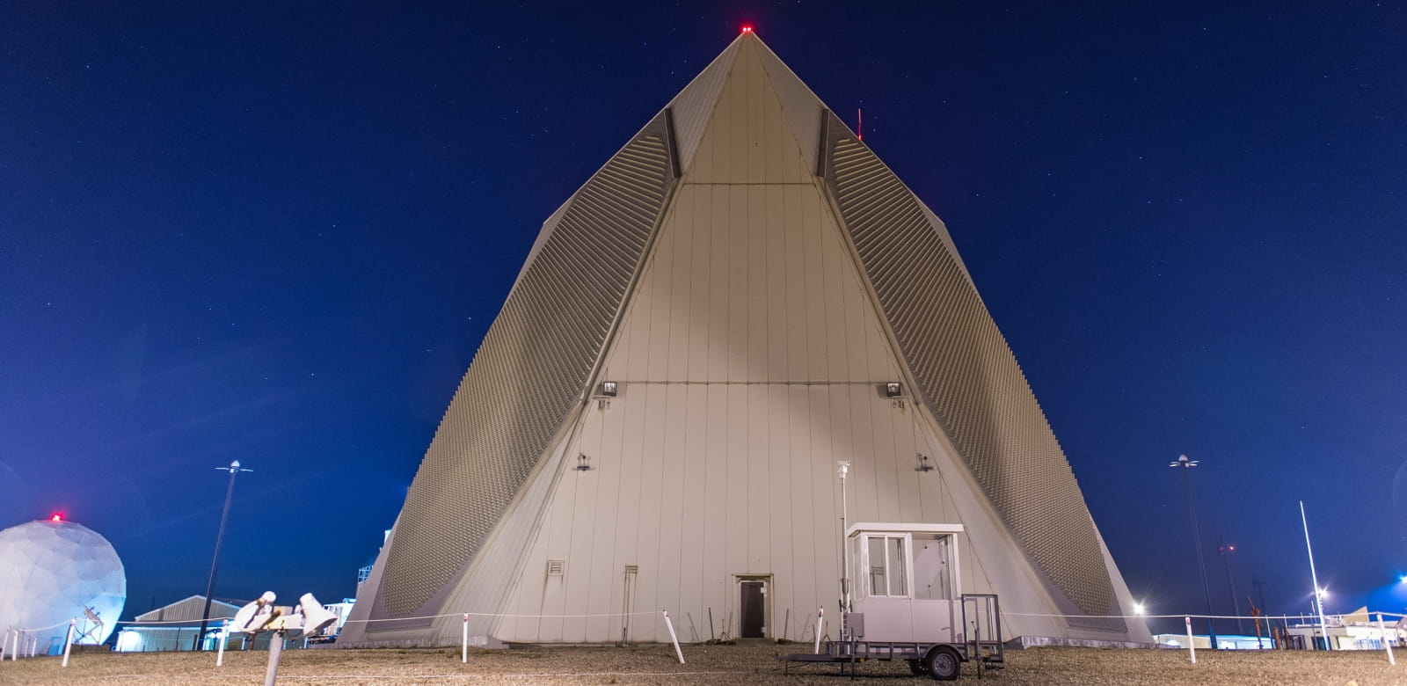
RADAR
Radio Detection and Ranging
In early 20th century many scientists fascinated with idea of communicating transatlantic with electricity [1, p.1-6]
Emission of electromagnetic pulses of energy to open space, and “listen” for reflection in the form of very low power complex voltages
Active vs. Passive
There are different types of radars [1, p. 6]
  Weather (S-C 2 – 8 GHz)
  SAR (P-Ka 0.3 – 40 GHz)
  Over-the-Horizon (HF 0.003 – 0.03 GHz)
  Ionosonde (MF-VHF 500kHz – 40Mhz)
  LiDAR (193.41 THz, 331.25 THz near IR )
  SONAR (Sound Navigation and Ranging – 3Hz – 500kHz)
  Many more
SONAR Array of NAVY- https://www.usni.org/magazines/proceedings/2024/november/sonar-101
Horus of OU - https://journals.ametsoc.org/view/journals/bams/107/1/BAMS-D-24-0296.1.xml
UEWR - https://www.rtx.com/raytheon/what-we-do/strategic-missile-defense/upgraded-early-warning-radar

Slide 4
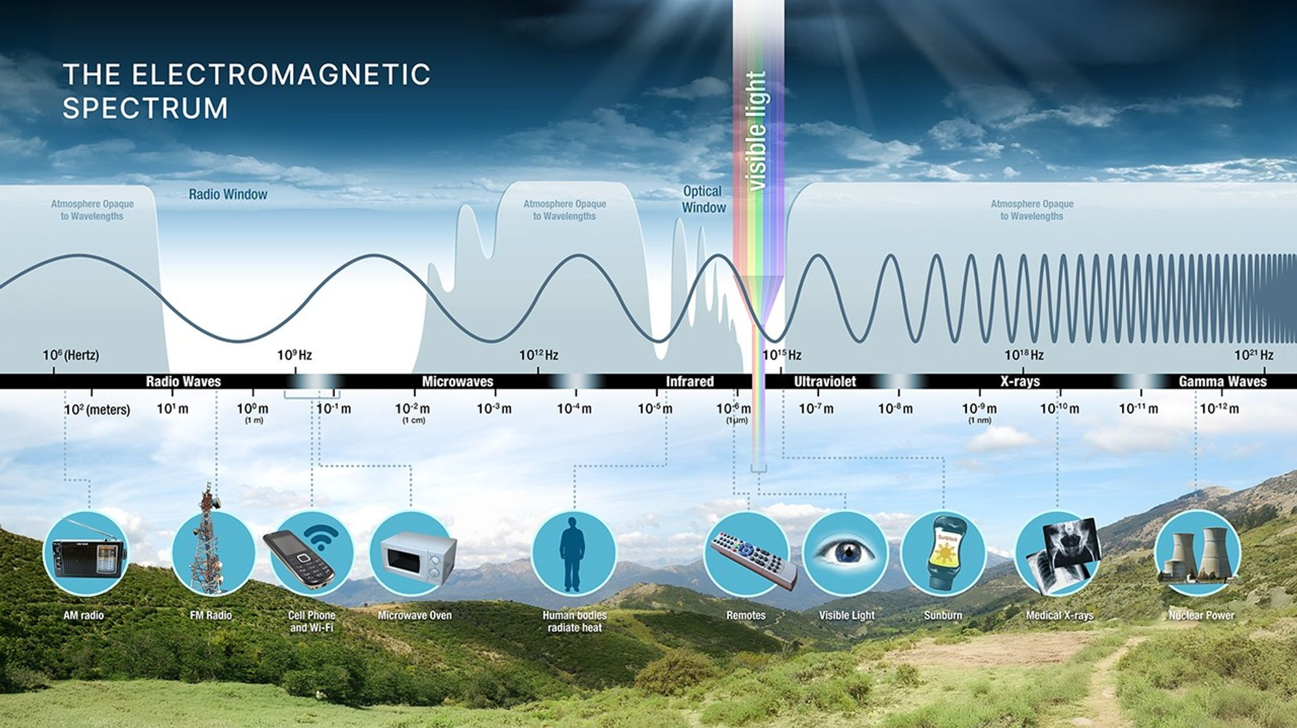
EM Spectrum vs. Earths Atmosphere
https://science.nasa.gov/ems/01_intro/

Slide 5
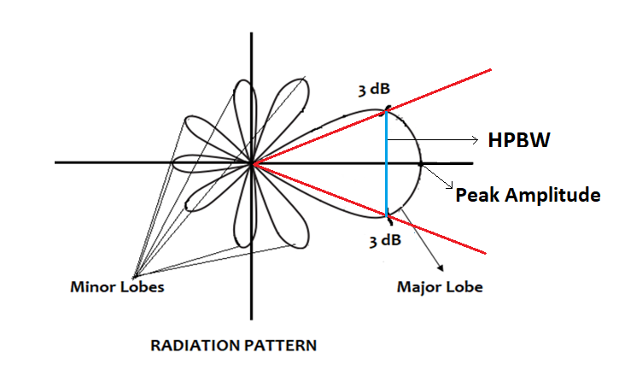
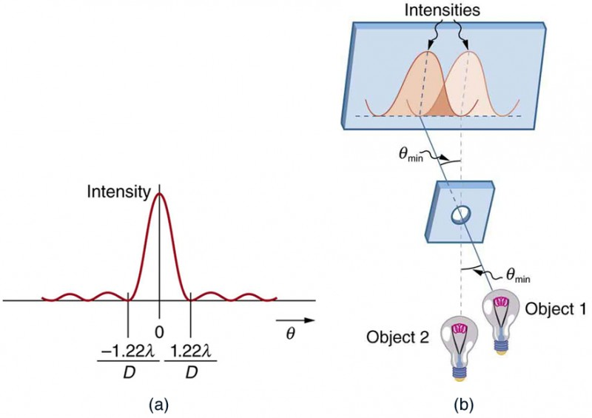
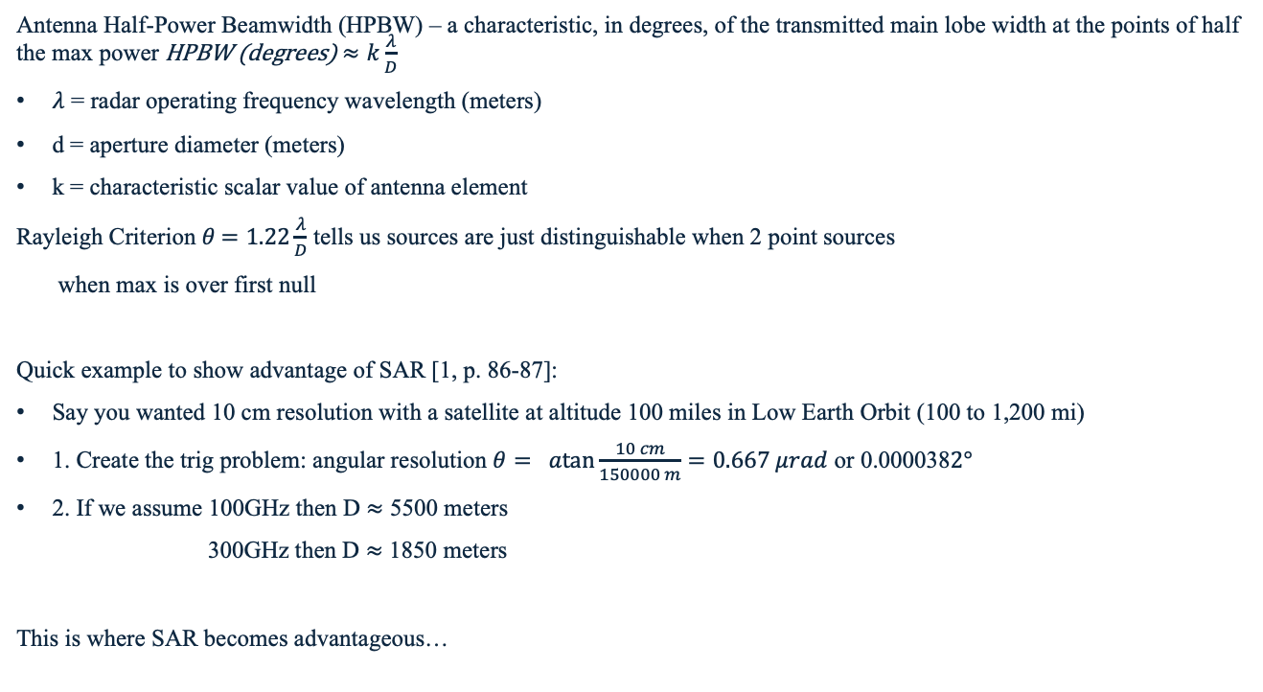
Radar parameters to care about
Antenna Half-Power Beamwidth (HPBW) – a characteristic, in degrees, of the transmitted main lobe width at the points of half the max power HPBW (degrees) $≈k\frac{λ}{D}$
$λ$ = radar operating frequency wavelength (meters)
d = aperture diameter (meters)
k = characteristic scalar value of antenna element
Rayleigh Criterion $θ$ $=1.22{\frac{λ}{D}}$ tells us sources are just distinguishable when 2 point sources
when max is over first null
Quick example to show advantage of SAR [1, p. 86-87]:
Say you wanted 10 cm resolution with a satellite at altitude 100 miles in Low Earth Orbit (100 to 1,200 mi)
1. Create the trig problem: angular resolution $θ= \operatorname{atan}{\frac{10 cm}{150000 m}}=0.667 μrad$ or 0.000038$2°$
2. If we assume 100GHz then D $≈$ 5500 meters
300GHz then D $≈$ 1850 meters
This is where SAR becomes advantageous…
Topological View Beampattern - https://www.everythingrf.com/community/what-is-half-power-beam-width
Rayleigh Criterion - https://courses.lumenlearning.com/suny-physics/chapter/27-6-limits-of-resolution-the-rayleigh-criterion/

Slide 6
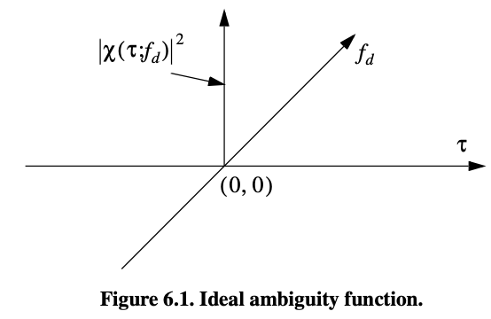

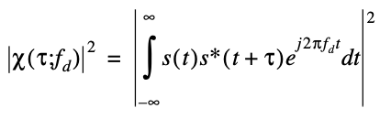
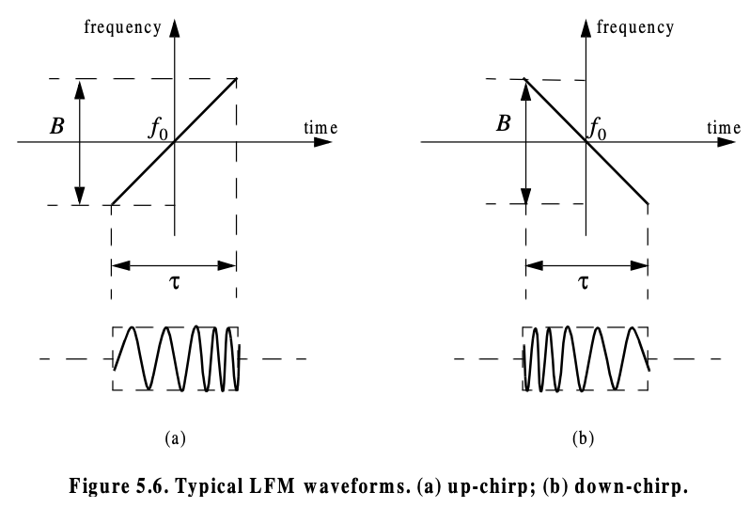
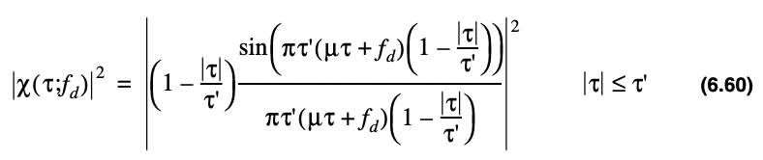
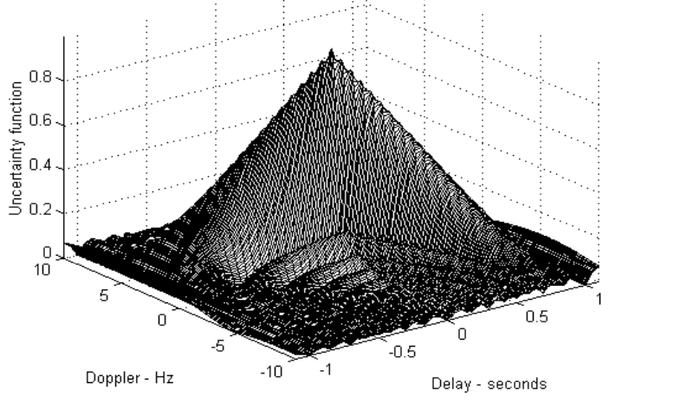
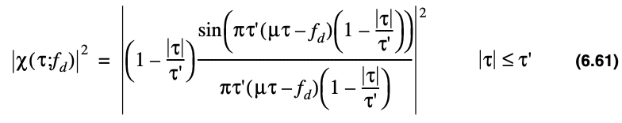
Radar parameters to care about
Ambiguity function / point spread function
Describes interference of matched output to target of equal RCS
s(t) represents radar signal
Total volume equals 4E²
First AF is for impulse
Second AF are for Up & Down chirp

Slide 7
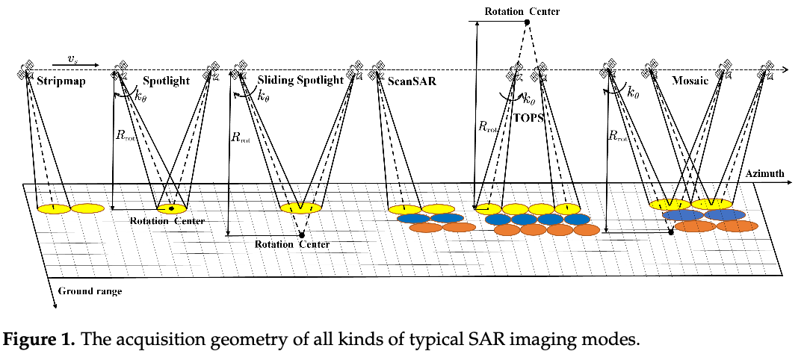

SAR parameters to care about
“Synthetic Aperture” D = $Tυ= \frac{λR}{2∆CR}$ where $T$ is the “aperture time” or time spent scanning in cross range direction, $υ$ = velocity of aperture
Physical aperture size designed based on desired Cross Range resolution – a wider beam is desired to illuminate target longer
SAR Cross Range resolution = $\frac{L}{2}$because Doppler Bandwidth of SAR = $\frac{2v}{L}$, CR = $\frac{v}{B}$
Higher doppler bandwidth → higher resolution
The advantage is excellent range and cross range resolution can be achieved versus having a massive radar floating in space
A few modes
From Article -- Spaceborne Sparse SAR Imaging Mode Design: From Theory to Implementation Yufan Song et al
https://www.mdpi.com/1424-8220/25/13/3888

Slide 8
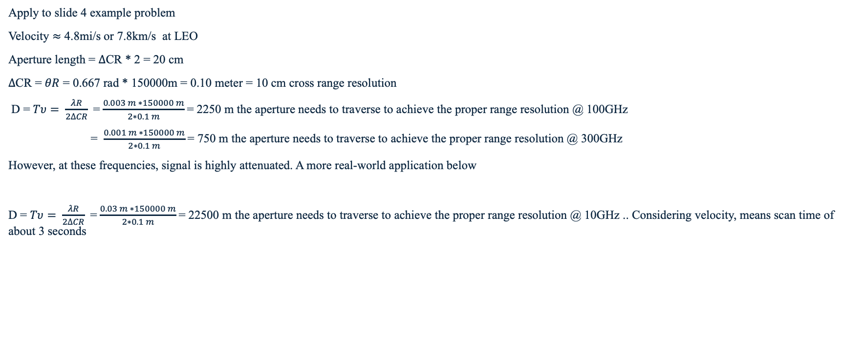
Example of Synthesized Aperture
Apply to slide 4 example problem
Velocity $≈$ 4.8mi/s or 7.8km/s at LEO
Aperture length = $∆$CR * 2 = 20 cm
$∆$CR = $θR$ = 0.667 rad * 150000m = 0.10 meter = 10 cm cross range resolution
D = $Tυ= \frac{λR}{2∆CR}$ = $\frac{0.003 m ∗150000 m}{2∗0.1 m}$= 2250 m the aperture needs to traverse to achieve the proper range resolution @ 100GHz
= $\frac{0.001 m ∗150000 m}{2∗0.1 m}$= 750 m the aperture needs to traverse to achieve the proper range resolution @ 300GHz
However, at these frequencies, signal is highly attenuated. A more real-world application below
D = $Tυ= \frac{λR}{2∆CR}$ = $\frac{0.03 m ∗150000 m}{2∗0.1 m}$= 22500 m the aperture needs to traverse to achieve the proper range resolution @ 10GHz .. Considering velocity, means scan time of about 3 seconds

Slide 9
EM Spectrum vs. Earths Atmosphere

Slide 10
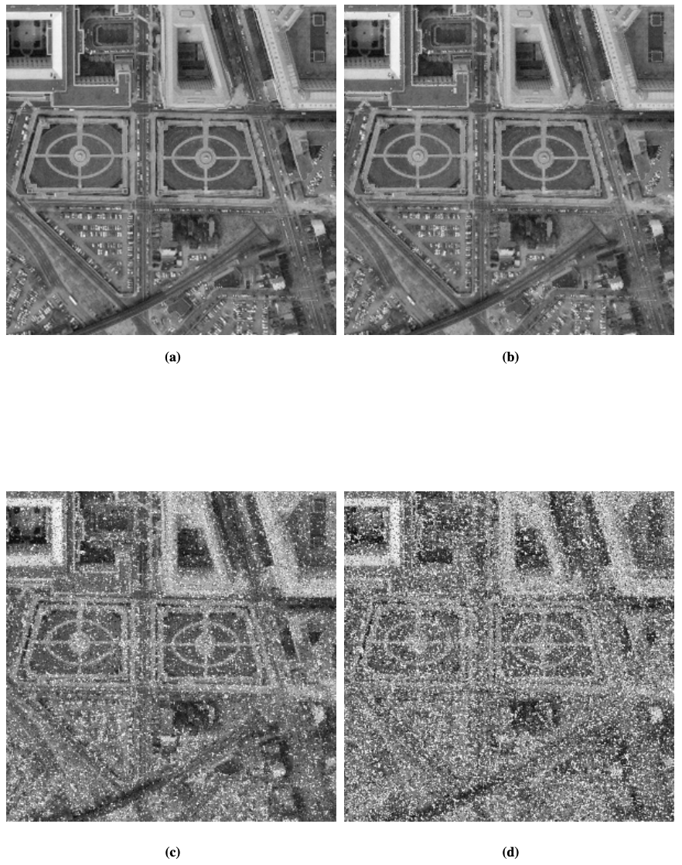
Noise – Speckle
Speckle noise due to phase incoherence at the receiver (most significant contributor)
Appears as super grainy resolution
[2] Figure 4

Slide 11
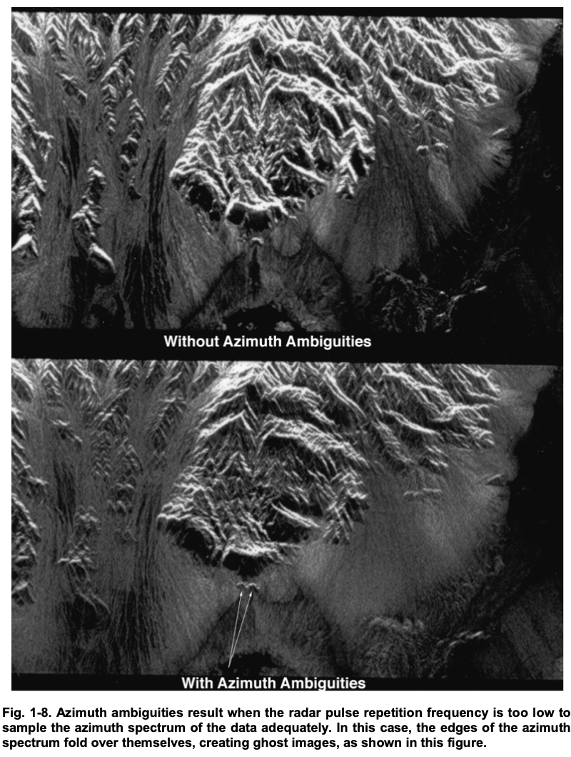
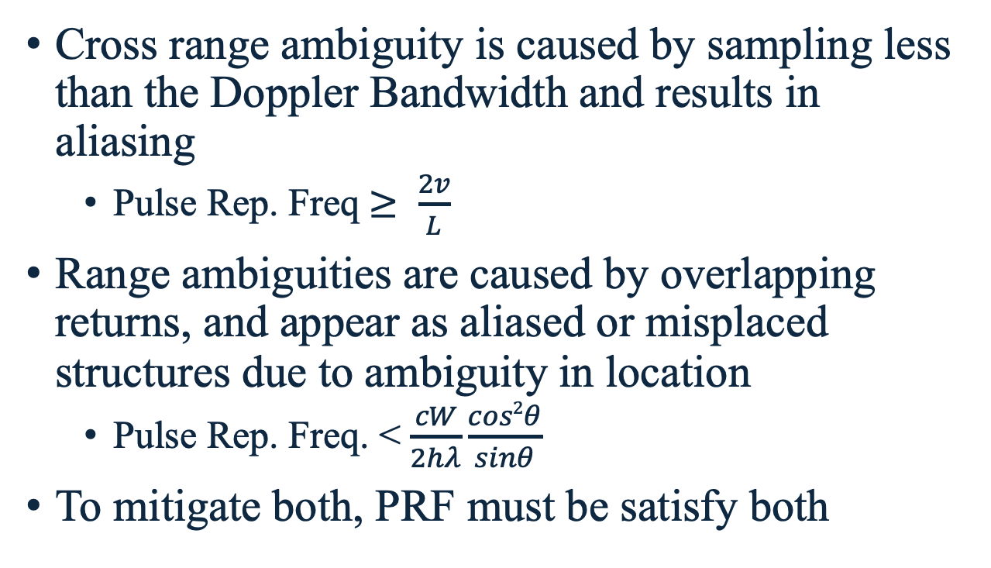
Noise – Cross Range Ambiguity
Cross range ambiguity is caused by sampling less than the Doppler Bandwidth and results in aliasing
  Pulse Rep. Freq $≥ \frac{2v}{L}$
Range ambiguities are caused by overlapping returns, and appear as aliased or misplaced structures due to ambiguity in location
  Pulse Rep. Freq. < $\frac{cW}{2hλ}\frac{cos2θ}{sinθ}$
To mitigate both, PRF must be satisfy both
From SAR Basics -
https://descanso.jpl.nasa.gov/SciTechBook/series2/02Chap1_110106_amf.pdf

Slide 12
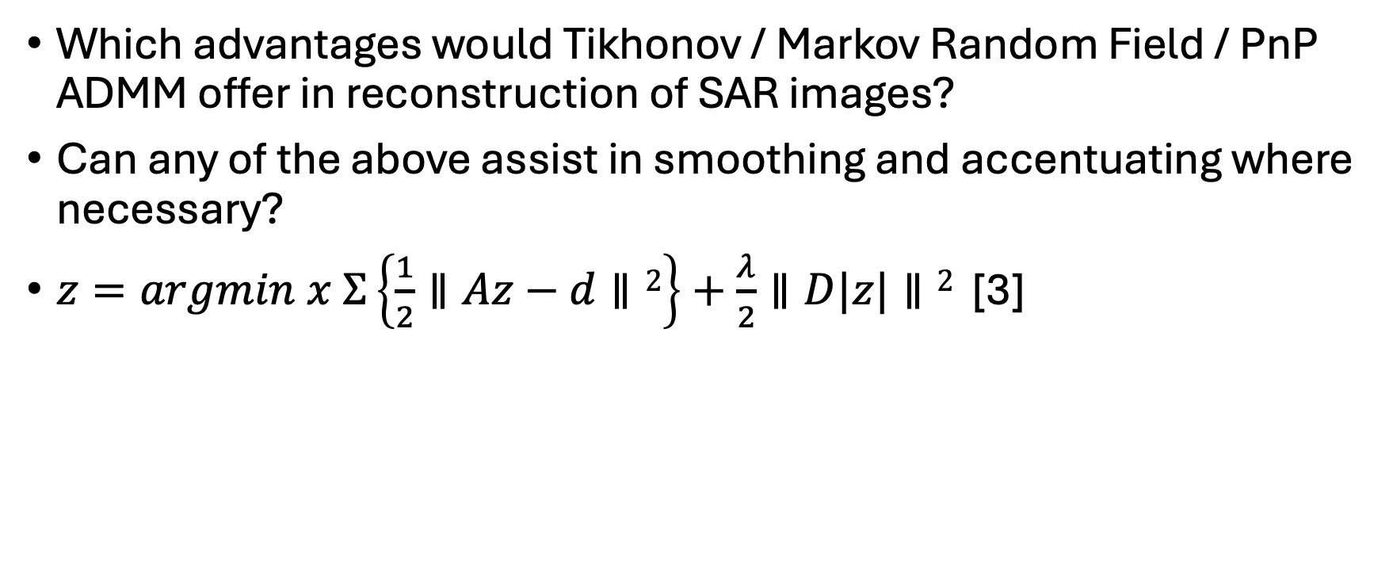
Regularization in SAR
Which advantages would Tikhonov / Markov Random Field / PnP ADMM offer in reconstruction of SAR images?
Can any of the above assist in smoothing and accentuating where necessary?
$z=argmin x Σ\left\{\frac{1}{2}∥Az−d∥2\right\}+\frac{λ}{2}∥D|z|∥2$ [3]

Slide 13
References
[1] Hysell, David. Antennas and Radar for Environmental Scientists and Engineers. Cambridge University Press, 2018.
[2] Lankoande, Ousseini; Majeed M. Hayat; and Bal Santhanam. "Speckle noise modeling and reduction of SAR Images based Markov random fields." (2005).
[3] Watson, F. M., et al. “On Regularisation of Coherent Imagery with Proximal Methods.” arXiv.Org, 29 Oct. 2024, arxiv.org/abs/2410.22161.
[4] Plug-and-Play Synthetic Aperture Radar Image Formation Using Deep Priors | IEEE Journals & Magazine | IEEE Xplore, ieeexplore.ieee.org/document/9308950/. Accessed 8 Apr. 2026.
[5] “Sar Data.” Pathfinder Radar ISR & SAR Systems, 8 Apr. 2022, www.sandia.gov/radar/pathfinder-radar-isr-and-synthetic-aperture-radar-sar-systems/complex-data-clone/.
[6] Mahafza, Bassem R. Radar Systems Analysis and Design Using MATLAB. CRC Press, 2000.

Slide 14
Reconstruction Methods - Tikhonov

Slide 15
Reconstruction Methods – Markov Random Field

Slide 16
Reconstruction Methods – Plug n Play ADMM

