Slide 1

Entanglement-enhanced optical ion clock
EC762 Quantum Optics
Department of Electrical and Computer Engineering
Christopher Lemus
lemusc@bu.edu
December 8th 2025

Slide 2
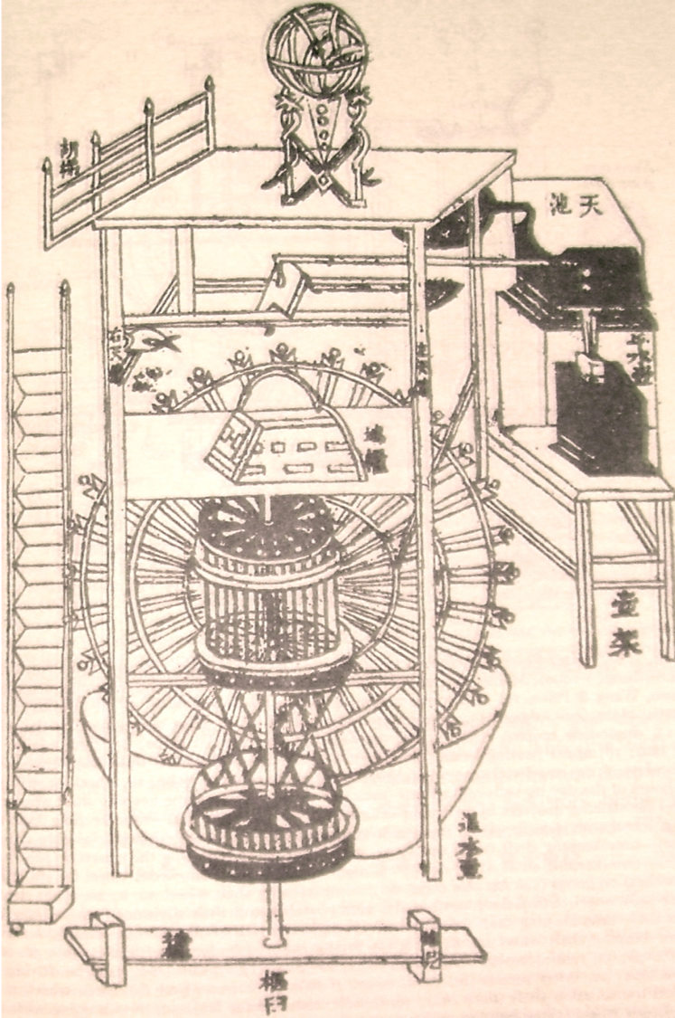
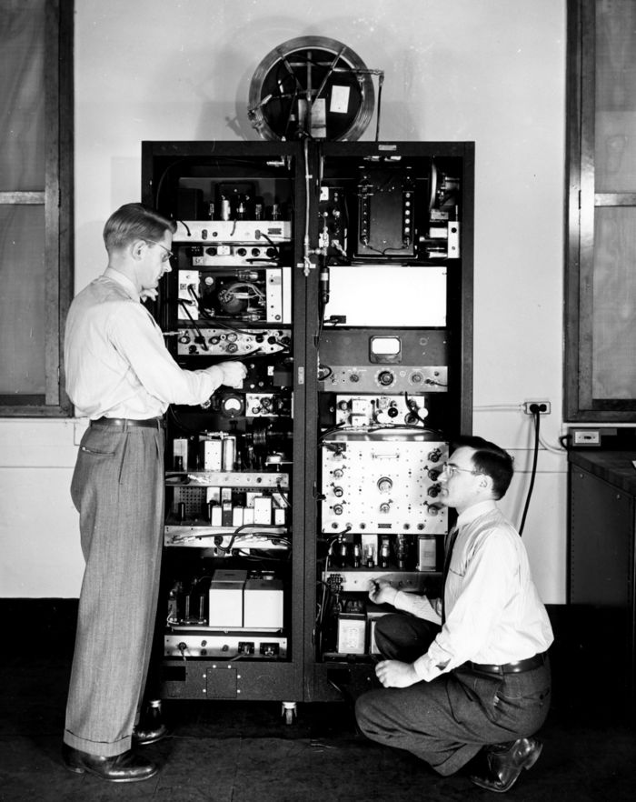

Introduction-time
  Progression from Sun -> Water -> Mechanical -> Quartz
  James Clerk Maxwell and William Kelvin
    Proposed the concept for matter to be used as time standard 1879 published in Elements of Natural Philosophy
  Dr. Harold Lyons (1913 – 1998)
    First Ammonia-based atomic clock under National Bureau of Standards 1948
    Frequency uncertainty: ~1 part in 10^8 _{[5]}
    ~ 1 second in 3 years
  Physicist Louis Essen (1908 – 1997)
    First Cesium atomic clock (1955)_{[2]} leveraging Isidor Rabi’s suggestion for Cesium
    Frequency uncertainty: ~1 part in 10^10 _{[5]}
    ~ 1 second in 300 years
  Currently NIST F4 is the most accurate Standard
    Frequency uncertainty: ~2 parts in 10^16
    ~ 1 second in 140 million years
  What about Optical ?
$∆t= \frac{∆f}{f}$ x t
Appendix B: Su Sung water clock 11-12 century
Appendix B: First Atomic clock NBS-1 (Ammonia)

Slide 3
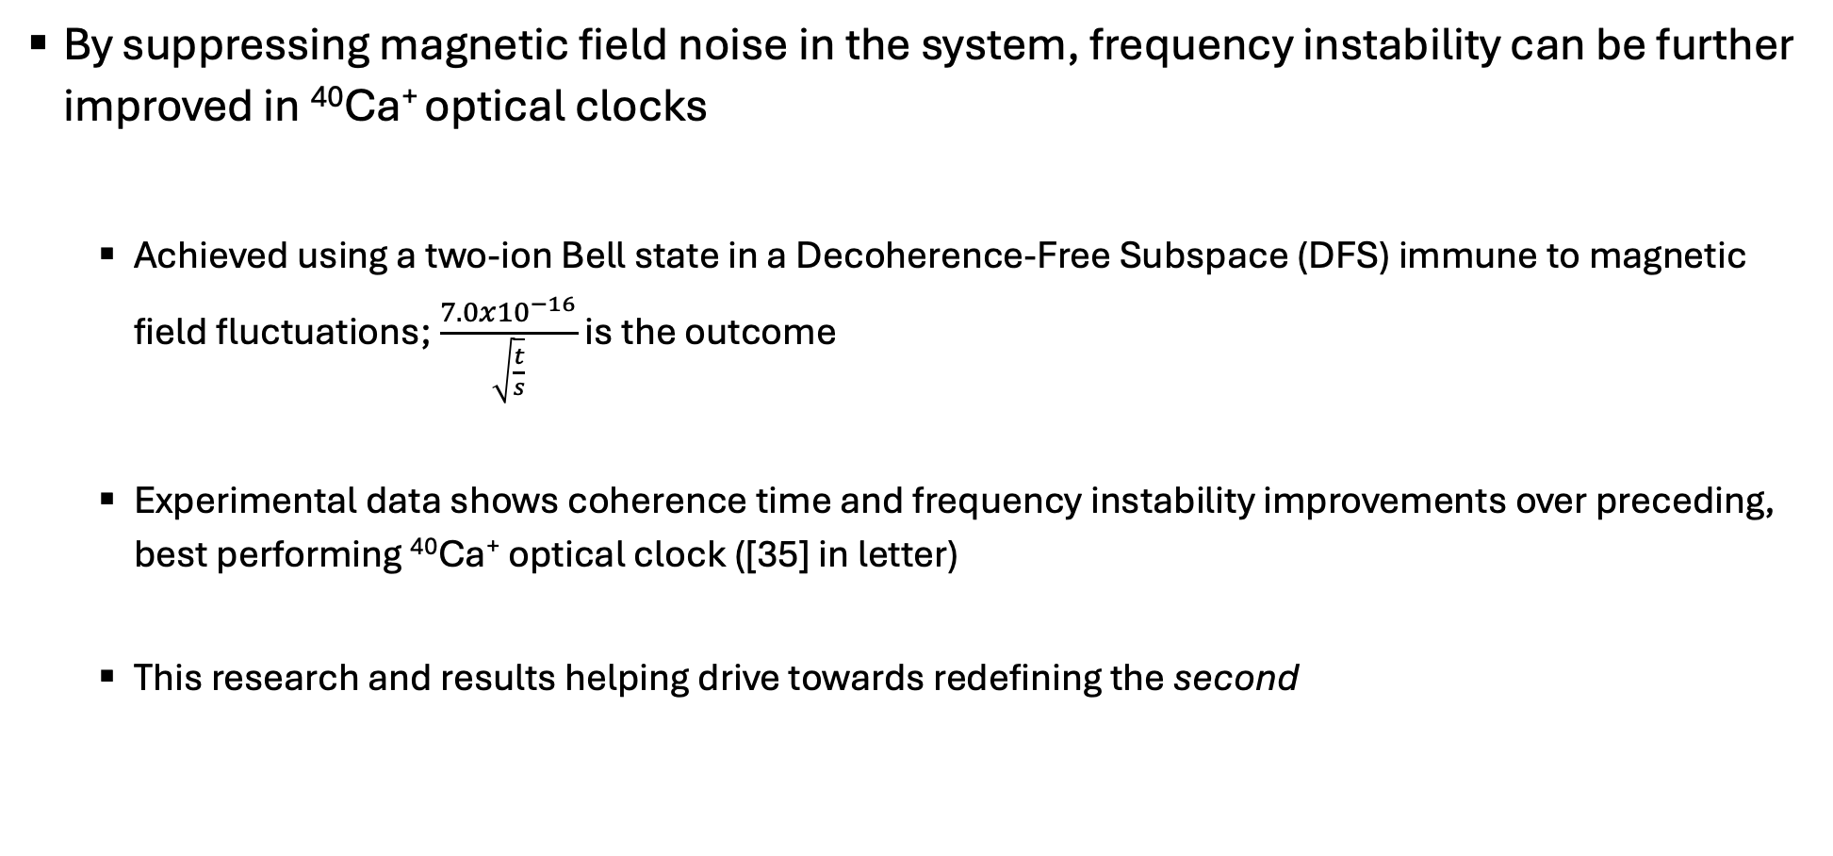
Introduction-purpose
By suppressing magnetic field noise in the system, frequency instability can be further improved in ⁴⁰Ca⁺ optical clocks
  Achieved using a two-ion Bell state in a Decoherence-Free Subspace (DFS) immune to magnetic field fluctuations; $\frac{7.0x{10}^{−16}}{\sqrt{\frac{t}{s}}}$ is the outcome
  Experimental data shows coherence time and frequency instability improvements over preceding, best performing ⁴⁰Ca⁺ optical clock ([35] in letter)
  This research and results helping drive towards redefining the second

Slide 4
How to create entangled decoherent-free subspace (DFS)
  Linear Paul-trap confines two ⁴⁰Ca⁺ ions
  Pre-defined magnetic field applied axially to spectrally separate Zeeman states
  Laser pulse(s) to manipulate trapped ions
  This yields Bell state (two-ion entanglement!)
  Each term of wavefunction experience equal and opposite Zeeman shift effects, making these states immune to first order magnetic field fluctuations
Figure x: Diagram of fountain atomic clock

Slide 5
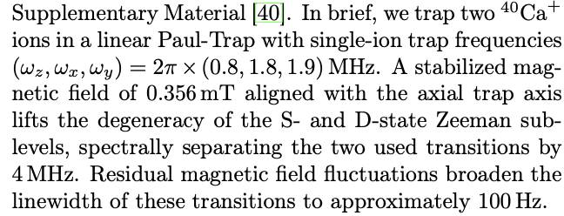
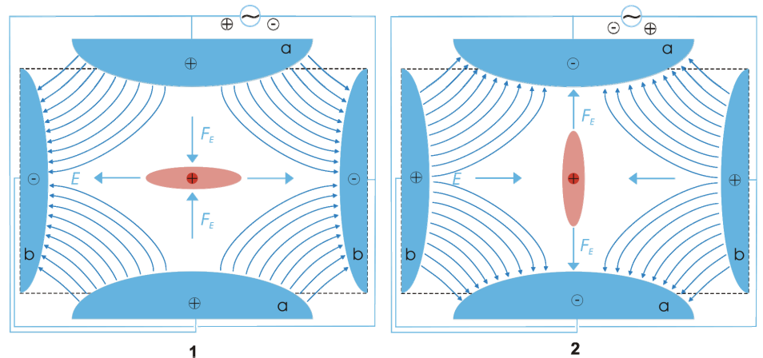
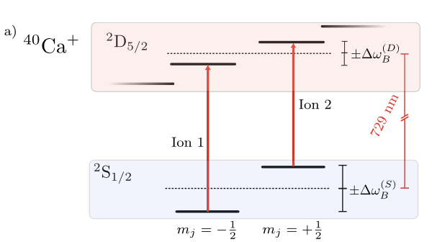
Starting with trapped ions
Resource-Linear Paul Trap
Figure 1a in letter-Level scheme

Slide 6


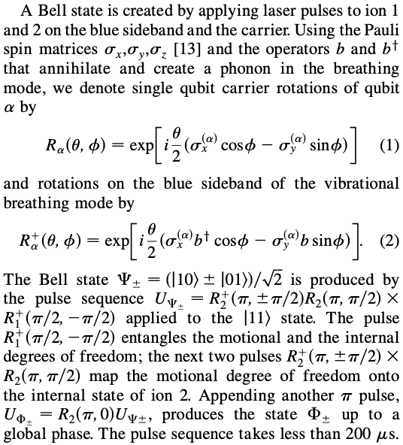
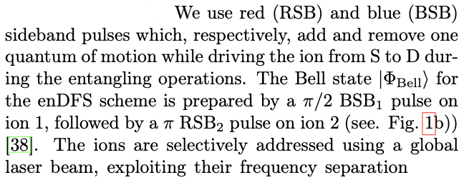
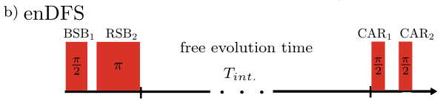
Entangled decoherence-free subspace (enDFS)
Starting with obtain
Coherence and superposition
Each term of superposition shifted by equal and opposite amounts, which is where first order magnetic immunity originates
Reference 38 in letter

Slide 7
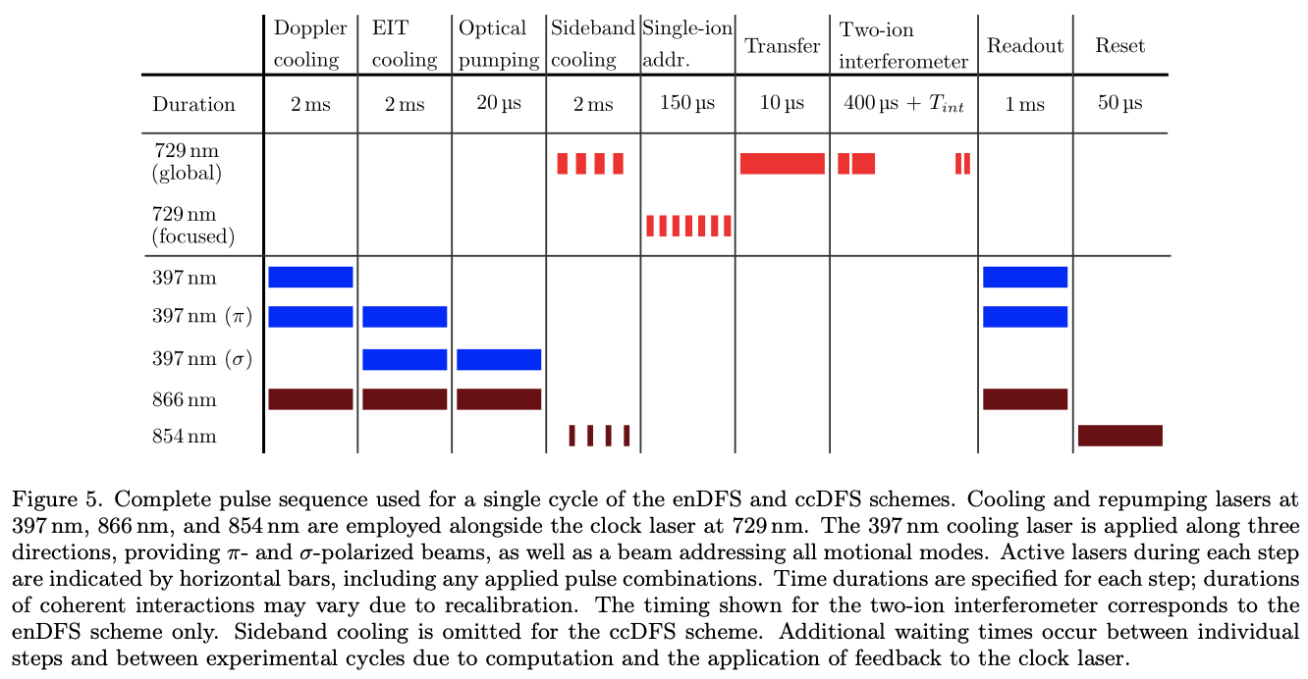
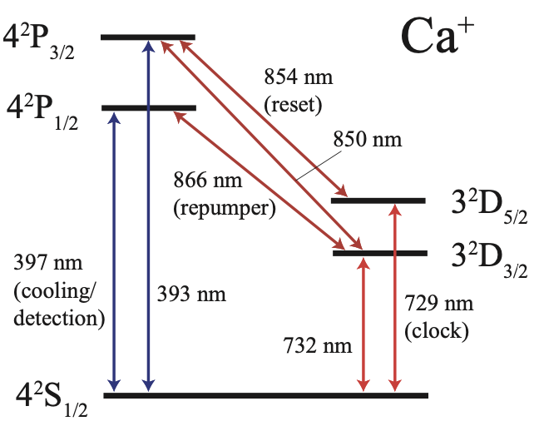
Laser parameters during experimentation
⁴⁰Ca⁺ level scheme
Reference Figure 2.1

Slide 8
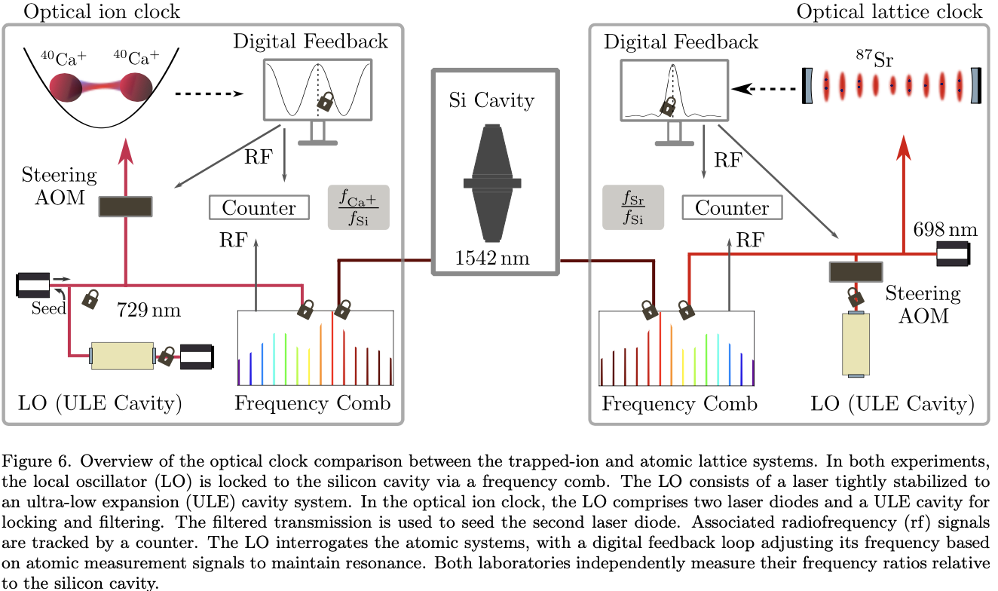
Comparison-⁴⁰Ca⁺ ion clock to ⁸⁷Sr lattice clock
Figure x: Diagram of fountain atomic clock
Notes:
Seed-more pure, clean, narrow linewidth spectrum
ULE-no expansion through temp change, great for stability

Slide 9
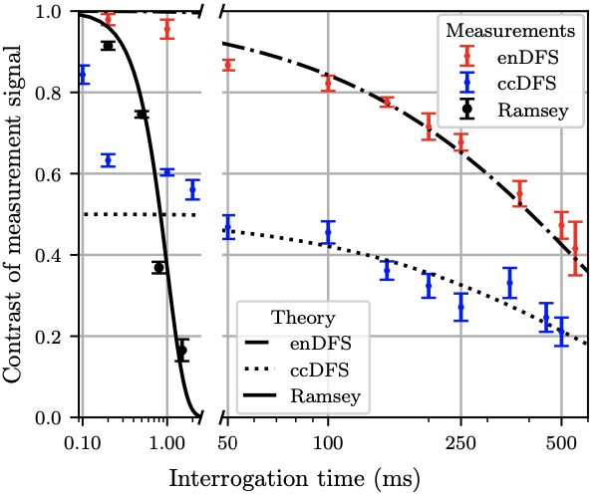
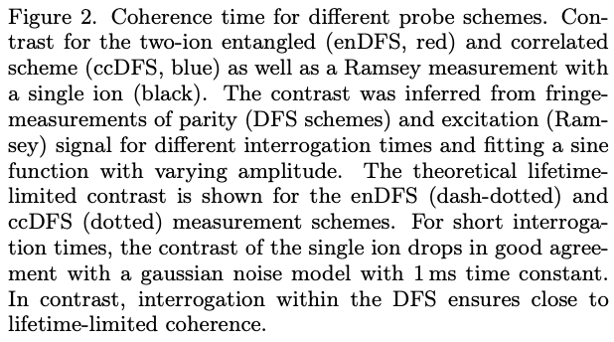
Coherence time for different probe schemes
Figure x: Diagram of fountain atomic clock
Notes:
Ramsey measures phase

Slide 10
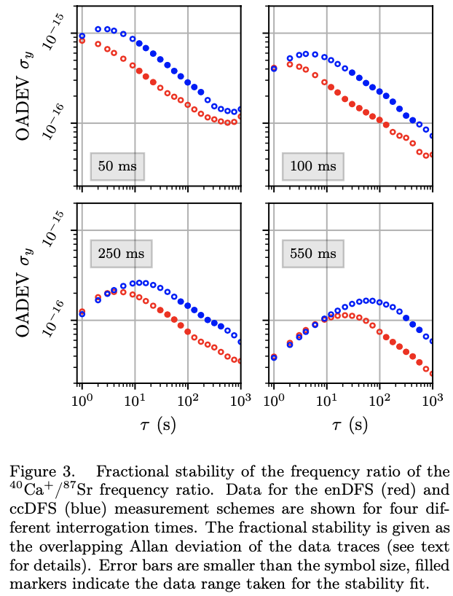
Comparison to ⁸⁷Sr lattice clock-Fractional stability

Slide 11
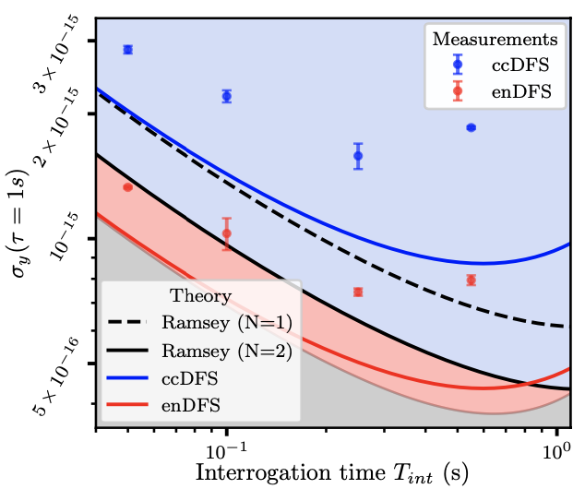
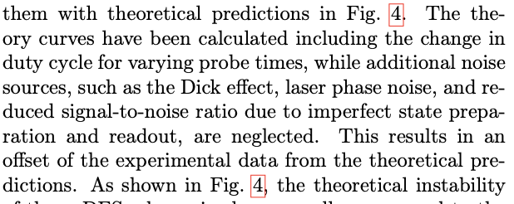

Comparison to ⁸⁷Sr lattice clock-Measured/Theoretical instabilities
  We see the $\frac{7.0x{10}^{−16}}{\sqrt{\frac{t}{s}}}$ frequency instability at 250ms probe time claimed

Slide 12
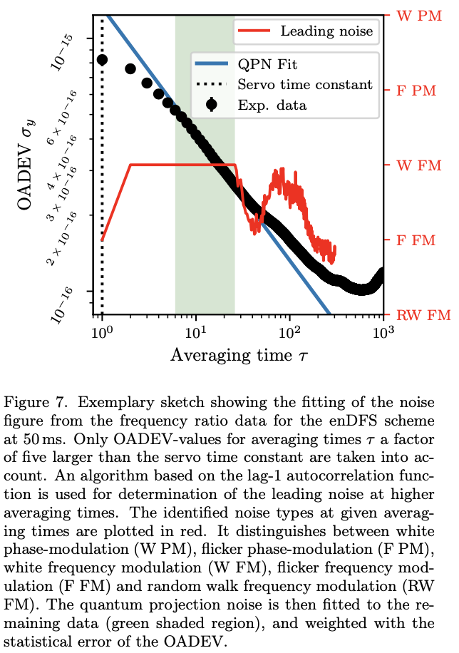
Quantum Projection Noise and Noise Figure

Slide 13
Conclusion
Magnetic field insensitivity due to the decoherence-free subspace enables near lifetime-limited probe times, and lower instability
Instabilities below the Quantum Projection Noise are observed for probe times under 100ms

Slide 14
What’s next?
Trying similar methods outlined in this paper with different ion candidates to see who responds the best
Improvements can still be made to the ⁴⁰Ca⁺ optical ion clock by scaling and mitigating systematic shifts with dynamical decoupling or more complex DFS states
Once the best candidate is found, new methods to scale down for commercial use can be started to make systems smaller

Slide 15
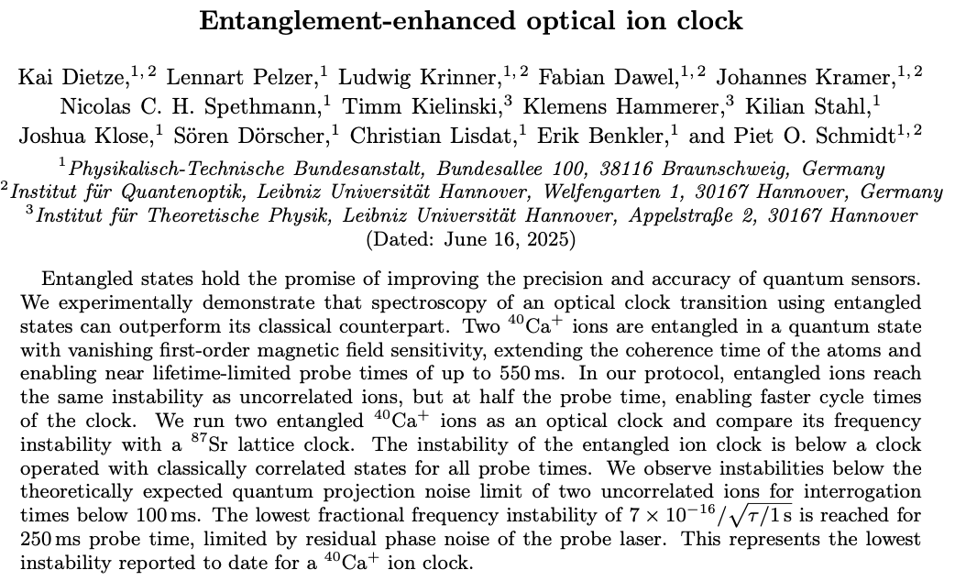
Appendix A
Reference article

Slide 16
Appendix: B
Dr. Harold Lyons patent 2,699,503 - https://ethw.org/w/images/a/a1/US_Patent_2699503.pdf
Figure B https://ethw.org/Milestones:First_Atomic_Clock,_1948
Figure A https://www.cabinet.ox.ac.uk/astronomical-clock-su-song-1020-1101
Figure C https://www.nist.gov/pml/time-and-frequency-division/time-realization/cesium-fountain-atomic-clocks
Figure D https://www.nist.gov/atomic-clocks/how-atomic-clocks-work/optical-clocks-future-time
Lombardi, M. A. & United States Government. (2012). The Evolution of Time Measurement, Part 4: The Atomic Second. In IEEE Instrumentation & Measurement Magazine (Vol. 47, Issue February, pp. 47–48) [Journal-article]. https://tf.nist.gov/general/pdf/2585.pdf
Hecht, Jeff. (2023). Louis Essen: Time lord of precision atomic clocks. https://spie.org/news/photonics-focus/marapr-2023/inventing-precision-atomic-clocks
Second: the past | NIST. (2023, September 25). NIST. https://www.nist.gov/si-redefinition/second-past
Lyons, H. & National Bureau of Standards. (1950). The Atomic Clock. In American Scholar (Vol. 19, pp. 159–168). https://ieeemilestones.ethw.org/w/images/5/57/Lyons_American_Scholar_1950.pdf
Lyons, H. (n.d.). ATOMIC CLOCKS. https://ethw.org/w/images/c/c9/Lyons_Scientific_American_1957.pdf

