Slide 1
Availability

Slide 2
Outline
Introduction
System centric
Availability zone centric
Disaster recovery
Other considerations
Key questions

Slide 3
Availability
Availability is defined as the degree to which a system or component is operational and accessible when required for use

Slide 4
Measuring availability
Typically measured in terms of percentage. E.g. 99.9999% uptime.
Difficult to measure directly.
Surrogate:
Availability = successful requests/total requests
Measured by requesting service based on HTTP response
Passed to observability back end for aggregation.

Slide 5
Maintaining System Availability
Identify single points of failure
Introduce detection mechanisms
Timeout
Health check
Introduce appropriate form of redundancy
Upon a failure, mitigate it using one of the forms of redundancy

Slide 6
Redundancy
Preparing for a failure involves some type of redundancy
Duplicate code
Possibly independently developed
Possibly alternative method of achieving function
Duplicate executable
Duplicate data
Duplicate hardware
Duplicate requests
Each of these forms of redundancy has its own considerations

Slide 7
Outline
Introduction
System centric
Availability zone centric
Disaster recovery
Other considerations
Key questions

Slide 8
Causes of failed requests
Notation: Service A is requesting service from Service B
A request fails because either
Service B is overloaded or
Service B has failed

Slide 9
Determining cause of failed request
Distinguishing between these two cases is difficult.
Service A has set a timeout.
After timeout period, Initial reaction is for Service A to retry request.
Typically, retry limited number of times (2 or 3) before deciding service B has failed.

Slide 10
Problems with retries
Service B now has two identical requests in queue
Retry spike

Slide 11
Identical requests in queue
Option 1: Service B is idempotent
Identical requests always return same results. E.g. multiply by 1
Option 2: Service A includes request ID and Service B keeps track of which requests it has serviced.

Slide 12
Retry Spike
A request from Service A does not generate a response within its deadline so it Service A retries.
Now Service A has two requests where before it only had one.
The Service now sends a third request, and so on
The Service B has many clients, each of which are doing the same thing.
This generates a “retry spike”

Slide 13
Avoiding retry spike
Bound number of incoming requests. Requests can be limited at upstream locations such as gateways or load balancers.
Limit retry requests from requestor.

Slide 14
Masking techniques for congestion or failure
Proceed without requested data. E.g. in a GPS system, if the data from the satellites are not received, proceed with dead reckoning based on other data.
Over-request. If multiple resources are being allocated, request more than needed and cancel the remaining requests once the necessary amount is reached.

Slide 15
Service B has failed
Failure in the cloud is inevitable.
In a data center with ~64,000 servers ~5 servers fail every day.
Detecting failure
Lack of response to a request for service
Health check.

Slide 16
Fallback if Service B has failed
Service A should have fallback in case Service B has failed.
alternative method for determining values,
showing default recommendations rather than personalized recommendations

Slide 17
Strategies to recover from failure of a single service
Stateful services
Stateless services

Slide 18
Recovering from failure of stateful service
Checkpoint
Record state on persistent repository and restore when start up service after failure.
Tradeoff between cost of creating checkpoint and data lost between last checkpoint and failure.
Hot spare
Keep a secondary mirror instance up to date and make active if primary fails.

Slide 19
Recovering from failure of stateless service
Create new instance of service
Could have pre-allocated instance
Trade off between cost of second instance and time required to create new instance
If multiple instances are executing, over allocate.

Slide 20
Maintaining state
Distributed Coordination Service (e.g. Zookeeper, etcd, consul) can be used to maintain state across multiple stateless instances
Distributed Coordination Service is fault tolerant
Will be available if instance fails.

Slide 21
Outline
Introduction
System centric
Availability zone centric
Disaster recovery
Other considerations
Key questions

Slide 22
Failure of availability zone
An AWS availability zone fails roughly once a year
https://aws.amazon.com/premiumsupport/technology/pes/
Options:
Live with it
Keep a hot spare in different region.
Data in transit during failure may be lost

Slide 23
Domino effect of nearest neighbor rollover
Suppose your system is hosted in availability zone A
Suppose you have set up redundancy on the closest availability zone to the zone A.
Availability zone A fails.
Your system fails over to the closest zone.
So does every other system hosted in zone A.
Closest zone gets overloaded.

Slide 24
Outline
Introduction
System centric
Availability zone centric
Disaster recovery
Other considerations
Key questions

Slide 25
Disaster Recovery Terminology
Disaster – event that makes a data center inoperable – flood, earthquake, tornado, power outage, etc
Business continuity – keeping your business going in the event of a disaster
Involves customers, employees, protecting people and equipment
Disaster Recovery – the IT portion of business continuity. Maintaining service to customers

Slide 26
Key measures per system
RTO – recovery time objective
How long before system is in service again
RPO – recovery point objective
How much data can be lost in the event of a disaster
Will vary for each system in an organization

Slide 27
Graphical representation
Data saved
System is available with data saved previously
RPO
Disaster
happens
RTO
Time

Slide 28
Tiers
Divide your systems into tiers based on RTO and RPO
Tier 1 (mission critical) – 15 minutes
Tier 2 (important support ) - 2 hours
Tier 3 (less important support) - 4 hours
Tier 4 (everything else) - 24 hours

Slide 29

Secondary data center
When a disaster occurs, your data center will be out of operation for days/weeks/months
You need a secondary (back up) data center

Slide 30
Tier 1 systems
Treat disaster as availability zone failure.
Maintain spares in secondary availability zone
Hot spares or ware spares depending on system criticality and cost.

Slide 31
Outline
Introduction
System centric
Availability zone centric
Disaster recovery
Other considerations
Key questions

Slide 32
Scheduling problem
In real time systems, threads are prioritized.
Priority inversion causes lower priorities to be run ahead of higher priorities

Slide 33
Priority inversion
Priority inversion is detected by looking at priorities of various threads vs execution of those threads
Priority inversion is prevented by using appropriate scheduling mechanism.

Slide 34
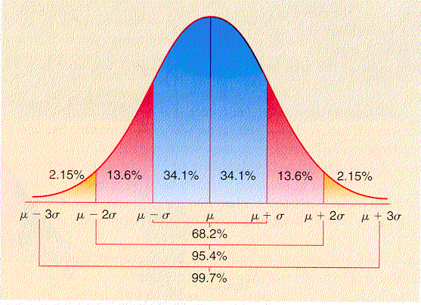
Short digression into probability
A distribution describes the probability than any given reading will have a particular value.
Many phenomenon in nature are “normally distributed”.
Most values will cluster
around the mean with
progressively smaller
numbers of values going
toward the edges.
In a normal distribution
the mean is equal to the
median

Slide 35
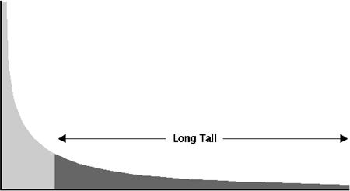
Long Tail
In a long tail distribution, there are some values far from the median.
These values are sufficient to influence the mean.
The mean and the
median are
dramatically
different in a long
tail distribution.

Slide 36
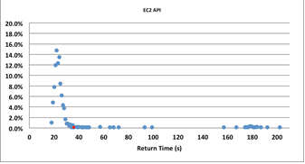
What does this mean?
If there is a partial failure of the cloud some activities will take a long time to complete and exhibit a long tail.
The figure shows
distribution of
1000 AWS
“launch instance”
calls.
4.5% of calls were
“long tail”

Slide 37
Masking long tail
“Hedged” request. Suppose you wish to launch 10 instances. Issue 11 requests. Terminate the request that has not completed when 10 are completed.
“Alternative” request. In the above scenario, issue 10 requests. When 8 requests have completed issue 2 more. Cancel the last 2 to respond.
Using these techniques reduces the time of the longest of the 1000 launch instance requests from 202 sec to 51 sec.

Slide 38
Outline
Introduction
System centric
Availability zone centric
Disaster recovery
Other considerations
Key questions

Slide 39
Key questions
Failure of which components will result in a violation of the requirement?
Is there redundancy in the design for those components?

Slide 40
Summary
Anticipate causes of unitability
Prepare masking strategy for each cause
Detect failure
Execute masking strategy.
Have disaster recovery plan in place

