Slide 1
Observability

Slide 2
Outline
Introduction
Utilization
Logging
Tracing
Designing for observability
Key questions

Slide 3
Observability
The extent to which you can understand the internal state or condition of a system based only on knowledge of its external outputs
Two aspects
Collecting data - metrics, traces and logs
Displaying data – alerts, dashboards

Slide 4
Purposes of gathering data
After a system is in operation, information is gathered for three purposes:
Alerting – Detecting that there is a problem
Forensics – determining what caused a problem
Improvement – finding bottlenecks in systems or determining causes of internet traffic.

Slide 5
General picture
Running system
Backend
Measurements
Measurements are taken from a running system and its environment and sent to a back end.

Slide 6
Back end
The back end has a database (usually a time series database). It
Generates alerts
Generates reports
Allows drilling down into aggregate information to get more detailed information
Has a dashboard to give fast indication of problems.

Slide 7
Data in Back End
Data can be either pushed into back end or pulled from back end
Data should be tagged with:
Service instance ID (if log)
VM or container instance ID i(if metric)
User and trace id
May want to add deployment history for instances

Slide 8
Outline
Introduction
Utilization
Logging
Tracing
Designing for observability
Key questions

Slide 9
Utilization
Utilization is measure of some activity over some period of time
Collected automatically by infrastructure over externally visible activities of VM or container
CPU – percentage busy
I/O – amount of traffic
etc
Collected by back end from infrastructure
Pushed by an infrastructure plug in that is dependent on back end.

Slide 10
Utilization measures
Taken over period of time
Instantaneous measurement is not meaningful.
At any instant a CPU is either busy or idle.
You want to know whether the CPU is overloaded. I.e. what percentage of the last five minutes (for example) was the CPU busy

Slide 11
Alerts
Back end has set of rules to establish when to send an alert. E.g. alert if CPU utilization is over 80% for 15 minutes.
Utilization numbers are bursty. The period must be sufficiently long to indicate problem.
False positives and false negatives are both problems.
An alert causes a page to be sent.

Slide 12
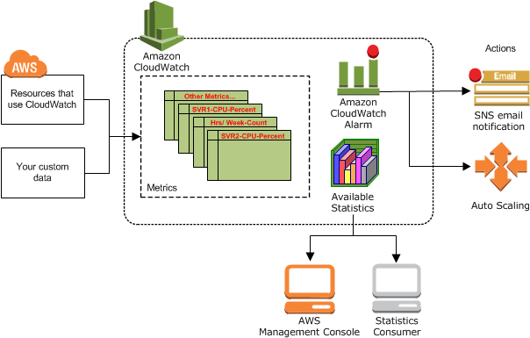
AWS Cloudwatch

Slide 13
Outline
Introduction
Utilization
Logging
Tracing
Designing for observability
Key questions

Slide 14
Logs
A log is an append only data structure
Written by each software application.
Located in a fixed directory within the operating system
Enumerates events from within application
Entry/exit and associated parameters
Troubleshooting
DB modifications
Exceptions
…

Slide 15
Log Daemon
A daemon resides on each server.
It copies logs generated by applications on that server to back end.
Logs can be voluminous and so daemon may also clean off log file periodically – once the contents have been sent to the back end.

Slide 16
Request number
Every request gets a unique id when it enters the system.
This id is passed with each message

Slide 17
Sequencing log entries
Having logs in sequential order is important for troubleshooting.
Time stamps are inadequate for this purpose since computer clocks drift and two computers on a network will likely have different times.
Lamport clock is early attempt to provide sequence. It provides a partial order among events.

Slide 18
Lamport clock
A process increments its counter before each message sending event);
When a process sends a message, it includes its counter value with the message after executing step 1
On receiving a message, the counter of the recipient is updated, if necessary, to the greater of its current counter and the counter in the received message. The counter is then incremented by 1 before the message is considered received.

Slide 19
Log entries
Entry and exit from service
Other activities that may be of interest
Includes
Id of external request
clock sequence number
Service id
Parameter values
Queue lengths, disk space, memory usage

Slide 20
What happened?
Logs are used to determine what happened.
Either
immediately after an alert to get the system working again or
later to determine frequent types of problems and their causes

Slide 21
Playback
Logs can also be used to play back a sequence of events during trouble shooting.
The input to a service consists of its entry log (and necessary state). The service can then be run under the control of a debugger to find problems.

Slide 22
Outline
Introduction
Utilization
Logging
Tracing
Designing for observability
Key questions

Slide 23
Tracing
Tracing provides an end to end picture of a request.
Utilization helps determine whether there is a problem.
Logging provides picture of a single event
Tracing provides a sequence of events
Tracing is used to understand the big picture

Slide 24
Spans
A trace captures the end to end actions in response to a user request.
A span is a named, timed operation that represents a piece of the trace.
Spans may have child spans
Displaying spans on a time axis allows you to see:
Parallelism
Where time is being spent

Slide 25
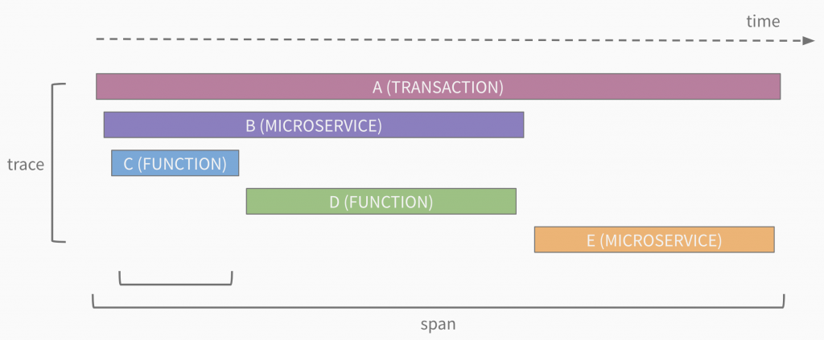
Sample span display*
*https://sflanders.net/2019/03/28/an-intro-to-distributed-tracing/

Slide 26
How does tracing work? - 1
This is one of many possible implementations.
Request enters the system from external source – user or external system
Request is given a unique ID that reflects the context
Context description is kept in a data base so that with context ID analyst can know details of the context.

Slide 27
How does tracing work? – 2
Context id becomes a portion of HTTP header. World Wide Web Consortium is standardizing how this will work.
The context ID is inserted by the HTTP server accepting the request and propagated by every service as it fans out the request. This is transparent to the requester.
Context can be used to control behavior of a service.

Slide 28
Examples of context
Test version. Use context to affect behavior or routing.
Application. Google might want to know what percentage of their network traffic might be due to search, Gmail, etc
Traffic prioritization. Give priority to certain requests to maintain quality of service.
Bottleneck determination. Where is the most time being spent in a collection of transactions?

Slide 29
Outline
Introduction
Utilization
Logging
Tracing
Designing for observability
Key questions

Slide 30
Process steps
Define contexts of interest
Save codes/definitions of context in database
include back end specific log daemons in build step of deployment

Slide 31
Design steps
Add log entries on entry exit
Invoking process
Parameters
Context
Queue lengths
…
Add other log entries
Exceptions

Slide 32
Utilization
Utilization is collected by the infrastructure
Setd by back end specific plug in

Slide 33
Outline
Introduction
Utilization
Logging
Tracing
Designing for observability
Key questions

Slide 34
Key questions
Is all measurement data readily available?
Can events be arranged sequentially?

Slide 35
Summary
Utilization is the measurement of how much the resources in an environment are being used.
Logging is the recording of specific events and information associated with those events.
Tracing ties together a sequence of services.

