Slide 1
Telephone Observability

Slide 2
Outline
Business context
Use cases
Constraints
Quality requirements
Software architecture
Satisfying requirements
Next steps

Slide 3
Business context
During the first 100 years of the telecom network the users were restricted to being stationary connected through fixed lines.
The emergence of mobile telephony in the 1980s made it possible to "move a call" and began the concept of "personal communication services" where each user had a personal handset. This lead to special mobility equipment (radio towers and databases that tracked movement of users) which augmented the fixed network.

Slide 4
Business context
The widespread use of the Internet made the Internet Protocol (IP) the data network protocol of choice and eventually the traditional public telephone network transformed to an all IP network.
The Long-Term Evolution (LTE) wireless system was developed to handle the increased volume of mobile traffic by building a network

Slide 5
Business context
Data traffic on AT&T's mobile network grew by 150,000% from 2007 (iPhone launch) to 2014.
Video traffic is 60% of the total network traffic.
The networks today support billions of applications, photo-sharing, video-streaming, mobile devices, and IoT.
Currently 1 minute of video uses 4 MB of data.
Virtual reality will multiply the traffic by orders of magnitude, using hundreds of MB per minute.

Slide 6
Business context – 5G
Currently an estimated 20 to 50 billion devices are connected to the network and this is growing rapidly.
In order to meet these new demands, the 5G network will offer:
From 5Mb/s (current) to 50 Mb/s
Peak speeds of 1 Gb/s simultaneously to many users in same area.
Hundreds of thousands of simultaneous connections for wireless sensor networks.
Better coverage.
Lower latency for such things as connected cars

Slide 7
Business context
The services or applications available have grown my orders of magnitude and are continually evolving requiring the need to keep pace by doing things differently.
In order to keep pace with growth, the following has occurred.
The network design has transitioned from hardware centric to software centric.

Slide 8
Business context
Software-defined networking (SDN) has made the creation and configuration of networks less costly by separating the control plane (the routing logic) from the data plan (forwarding function) which allows greater flexibility.
Network Function Virtualization (NFV) has resulted in the transition of network functions (applications and servers on a telephony network) from proprietary, black-box, devices to virtualized software running on commodity hardware (regular old servers).

Slide 9
Business context
AT&T has moved from the data center architecture to a cloud architecture.
AT&T has transitioned to a workforce trained in software and cloud skills.

Slide 10
Business context
Data Collection Analytics and Events
AT&T has developed the Open Source Open Network Automation Platform (ONAP) which allows users to configure, manage, and administer virtualized network and service functions in the AT&T network cloud.

Slide 11
Business context
The focus of our group is Data Collection Analytics and Events (DCAE) which provides Observability for the network cloud platform.
It has the following components:
Analytics framework and analytics applications
Collection Framework
Data distribution bus
Persistence storage framework
Orchestrator

Slide 12
Basic functionality
DCAE receives, stores, and analyzes Observability Events.
The focus here is:
Logs
Performance metrics (counters)
Traces from probes

Slide 13
Analytic applications
Users can create analytics applications.
The context for using these data is:
Operations Support
Capacity Planning

Slide 14
Outline
Business context
Use cases
Constraints
Quality requirements
Software architecture
Satisfying requirements
Next steps

Slide 15
UC 1 – Get information from Dashboard
A user logged into a portal can see a listing of
Current alerts for the platform.
Performance metrics (counters) for all elements on the platform.
Aggregated logs from multiple elements
Developers can managge alerts based on events that appear in the logs.

Slide 16
UC 2 – Ticket Creation
An operations user receives a ticket in a queue for alarms that are "actionable,"
The operations user can view all the tickets in any team queue but can only update the tickets belonging to their team queue.
The operations user can
Edit (add comments and status)
Move the ticket to the queue of another team.
Assign ownership of the ticket
Close the ticket
Escalate the ticket to the next level tier support

Slide 17
UC 3 – Correlation
An operations user can view an analytics dashboard that gathers data from many sources that can be correlated and analyzed using advanced analytics and visualization techniques.
During the troubleshooting process, this will proactively detect anomalies, failures, and capacity exhaust by allowing the operator to select and drill down on subsets of the data.

Slide 18
Outline
Business context
Use cases
Constraints
Quality requirements
Software architecture
Satisfying requirements
Prepare for the next iteration

Slide 19
Constraints
Business analysts must interact with the dashboards through a web browser in different platforms: Windows, OSX, and Linux. Administrators should access systems via ssh
The systems are deployed in an Open Stack private cloud.

Slide 20
Outline
Business context
Use cases
Constraints
Quality requirements
Software architecture
Satisfying requirements
Next steps

Slide 21
Security requirement
The system must include an Identify Access Management (IAM) subsystem that will authenticate users and ensure that they have permissions to resources that followed the Least Privilege Principles.
The system must mitigate for the OWASP top ten threats.
Published vulnerabilities, e.g. OS, database, application, must be addressed in a timely manner and systems must be patched.

Slide 22
Performance requirement
The acceptable latency period for batch data to arrive is no more than 15 minutes.
Alerts should arrive no longer than 5 minutes from the time they were generated on the system.
Data retrieval on dashboard applications should be around 1.0 second, but no longer than 10 seconds.
For operations that do not involve data retrieval, the response time should be 100 milliseconds.

Slide 23
Resiliency requirement
System faults should not cause a service interruption.
Common faults include:
Failed storage
Server performance problem of crash
Server unreachable

Slide 24
Modifiability requirement
Upgrades need to be performed regularly during maintenance windows to ensure minimal system downtime without the need to take the entire system offline.

Slide 25
Maintainability requirement
The system must be maintainable by allowing operations to login via SSH to perform maintenance tasks.
Actionable events trigger a ticket in the ticketing system.
Logs must be available for collection and analysis.

Slide 26
Testability requirement
The system must testable following upgrades to ensure that there is a high probably of finding any new bugs introduced by the upgrade.

Slide 27
Interoperability requirement
The system must be interoperable with the network elements that generate logs, alerts, and performance metrics. The DCAE system must be able to communicate with these elements (syntactic interoperability) and the data format must be consistent (semantic interoberability).

Slide 28
Outline
Business context
Use cases
Constraints
Quality requirements
Software architecture
Satisfying requirements
Prepare for the next iteration

Slide 29
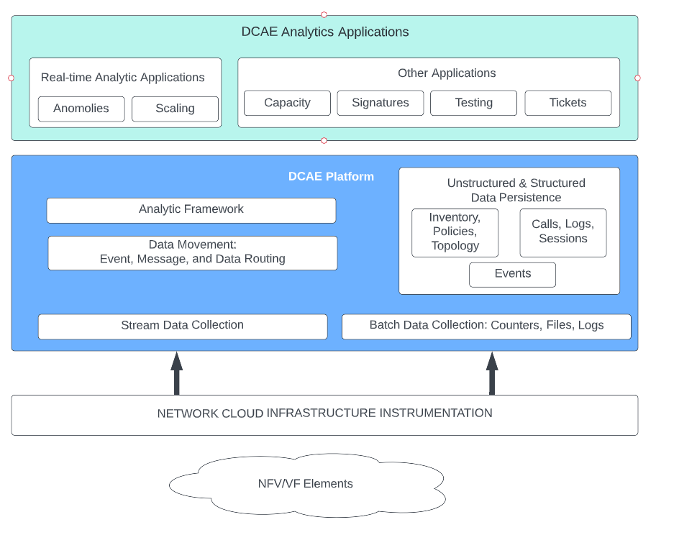
Module view

Slide 30
Real Time Analytics applications
Provides dashboard functionality for real time data

Slide 31
Capacity
Performs capacity planning based on:
CPU utilization
Memory utilization
Disk usage
Network bandwidth

Slide 32
Signatures
Perform fault and event correlation based on defined rules, policies, known signatures, and other knowledge about the network or service behavior in order to determine the root cause of an outage.
It may trigger actions to remediate faults.

Slide 33
Testing
Manage test cases and results
Tests can be performed on running system to determine faults

Slide 34
Tickets
Create, route, and edit tickets.

Slide 35
Analytic Framework
A framework to support analysis applications.

Slide 36
Data Movement
Receive and forward events.

Slide 37
Data Persistence
Data base functions

Slide 38
Stream Data collection
Manage and aggregate streamed data.

Slide 39
Batch Data collection
Periodically retrieves data to be batched (e.g. logs)
Stores data in Data Persistence
Cleans up logs on servers

Slide 40
Outline
Business context
Use cases
Constraints
Quality requirements
Software architecture
Satisfying requirements
Next steps

Slide 41
Steps to achieve UC 1
Analytic Framework subscribes to topics from both stream data collection and batch data collection
Analytic Framework aggregates logs and counters on request
HMI displays dashboard with information from aggregated events and allows drilling down into aggregated events

Slide 42
Steps to achieve UC 1
Dashboard is recalculated and updated periodically by analytic framework and real time analytics
HMI allows creation and management of alerts
Real Time Analytics manages active alerts
Real Time Analytics manages authentication and authorization for users through an IAM
Data Persistence stores specification of alerts

Slide 43
Steps to achieve UC 2
Tickets and their status are managed in Tickets and maintained in Data Persistence
Ticket management authorizes users through an IAM
Users are allowed to perform the functions in UC2
Users interact with Tickets through HMI

Slide 44
Steps to achieve UC 3
Real Time Analytics has capabilities to correlate data and detect failures.
Real time Analytics subscribes to the data sources necessary to detect failure.
Real time Analytic analyzes current data to predict capacity exhaustion and Capacity plans for reallocation of resources and the need for additional resources both in the short term and the long term.

Slide 45
Steps to achieve security
The system must include an Identify Access Management (IAM) system that will authenticate users and ensure that they have permissions to resources that followed the Least Privilege Principles.
Add IAM to the architecture

Slide 46
Steps to achieve security
The system must mitigate for the OWASP top ten threats.
The testing module will exercise the top ten OWASP threats

Slide 47
Steps to achieve security
Published vulnerabilities, e.g. OS, database, application, must be addressed in a timely manner and systems must be patched.
A Bill of Materials is generated during the build process and Testing periodically scans the BOM and compares it to the CVE.

Slide 48
Satisfying performance requirement
The acceptable latency period for batch data to arrive is no more than 15 minutes.
This is assigned to Batch Data Collection

Slide 49
Satisfying performance requirement
Alerts should arrive no longer than 5 minute from the time they were generated on the system.
This is assigned to Real Time Analytic Applications

Slide 50
Satisfying performance requirement
Data retrieval on dashboard applications should be around 1.0 second, but no longer than 10 seconds.
This is assigned to Real Time Analytic Applications

Slide 51
Satisfying performance requirement
For operations that do not involve data retrieval, the response time should be 100 milliseconds.
This is assigned to Real Time Analytic Applications
Network latency is reduced by implementing SRIOV, which is a network interface that allows a single physical peripheral component interconnect (PCI) express hardware interface to be shared by different VMs.
Allocating a VF to VM instance enables network traffic to bypass the hypervisor and flow directly between the VF and the VM. This allows near line rate performance without dedicating a single physical NIC to each VM.

Slide 52
Steps to support resiliency
Systems are deployed in at least two geographic regions so that systems can failover when faults occur. Failover is managed by Signatures
Systems are locally redundant. Again, failover is managed by Signatures
Chaos testing is performed. Assigned to Testing

Slide 53
Steps to support modifiability
These requirements impact the process of development and deployment

Slide 54
Steps to support maintainability
These requirements are assigned to Tickets
Real Time analytics may create a ticket when an alert occurs.

Slide 55
Steps to support testability
This requirement is assigned to Testing

Slide 56
Steps to support interoperability
This requirement is assigned to
Stream Data Collection
Data Movement
Analytic Framework
Batch Data collection

Slide 57
Satisfying constraints
These steps are assigned to process and Testing

Slide 58
Outline
Business context
Use cases
Constraints
Quality requirements
Software architecture
Satisfying requirements
Next steps

Slide 59
Process steps
Add IAM to architecture with responsibilities for managing login, authentication and authorization
Determine information to be presented on dashboard
Define topics for communication
Define protocol for communication with Data Movement
Define schema for Data Persistence

Slide 60
Process steps
Create benchmarks to test performance requirements.

Slide 61
Requirements for Real Time Analytics applications
Responsibilities
Present dashboard through HMI.
Data for dashboard is retrieved periodically from data persistence
Calculate, present and inform relevant people of active alerts
Support specification of alerts
Use token from IAM to determine authorizations
Developers can create alerts based on events that appear in the logs.

Slide 62
Requirements for Real Time Analytics applications
Manage scaling rules and operations
Correlate data and detect failures and report them to signatures
Analyzes current data to predict capacity exhaustion. Report predictions to Capacity.

Slide 63
Requirements for Real Time Analytic applications
Quality requirements
Security - users are authorized via IAM
Performance – dashboard refresh intervals for data types (batch, alerts, stream) are settable.
Real Time Analytics must schieve performance requirements for dashboard refresh, and data retrieval,

Slide 64
Requirements for Capacity
Responsibilities
Perform capacity planning based on:
Cpu utilization
Memory utilization
Disk usage
Network bandwidth
Subscribe to relevant topics from Data Movement
Communicate with Real Time Analytics for short term planning
Retrieve data from Persistent Storage for long term planning

Slide 65
Requirements for Capacity
Quality requirements
Security - users are authorized via IAM

Slide 66
Requirements for Signatures
Responsibilities
Notified of fault from Real Time Analytics or Testing
Perform fault and event correlation based on defined rules, policies, known signatures, and other knowledge about the network or service behavior in order to determine the root cause of an outage.
Subscribe to relevant topics from Data Movement
Initiales actions to repair faults

Slide 67
Requirements for Signature
Quality requirements
Performance and resilience – periodically retrieve data from Data Persistence and examine it for faults.
Resilience – fail over servers if necessary

Slide 68
Requirements for Testing
Manage test cases and results. Include OWASP top 10 in set of test cases.
Tests can be performed on running system to determine faults
Run scanners during run time to check BOM against CVE

Slide 69
Requirements for Testing
Run test suites during build and report results to specified locations
Perform chaos testing and, if fault is detected, inform Signatures

Slide 70
Requirements for Testing
Quality requirements
Security – include OWASP top 10 in test suite

Slide 71
Requirements for Tickets
Create, route, and edit tickets.
Receive some ticket requests from Real Time Analytics
Receive other ticket requests from HMI
Verify authorization from HMI

Slide 72
Requirements for Analytic Framework
A framework to support analysis applications.
Subscribe to data movement for relevant topics
Retrieve relevant data from Data Persistence
Aggregate data as appropriate

Slide 73
Requirements for Data Movement
Receives events and messages from stream data collection
Publishes topics
Kafka is tool used for Data Movement

Slide 74
Requirements for Data Persistence
Data base functions
Stores data from Batch Data Collection
Stores data from Real Time Analytics
Provides interfaces for data storage and retrieval

Slide 75
Requirements for Stream Data Collection
Manage and aggregate streamed data.
Publish to Data Movement

Slide 76
Requirements for Batch Data Collection
Periodically retrieves data to be batched (e.g. logs)
Stores data in Data Persistence
Cleans up logs on servers

