Slide 1
What is MLOps?

Slide 2
MLOps Definition
MLOps, or Machine Learning Operations, is a set of practices that automates and manages the process of developing, deploying, and maintaining machine learning (ML) models in production.

Slide 3
Outline
Stages of MLOps
Types of MLOps tools
Challenges of MLOps
Differences with DevOps

Slide 4
Key Stages of MLOps
Data Preparation and Engineering
Model Development and Training
Testing and Validation
Deployment and Serving
Monitoring and Retraining
Goveerance

Slide 5
Data Preparation and Engineering
The MLOps process starts with collecting, cleaning, and transforming raw data into a usable format.
Practices such as data versioning and using feature stores are aspects of data preparation and engineering

Slide 6
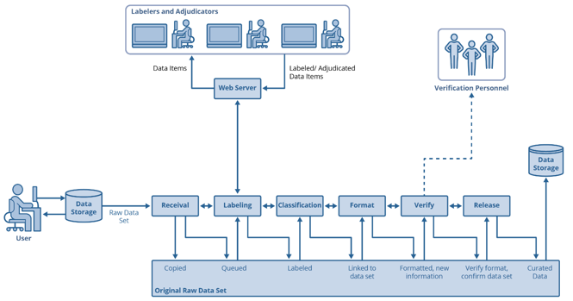
Data Curation Pipeline
inputs raw data and outputs curated data.
implements each step to label, classify, and format data.
may need personnel to label raw data.
should run before and parallel to Dev pipeline.

Slide 7
Verification of Data
This phase assures a correctly formatted data set.
More importantly, it validates the following:
The data is objective.
The data is compatible with expected use cases.
There are no individual assumptions.
Adversarial AI is absent.
The phase could benefit from both human and machine inspection.
Consider setting parameters with automated checking to ensure you meet all the points above.
This phase supports Shift-Left testing → finds issues in data before its use in AI model development.

Slide 8
Model Development and Training
Data scientists and ML engineers experiment with different algorithms and tune hyperparameters to develop the best-performing model. Experiment tracking tools are used to log and compare different training runs.

Slide 9
Testing and Validation
Models are tested and validated against previously unseen data to ensure they are accurate and generalize well to real-world conditions. This includes testing for data validation and model accuracy.

Slide 10
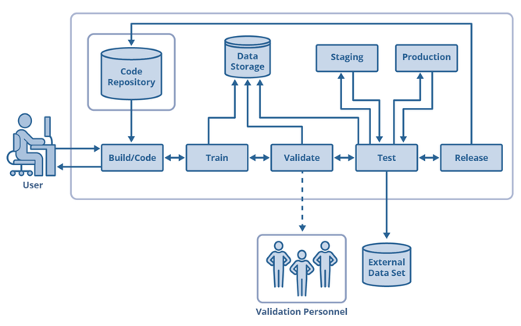
AI Model Development Pipeline
builds model implementation code.
trains and validates models.
includes feedback loop at each step.
uses processed data from curation pipeline via common storage.
outputs a trained and tested AI model.

Slide 11
Deployment and Serving
The trained and validated model is packaged and deployed into a production environment, where it can serve predictions to end-user applications via an API. Deployment is often automated through continuous integration and continuous deployment (CI/CD) pipelines.

Slide 12
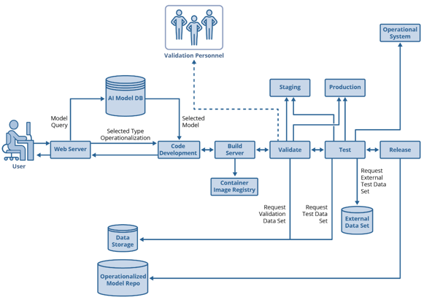
AI Model Operationalization Pipeline
makes models that are usable in the real world.
packages in a deployable artifact.
may need data curation pipeline.
tests in operational environments and systems.
provides public methods for data ingestion, prediction, and continuous monitoring.

Slide 13
Monitoring and Retraining
After deployment, the model's performance is continuously monitored for accuracy, latency, and model drift. If performance degrades, a retraining process is triggered using new data.
Monitoring the model’s decision making for the following:
bias, subjectivity, and assumptions
incompatibility with target population
other issues that indicate a lack of objectivity or relevancy to target population
the potential presence of adversarial AI
Supports Shift-Left testing → identify improper functionality prior to deployment.

Slide 14
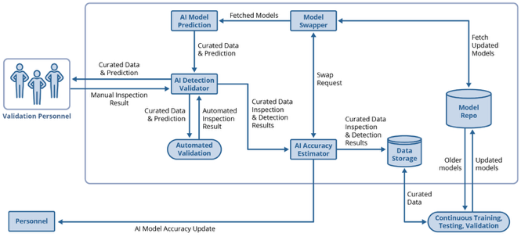
Post-Deployment Monitoring
works with operationally deployed models.
validates each model prediction.
constantly trains models with real-world data.
can dynamically swap models.
may include personnel for prediction validation.

Slide 15
Goveerance
Throughout the lifecycle, governance practices ensure the model is fair, transparent, and compliant with regulations. This includes managing model versions and tracking lineage.

Slide 16
Outline
Stages of MLOps
Types of MLOps tools
Challenges of MLOps
Differences with DevOps

Slide 17
Types of MLOps Tools
Experiment tracking
Data and pipeline versioning
Orchestration and workflow
Model deployment and serving
Model monitoring

Slide 18
Experiment tracking
Tools like MLflow and Weights & Biases help track experiments, parameters, and results.

Slide 19
Data and pipeline versioning
Data Version Control (DVC) and lakeFS allow teams to version control datasets and ML pipelines in a Git-like manner.

Slide 20
Orchestration and workflow
Platforms like Kubeflow and Apache Airflow are used to automate and manage complex ML pipelines.

Slide 21
Model deployment and serving
Tools such as BentoML and TensorFlow Extended (TFX) simplify packaging and deploying models for serving predictions.

Slide 22
Model monitoring
Platforms like Evidently AI and Fiddler AI offer features to monitor model performance and detect data drift in real-time.

Slide 23
End to End Platforms
Comprehensive solutions like Amazon SageMaker, Google Cloud Vertex AI, and Databricks offer integrated tools for the entire MLOps lifecycle.

Slide 24
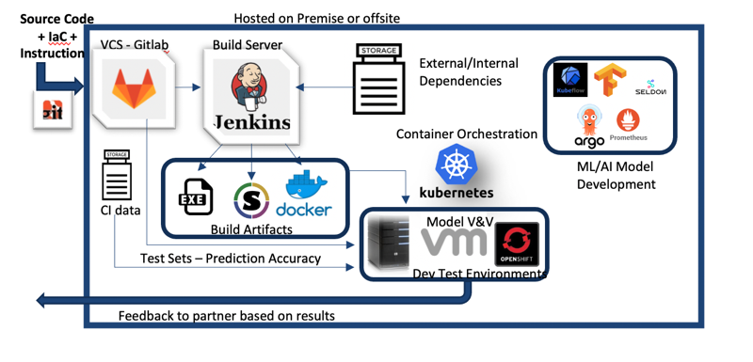
Exemplary MLOps implementation scenarios

Slide 25
Outline
Stages of MLOps
Types of MLOps tools
Challenges of MLOps
Differences with DevOps

Slide 26
Challenges of MLOps
Data dependency
Reproducability
Scalability
Collaboration

Slide 27
Data dependency
ML models rely on data, which is constantly changing. A model's performance can degrade over time, a phenomenon known as "model drift," requiring retraining on fresh data.

Slide 28
Reproducability
Replicating experiments and model behavior can be difficult due to changes in data, code, and environment configurations.

Slide 29
Scalability
Manually managing many models and large datasets is time-consuming and difficult to scale effectively.

Slide 30
Collaboration
Different teams, including data scientists, ML engineers, and IT operations, must work together effectively to move models from experimentation to production.

Slide 31
Outline
Stages of MLOps
Types of MLOps tools
Challenges of MLOps
Differences from DevOps

Slide 32
Differences Between DevOps and MLOps
Scope
Complexity
Teams

Slide 33
Scope
DevOps focuses on the software development lifecycle, while MLOps addresses the lifecycle for ML systems, which includes data collection, experimentation, and model retraining in addition to software development.

Slide 34
Complexity
ML models are more complex than traditional software due to their dependency on data, which introduces challenges like model drift and the need for continuous retraining.

Slide 35
Teams
While DevOps primarily bridges development and operations, MLOps requires close collaboration between software engineers, data scientists, data engineers, ML engineers, and IT operations

Slide 36
Summary
MLOps = DevOps + model creation and management
MLOps can be viewed as six distinct stages, each with a collection of tools
Model development and management introduces challenges because of its dependence on data that may drift or not represent the environment in which it is used.

