Slide 1
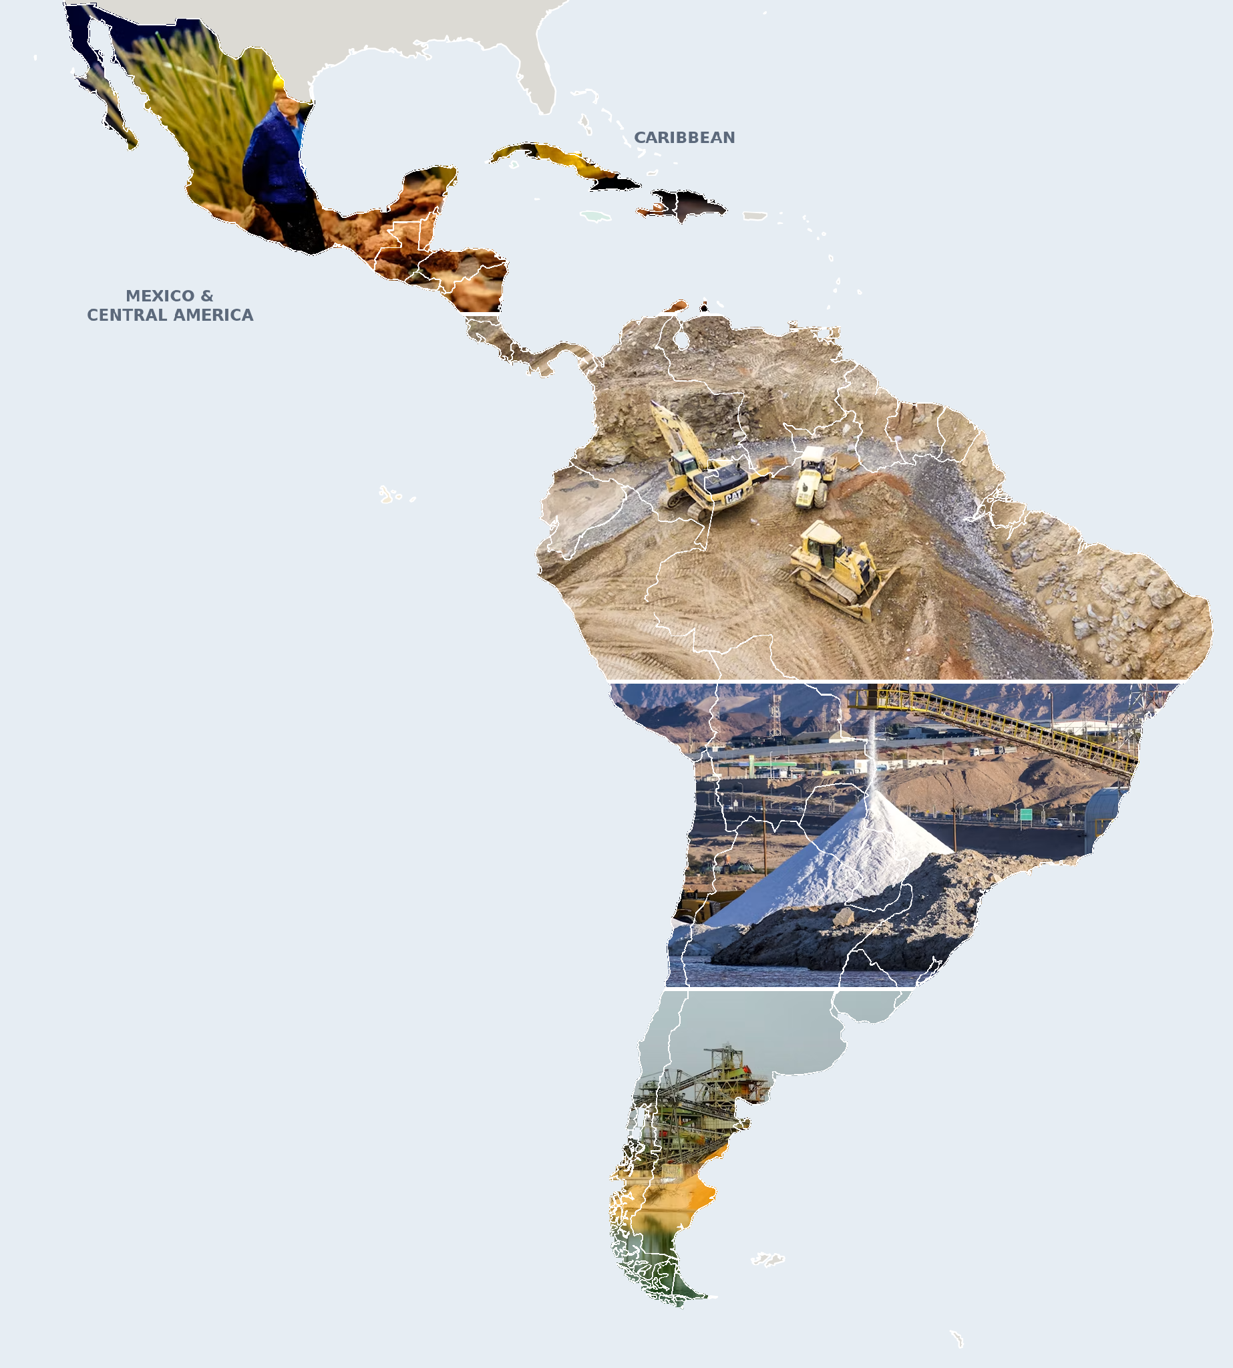




Where mining meets conflict
CRITICAL MINERALS IN LATIN AMERICA
Demand
rises for minerals and gold
Mining
expands in Latin America
Conflict
follows the mines
Defenders
killed: the extreme form
Diego & Lena
Team Tokio · Ironhack
Sources: IEA (2026); ICMM Global Mining Dataset v1.5 (2026); OCMAL; Global Witness.
Notes:
LENA (~27s): Good morning everyone. We are Diego and Lena from Team Tokio. Our project is about critical minerals in Latin America. Our hypothesis fits in four steps, shown here: demand for critical minerals and gold is rising. That demand pushes mining to expand in Latin America. Where mines go, conflicts follow. And the most extreme form of those conflicts is the killing of environmental defenders.
— Background (not to read out) —
Our hypothesis in four steps: rising demand for critical minerals and gold (lithium demand x4 by 2040, IEA) expands mining in Latin America (709 mining sites, ICMM). Where mines go, conflicts follow (284 recorded mining conflicts, OCMAL), and the most extreme form of conflict is the killing of environmental defenders (200 mining-linked killings 2012–2025, Global Witness).

Slide 2
THE STORY IN FOUR STEPS
From global demand to local conflict
01
02
03
04
Introduction
Production & sites
Conflicts & abuses
Conclusions
Why critical minerals, and why Latin America
Who produces what, and where the mining sites are
Mining conflicts, and a deep dive on killed defenders
What the data supports, and what stays open
Team Tokio · Diego and Lena
Notes:
LENA (~15s): We will tell this story in four parts: first why these minerals matter, then who produces them and where the mines are, then the conflicts, with a deep dive on defenders, and finally our conclusions.
— Background (not to read out) —
Four parts. We start with one protest, zoom out to global demand for critical minerals, then look at production and mining sites, then at mining conflicts and a deep dive on killed defenders, and finish with conclusions.

Slide 3
PART 01 OF 04
01
Introduction
Why critical minerals, and why Latin America
01 Intro
02 Production & sites
03 Conflicts & abuses
04 Conclusions
Notes:
DIEGO (~2s): Let's start with the introduction.
— Background (not to read out) —
Part 01: Intro. Why critical minerals, and why Latin America.

Slide 4
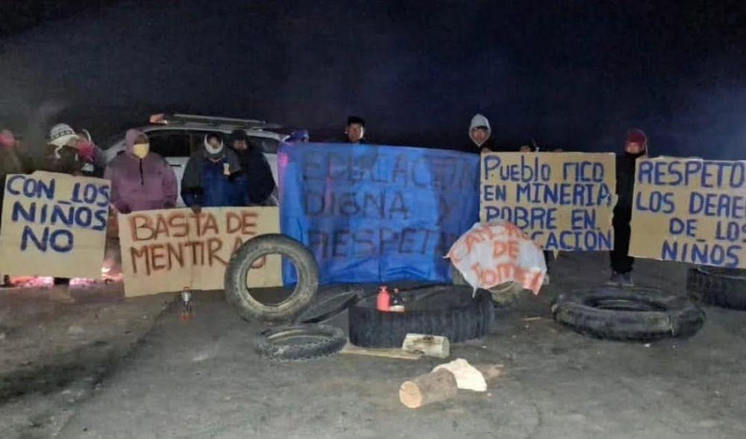
INTRO · ONE PROTEST
[Diego: protest photo]
Argentine protest sample — insert photo with credit
Argentina, 2026: “A town rich in mining, poor in education”
In June, in Antofagasta de la Sierra, Argentina’s Northwest, a group of parents protested against the low budget allocated to the local primary school’s canteen.
In recent years, the town has boomed its production of lithium, a critical mineral for the energy transition
What is the context behind?
PPhoto: Pucará Assembly
Notes:
Diego opens with the Argentine protest sample. Candidate from our own sources: Jujuy, June 2023 — protests against a provincial constitutional reform passed without Indigenous consent, in lithium areas; Amnesty International documented police repression. Check and replace the bracketed text.

Slide 5
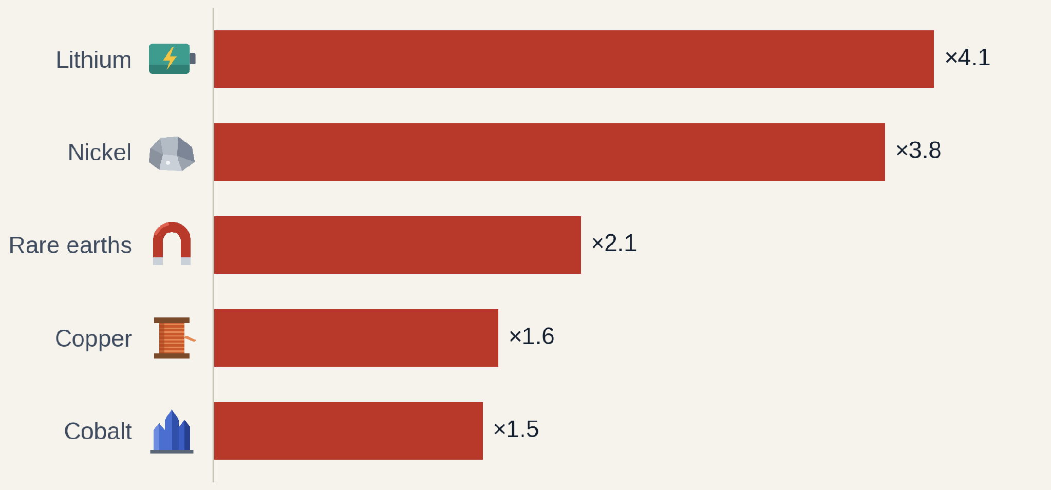
INTRO · WHY CRITICAL MINERALS?
Will rising demand for critical minerals will increase production?
Demand from clean-energy technologies, 2040 as a multiple of 2025
×4
lithium demand for EVs, batteries and power grids: 203 kt in 2025, 836 kt in 2040
Copper +63 %: 8.0 Mt → 13.1 Mt. Nickel 625 kt → 2.4 Mt.
IEA Global Critical Minerals Outlook 2026, Stated Policies scenario, demand from all energy technologies (world).
Notes:
LENA (~25s): Why critical minerals? Because of the energy transition. Electric cars, batteries, solar panels and power grids all need minerals. According to the IEA, clean-energy demand for lithium will be about four times higher in 2040 than today. Nickel almost four times, rare earths double, copper plus sixty percent. This is the pressure that pushes mining into new areas.
— Background (not to read out) —
Why this topic: the energy transition. The IEA projects that clean-energy demand for lithium grows about four times between 2025 and 2040 in its Stated Policies scenario, nickel almost four times, rare earths twice, copper by about 60 %. In the High Demand scenario the growth is stronger (lithium 1,131 kt in 2040). This demand pushes mining into new areas.

Slide 6
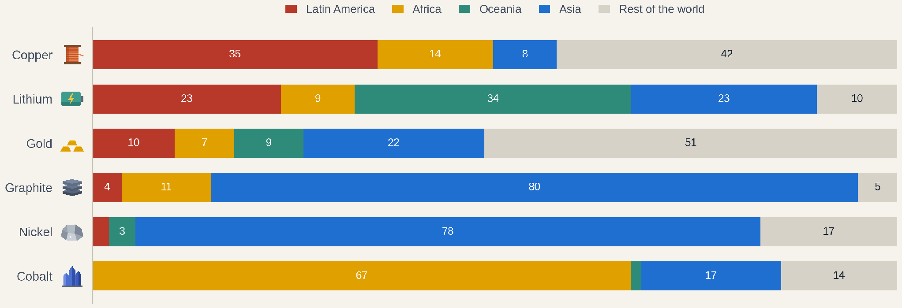
INTRO · GLOBAL OUTLOOK
Latin America is a major supplier of copper and lithium
Share of world mining output 2025, %. IEA Critical Minerals Data Explorer 2026, base case; gold: USGS Mineral Commodity Summaries 2026 (2025 estimate). Latin America = Argentina, Brazil, Chile, Peru (IEA) + Mexico for gold; IEA does not report Mexico separately.
Notes:
LENA (~24s): And Latin America is right at the centre of it. Each bar is one hundred percent of world mining for one mineral. The red part is Latin America: about a third of the world's copper, almost a quarter of its lithium, and around ten percent of its gold. For graphite, nickel and cobalt, Asia and Africa dominate.
— Background (not to read out) —
Lena: share of world mining production in 2025. Latin America (Chile, Peru, Argentina, Brazil, plus Mexico for gold) produces about 35 % of the world's copper and 23 % of its lithium. Africa (mostly DR Congo) dominates cobalt; Australia (Oceania) leads lithium; Asia (China, Indonesia) dominates graphite and nickel. Gold is spread out: Mexico, Peru and Brazil together mine about 10 %, while China, Russia and Australia lead. For the IEA minerals Mexico is not reported separately, so its copper and zinc sit in 'rest of the world'. Caveat: sources only name the top producers; everything else is one 'rest of the world' block.

Slide 7
PART 02 OF 04
02
Production & sites
Who produces what, and where the mining sites are
01 Intro
02 Production & sites
03 Conflicts & abuses
04 Conclusions
Notes:
LENA (~4s): Part two: who produces, and where are the mines?
— Background (not to read out) —
Part 02: Production & sites. Who produces what, and where the mining sites are.

Slide 8
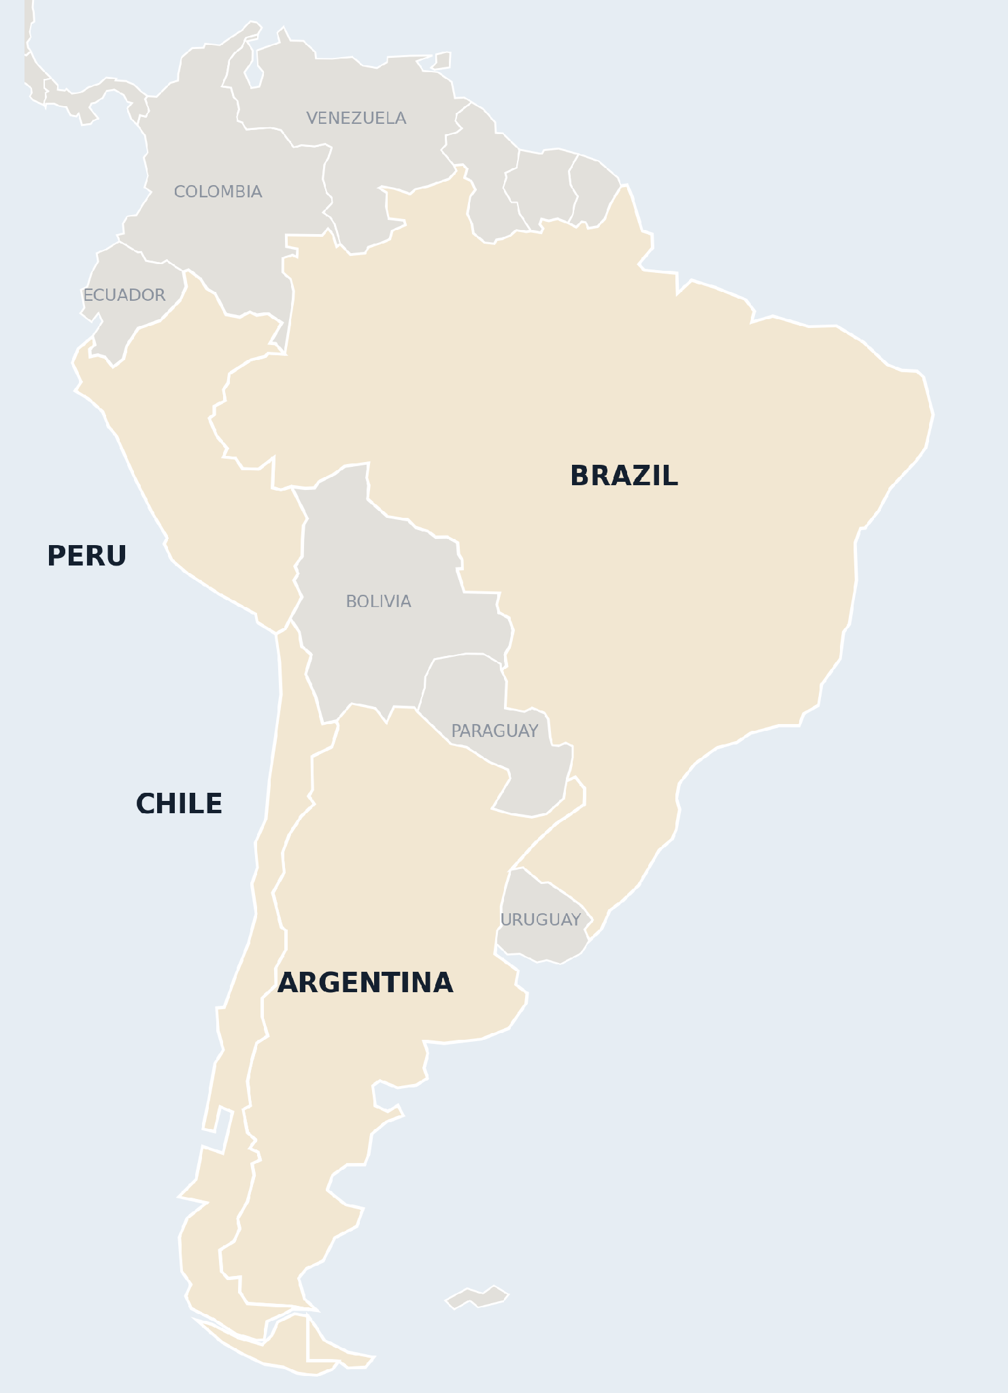
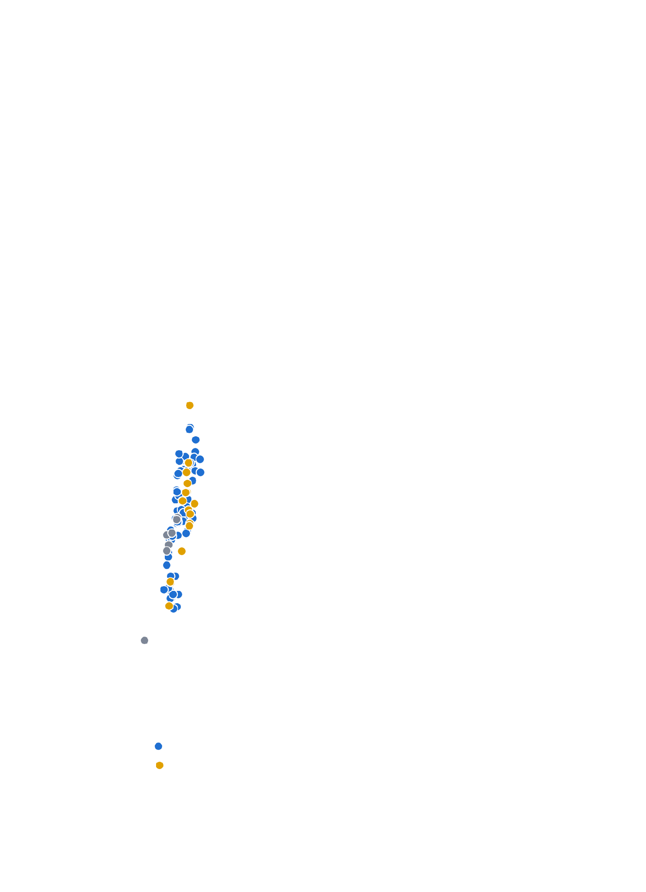
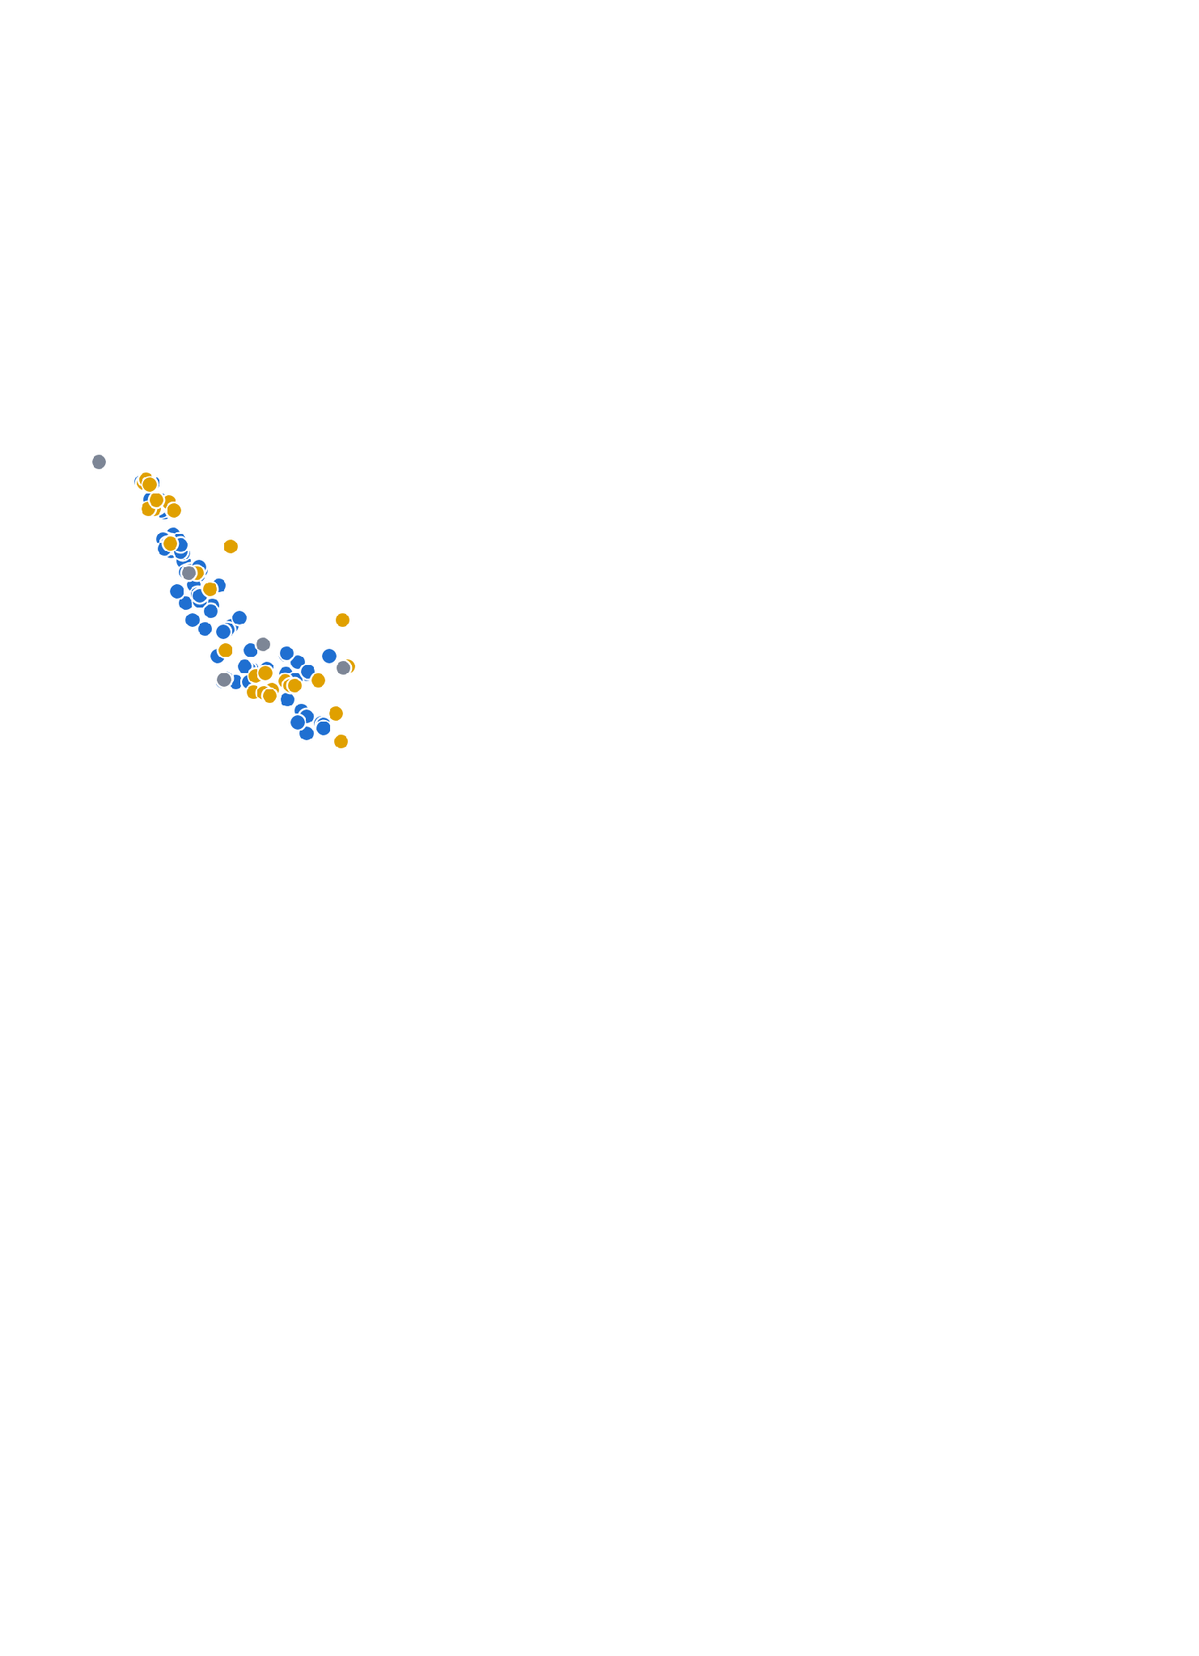
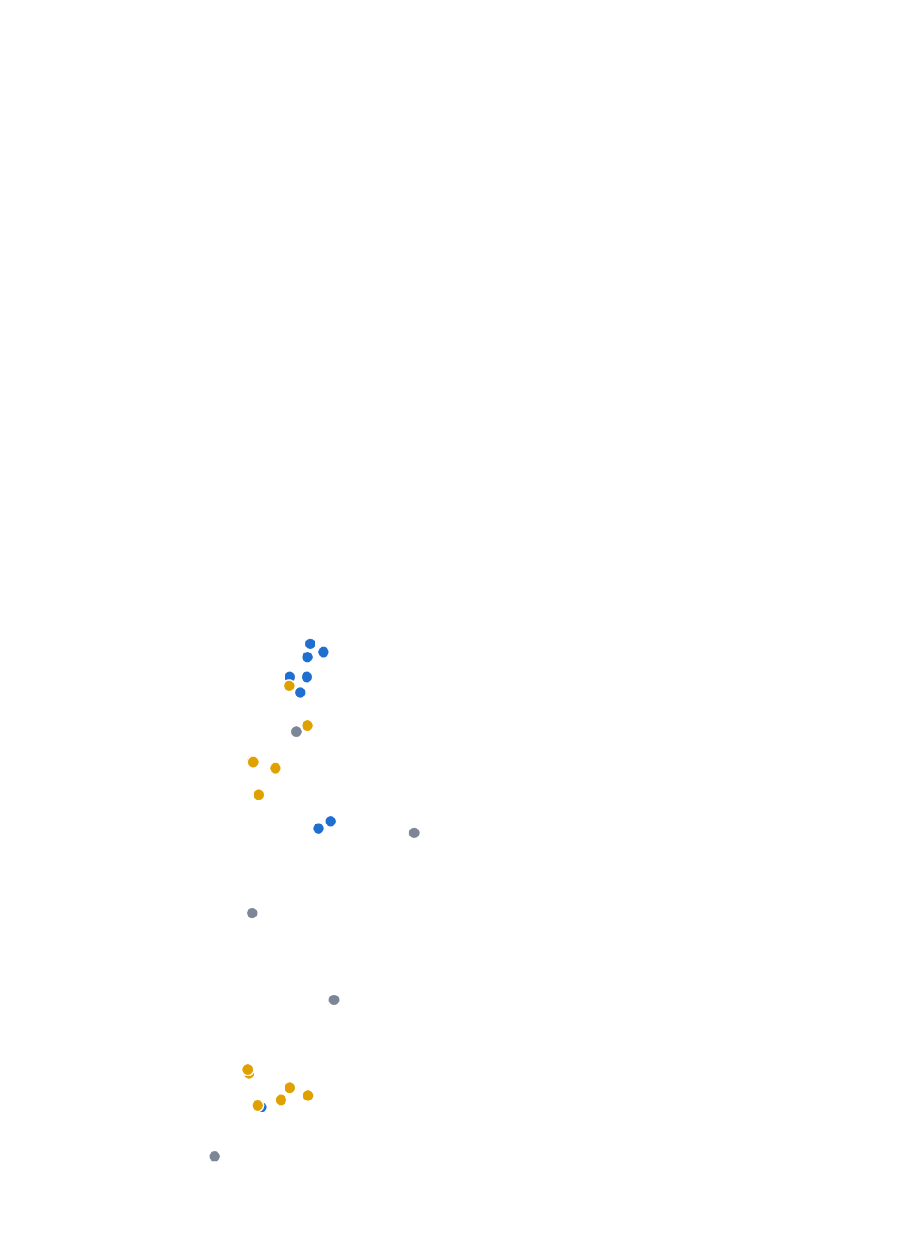
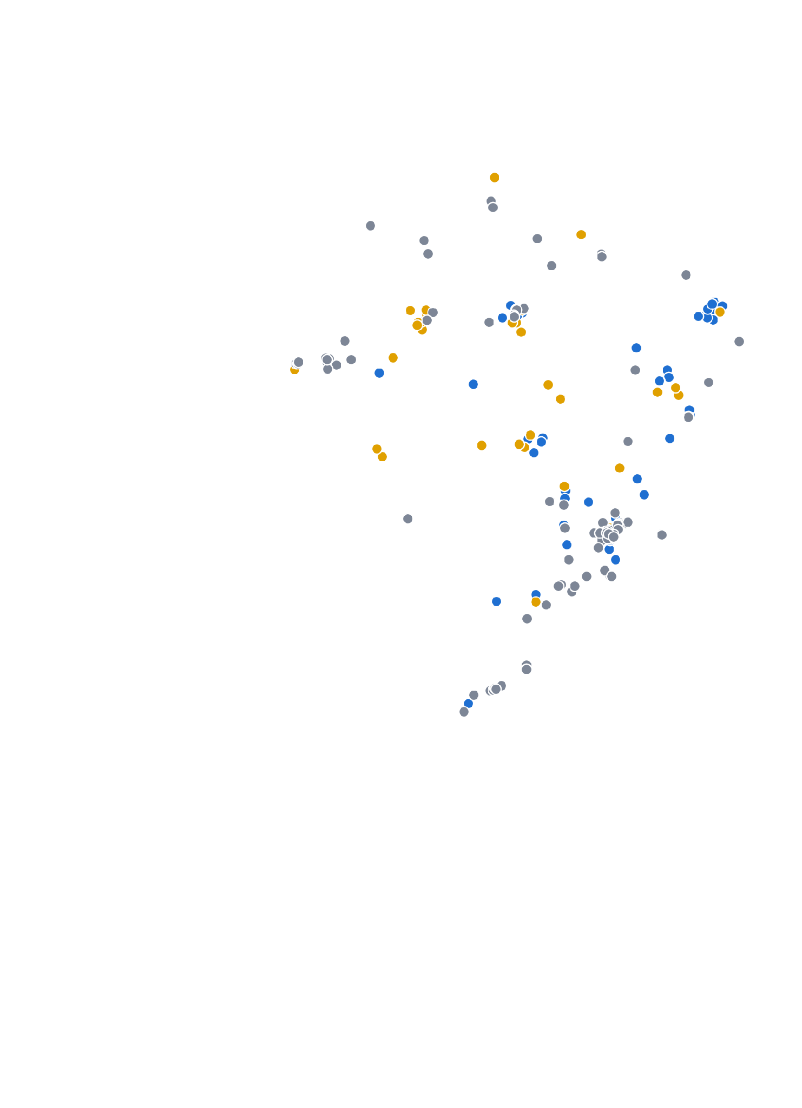
PRODUCTION & SITES · WHERE THE MINES ARE
Mining sites in our four countries
Chile 102 sites
The copper belt of the north: copper and gold
Peru 129 sites
Silver, gold, copper and zinc along the Andes
Argentina 29 sites
Gold in Patagonia and San Juan, lithium in the north-west
Brazil 196 sites
Iron ore, gold and steel, spread across the country
Critical minerals
Gold
Other (iron, steel, coal…)
Source: ICMM Global Mining Dataset v1.5 (2026): mines, smelters, refineries and plants.
Notes:
LENA (~30s): Here are the mines on the map, from the ICMM global mining dataset. With each click we add one country. Chile: one hundred and two sites, along the copper belt in the north. Peru: one hundred and twenty-nine, along the Andes. Argentina: twenty-nine, gold in the south and lithium in the north-west. Brazil: one hundred and ninety-six, mostly iron ore and gold. Blue dots are critical minerals, yellow is gold.
— Background (not to read out) —
Our four countries together hold 456 of the 709 mining sites in the ICMM list. Each click adds one country. Chile: 102 sites, the copper belt of the Atacama (71 with copper as main mineral). Peru: 129 sites, silver, gold, copper and zinc in the Andean highlands. Argentina: 29 sites, gold in Patagonia and San Juan, lithium brines in the Puna (Jujuy, Salta, Catamarca). Brazil: 196 sites, mostly iron ore and steel in Minas Gerais, gold and tin in the Amazon. Blue = critical minerals, yellow = gold, grey = other.

Slide 9
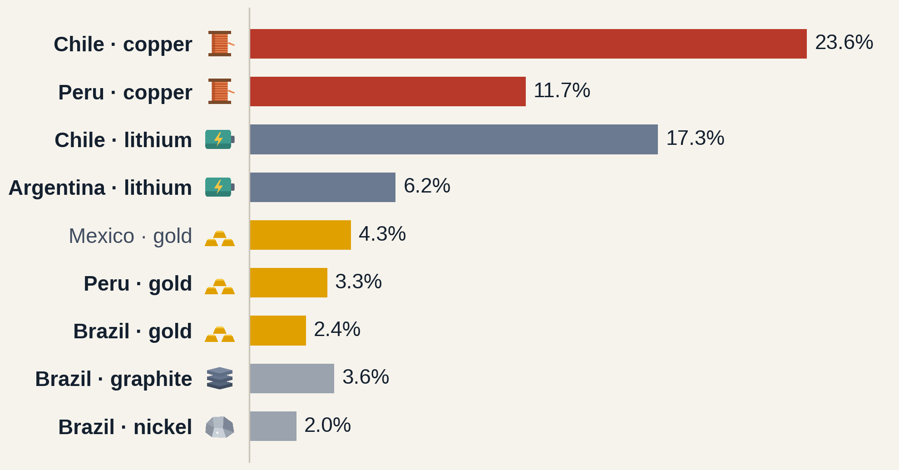
PRODUCTION · WHO PRODUCES, AND HOW MUCH
Chile and Peru lead in copper, Chile and Argentina in lithium, Mexico in gold
Share of world mining output, 2025
Country | Mineral | 2025 | 2040
Chile | Copper | 5,485 kt | 4,165 kt
Peru | Copper | 2,726 kt | 1,859 kt
Chile | Lithium | 52.1 kt | 58.6 kt
Argentina | Lithium | 18.7 kt | 54.4 kt
Mexico | Gold | 140 t | —
Peru | Gold | 110 t | —
Brazil | Gold | 80 t | —
Brazil | Graphite | 64.1 kt | 83.9 kt
Brazil | Nickel | 85.0 kt | 82.0 kt
Mining output in kt; gold in tonnes. IEA Critical Minerals Data Explorer 2026, base case; gold: USGS Mineral Commodity Summaries 2026 (2025 estimate, no 2040 projection).
Notes:
LENA (~35s): Four countries stand out, and they come back through the whole presentation: Chile, Peru, Argentina and Brazil. Chile alone mines almost a quarter of the world's copper, about five and a half million tonnes a year. Peru is second for copper. Chile and Argentina lead in lithium, and Mexico, Peru and Brazil are the main gold producers. The table shows the tonnes for 2025 and the IEA projection for 2040; gold has no projection because the IEA does not cover it.
— Background (not to read out) —
Which countries produce and how much. Chile alone mines almost a quarter of the world's copper (5.5 Mt) and 17 % of its lithium. Peru is the second copper producer of the region. Argentina is the fast-growing lithium producer. Brazil appears for graphite and nickel. For gold, Mexico is the largest Latin American producer (140 t, 4.3 % of world output), ahead of Peru (110 t, 3.3 %) and Brazil (80 t, 2.4 %). Other Latin American countries are not reported separately by the IEA (shown as 0 in our cleaned file, which does not mean no production).

Slide 10
PART 03 OF 04
03
Conflicts & abuses
Mining conflicts, and a deep dive on killed environmental defenders
01 Intro
02 Production & sites
03 Conflicts & abuses
04 Conclusions
Notes:
DIEGO (~2s): Part three: the conflicts.
— Background (not to read out) —
Part 03: Conflicts & abuses. Mining conflicts, and a deep dive on killed environmental defenders.

Slide 11
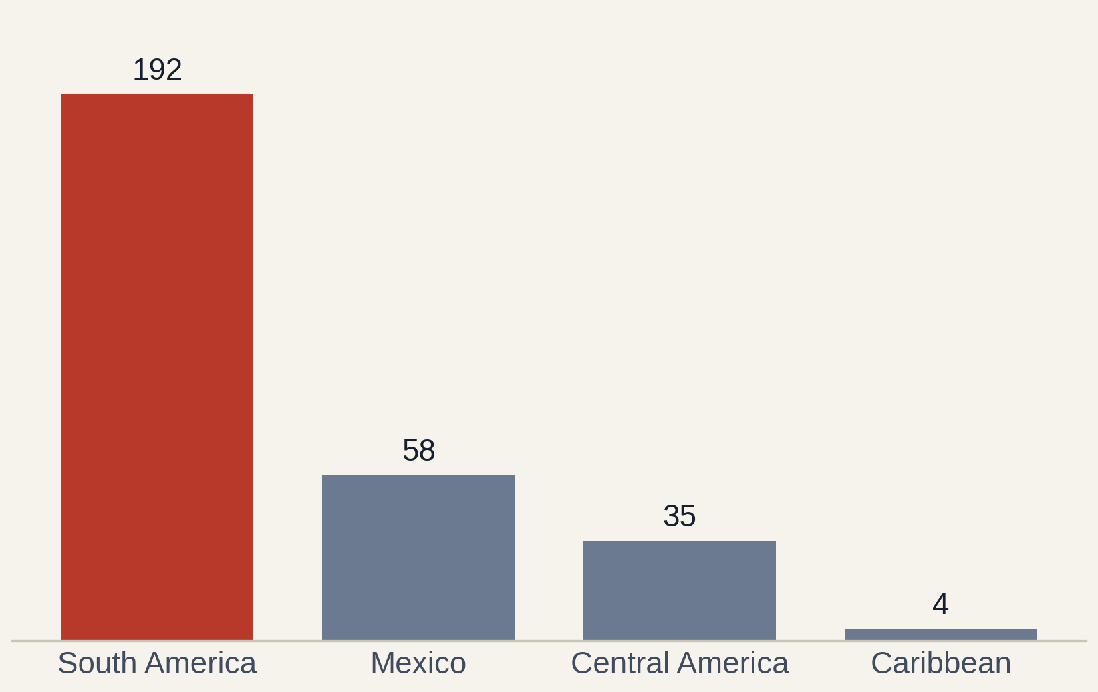
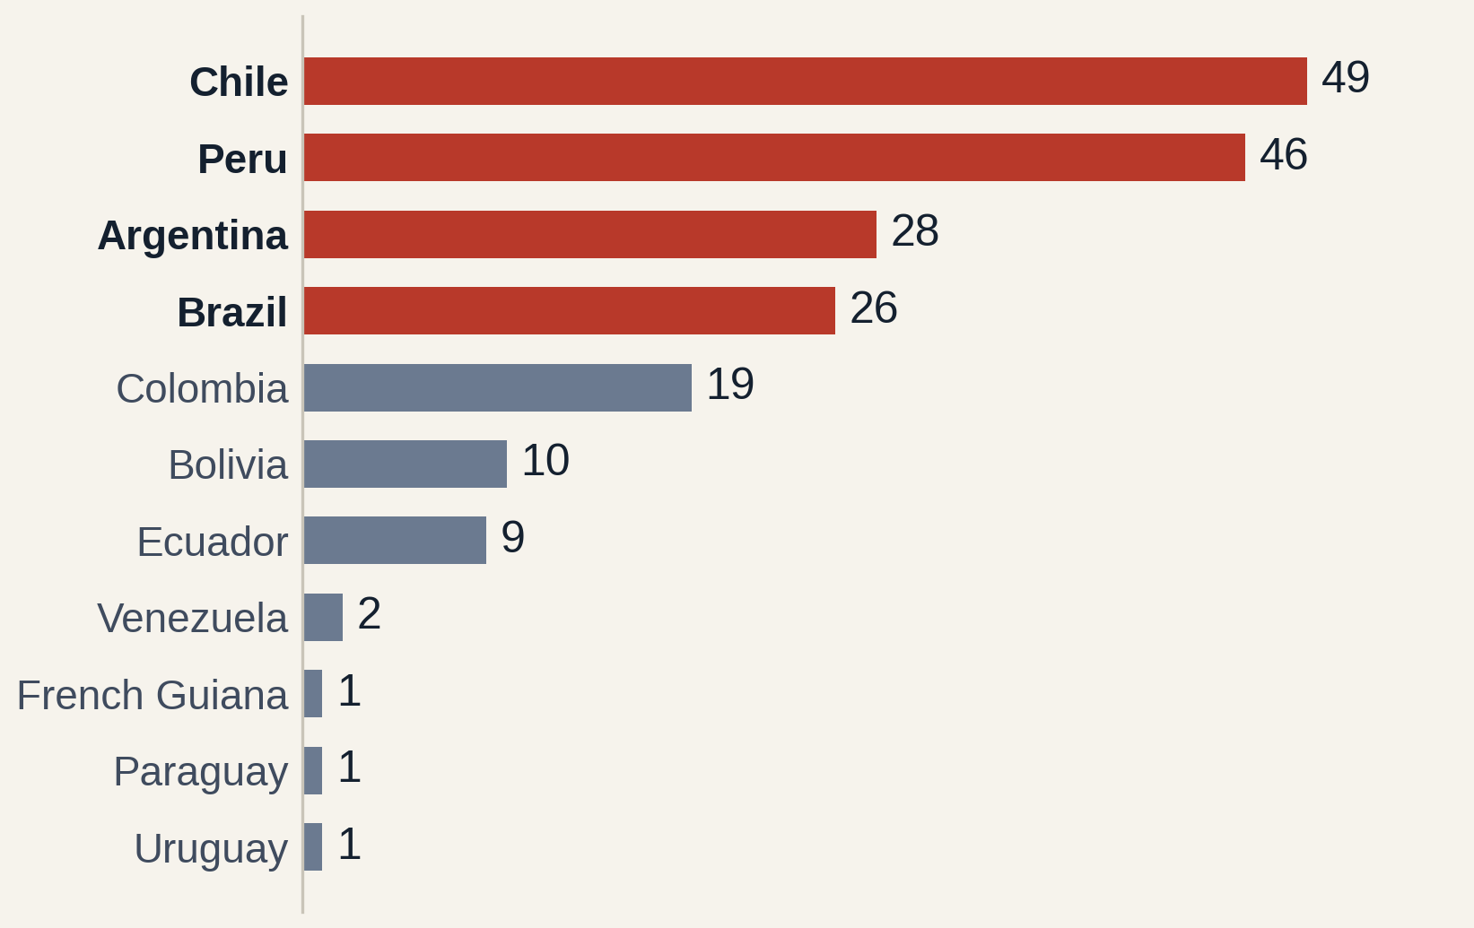
CONFLICTS · OBSERVATORY OF MINING CONFLICTS
Most mining conflicts are in South America, led by our four countries
Mining conflicts per region
Mining conflicts in South America, per country
Source: Observatory of Mining Conflicts in Latin America (OCMAL), 289 conflict-country rows, conflicts started 1972–2019.
Notes:
DIEGO (~20s): We scraped the Observatory of Mining Conflicts in Latin America, called OCMAL. It lists 284 mining conflicts. On the left, most of them are in South America. On the right, inside South America, our four countries lead: Chile, Peru, Argentina and Brazil. Mexico alone also has fifty-eight.
— Background (not to read out) —
We scraped the OCMAL conflict list: 289 conflict-country rows. South America has 192, Mexico 58, Central America 35, the Caribbean 4. In South America, Chile (49), Peru (46), Argentina (28) and Brazil (26) account for 149 of 192 conflicts (78 %). Mexico alone has 58, the most of any single country.

Slide 12
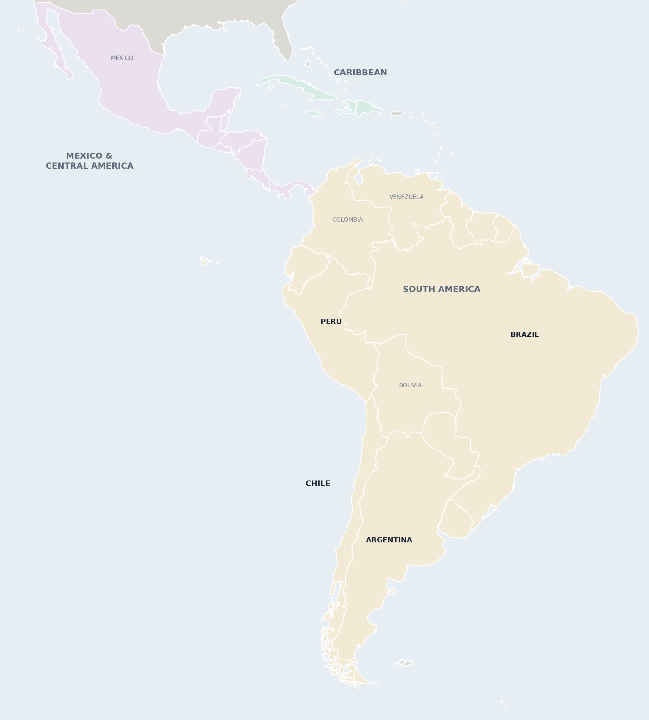
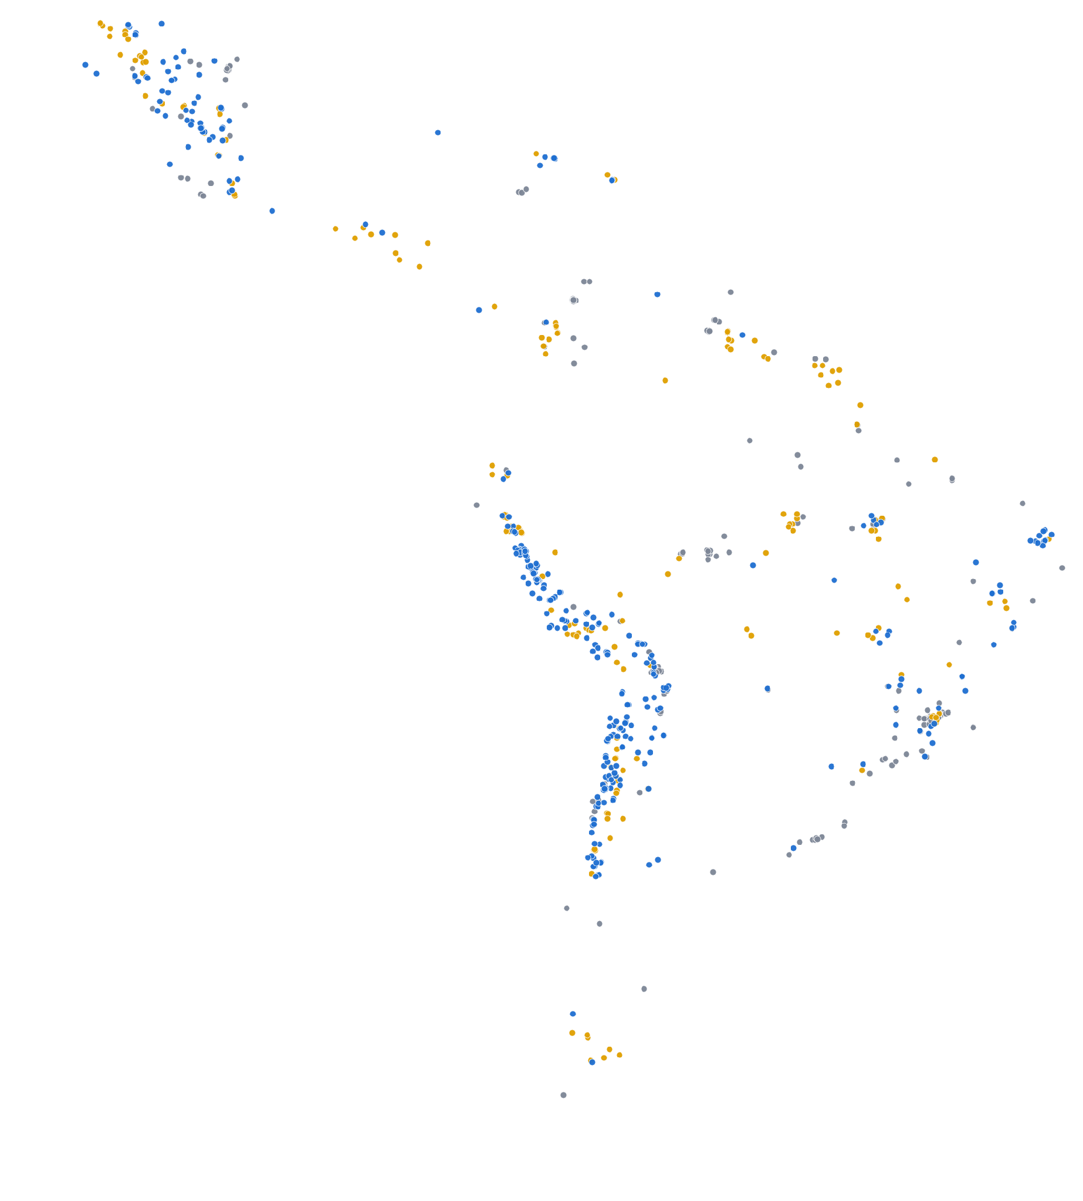
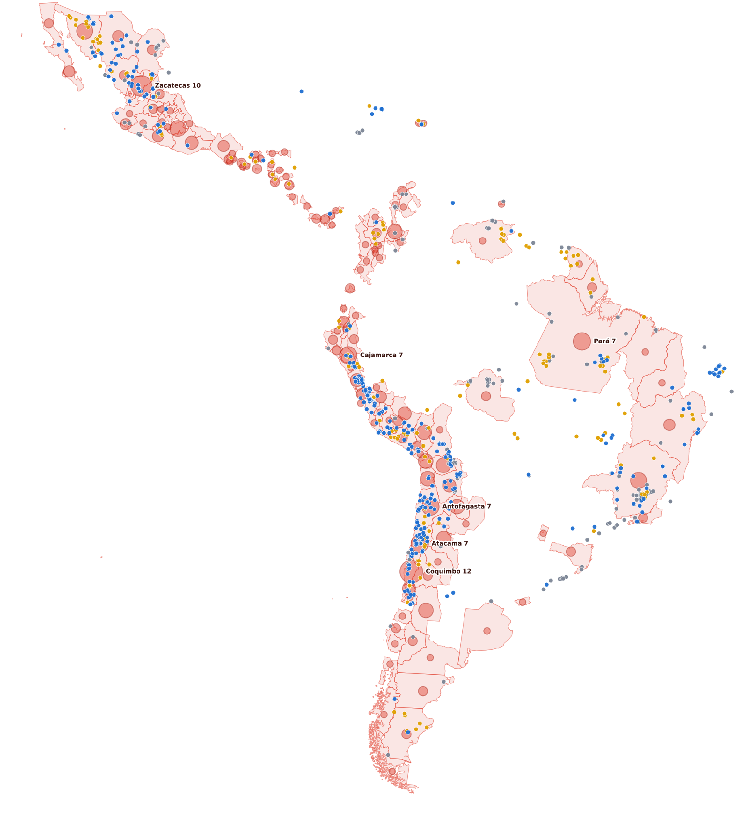




Conflicts follow the mines
CONFLICTS · ALL OF LATIN AMERICA
1 Countries and regions
South America
Mexico & Central America
Caribbean
2 Mining sites
Critical minerals 328
Gold 180
Other minerals 201
3 Conflicts in 129 provinces
Circle size = conflicts in the province
Sources: ICMM Global Mining Dataset v1.5 (2026); OCMAL mining-conflict database (conflicts started 1972–2019).
Notes:
DIEGO (~22s): Now we put both on one map. First, the mining sites you already know. [Click.] Now the conflicts, placed in their province; the bigger the circle, the more conflicts. You can see that conflicts appear in the same places as the mines: northern Chile, the Peruvian Andes, northern Mexico and south-east Brazil.
— Background (not to read out) —
Same mining sites as in part 2, now for all of Latin America: 709 sites. Click: the conflict layer appears. Each conflict is placed in its province; circle size = number of conflicts. 221 of 283 placed conflicts (78 %) are in provinces that also host a mining site. Hotspots: the Chilean copper belt (Coquimbo, Atacama, Antofagasta), Cajamarca in Peru, Zacatecas and Sonora in Mexico, Pará and Minas Gerais in Brazil.

Slide 13
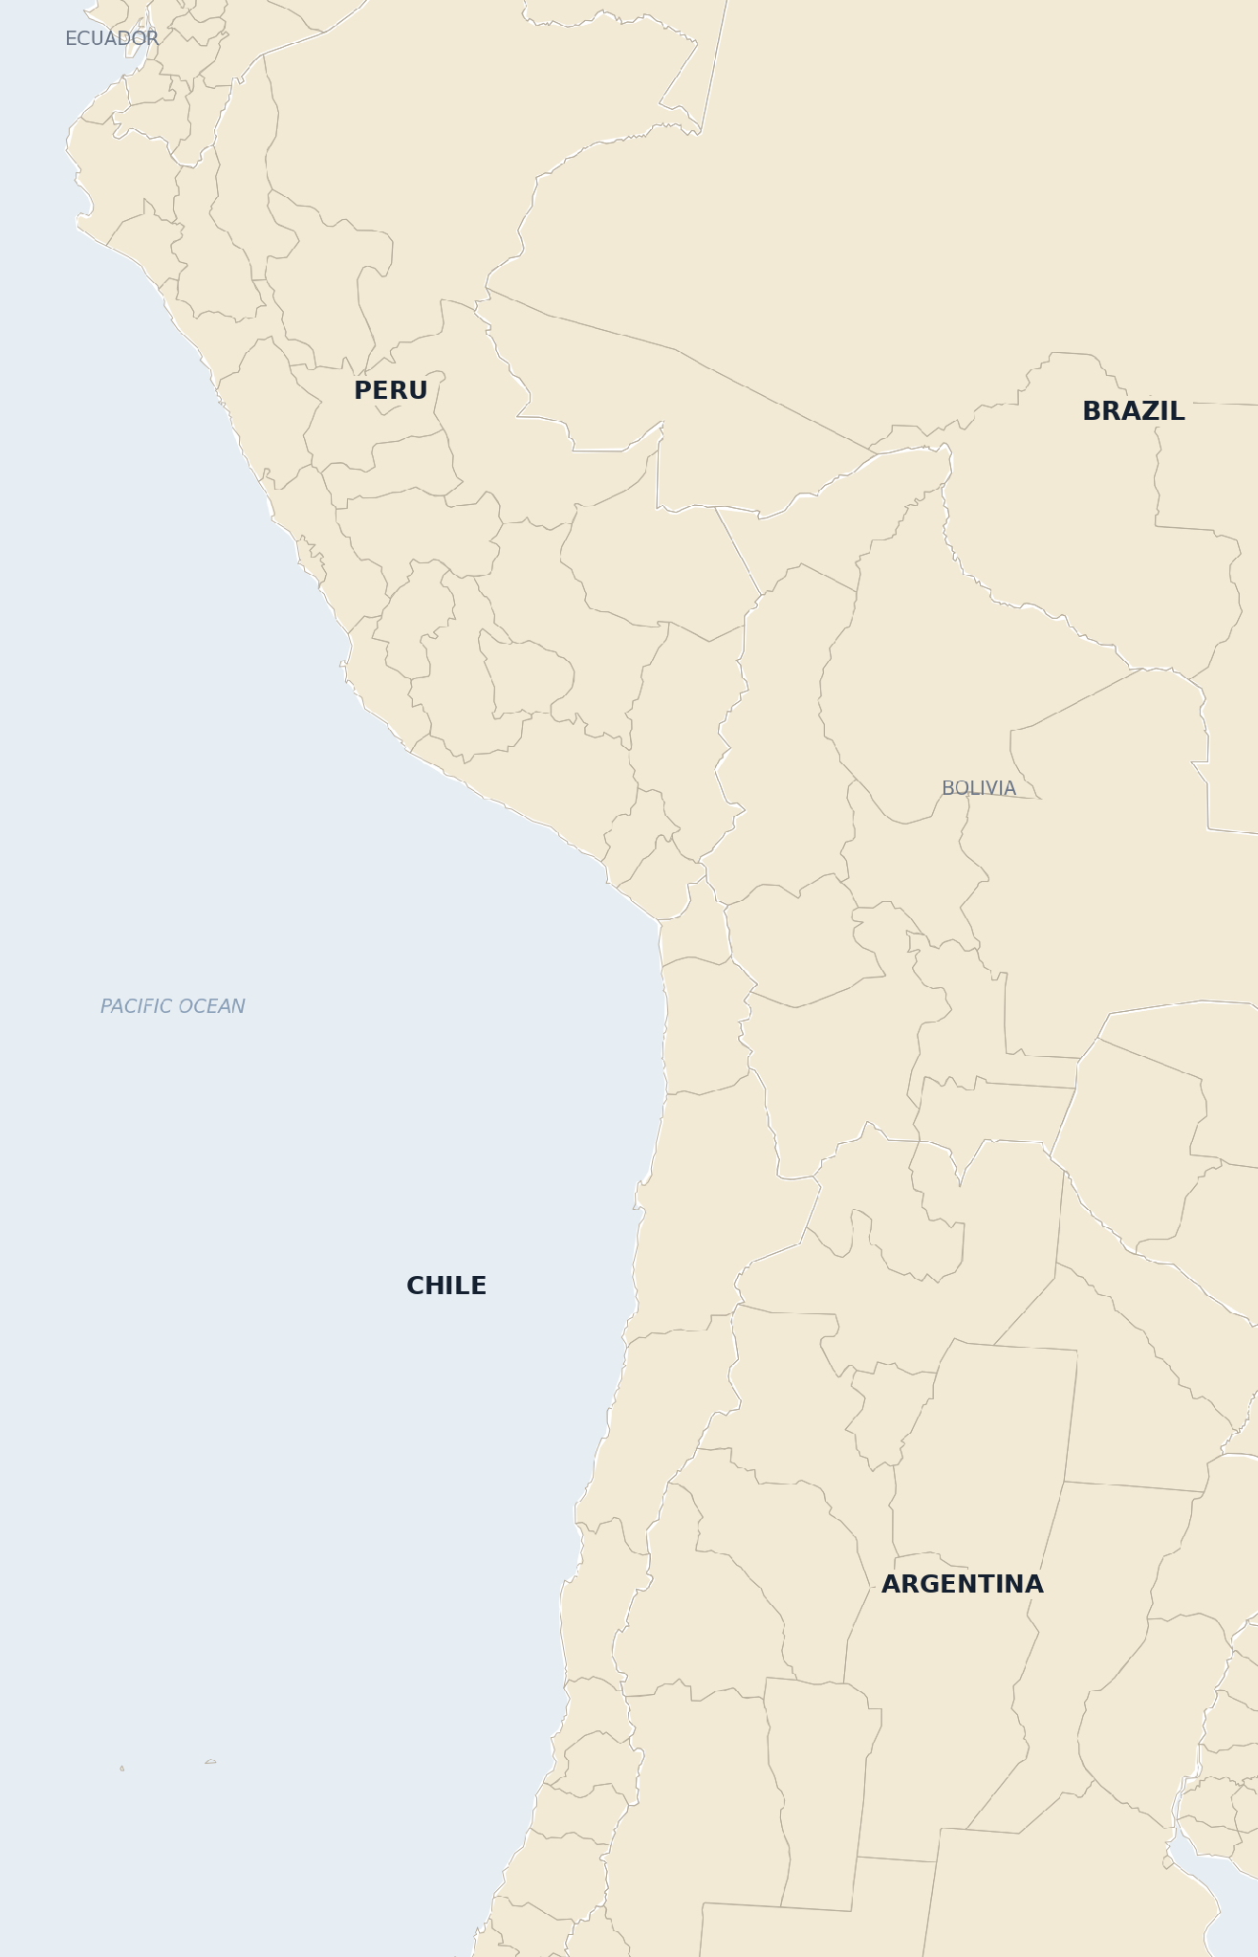
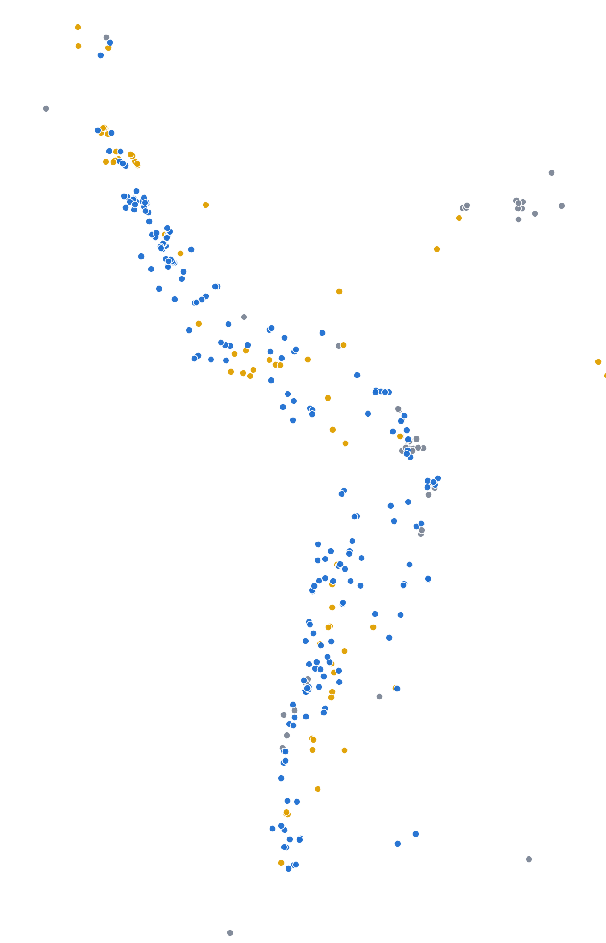
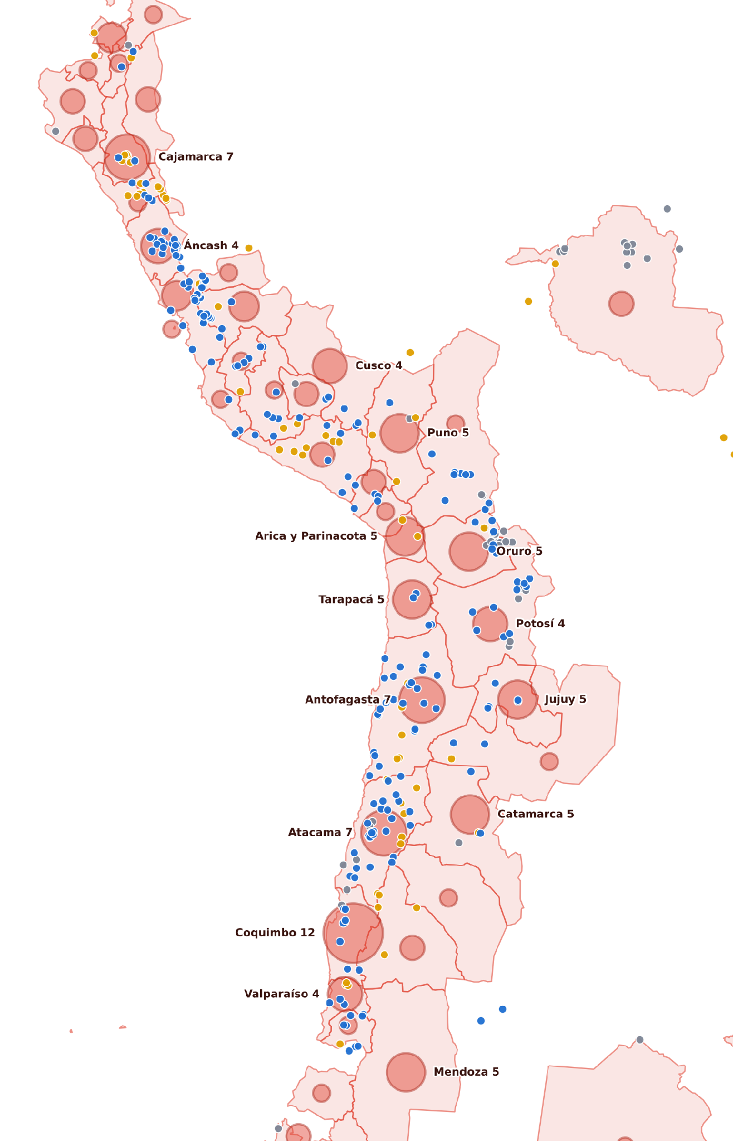
Peru, Chile and Argentina
CONFLICTS · ZOOM ON THE ANDES
1 Provinces and regions
Thin lines show the provinces: the unit the conflicts are placed in.
2 260 mining sites in Peru, Chile and Argentina
Critical minerals: copper, silver, zinc, lithium
Gold
Other
3 123 conflicts in Peru, Chile and Argentina
Coquimbo (Chile) has 12 conflicts, more than any province in Latin America. Next door, Atacama and Antofagasta hold 69 mining sites and 14 conflicts.
Sources: ICMM Global Mining Dataset v1.5 (2026); OCMAL mining-conflict database (conflicts started 1972–2019).
Notes:
DIEGO (~29s): Let's zoom on the Andes: Peru, Chile and Argentina. Again, mines first. [Click.] And the conflicts. The province with the most conflicts in all of Latin America is Coquimbo, in Chile, with twelve. Next door, Atacama and Antofagasta, the heart of the copper and lithium area, have many mines and many conflicts. Of course, this is an overlap on the map, not proof that mines cause the conflicts.
— Background (not to read out) —
Zoom on our three Andean countries: 260 mining sites (Peru 129, Chile 102, Argentina 29). Click: 123 recorded mining conflicts (Chile 49, Peru 46, Argentina 28) appear in the same provinces as the mines: the Chilean copper belt, the Peruvian highlands (Cajamarca, Áncash, Cusco, Puno) and the lithium area of Jujuy and Catamarca. Coquimbo has 12 conflicts, more than any province in Latin America.

Slide 14
DEEP DIVE · ENVIRONMENTAL DEFENDERS
Do resource-rich countries in Latin America see more killings of environmental defenders?
Our research question · data: Global Witness, 2012–2025
Notes:
DIEGO (~18s): This brings us to our research question: do resource-rich countries in Latin America see more killings of environmental defenders? Killings are the most extreme form of conflict, so we looked at them in depth, using Global Witness data from 2012 to 2025.
— Background (not to read out) —
Our research question. The maps showed that mining sites and mining conflicts appear in the same countries and provinces. Now we ask whether the same holds for the most extreme form of conflict: the killing of environmental defenders (Global Witness, Latin America, 2012–2025).

Slide 15
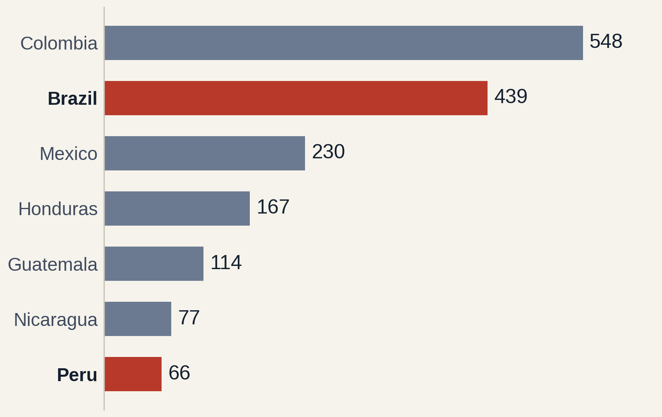
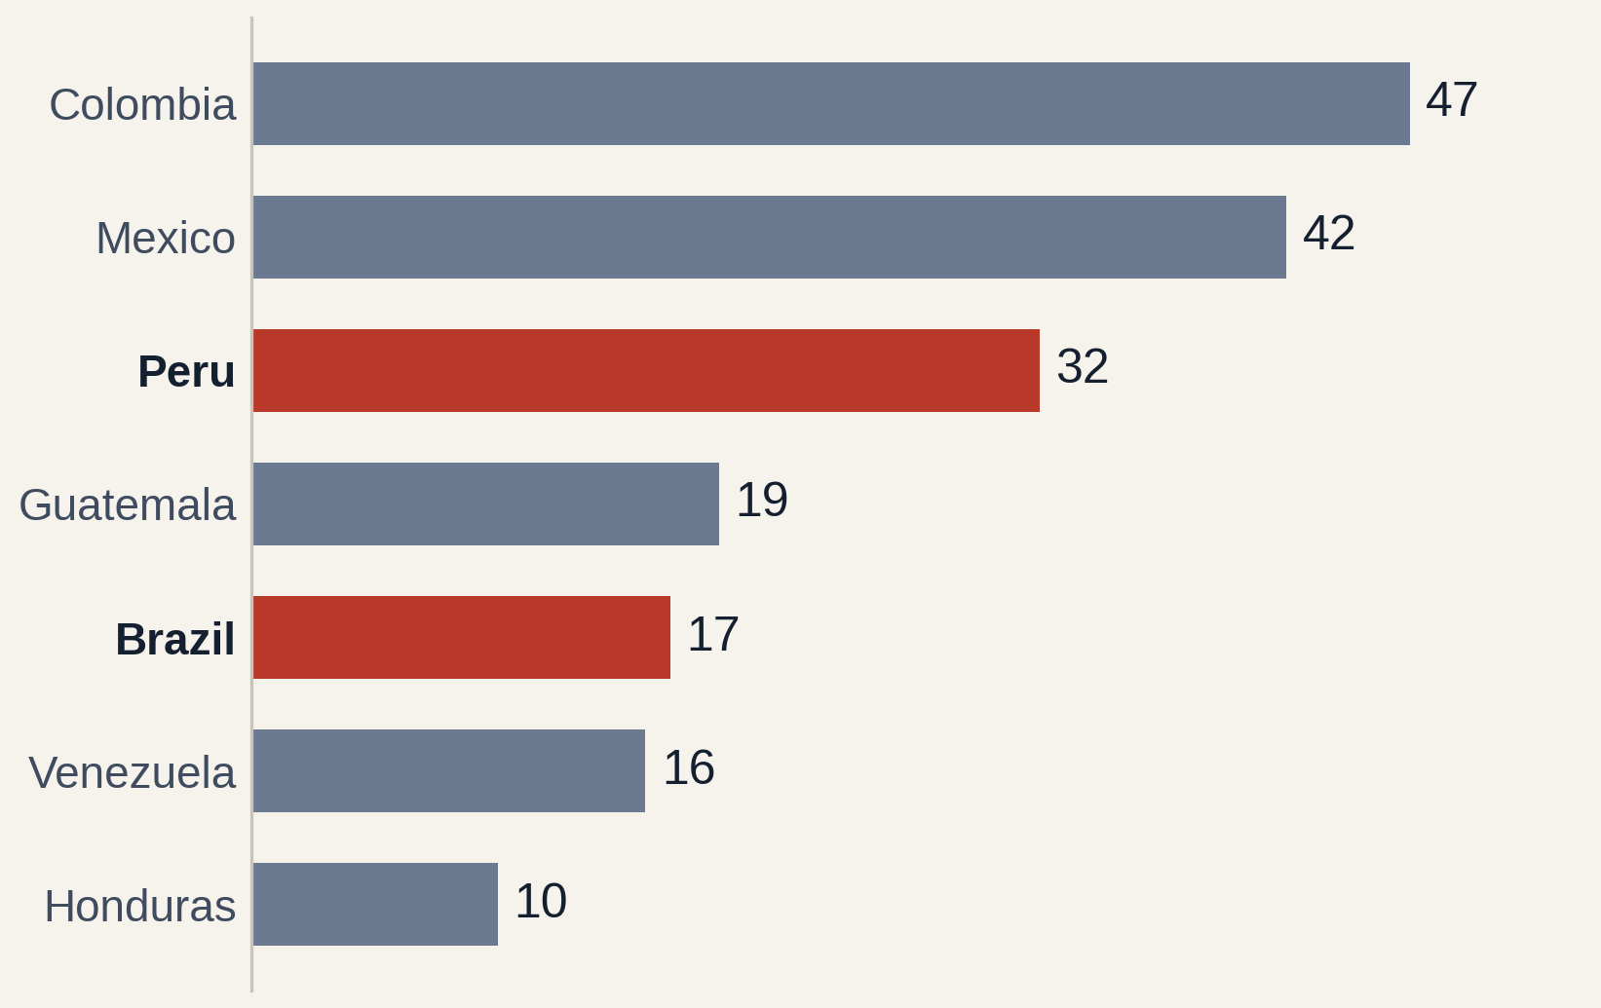
DEEP DIVE 1/2 · ENVIRONMENTAL DEFENDERS
Mining is the 2nd most important driver behind the killings of environmental defenders.
All killings of defenders, 2012–2025: 1,722
Linked to mining & extractives: 200 (12 %)
Global Witness land and environmental defenders data, 2012–2025, Latin America (USA and Canada excluded). One industry driver per case.
Notes:
DIEGO (~23s): Global Witness recorded 1,722 land and environmental defenders killed in Latin America in that period. On the left, all killings: Colombia and Brazil lead by far. On the right, only the killings linked to mining: 200 people. Here Colombia, Mexico and Peru lead. Mining is the second driver of these killings, after land disputes.
— Background (not to read out) —
Diego: attacks on environmental defenders, and above all killings, are the most extreme form of mining conflict, so we treat them as part of the conflict picture and look at them in depth. Global Witness records 1,722 killed land and environmental defenders in Latin America between 2012 and 2025. 200 of them (12 %) are linked to mining and extractives. Colombia and Brazil top the overall list; for mining-related killings Colombia, Mexico and Peru lead. Note that one case has only one driver: a killing tied to both land and mining may be filed under land.

Slide 16
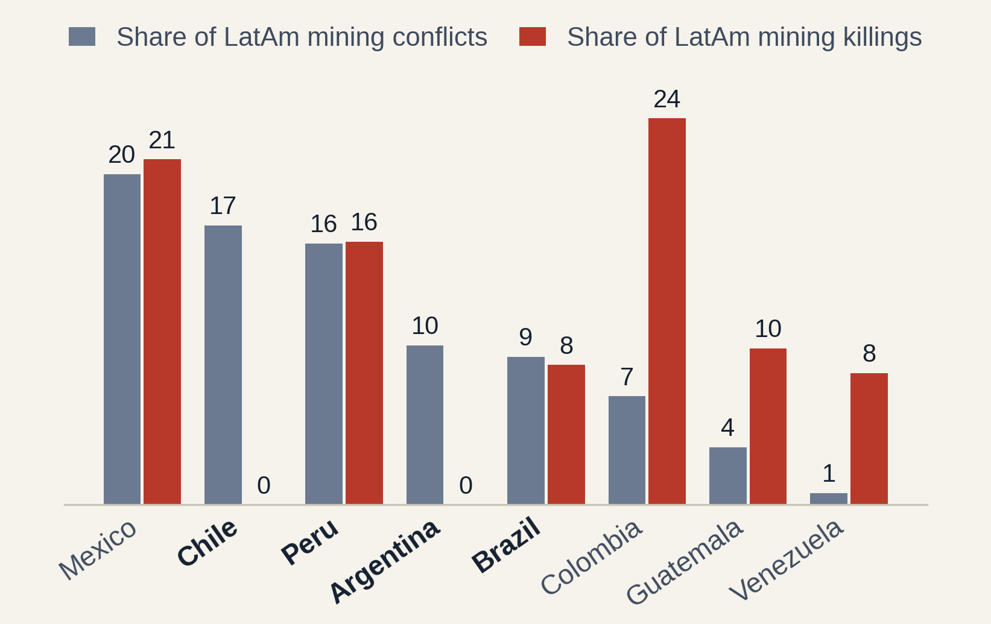
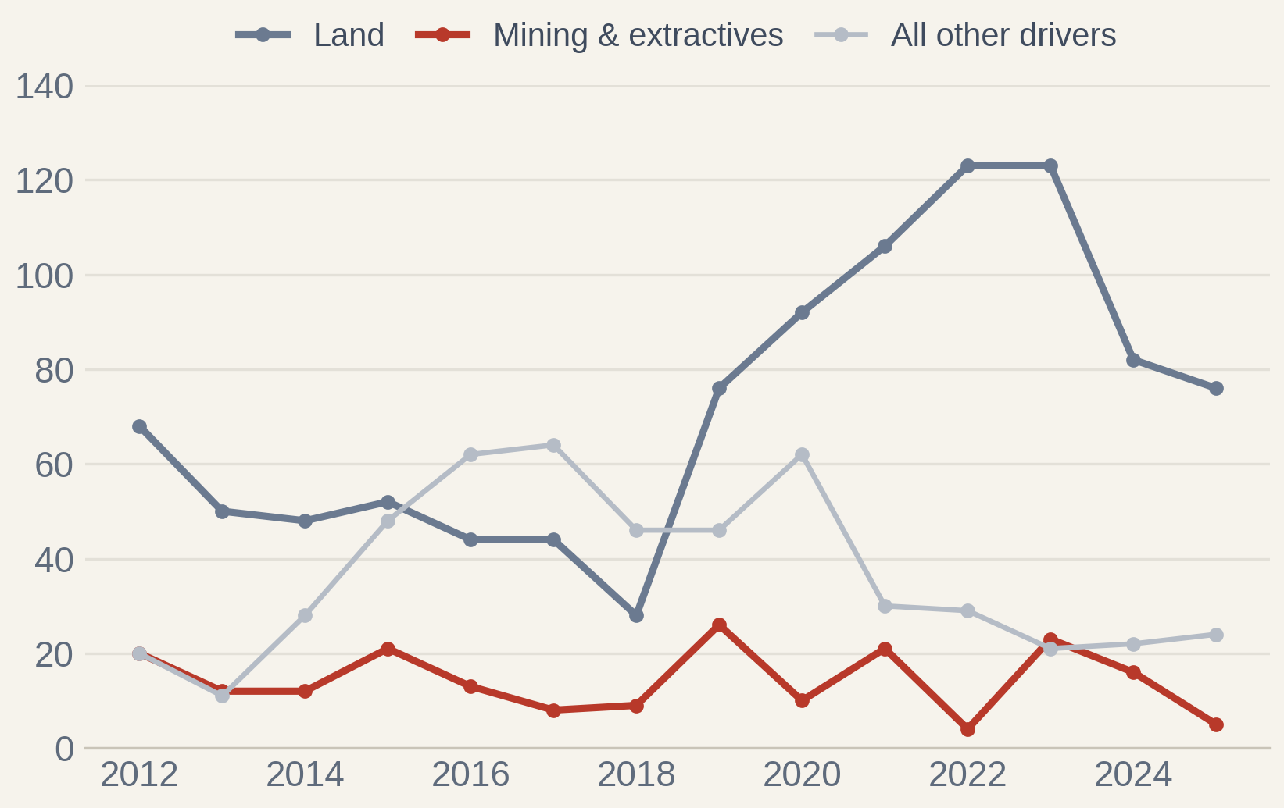
DEEP DIVE 2/2 · DEFENDERS VS CONFLICTS
Where mining is contested is not always where defenders die
Share of Latin American total, %
Killings per year by industry driver, Americas
Global Witness 2012–2025 (Americas, incl. 3 cases in USA/Canada); OCMAL conflicts 1972–2019. Left: Spearman ρ = 0.35 (p = 0.19), 16 countries.
Notes:
DIEGO (~32s): And here is the surprise. On the left we compare each country's share of mining conflicts with its share of mining killings. Mexico and Peru are high on both. But Chile and Argentina have many conflicts and no recorded mining killings, while Colombia has few conflicts and the most killings. On the right, over time, land disputes are always the main driver, and they rose sharply after 2018. Mining stays lower, but it never disappears.
— Background (not to read out) —
Mexico and Peru are high on both lists. Chile and Argentina have many conflicts but no recorded mining killings. Colombia, Guatemala and Venezuela have far more mining killings than their conflict count suggests. The rank correlation is weak (rho 0.35, not significant). Right chart, from Diego's notebook: land disputes are the largest driver in every year and rose sharply after 2018 (28 killings in 2018, 123 in 2022 and 2023). Mining-related killings go up and down between 4 and 26 a year, with peaks in 2019, 2021 and 2023; in 2022 they dropped to 4. Mining was never the main driver, but it was often the second one.

Slide 17
PART 04 OF 04
04
Conclusions
What the data supports, and what stays open
01 Intro
02 Production & sites
03 Conflicts & abuses
04 Conclusions
Notes:
LENA (~1s): Let's conclude.
— Background (not to read out) —
Part 04: Conclusions. What the data supports, and what stays open.

Slide 18
CONCLUSIONS
What our data shows
1
Demand is rising
Clean-energy demand for lithium grows about four times by 2040, and Latin America mines a third of the world's copper.
2
Zoom in the Andes
Mining conflicts are recorded in the same countries and provinces as the mining sites: Chile, Peru, Argentina and Brazil lead.
3
What our data can't show
Whether rising demand for critical minerals will spark more conflicts in Latin America over time: our conflict data stop in 2019.
4
Our answer: only partly
Resource-rich countries see more conflicts, but not always more killings of defenders. Land disputes drive most killings.
Association, not cause: all sources under-record, and counts do not measure size or severity.
Notes:
LENA (~35s): Four points. One: demand is rising, and Latin America is a key supplier. Two: mines and conflicts overlap, in the same countries and provinces. Three: what our data can't show is whether rising demand will spark more conflicts in the future; our conflict data stop in 2019. And four, our answer to the research question: only partly. Resource-rich countries see more mining conflicts, but not always more killings. Violence depends on other factors too, such as land disputes and armed groups.
— Background (not to read out) —
1) Demand: IEA projects clean-energy demand for lithium about four times higher in 2040 than in 2025; Latin America mines about 35 % of world copper. 2) The maps show mining conflicts in the same countries and provinces as mining sites. 3) What our data can't show: whether rising demand for critical minerals will spark more conflicts over time. The conflict list stops in 2019 and we have no projection of conflicts, only of production. 4) Answer to our research question: resource-rich countries do see more mining conflicts, but not consistently more killings; land disputes are the first driver of killings, mining the second. Association, not cause: all sources under-record.

Slide 19
CRITICAL MINERALS IN LATIN AMERICA
Demand
rises for minerals and gold
Thank you
Mining
expands in Latin America
Questions?
Conflict
follows the mines
Diego & Lena
Team Tokio · Ironhack
Defenders
killed: the most extreme form
Notes:
BOTH (~5s): Thank you for listening. We are happy to take your questions.
— Background (not to read out) —
Thank the audience and open the floor for questions.

