Slide 1
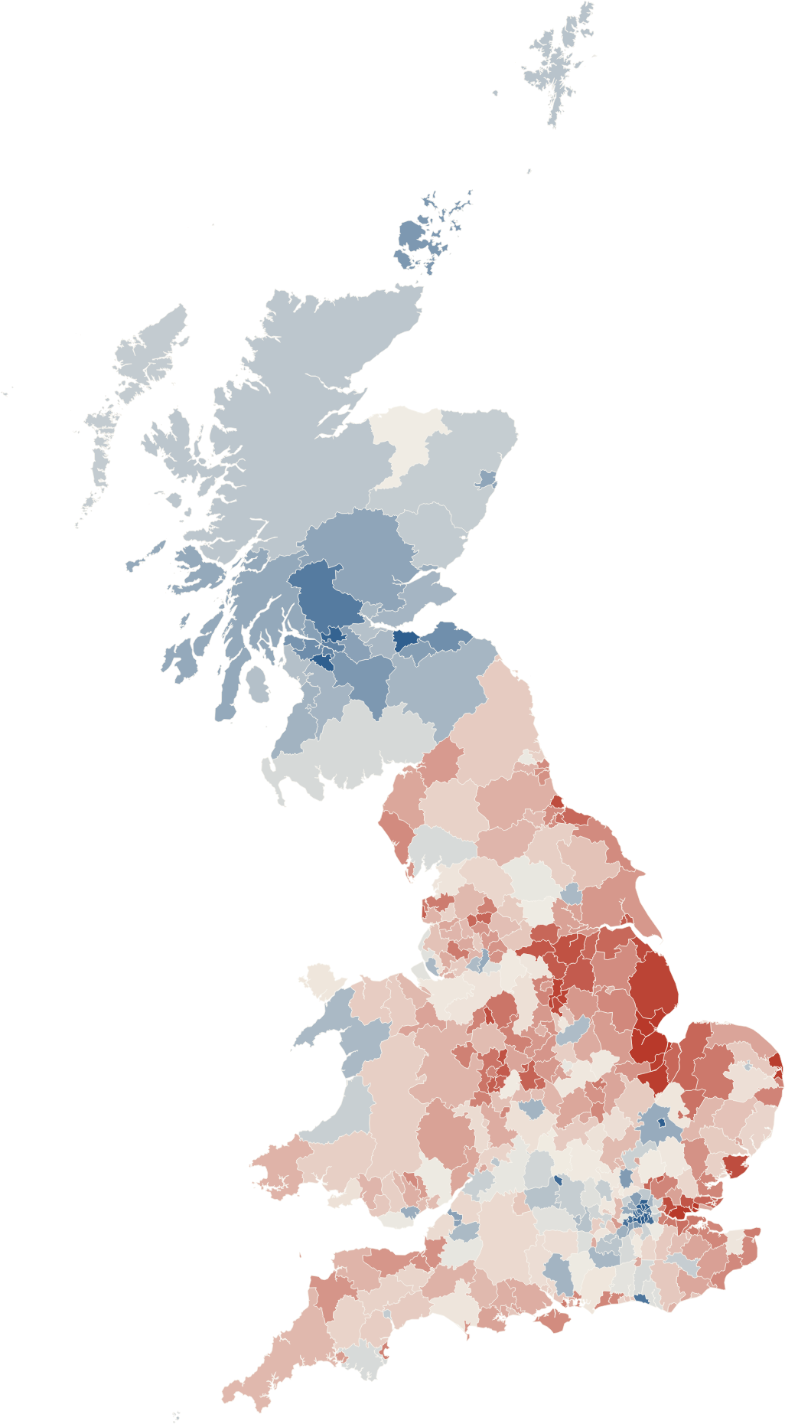




THE 2016 EU REFERENDUM · IRONHACK DATA ANALYTICS
Why Britain voted Leave, and where the explanation breaks
The vote
Education
Machine learning
Conclusion
who chose Leave
the best clue
predict unseen regions
where it breaks
Lena Chouchan
Ironhack Data Analytics · November 2026
Sources: Electoral Commission (2016); 2011 Census, ONS.
Notes:
[0:00–0:15] Hello, I'm Lena. My project is about the 2016 Brexit referendum: who voted Leave, and where the explanation stops working.

Slide 2


One night in June 2016, Britain decided to leave the European Union.
Ten years later, the question is still open.
A deal, not a new vote
Ten years on, London and Brussels are negotiating a “reset” (food checks, energy, young people) instead of a second referendum.
The experts got it wrong
Polls and markets expected Remain. If the forecasts missed it, can data explain it afterwards?
A very divided country
From 21% Leave in one area to 76% in another. Same country, same day, same question.
My question: what kind of place voted Leave, and can a model predict it?
Notes:
[0:15–1:05] One night in June 2016, Britain voted to leave the European Union. Ten years later, the question is still open: there is no new referendum, but London and Brussels are negotiating a reset to get closer again. I chose this topic for two reasons. First, almost nobody saw it coming: polls and markets expected Remain. If the forecasts got it wrong, can data explain the result afterwards? Second, the country was very divided: from 21% Leave in one area to 76% in another, on the same day, with the same question. So my question is: what kind of place voted Leave, and can a model predict it?

Slide 3
From one vote to one exception
THE STORY IN FOUR STEPS
01
The vote
Who voted Leave, area by area
02
What explains it
Education, age, pay and jobs, tested
03
Machine learning
Predicting a region the model has never seen
04
Conclusion
What it shows, where it breaks, and its limits
Data: 380 voting areas of Great Britain · 9 population features (2011 Census, ONS)
Notes:
[1:05–1:15] The story has four steps: the vote, what explains it, a machine-learning test, and what it all shows, including where the explanation breaks.

Slide 4
The vote
PART 01 OF 03
01
What happened on 23 June 2016
01 The vote
02 What explains it
03 Machine learning
Notes:
[1:15] Part one: the vote.

Slide 5
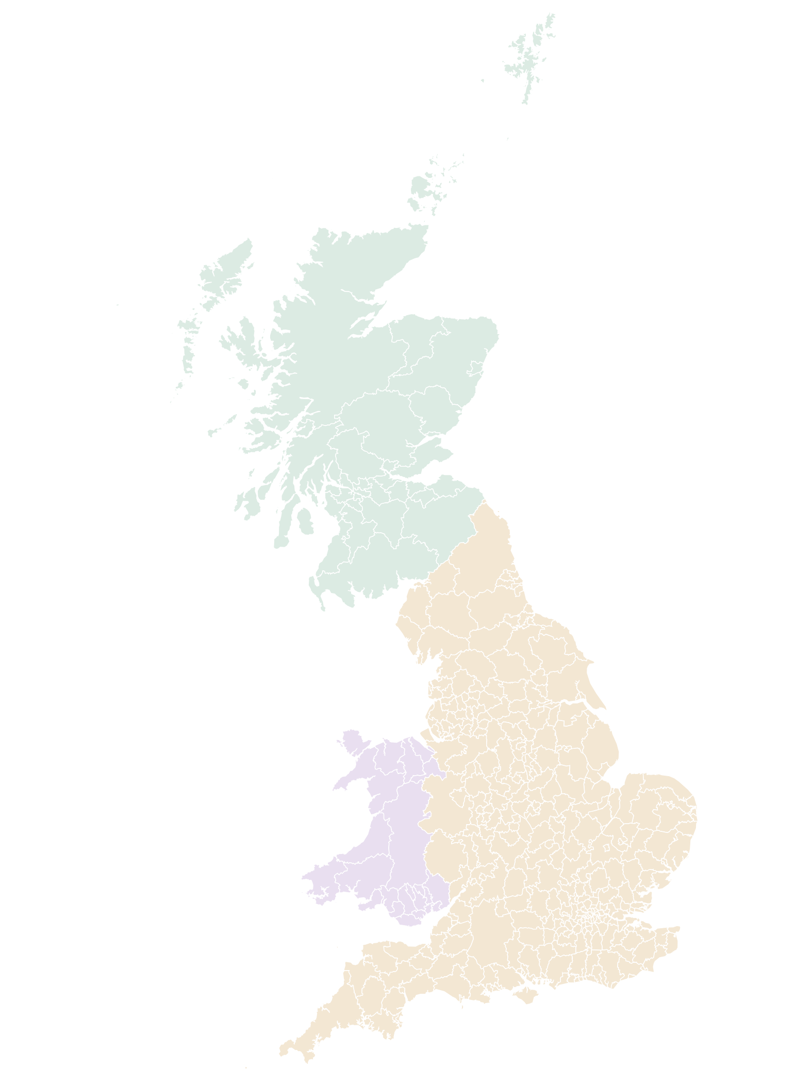
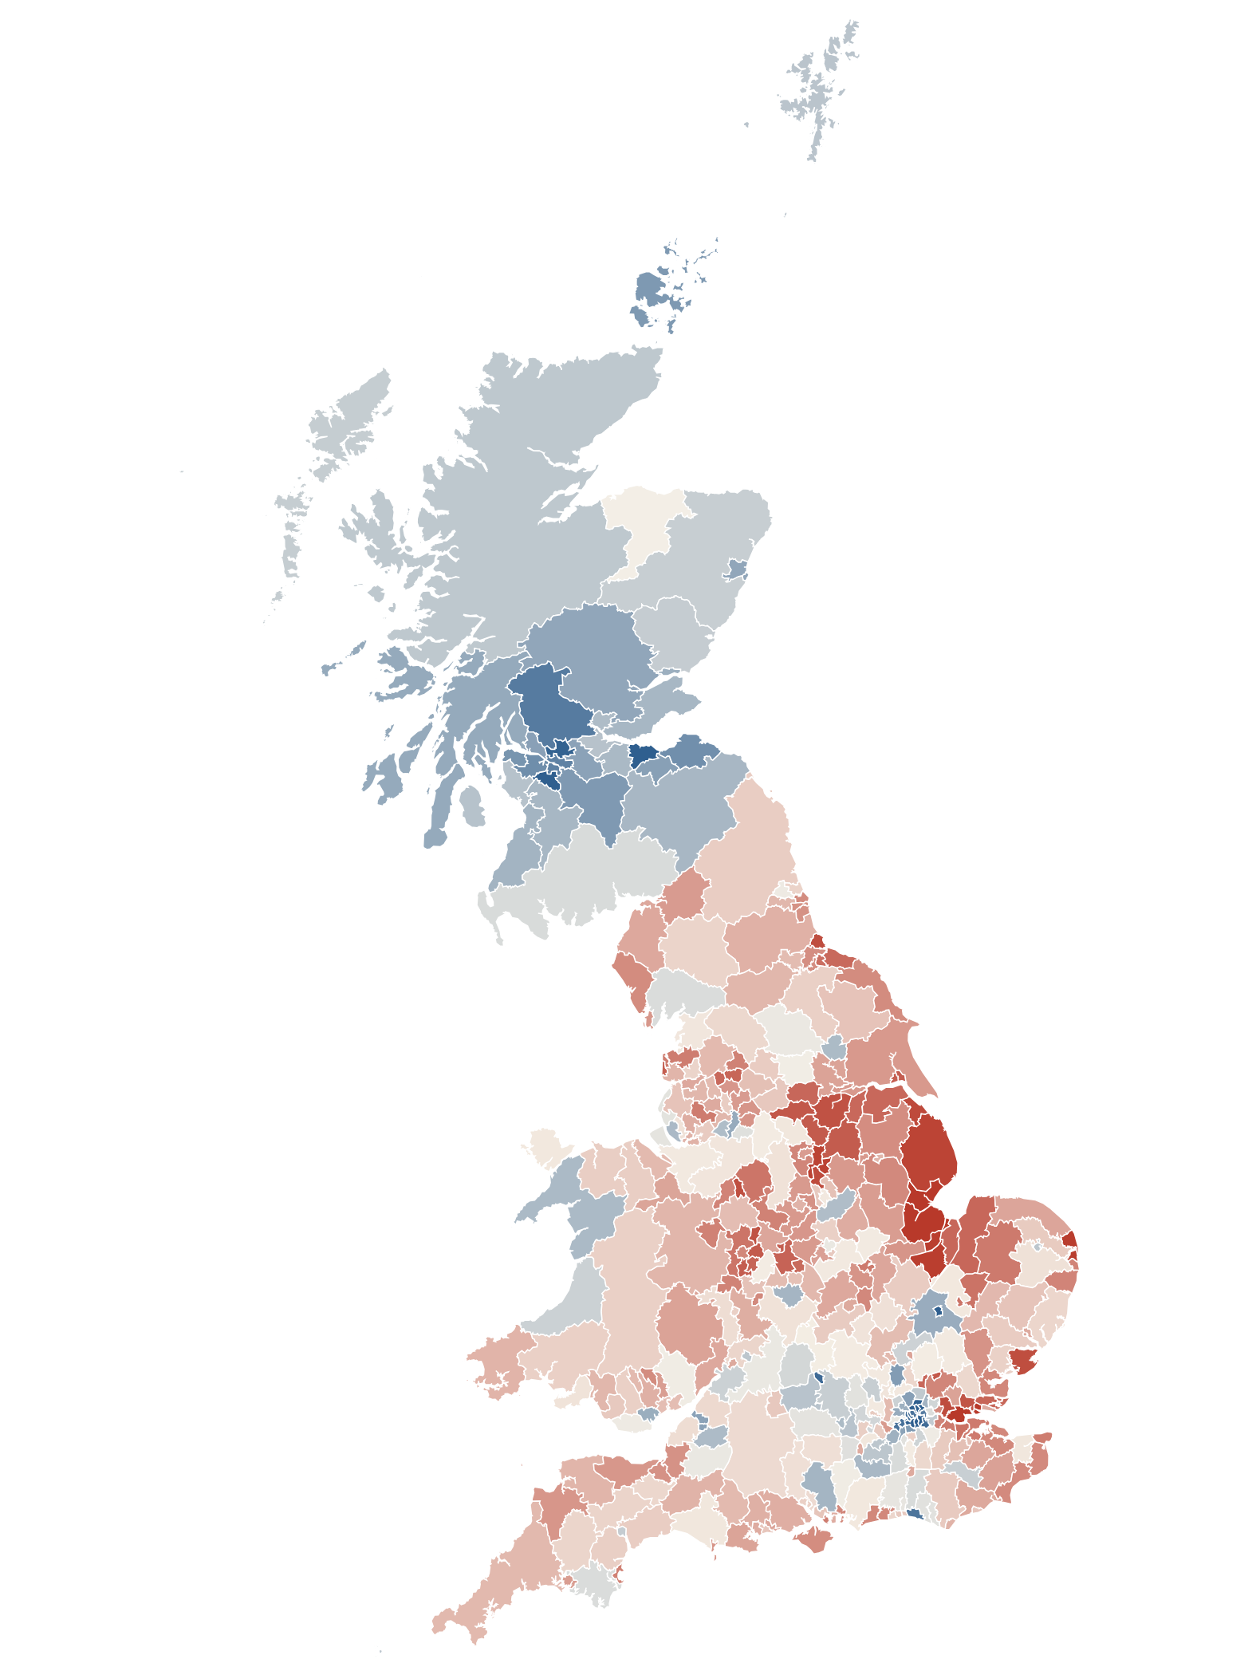

THE VOTE · 380 AREAS
Leave won Britain, but not London or Scotland
1 Nations and regions
England
Wales
Scotland
2 The 2016 vote
Remain → Leave
263 of 380 areas voted Leave · 0 of 32 in Scotland
Boston: 75.6% Leave, the highest in the UK. Edinburgh: 25.6%.
Source: Electoral Commission, 2016 EU referendum results · Notebook 01
Notes:
[1:20–2:05] This is Great Britain: England, Wales and Scotland, 380 voting areas. (CLICK) Now the vote. Red is Leave, blue is Remain. Leave won 263 areas, but none of Scotland's 32 councils. Look at the extremes: Boston, 76% Leave, the highest in the UK; Edinburgh, 26%.

Slide 6
What explains it
PART 02 OF 03
02
Education, age, pay and jobs, tested one by one
01 The vote
02 What explains it
03 Machine learning
Notes:
[2:05] Part two: what explains the vote.

Slide 7
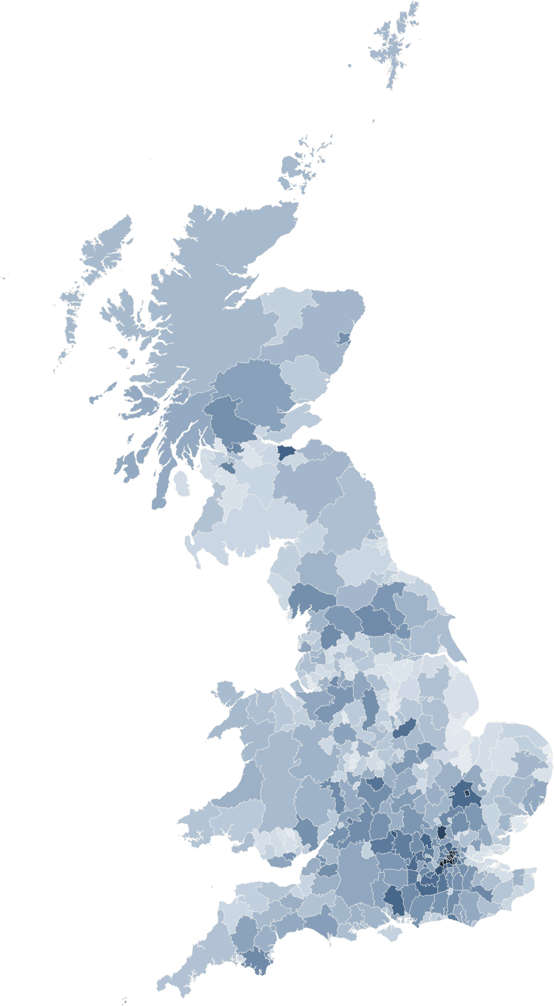
Fewer graduates, more Leave: the strongest link
WHAT EXPLAINS IT · KPI GAPS AND REGRESSION
Leave gap, top fifth − bottom fifth (points)
Welch t-test: all p < 0.001 except unemployment (p = 0.16)
r = −0.77
correlation between graduate share and Leave, the strongest of all
72%
of the differences between areas explained by 4 characteristics together, mainly graduates. Age only looks important: older areas have fewer graduates.
More of it → less Leave
More of it → more Leave
Open my Tableau dashboard ↗
No real difference
Darker = more graduates
Social grade AB = share of people in professional or managerial jobs (doctors, lawyers, managers). Gaps: top fifth minus bottom fifth of areas, vote-weighted · Notebooks 02 and 02b
Notes:
TABLEAU LINK: https://public.tableau.com/app/profile/lena.chouchan/viz/BrexitLeavevote/WhatexplainsLeavevote
[2:10–3:00] What explains these differences? Let me start with education. I took the 76 areas with the most graduates, like Cambridge and Oxford, and the 76 areas with the fewest graduates, like Boston. In the areas with the most graduates, 39% voted Leave. In the areas with the fewest, 63%. That is a difference of 24 points: the first bar of the chart.
I did the same for each characteristic. More managers and professionals: 18 points less Leave. Higher pay: 15 points less. More people over 65: 12 points more Leave. Unemployment: only 1 point, and the test says it could be chance. So Leave was not simply a vote of the poorest areas.
The map on the left shows graduates: it looks like the vote map in reverse. The correlation, minus 0.77, says the link is strong: the more graduates, the less Leave. And together, these factors explain 72% of the differences between areas.
One trap: age. Older areas also have fewer graduates. When I compare areas with the same education, age makes no difference.
[3:00–3:30] TABLEAU DEMO (optional). Click the button, then:
1) Point at the three tiles: “52.1% of Britain voted Leave, 263 of the 380 areas voted Leave, and the graduate gap is minus 24 points.”
2) Click London on the region map: “Everything filters to London: Leave goes from 21% in Lambeth to 70% in Havering.” Click again to reset.
3) Point at the graduates chart: “The fewer graduates an area has, the more it voted Leave, step by step. The dashboard shows the pattern; my notebooks test it.”
Go back to PowerPoint.

Slide 8
Machine learning
PART 03 OF 03
03
Can a model predict a region it has never seen?
01 The vote
02 What explains it
03 Machine learning
Notes:
[3:30] Part three: machine learning.

Slide 9



Train on 10 regions, predict the 11th, repeat 11 times
MACHINE LEARNING · THE HARD TEST
1 Learn
9 features per area: education, social grade, age, pay, unemployment, child poverty
2 Hide a region
The model never sees it while learning, then predicts every area in it
3 Compare
Baseline, linear regression, tree, Random Forest, Gradient Boosting, KNN
Which model? Error on regions it has never seen
RMSE, points of Leave share · lower is better
What does the model rely on?
Extra error when one feature is shuffled (points)
Baseline
Other models
Chosen model
Chosen: Random Forest. The lowest error on unseen regions, and no extreme predictions in London.
Graduates carry the model: 9.7 points; every other feature under 1.
LeaveOneGroupOut over 11 regions · RMSE in points of Leave share · permutation importance on the Random Forest, 10 repeats · Notebook 05
Notes:
[3:35–4:35] A random test would be too easy, because neighbouring areas look alike. So the model learns from 10 regions and predicts the 11th, which it has never seen; I repeat that for every region. Left chart: guessing the average gives an error of 11 points; the Random Forest brings it under 7, the lowest of all, so it is the model I chose. Right chart: what does it rely on? If I shuffle the graduate share, the error grows by almost 10 points; shuffling any other feature changes it by less than one. The model is basically an education model. But the average hides something.

Slide 10
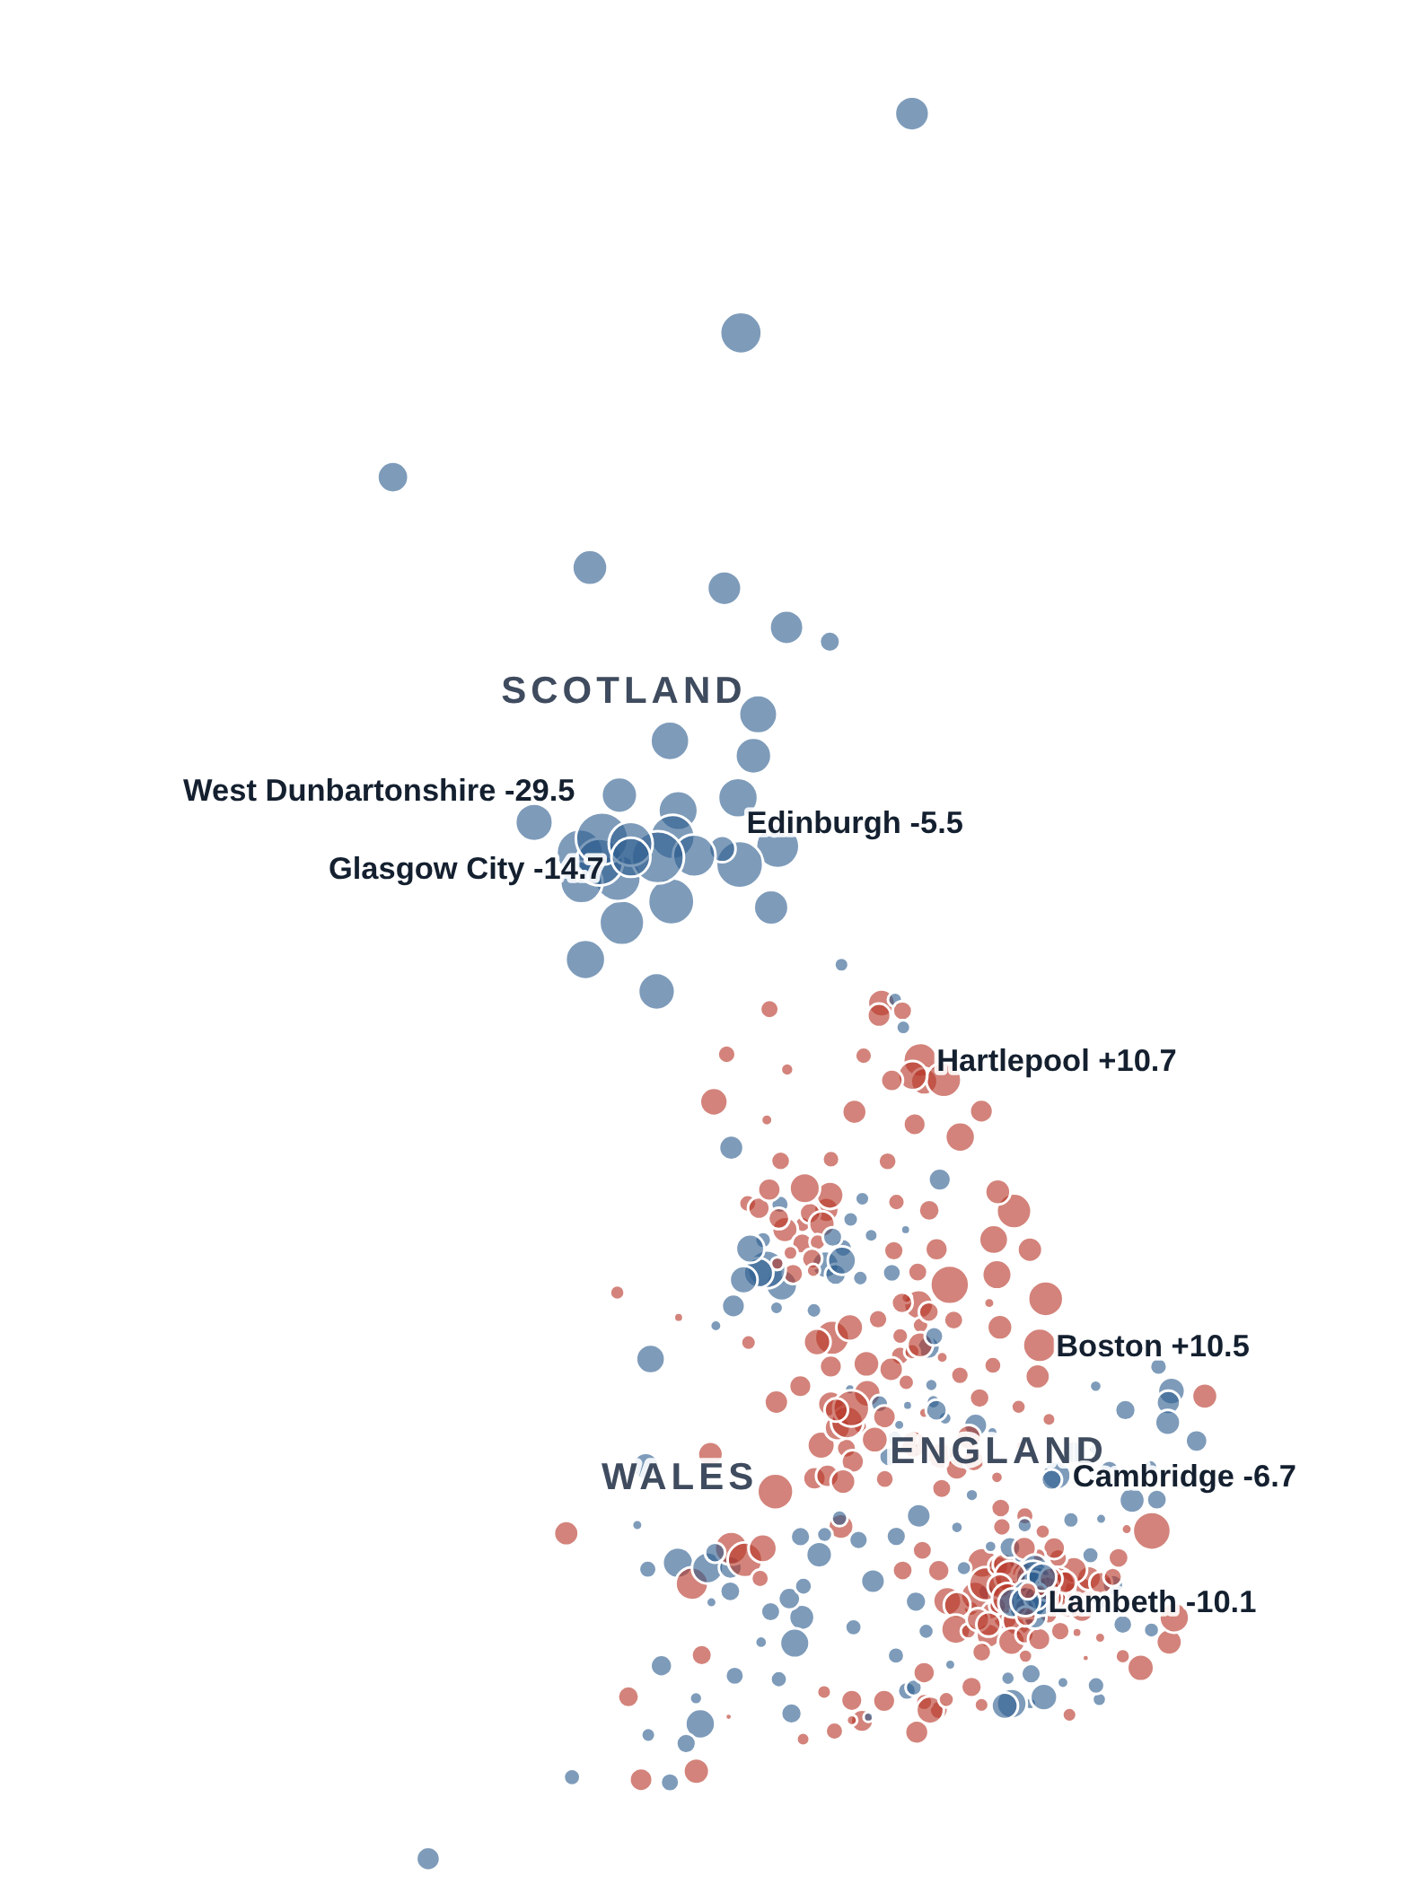
MACHINE LEARNING · WHERE IT FAILS
The model works everywhere except Scotland
2 The 2016 vote
Remain → Leave
3 Where the model fails
less Leave than predicted
more Leave
Circle size = points the model missed (region held out)
75%
3%
of areas outside Scotland within 5 points
of Scottish councils within 5 points. Average: −16 points
Random Forest trained on 10 regions, tested on the 11th · error = actual − predicted Leave · Notebook 05
Notes:
[4:35–5:25] Back to the vote map. (CLICK) Now the model's errors: each circle is how many points the model missed, blue when the area voted less Leave than predicted. England and Wales: small circles. Scotland: big blue circles everywhere, the 10 worst misses are all Scottish, West Dunbartonshire almost 30 points. (CLICK) Outside Scotland, 75% of areas are predicted within 5 points. In Scotland: 3%. The error follows a border, not the population. Explaining Scotland needs its own study: I come back to it in the conclusion.

Slide 11
What my data shows
CONCLUSIONS
1
Education explains the vote
In England and Wales the graduate share is the best single clue: r = −0.77.
2
Age and jobs add little
Age is education in disguise; unemployment shows no real gap.
3
Scotland breaks the model
16 points less Leave than predicted. First clues: not a vote for independence, half the gap is political. It needs its own study.
4
Limits: what I didn't analyse
Immigration, the campaigns and the media, social networks, and people's own reasons (sovereignty, identity).
Also: results describe areas, not individual voters · correlation is not causation · 32 Scottish councils and one past vote: no forecast of a future referendum
Notes:
[5:25–6:15] To conclude, four points. One: in England and Wales, education is the best single clue to the vote. Two: age and unemployment add little. Three: Scotland breaks the model: it voted 16 points less Leave than its population predicts. My first checks show it was not a vote for independence, and that about half of the gap is political, but explaining Scotland properly needs its own study: that is my next step. Four, the limits: I did not analyse immigration, the campaigns and the media, social networks, or people's own reasons, like sovereignty and identity. And my data describes areas, not individual voters, and correlation is not causation.

Slide 12

WHY BRITAIN VOTED LEAVE
Thank you
Questions?
The vote
Education
Machine learning
Conclusion
who chose Leave
the best clue
predict unseen regions
where it breaks
Scan to explore the data
brexit-leave-vote.streamlit.app
Open my Streamlit app ↗
Explore the map ↗
Lena Chouchan · Ironhack Data Analytics
Notes:
[6:15–6:25] Thank you. Happy to take questions. If you want to explore the data yourself, scan the QR code: my Streamlit app follows the same steps as this talk. (App: https://brexit-leave-vote.streamlit.app/)

