Slide 1

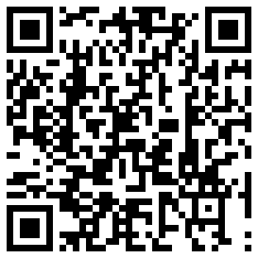
ActiveTracker
http://www.len.ro/activeTracker
1.
Install the ActiveTracker app on your Android phone by scaning the QRCode below or by searching ro.len.ActiveTracker in Google Play
2.
Once the ActiveTracker installed, select the event, enter your event participation number and start tracking. Do this 10 to 15 mins before the event starts (see notices below). Don't forget to stop tracking once the event has ended.
3.
Everyone can then track your participation on the event ActiveTracker page.
this app is provided “AS IS” with no warranty of any kind.
on some mobile phones it can take up to 15 mins in the open for a GPS lock, make sure GPS location is enabled.
note that tracking only works if you have data enabled and there is network coverage.
during usage, the GPS and data connection are used. This can affect your battery usage and data connection charges
use ONLY the "Active Test" event for testing the tracking
Notices

