Slide 1
"A picture is worth a thousand words"
Frame Sketcher
sketch & compare bicycle frames
http://www.len.ro/tools/frameSketcher/

Slide 2
Choosing a bicycle frame can be difficult, especially online...
There are several measurements to bicycle frame which go beyond the simple 18'' or 20'' notation. It's not always very easy to visualize all of them

Slide 3
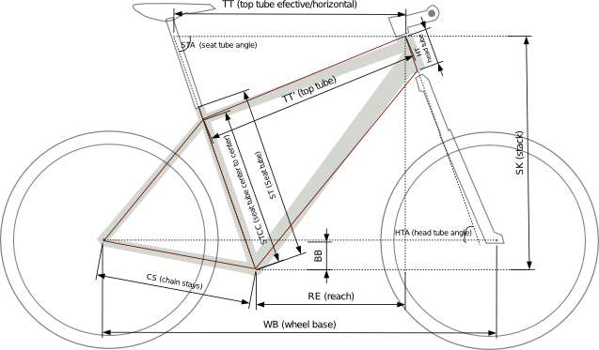
I had the same problem a few months ago so I decided to write a tool, based on a simplified model, to help me take a more informed decision.

Slide 4
Start with your inseam and a frame you already tested. Either choose an existing frame or enter the frame data.

Slide 5
Not all manufacturers provide the same data. Some provide the top tube horizontal (TT) and top tube sloped (TTT)...

Slide 6
...other provide reach (RE) and stack (SK).

Slide 7
Draw the inseam line and the selected frame.

Slide 8
Hmm, the 18'' seemed a little small, how about the 20''?

Slide 9
Not all 20'' are exactly the same, angles and length count too!

Slide 10
Not to mention 29'' ers.

Slide 11

Good luck finding
your dream bicycle!
http://www.len.ro/tools/frameSketcher/
© www.len.ro

