Slide 1
P2

Slide 2
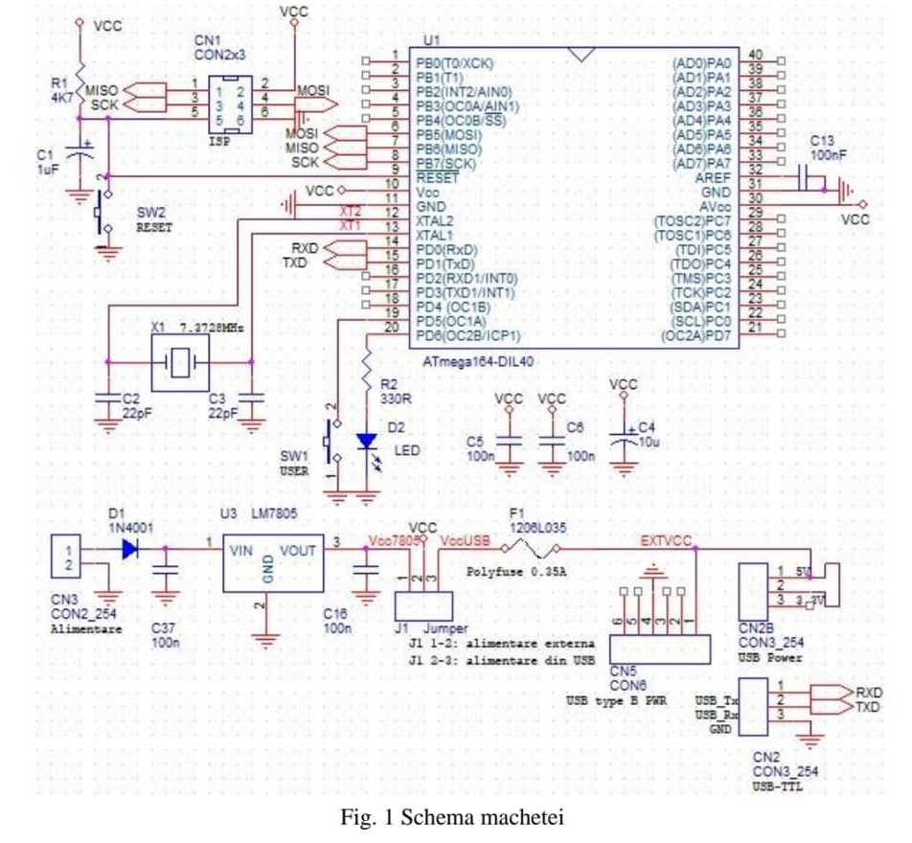

Slide 3
ATMega 164
C5,C6,C13,C37,C16 5x100n
C4 10u
D2 LED
SW1,SW2 2x push button
C3,C2 2x22p smd
X1 osc cuart
C1 1u electrolitic
R2 330ohm
R1 4.7k
CN1 conector 2x3
CN3 1x2 pini tata
CN2 CNb2 1x6 pini mama
J1 1x3 pini tata
D1 dioda
U3 LM7805

Slide 4
Sa cumparat:
USB
TTL convertor
Pt a putea programa

