Slide 1

By Lena Dahlin

Slide 2
Why was it created?
The founders couldn’t find a database at the time that met their scalability and agility needs [1].
They also wanted to improve developer productivity, which is why the document model was chosen [1].

Slide 3
Document Storage Data Model
Documents are stored in collections of similar data
In BSON format while stored, JSON when queried
Why choose Documents?
Intuitive to developers
Can save time and money with queries
Less time to code
Schema-less
Schema-less databases allow a dynamic structure as the database requirements change, however MongoDB does offer schema validation [2].

Slide 4
Application Areas
Ideal for large amounts of diverse and real-time data, and complex data structures that evolve over time [2].
Used by Uber, eBay, and Shutterfly

Slide 5
Features
Schema-less [3].
High scalability with vertical and horizontal scaling.
Can be run through a cloud provider, or locally using a container.
MongoDB Atlas provides an easy setup with 3 cloud provider options.

Slide 6
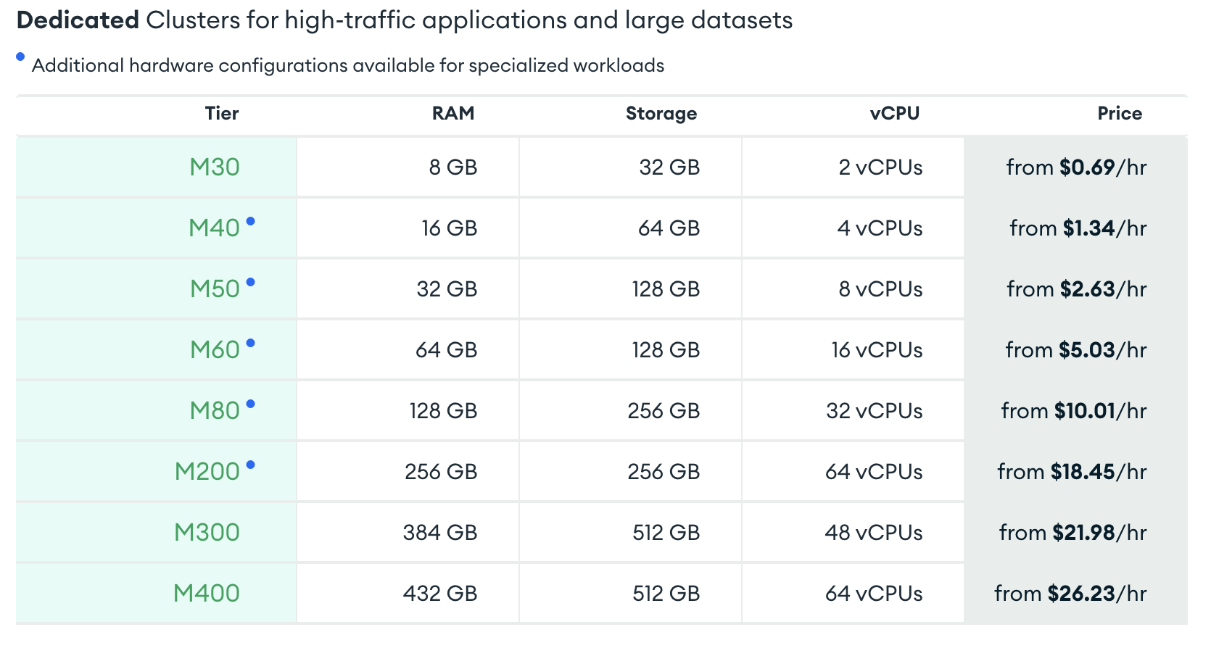
Vertical Scaling using MongoDB Atlas
Different tiers can be selected depending on what you need [4].
Optional auto-scaling
Expensive and can reach a threshold where it would be cheaper to scale horizontally
Image of vertical scaling options, adapted from [4].

Slide 7
Horizontal Scaling
Sharding is handled automatically and spreads data across multiple nodes to improve efficiency for large amounts of write operations [5].
Ranged sharding:
Partitions documents according to a key value to ensure similar values are on the same shard
Optimal for range-based queries
Hashed sharding:
Evenly distributes documents
Optimal for streams of time-series and event data
Zoned sharding:
Used for zone-specific rules governing data placement in a specific cluster

Slide 8
Fault Tolerance: Replica Sets
All data is replicated on up to 50 nodes [6].
One primary node receives and implements all write operations.
Write operations are replicated on secondary nodes.
Users can read from any node to reduce latency.
If a primary node fails, a secondary node is elected as the new primary node to provide fault tolerance [6].

Slide 9
Concurrency Control
MongoDB is ACID compliant as of the 4.0 release [7].
Multi-document transactions allow CRUD operations to be performed across multiple documents, collections, and shards.
Multi-granularity locking allows operations to lock at a global, database, or collection level [8].

Slide 10
Advantages
High scalability and agility
Easily customized to meet requirements with optional schemas and scaling
Intuitive design for developers
CAP Theorem: Prioritizes consistency and partition tolerance [9].

Slide 11
Limitations
Document sizes are limited to 16MB
Nesting is limited to 100 levels
CAP Theorem: Availability is not prioritized due to the downtime during a primary node election [9].
Transactions have a high performance cost as the database was not designed with transactions in mind

Slide 12
Query Capabilities
Basic CRUD operations
Aggregation pipeline allows joins
Multi-document transactions
CRUD and Join shown in demo

Slide 13
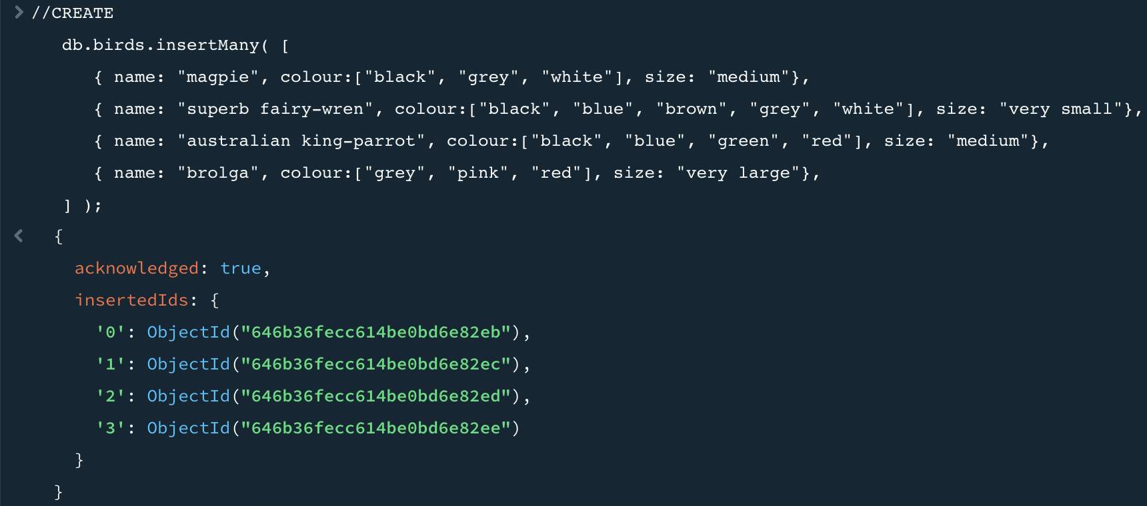
Create

Slide 14
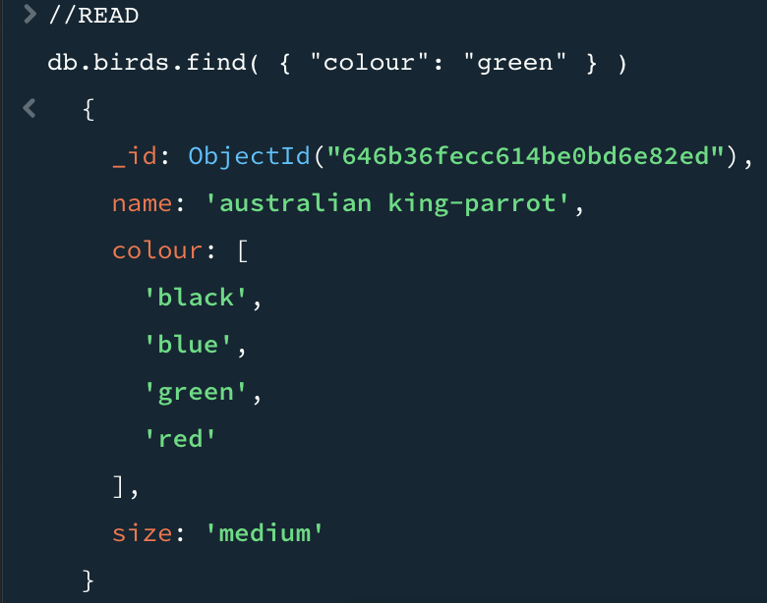
Read

Slide 15
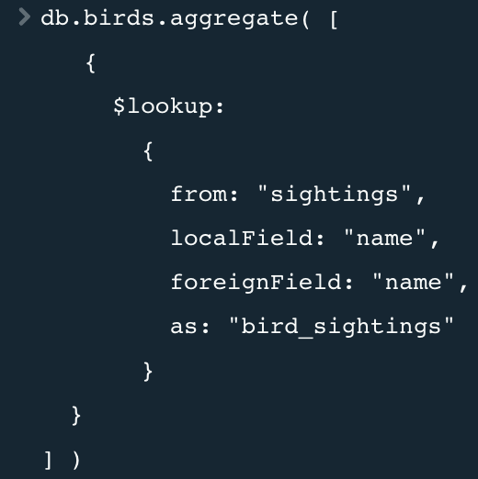
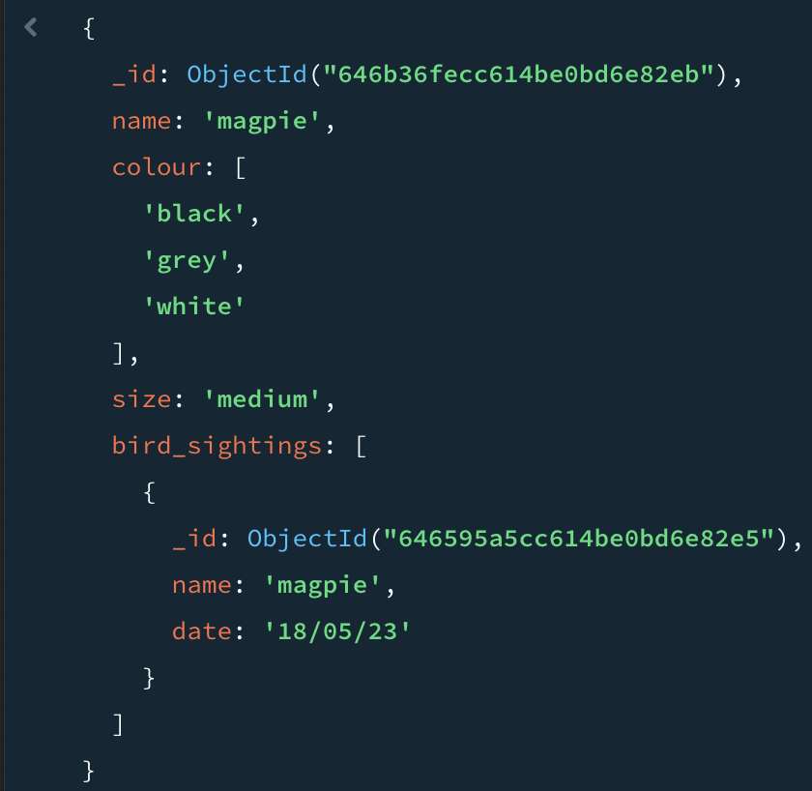
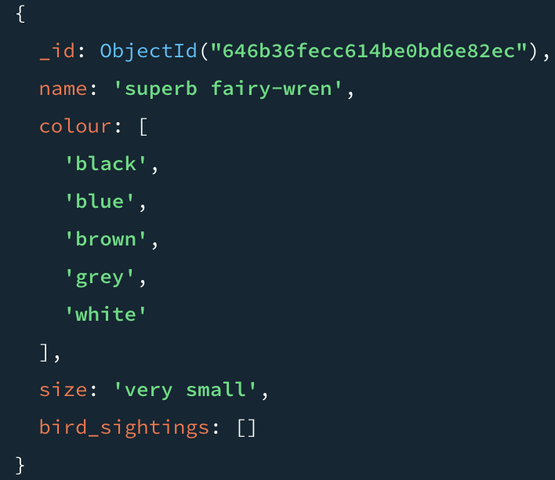
Left Join Example

Slide 16
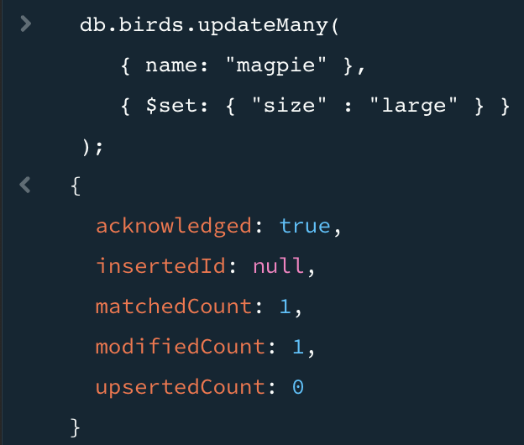
Update

Slide 17
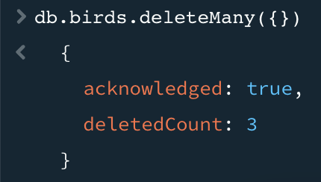
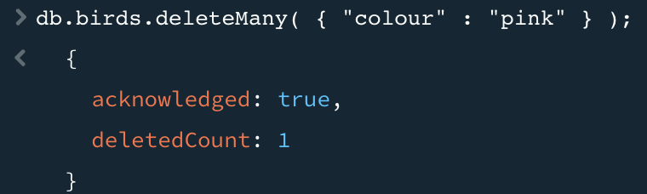
Delete

Slide 18
References
[1] “About us - Our Story,” MongoDB, https://www.mongodb.com/company (accessed May 21, 2023)
[2] “Why use mongodb and when to use it?,” MongoDB, https://www.mongodb.com/why-use-mongodb (accessed May 21, 2023).
[3] “Schema Validation,” MongoDB, https://www.mongodb.com/docs/manual/core/schema-validation/ (accessed May 12, 2023).
[4] “How to scale MongoDB,” MongoDB, https://www.mongodb.com/basics/scaling (accessed May 12, 2023).
[5] M. Keep and H. Ingo, “Performance Best Practices: Sharding,” MongoDB, https://www.mongodb.com/blog/post/performance-best-practices-sharding (accessed May 12, 2023).
[6] “Replication,” MongoDB, https://www.mongodb.com/docs/manual/replication/ (accessed May 12, 2023).
[7] “What are ACID Properties in Database Management Systems?,” MongoDB, https://www.mongodb.com/basics/acid-transactions (accessed May 12, 2023).
[8] “FAQ: Concurrency,” MongoDB, https://www.mongodb.com/docs/manual/faq/concurrency/ (accessed May 12, 2023).
[9] B. Katwal, “MongoDB vs Cassandra vs RDBMS, where do they stand in the cap theorem?,” Medium, https://bikas-katwal.medium.com/mongodb-vs-cassandra-vs-rdbms-where-do-they-stand-in-the-cap-theorem-1bae779a7a15#:~:text=CAP%20stands%20for%20Consistency%2C%20Availability,Never%20return%20inconsistent%20data (accessed May 21, 2023).

