Slide 1

Reactive Interactive
visualization of
F# jobs
Alena Dzenisenka
Progressive .NET Tutorials, July 3rd, London, UK

Slide 2

Alena dzenisenka
Software architect at Luxoft Poland
Member of F# Software Foundation Board of Trustees
Researcher in the field of mathematical theoretical possible in modern programming concepts
Speaker and Active software engineering community member
@lenadroid

Slide 3
Contents
Why is dynamic data visualization important?
Why F# for working with data?
Approaches to web based dynamic visualization.
Examples .

Slide 4

Data here . Data there . Data everywhere .

Slide 5

Why F# for working with data?

Slide 6
F#
Exploratory programming, interactive environment
Functional programming paradigm
Immutability, pattern Matching, type inference, higher order functions, computation expressions, type providers, …
Prototyping and modeling, dsls
Concurrent programming
Distributed and cloud programming
Frameworks and libraries

Slide 7
powerful and beautiful visualization on the web ?

Slide 8
Javascript

Slide 9

D3.js Highcharts C3.js Chartist.js Chart.js Zing Chart Ember Charts Vis.js xCharts Amcharts Sigma.js Leaflet Dygraphs.js Springy.js Cubism.js FusionCharts Google Visualization API Raphael.js Polymaps

Slide 10
somewhere
Actions with data
Analytics, computations, etc.
(generates new data too)
Data
Visualization

Slide 11
Very persistent… … much full-duplex so server push… …wow…
websockets

Slide 12
Application
Hubs api
Persistent connection api
transports

Slide 13
Transport
Long polling
Forever
frames
Web sockets
Server Sent Events

Slide 14
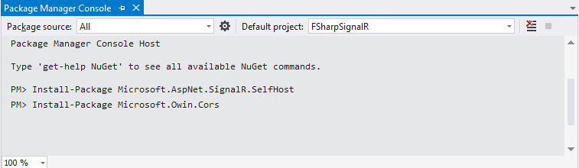
Hosting Signalr server
Self hosting SignalR in console application outside of Iis for less overhead during F# jobs.
owin – decoupling .NET servers and web Applications
owin.Cors - cross-domain support, when SignalR and a web client are hosted in different domains.

Slide 15
first set up
type public Startup() =
member public this.Configuration(app) =
let config = new HubConfiguration()
config.EnableDetailedErrors <- true
Owin.MapExtensions.Map(app, "/signalr",
fun map ->
Owin.CorsExtensions.UseCors(map,
Microsoft.Owin.Cors.CorsOptions.AllowAll) |> ignore
Owin.OwinExtensions.RunSignalR(map, config))
|> ignore

Slide 16
cross-domain calls using CoRS
Owin.CorsExtensions.UseCors(map,
Microsoft.Owin.Cors.CorsOptions.AllowAll)
detailed error messages
config.EnableDetailedErrors <- true
Choose transport scheme
$.connection.hub.start( { transport: ['webSockets',
'longPolling'] });

Slide 17
hubs

Slide 18


Slide 19
Hubs – strong typing ♥
type IClient =
abstract member addMessage: string -> string -> unit
[<HubName("fsharpHub")>]
type public FsharpHub() as this =
inherit Hub<IClient>()
member public x.Send(name : string, message: string) =
this.Clients.All.addMessage name message
|> ignore

Slide 20
Kicking off the server
[<EntryPoint>]
let main argv =
let url = "http://localhost:8080/"
use app = WebApp.Start<Startup>(url)
Console.WriteLine("Server running on {0}", url)
let context : IHubContext =
GlobalHost.ConnectionManager.GetHubContext<FsharpHub>()
Console.ReadLine() |> ignore
0

Slide 21
Javascript part

Slide 22
. Live updates .

Slide 23
Live updates Data – Popularity by states and browsers
type PopularityByStates = { State: string; browsers: PopularityByBrowsers }
// Count of users online
[<DataContract>]
type PopularityByBrowsers = {
[<field: DataMember(Name="Chrome")>]
Chrome: int
[<field: DataMember(Name="Firefox")>]
Firefox: int
[<field: DataMember(Name="Safari")>]
Safari: int
[<field: DataMember(Name="IE")>]
IE: int
}

Slide 24
onconnect schema exchange
[<HubName("fsharpHub")>]
type public FsharpHub() as this =
inherit Hub<ClientHub>()
override this.OnConnected() =
let exchangeObject =
[| { State = "California";
Browsers = { Chrome = 0; Firefox = 0; Safari = 0; IE = 0} };
// ... other schema data
|]
this.Clients.Caller.exchangeSchema(JsonConvert.SerializeObject(exchangeObject))
|> ignore
base.OnConnected()
// ...other hub methods

Slide 25
Javascript mission with received schema
hub.client.exchangeSchema = function (schema) {
var schemaJs = JSON.parse(schema);
// do required setup using schema data manually or cast it to JS prototype instead
// and work with it instead
function iterate(obj, stack) {
for (var property in obj) {
if (obj.hasOwnProperty(property)) {
if (typeof obj[property] == "object") {
iterate(obj[property], stack + '.' + property);
} else {
console.log(property + " " + obj[property]);
// jQuery('#output').append(jQuery("<div/>").text(stack + '.' + property))
}
}
}
}
iterate(schemaJs, '')
// Do anything else required with received type for initial JS-side set up.
// ...
}

Slide 26
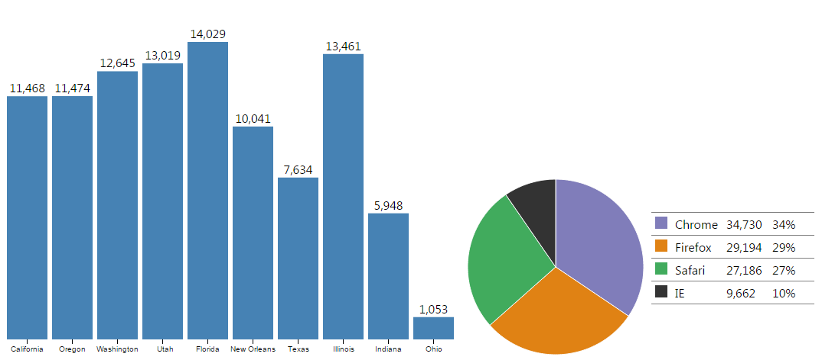
. Live updates .

Slide 27
. Time series data
from the cloud .

Slide 28

MBrace

Slide 29
Getting our clouds ready
Setting connection strings:
let myStorageConnectionString = "your connection string"
let myServiceBusConnectionString = "your connection string"
let config =
{ Configuration.Default with
StorageConnectionString = myStorageConnectionString
ServiceBusConnectionString = myServiceBusConnectionString }
Getting Mbrace runtime:
let cluster = Runtime.GetHandle(config)
cluster.ShowProcesses()
cluster.ShowWorkers()
cluster.AttachClientLogger(ConsoleLogger())

Slide 30
Getting our clouds ready
Defining Cloud ChannelS:
let channel = cluster.StoreClient.Channel
let sendPort1, receivePort1 = channel.Create<TimeSeries []>()
let sendPort2, receivePort2 = channel.Create<TimeSeries []>()
Getting Mbrace runtime:
let updates (receive : IReceivePort<TimeSeries []>) (send : ISendPort<TimeSeries []>) = cloud {
while true do
let! result = Cloud.Catch <| receive.Receive()
match result with
| Choice1Of2 x ->
let timeSeries = getTimeSeriesDataFor result
do! send.Send timeSeries // e.g. {x = 1434994711; y = 81.2406}
| Choice2Of2 _ -> ()
}
let job = cluster.CreateProcess(updates receivePort1 sendPort2)

Slide 31
Send something to the cloud !
Define the destination where we’d like to send data:
let connection = new HubConnection("http://localhost:8080")
let fsharpHub = connection.CreateHubProxy "fsharpHub"
let sendSomething message = async { return! channel.SendAsync(sendPort1, message) }
let receiveMessages = async {
while true do
let! result = channel.ReceiveAsync(receivePort2)
sendUpdatesTimeSeries fsharpHub result
printfn "Received: %A" result
}
connection.Start().Wait()
Send messaGEs to the cloud and receive responses:
Start the connection before calling receive messages:

Slide 32
Update clients with fresh data
let sendUpdatesTimeSeries (hub: IHubProxy) (message) =
let x = JsonConvert.SerializeObject(message)
hub.Invoke<string>("timeSeries", x).ContinueWith(fun (t : Task) ->
if t.IsFaulted then
Console.WriteLine("Could not Invoke method: {0}", t.Exception.GetBaseException())
else
Console.WriteLine("Success calling timeSeries method"))
|> ignore

Slide 33
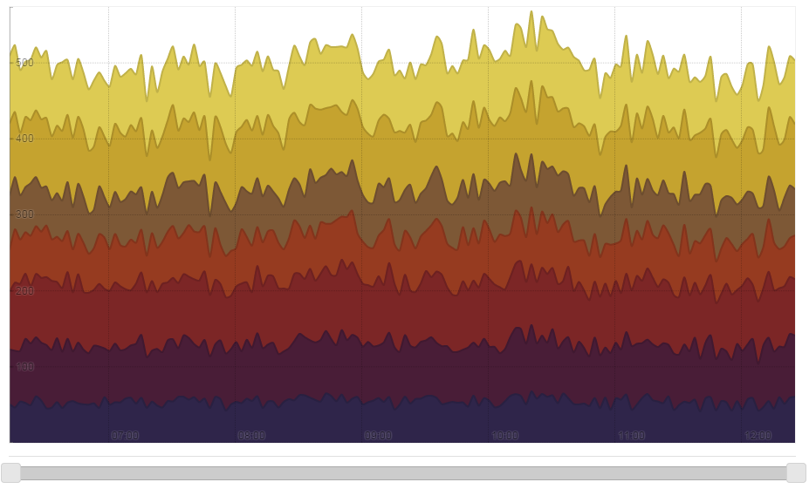
. Time series data .

Slide 34
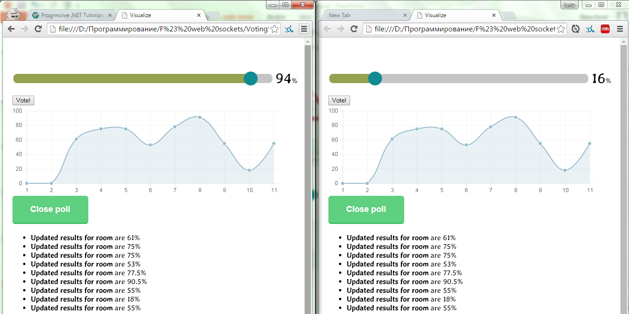
. Voting server .

Slide 35
. Voting hUB .
[<HubName("voteHub")>]
type public VoteHub() as this =
inherit Hub()
override this.OnConnected() =
//...
this.Clients.Caller.exchangeSchema(schemaObject) |> ignore
base.OnConnected()
member public x.Vote(room: string, percent: int) =
// ...
this.Clients.Group(room)?addMessage(room,
votingService.RoomResults.Head.PercentOfAgree)
|> ignore
member public x.ClosePoll(room: string) =
this.Clients.Group(room)?addMessage(room,
votingService.RoomResults.Head.PercentOfAgree, "disconnect")
|> ignore
member public x.JoinRoom(room: string) =
//...
this.Groups.Add(this.Context.ConnectionId, room)
member public x.LeaveRoom(room: string) =
this.Groups.Remove(this.Context.ConnectionId, room)

Slide 36
SignalR type provideR
Server hub definition:
[<HubName("somehub")>]
type SomeHub() =
inherit Hub()
member this.Send(x: string) = x + "!"
Client definition:
let signalR = Globals.Dollar.signalR
let serverHub = new Hubs.somehub(signalR.hub)
serverHub.Send ("string")

Slide 37
. ThanK you .

