Slide 1



Introduction into fMRI analysis:
Software Installation and materials
Dr. Elena Galeano Weber
e.galeano-weber@dipf.de
Education and Human Development & Individualized Learning Laboratory, DIPF | Leibniz Institute for Research and Information in Education
1
Notes:
Welcome to our hands-on fMRI analysis workshop, designed for students in Psychology and related fields at Goethe University. In this workshop, you will learn the essential steps required to conduct fMRI research—from data acquisition and preprocessing to analysis—using MATLAB’s SPM toolbox. Our core philosophy is that a critical skill for a cognitive neuroscientist is the ability to assess the possibilities and limitations of fMRI experiments from a conceptual standpoint. To develop this insight, it’s essential to grasp both the fundamental principles of fMRI and the rationale behind the most common analysis techniques.
1

Slide 2
Workshop
3 full-day sessions (8 hours each, "Blockseminar")
Each session:
a specific phase of the fMRI processing and analysis pipeline
in-depth discussion of the theory and logic underpinning
extensive hands-on exercises to reinforce your learning
→ You will be well-equipped with both the conceptual understanding and practical skills necessary to design, execute, and critically evaluate fMRI experiments.
Notes:
The workshop is organized into three full-day sessions (8 hours each, "Blockseminar"). In each session, we will concentrate on a specific phase of the fMRI processing and analysis pipeline. Every session will begin with an in-depth discussion of the theory and logic underpinning that day’s focus, followed by extensive hands-on exercises to reinforce your learning. By the end of the workshop, you will be well-equipped with both the conceptual understanding and practical skills necessary to design, execute, and critically evaluate fMRI experiments.

Slide 3

Theoretical Topics and Practical Sessions
Key Theoretical Topics:
Basics of fMRI
Preprocessing steps
General Linear Models (GLM)
Contrast analysis
Group analysis and reporting
Introduction to multivariate analysis
Hands-On Activities:
Generating condition files from BIDS
Running GLM with SPM
Creating contrast maps
Conducting group-level analysis
Reporting results
Notes:
Theoretical Topics and Practical Sessions
Our workshop will guide you through the entire fMRI analysis pipeline—from processing raw MR images to reporting group-level univariate results. We’ll also introduce common multivariate analysis techniques.
Key Theoretical Topics:
Basics of fMRI
Preprocessing steps
General Linear Models (GLM)
Contrast analysis
Group analysis and reporting
Introduction to multivariate analysis

Slide 4

Resources & Software Installations:
MATLAB (2018 or later)
SPM12
ITK-Snap (version 3.0 or later)
Data
All the data that we will use in this workshop can be
downloaded from the links below and from github:
https://github.com/lenagaleano/fMRI-method

Slide 5
Data
Content-3t dataset
at: https://openneuro.org/datasets/ds001497/versions/1.0.2
Original publication at: https://www.jneurosci.org/content/28/35/8765.short
Process-specific dataset
at: https://openneuro.org/datasets/ds000164/versions/00001 Publication at: https://pubmed.ncbi.nlm.nih.gov/25143543/

Slide 6
Software Installation
Matlab
SPM
ITK-Snap
6
Notes:
6

Slide 7
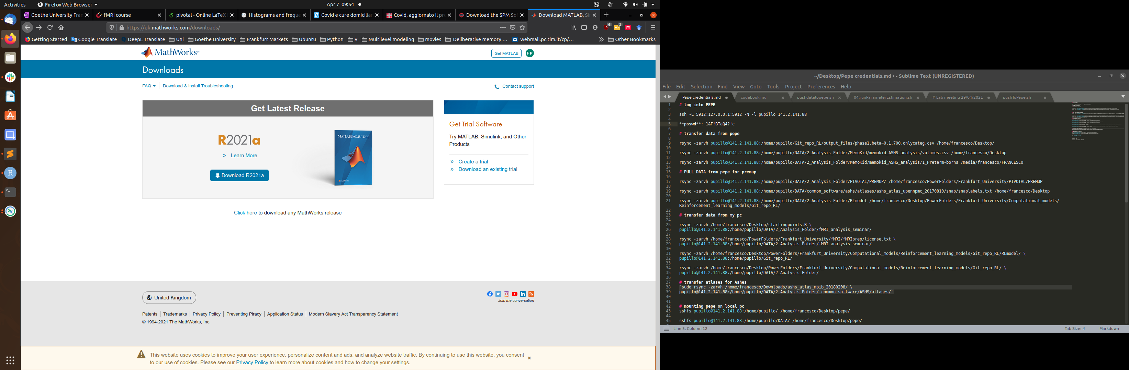
Matlab
Follow the step-by-step guide at
https://www.rz.uni-frankfurt.de/72309152/TAH_Schnellstartanleitung.pdf
To download Matlab and activate it with your HRZ account
7
Notes:
7

Slide 8
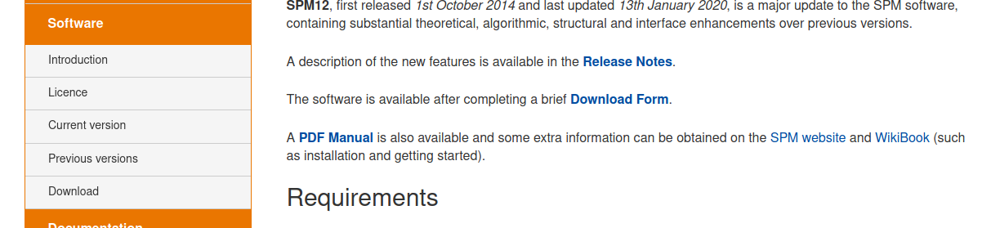
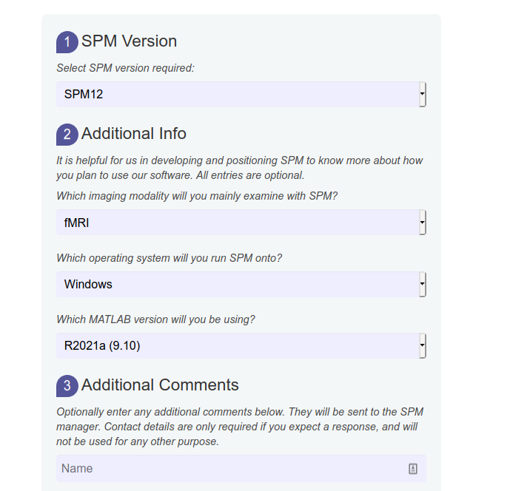
SPM
Go to https://www.fil.ion.ucl.ac.uk/spm/software/spm12/
1. Select “Download”
2. Fill the fields and proceed to the download
3. To install it, follow the instructions at https://en.wikibooks.org/wiki/SPM#Installation
8
Notes:
8

Slide 9
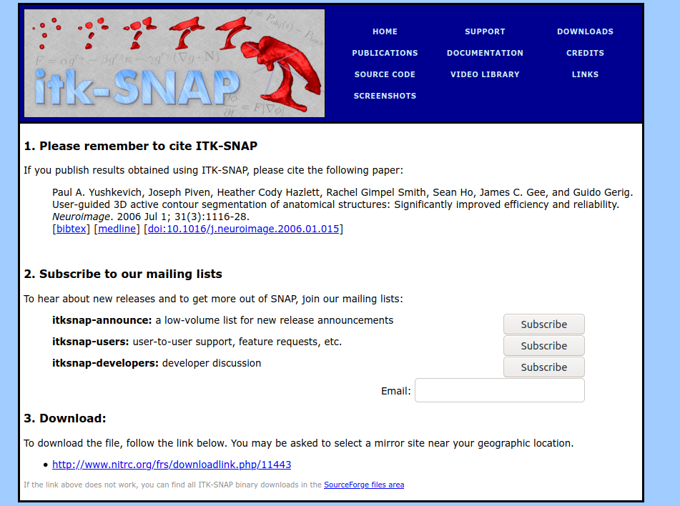
ITK-Snap
Go to http://www.itksnap.org/pmwiki/pmwiki.php?n=Downloads.SNAP3
After selecting the latest version (3.8.0) and your operative system, submit the form and go to the download page.
Click on the download link
After the file has been downloaded, start the executable file downloaded to install ITK-Snap
9
Notes:
9

Slide 10
The Datasets
All information on the seminar can be found at the following Github repository: https://github.com/lenagaleano/fMRI-method
The datasets can be downloaded from the following links. The total file size is ~17GB so make sure you have a stable connection and enough time. Pull the data from OpenNeuro:
Content-3t dataset
Data at: https://openneuro.org/datasets/ds001497/versions/1.0.2
Original publication at: https://www.jneurosci.org/content/28/35/8765.short
Process-specific dataset
Data at: https://openneuro.org/datasets/ds000164/versions/00001
Publication at: https://pubmed.ncbi.nlm.nih.gov/25143543/
10
Notes:
10

Slide 11
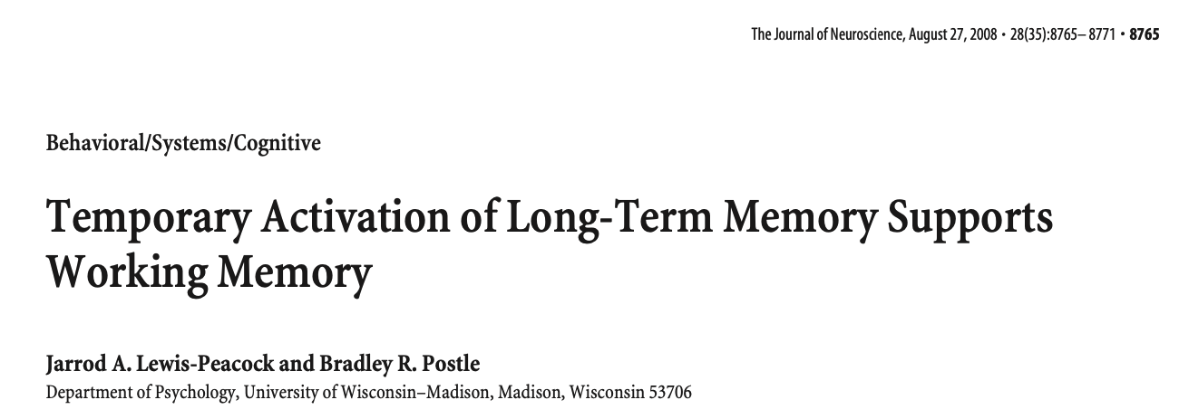
Content-specific Dataset
An example of how to investigate brain activity related to the processing of different domains (faces, places, body-parts)
11
Notes:
11

Slide 12
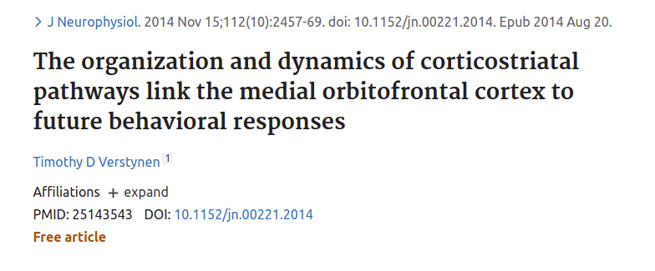
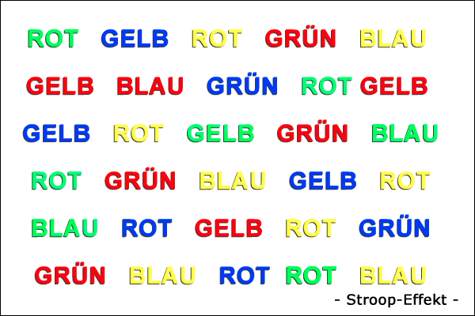
Process-specific Dataset
This dataset allows to look at brain activity during a Stroop task and to identify brain regions underlying processing of congruent vs incongruent infomation
Conditions:
Congruent
Incongruent
Neutral
RED GREEN
CHAIR DOG
12
Notes:
12

Slide 13
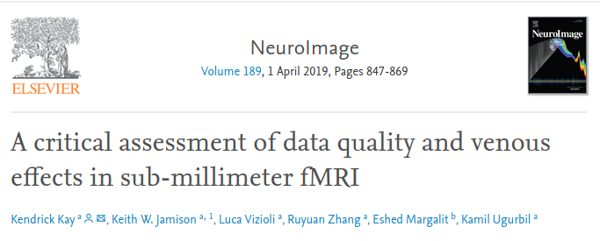
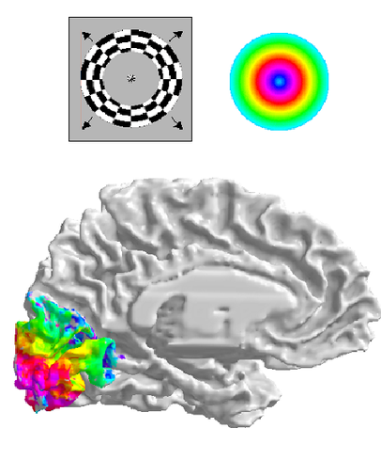
Spatial Dataset
Since the visual cortex is retinotopically
organized, we can map participants’
visual field to specific parts of the
occipital lobe.
13
Notes:
13

Slide 14
… Open question?
14
Notes:
14

Slide 15
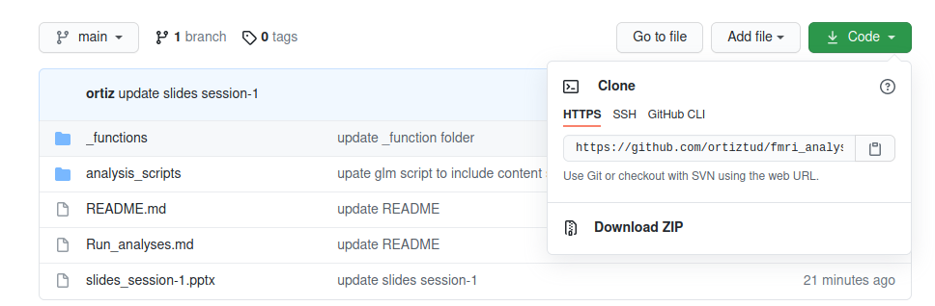
Know my repository
https://github.com/lenagaleano/fMRI-method
Click on “Code” and then on “Download Zip” to download the content of the repository
15
Notes:
15

Slide 16
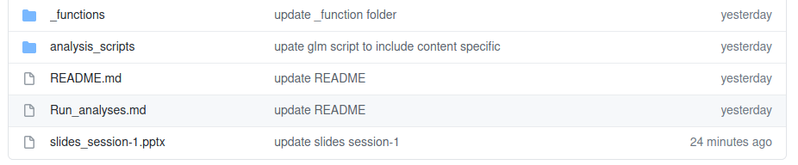
Know our repository
https://github.com/lenagaleano/fMRI-method
The repository contains the slides of the sessions, exercises, functions and scripts that we will use during the course.
16
Notes:
16

