Slide 1


Slide 2
Message-Oriented Middleware (MOM)
asynchronous
for developing loosely coupled applications
JSR343

Slide 3
When to use
The provider wants the components not to depend on information about other components' interfaces, so components can be easily replaced.
The provider wants the application to run whether or not all components are up and running simultaneously.
The application business model allows a component to send information to another and to continue to operate without receiving an immediate response.

Slide 4
Components
A JMS provider: a messaging system that implements the JMS interfaces and provides administrative and control features
JMS clients: Java applications that send and receive messages.
Messages: Objects that are used to communicate information between JMS clients.
Administered objects: Preconfigured JMS objects that are created by an administrator for the use of JMS clients.

Slide 5
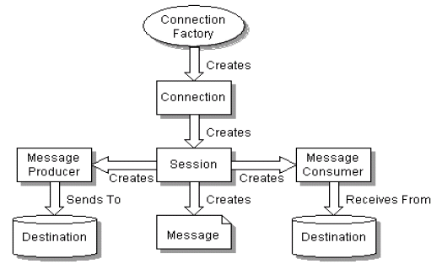

Slide 6
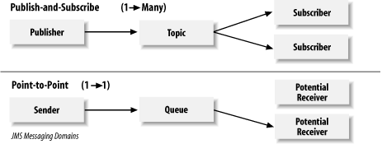
point-to-point (queue)
publish-subscribe(topic)

Slide 7
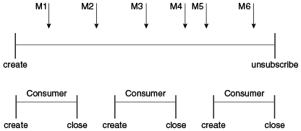
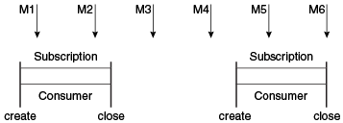
Topic subscription
durable
nondurable
shared
unshared

Slide 8
JMS Message
Header(required)
Properties(optional)
Body(optional)
Message(without a body)
StreamMessage(stream of Java primitive types)
MapMessage(set of name/value pairs)
TextMessage(java.lang.String object)
ObjectMessage(Serializable object)
BytesMessage(stream of uninterpreted bytes)

Slide 9
Message Headers
Header Field | Description | Set By
JMSMessageID | Value that uniquely identifies each message sent by a provider | JMS provider send method
JMSDestination | Destination to which the message is being sent | JMS provider send method
JMSReplyTo | Destination where replies to the message should be sent | Client application
JMSCorrelationID | Value that links one message to another; commonly the JMSMessageID value is used | Client application
JMSType | Type identifier supplied by client application | Client application
JMSExpiration | Expiration time of the message (default – 0 never) | JMS provider send method
JMSPriority | The priority of the message 0 (lowest) to 9 (highest), default - 4 | JMS provider send method
JMSDeliveryMode | Delivery mode specified when the message was sent | JMS provider send method
JMSRedelivered | Whether the message is being redelivered | JMS provider prior to delivery

Slide 10
JMS Message Selectors
filter the messages
is a String that contains an expression
SQL92 conditional expression syntax
receives only messages whose headers and properties match the selector
cannot select messages on the basis of the content of the message body
NewsType = 'Sports' OR NewsType = 'Opinion'

Slide 11
Queue browsers
objects that allow an application to browse messages on a queue.

Slide 12
Delivery modes
PERSISTENT(default) - will not be lost in the event of JMS provider failure
NON_PERSISTENT

Slide 13
Controlling Message Acknowledgment
The client receives the message.
The client processes the message.
The message is acknowledged.
transacted - a message is acknowledged when the session or transaction is committed
Nontransacted:
JMSContext.AUTO_ACKNOWLEDGE(default)
JMSContext.CLIENT_ACKNOWLEDGE
JMSContext.DUPS_OK_ACKNOWLEDGE

Slide 14
Links
http://www.jcp.org/en/jsr/detail?id=343.
https://docs.oracle.com/javaee/7/tutorial/jms-concepts.htm#BNCDQ
https://docs.oracle.com/javaee/7/tutorial/jms-examples.htm#BNCGV

