Slide 1
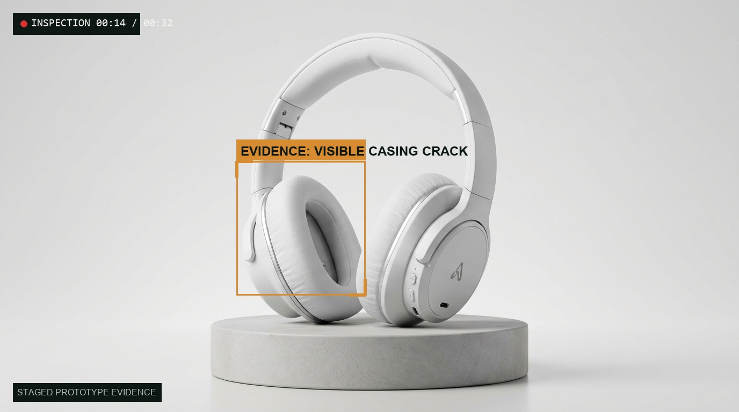
AGENTX HACKATHON 2026 · TRACK PS-04
RETURNLENS
RETURNLENS SELLER CONSOLE · CASE #RET-4082 ORDER #ORD-9021
ORDER TRUTH
HEAD-WHT-02 · White Headphones
₹1,499 · Delivered Day 4 (Within 7d window)
EVIDENCE CITATION
Inspection Frame 00:14
Casing crack verified at lower seam
POLICY VERIFICATION
P-01 Physical Defect: PASS
“Review returns with cited video evidence.”
An evidence-backed return triage agent for small direct-to-consumer sellers.
Team Rookie · 3 members · PS-04 submission
User: Solo D2C merchant managing orders and returns alone.
Scope in 24h: Return triage only, mock store data + 1 order-status route.
Not another chatbot; not an autonomous refund gate.
READY FOR SELLER REVIEW
Approve Return & Draft Refund
ReturnLens · Idea Pitch Deck · PS-04 · Team Rookie (3 members)
Slide 1 / 6

Slide 2
THE PROBLEM · SOLO SELLER BOTTLENECK
One return decision. Four disconnected sources.
The return decision is made from memory, before the evidence is checked.
01 BUYER CHAT
“Received damaged item”
Buyer upload: 30–60s unboxing video + reason
02 ORDER RECORD
White Headphones · ₹1,499
Shopify mock store API inventory database
CRITICAL INFORMATION GAP
NO SINGLE RECORD TIES ORDER, VIDEO & POLICY TOGETHER
Today the seller opens many tabs, then decides alone. A wrong refund loses money and stock; an unfair denial loses a repeat customer. The gap is not a missing returns portal, it is that no single record ties order, video frame, policy clause, and decision together.
03 COURIER TRACKING
Delivered 4 days ago
Shippo mock tracking API scan
04 RETURN POLICY
7-Day Window · Sealed Tag
Deterministic code rules P-01 to P-08, never prompts
Fraud estimates differ by definition: 9% (NRF 2025, fraud only) vs 15.14% (Appriss/Deloitte 2024, fraud + abuse).
Slide 2 / 6

Slide 3
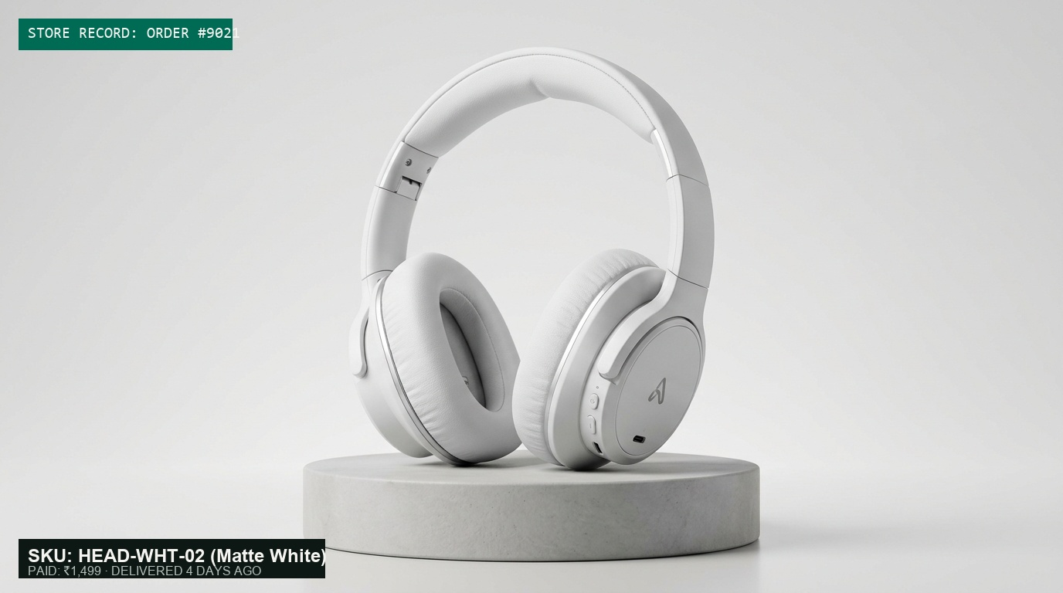
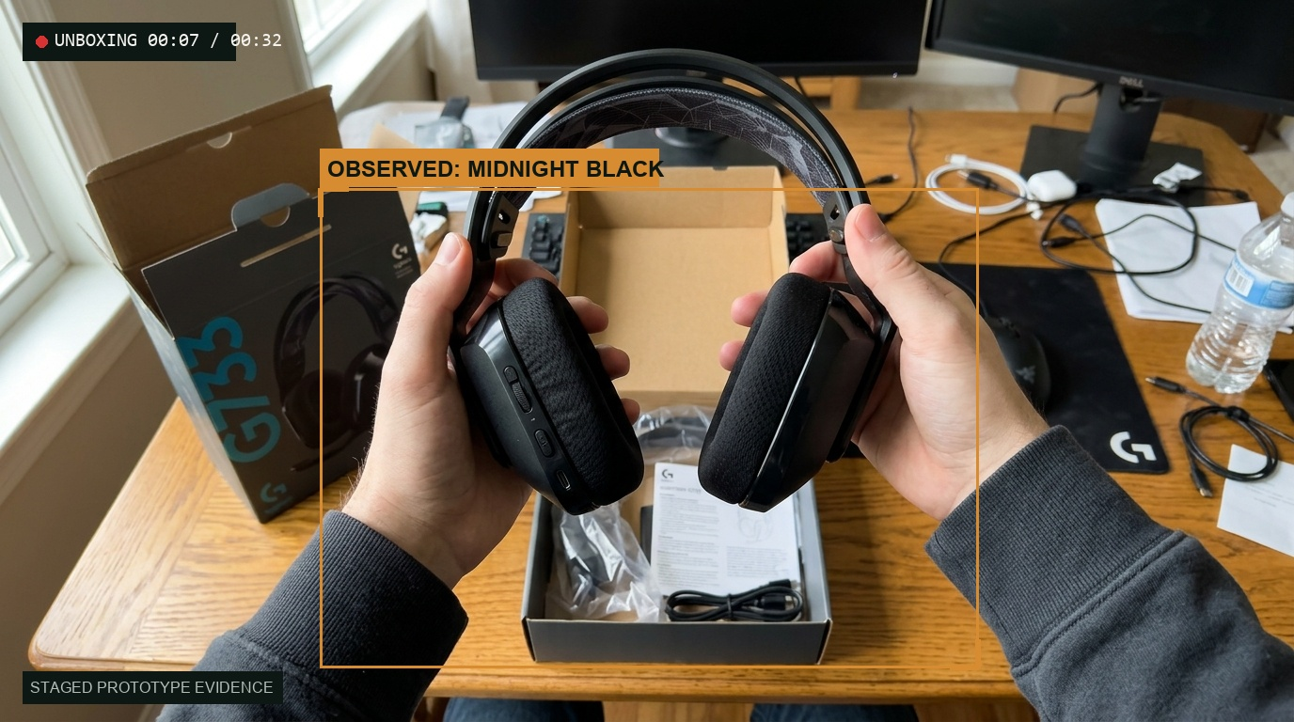
VISUAL EVIDENCE BENCHMARK · CORE DEMONSTRATION
The order says white. The video shows black.
ReturnLens surfaces the contradiction instead of auto-denying.
DETERMINISTIC POLICY GATE
Policy P-03 Check: FAIL
Specification contradiction flagged against Shopify order manifest.
typed JSON, requires_seller_approval: true
STATUS: ESCALATE (NEEDS SELLER REVIEW)
Seller Action Options:
1. Accept as merchant mis-shipment
2. Ask customer for outside-box shipping label
3. Hold return for physical inspection at warehouse
Cap: 0 < amount <= min(₹4,999, remaining refundable amount, order paid amount)
No auto-denial · No refund released without seller click
COLOR MISMATCH
ORDER RECORD · SKU: HEAD-WHT-02
Matte White · ₹1,499 · Delivered 4 days ago · Tag present
VIDEO FRAME · TIME 00:07 / 00:32
Observed: HEAD-BLK-09 · Midnight Black · Mock evidence pack
Illustrative staged evidence · Mock Shopify & Shippo APIs
Slide 3 / 6

Slide 4
SYSTEM ARCHITECTURE · DETERMINISTIC PIPELINE
Models observe. Code verifies. Seller authorizes.
Policy checks and seller approval control actions.
01 PLAN
Planner
02 RETRIEVE
Tools & Video
03 EVALUATE
Policy Engine
04 AUDIT
Critic
05 AUTHORIZE
Seller Gate
06 RECORD
Audit Log
MODEL
CODE
CODE
MODEL
HUMAN
CODE
1. CONTRADICTION → ESCALATE
Discrepancy flagged (e.g. Case B). Inhibits automated label and refund draft.
2. HARD FAIL → ESCALATE
Mandatory rule violation (e.g. expired window). Seller reviews; never auto-deny.
3. UNCLEAR ONLY → ASK MORE
Low brightness or blur (e.g. Case C). Prompts exact re-film checklist (1 retry limit).
4. ALL PASS → APPROVE REVIEW
All clauses pass (e.g. Case A). Prepares mock label and drafts refund in pending_return_receipt.
■ Model Calls: Exactly 3 base calls per case (planner, vision, critic) plus retries | ■ Policy Clauses: Deterministic Python rules P-01 to P-08, never prompts
■ Critic: The critic reviews cited frames and flags unsupported observations | ■ Safety: Prompt injection cannot alter policy code or bypass human gate
Structured audit log recorded at every state transition · Decision priority: Contradiction > Hard fail > Unclear only > All pass
Slide 4 / 6

Slide 5
DEMO SCENARIOS · GROUNDED VERIFICATION
Four scenarios. Four predictable behaviors.
Every decision can be clicked back to a frame, a clause, and a log entry.
CASE A · READY
ORD-1042 (₹1,499) · SKU matches manifest, tag present, visible defect within 7-day window.
→
Seller approval releases mock return label and refund draft in pending_return_receipt, not executed refund.
CASE B · ESCALATE
HEAD-WHT-02 vs HEAD-BLK-09 at Frame 00:07 · Policy P-03 SKU mismatch FAIL.
→
ESCALATE (no label, no refund, no denial). Seller options: mis-shipment / box label / physical inspection.
CASE C · ASK MORE
4-second dark video, brightness 28, only 2 usable frames · Unclear evidence check.
→
Case stays open with exact re-film checklist. One retry limit prevents customer lock-out.
CASE D · CONTINUITY
Unbroken take: opening sealed parcel to showing the label in one continuous sequence.
→
Continuity verified: prevents photo-swap fraud before mock return label generation. Proves why video beats photos.
Staged sample videos, mock store data, no real customer PII · Cap: min(₹4,999, remaining refundable amount, order paid amount)
Slide 5 / 6

Slide 6
EXECUTION PLAN · TEAM ROOKIE (3 MEMBERS)
Built for a 24-hour sprint.
Buildable in 24 hours by 3 people, if the scope stays narrow.
PERSON A
Backend & Agent Core
Backend, agent graph, policy, critic, audit log.
PERSON B
Video Pipeline & UI
Video pipeline, video indexer, seller console, evidence pack view.
PERSON C
Integration & Verification
Integration, mock data, 4 demo cases, fallback testing, demo video, README.
NEVER CUT (CORE ENGINE)
• Deterministic policy engine (P-01 to P-08)
• Evidence-pack frame citation
• Fail-closed seller approval gate
• Structured JSON audit log
• 4 reproducible demo cases
CUT FIRST (DEFERRED EXPANSION)
• Video OCR barcode scanner
• Auto-drafted customer email reply
• Seller analytics dashboard
• Production payment gateways / live WhatsApp webhooks
• Public cloud deployment
“The winning hackathon agent is not the one with the most tool definitions. It is the one where every action is held to evidence, and the seller stays in control.”
Team Rookie (3 members) · PS-04 Autonomous Support Agent · 24-Hour Prototype Feasibility
Slide 6 / 6

