Slide 1
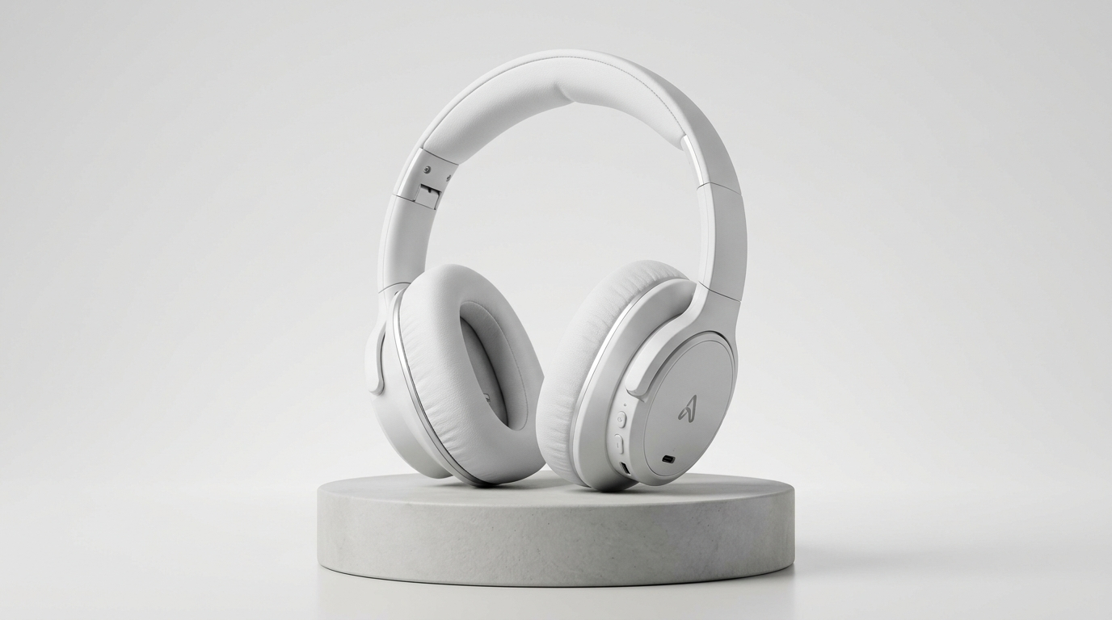

AgentX Hackathon 2026 · Track PS-04
CASE #RT-8821 · NEEDS SELLER DECISION
ReturnLens
Every return decision, backed by evidence.
An evidence triage assistant that connects customer claims, unboxing video, order records, and store policy into one clear decision pack for solo merchants.
Order #ORD-7729 · Studio Wireless · ₹1,499 paid · Delivered 4d ago
Ordered: White
SKU: HEAD-WHT-02 · Matte White
Observed: Black
Keyframe 00:07 · Barcode unverified
Color mismatch: Ordered White vs Observed Black · Barcode unverified
Recommended Next Step: Request outer-box label photo
Models observe. Code verifies. Seller authorizes.
Agent collects info & clarifies · Seller approves returns, labels & refunds
Seller authorizes all consequential actions
No automated refund · No automated rejection
Review Evidence & Decide →
01 / 06
Notes:
[0:00 - 0:15 | Slide 1: Introduction]
Judges, this is ReturnLens. For solo online sellers, returns are overwhelming. ReturnLens unifies buyer claims, video evidence, and store rules into one clear decision pack. Models observe, code verifies, but the seller always decides.

Slide 2
The Merchant's Reality
One claim. Four disconnected sources.
“I ordered white headphones, but received black. Please refund me.”
Attached: unboxing_video.mp4 (18s)
01
Customer Chat
Claim text and unboxing video upload
02
Shopify Order
Matte White (SKU HEAD-WHT-02), ₹1,499 paid
03
Courier Scan
Shippo confirms delivery 4 days ago
04
Store Policy
7-day return window for wrong or damaged items
Packing mistake, delivery error, or unboxing swap? The seller needs verified facts before deciding to refund, replace, or inspect.
02 / 06
Notes:
[0:15 - 0:40 | Slide 2: The Problem]
A customer chats in: 'I ordered white headphones, but received black. Please refund me,' attaching an unboxing clip. The merchant has to check four tabs: chat, Shopify, tracking, and store policy. Was this a warehouse mix-up, an honest confusion, or a swap? Blind refunds erode margins, while blind rejections destroy trust. The merchant needs unified facts to choose the next step.

Slide 3
Core Evidence Comparison
White ordered. Black received.
ReturnLens highlights the visible discrepancy without jumping to unverified conclusions.
STORE SPECIFICATION · SHOPIFY
OBSERVED EVIDENCE · VIDEO FRAME 00:07
≠
Ordered: White
HEAD-WHT-02 · ₹1,499 paid · Delivered 4d ago
Observed: Black
Barcode unverified · Exact model unverified
1. Accept mis-pack
Issue replacement return label
2. Request label photo
“Please share the outer-box label so we can check your shipment.”
3. Hold for inspection
Inspect returned parcel before refund
* Illustrative scenario with staged mock evidence. Barcode and exact model unverified.
03 / 06
Notes:
[0:40 - 1:25 | Slide 3: The Core Demonstration]
Here is our core demonstration. The Shopify order specifies white headphones, but the customer's video shows black casing. ReturnLens flags this visible difference clearly. Notice our honest AI grounding: we state that the barcode and exact model are unverified from the video frame. We do not jump to calling this fraud—it could easily be a warehouse packing error. Instead, ReturnLens prepares three practical options for the seller. Notice option two: a drafted reply is ready, asking for the outer-box label to verify the shipment. The seller reviews and clicks to approve.

Slide 4
Agent Architecture
From evidence to next step.
A structured pipeline where models observe, code verifies, and the seller approves.
1. Collect
Vision & Ingestion
Ingests customer chat, tracking scan, and extracts cited video keyframes.
→
2. Compare
Rule Engine
Cross-checks observed color against catalog specs, delivery date, and 7-day policy.
→
3. Recommend
Planning & Drafting
Synthesizes matches and discrepancies into 3 actionable choices and drafts replies.
→
4. Seller Decides
Merchant Decision
Merchant reviews the evidence dossier and approves returns, labels, or refunds.
Case C Clarification Loop
Unclear evidence → Request a close-up photo → Add to case file → Continue review
If footage is dark or blurry, agent requests 1 close-up photo or box label and continues the same case. Never auto-rejects.
04 / 06
Notes:
[1:25 - 2:05 | Slide 4: Agent Behavior]
How does the agent move the case forward? It follows four stages: First, Collect—ingesting chat, tracking data, and keyframes. Second, Compare—deterministic code verifies the seven-day return window and checks color alignment. Third, Recommend—the agent drafts resolution choices and customer replies. And fourth, Seller Decides—the merchant makes the call. If footage is too dark or blurry, the agent requests a close-up photo, appends it to the same case file, and resumes review. Models observe visual traits, code checks rules, and the seller approves returns, labels, and refunds.

Slide 5
Prototype Scenarios
Three situations. Clear next steps.
Expected prototype behavior across clean, conflicting, and unclear evidence.
CASE SCENARIO
SITUATION
AGENT RESPONSE
SELLER'S NEXT STEP
Case A
Consistent Claim
Unboxing video shows cracked headband; delivered 4 days ago, within the 7-day return window.
Validates delivery date and visible headband crack; drafts return shipping label.
Approve return label. Refund waits for parcel receipt.
Case B
Color Discrepancy
Customer claims: “I ordered white headphones, but received black.”
Flags color mismatch; notes barcode unverified; drafts 3 resolution choices.
Choose a resolution or request the box label.
Case C
Unclear Evidence
Video footage is too dark or blurry to confirm product condition or serial label.
Requests 1 clear close-up photo or box label; appends new evidence to same case file.
Review added evidence; handle manually if still unclear.
* Planned prototype behavior across core scenarios.
05 / 06
Notes:
[2:05 - 2:30 | Slide 5: Three Scenarios]
Our prototype focuses on three everyday situations: In Case A, evidence is clean—a visible cracked headband on arrival within seven days. The agent drafts a return label. In Case B, color discrepancy—the agent surfaces the conflict and prepares choices. In Case C, unclear evidence—the agent requests a close-up photo. Each scenario produces a clear next step.

Slide 6
24-Hour Prototype Sprint
A focused 24-hour prototype.
00–06h
Ingestion & Schema
Mock order and courier fixtures; case state schema.
06–12h
Vision & Rules
Keyframe extraction and deterministic policy checks.
12–18h
Seller Console UI
Side-by-side evidence review console with drafted replies.
18–24h
Walkthrough & QA
Scenario walkthroughs and checks across Cases A, B, and C.
Team
A — Workflow, policy checks and clarification.
B — Evidence extraction and seller console.
C — Scenario data and walkthrough checks.
Build first
Mock order and courier data · Keyframe evidence viewer · 3 core scenarios · Fail-closed seller console
Later
Live Shopify and courier APIs · Automated payment gateways · Advanced video forensics
One clear evidence pack. The seller makes the call.
06 / 06
Notes:
[2:30 - 3:00 | Slide 6: Execution Roadmap & Closing]
For this 24-hour hackathon, our scope is strictly disciplined: Person A builds the state machine and policy checks; Person B builds the keyframe viewer and merchant console; Person C tests all three scenarios. We are not building live Shopify webhooks or banking integrations. One clear evidence pack. The seller makes the call. Thank you!

