Slide 1
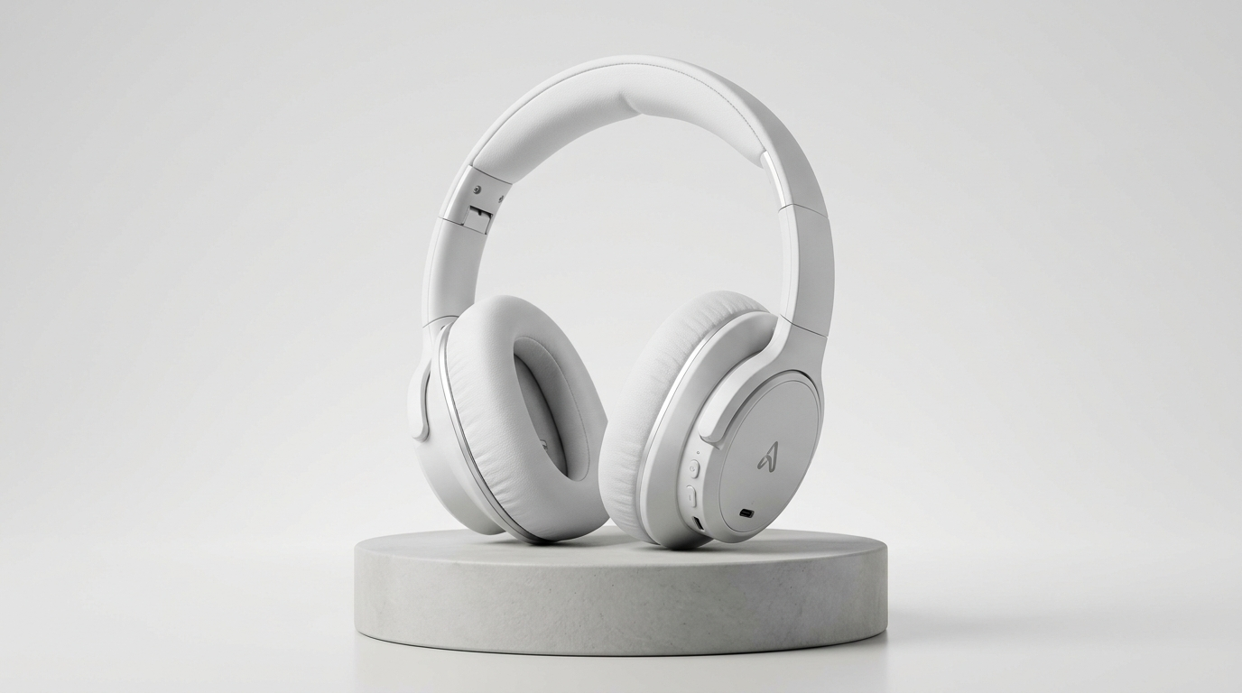

AGENTX HACKATHON 2026 · TRACK PS-04
ReturnLens
Every return decision, backed by evidence.
An evidence-backed triage assistant that unifies customer claims, unboxing video footage, and store records for solo online sellers.
RETURNLENS SELLER CONSOLE · CASE #RT-8821
Order #ORD-7729 · Studio Wireless · ₹1,499 paid · Delivered 4d ago (Within 7d window)
STORE SPECIFICATION
Matte White (SKU HEAD-WHT-02)
Shippo #SH-9012 verified · Security tag required
OBSERVED EVIDENCE · 00:07
Black Casing (Discrepancy)
Barcode unverified · Exact SKU not verified
COLOR DISCREPANCY: Ordered Matte White; unboxing video shows Black casing.
Automation halted · No automated refund · Prepared 3 resolution choices for seller.
CORE ARCHITECTURAL THESIS
“Models observe.
Code verifies.
Seller authorizes.”
Zero automated refunds · Zero automated rejections
● SELLER GATE (FAIL-CLOSED)
Human confirms every action
Review Evidence & Decide →
RETURNLENS V8 · AGENTX HACKATHON 2026 PS-04 · IDEA ROUND
01 / 06
Notes:
[0:00 - 0:15 | Slide 1: Introduction]
Judges, this is ReturnLens. For independent online sellers, returns are exhausting. When a customer claims they received the wrong product, the solo merchant is stuck cross-referencing customer chat, Shopify orders, and courier tracking just to figure out what happened. ReturnLens unifies customer claims, video evidence, and store rules into one simple decision pack. Notice our core button: 'Review Evidence & Decide'. We never automate refunds or rejections. The model observes, our code verifies, but the seller always authorizes the decision.

Slide 2
THE SELLER'S DILEMMA · SOLO D2C BOTTLENECK
One customer claim. Four disconnected sources.
A solo merchant must piece together fragmented records before deciding how to respond.
INCOMING CUSTOMER CLAIM · CHAT TICKET #TK-4412
“I opened the delivery box today and the headphones inside are black, not the white ones I ordered. I want an immediate refund.”
Attached unboxing video (18s MP4) · Order reference ORD-7729 provided by customer
1. Customer Message
Unstructured chat text and unverified unboxing video footage.
2. Shopify Order
Catalog specs: SKU HEAD-WHT-02, Matte White, ₹1,499 paid.
3. Courier Tracking
Shippo scan confirms physical parcel delivery 4 days ago.
4. Store Policy
7-day return policy for unopened or mis-shipped goods.
THE SOLO SELLER'S DILEMMA:
Is this a warehouse packing error, an honest customer mix-up, or an unboxing swap? Blindly refunding destroys profit margins; blindly rejecting destroys customer trust. The merchant needs verified facts to choose the next step.
RETURNLENS V8 · AGENTX HACKATHON 2026 PS-04 · IDEA ROUND
02 / 06
Notes:
[0:15 - 0:40 | Slide 2: The Problem]
A customer chats in: 'You sent the wrong color, refund me immediately' and attaches an unboxing clip. Right now, the merchant has to jump across four separate tabs: checking the chat claim, looking up the SKU in Shopify, verifying courier delivery on Shippo, and re-reading their store return policy. Was this a warehouse mix-up, an honest confusion, or an item swap? Blindly refunding burns scarce margin, but blindly rejecting the customer destroys brand loyalty. Solo merchants don't have a fraud department—they need a unified view of the facts.

Slide 3
CORE DEMONSTRATION · STAGED MOCK SCENARIO
The order says white. The video shows black.
ReturnLens pinpoints the visible discrepancy without jumping to unverified conclusions.
STORE SPECIFICATION · SHOPIFY
OBSERVED EVIDENCE · VIDEO FRAME 00:07
≠ COLOR DISCREPANCY
Studio Wireless Headphones · Matte White (SKU HEAD-WHT-02)
Order #ORD-7729 · ₹1,499 paid · Delivered 4d ago
Black Casing Observed
Color mismatch flagged · Barcode unverified · Exact model unverified
WHAT RETURNLENS DELIVERS TO THE SELLER (ACTIONABLE RESOLUTION OPTIONS):
* Illustrative concept scenario with staged mock evidence. Not live production video footage.
1. Accept warehouse mis-pack
Warehouse staff likely grabbed black inventory by mistake. Issue replacement return label.
2. Request box label photo
Ask customer for a quick photo of the barcode on the outer shipping box to trace parcel origin.
3. Hold for inspection
Approve physical return, but hold refund release until parcel is inspected at warehouse.
RETURNLENS V8 · AGENTX HACKATHON 2026 PS-04 · IDEA ROUND
03 / 06
Notes:
[0:40 - 1:25 | Slide 3: The Core Demonstration]
Here is our core demonstration. The Shopify order clearly specifies Matte White headphones. But in the unboxing clip at frame seven seconds, the customer unboxes black headphones. ReturnLens instantly flags this visible color mismatch. Crucially, we practice honest AI grounding: our agent acknowledges that the barcode and exact SKU are unverified from the video frame. We do not jump to calling the customer a fraudster—this could easily be a warehouse packing error. Instead, ReturnLens presents three clear, practical options with drafted customer replies ready for the seller to approve.

Slide 4
AGENT BEHAVIOR · WORKFLOW & RESPONSIBILITIES
Models observe. Code verifies. Seller authorizes.
A structured agent pipeline that investigates, checks policies, and drafts the next step.
1. Collect
VISION & INGESTION
Ingests customer chat, order records, carrier tracking, and extracts cited keyframes.
2. Compare
RULE ENGINE
Cross-checks observed visual traits against catalog truth, delivery date, and 7-day policy.
3. Recommend
PLANNING & DRAFTING
Synthesizes matches, conflicts, or missing evidence into 3 actionable resolution paths.
4. Authorize
SOLO MERCHANT
Seller reviews the evidence pack and clicks one button to confirm the action.
DYNAMIC CLARIFICATION (CASE C):
If video is dark or blurry (<50/255 luminance), agent asks customer for 1 guided re-upload, pauses case in WAITING_FOR_EVIDENCE, and automatically resumes when new footage arrives. Max 1 retry before escalating to seller.
MODELS OBSERVE
Vision and language models transcribe claims, cite keyframe timestamps, and draft replies.
CODE VERIFIES
Deterministic Python code calculates return windows, delivery validity, and refund limits.
SELLER AUTHORIZES
Human seller retains full authority. Zero automated refunds; zero automated customer denials.
RETURNLENS V8 · AGENTX HACKATHON 2026 PS-04 · IDEA ROUND
04 / 06
Notes:
[1:25 - 2:05 | Slide 4: How the Agent Moves the Case Forward]
How does the agent actually work? It follows four clear stages: First, Collect—ingesting the chat, tracking data, and video keyframes. Second, Compare—deterministic code verifies the 7-day window and checks color alignment. Third, Recommend—the agent drafts clear resolution choices. And fourth, Authorize—the merchant makes the call. If evidence is dark or blurry, like in our Case C, the agent guides the customer to turn on a light, pauses the case, and resumes when the new clip arrives. Notice the clean separation: models observe, code verifies rules, and the human seller authorizes.

Slide 5
PROTOTYPE SCENARIOS · EXPECTED BEHAVIOR
Three situations. Three useful next steps.
ReturnLens handles clean claims, flags discrepancies, and guides unclear evidence.
CASE A
CASE B
CASE C
Consistent Claim
SITUATION:
Unboxing footage clearly shows cracked headphone headband upon box opening. Within 4-day delivery window.
AGENT BEHAVIOR:
Validates delivery date and visible physical damage; drafts return shipping label for merchant review.
SELLER OUTCOME:
1-click approval to issue return label. Refund remains pending until parcel is scanned at warehouse.
Color Discrepancy
SITUATION:
Customer claims defective white headphones, but unboxing video shows black casing.
AGENT BEHAVIOR:
Halts auto-routing; highlights color mismatch; notes barcode is unverified; prepares 3 resolution options.
SELLER OUTCOME:
Seller decides: accept warehouse packing error, ask for outer box photo, or hold return for inspection.
Unclear Evidence
SITUATION:
4-second dark, shaky unboxing video (<50/255 brightness score). Product condition cannot be verified.
AGENT BEHAVIOR:
Guides customer with tips to re-film in good light; pauses case; resumes seamlessly on new upload.
SELLER OUTCOME:
Customer gets a fair chance to clarify. If 2nd attempt fails, escalates directly to seller with full history.
RETURNLENS V8 · AGENTX HACKATHON 2026 PS-04 · IDEA ROUND
05 / 06
Notes:
[2:05 - 2:30 | Slide 5: Three Scenarios]
In our prototype, we focus on three core situations that represent 95% of returns: In Case A, the evidence is consistent—a visible crack on arrival. The agent drafts a return label ready for one-click approval. In Case B, there is a color discrepancy—the agent surfaces the conflict and offers options without accusing the customer. In Case C, the footage is too dark—instead of rejecting the customer, the agent politely asks for a clearer clip with helpful tips. Each scenario leads to an actionable, low-stress outcome for the solo merchant.

Slide 6
24-HOUR PROTOTYPE SPRINT · EXECUTION PLAN
A focused 24-hour prototype. Clear scope boundaries.
Delivering an interactive, verifiable triage experience within hackathon sprint limits.
00–06h
Phase 1: Ingestion & Schema
Mock order/tracking fixtures & case state schema.
06–12h
Phase 2: Vision & Rules
Keyframe extraction & deterministic rule comparisons.
12–18h
Phase 3: Seller Console UI
Interactive side-by-side evidence review console.
18–24h
Phase 4: Walkthrough & QA
End-to-end walkthrough across Cases A, B, and C.
3 TEAM ROLES (MAX 2 DELIVERABLES EACH)
• Person A · Workflow & Rules: State machine logic · Case C re-upload loop · Rule checks
• Person B · Vision & Interface: Keyframe extractor · Discrepancy viewer · Decision cards
• Person C · Fixtures & Testing: Realistic order/courier mock data · 10-test scenario runner
SCOPE DISCIPLINE: SPRINT MUST-DELIVER VS. STRETCH
• MUST DELIVER (Sprint Core): Mock order/courier data · Keyframe evidence viewer · 3 core scenarios (A, B, C) · Fail-closed seller console
• CUT FIRST (Stretch Goals): Live Shopify/courier API webhooks · Automated payment gateways · Advanced video forensics
“ReturnLens gives solo sellers the clarity of an enterprise returns team, while keeping every final decision in human hands.”
RETURNLENS V8 · AGENTX HACKATHON 2026 PS-04 · IDEA ROUND
06 / 06
Notes:
[2:30 - 3:00 | Slide 6: Execution Roadmap & Closing]
For this 24-hour hackathon, our scope is strictly disciplined: Person A builds the state machine and policy checks; Person B builds the keyframe viewer and merchant console; Person C prepares realistic mock fixtures and tests all three scenarios. We are not building live Shopify webhooks or banking integrations during the sprint—our focus is proving the end-to-end evidence triage workflow. ReturnLens gives solo online sellers the clarity of a full-scale returns department, while keeping every decision firmly in human hands. Thank you!

