Slide 1

AGENTX HACKATHON 2026 · PS-04 TRACK
ReturnLens
Review returns with cited video evidence.
A focused return triage agent for solo direct-to-consumer sellers. It links buyer unboxing clips to store records and policy rules for 1-click decision making.
Team Rookie · 3 Members · 24-Hour Prototype · Mock Data & Staged Evidence
CASE #RET-2026-084 [PENDING REVIEW]
Order #ORD-1042 · Customer: Anita S.
ITEM: Wireless Over-Ear Headphones (White)
SKU: HEAD-WHT-02 · Paid: ₹1,499 · Delivered 4d ago
STORE RECORD:
Delivered in 7d window
Packaging verified
Policy eligible: Yes
CITED FRAME: 00:14 / 00:45
"Seam tear on left casing verified. Brand tag matches store SKU."
NEXT ACTION: [ Approve Return (1-Click) ]
Seller approval mandatory · Creates mock label & refund draft in pending_return_receipt
ReturnLens · Evidence-Backed Return Triage · Slide 1 / 6

Slide 2
THE PROBLEM · SOLO SELLER BOTTLENECK
Return evidence is scattered across four sources
Sellers make high-stakes return decisions from memory while toggling between fragmented tabs.
1. BUYER CHAT / VIDEO
"Received damaged unit. Need full refund."
📎 unboxing_clip_32s.mp4
2. ORDER RECORD
ORD-8492 · ₹1,499
SKU: HEAD-WHT-02
Customer: Rohit K.
3. DELIVERY STATUS
Delivered: 26 Oct (4d ago)
Tracking: TRK-98214-DEL
Carrier: MockPost
4. RETURN POLICY
7-day limit from delivery.
Tags intact. Original box.
Refund cap: ₹4,999.
THE COST OF GUESSWORK
• Wrong Approval: Unrecoverable cash, shipping fees, and inventory lost to fraud or abuse.
• Unfair Denial: Permanent loss of customer goodwill, chargebacks, and marketplace penalties.
SOURCED INDUSTRY BENCHMARK
Fraud estimates differ by definition: 9% (NRF 2025, fraud only) vs 15.14% (Appriss/Deloitte 2024, fraud & abuse).
*U.S. retail estimates; not measured on our target sellers.
ReturnLens · Problem Context · Slide 2 / 6

Slide 3
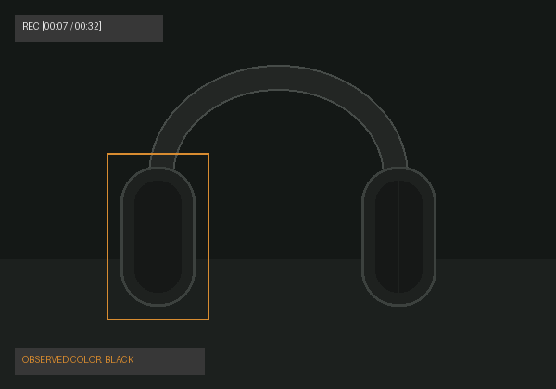
PRODUCT DEMONSTRATION · VISUAL EVIDENCE BENCHMARK
A color mismatch needs seller review
When video evidence contradicts store truth, ReturnLens surfaces the discrepancy without auto-denying.
STORE API RECORD [ORDER TRUTH]
VIDEO EVIDENCE [STAGED FRAME 00:07]
POLICY P-03: FAIL (MISMATCH)
STATUS: NEEDS SELLER REVIEW
No automatic denial. No return label or refund draft issued at this stage.
Seller Resolution Options:
1. Review possible warehouse mis-shipment
2. Request outside-box shipping label photo
3. Hold for physical inspection upon return
Illustrative prototype · Staged mock evidence
SKU: HEAD-WHT-02
Product: Wireless Headset
Ordered Color: White
Price: ₹1,499 · Delivered 4d ago
Customer: Rohit K. · In 7-day window
Observed color: Black
SKU: Not verified (unreadable)
Tag: Tag not visible in this frame
Discrepancy: Color divergence detected
Illustrative Prototype · Staged Mock Evidence · No Real Customer PII · Slide 3 / 6

Slide 4
WORKFLOW & DECISION AUTHORITY · DETERMINISTIC ARCHITECTURE
Evidence checks and seller approval
A deterministic pipeline where models observe, code verifies, and the seller authorizes.
01 · INGEST
Receive & Retrieve
Buyer video via mock chat; queries order & courier APIs.
02 · OBSERVE
Model Observation
Models inspect frames; output structured observations.
03 · CHECK
Policy Engine (Code)
Pure code checks 7d window, delivery date, SKU match, refund cap.
04 · VERIFY
Independent Critic
Audits cited frames to confirm observations are supported.
05 · AUTHORIZE
Seller Gate
Seller 1-click approval permits mock label & refund draft.
UNCLEAR EVIDENCE
Asks for specific photo (e.g. tag/serial) and resumes the exact same case.
MISMATCH / CONTRADICTION
Escalates directly to seller review with proof pack; never auto-denies.
ALL POLICY CHECKS PASS
Prepares 1-click approval package for seller; draft in pending_return_receipt.
AUTHORITY MODEL: Server-enforced limits · Models observe; pure code evaluates policy · Seller approval required for all actions
ReturnLens · System Architecture & Decision Flow · Slide 4 / 6

Slide 5
DEMO SCENARIOS · BENCHMARK MATRIX
Four return scenarios
Expected prototype behavior across diverse real-world return situations.
Scenario | Case Identifier | Evidence Situation | Expected Prototype Behavior
Ready | Case A · ORD-1042 ₹1,499 | Seam tear verified at 00:14; inside 7-day window; brand tag matches. | Prepare for seller approval → Generates mock label & refund draft in pending_return_receipt.
Mismatch | Case B · ORD-8492 ₹1,499 | White ordered vs Black observed in frame 00:07; tag missing. | Needs seller review → Flagged with proof pack for manual decision; no auto-denial, no label created.
Unclear | Case C · ORD-5120 ₹850 | 4-second dark video (brightness 28); only 2 usable frames. | Request specific evidence → Prompts buyer for well-lit tag photo; preserves active case session.
Context | Case D · ORD-3391 ₹2,199 | Continuous take tracking parcel from sealed label to unboxing. | Check sequence continuity → Verifies chronological context; asks for missing angles if needed.
Consistent Demo Benchmark Suite · 4 Scenarios · Slide 5 / 6

Slide 6
DELIVERY PLAN · TEAM ROOKIE
A focused 24-hour prototype
Realistic scope and role allocation for a 3-person sprint during the hackathon.
24-HOUR SPRINT TIMELINE
00h – 06h: Mock APIs & Core Flow
FastAPI mock store and shipping services, SQLite seed data, core StateGraph.
06h – 12h: Evidence Pipeline & Policy Checks
ffmpeg CPU frame extraction (~1 fps), multimodal prompt grounding, deterministic code policy rules.
12h – 18h: Integration & 4 Demo Scenarios
End-to-end testing across Cases A, B, C, D; critic checks; fallback error handling.
18h – 24h: Demo Polish & Packaging
Seller review console polish, 3-minute video walk-through, GitHub README, submission package.
TEAM ROLES (3 MEMBERS)
• Person A (Backend & Logic): Agent flow, state graph, deterministic policy engine, critic, audit log.
• Person B (Multimodal & UI): Video pipeline, frame indexer, seller console, evidence pack view.
• Person C (QA & Integration): Integration, mock store data, 4 demo cases, fallback testing, demo video.
STRICT 24-HOUR SCOPE GUARDRAILS:
• Mock services, staged evidence, single seller return workflow, no production payments.
• Deliverable: Checkable, reproducible agent workflows with transparent action trail.
Project-specific logic written inside the 24 hours · Checkable, buildable agent prototype · Slide 6 / 6

