Slide 1
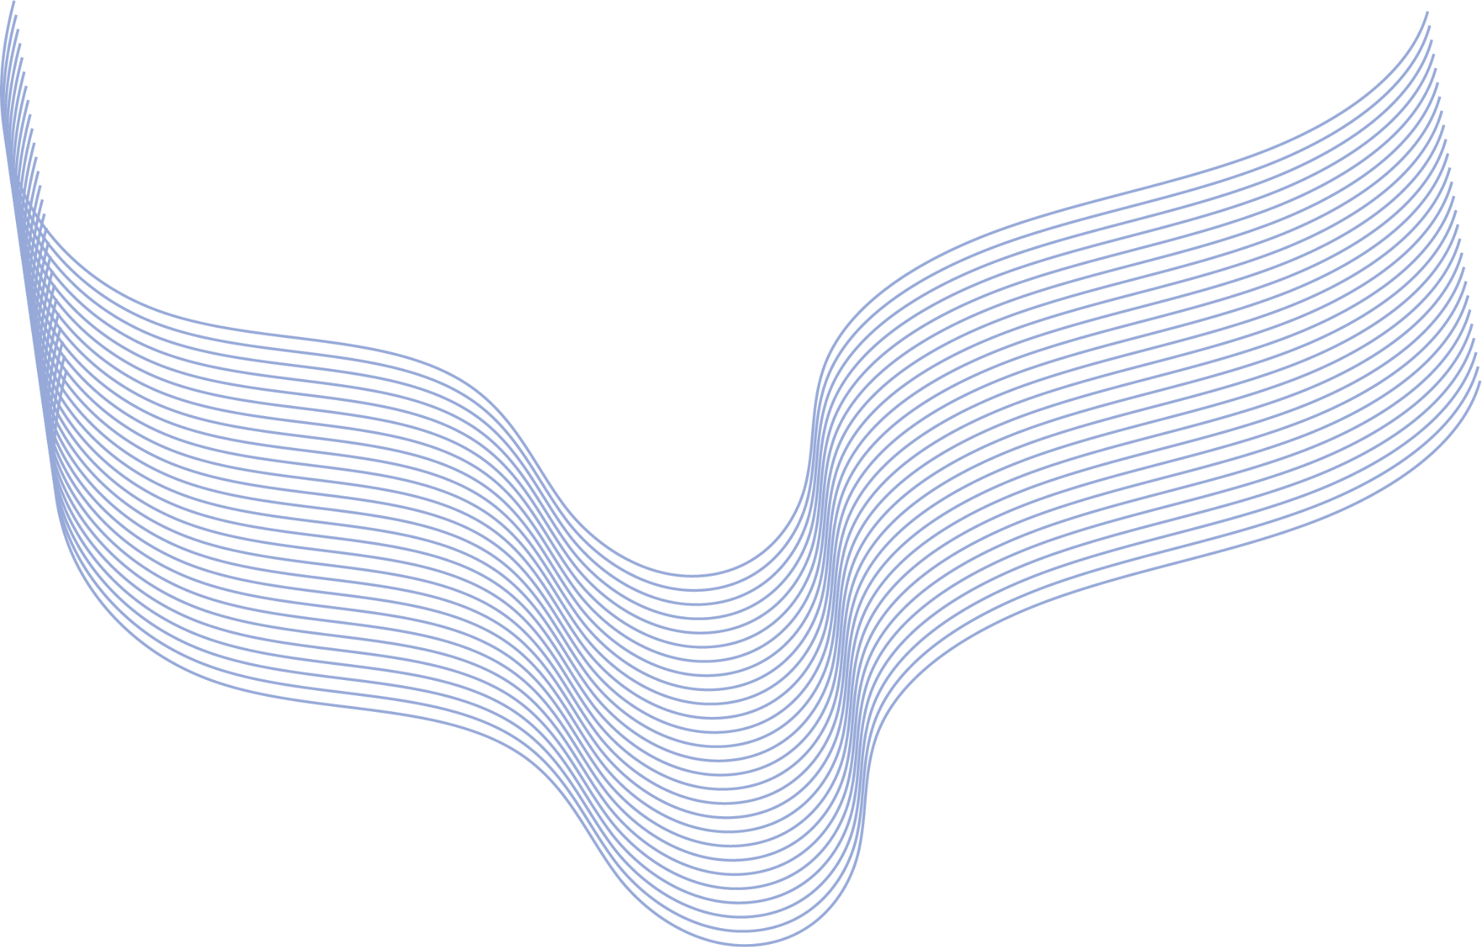
SignLink: Real-Time Sign Language Translation via EMG Processing and Machine Learning
Done by Sombatla Truc Deydeepya
Lakshmi & Satwik Biswas

Slide 2
Table of contents
01
03
02
04
Introduction & Problem Statement
Machine Learning Aspect
Problem Statement, and a Review of Existing Knowledge.
Approached used and what we propose.
Android Application
Hardware Iterations
In an ideal situation, what would exist – a Demo.
Iterative approaches used to collect sEMG signals.

Slide 3
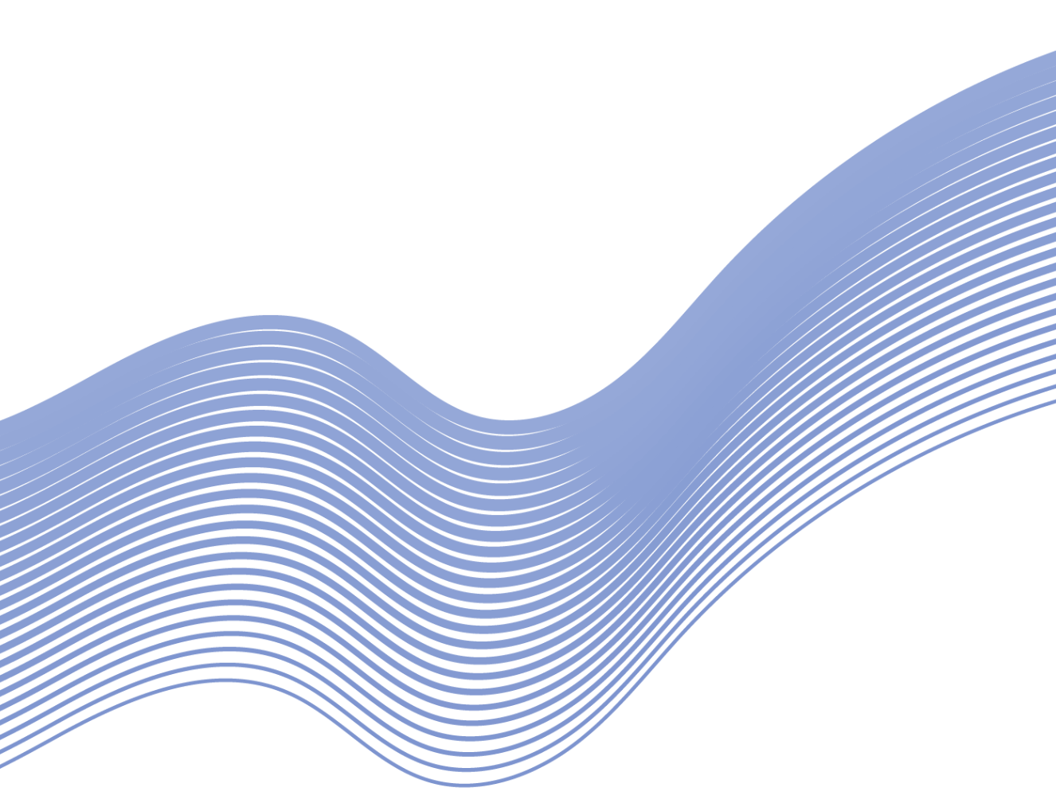
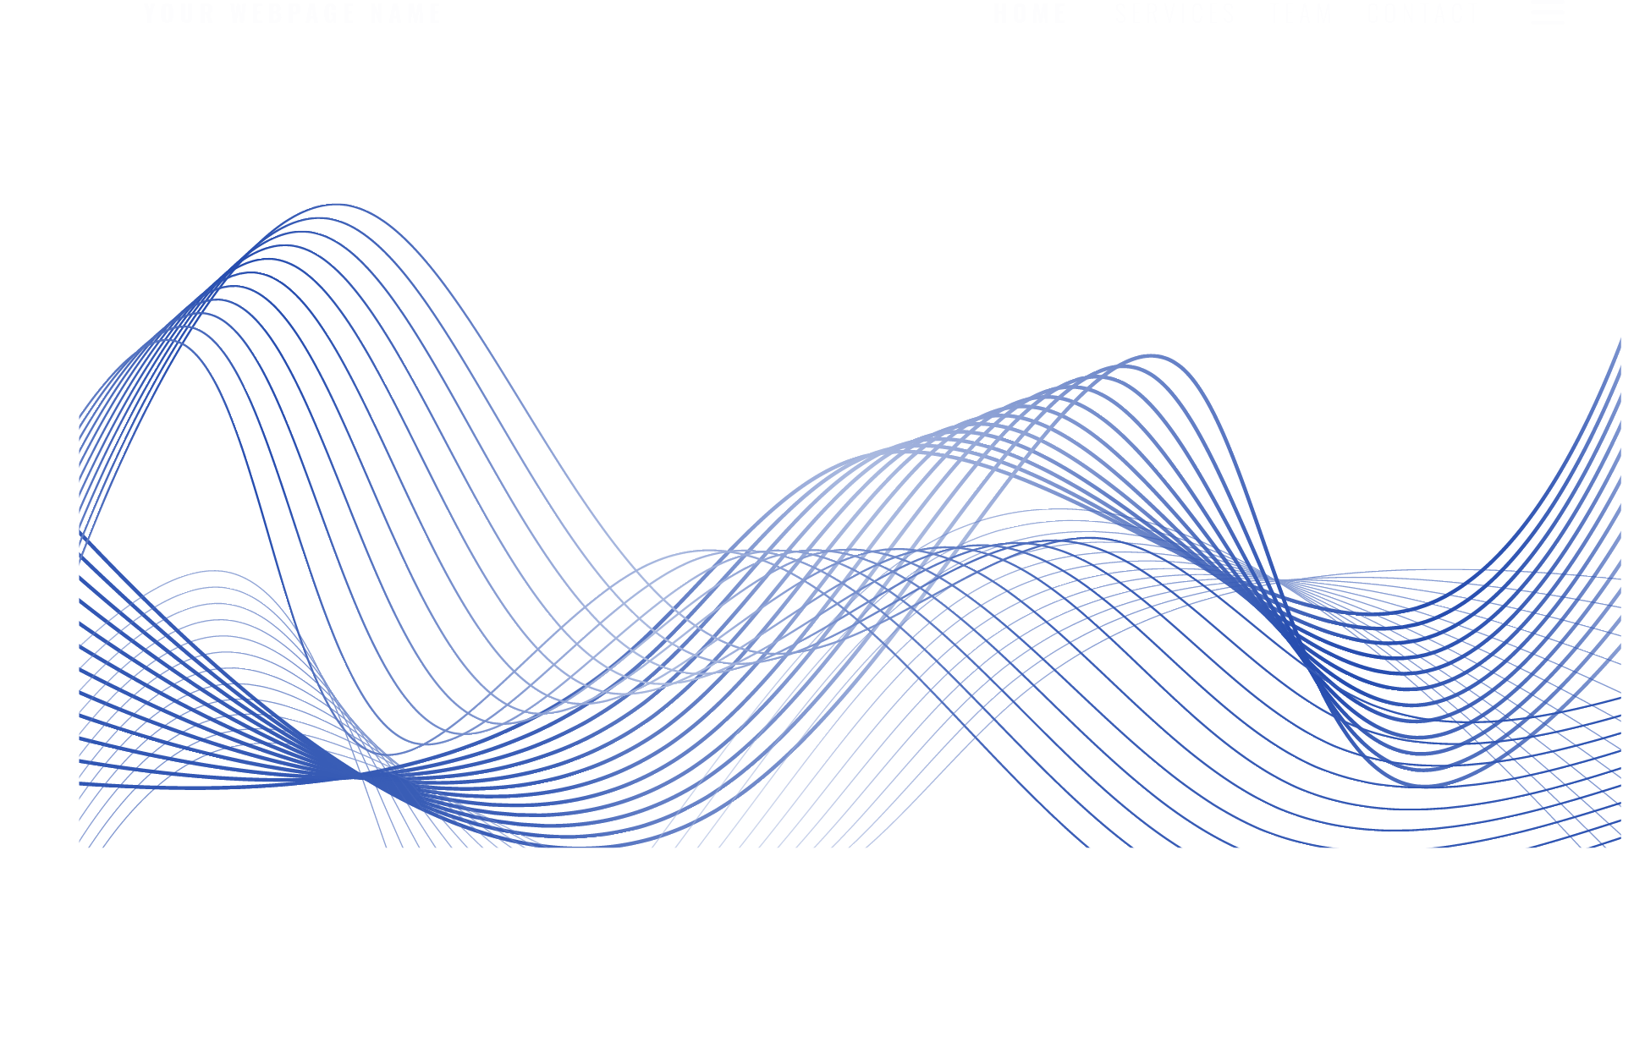
Introduction & Problem Statement
01
Problem Statement, Aim, Significance and a Review of Existing Knowledge

Slide 4
Problem Statement
Communication is a basic human right that is crucial for social inclusion.
Over 1.5B
experience hearing loss globally.
With over 430 Million people
requiring rehabilitation (WHO, 2026).
In this regard, the United Nations Convention
on the Rights of Persons with Disabilities
acknowledges sign languages as valid forms of communication and highlights the importance of accessible communication (United Nations, 2006).
Despite the progress in technology, significant obstacles remain between sign language users and individuals who do not understand sign language.
To address this communication divide, automated sign language translation has become an important area of research, utilizing recent advancements in artificial intelligence, wearable sensing, and mobile computing to transform gestures into real-time text and speech outputs.

Slide 5
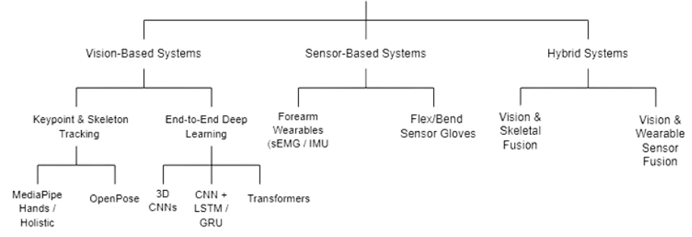
Pre-existing Approaches

Slide 6
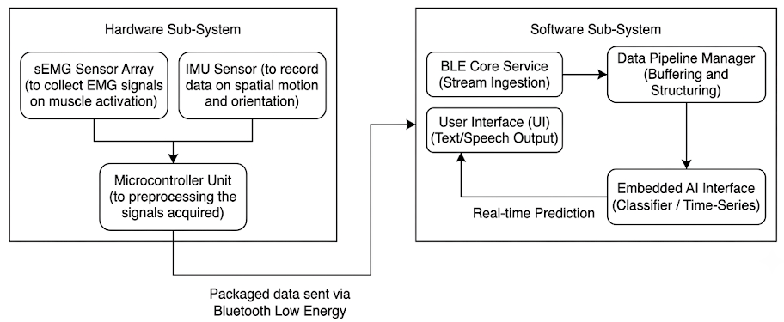
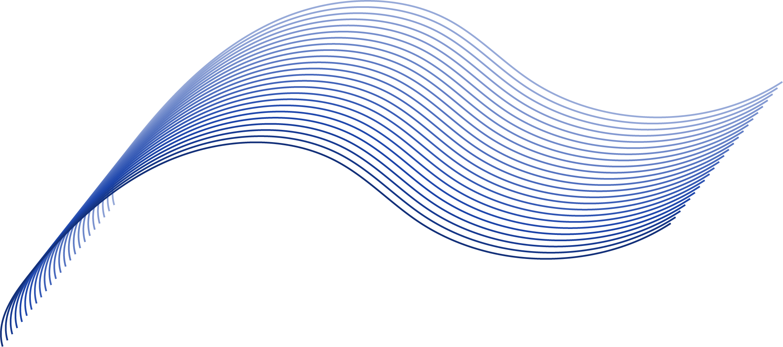
Proposed Framework

Slide 7
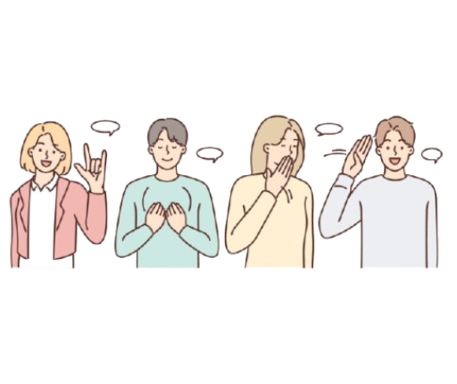
Aim
To design, develop, and evaluate an:
Intelligent,
Environment-immune,
User-Friendly and
Efficient
sign language translation framework that bridges the communication gap between signers and non-signers.
Significance
It also aligns with the United Nations Sustainable Development Goal 10 (Reduced Inequalities) by supporting accessibility and technological inclusion (United Nations, 2015).

Slide 8
Mobile Application – Android
02
Ideally, the app should work for all types of OS but for this demo, you will be seeing the app on an Android device.

Slide 9
How the app works
01
02
Welcome screen, then choose a profile: Deaf, mute, hearing or learner
Pair the wearable over Bluetooth Low Energy (simulated in this demo)
05
04
03
Translation, speech-to-text, text-to-speech, chat history, settings
Home hub links to every feature
Calibration wizard: rest, fist, open palm, point, wave

Slide 10
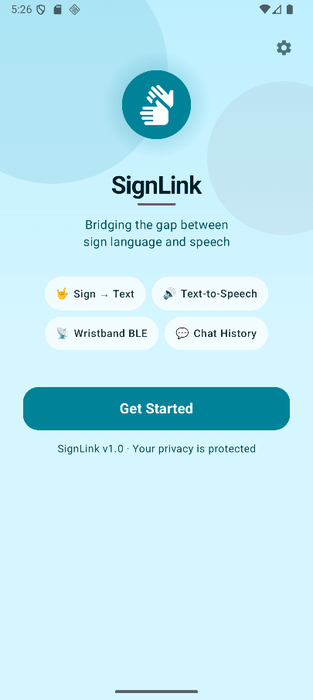
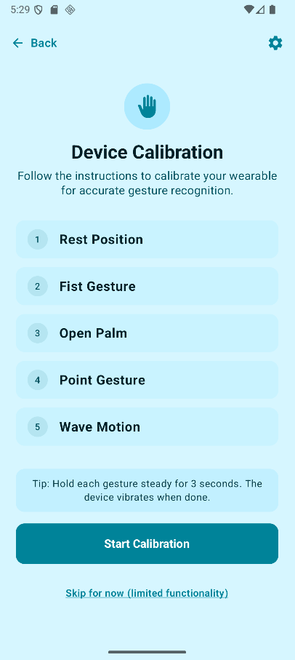
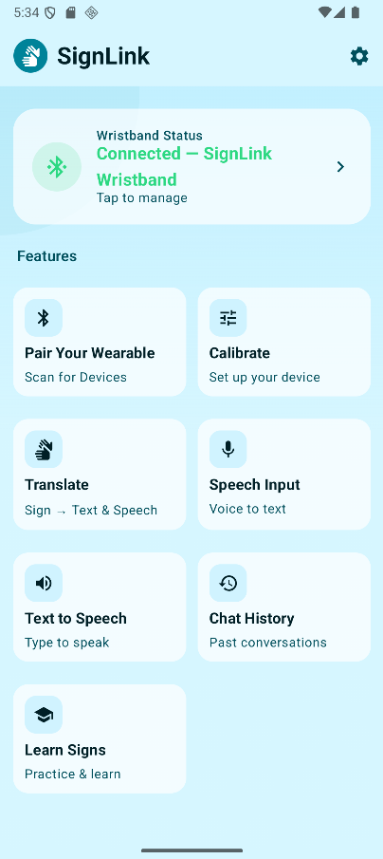
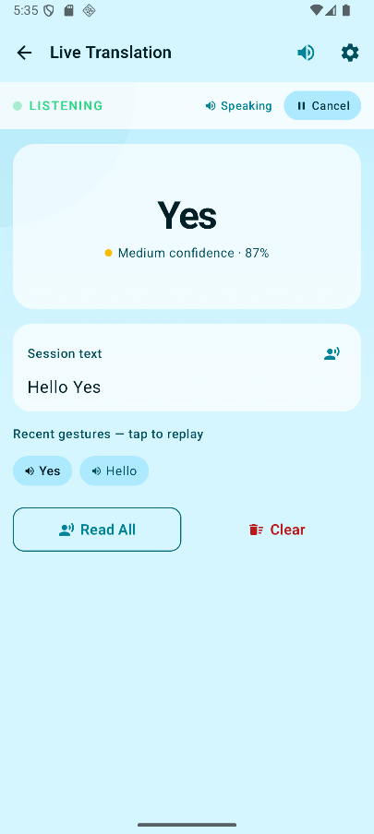
Inside the app (one set)
Welcome
Calibration
Home hub
Live translation

Slide 11
Usability testing
Phase 1: Figma prototype
Final: Kotlin app
SUS 89.0 (Grade A), 5 participants. One user could not find the pairing button, which led to clearer Bluetooth cues.
SUS 96.8 (Grade A+), 15 participants: 9 on-site and 6 remote.
Preliminary results: small sample, tested without the wearable connected.

Slide 12
Machine Learning Aspect
03
Models used and the results yielded from it.

Slide 13
From signals to features
Dataset
Cleaning
9 users, 26 ASL letters, 8 EMG and IMU channels*
Range and null checks, EMG zeroed to rest
Features
Models
5 statistics, 17 channels, 5 segments: 510
Feature selection, then Random Forest and Extra Trees
*with temporal information thus giving 900+features
Notes:
Sources: honours project section 3.4 and the AMI submission section 3.1. The AMI paper adds domain features (RMS, MAV, waveform length, zero crossings, slope sign changes, Willison amplitude) for up to 914 features. The code build of that CSV has 924 columns, so check that count before quoting it.

Slide 14
Accuracy by model
75.0%
84.7%
92.8%
Random Forest
Tuned Forest
Extra Trees
Baseline: 510 features, 80:20 split
Mean of 17 random splits (+/- 2.8)
315 features, best split
All nine users appear in both train and test sets. The Extra Trees figure is the best split, not an average.
Notes:
Random Forest numbers: honours project sections 3.4.4 and 4.2 (75.0% baseline, 84.67% +/- 2.80% over 17 random states). Extra Trees: AMI submission, 92.8% at 315 features. These are seen-user results (every user is in train and test). Re-running with feature selection inside the cross-validation folds and several seeds gave roughly 86 to 91 percent for the pooled setup, so treat 92.8% as a best case.

Slide 15
20-25%
Accuracy on a user the model has never seen, so SignLink calibrates to each user
Notes:
Source: honours project section 3.4.5 and AMI submission section 3.1 (leave-one-group-out). EMG differs between people (muscle mass, skin, armband placement), so the app has a calibration phase.

Slide 16
How calibration works
1. Calibrate
2. Train
New user signs each letter 3 times: 78 recordings
Personal Extra Trees model, fitted on those only
3. Test
4. Repeat
Scored on their remaining, unseen recordings
9 users x 5 random draws; mean and spread reported
Notes:
How calibration works. k is the number of recordings per letter the new user provides: k=3 means each letter signed three times, 78 recordings in all. A personal Extra Trees model is fitted on those recordings only, then scored on that user's remaining recordings, which were never used for training. Repeated for every user with 5 random draws of which recordings are calibration. Settings were fixed in advance and nothing was tuned on the test recordings. Caveat: the hyperparameters came from the earlier pooled experiments, so a small optimism remains.

Slide 17
Accuracy by calibration level
77.3%
90.3%
93.0%
k = 1
k = 2
k = 3
1 per letter: 26 recordings
2 per letter: 52 recordings
3 per letter: 78 recordings
Mean of 9 users x 5 random draws; spread across users 7.9, 5.8, 3.9 points. At 4 per letter: 94.2%. Pooled model for reference: 86-91% on a stricter re-check.
Notes:
Results, mean across the 9 users and 5 random draws each (924 features, 500 trees).
k=1: 77.3% (spread across users 7.9 points, 95% CI 72.3 to 81.8), about 105 test recordings per user.
k=2: 90.3% (5.8, CI 86.2 to 93.2), about 79 test recordings.
k=3: 93.0% (3.9, CI 90.2 to 95.0), about 53 test recordings.
k=4: 94.2% (3.4, CI 91.9 to 96.2), about 28 test recordings, so noisier.
Pooled model for reference: 86 to 91% when feature selection is moved inside the folds and several seeds are used; 92.8% was the best single split. Different protocols, so treat this as indicative, not a head-to-head.
If asked about DyFAV: it reports 95.36% training on 5 recordings per letter per user. Our k=4 result of 94.2% is comparable, not better, and their cross-validation scheme is not specified in the paper.

Slide 18
Why calibration performs better
Personal fit
Simpler task
Learns one person's signals, not nine
26 letters in one signal style, not nine at once
Far less data
Realistic test
78 recordings, not about 940 in the pooled split
Scored on unseen recordings of the same user
Notes:
Why calibration performs better. The honest summary: the pooled model was a good first benchmark; the personal model reaches the same range with a fraction of the data. At k=2 it is already about 90% from 52 recordings (the pooled split trained on about 940), and at k=3 it is 93%.
Likely reasons: EMG differs between people (muscle mass, skin, armband placement), so a model for one wearer has one signal style to learn instead of nine. It also needs far less data, and it is scored on recordings of the same user it never saw.
Caveat if challenged: the first two reasons are explanations supported by a quick check (adding the other 8 users to the calibration data did not beat training on the user alone at k=2 and 3), not a proven mechanism.
Still true: a brand-new user with no calibration gets about 20 to 25%, which is why the app has a calibration step.
Exploratory only, not on the slides: Riemannian covariance-distance features added about 1 point at k=2 and 3. Training time and model size on a PC still need to be measured on our own machine (benchmark_timing.py).

Slide 19
EMG-Acquiring Hardware Iterations
04
Iterative approaches used to collect sEMG signals for training and testing.

Slide 20
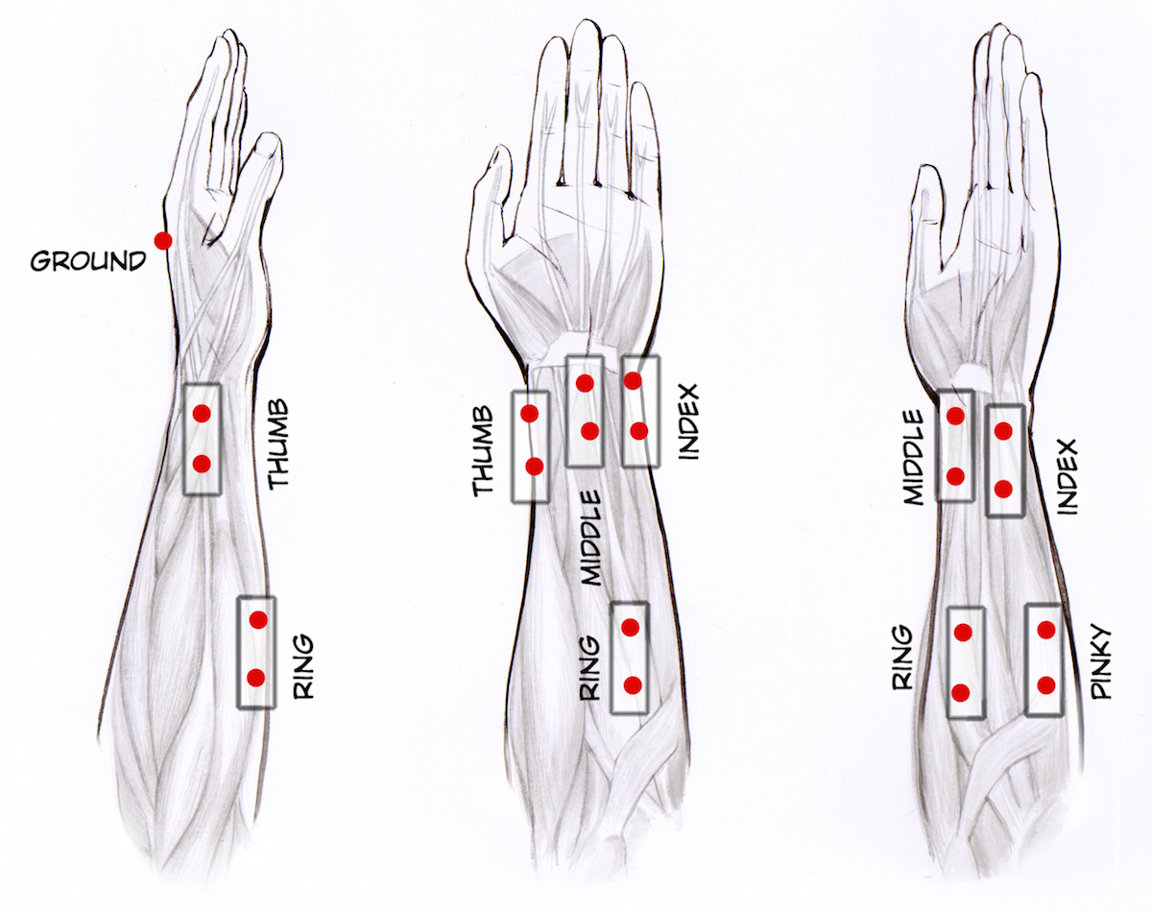
Placement Points

Slide 21
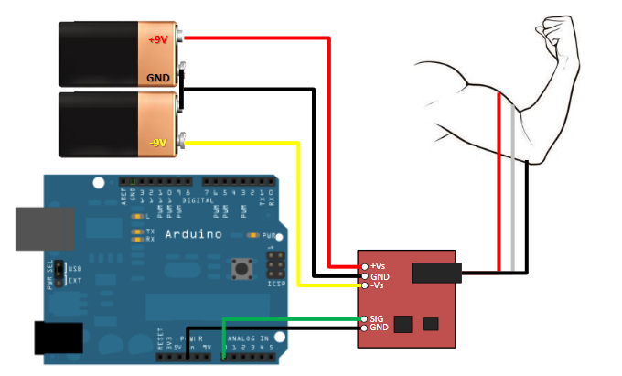
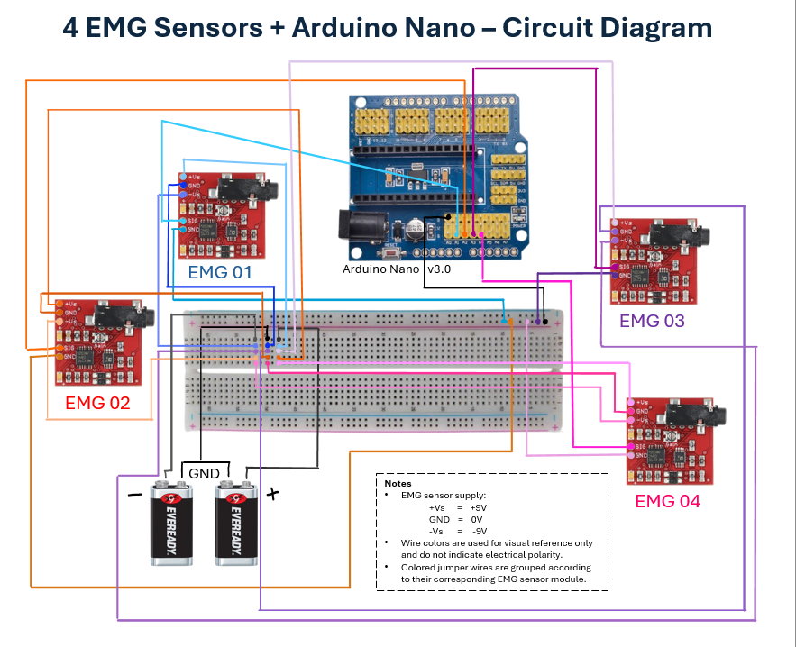
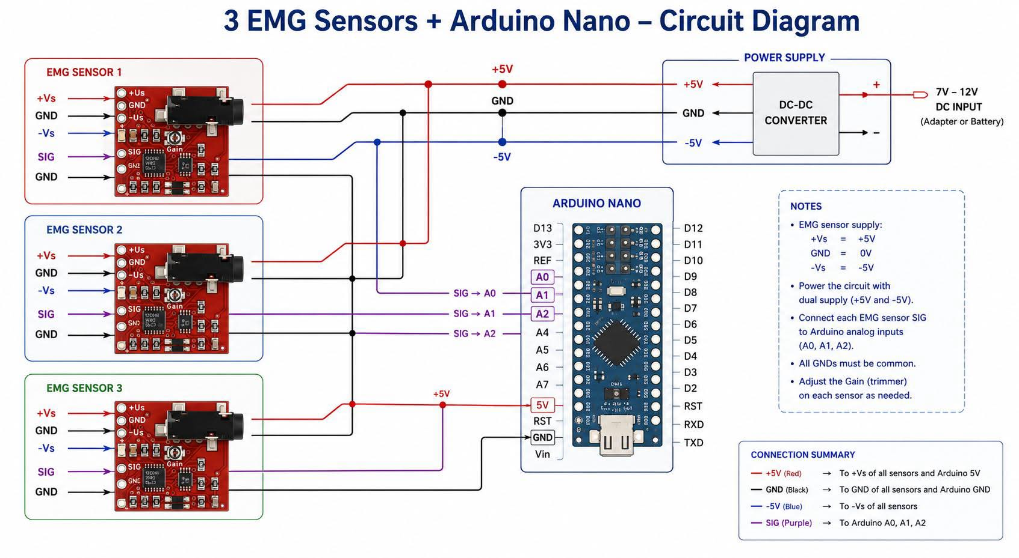
Three hardware iterations
V1: one sensor
V2: 4 sensors
V3: latest build
1 EMG sensor and Arduino Uno. Tested signals and placement, but one channel is too few.
Arduino Nano V3 with 4 sensors. Loose jumper wires gave unstable signals, so joints were soldered.
Four-sensor design with 3 in use for circuit stability. Still under testing.

Slide 22
Three hardware iterations
V1: one sensor
1 EMG sensor and Arduino Uno. Tested signals and placement, but one channel is too few.

Slide 23
Three hardware iterations
V2: 4 sensors
Arduino Nano V3 with 4 sensors. Loose jumper wires gave unstable signals, so joints were soldered.

Slide 24
Three hardware iterations
V3: latest build
Four-sensor design with 3 in use for circuit stability. Still under testing.

Slide 25
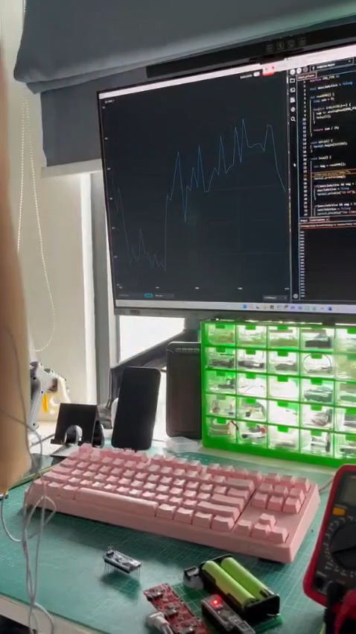
V3: latest build (but testing with one EMG for more clarity)

Slide 26

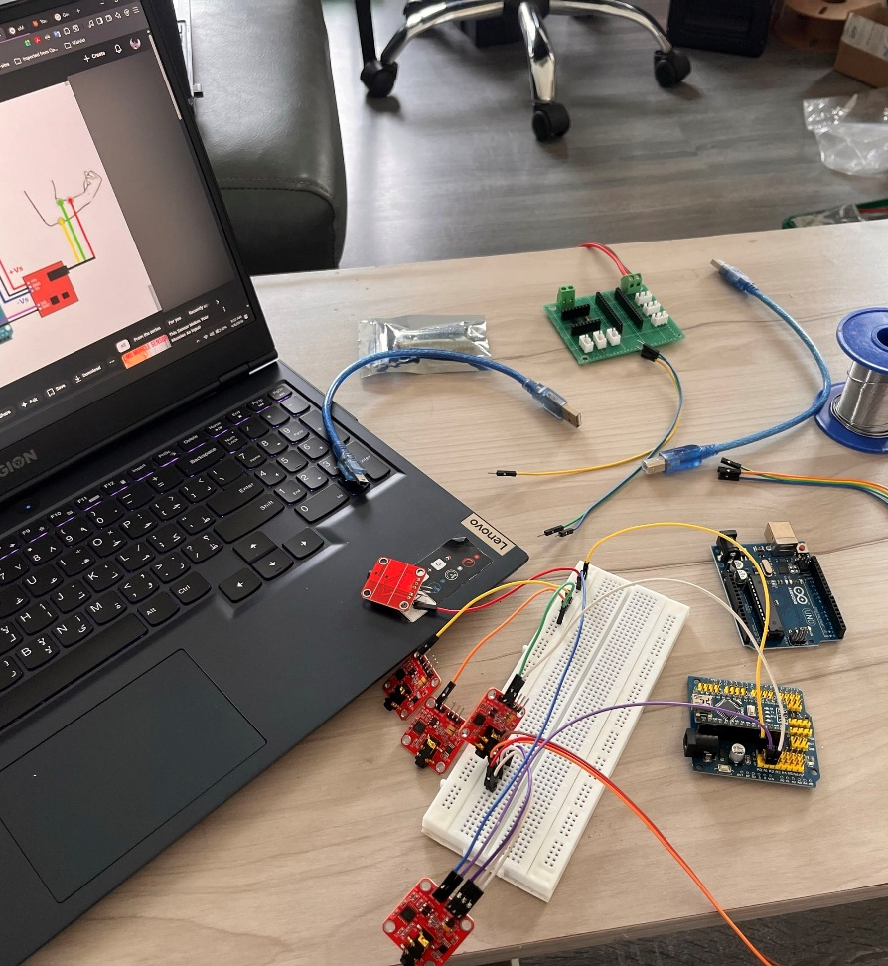
Why a public dataset?
Signal noise, electrode placement and no large labelled dataset stopped us training on our own hardware, so the ASU Myo dataset was used. The hardware stays a proof of concept for real-time integration.

Slide 27
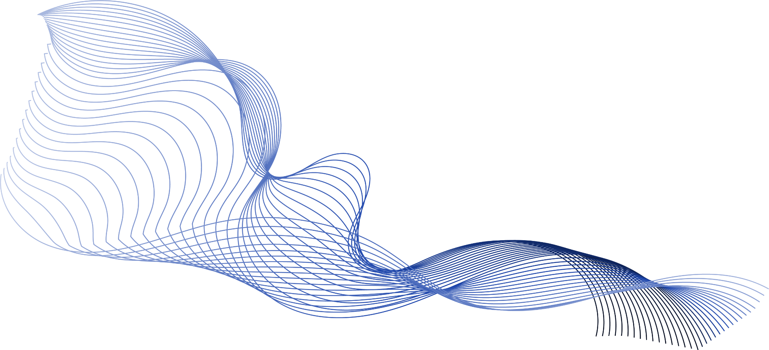
Conclusion
What we have, and what comes next:
EMG with machine learning can recognise fingerspelling on public Myo data, reaching about 93% with per-user calibration
The app is built and tested; wearable, model and app are not yet connected
Next: our own EMG dataset, a wireless real-time link, words and phrases

Slide 28
Thanks!
Do you have any questions?
github.com/lenarae/SignLink

