Slide 1

Instacart's Growth And It’s Role In The Labor Market
Lena Viazmitinov

Slide 3
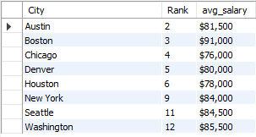
Instacart’s Most Popular cities

Slide 4
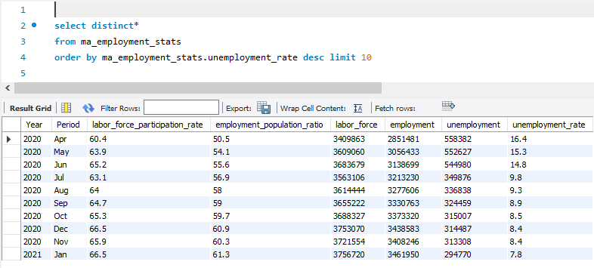
Massachusetts Unemployment Rates
2011 – 2021

Slide 5
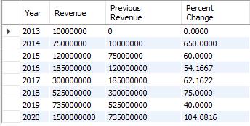
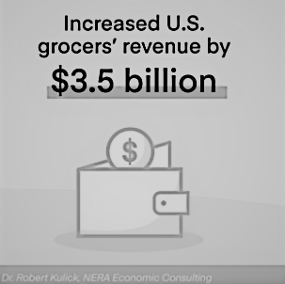

Instacart’s Yearly Revenue

Slide 6
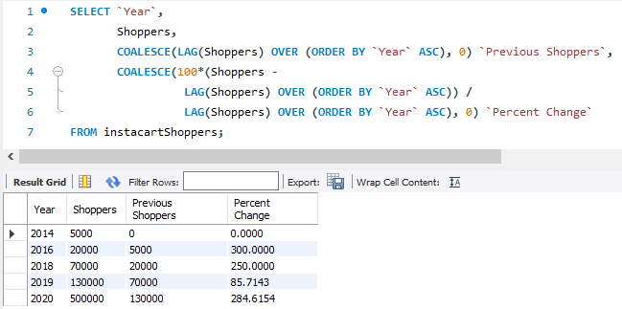
Instacart’s Labor Growth

