Slide 1




Analyzing Covid-19’s Effect On The Labor Market
Lena Viazmitinov

Slide 2
My Goals For This Project
Use MySQL to comprise different datasets to form a database and answer questions about the current labor market.
Use Node.js, Canvas.js, and Visual Studio Code with my database to generate figures with HTML files to display in the browser.
Write MySQL queries that highlight key points in the datasets.
Begin to understand the success behind service apps (Instacart, UberEats, DoorDash, etc) and make predictions about the future.

Slide 3
The Rise Of Service App Employment
Instacart is a grocery delivery app where users can order their groceries from any supported market.
What role do these industries have in the labor market?
How has Instacart performed during the pandemic compared to other industries as a whole?
Examine unemployment rates and labor turnover perform my own analysis.
Notes:
Through the past year and a half, I have worked through the pandemic as a cashier at Wegmans in Northborough. On an average day, atleast half of my customers in an 8 hour shift were working for instacart. Simultaneously, we were experiencing huge shortages. I would ask these instacart workers about their experiences working through the app and they all reported positives, and it got me thinking about the shift we are experiencing in today’s labor market. I had seen this with my own eyes, however I wanted to see the data for myself and perform my own analysis.

Slide 4
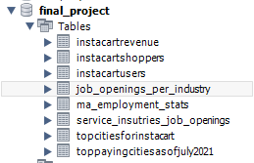
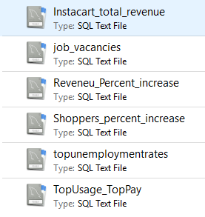
Datasets used
Database consist of .csv files
Main datasets I was searching for:
Massachusetts unemployment rates
Labor turnover by industry
Instacart’s revenue per year
Instacart employment statistics
The effect Covid-19 had on US employment by state/region in the US

Slide 5
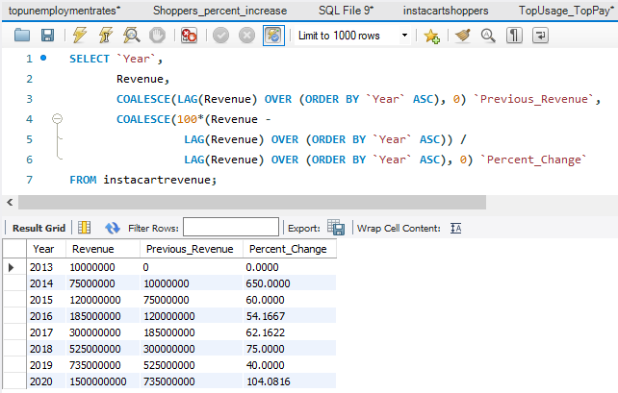

Instacart Revenue From 2013 - 2020
Data from
the .csv file,
MySQL script generated two additional columns
$3,450,000,000

Slide 6
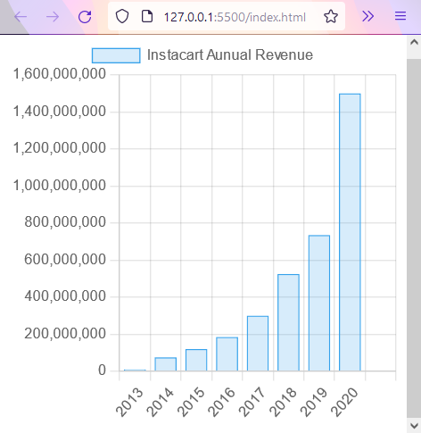
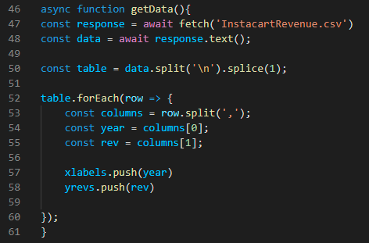
Data Modeling in JavaScript

Slide 7
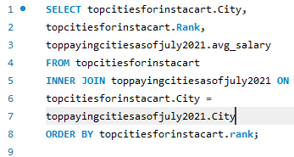
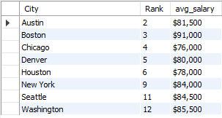
Top Cities For Instacart Use
Intersection between the top 12 cities for instacart and top paying US cities
What information does this tell us?

Slide 8
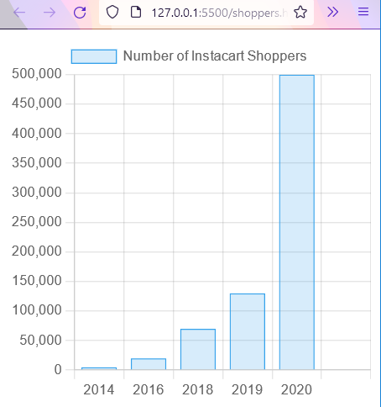
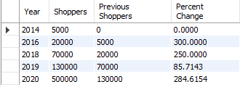
Instacart’s Employment Growth
MySQL Query describing Instacart’s employment growth
MySQL data graphed in Javascript
Instacart found their highest growth of Employees and Revenue during the Covid-19 Pandemic of 2020

Slide 9
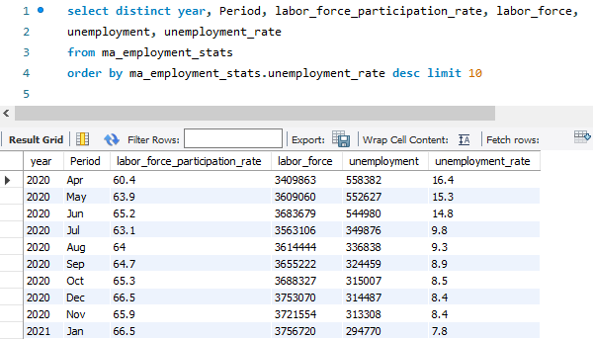
Massachusetts Unemployment Rates
Notes:
A couple reason I decided to focus on Massachusetts unemployment rates is it’s simpler for the time being so I can get this project started, and Boston MA has the third highest Instacart usage. We all know that covid was the reason for record high unemployment rates, we can see this in the MySQL query

Slide 10
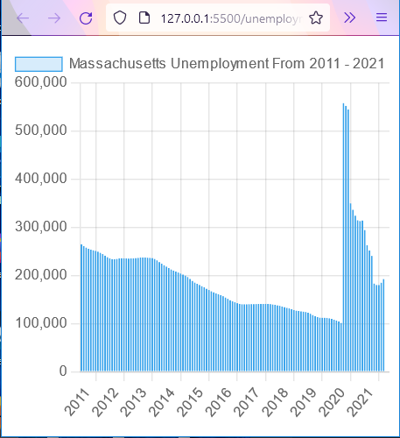
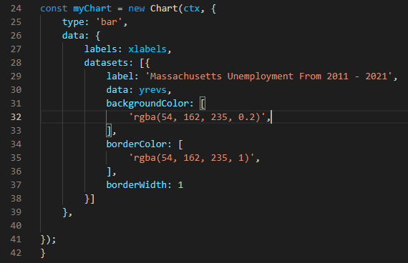
Data Modeling in JavaScript

Slide 11
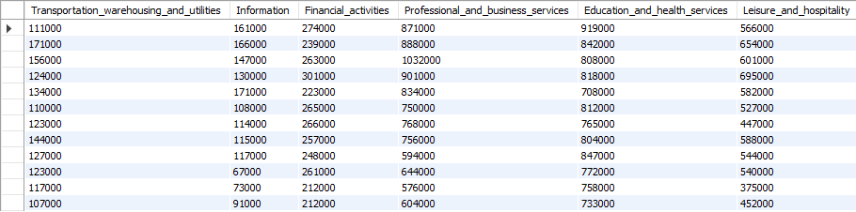
Job Vacancies By Industry Breakdown
Dataset of 14 different industries in the US
Breakdown of job vacancies in each industry from 2000 - 2021

Slide 12
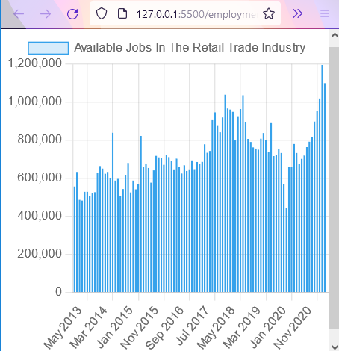
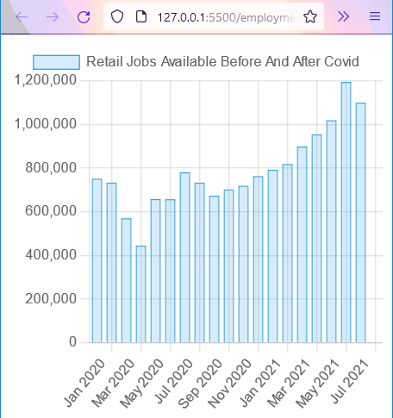
Retail Trade
Available Jobs in the Retail Trade Industry over all vs a closer look at the Covid impact
*Covid-19

Slide 13
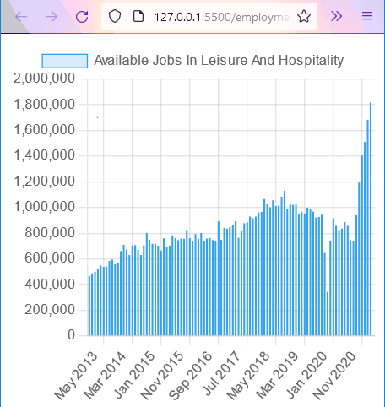
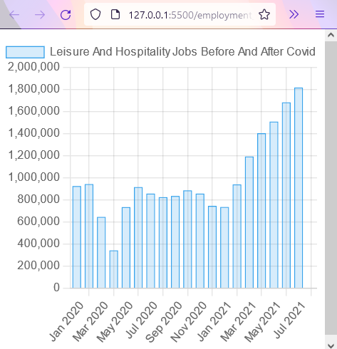
Leisure And Hospitality
Available Jobs in the Leisure and Hospitality Industry over all vs a closer look at the Covid impact
*Covid-19

Slide 14
Data Analysis Summary
Massachusetts had a record high unemployment rate of 16.4% in April 2020.
As of July 2021 there were 1,819,000 vacancies in the Leisure and Hospitality Industry and 1,195,000 vacancies in the Retail Trade Industry.
Instacart had a 104% revenue increase and 285% workforce increase during 2020, with 75% of it’s business occurring in cities with an average income of at least $76,000.
The service industry labor market currently is still experience a severe shortage of workers
Benefits of flexible hours, no supervisors or co-workers, and no required location has drawn many service workers to switch over to companies such as Instacart and I believe they will continue to grow after Covid-19

Slide 15
Moving Forward
I want to gather more updated data by the end of 2021 and update my database to see any changes.
Host a website using LAMP Stack (Linux, Apache, MySQL, PHP) to create a dynamic front end for my database and display my analysis and figures that I could update.
Things I Would Have Done Differently
Gathered additional datasets for companies with similar business models (UberEats, Uber, DoorDash) to see if they had the same growth as Instacart did.
Created an Index.html file that generated all my figures on one screen with a basic layout.

Slide 16
Sources
https://www.bls.gov/news.release/jolts.t04.htm
https://therideshareguy.com/instacart-statistics/
https://www.nera.com/content/dam/nera/publications/2021/NERA_Instacart_White_Paper_Final_September_2021.pdf
https://www.stats.govt.nz/large-datasets/csv-files-for-download/
https://www.bls.gov/news.release/jolts.t02.htm
https://www.bls.gov/news.release/pdf/jolts.pdf

