Slide 1
POD NOVA • AUGUST COHORT • BUSINESS ANALYSIS
Checkpoint
Who decides what, and when?
Redesigning the discharge and follow-up workflow at Lakeside Health Network so humans and AI each own the decisions they're best placed to make.
TEAM
• Helena Delali Vormawor
• Phionah Atukunda, MPH, CHES®
• Angela Eze
• Olushola Omotosho
Focus Area 2: AI and the Future of Work

Slide 2
THE BUSINESS PROBLEM
Two hospitals merged. One AI tool. No decision owner.
Lakeside Health Network wants AI to predict which patients will be readmitted within 30 days of discharge, so nurses can prioritise follow-up. The technology is the easy part — the hard part is deciding who owns each decision once AI is in the loop.
1
2
3
Two systems, two processes
Duplicate patient identities
No one owns the decision
Lakeside General and Riverside Specialist ran independent discharge workflows before the merger.
The same patient can exist under two different IDs, one at each hospital.
Nobody has defined which AI decisions can be automated and which need a human.
Checkpoint • Pod Nova • 10Alytics Students Hackathon 2026
2 / 14

Slide 3
OUR SOLUTION & METHODOLOGY
AI narrows the decision. A named human owns it.
Checkpoint scores and tiers patients at discharge, then routes every tier through a named human checkpoint before it reaches a patient.
1
2
3
4
Stakeholder analysis
Process mapping
Decision-rights design
Requirements & validation
Mapped everyone affected; one accountable owner per decision (RACI)
AS-IS discharge workflow at both hospitals → TO-BE workflow with AI
Every decision classified: automated, AI-recommends, or human-only
BRD, use cases, traceability, and a shadow pilot before go-live
Three jobs are redesigned around this principle: follow-up nurse, Health Records steward, ward staff.
Checkpoint • Pod Nova • 10Alytics Students Hackathon 2026
3 / 14

Slide 4
HOW IT WORKS
AI scores and sorts. Humans decide.
Discharge
ordered
Match patient
identity
AI generates
risk score
Nurse approves
or overrides
Tailored
follow-up
Four mandatory human checkpoints
HC1
HC2
HC3
HC4
Confirm uncertain identity match
Manually assess low-confidence cases
Approve or override every tier
Monthly governance review of overrides
Checkpoint • Pod Nova • 10Alytics Students Hackathon 2026
4 / 14

Slide 5
GOVERNANCE MODEL
Which decisions AI makes alone — and which need a person
A
Automate
B
AI recommends, human approves
C
Human decides
Rule-based, reversible, no direct care impact
A named person must confirm first
AI may inform, never choose
Decision | Level | Accountable role
Link records on an exact multi-identifier match | A | Health Records
Assign tier when data is complete and confident | B | Follow-up nurse
Assign tier when confidence is low | C | Follow-up nurse
Change thresholds or release a new model version | C | Governance committee
Full ten-decision table is in the business case document, Section 5.
Checkpoint • Pod Nova • 10Alytics Students Hackathon 2026
5 / 14

Slide 6
OPTIONS ANALYSIS
Four options considered — one that fits the brief
Option | Why (or why not) | Chosen
A. Do nothing | High-risk patients keep getting missed; the merger's process gaps persist | No
B. Harmonise process only, no AI | Fixes some data problems, but never targets follow-up effort | No
C. AI-supported, human-in-the-loop | Targets follow-up, keeps accountability with clinicians, builds trust | Yes
D. Full automation | No safeguard against data errors or drift; highest patient-safety risk | No
Why Option C
It's the only option that uses AI to target follow-up and satisfies the brief's requirement for defined human-review points — and its costs are proportionate to the benefit case.
Checkpoint • Pod Nova • 10Alytics Students Hackathon 2026
6 / 14

Slide 7
BUSINESS CASE AT A GLANCE
The case for Checkpoint, in one slide
Dimension | Summary
Problem | Two merged hospitals, inconsistent processes, duplicate patient identities, no decision-rights model for AI
Recommended solution | AI-scored, human-approved discharge follow-up workflow with 4 checkpoints and a 3-level automation policy
Illustrative one-time cost | CAD 1.09 million
Illustrative annual net benefit | CAD 1.18 million per year, after ongoing costs
Illustrative payback | Under 12 months
Primary risk | Automation bias and low nurse trust — mitigated by mandatory review and override rights
Timeframe | 28 weeks to supervised go-live, then phased scale-up
All figures are illustrative order-of-magnitude estimates, to be recalibrated with Lakeside's own data before an investment decision. Full detail in the business case, Sections 1, 7 and 8.
Checkpoint • Pod Nova • 10Alytics Students Hackathon 2026
7 / 14

Slide 8
FINANCIAL SUMMARY
Illustrative benefit outpaces cost from year one
Payback period
~11 to 12 months from go-live
3-year cumulative net benefit
CAD 2,285,000 (illustrative)
Simple 3-year return
~210% on the one-time investment
The readmission-avoidance benefit is the most sensitive assumption, and the first to validate in the shadow pilot.
Checkpoint • Pod Nova • 10Alytics Students Hackathon 2026
8 / 14

Slide 9
KEY RISKS & MITIGATIONS
The risks we designed for, up front
Automation bias
Wrong record merge
Mitigation: Mandatory review (HC3), visible confidence and drivers
Mitigation: Reversible merges, HC1 steward review
Low nurse trust
Uneven model performance
Mitigation: Override rights, plain-language drivers, co-design
Mitigation: Subgroup monitoring, monthly governance review (HC4)
Checkpoint • Pod Nova • 10Alytics Students Hackathon 2026
9 / 14

Slide 10
IMPLEMENTATION ROADMAP
28 weeks to a supervised go-live
0
1
2
3
4
Prepare
Clean up & train
Shadow pilot
Supervised go-live
Scale & embed
Wks 1–4
Wks 5–12
Wks 13–20
Wks 21–28
Wk 29+
Baseline, privacy assessment
Fix duplicates, train staff
Score without acting, validate
One ward per site
Extend network-wide
Shadow pilot (Phase 2) is the key gate: it validates the benefit case before wider investment.
Checkpoint • Pod Nova • 10Alytics Students Hackathon 2026
10 / 14

Slide 11
SUCCESS CRITERIA & KPIS
How we'll know Checkpoint is working
Every measure is SMART — a specific number, a named baseline, a fixed review cycle. Figures are illustrative targets pending the Phase 0 baseline.
Measure | Illustrative target | Review
High-tier patients contacted | ≥90% within 2 working days of discharge | Monthly
30-day readmission, High-tier | ≥15% reduction vs. baseline within 6 months | Quarterly
Override rate vs. AI tier | 10–20% band; any reason code >10% triggers review | Monthly, HC4
Duplicate record rate | From ~8% baseline to <2% within 90 days | Monthly, Phase 1
Nurse trust score | ≥80% rate the tool 4/5 or higher | End of pilot
Subgroup performance gap | ≤5 percentage points across subgroups | Monthly, HC4
Checkpoint • Pod Nova • 10Alytics Students Hackathon 2026
11 / 14

Slide 12
ALIGNMENT TO THE CHALLENGE
Built for Focus Area 2: AI and the Future of Work
“How can organisations redesign jobs and workflows to help humans work effectively alongside AI?”
Follow-up nurse
Health Records team
Ward staff
From building call lists by hand, to reviewing a prioritised worklist and owning the decision
From filing and retrieval, to network patient-identity stewardship
From two discharge standards, to one harmonised process
3
Good Health & Well-Being
10
Reduced Inequalities
17
Partnerships for the Goals
Better-targeted follow-up
One standard of care, both sites
Governed data sharing
Checkpoint • Pod Nova • 10Alytics Students Hackathon 2026
12 / 14

Slide 13
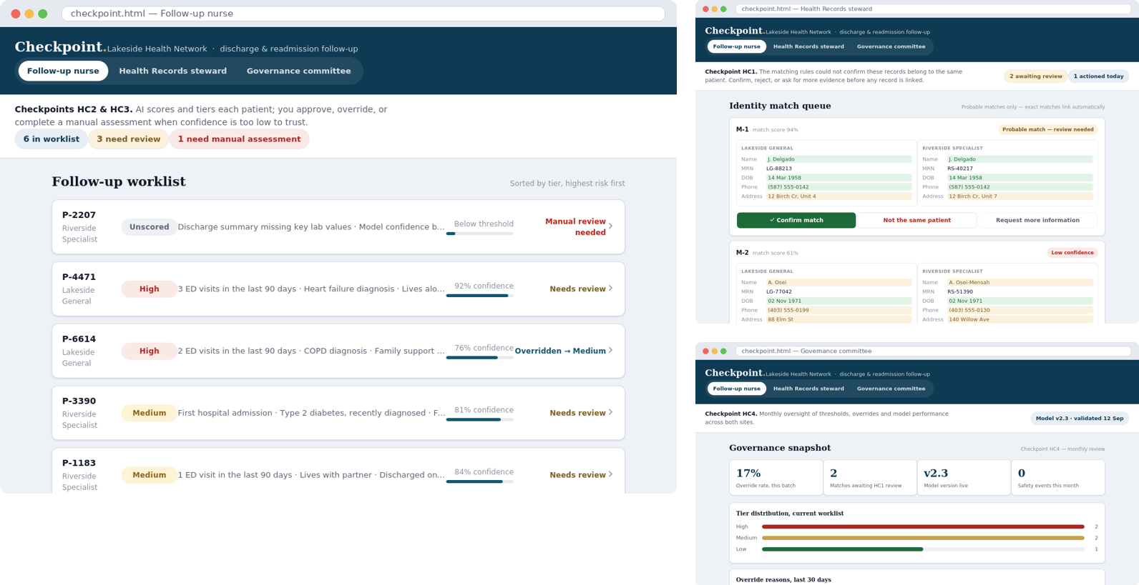
WORKING PROTOTYPE
Checkpoint, built and clickable
Three roles, one tool
Follow-up nurse: approve or override every tier
Health Records: resolve identity matches
Governance: monthly oversight of overrides
Every action logged and reversible
LIVE DEMO
lenavon.github.io/10alytics-
Hackathon---Checkpoint-/
A recorded demo is included with this submission
Checkpoint • Pod Nova • 10Alytics Students Hackathon 2026
13 / 14

Slide 14
RECOMMENDATION & THANK YOU
Proceed with a shadow pilot
Prove the decision model and the benefit case before wider investment.
1
Secure sponsorship
Board of Directors sponsor and a governance committee with clear terms of reference
2
Baseline the numbers
Replace illustrative figures with Lakeside's real duplicate rate, readmissions and follow-up timing
3
Run the shadow pilot
20 weeks to a validated benefit case and a go or no-go decision, before scaling
Thank you. Checkpoint — a human-centred path to AI-supported care at Lakeside Health Network.
Developed with the assistance of Claude (Anthropic) for drafting, diagrams and prototype code. All analysis, requirements decisions and business judgement are the work of the Pod Nova team.

