Slide 1
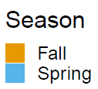
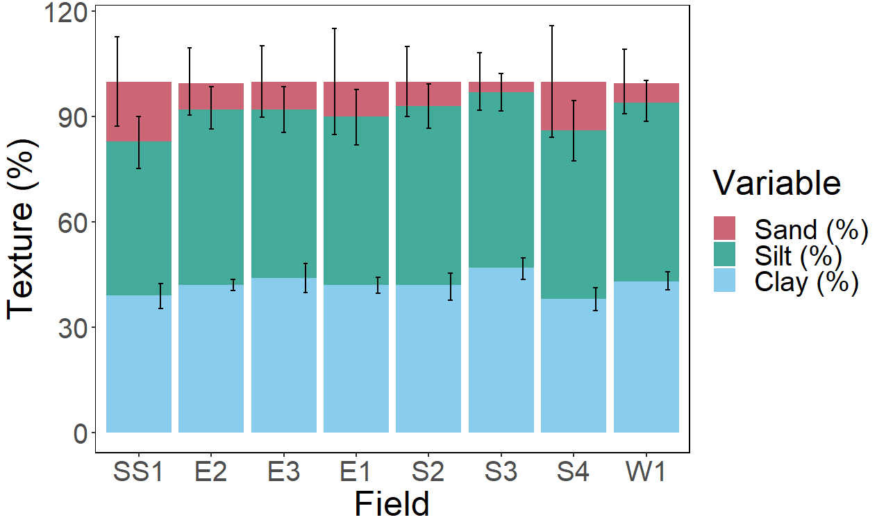
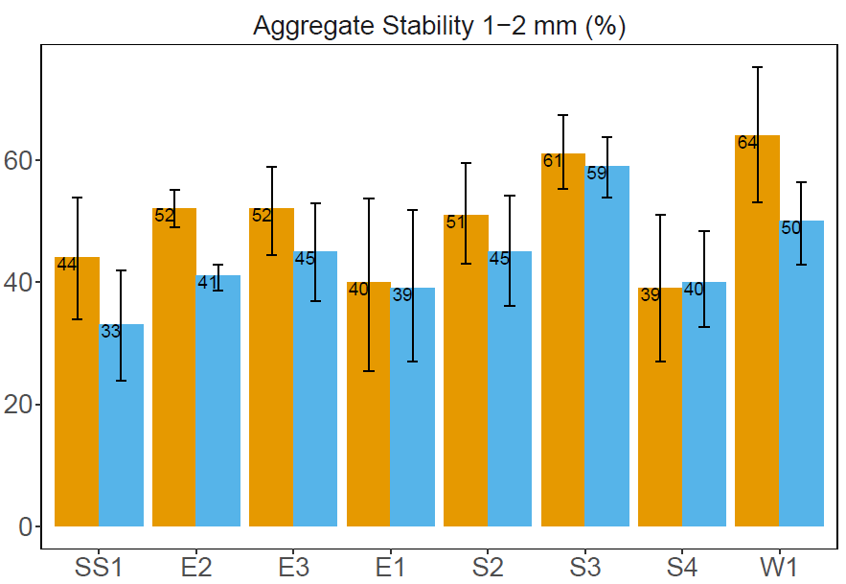
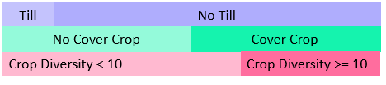
Physical Properties
Texture (%)
Till
No Till
No Cover Crop
Cover Crop
Crop Diversity < 10
Crop Diversity >= 10
Notes:
In fine textured soil, cover cropping and conventional till saw a 4.8% increase compared to cover cropping with NT practices, primarily studies in shorter term projects

Slide 2
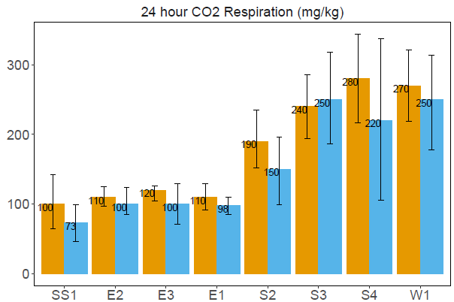
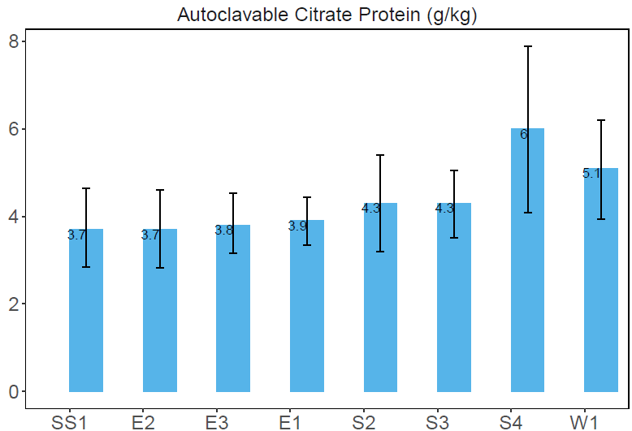
Biological Properties

Slide 3
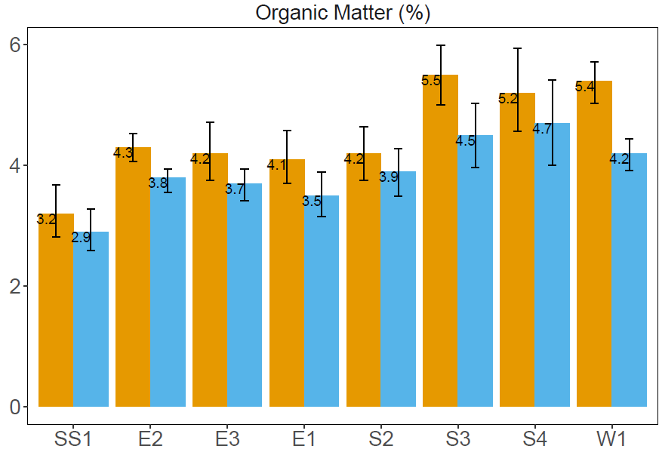
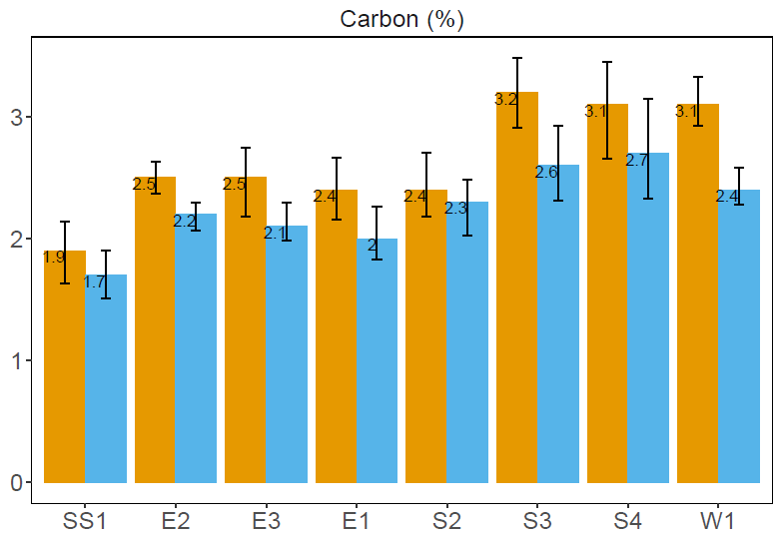
Biological Properties
Carbon (%) is estimated from Organic Matter using the following calculation:
Carbon = Organic Matter / 1.72
Notes:
Less % Carbon but more of it is extractable.
Perhaps more the and carbon and organic matter has died off and therefore is more extractable. Perhaps we are seeing winter decomposition, and the organic matter decrease is organic matter that decomposed and then got washed out of the system.

Slide 4
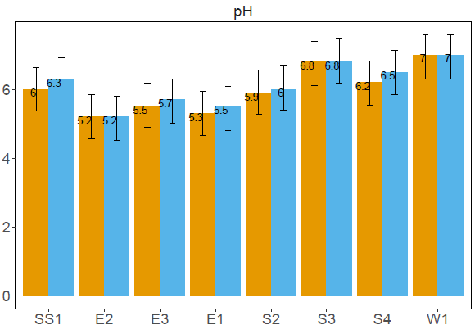
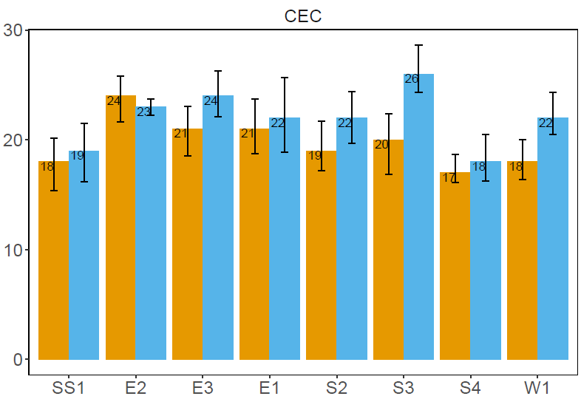
Chemical Properties
Notes:
Why did the CEC increase? Could this be a temperature thing instead? Because we’ve seen a decrease in OM.

Slide 5
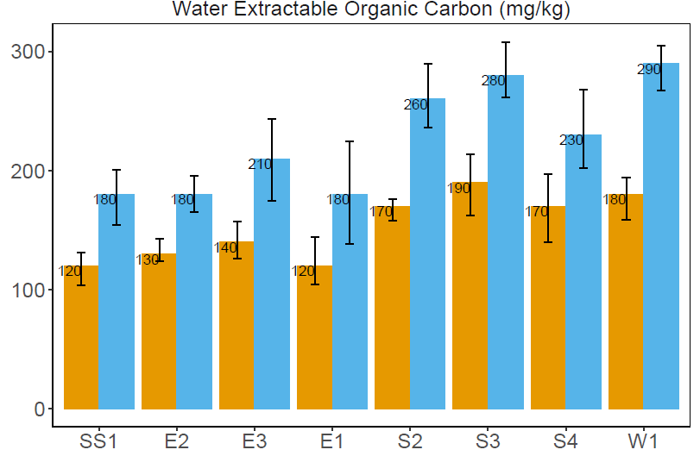
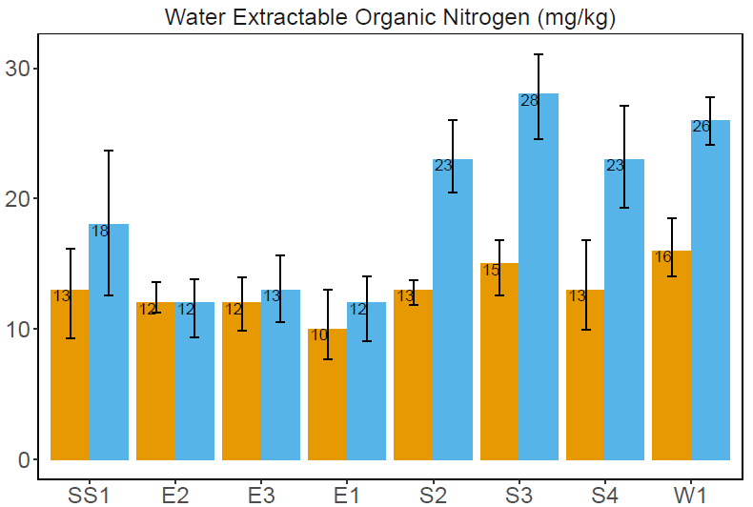
Water Extracts

Slide 6
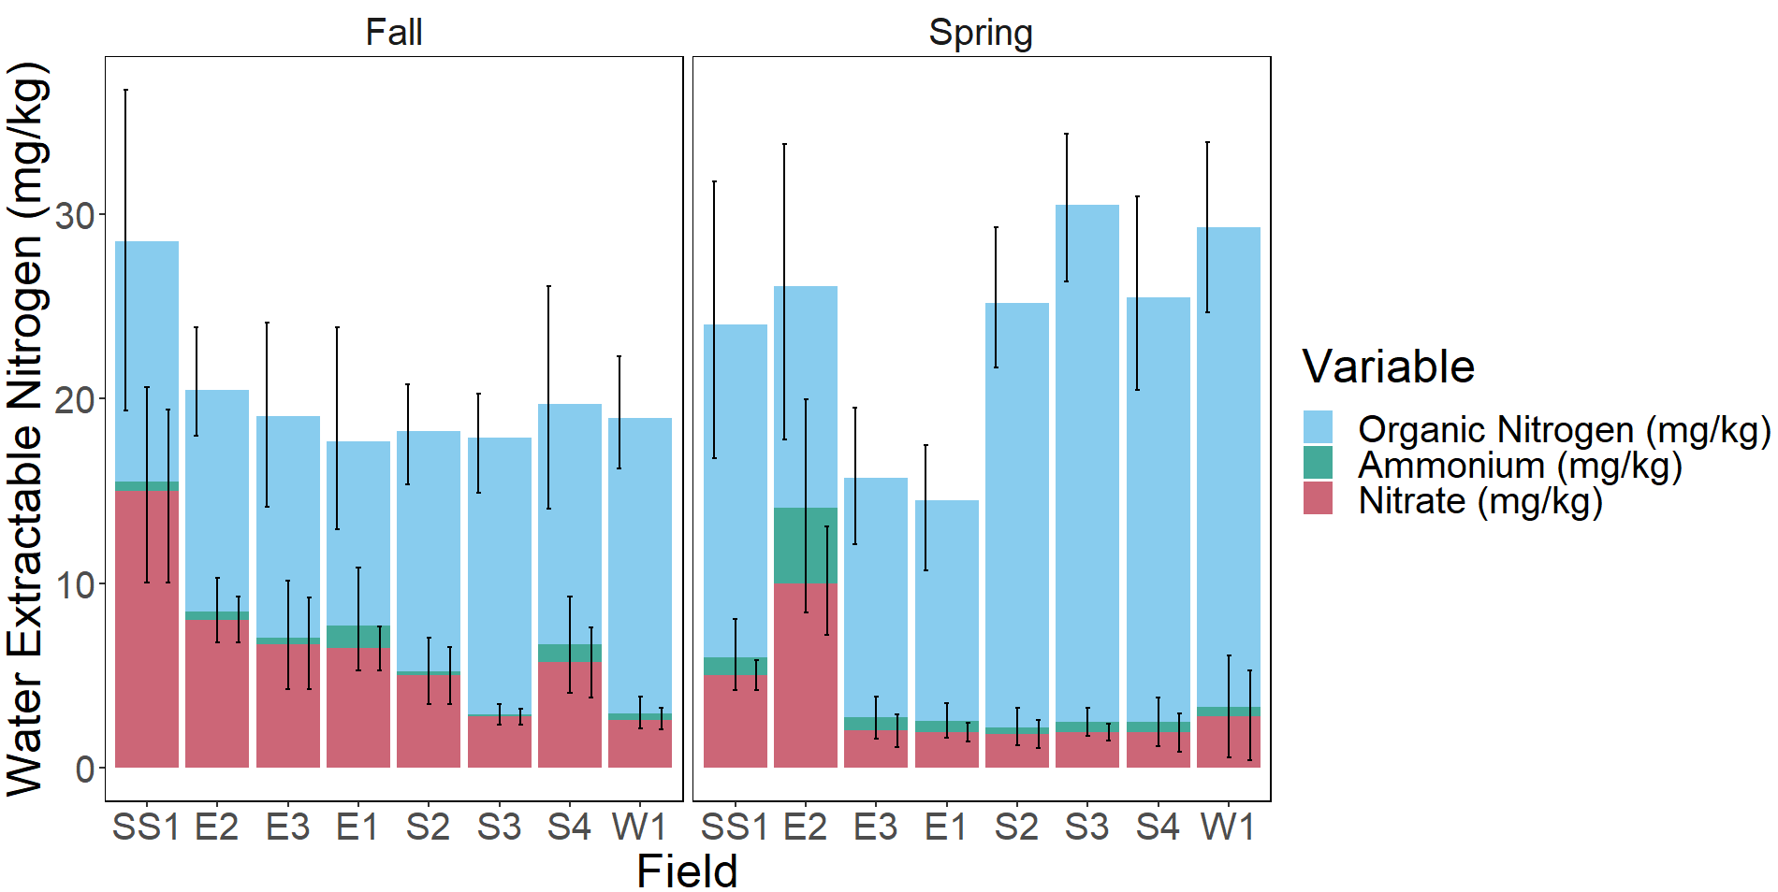
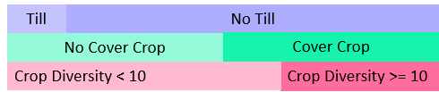
Soil Extractable Nitrogen Forms
Water Extractable Nitrogen from Soil (mg/kg)

Slide 7
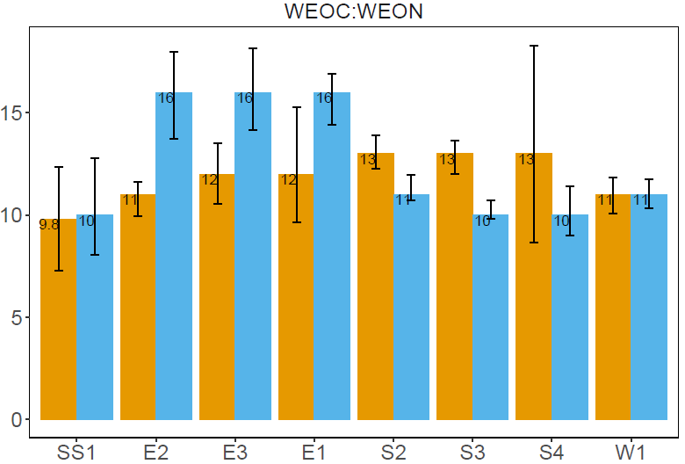
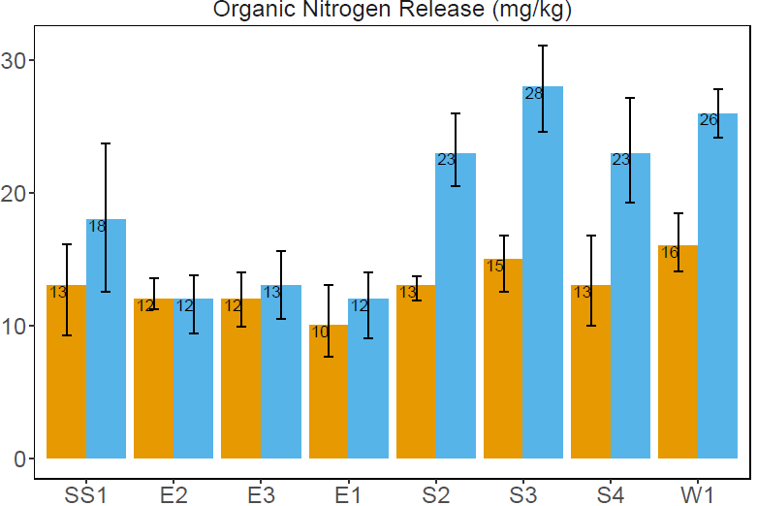
Water Extractable C:N and Nitrogen Mineralization

Slide 8
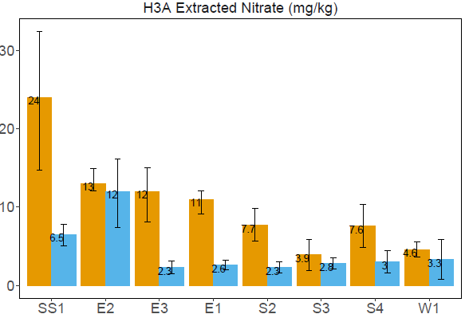
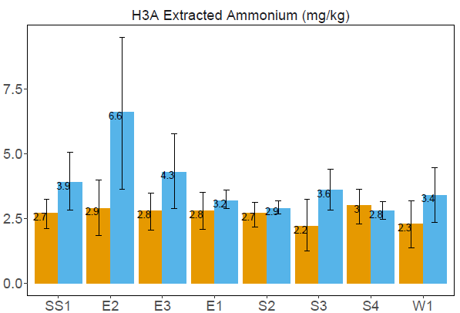
H3A Nitrogen

Slide 9
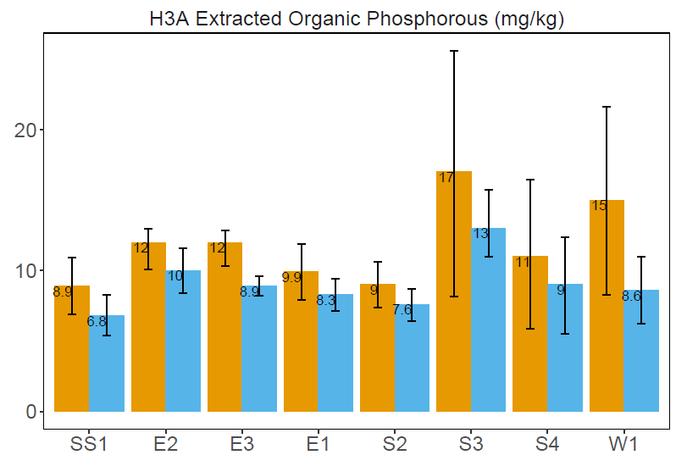
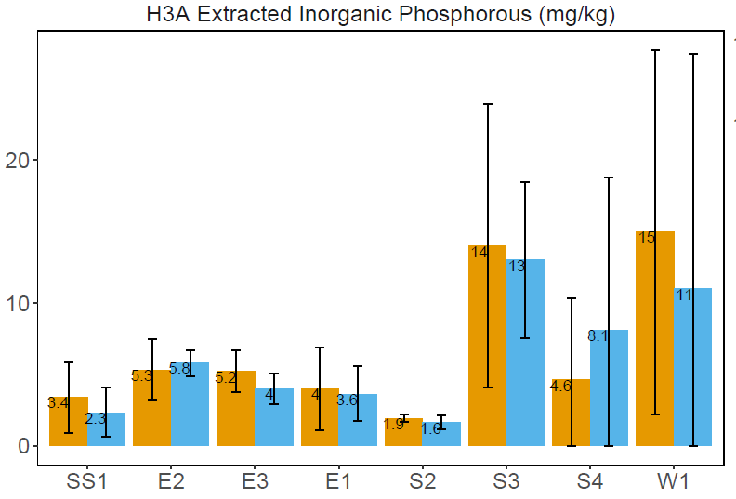
H3A Phosphorous

Slide 10
PLFA Data

Slide 11
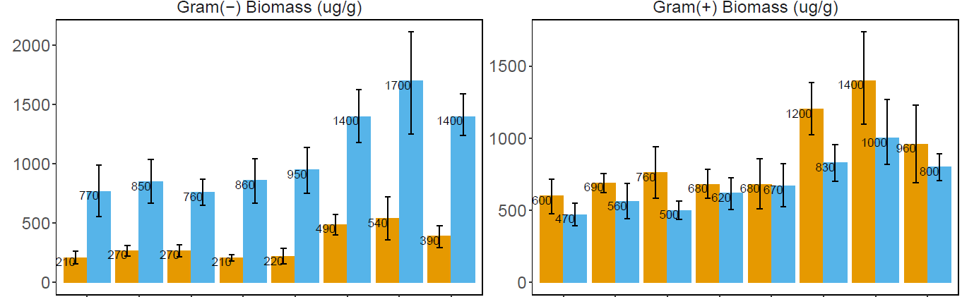
PLFA: Gram(–) Biomass and Gram(+) Biomass

Slide 12
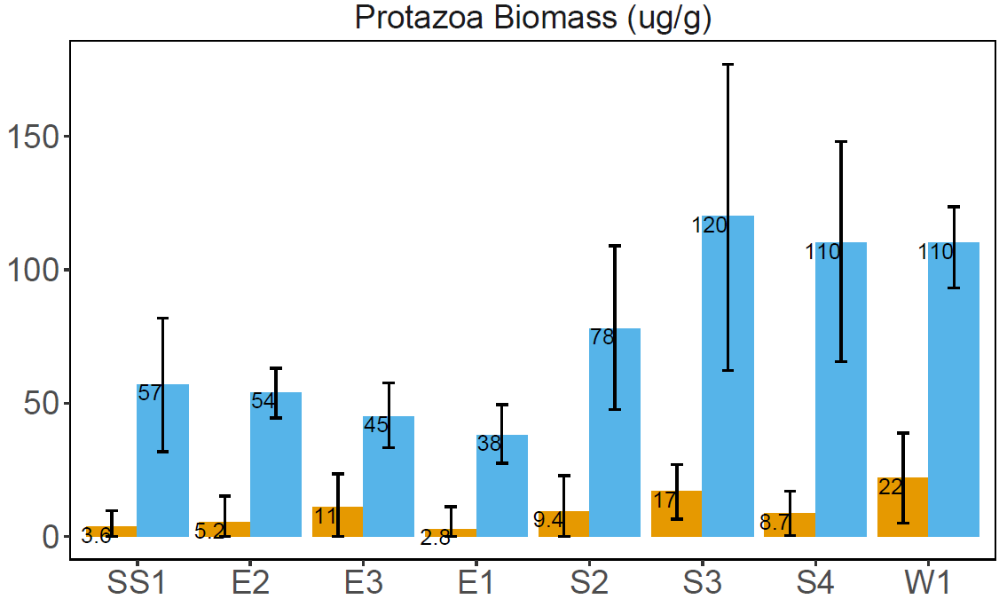
PLFA: Protozoa Biomass
70% of Soil Respiration may be attributed to Protozoa
Foissner, W., 1999.
Protozoa Biomass (ug/g)

Slide 13
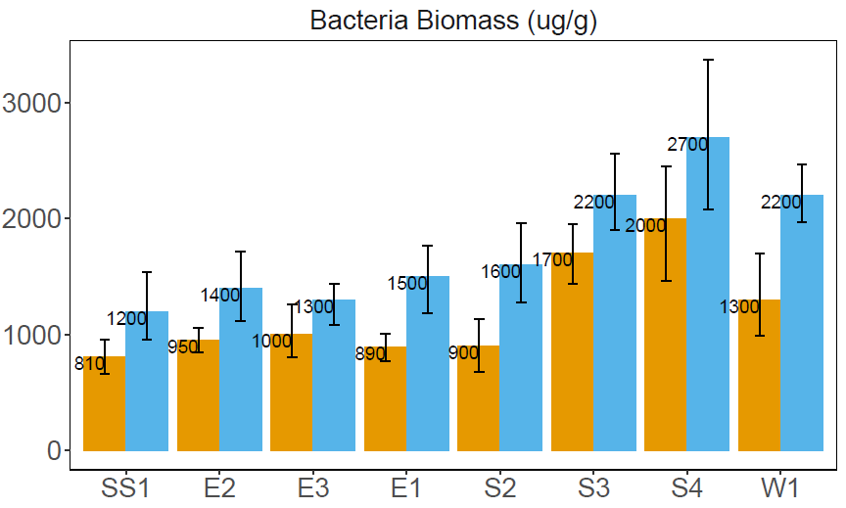
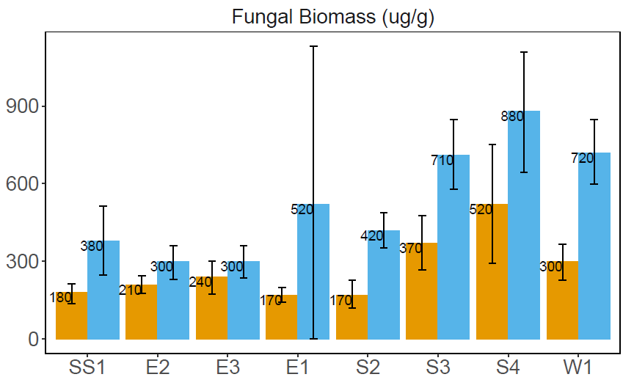
PLFA: Bacterial and Fungal Biomass

Slide 14
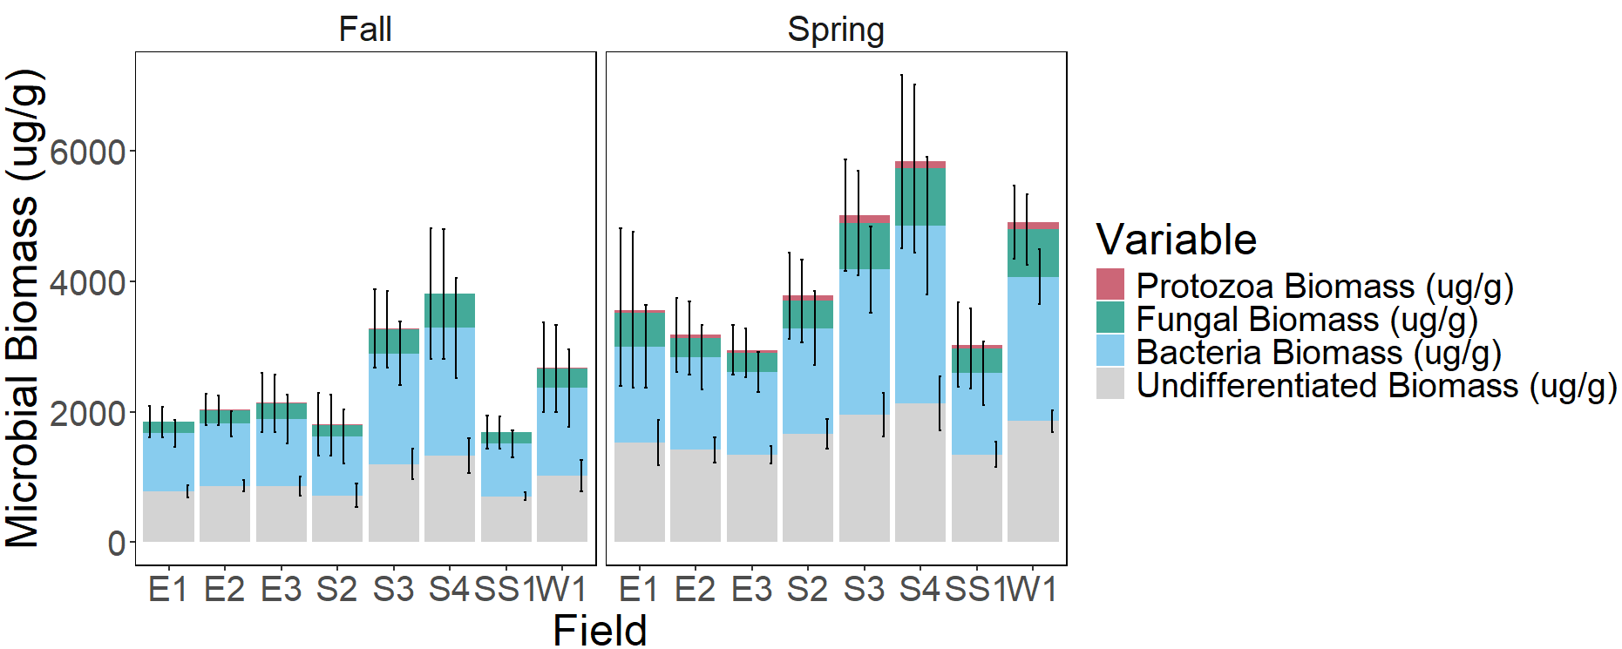
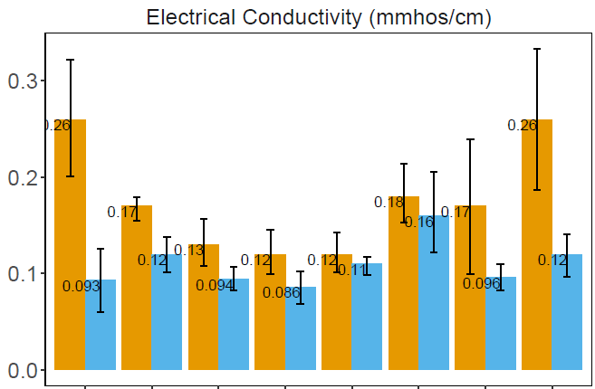
PLFA: Microbial Biomass and Electrical Conductivity
Microbial Biomass (ug/g)
Notes:
Aggregate stability for protozoa biomass, because protozoa have to swim through the soils? 55 degrees for good PLFA analysis.

Slide 15
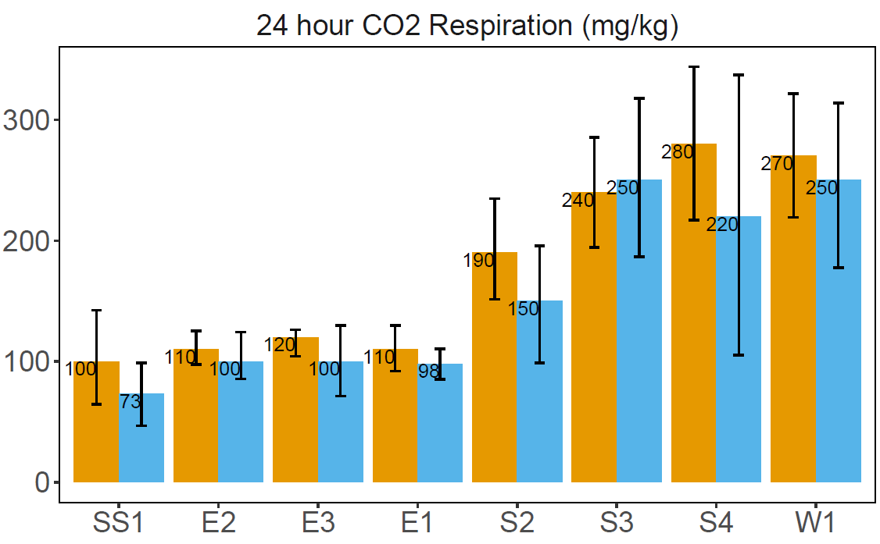
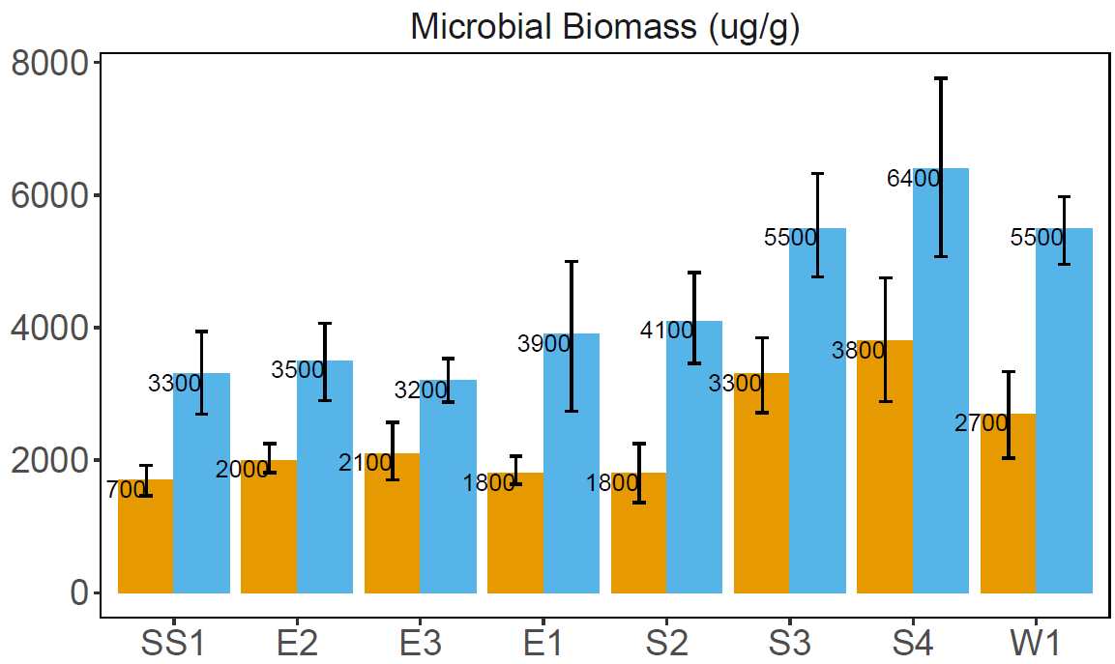
PLFA: Microbial Biomass and Respiration
Water Extractable Organic Carbon (mg/kg)
Microbial Biomass (ug/g)
Till
No Till
No Cover Crop
Cover Crop
Crop Diversity < 10
Crop Diversity >= 10

Slide 16
Potential Explanations for inverse relationship between Respiration and Biomass
Biomass is not correlated to soil respiration, mineralization, and turnover. Wang, W.J. et al., (2003)
Climate Driven Karhu, K et al., (2006), Zhou et al., (2017)
KSU Mesonet Data 1 Month Prior to Soil Sampling Periods
Corning 2NW
 | Air Temperature (°F) |  | Soil Temperature (°F) |  | Total Precipitation (inches)
 | Average | Average Difference | Average | Average Difference
Oct 20th - Nov 20th | 51.50 | -0.75 | 52.73 | -0.33 | 1.17
Mar 8th – Apr 8th | 47.09 | 0.46 | 45.74 | 0.20 | 1.37
Notes:
Rossville near Kansas river, different fall winter pattern. Corning 2NW are different, cold and warm fronts moving around. Having more local information, collecting that data when going out sampling is going to be a key factor. Send the slides around – Shane. WEOC, Carbon, Biomass next to each other.
Protozoa and water stable aggregates next to each other.

Slide 17
References
Wang, W.J., Dalal, R.C., Moody, P.W. and Smith, C.J., 2003. Relationships of soil respiration to microbial biomass, substrate availability and clay content. Soil biology and biochemistry, 35(2), pp.273-284.
Foissner, W., 1999. Soil protozoa as bioindicators: pros and cons, methods, diversity, representative examples. In Invertebrate Biodiversity as Bioindicators of Sustainable Landscapes (pp. 95-112). Elsevier.
Karhu, K., Auffret, M.D., Dungait, J.A., Hopkins, D.W., Prosser, J.I., Singh, B.K., Subke, J.A., Wookey, P.A., Ågren, G.I., Sebastia, M.T. and Gouriveau, F., 2014. Temperature sensitivity of soil respiration rates enhanced by microbial community response. Nature, 513(7516), pp.81-84.
Zhou, W.P., Shen, W.J., Li, Y.E. and Hui, D.F., 2017. Interactive effects of temperature and moisture on composition of the soil microbial community. European Journal of Soil Science, 68(6), pp.909-918.

