Slide 1
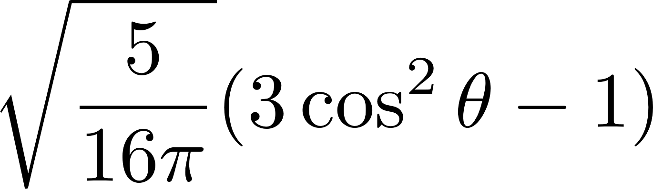
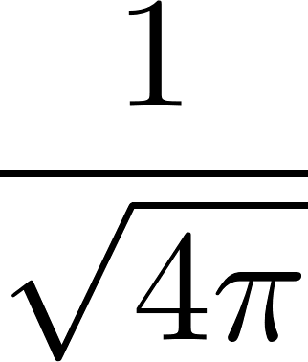
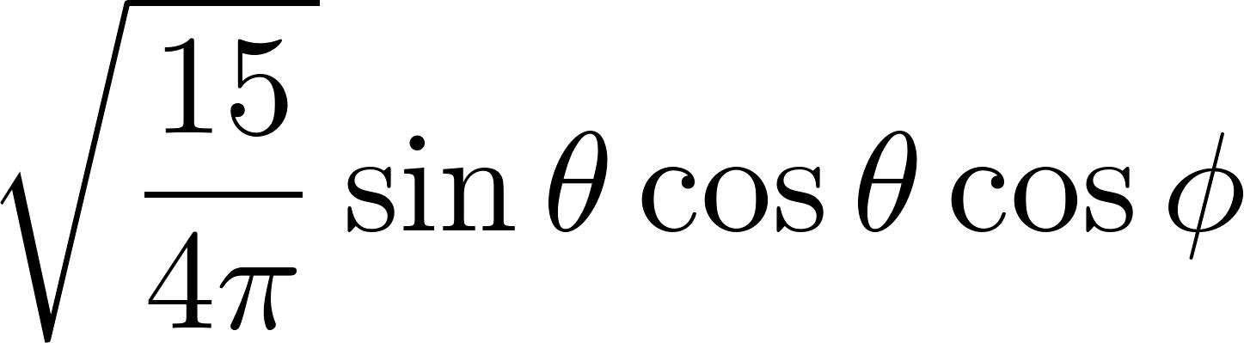
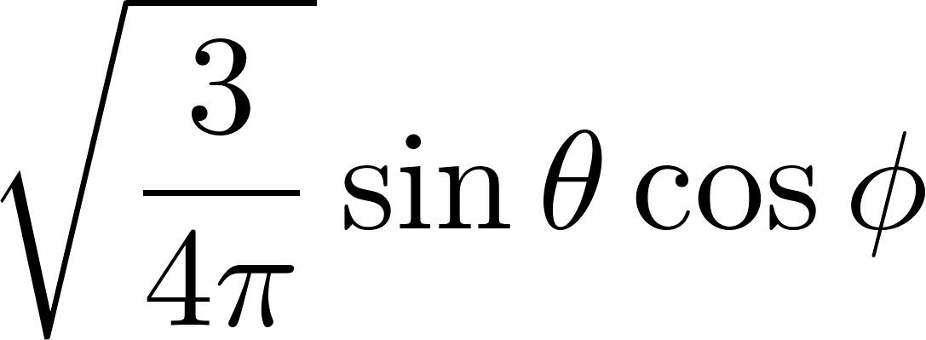

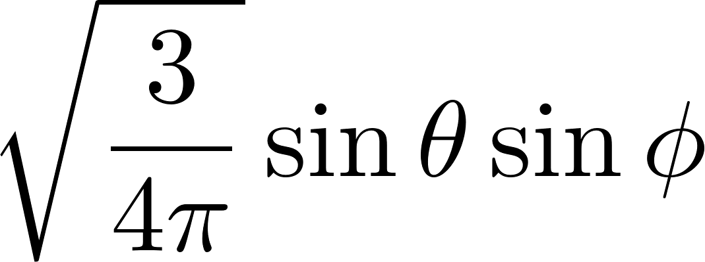
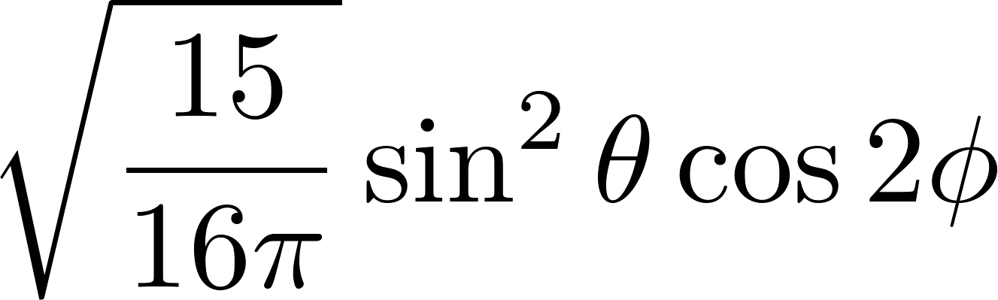
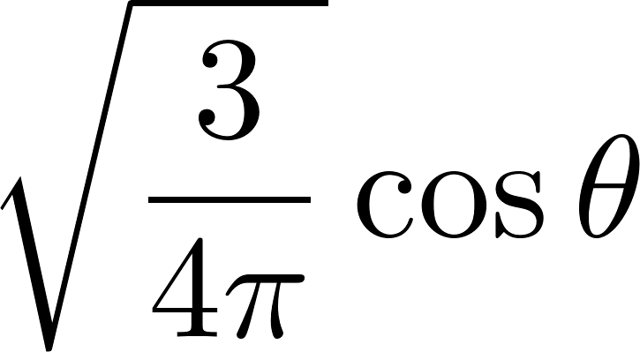
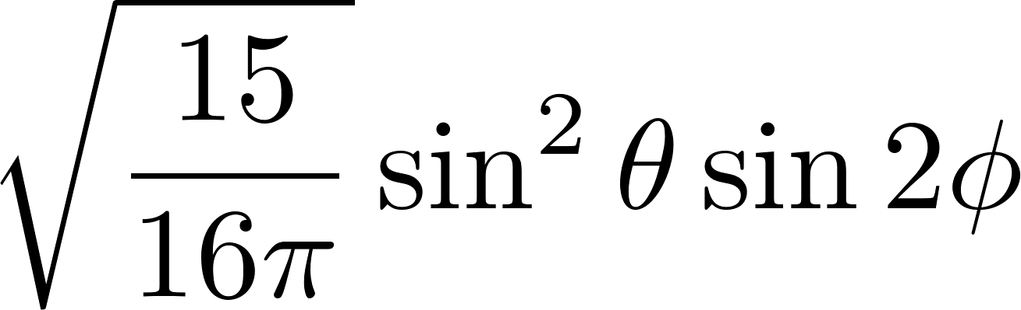
wannier90 basis set
dz2
s
dxz
px
dyz
py
dx2-y2
pz
dxy

Slide 2
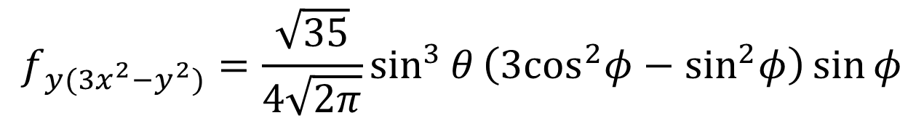
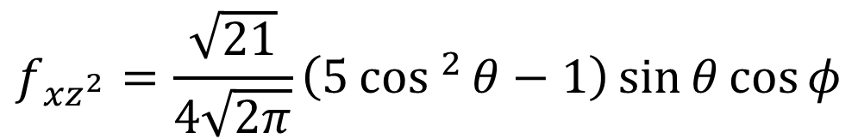
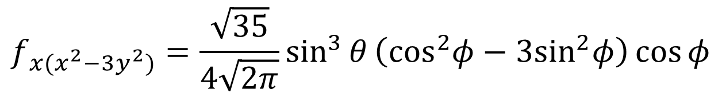
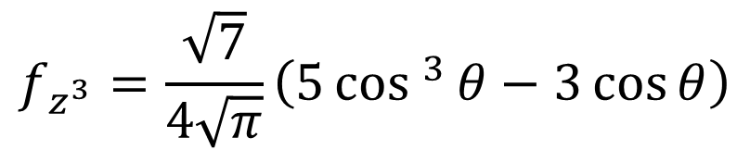
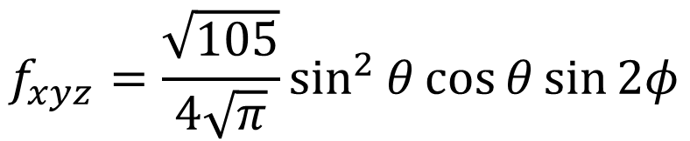
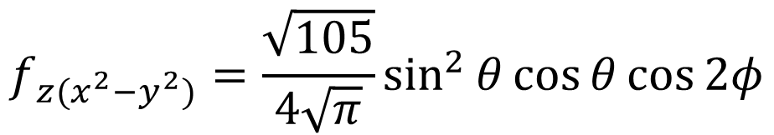
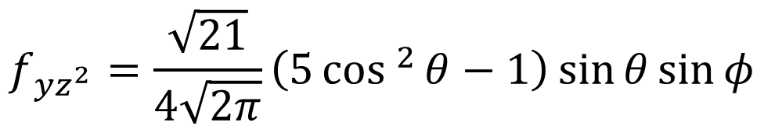
$$f_{z^{3}}=\frac{\sqrt{7}}{4\sqrt{π}}\left(5cos ^{3}{θ}−3\cos{θ}\right)$$
$$f_{{xz}^{2}}=\frac{\sqrt{21}}{4\sqrt{2π}}\left(5cos ^{2}{θ}−1\right)\sin{θ}\cos{φ}$$
$$f_{{yz}^{2}}=\frac{\sqrt{21}}{4\sqrt{2π}}\left(5cos ^{2}{θ}−1\right)\sin{θ}\sin{φ}$$
$$f_{z(x^{2}−y^{2})}=\frac{\sqrt{105}}{4\sqrt{π}}\sin^{2}{θ}\cos{θ}\cos{2φ}$$
$$f_{xyz}=\frac{\sqrt{105}}{4\sqrt{π}}\sin^{2}{θ}\cos{θ}\sin{2φ}$$
$$f_{x(x^{2}−3y^{2})}=\frac{\sqrt{35}}{4\sqrt{2π}}\sin^{3}{θ}\left({\text{cos}}^{2}φ−3{\text{sin}}^{2}φ\right)\cos{φ}$$
$$f_{y(3x^{2}−y^{2})}=\frac{\sqrt{35}}{4\sqrt{2π}}\sin^{3}{θ}\left({\text{3}\text{cos}}^{2}φ−{\text{sin}}^{2}φ\right)\sin{φ}$$

Slide 3
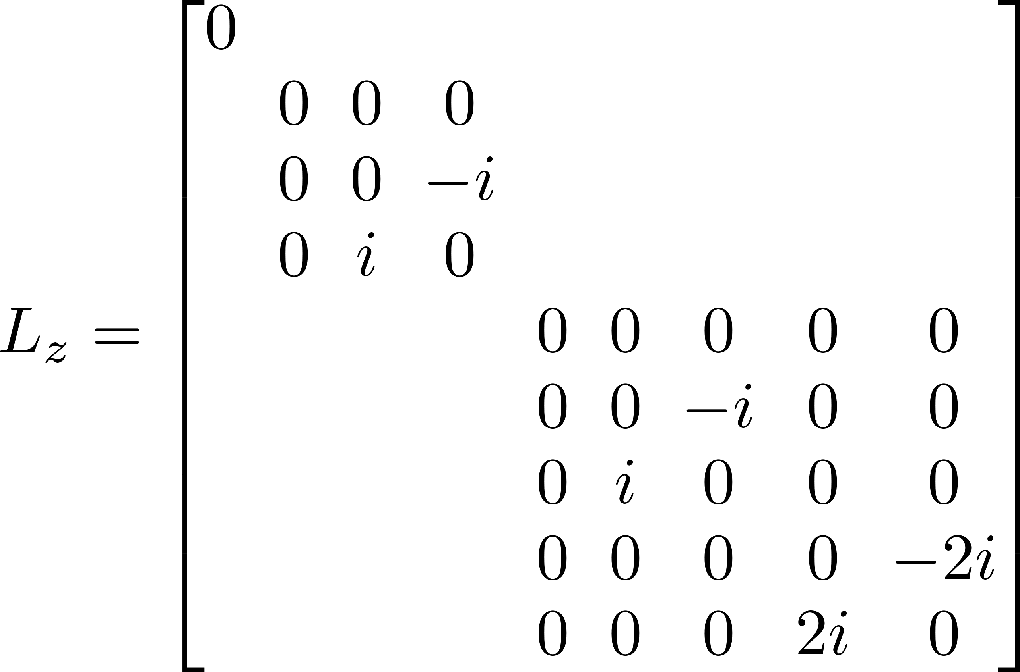
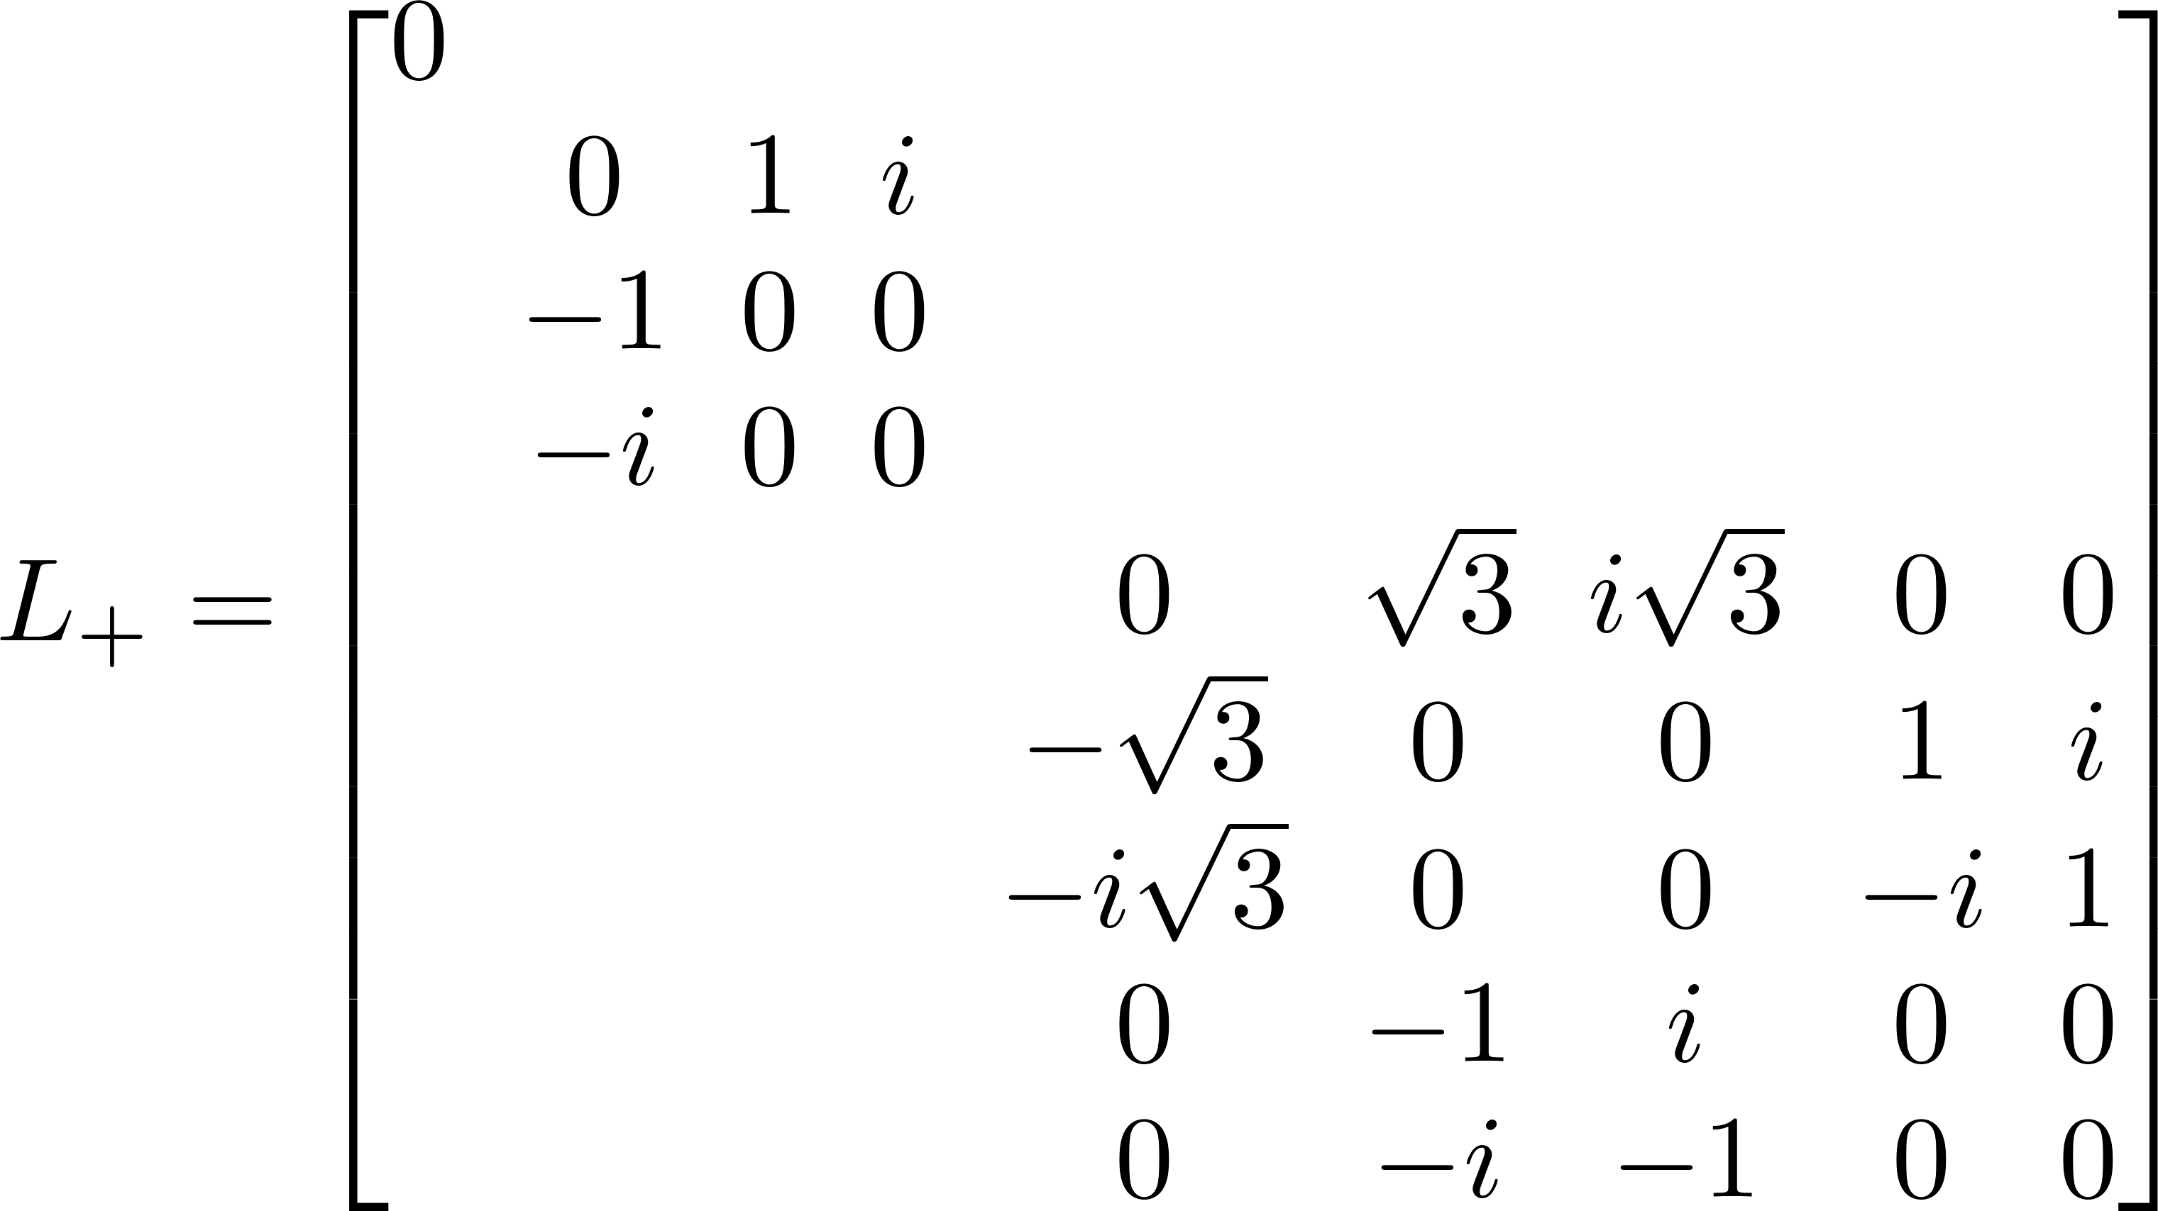
L operators: s, p ,d
s
pz
px
py
dz2
dxz
dyz
dx2y2
dxy
s
pz
px
py
dz2
dxz
dyz
dx2y2
dxy

Slide 4






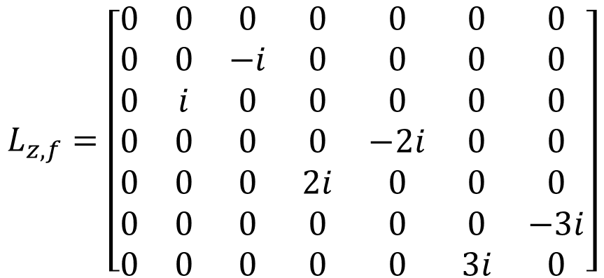





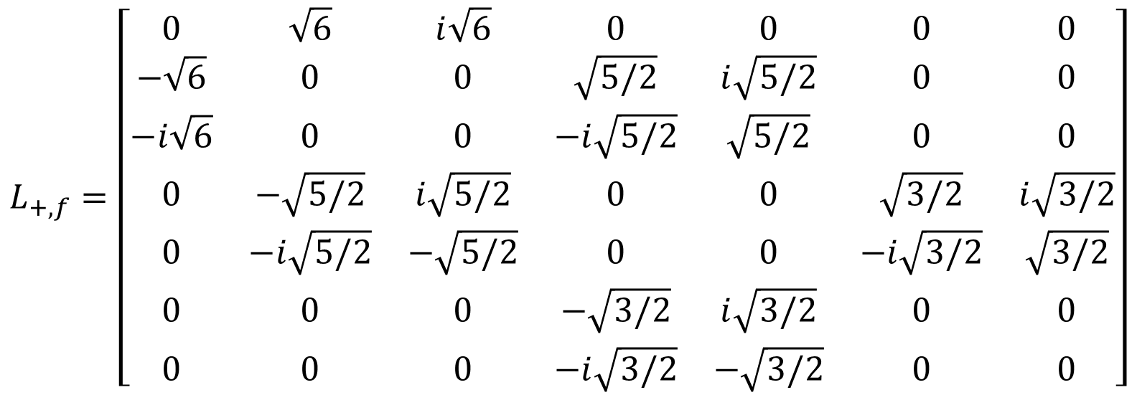



L operators: f
$$L_{z,f}=\left[\begin{matrix}0 & 0 & 0 & 0 & 0 & 0 & 0 \\ 0 & 0 & −i & 0 & 0 & 0 & 0 \\ 0 & i & 0 & 0 & 0 & 0 & 0 \\ 0 & 0 & 0 & 0 & −2i & 0 & 0 \\ 0 & 0 & 0 & 2i & 0 & 0 & 0 \\ 0 & 0 & 0 & 0 & 0 & 0 & −3i \\ 0 & 0 & 0 & 0 & 0 & 3i & 0\end{matrix}\right]$$
$$f_{z^{3}}$$
$$f_{{xz}^{2}}$$
$$f_{{yz}^{2}}$$
$$f_{z(x^{2}−y^{2})}$$
$$f_{xyz}$$
$$f_{x(x^{2}−3y^{2})}$$
$$f_{y(3x^{2}−y^{2})}$$
$$L_{+,f}=\left[\begin{matrix}0 & \sqrt{6} & i\sqrt{6} & 0 & 0 & 0 & 0 \\ −\sqrt{6} & 0 & 0 & \sqrt{5/2} & i\sqrt{5/2} & 0 & 0 \\ −i\sqrt{6} & 0 & 0 & −i\sqrt{5/2} & \sqrt{5/2} & 0 & 0 \\ 0 & −\sqrt{5/2} & i\sqrt{5/2} & 0 & 0 & \sqrt{3/2} & i\sqrt{3/2} \\ 0 & −i\sqrt{5/2} & −\sqrt{5/2} & 0 & 0 & −i\sqrt{3/2} & \sqrt{3/2} \\ 0 & 0 & 0 & −\sqrt{3/2} & i\sqrt{3/2} & 0 & 0 \\ 0 & 0 & 0 & −i\sqrt{3/2} & −\sqrt{3/2} & 0 & 0\end{matrix}\right]$$
$$f_{z^{3}}$$
$$f_{{xz}^{2}}$$
$$f_{{yz}^{2}}$$
$$f_{z(x^{2}−y^{2})}$$
$$f_{xyz}$$
$$f_{x(x^{2}−3y^{2})}$$
$$f_{y(3x^{2}−y^{2})}$$

Slide 5
Derivation

Slide 6
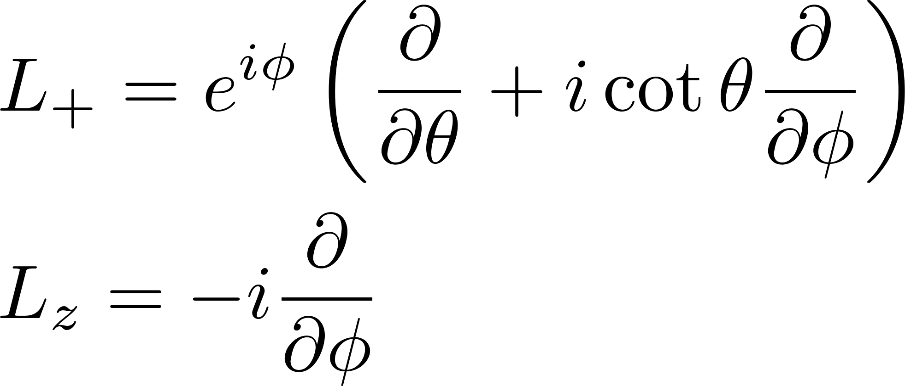


Angular momentum operation
$$L_{+}^{T}=−L_{+}$$
$$L_{−}=L_{+}^{†}$$

Slide 7
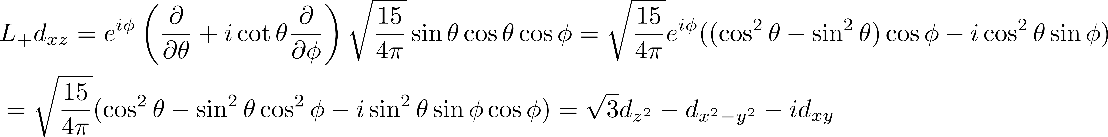
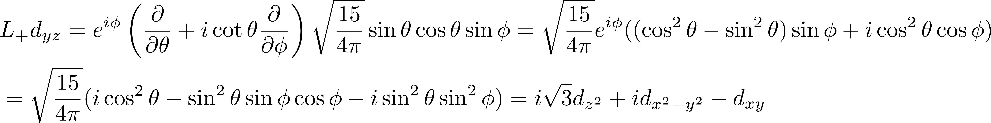

Slide 8
s
pz
px
py
dz2
dxz
dyz
dx2y2
dxy
s
pz
px
py
dz2
dxz
dyz
dx2y2
dxy

Slide 9
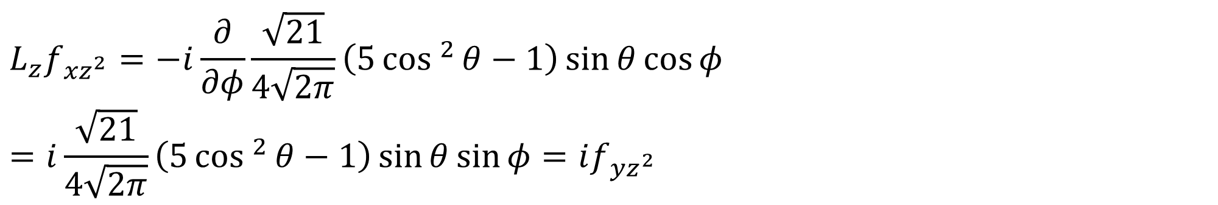

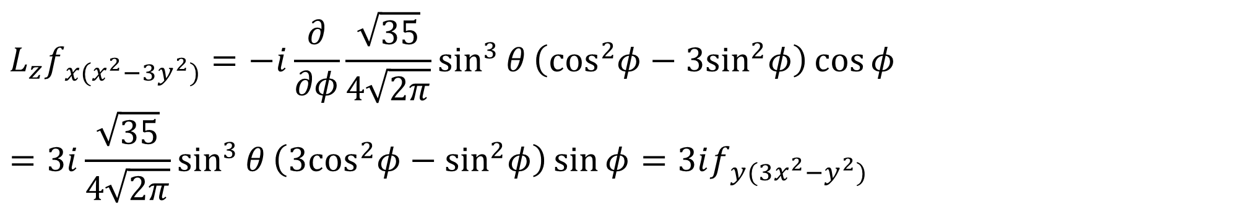
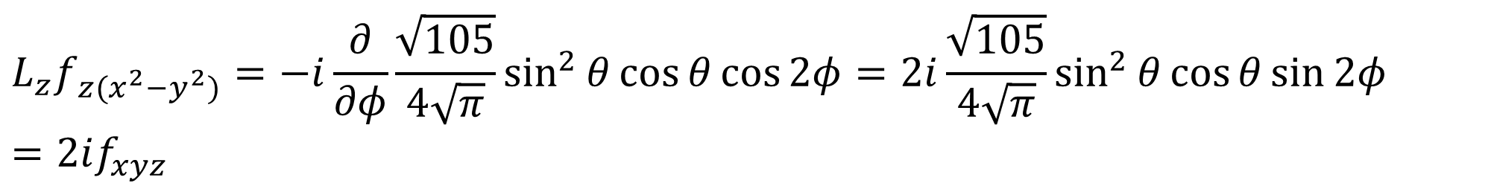
$$L_{z}f_{z^{3}}=0$$
$$L_{z}f_{{xz}^{2}}=−i\frac{∂}{∂φ}\frac{\sqrt{21}}{4\sqrt{2π}}\left(5cos ^{2}{θ}−1\right)\sin{θ}\cos{φ}=i\frac{\sqrt{21}}{4\sqrt{2π}}\left(5cos ^{2}{θ}−1\right)\sin{θ}\sin{φ}=if_{{yz}^{2}}$$
$$L_{z}f_{z(x^{2}−y^{2})}=−i\frac{∂}{∂φ}\frac{\sqrt{105}}{4\sqrt{π}}\sin^{2}{θ}\cos{θ}\cos{2φ}=2i\frac{\sqrt{105}}{4\sqrt{π}}\sin^{2}{θ}\cos{θ}\sin{2φ}=2if_{xyz}$$
$$L_{z}f_{x(x^{2}−3y^{2})}=−i\frac{∂}{∂φ}\frac{\sqrt{35}}{4\sqrt{2π}}\sin^{3}{θ}\left({\text{cos}}^{2}φ−3{\text{sin}}^{2}φ\right)\cos{φ}=3i\frac{\sqrt{35}}{4\sqrt{2π}}\sin^{3}{θ}\left({\text{3}\text{cos}}^{2}φ−{\text{sin}}^{2}φ\right)\sin{φ}=3if_{y(3x^{2}−y^{2})}$$

Slide 10



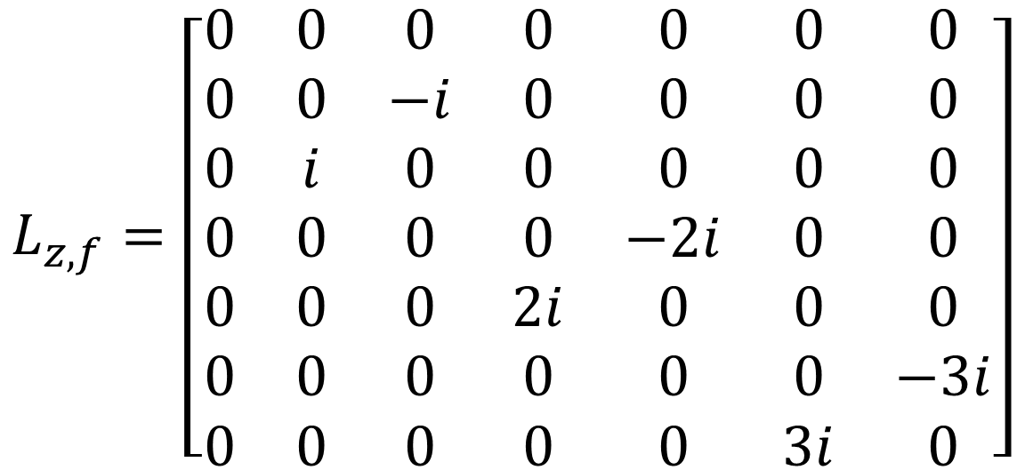




$$L_{z,f}=\left[\begin{matrix}0 & 0 & 0 & 0 & 0 & 0 & 0 \\ 0 & 0 & −i & 0 & 0 & 0 & 0 \\ 0 & i & 0 & 0 & 0 & 0 & 0 \\ 0 & 0 & 0 & 0 & −2i & 0 & 0 \\ 0 & 0 & 0 & 2i & 0 & 0 & 0 \\ 0 & 0 & 0 & 0 & 0 & 0 & −3i \\ 0 & 0 & 0 & 0 & 0 & 3i & 0\end{matrix}\right]$$
$$f_{z^{3}}$$
$$f_{{xz}^{2}}$$
$$f_{{yz}^{2}}$$
$$f_{z(x^{2}−y^{2})}$$
$$f_{xyz}$$
$$f_{x(x^{2}−3y^{2})}$$
$$f_{y(3x^{2}−y^{2})}$$

Slide 11
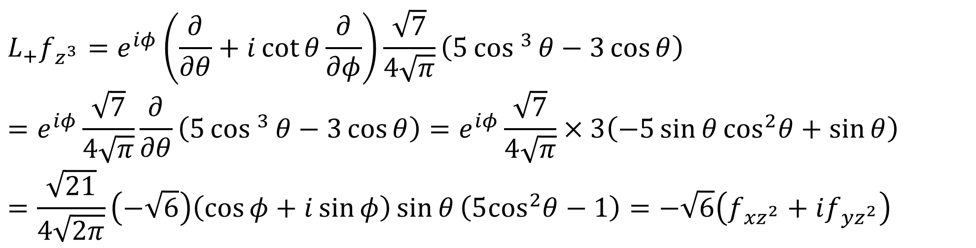
$$L_{+}f_{z^{3}}=e^{iφ}\left(\frac{∂}{∂θ}+i\cot{θ}\frac{∂}{∂φ}\right)\frac{\sqrt{7}}{4\sqrt{π}}\left(5cos ^{3}{θ}−3\cos{θ}\right)=e^{iφ}\frac{\sqrt{7}}{4\sqrt{π}}\frac{∂}{∂θ}\left(5cos ^{3}{θ}−3\cos{θ}\right)=e^{iφ}\frac{\sqrt{7}}{4\sqrt{π}}×3\left(−5\sin{θ}{\text{cos}}^{2}θ+\sin{θ}\right)=\frac{\sqrt{21}}{4\sqrt{2π}}\left(−\sqrt{6}\right)\left(\cos{φ}+i\sin{φ}\right)\sin{θ}\left(5{\text{cos}}^{2}θ−1\right)=−\sqrt{6}\left(f_{{xz}^{2}}+if_{{yz}^{2}}\right)$$

Slide 12
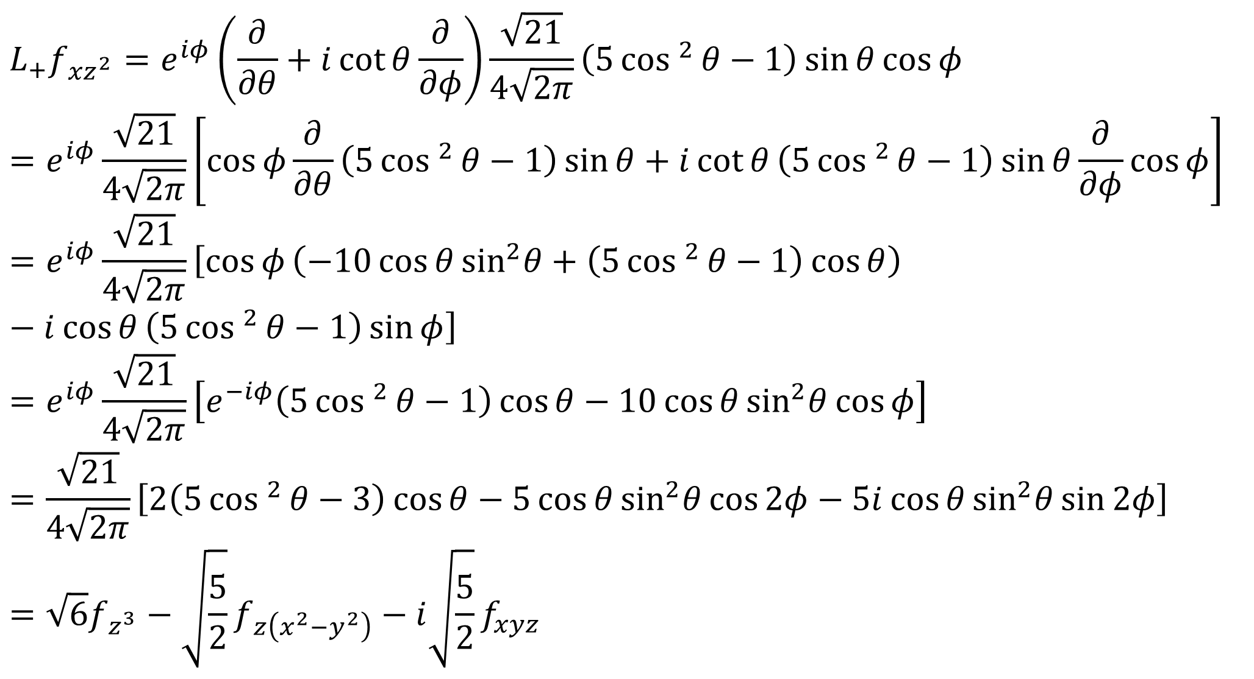
$$L_{+}f_{{xz}^{2}}=e^{iφ}\left(\frac{∂}{∂θ}+i\cot{θ}\frac{∂}{∂φ}\right)\frac{\sqrt{21}}{4\sqrt{2π}}\left(5cos ^{2}{θ}−1\right)\sin{θ}\cos{φ}=e^{iφ}\frac{\sqrt{21}}{4\sqrt{2π}}\left[\cos{φ}\frac{∂}{∂θ}\left(5cos ^{2}{θ}−1\right)\sin{θ}+i\cot{θ}\left(5cos ^{2}{θ}−1\right)\sin{θ}\frac{∂}{∂φ}\cos{φ}\right]=e^{iφ}\frac{\sqrt{21}}{4\sqrt{2π}}\left[\cos{φ}\left(−10\cos{θ}{\text{sin}}^{2}θ+\left(5cos ^{2}{θ}−1\right)\cos{θ}\right)−i\cos{θ}\left(5cos ^{2}{θ}−1\right)\sin{φ}\right]$$
$$=e^{iφ}\frac{\sqrt{21}}{4\sqrt{2π}}\left[e^{−iφ}\left(5cos ^{2}{θ}−1\right)\cos{θ}−10\cos{θ}{\text{sin}}^{2}θ\cos{φ}\right]$$
$$=\frac{\sqrt{21}}{4\sqrt{2π}}\left[2\left(5cos ^{2}{θ}−3\right)\cos{θ}−5\cos{θ}{\text{sin}}^{2}θ\cos{2φ}−5i\cos{θ}{\text{sin}}^{2}θ\sin{2φ}\right]$$
$$=\sqrt{6}f_{z^{3}}−\sqrt{\frac{5}{2}}f_{z\left(x^{2}−y^{2}\right)}−i\sqrt{\frac{5}{2}}f_{xyz}$$

Slide 13
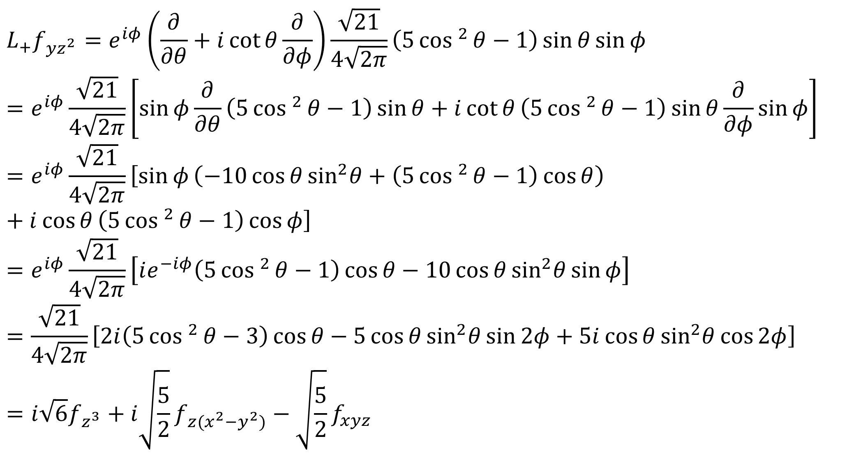
$$L_{+}f_{{yz}^{2}}=e^{iφ}\left(\frac{∂}{∂θ}+i\cot{θ}\frac{∂}{∂φ}\right)\frac{\sqrt{21}}{4\sqrt{2π}}\left(5cos ^{2}{θ}−1\right)\sin{θ}\sin{φ}$$
$$=e^{iφ}\frac{\sqrt{21}}{4\sqrt{2π}}\left[\sin{φ}\frac{∂}{∂θ}\left(5cos ^{2}{θ}−1\right)\sin{θ}+i\cot{θ}\left(5cos ^{2}{θ}−1\right)\sin{θ}\frac{∂}{∂φ}\sin{φ}\right]=e^{iφ}\frac{\sqrt{21}}{4\sqrt{2π}}\left[\sin{φ}\left(−10\cos{θ}{\text{sin}}^{2}θ+\left(5cos ^{2}{θ}−1\right)\cos{θ}\right)+i\cos{θ}\left(5cos ^{2}{θ}−1\right)\cos{φ}\right]$$
$$=e^{iφ}\frac{\sqrt{21}}{4\sqrt{2π}}\left[ie^{−iφ}\left(5cos ^{2}{θ}−1\right)\cos{θ}−10\cos{θ}{\text{sin}}^{2}θ\sin{φ}\right]$$
$$=\frac{\sqrt{21}}{4\sqrt{2π}}\left[2i\left(5cos ^{2}{θ}−3\right)\cos{θ}−5\cos{θ}{\text{sin}}^{2}θ\sin{2φ}+5i\cos{θ}{\text{sin}}^{2}θ\cos{2φ}\right]$$
$$=i\sqrt{6}f_{z^{3}}+i\sqrt{\frac{5}{2}}f_{z(x^{2}−y^{2})}−\sqrt{\frac{5}{2}}f_{xyz}$$

Slide 14
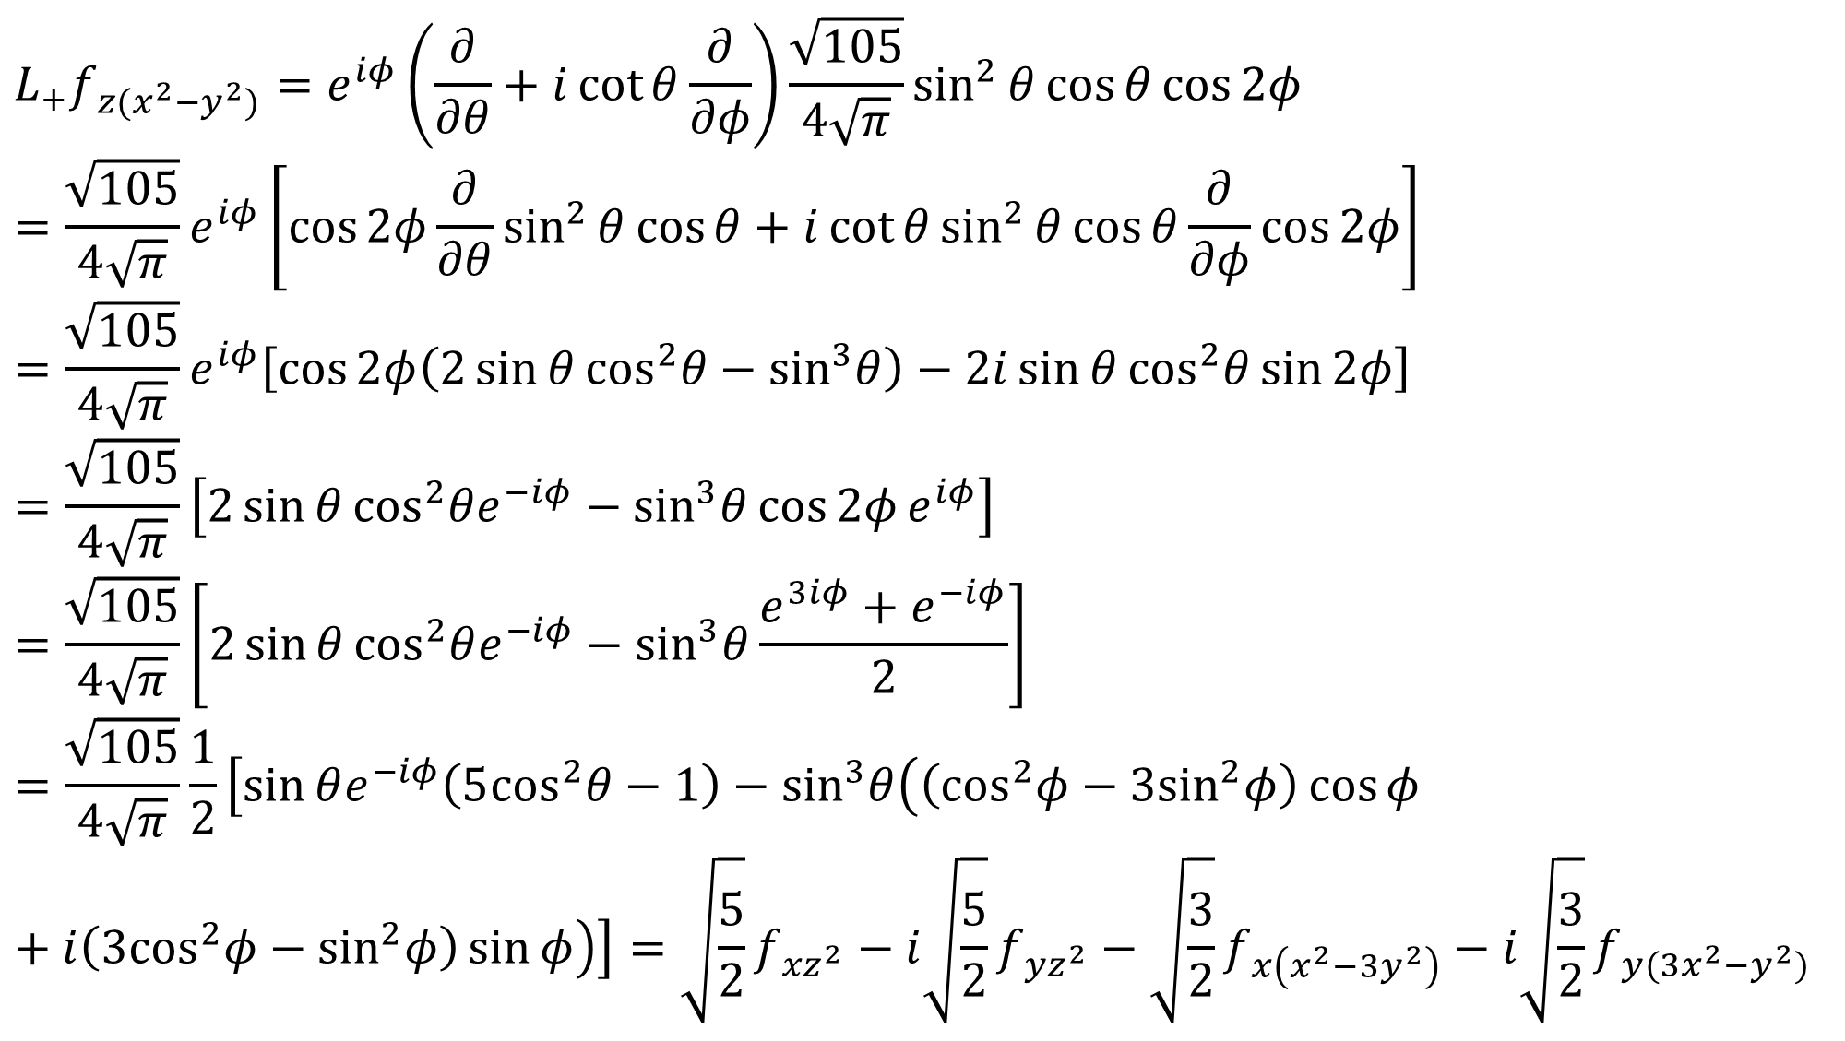
$$L_{+}f_{z(x^{2}−y^{2})}=e^{iφ}\left(\frac{∂}{∂θ}+i\cot{θ}\frac{∂}{∂φ}\right)\frac{\sqrt{105}}{4\sqrt{π}}\sin^{2}{θ}\cos{θ}\cos{2φ}$$
$$=\frac{\sqrt{105}}{4\sqrt{π}}e^{iφ}\left[\cos{2φ}\frac{∂}{∂θ}\sin^{2}{θ}\cos{θ}+i\cot{θ}\sin^{2}{θ}\cos{θ}\frac{∂}{∂φ}\cos{2φ}\right]$$
$$=\frac{\sqrt{105}}{4\sqrt{π}}e^{iφ}\left[\cos{2φ\left(2\sin{θ}{\text{cos}}^{2}θ−{\text{sin}}^{3}θ\right)−2i\sin{θ}{\text{cos}}^{2}θ}\sin{2φ}\right]$$
$$=\frac{\sqrt{105}}{4\sqrt{π}}\left[2\sin{θ}{\text{cos}}^{2}θe^{−iφ}−{\text{sin}}^{3}θ\cos{2φ}e^{iφ}\right]$$
$$=\frac{\sqrt{105}}{4\sqrt{π}}\left[2\sin{θ}{\text{cos}}^{2}θe^{−iφ}−{\text{sin}}^{3}θ\frac{e^{3iφ}+e^{−iφ}}{2}\right]$$
$$=\frac{\sqrt{105}}{4\sqrt{π}}\frac{1}{2}\left[\sin{θe^{−iφ}\left(5{\text{cos}}^{2}θ−1\right)−{\text{sin}}^{3}θ\left(\left({\text{cos}}^{2}φ−3{\text{sin}}^{2}φ\right)\cos{φ}+i\left({\text{3}\text{cos}}^{2}φ−{\text{sin}}^{2}φ\right)\sin{φ}\right)}\right]=\sqrt{\frac{5}{2}}f_{{xz}^{2}}−i\sqrt{\frac{5}{2}}f_{{yz}^{2}}−\sqrt{\frac{3}{2}}f_{x\left(x^{2}−3y^{2}\right)}−i\sqrt{\frac{3}{2}}f_{y(3x^{2}−y^{2})}$$

Slide 15
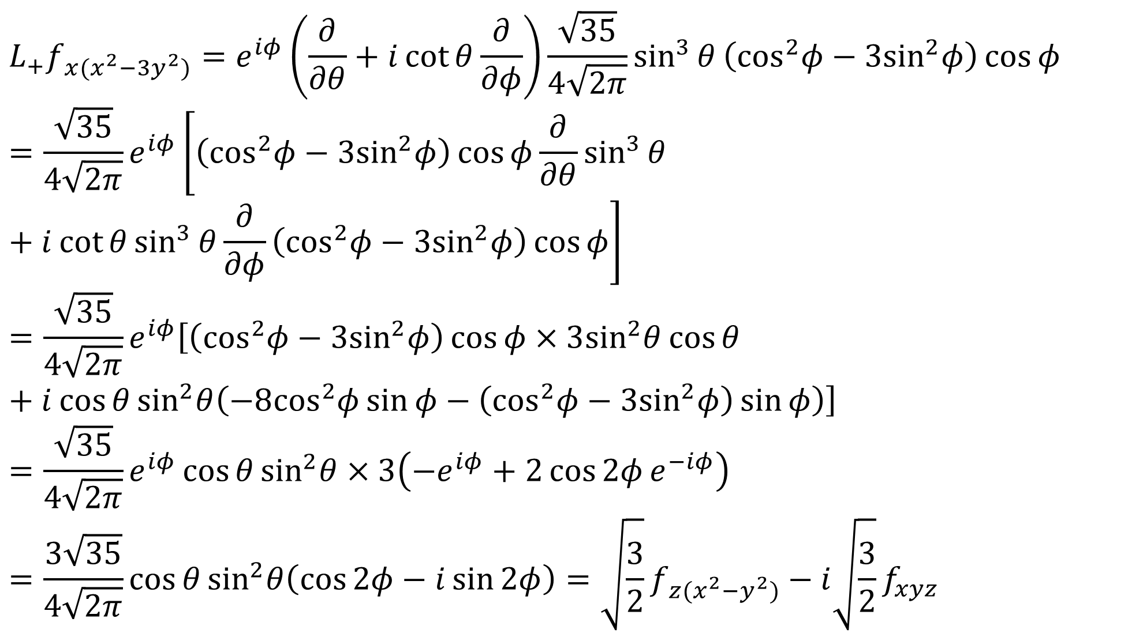
$$L_{+}f_{x(x^{2}−3y^{2})}=e^{iφ}\left(\frac{∂}{∂θ}+i\cot{θ}\frac{∂}{∂φ}\right)\frac{\sqrt{35}}{4\sqrt{2π}}\sin^{3}{θ}\left({\text{cos}}^{2}φ−3{\text{sin}}^{2}φ\right)\cos{φ}$$
$$=\frac{\sqrt{35}}{4\sqrt{2π}}e^{iφ}\left[\left({\text{cos}}^{2}φ−3{\text{sin}}^{2}φ\right)\cos{φ}\frac{∂}{∂θ}\sin^{3}{θ}+i\cot{θ}\sin^{3}{θ}\frac{∂}{∂φ}\left({\text{cos}}^{2}φ−3{\text{sin}}^{2}φ\right)\cos{φ}\right]$$
$$=\frac{\sqrt{35}}{4\sqrt{2π}}e^{iφ}\left[\left({\text{cos}}^{2}φ−3{\text{sin}}^{2}φ\right)\cos{φ}×3{\text{sin}}^{2}θ\cos{θ}+i\cos{θ}{\text{sin}}^{2}θ\left(−8{\text{cos}}^{2}φ\sin{φ}−\left({\text{cos}}^{2}φ−3{\text{sin}}^{2}φ\right)\sin{φ}\right)\right]$$
$$=\frac{\sqrt{35}}{4\sqrt{2π}}e^{iφ}\cos{θ}{\text{sin}}^{2}θ×3\left(−e^{iφ}+2\cos{2φ}e^{−iφ}\right)$$
$$=\frac{3\sqrt{35}}{4\sqrt{2π}}\cos{θ}{\text{sin}}^{2}θ\left(\cos{2φ}−i\sin{2φ}\right)=\sqrt{\frac{3}{2}}f_{z(x^{2}−y^{2})}−i\sqrt{\frac{3}{2}}f_{xyz}$$

Slide 16
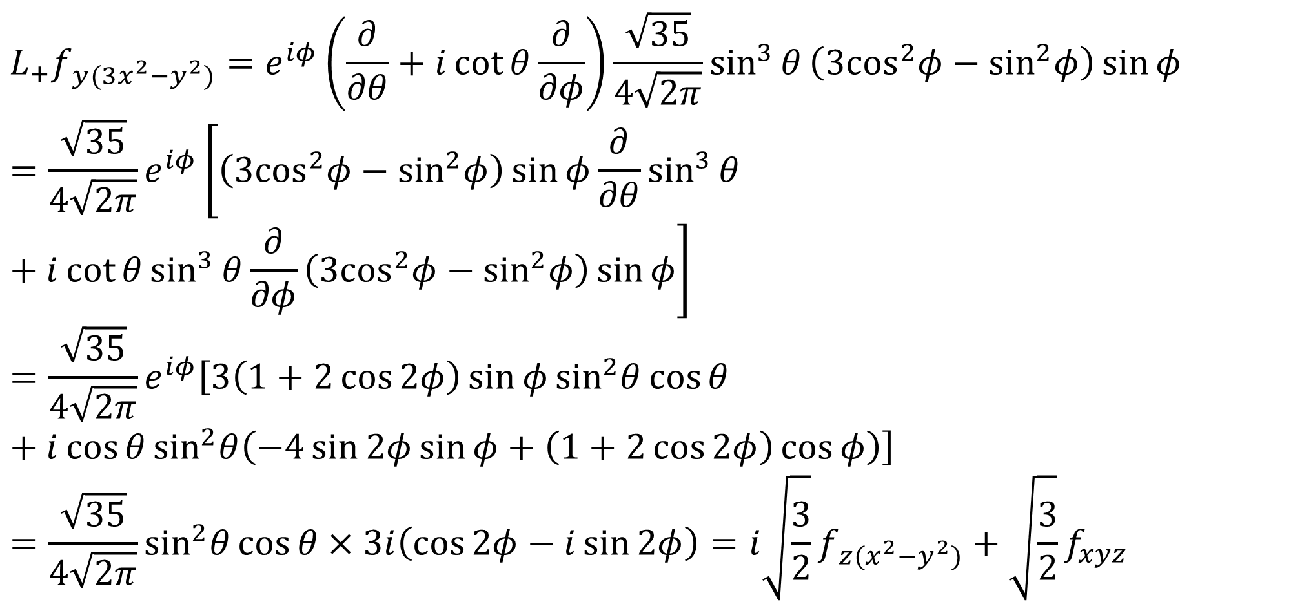
$$L_{+}f_{y(3x^{2}−y^{2})}=e^{iφ}\left(\frac{∂}{∂θ}+i\cot{θ}\frac{∂}{∂φ}\right)\frac{\sqrt{35}}{4\sqrt{2π}}\sin^{3}{θ}\left({\text{3}\text{cos}}^{2}φ−{\text{sin}}^{2}φ\right)\sin{φ}$$
$$=\frac{\sqrt{35}}{4\sqrt{2π}}e^{iφ}\left[\left({\text{3}\text{cos}}^{2}φ−{\text{sin}}^{2}φ\right)\sin{φ}\frac{∂}{∂θ}\sin^{3}{θ}+i\cot{θ}\sin^{3}{θ}\frac{∂}{∂φ}\left({\text{3}\text{cos}}^{2}φ−{\text{sin}}^{2}φ\right)\sin{φ}\right]$$
$$=\frac{\sqrt{35}}{4\sqrt{2π}}e^{iφ}\left[3\left(1+2\cos{2φ}\right)\sin{φ}{\text{sin}}^{2}θ\cos{θ}+i\cos{θ}{\text{sin}}^{2}θ\left(−4\sin{2φ}\sin{φ}+\left(1+2\cos{2φ}\right)\cos{φ}\right)\right]$$
$$=\frac{\sqrt{35}}{4\sqrt{2π}}{\text{sin}}^{2}θ\cos{θ}×3i\left(\cos{2φ}−i\sin{2φ}\right)=i\sqrt{\frac{3}{2}}f_{z(x^{2}−y^{2})}+\sqrt{\frac{3}{2}}f_{xyz}$$

Slide 17



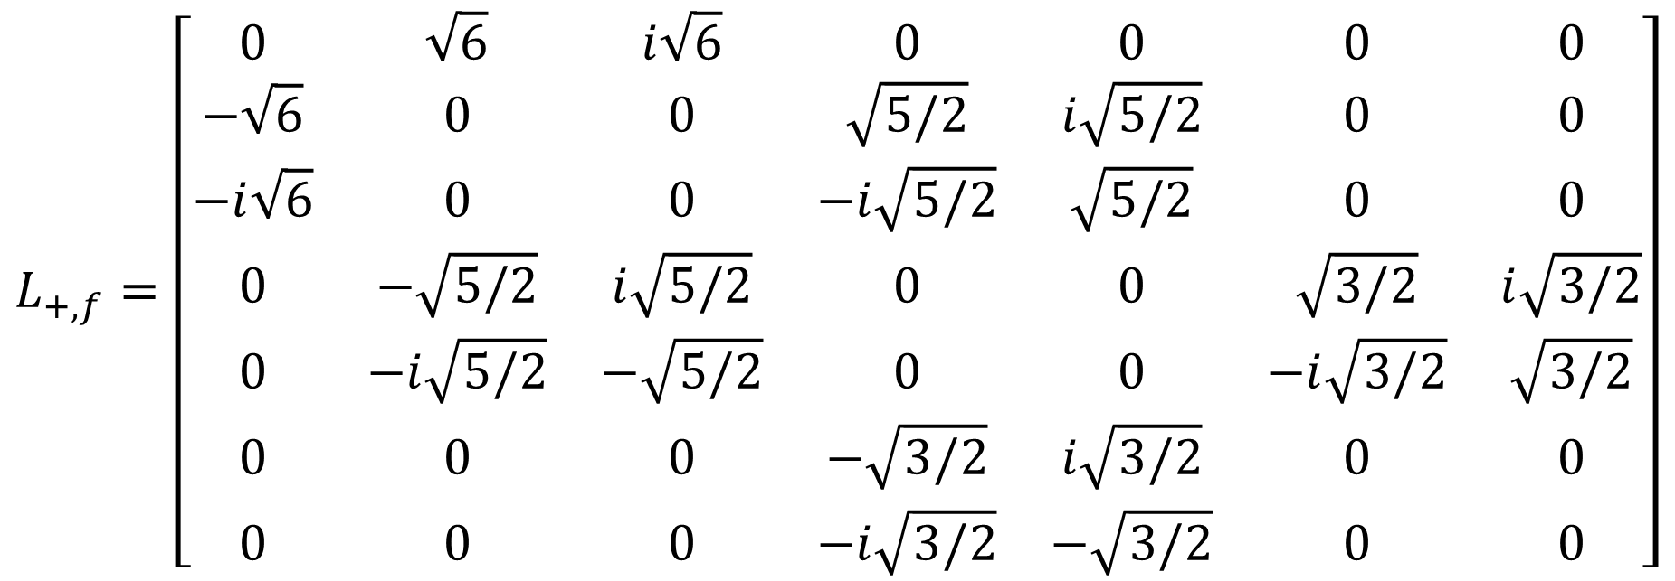




$$f_{z^{3}}$$
$$f_{{xz}^{2}}$$
$$f_{{yz}^{2}}$$
$$f_{z(x^{2}−y^{2})}$$
$$f_{xyz}$$
$$f_{x(x^{2}−3y^{2})}$$
$$f_{y(3x^{2}−y^{2})}$$
$$L_{+,f}=\left[\begin{matrix}0 & \sqrt{6} & i\sqrt{6} & 0 & 0 & 0 & 0 \\ −\sqrt{6} & 0 & 0 & \sqrt{5/2} & i\sqrt{5/2} & 0 & 0 \\ −i\sqrt{6} & 0 & 0 & −i\sqrt{5/2} & \sqrt{5/2} & 0 & 0 \\ 0 & −\sqrt{5/2} & i\sqrt{5/2} & 0 & 0 & \sqrt{3/2} & i\sqrt{3/2} \\ 0 & −i\sqrt{5/2} & −\sqrt{5/2} & 0 & 0 & −i\sqrt{3/2} & \sqrt{3/2} \\ 0 & 0 & 0 & −\sqrt{3/2} & i\sqrt{3/2} & 0 & 0 \\ 0 & 0 & 0 & −i\sqrt{3/2} & −\sqrt{3/2} & 0 & 0\end{matrix}\right]$$

