Slide 1
Analyzing House Prices and School Ratings for Scarborough
Applied Data Science Capstone
By Ben 202003

Slide 2
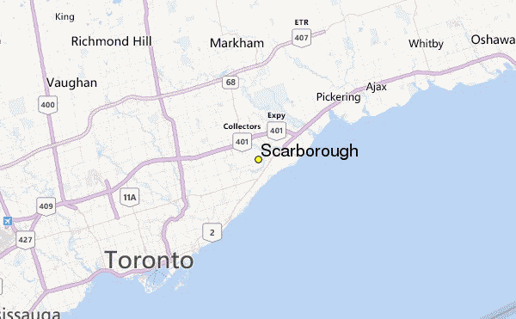

Slide 3
Part 1: Introduction
I think people who are deciding to live in a specific area of Canada would like to have access to information like housing prices and school ratings. This projects aim to conduct a comparative analysis between neighborhoods. The features include house price and school ratings, weather conditions, crime rates and recreational facilities, which would help people to know more about the places before making the movement.
In the project, we will rank the neighborhoods by the housing prices and school ratings.

Slide 4
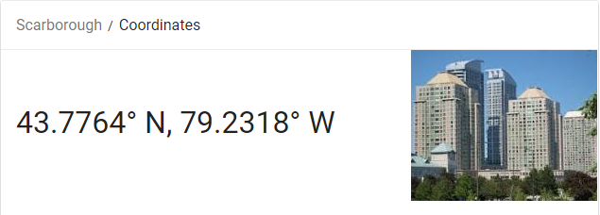
Part 2: Data Selection
Longitude and Latitude Data:
We will need geo-locational information about that specific borough and the neighborhoods in that borough. It is "Scarborough" in Toronto.
Dataset comprising latitude and longitude, zipcodes is already available through the previous notebook. The location of Scarborough would be filtered using the same:

Slide 5
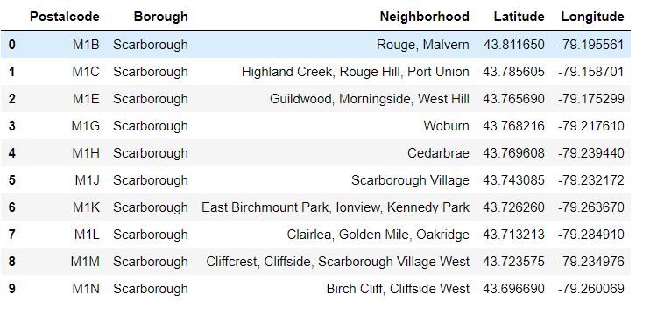

Slide 6
Foursquare API Data
Connecting to Foursquare and Retrieving Locational Data for Each Venue in Every Neighborhood
After finding the list of neighborhoods, we then connect to the Foursquare API to gather information about venues inside each and every neighborhood. For each neighborhood, we have chosen the radius to be 100 meter.

Slide 7
Data Preprocessing
Processing the Retrieved Data and Creating a DataFrome for All the Venues inside the Scarborough
When the data is completely gathered, we will perform processing on that raw data to find our desirable features for each venue. Our main feature is the category of that venue. After this stage, the column "Venue's Category" will be One-hot encoded and different venues will have different feature-columns.

Slide 8
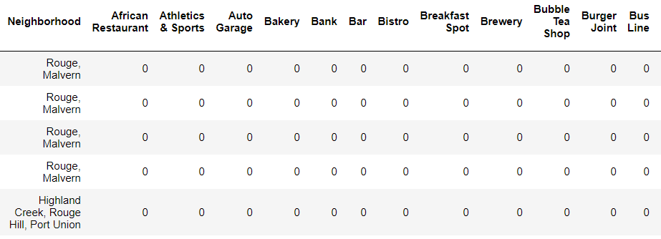
Creating a DataFrAme
Processing the Retrieved Data and Creating a DataFrame for All the Venues inside the Scarborough

Slide 9
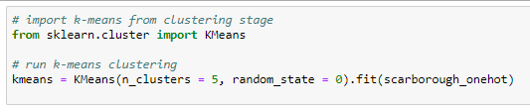
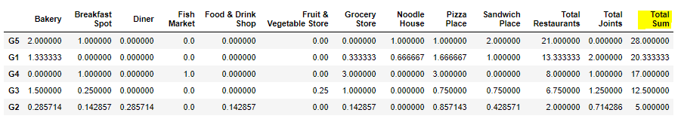
Main Article
Part 4: Applying K-Means Clustering

Slide 10
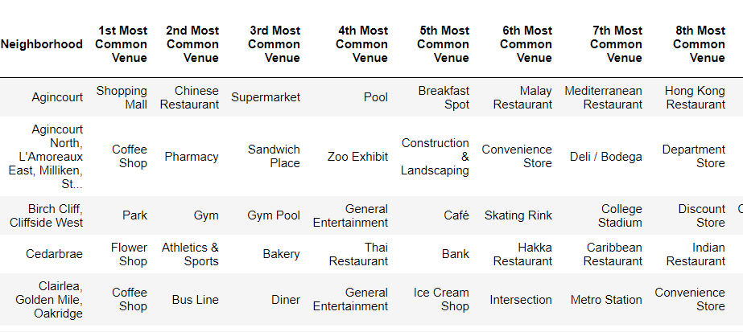
Finding Most Common Venues

Slide 11
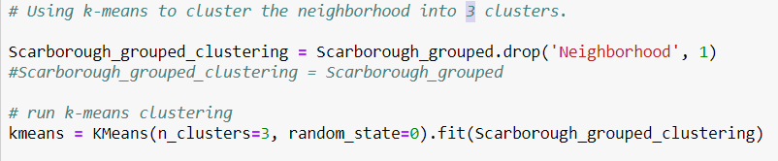
Clustering

Slide 12
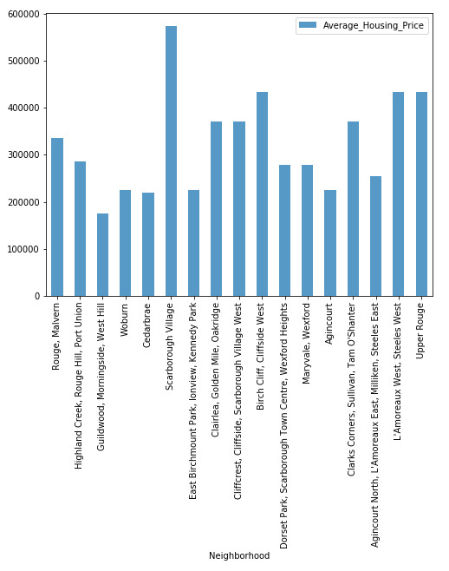
NEIGHBORHOOD MEDIAN HOUSING PRICES

Slide 13
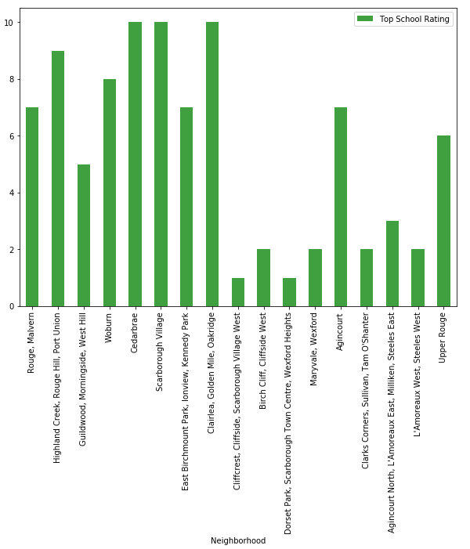
NEIGHBORHOOD SCHOOL RATINGS

Slide 14
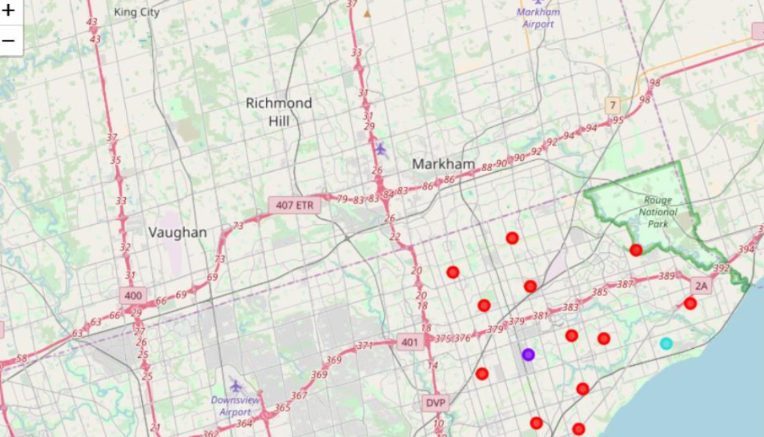
Conclusion:
In this project, we use K-means cluster algorithm to separate the neighborhood into 3 clusters. Based on the clustering result, we compare them with the average house prices and school rating.

Slide 15
THANKS

