Slide 1
使用Abella证明datalog规则的等价性
以polonius为例

Slide 2
Datalog Engine
swi(scala)
racket
https://docs.racket-lang.org/datalog/Tutorial.html
不过似乎没有否定语句？
souffle (c++)
parallel
Rust is using
bddbddb (java)
用bdd
https://github.com/vmware/differential-datalog
gnu-prolog gprolog (C)

Slide 3
形式化证明工具
Isabella
Lean3 Lean4
lambda prolog
Teyjus
ELPI（OCaml）
Abella（OCaml）
A lot of developing ...

Slide 4
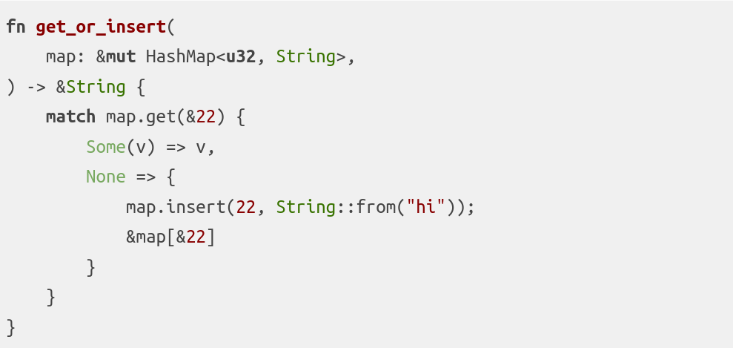
What polonius can help
https://nikomatsakis.github.io/rust-belt-rust-2019/#72
https://www.youtube.com/watch?v=_agDeiWek8w&t=329s&ab_channel=RustBeltRustConference

Slide 5
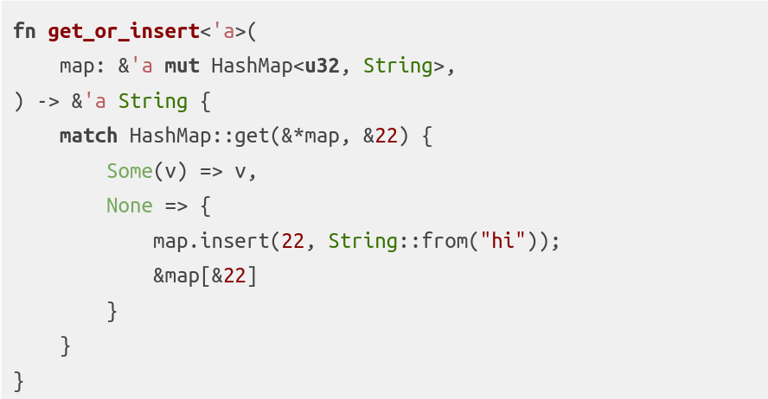
Desugared

Slide 6
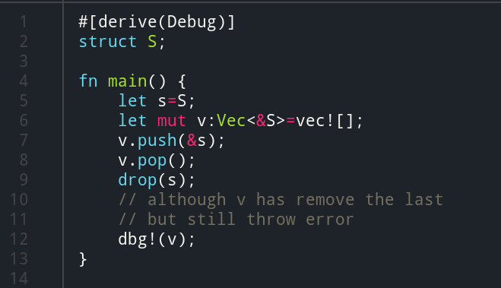
Polonius can’t deal with 1

Slide 7
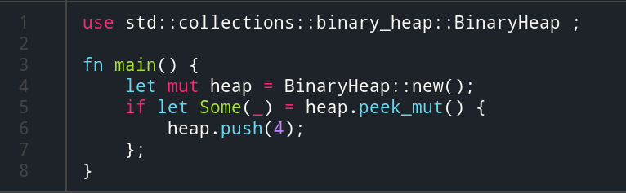
Polonius can’t deal with 2
https://github.com/rust-lang/rust/issues/70797

Slide 8
How polonius work?
liveness calculation => origin_live_on_entry
move error
origin error

Slide 9
Some tricky point of proof
How to express negative
In polonius, origin_live_on_entry and ! origin_live_on_entry are quite common
I use two rules to express it:
origin_live_on_entry and not_origin_live_on_entry
And two axioms:
origin_live_on_entry Origin Point ->
not_origin_live_on_entry Origin Point -> false
Theorem Axiom1: forall Origin, forall Point,
origin_live_on_entry Origin Point \/ not_origin_live_on_entry Origin Point

