Slide 1



Joint Capacity Planning and Operational Management for Sustainable Data Centers and Demand Response
June 22, 2016
Tan N. Le, Zhenhua Liu, Yuan Chen, and Cullen Bash
Notes:
Introduce my self
I am a Phd Student from Stony Brook University, NY.
This joint work with my advisor Dr. Zhenhua Liu, and 2 co-authors from HP labs Yuan Chen and Cullen Bash

Slide 2
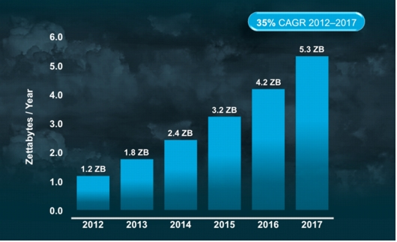
Total Global Cloud Traffic Growth
www.cisco.com
Notes:
The total data center traffic has been significantly increasing at 25% at year as the high demand from the Internet users.
Especially, could data centers are significantly increasing
Source: http://www.cisco.com/

Slide 3
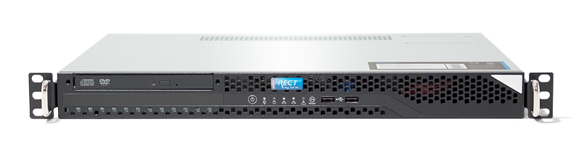

Environmental threat from data centers
Emissions in 2013
450W
5.2 tons carbon a year
=
Carbon footprints of servers can vary by 10x, www.vertatique.com
E. Facts. Greenhouse gas emissions from a typical passenger vehicle, 2005.
www.nrdc.org & wikipedia.org
Notes:
High light the emission

Slide 4
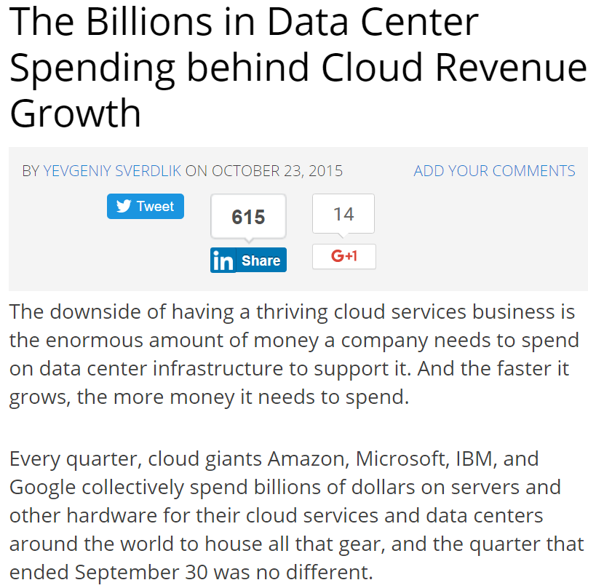
Where do the costs come from?
http://www.datacenterknowledge.com/
Notes:
How much do data centers cost?

Slide 5






Power sources
fuel
What are the drawbacks of separate CP & OM?
servers
cooling
electricity bills
maintenance
Capacity Planning
(CP)
Operational
Management
(OM)
Traditionally, they are separate
Notes:
Emphasize that Capacity Planning and Operational Management are separate
Highlight that staff salary is small
What is the drawback?

Slide 6
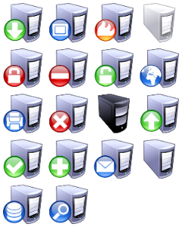

based on the peak demand
Traditional Capacity Planning
Over capacity planning
Demand
Supply
good news
Power demand can be shaped
Power demand of a data center
Notes:
This is a example of how people do capacity planning.
Todo: Cite

Slide 7
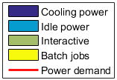
Example: shaping power demand
Scheduling the batch jobs
[Aksanli SIGOPT’12 ]
~500kW
~400kW
Waste of 20% of supply & demand
More data center demand management techniques
Server consolidation [Lin ToN’13, Zhang ICAC’12]
Network consolidation
[Zhang ICNC’10, Andrews ToN’12]
Optimize cooling power
[Pakbaznia ISLPED’09,
Liu SIGMETRICS’12]
Geographical load balancing
[Qureshi SIGCOMM’09, Liu SIGMETRICS’ 11]
Notes:
Shifting the batch job workload
500

Slide 8
Proposed Optimization Framework
Capacity Planning
(CP)
Operational
Management
(OM)
Joint
Notes:
Proposed Framework

Slide 9

Goal: Reduce data center costs
Approach: Joint Optimization Framework
Capacity Planning
(CP)
Operational
Management
(OM)
Joint
Modeling
Evaluation

Slide 10


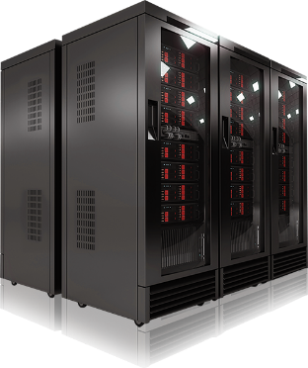
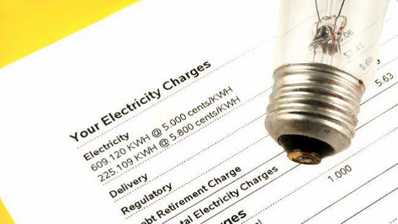
Joint Optimization Framework
minimize
UtilBill
+ RGEx
+ NGEx
+ ITEx
Renewable Generation Expense (RGEx)
Non-renewable Generation Expense (NGEx)
IT expense (ITEx)
Utility bills (UtilBill)
Purchase
– sellback
Infrastructure cost
+ O&M cost
Infrastructure cost
+ Fuel cost
+ O&M cost
Infrastructure cost
+ O&M cost
Notes:
Utility bills

Slide 11


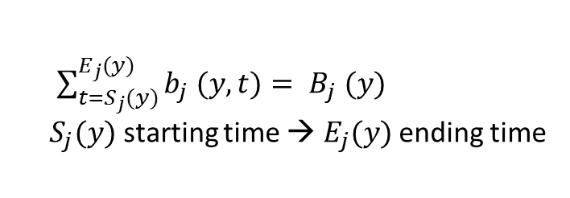



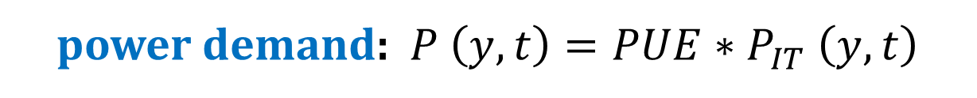
Modeling power demand at time $t$ year $y$
IT power: $P_{IT} \left(y,t\right)=\sum_{i=1}^{N}{a_{i} (y,t)}+\sum_{j=1}^{J}{b_{j} (y,t)}+P_{idle} \left(y,t\right)$
$N$ interactive workloads
$J$ batch jobs
idle power
$a_{i} (y,t)$: power for workload $i$
$B_{j} (y)$: power for job $j$
$\sum_{t=S_{j}(y)}^{E_{j}(y)}{b_{j} (y,t)}= B_{j} (y)$
$S_{j}(y)$ starting time → $E_{j}(y)$ ending time
used to schedule batch jobs
power demand: $P \left(y,t\right)=PUE∗P_{IT} \left(y,t\right)$

Slide 12
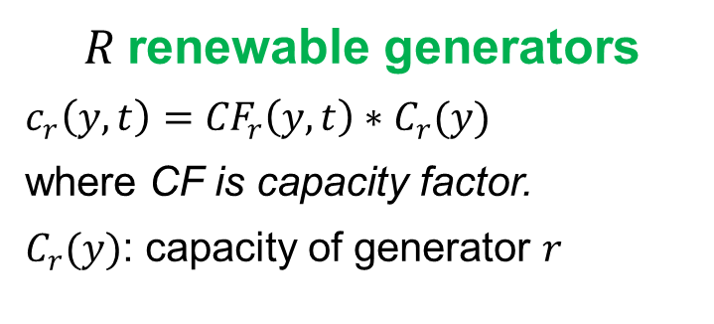


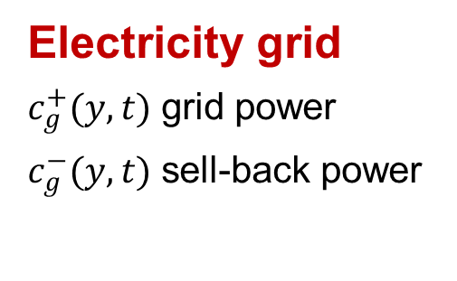
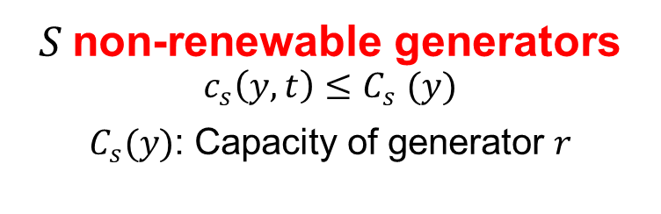
Modeling power supply at time $t$ year $y$
power supply: $\sum_{r=1}^{R}{c_{r}\left(y,t\right)}+\sum_{s=1}^{S}{c_{r}\left(y,t\right)}+c_{g}^{+}\left(y,t\right)−c_{g}^{−}(y,t)$
$R$renewable generators
$c_{r}\left(y,t\right)={CF}_{r}\left(y,t\right)∗C_{r}(y)$
where CF is capacity factor.
$C_{r}(y)$: capacity of generator $r$
$S$non-renewable generators
$$c_{s}\left(y,t\right){≤C}_{s}(y)$$
$C_{s}(y)$: Capacity of generator $r$
Electricity grid
$c_{g}^{+}(y,t)$ grid power
$c_{g}^{−}(y,t)$ sell-back power
power supply $≥$ power demand

Slide 13
How the framework operates?
Capacites
Renewable generation
non-renewable generation
IT power demand
Inputs (forecasted)
Workload traces
Electricity prices
Infrastructure costs
O&M costs
Joint
Optimization
Framework
Operational outputs
non-renewable generation
Grid power usage
Sell-back power
Power allocated to IT workloads
Notes:
Optimization problem

Slide 14
Goal: Reduce data center costs
Approach: Joint Optimization Framework
Capacity Planning
(CP)
Operational
Management
(OM)
Joint
Modeling
Evaluation

Slide 15
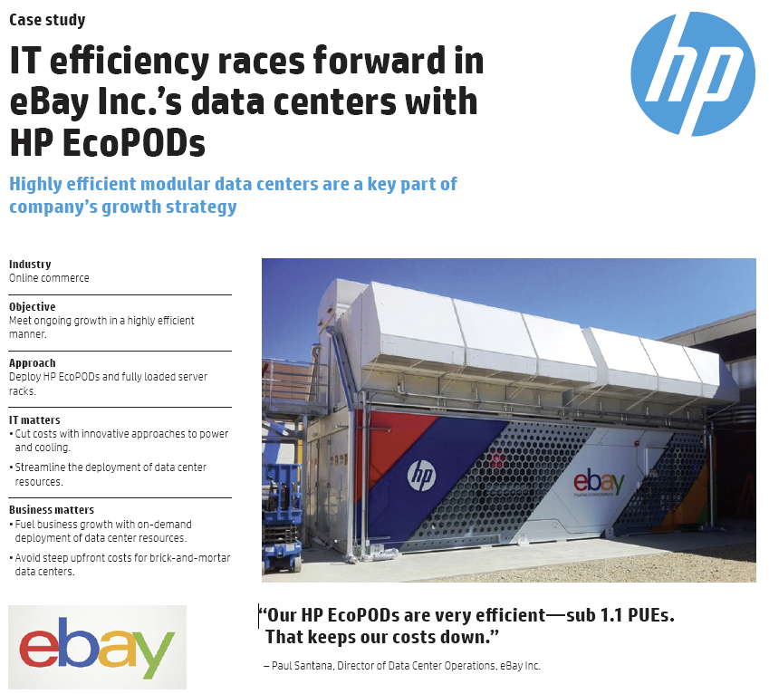
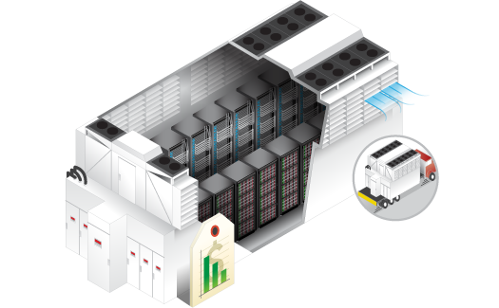
Simulation based on 1MW HP EcoPod Data Center
HP EcoPODs 240a
www.hp.com

Slide 16
Power Demand
Peak power usage: 720kW
Peak-to-Mean ratio: 3
PUE: 1.2
SAP CPU power usage trace
Batch jobs: 50%
Flexibility 24 hours
Maximum utilization is 90%
Interactive workload: 50%
Utilization of server: 40%
We do not include capacity planning for IT equipment
Notes:
We do not include capacity planning for IT equipment

Slide 17
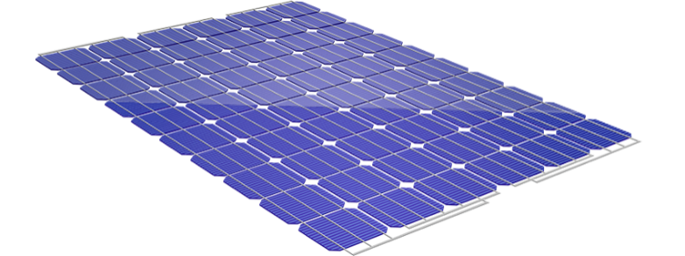
Power Supply
General Electric (GE)
Natural Gas generation
Amortized cost: $1/W a year
O&M cost: 0.06+$0.005/kWh
Emission rate: 0.443g/kWh
PV generation
Houston PV generation
Amortized cost: $2.15/W a year
O&M cost: $0 + $0.005/kWh
Capacity factor: ~18%
Emission rate: 0.034g/kWh
Electricity grid
Prices: $0.056/kWh
Emission rate: 0.5g/kWh

Slide 18
Comparisons with Baseline methods
Grid Only (GRID) in traditional data centers Only provision power from the electricity grid
Supply-only Optimization (SUP) Optimize power sources based on given demand
Demand-only Optimization (DEM) Optimize power demand based on given the capacity planning
e.g., 500kW PV & 700kW GE
Proposed framework PROP = SUP + DEM

Slide 19




How much cost savings and emission reductions?
I: Infrastructure
O: Operational
Util: Utility bill
Cost: PROP = 50 % GRID
Emissions: PROP = 25 % GRID
GRID: Grid only
DEM: Demand-only optimization
SUP: Supply-only optimization
PROP: Proposed framework
Notes:
Grid: Grid only
Dem: Demand-only optimization
Sup: Supply-only optimization
Prop: Proposed framework

Slide 20
Costs and Emissions under Prediction Errors
58%
49%
Expenditures vs. prediction errors
Emissions vs. prediction errors
PROP significantly outperforms GRID under large prediction errors
Notes:
PROP significantly outperforms GRID under large prediction errors
58%

Slide 21

Data Center vs. Electricity Grid
impact
Data centers are large loads
Electricity grid
1MW data center = 750 houses in CA
Power demand can be shaped
High potential of Data Center Demand Response (DCDR)
http://enduse.lbl.gov/
Electricity grid
Notes:
Data center demand response is promising

Slide 22
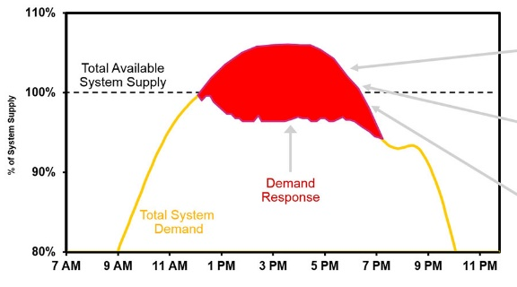


Example: how demand response (DR) works?
Grid condition
DR signal
Accept → reward
Reject → penalty
Notes:
How demand response (DR) works by example

Slide 23
Extending Joint Optimization Framework for DCDR
minimize
UtilBill
+ RGEx
+ NGEx
+ ITEx
RG Expense (RGEx)
NG Expense (NGEx)
IT expense (ITEx)
Utility bills (UtilBill)
Purchase
– sellback
Infrastructure cost
+ O&M cost
Infrastructure cost
+ Fuel cost
+ O&M cost
Infrastructure cost
+ O&M cost
- DR reward
+ DR penalty
Notes:
Utility bills

Slide 24
Demand response (DR) programs
Passive participations
Active participations
Customers voluntarily to have DR contracts with Utilities
Customers have to participate in DR programs
Example:
Time of Use (ToU): prices vary in different periods a day.
Example:
Ancillary services to maintain the reliability of grid, e.g., Spinning Reserve (SR)
[Wierman ISGC’14]

Slide 25
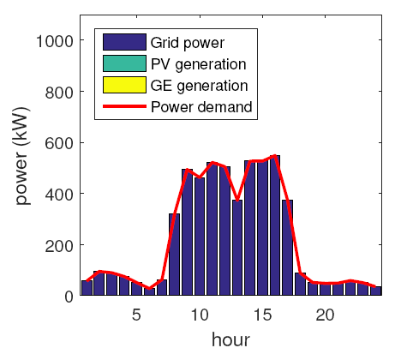
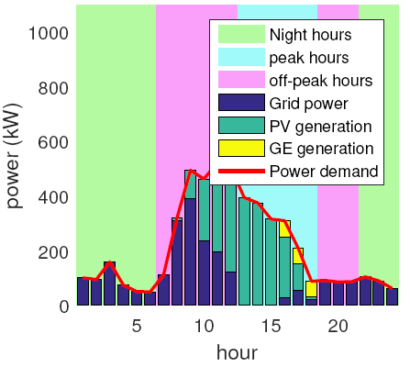
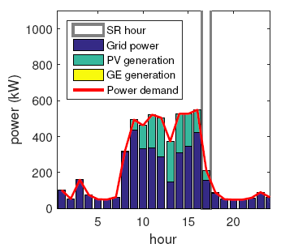
Operation of Framework in DR programs
Without DR programs
Time of Use (ToU)
Spinning Reserve (SR)
Base price: $0.056/kWh
$0.05 (night), $0.219 (peak), $0.06 (off) /kWh
SR rate: $0.02/kWh
Notes:
Without DR programs

Slide 26
How DR impacts on data centers?
Little change on total costs
Some DR programs result in low emissions
IBR: Inclining Block Rates
CPP: Critical Coincident Peak Pricing
WS: Wholesale market
$0.2 (<50kW), $0.5 (<100kW)
CPP rate: $11.2/kWh
$0.05/kWh
Notes:
IBR: Inclining Block Rates

Slide 27
Goal: Reduce the total cost for data centers
Method: Joint optimization framework
Capacity Planning
(CP)
Operational
Management
(OM)
Joint

Slide 28


Joint Capacity Planning and Operational Management
Cost saving 50%
Emission reduction 75%
Well adapting to
Demand Response
Programs
Thank you
Notes:
Thank you

Slide 29

www.theodysseyonline.com

Slide 31
Backup slides

Slide 33
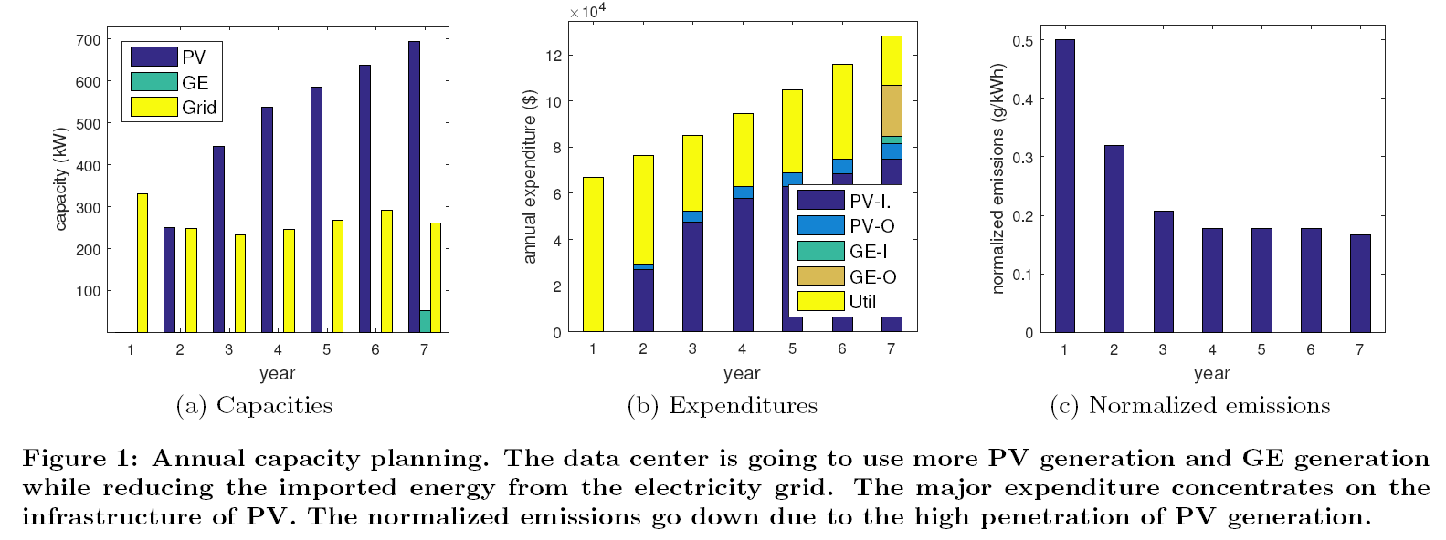

Slide 34
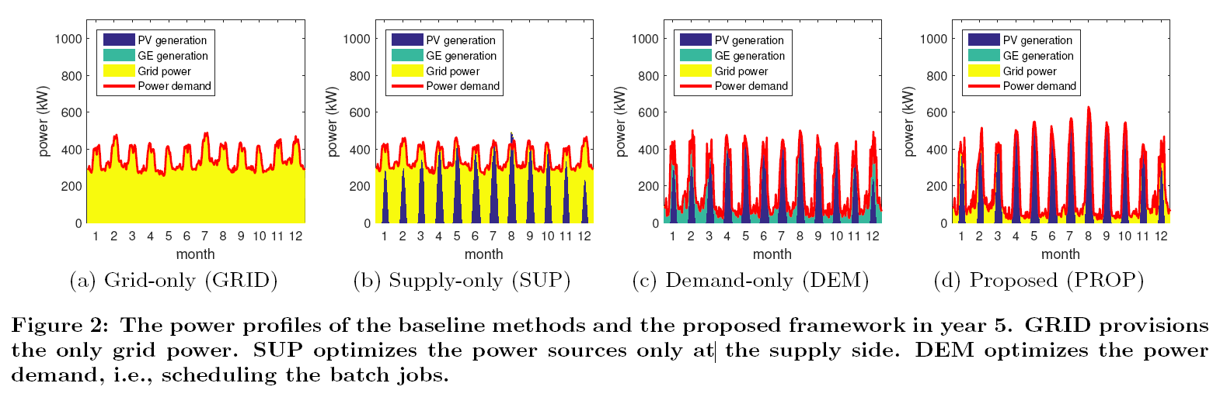

Slide 35
Impacts on
Net-zero energy data centers
Notes:
Total local supply >= total demand in long-run

Slide 36
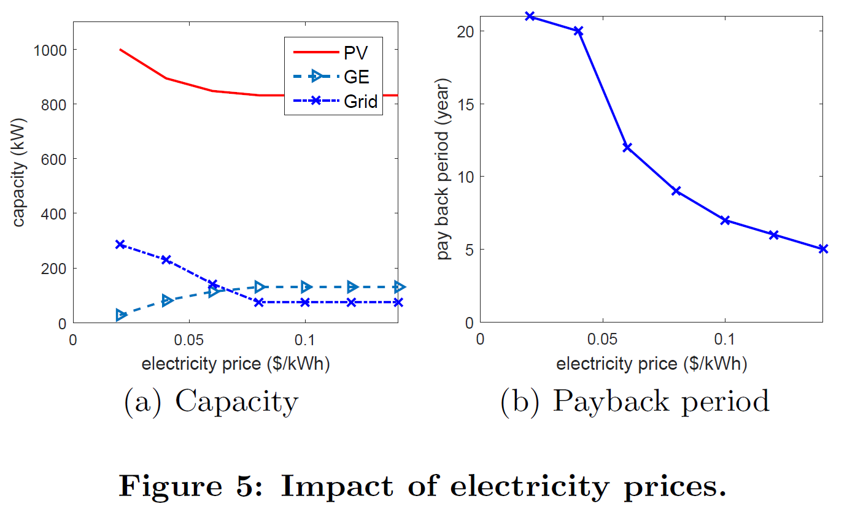
Notes:
the data center starts to use more GE to provide power during night and given the increased GE capacity, more GE generation is used during day time to replace PV.

Slide 37
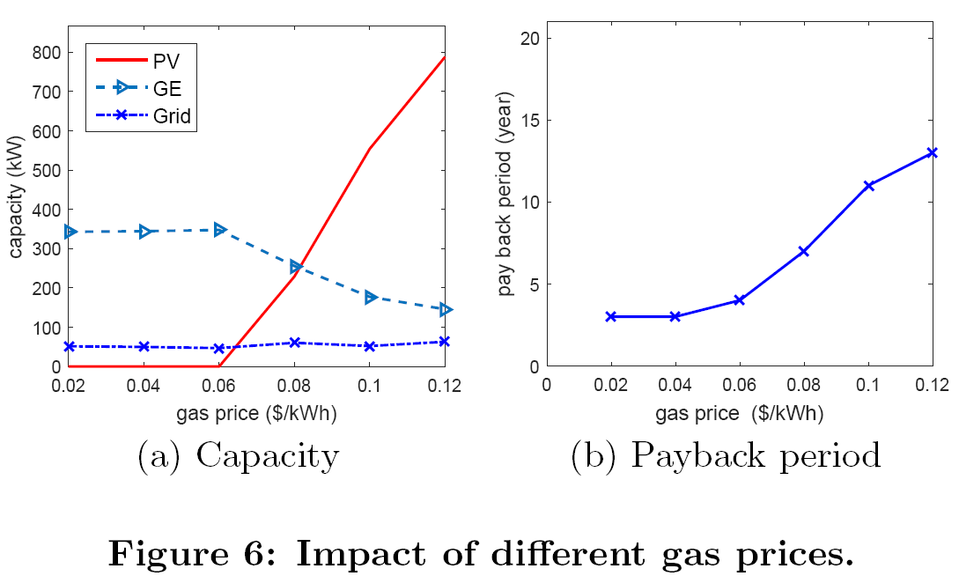
Notes:
Especially, there is the sharp increase of PV capacity when the gas price is more than $0.06$.
Due to the non-dispatchability of solar energy, the data center needs the large capacity of PV generation to compensate the reduction of GE generation.

Slide 38
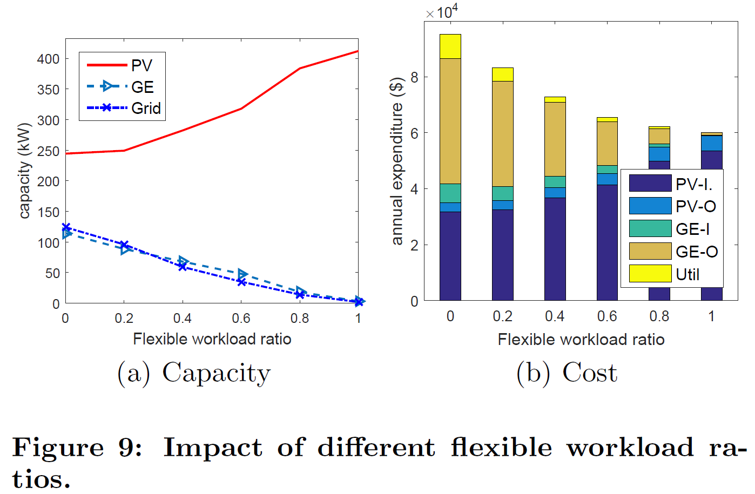

Slide 39
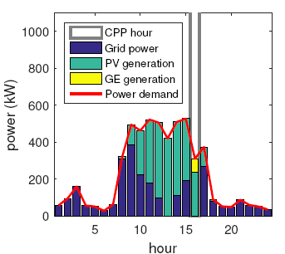
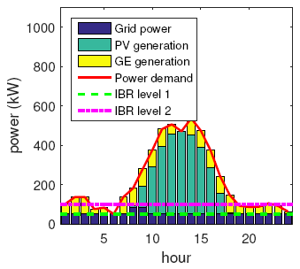
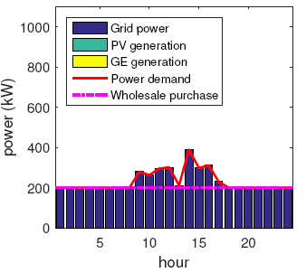
Without DR programs
Time of Use (ToU)
Critical Peak Pricing (CPP)
Base price: $0.056/kWh
$0.05 (night), $0.219 (peak), $0.06 (off) /kWh
CPP rate: $11.2/kWh
IBR
Spinning Reserve (SR)
Wholesale (WS) market
$0.2 (<50kW), $0.5 (<100kW)
SR rate: $0.02/kWh
$0.05/kWh
Notes:
Without DR programs

Slide 40
Proposed Joint Optimization framework for capacity planning and operational management
50% cost savings
75% emission reductions
Proposed framework
promotes the use of renewable energy
adapts well to DR programs

