Slide 1



Joint Capacity Planning and Operational Management for Sustainable Data Centers and Demand Response
June 21, 2016
Tan N. Le, Zhenhua Liu, Yuan Chen, and Cullen Bash
Notes:
ACM e-Energy 2016

Slide 2
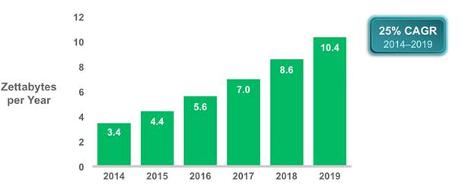
Global IP traffic increasing
Notes:
Global IP traffic increasing

Slide 3
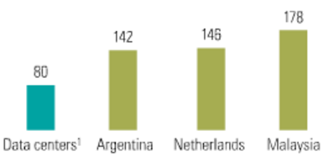
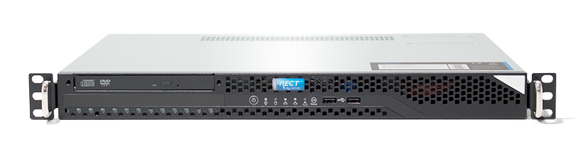

Environmental threat from data centers
450W
5.2 tons carbon
=
Megatons Carbon a year
https://arnoudm.wordpress.com/2009/01/13/datacenter-power-consumtion/
Notes:
Megatons Carbon

Slide 4
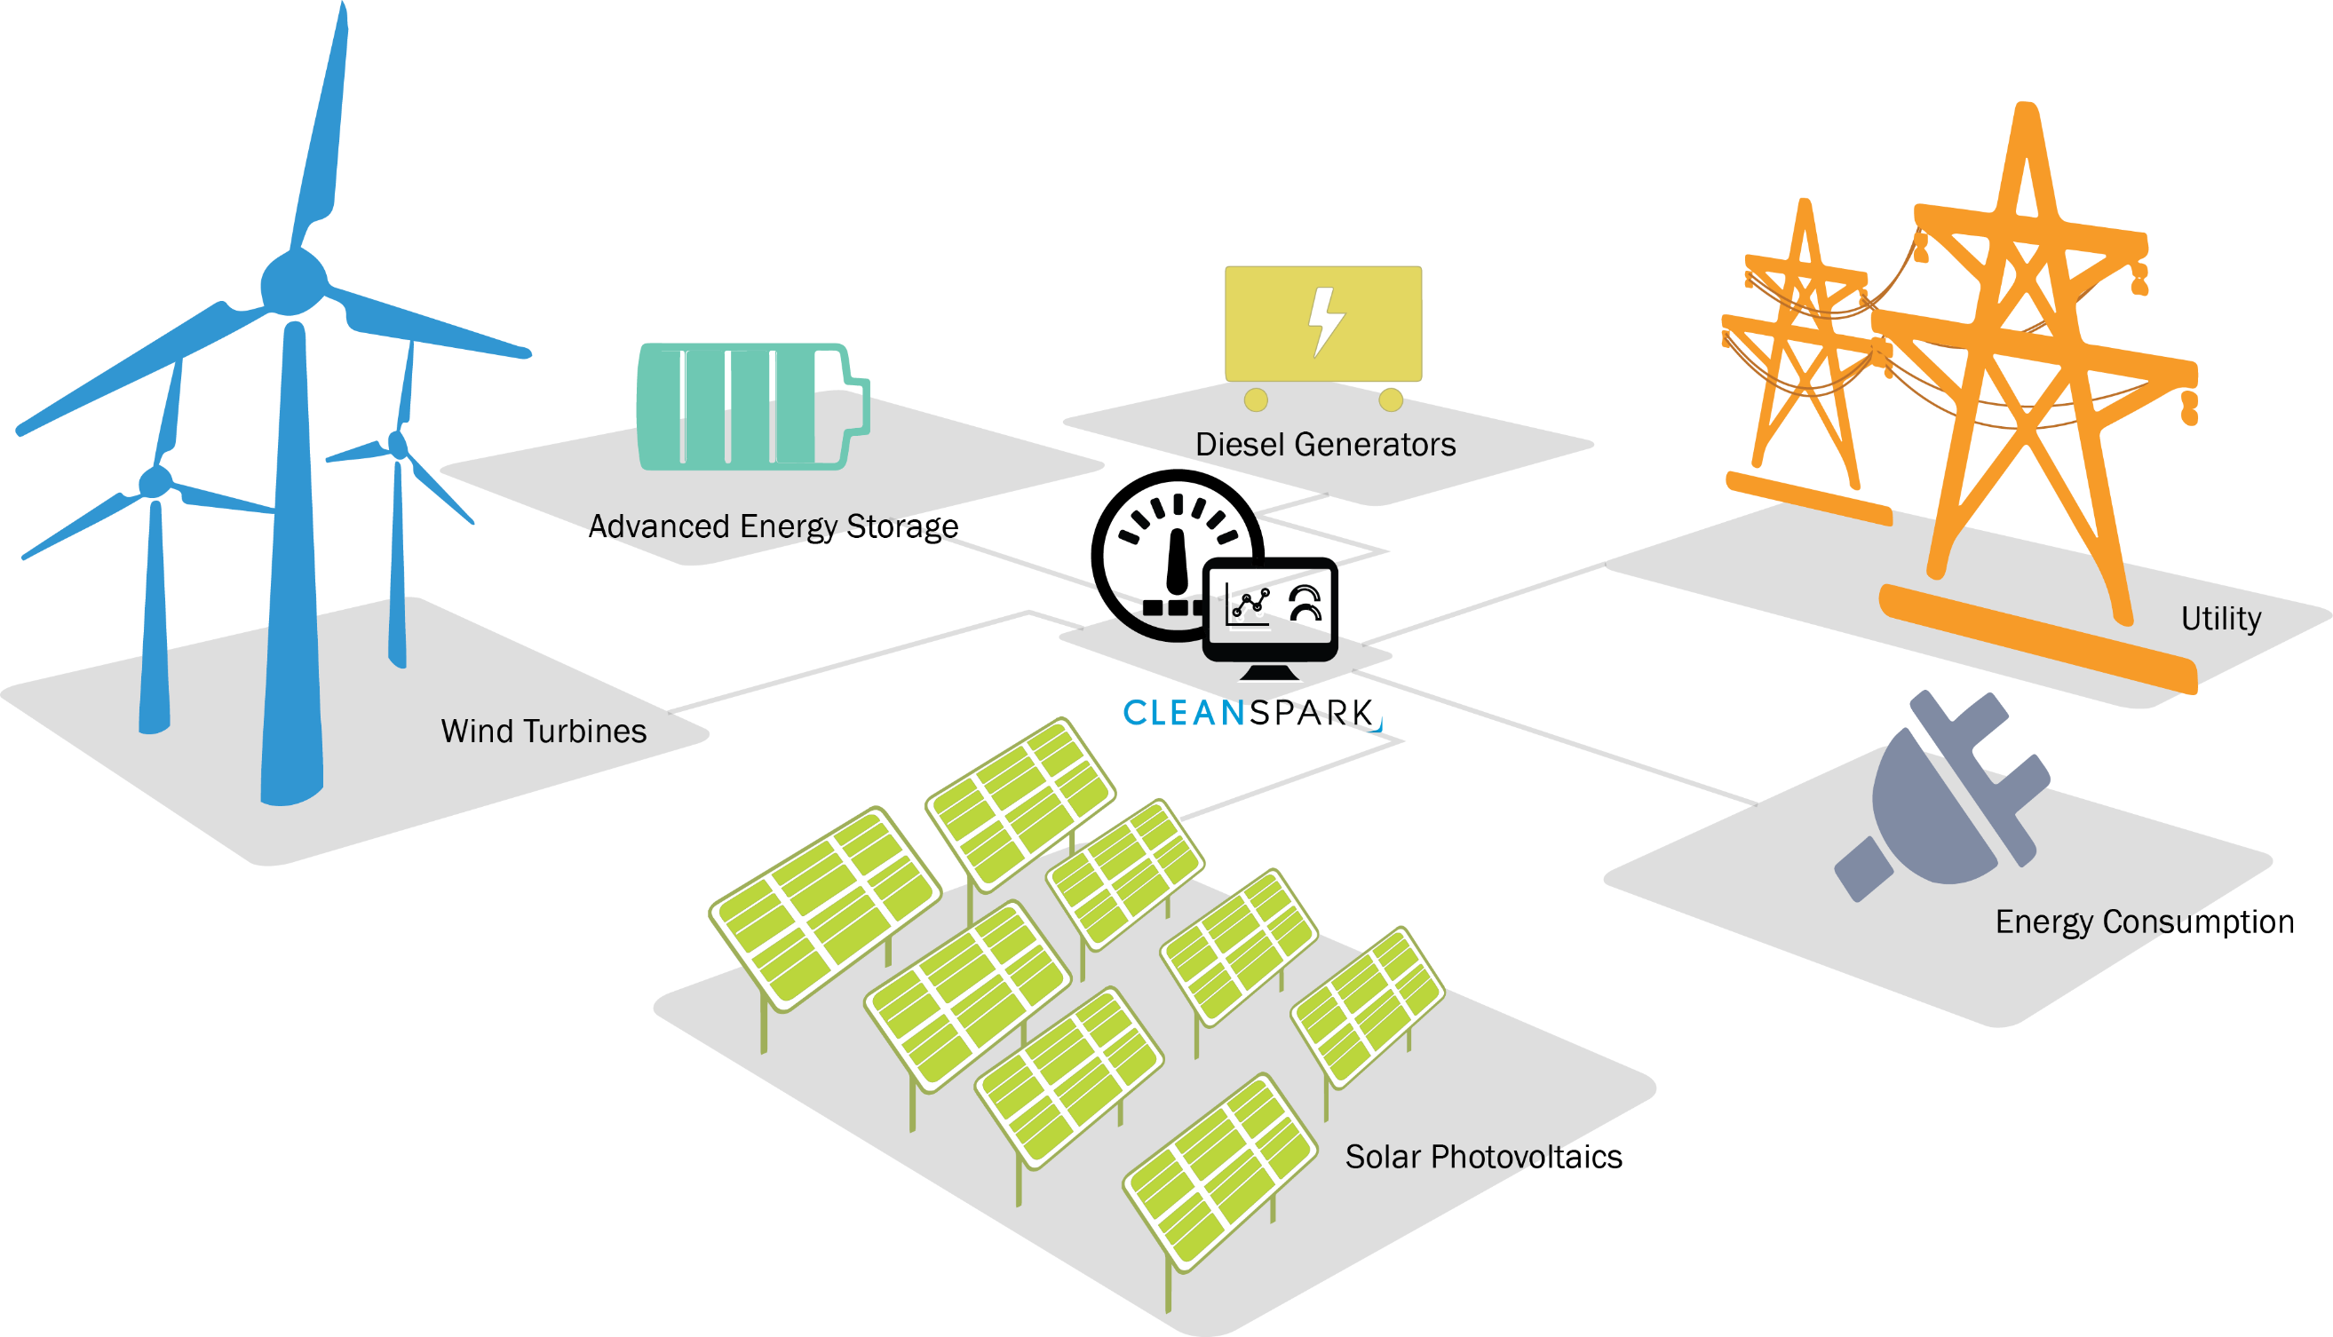
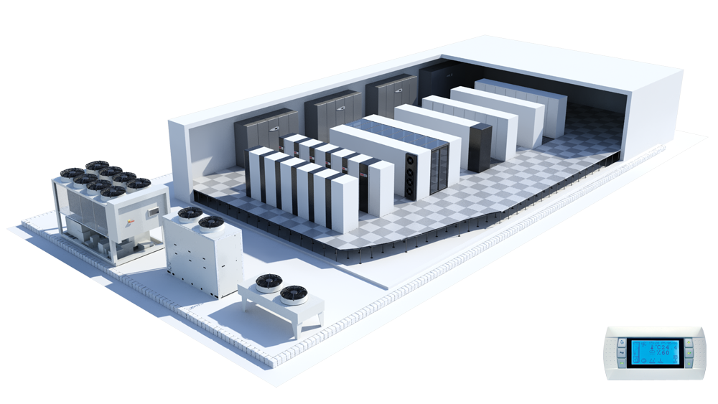
We need
Sustainable Data Centers (SDCs)
http://www.cleanspark.com/
Notes:
We need sustainable data centers

Slide 5
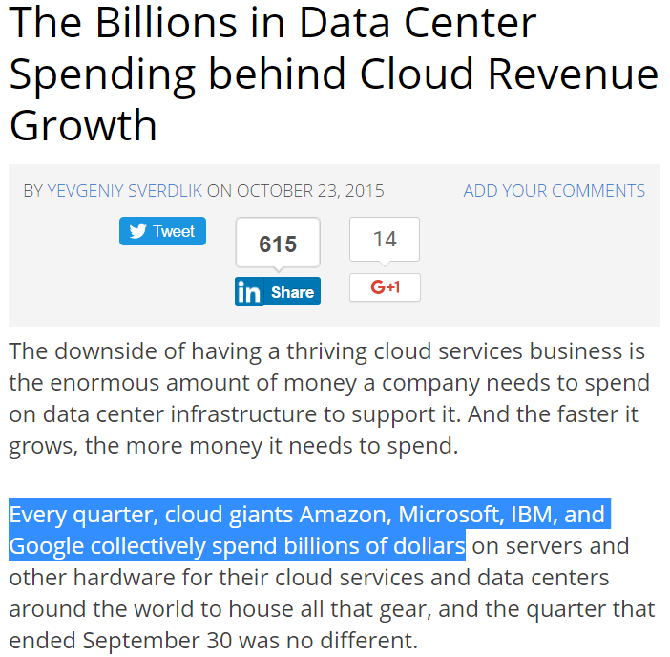
How much do data centers cost?
http://www.datacenterknowledge.com/
Notes:
How much do data centers cost?

Slide 6






Capital
Expense
Operational
Expense
Capacity planning → Operational Management
Notes:
Total Cost of Ownership
Capital Expense
Operational Expense

Slide 7
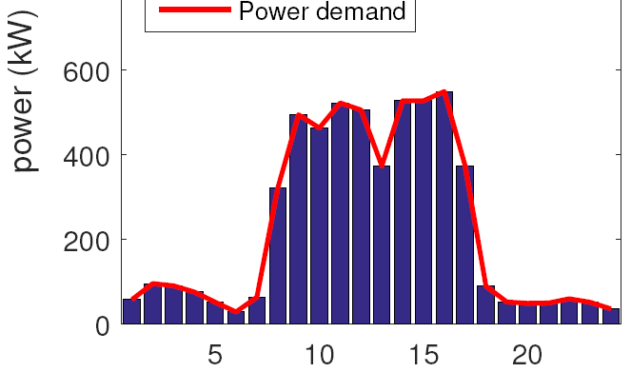
A lot of cost wastes in traditional capacity planning
Step 1: Analyze Current Capacity
Step 2: Planning for the future
A significant drawback
Peaks are much higher than average
Notes:
A lot of cost wastes

Slide 8
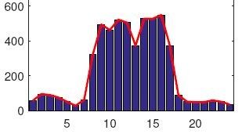
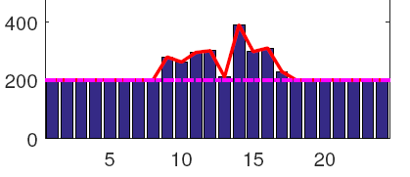
Power demand can be dynamically shaped
How we do capacity planning when power demand is flexible?
Notes:
How we do capacity planning when power demand is flexible

Slide 9
Joint Optimization Framework
Capacity Planning
Joint
Operational Management
Notes:
Proposed Framework

Slide 10




What is the objective of framework?
Minimize total cost of
Utility bills (Util)
Renewable Generation
Expense (RGEx)
Non renewable
Generation
Expense (NGEx)
IT equipment expense (ITEx)
Notes:
Utility bills

Slide 11
Power demand from IT workloads
 | Interactive workloads | Batch jobs
Examples: | Chat, video streaming apps | analysis apps
Flexible | Can not be delayed | Can be postponed
Notes:
Idle power

Slide 12
Inputs (forecasted)
Workload traces
Electricity prices
Infrastructure cost
O&M cost
Emission rate
Capacity planning outputs
Capacities of renewables
Capacities of non-renewables
Capacity of IT power demand
Capacity of Electricity grid
Joint
Optimization
Framework
Operational management outputs
non-renewable generation
Grid power usage
Sell-back power
Power allocated to IT workloads
Notes:
Optimization problem

Slide 13
Evaluation
Notes:
Evaluation

Slide 14
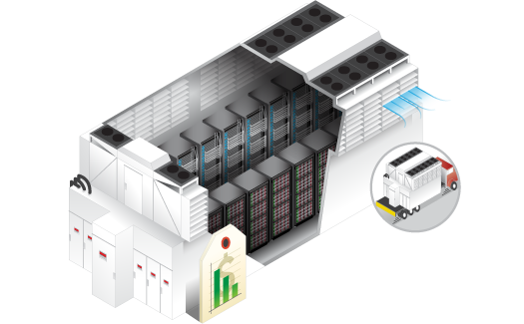
IT equipment based on 1MW HP EcoPod data center
Increase of workload demand | 1.09 a year
IT workloads | Ratios
Interactive workload | 50%
Batch jobs (24h deadlines) | 50%
HP EcoPODs 240a

Slide 15
Parameters of power sources
PV array | Values
Amortized cost | $2.15/W a year
Max capacity | 1MW
Operation cost | $0/kWh
Maintenance cost | $0.005/kWh
Capacity factor | ~18%
Infra. cost of PV increase rate | 0.88 a year

Slide 16
Other parameters
Electricity grid | Values
Prices | $0.056/kWh
Natural gas engines (GE) | Values
Amortized cost | $1/W a year
Max capacity | 1.4 MW
Operational cost | $0.06/kWh
Maintenance cost | $0.005/kWh
Efficiency | 30%
Annual change rates | Values
Electricity prices | 1.05
Natural gas | 1.01

Slide 17
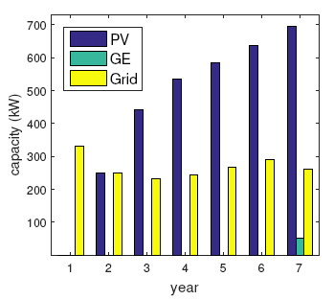
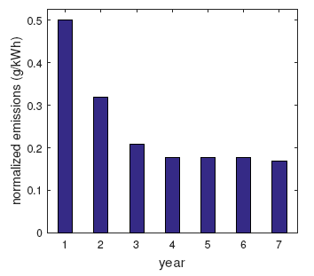
How proposed framework does capacity planning?
PV increases
PV: Photovoltaic array - GE: General Electric natural gas engines - Grid: Peak of grid power consumption
Notes:
Messages:
The quickly increasing of PV
Emissions go down
PV increases

Slide 18
Compare with baseline methods
Methods | Descriptions
Grid only (GRID) | Only provision power from the electricity grid
Supply only (SUP) | Optimize capacity planning based on given demand
Demand only (DEM) | Optimize power demand based on given the capacity planning
Proposed framework (PROP) | = SUP + DEM

Slide 19
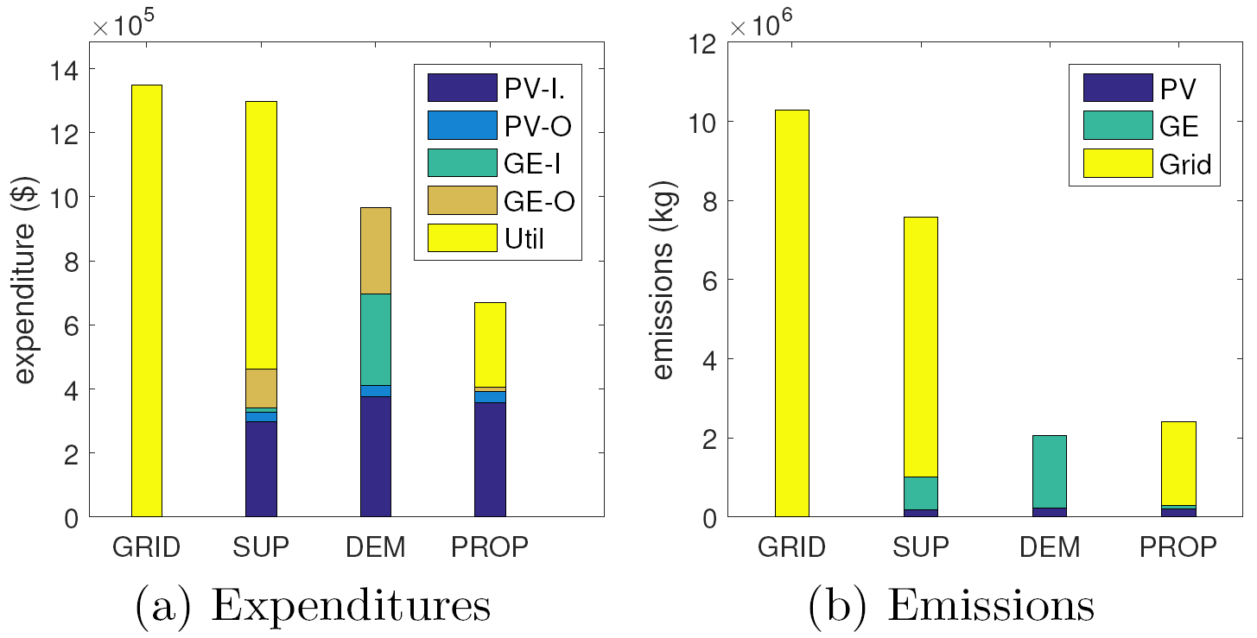
How much cost savings and emission reductions?
50%
I: Infrastructure
O: Operational
Util: Utility bill
75%
GRID: Grid only
DEM: Demand-only optimization
SUP: Supply-only optimization
PROP: Proposed framework
Notes:
Grid: Grid only
Dem: Demand-only optimization
Sup: Supply-only optimization
Prop: Proposed framework

Slide 20
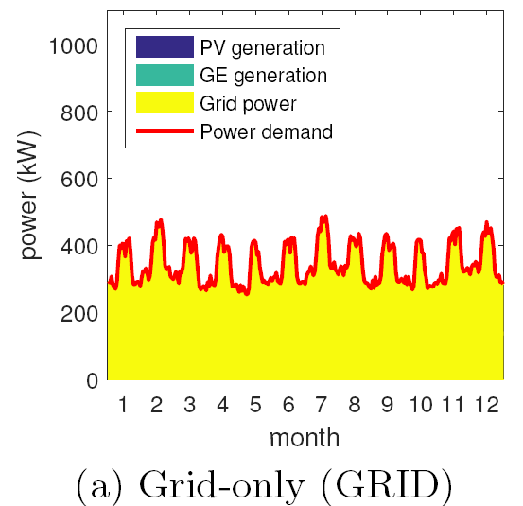
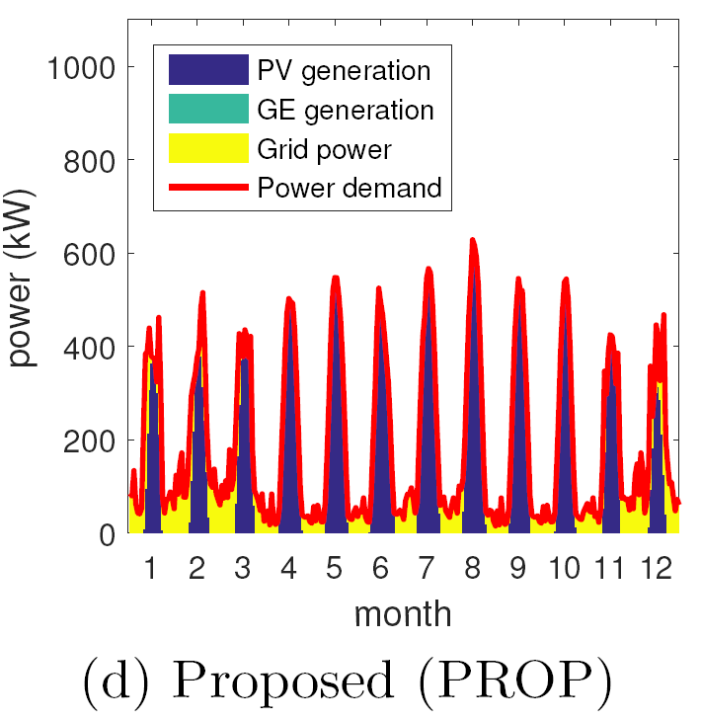
Why PROP outperforms others?
shapes the demand and utilizes PV
Notes:
Utilize PV

Slide 21
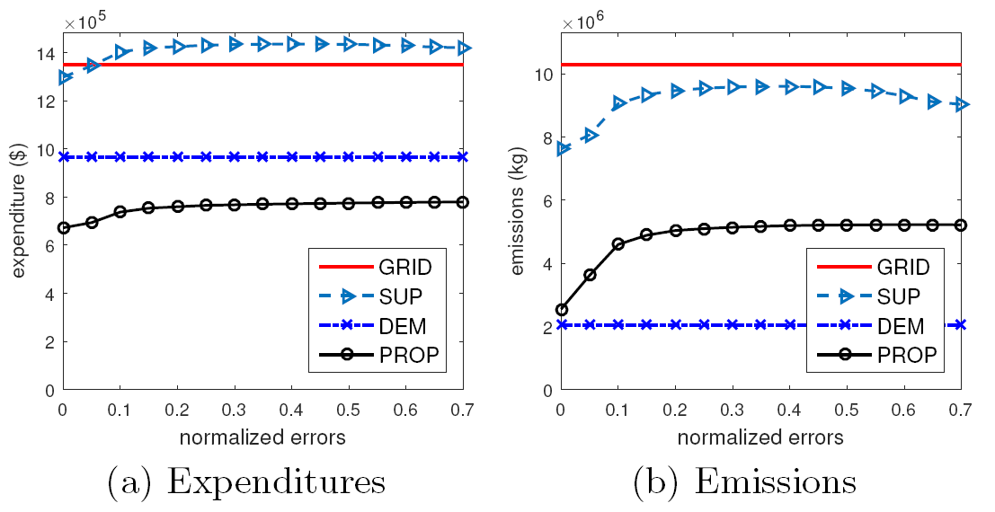
Would the proposed framework performs well under prediction errors?
PROP significantly outperforms GRID under large prediction errors
Notes:
PROP significantly outperforms GRID under large prediction errors

Slide 22
How Proposed Framework does
Demand Response?
Notes:
Data center demand response

Slide 23
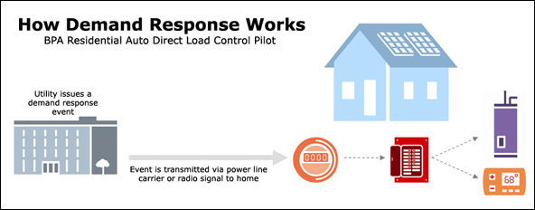
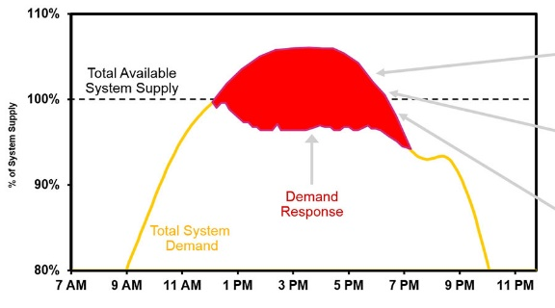
Notes:
Todo: make a diagram for DR programs

Slide 24
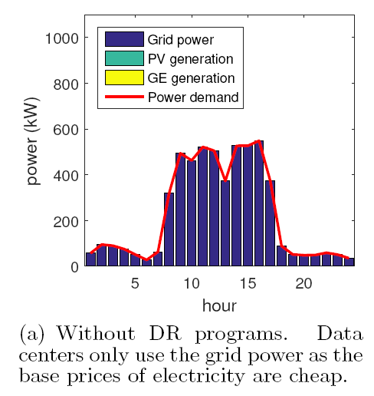
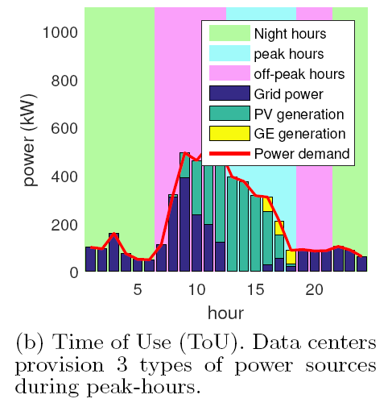
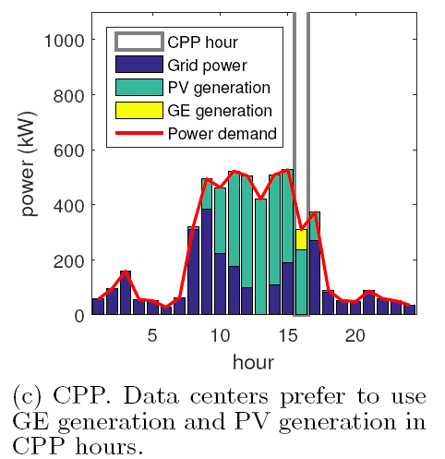
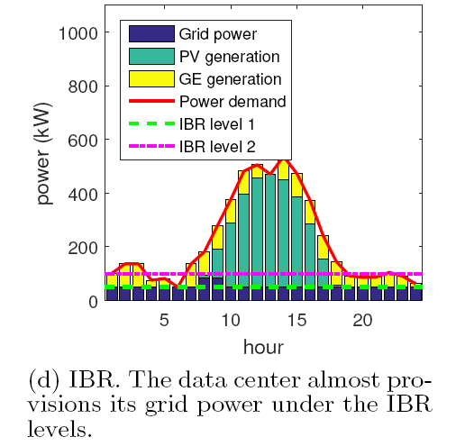
$0.05 (night), $0.219 (peak),
$0.06 (off) per kWh
CPP Coincident Peak Pricing:
$11.2/kWh
Inclining Block Rates
$0.2 (<50kW), $0.5 (<100kW)

Slide 25
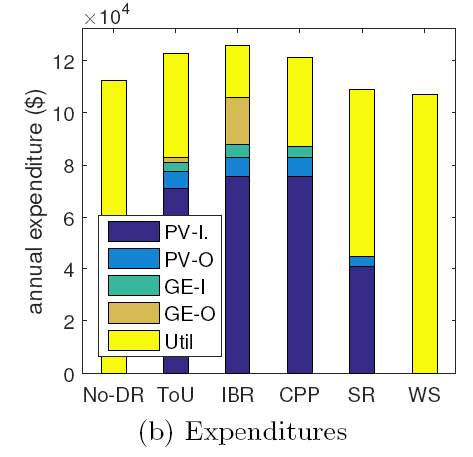
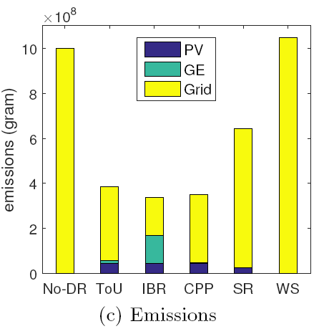
How DR impacts on data centers?

Slide 26
Summary
Optimization framework for joint capacity planning and operational management
50% cost savings
75% emission reductions
Proposed framework
promotes the use of renewable energy
adapts well to DR programs

Slide 27
Future Directions
Stochastic characteristics of workload and renewable energy in capacity planning and operational management
Capacity planning for geographically distributed data centers

Slide 29
Backup slides

Slide 30
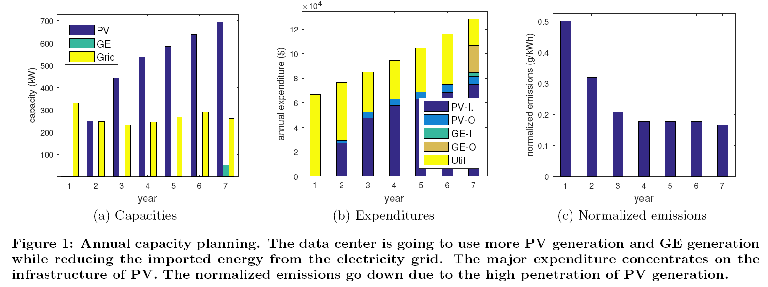

Slide 31
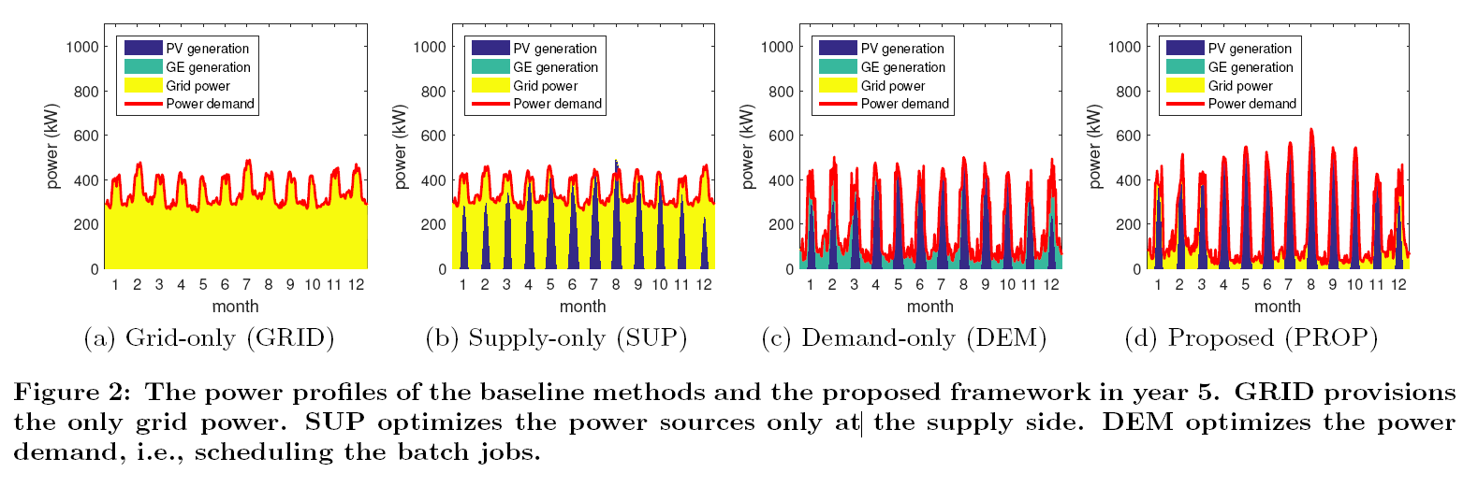

Slide 32
Impacts on
Net-zero energy data centers
Notes:
Total local supply >= total demand in long-run

Slide 33
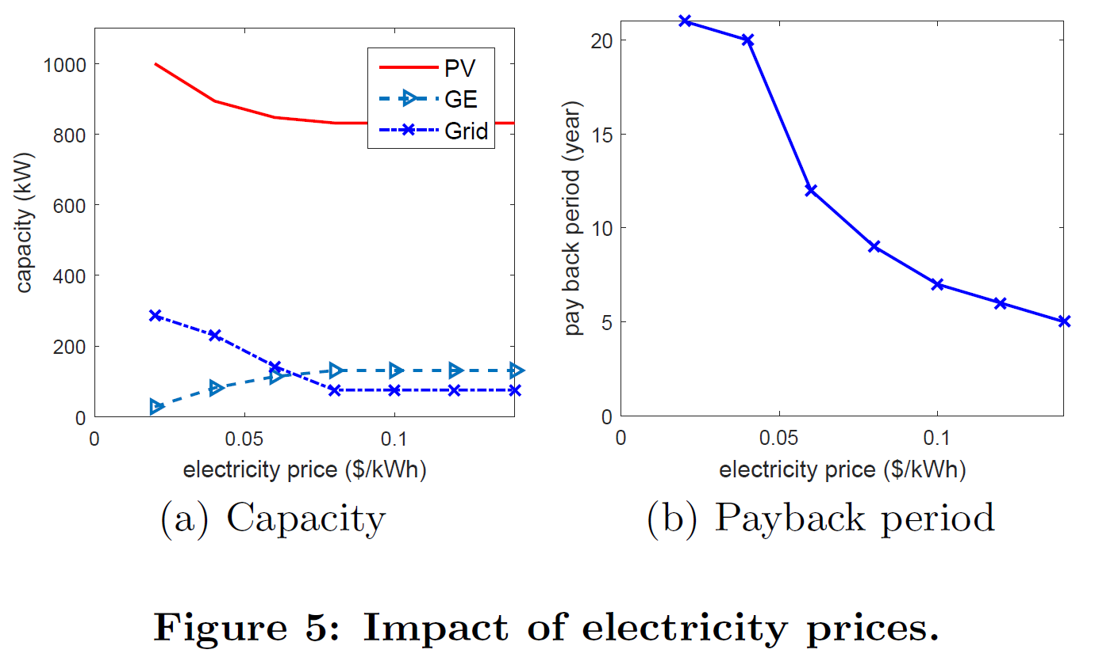
Notes:
the data center starts to use more GE to provide power during night and given the increased GE capacity, more GE generation is used during day time to replace PV.

Slide 34
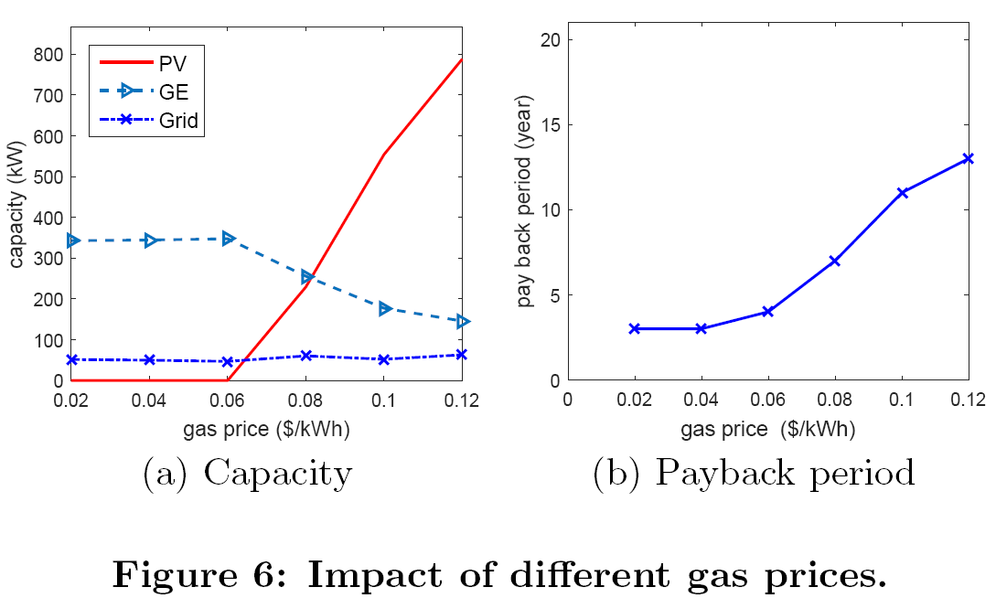
Notes:
Especially, there is the sharp increase of PV capacity when the gas price is more than $0.06$.
Due to the non-dispatchability of solar energy, the data center needs the large capacity of PV generation to compensate the reduction of GE generation.

Slide 35
