Slide 1



Joint Capacity Planning and Operational Management for Sustainable Data Centers and Demand Response
June 21, 2016
Tan N. Le, Zhenhua Liu, Yuan Chen, and Cullen Bash
Notes:
Introduce my self
I am a Phd Student from Stony Brook University, NY.
This joint work with my advisor Dr. Zhenhua Liu, and 2 co-authors from HP labs Yuan Chen and Cullen Bash

Slide 2
Agenda
Introduction & Motivation
Proposed Optimization Framework
Numerical Evaluation
Data Center Demand Response
Conclusions & Future Directions

Slide 3
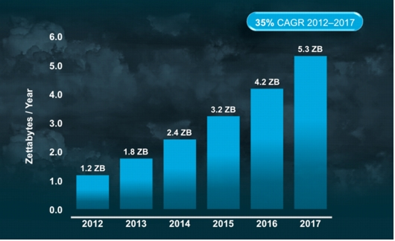
Total Global Cloud Traffic Growth
www.cisco.com
Notes:
The total data center traffic has been significantly increasing at 25% at year as the high demand from the Internet users.
Especially, could data centers are significantly increasing
Source: http://www.cisco.com/

Slide 4
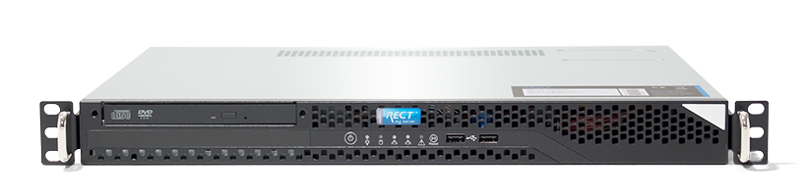

Environmental threat from data centers
Emissions in 2013
450W
5.2 tons carbon a year
=
Carbon footprints of servers can vary by 10x, www.vertatique.com
E. Facts. Greenhouse gas emissions from a typical passenger vehicle, 2005.
www.nrdc.org & wikipedia.org
Notes:
High light the emission

Slide 5
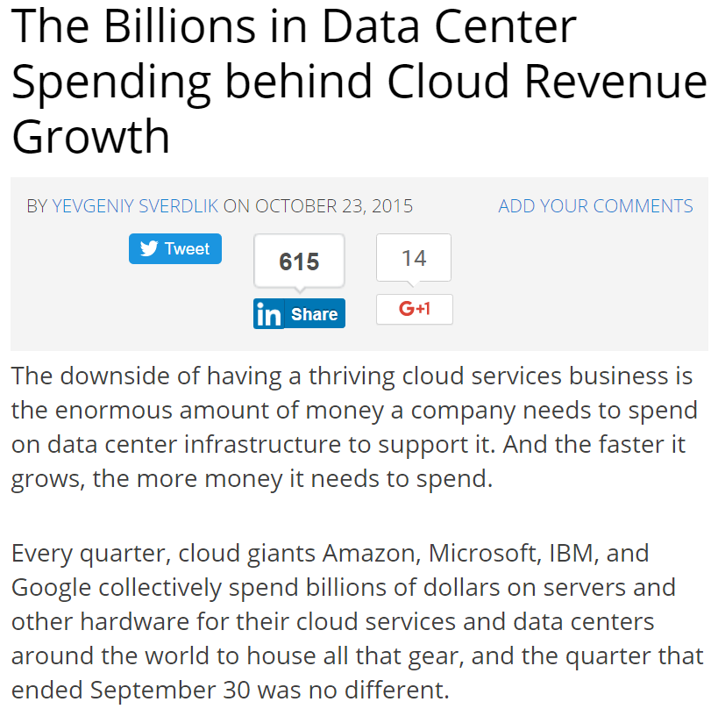
How much do data centers cost?
Where do the costs come from?
http://www.datacenterknowledge.com/
Notes:
How much do data centers cost?

Slide 6






Power sources
fuel
What are the drawbacks of separate CP & OM?
servers
cooling
electricity bills
maintenance
Capacity Planning
(CP)
Operational
Management
(OM)
Traditionally, they are separate
Notes:
Emphasize that Capacity Planning and Operational Management are separate
Highlight that staff salary is small
What is the drawback?

Slide 7


CP based on the peak demand
Traditional Capacity Planning
Over capacity planning
Demand
Supply
good news
Power demand can be shaped
Power demand of a data center
Notes:
This is a example of how people do capacity planning.
Todo: Cite

Slide 8
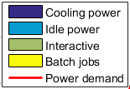
Shaping power demand
Scheduling the batch jobs
[Aksanli SIGOPT’12 ]
~500kW
~400kW
Waste of 20% of supply & demand
There so many data center demand management techniques
Server consolidation [Lin ToN’13, Zhang ICAC’12]
Network consolidation
[Zhang ICNC’10, Andrews ToN’12]
Optimize cooling power
[Pakbaznia ISLPED’09,
Liu SIGMETRICS’12]
Geographical load balancing
[Qureshi SIGCOMM’09, Liu SIGMETRICS’ 11]
Notes:
Shifting the batch job workload
500

Slide 9
Agenda
Introduction & Motivation
Proposed Optimization Framework
Numerical Evaluation
Data Center Demand Response
Conclusions & Future Directions

Slide 10
Proposed Optimization Framework
Capacity Planning
(CP)
Operational
Management
(OM)
Joint
Notes:
Proposed Framework

Slide 11

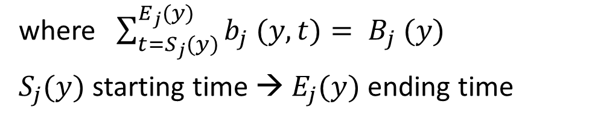
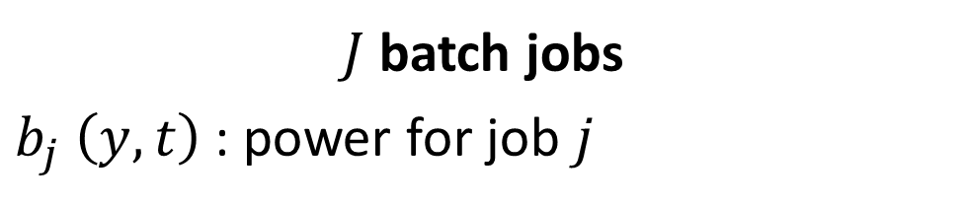
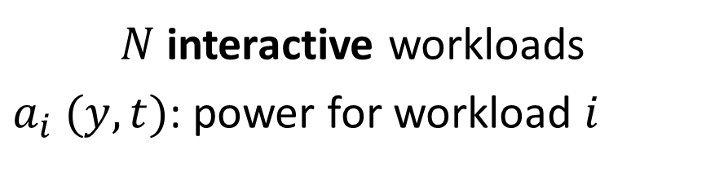

Modelling power demand at time $t$ year $y$
$N$ interactive workloads
$a_{i} (y,t)$: power for workload $i$
$J$ batch jobs
$b_{j} \left(y,t\right)$ : power for job $j$
where $\sum_{t=S_{j}(y)}^{E_{j}(y)}{b_{j} (y,t)}= B_{j} (y)$
$S_{j}(y)$ starting time → $E_{j}(y)$ ending time
idle power $P_{idle} \left(y,t\right)$
total IT power$P_{IT} \left(y,t\right)=P_{idle} \left(y,t\right)+\sum_{i=1}^{N}{a_{i} (y,t)}+\sum_{j=1}^{J}{b_{j} (y,t)}$
total power $P \left(y,t\right)=PUE∗P_{IT} \left(y,t\right)$

Slide 12
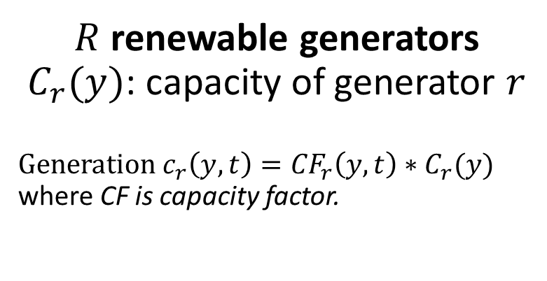

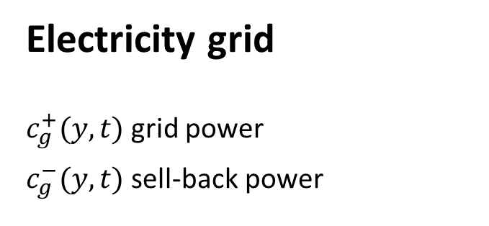
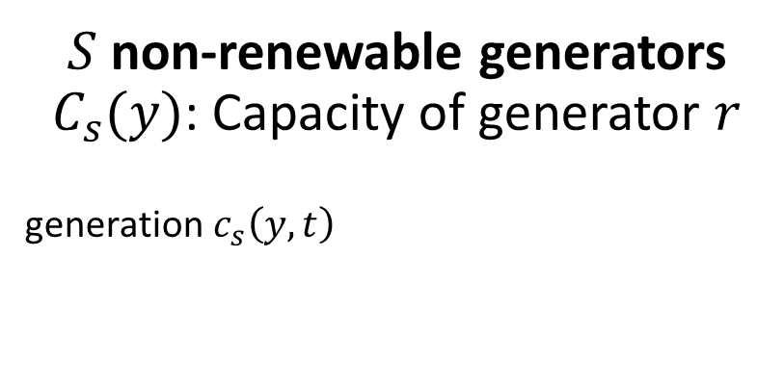
Modelling power supply at time $t$ year $y$
$R$renewable generators $C_{r}(y)$: capacity of generator $r$
Generation $c_{r}\left(y,t\right)={CF}_{r}\left(y,t\right)∗C_{r}(y)$ where CF is capacity factor.
Electricity grid
$c_{g}^{+}(y,t)$ grid power
$c_{g}^{−}(y,t)$ sell-back power
$S$non-renewable generators $C_{s}(y)$: Capacity of generator $r$
generation$c_{s}\left(y,t\right)$

Slide 13


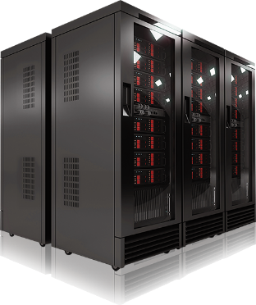

Joint Optimization Framework
minimize UtilBill + RGEx + NGEx + ITEx
RG Expense (RGEx)
NG Expense (NGEx)
IT expense (ITEx)
Utility bills (UtilBill)
Purchase
– sellback
Infrastructure cost
+ O&M cost
Infrastructure cost
+ Fuel cost
+ O&M cost
Infrastructure cost
+ O&M cost
Notes:
Utility bills

Slide 14
Inputs (forecasted)
Workload traces
Electricity prices
Infrastructure cost
O&M cost
Emission rate
Capacity planning outputs
Capacities of renewables
Capacities of non-renewables
Capacity of IT power demand
Capacity of Electricity grid
Joint
Optimization
Framework
Operational management outputs
non-renewable generation
Grid power usage
Sell-back power
Power allocated to IT workloads
Notes:
Optimization problem

Slide 15
Agenda
Introduction & Motivation
Proposed Optimization Framework
Numerical Evaluation
Data Center Demand Response
Conclusions & Future Directions

Slide 16
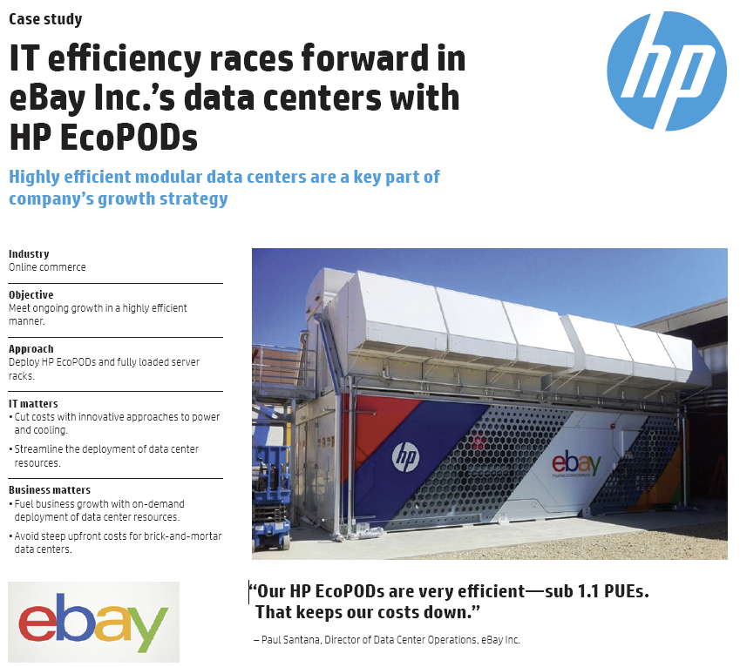
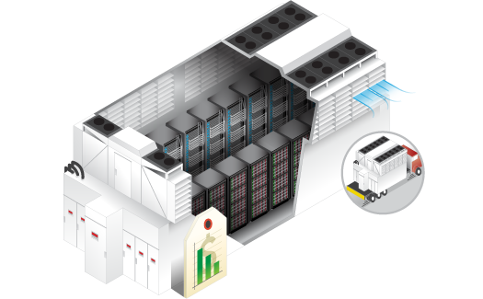
7 year simulation based on 1MW HP EcoPod Data Center
www.hp.com HP EcoPODs 240a

Slide 17
Demand side
Peak power usage: 720kW
Peak-to-Mean ratio: 3
PUE: 1.2
Interactive workload: 50%
Utilization of server: 40%
Batch jobs: 50%
~ 24 hours
Maximum utilization is 90%
CPU power usage trace
Notes:
Todo: cite the trace? From SAP?

Slide 18
Supply side
PV generation
General Electric (GE)
Natural Gas generation
Amortized cost: $1/W a year
Operational cost: $0.06/kWh
Maintenance cost: $0.005/kWh
Efficiency: 30%
Houston PV generation
Max capacity: 1MW
Amortized cost: $2.15/W a year
Operational cost: $0/kWh
Maintenance cost: $0.005/kWh
Capacity factor: Houston trace
Electricity grid
Prices: $0.056/kWh

Slide 19
Comparisons with Baseline methods
Grid Only (GRID) in traditional data centers Only provision power from the electricity grid
Supply-only Optimization (SUP) Optimize power sources based on given demand
Demand-only Optimization (DEM) Optimize power demand based on given the capacity planning
Proposed framework (PROP) = SUP + DEM

Slide 20




How much cost savings and emission reductions?
I: Infrastructure
O: Operational
Util: Utility bill
Cost: PROP = 50 % GRID
Emissions: PROP = 25 % GRID
GRID: Grid only
DEM: Demand-only optimization
SUP: Supply-only optimization
PROP: Proposed framework
Notes:
Grid: Grid only
Dem: Demand-only optimization
Sup: Supply-only optimization
Prop: Proposed framework

Slide 21

Costs and Emissions under Prediction Errors
58%
49%
Expenditures vs. prediction errors
Emissions vs. prediction errors
PROP significantly outperforms GRID under large prediction errors
Notes:
PROP significantly outperforms GRID under large prediction errors
58%

Slide 22
Agenda
Introduction & Motivation
Proposed Optimization Framework
Numerical Evaluation
Data Center Demand Response
Conclusions & Future Directions

Slide 23
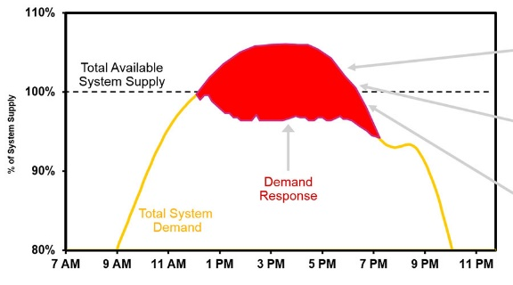


How demand response (DR) works
Grid condition
DR signal
Accept → reward
Reject → penalty
Notes:
How demand response (DR) works by example

Slide 24
Demand response programs
Passive participations
Active participations
DR signals are given to encourage customers to adjust their power profiles by using electricity prices
Customers voluntarily to have DR contracts with Utilities
Time of Use (ToU): prices vary in different periods a day,
Ancillary services to maintain the reliability of grid, e.g., Spinning Reserve (SR)
Inclining Block Rates (IBR): prices are based on load levels
Wholesale markets (WS) offer cheap prices if purchasing ahead
Critical Coincident Peak Pricing (CPP): Very high prices for coincident peaks
[Wierman ISGC’14]

Slide 25
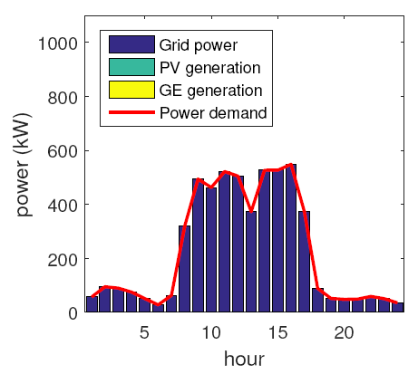
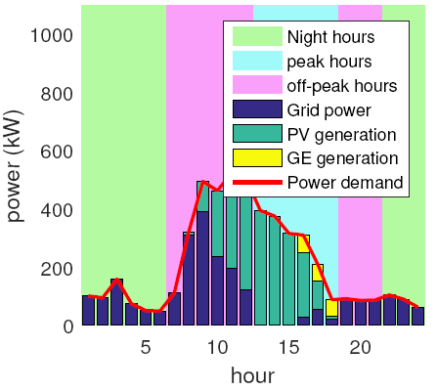
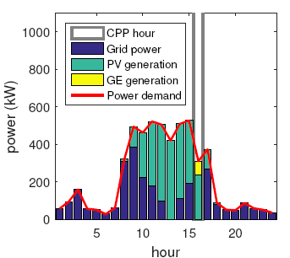
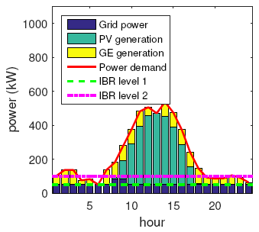
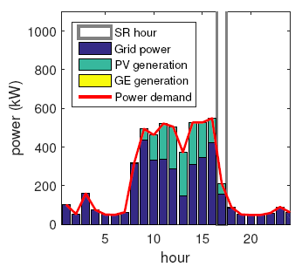
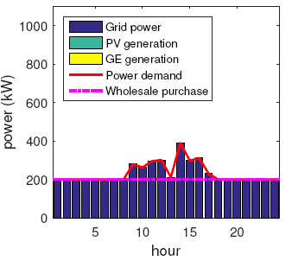
Without DR programs
Time of Use (ToU)
Critical Peak Pricing (CPP)
Base price: $0.056/kWh
$0.05 (night), $0.219 (peak), $0.06 (off) /kWh
CPP rate: $11.2/kWh
IBR
Spinning Reserve (SR)
Wholesale (WS) market
$0.2 (<50kW), $0.5 (<100kW)
SR rate: $0.02/kWh
$0.05/kWh
Notes:
Without DR programs

Slide 26
How DR impacts on data centers?
Little change on total costs
Some DR programs result in low emissions
Notes:
Little change on total costs

Slide 27
Agenda
Introduction & Motivation
Proposed Optimization Framework
Numerical Evaluation
Data Center Demand Response
Conclusions & Future Directions

Slide 28
Conclusions
This work is motivated by the huge expenses on capacity planning and operational management of data center
Proposed Joint Optimization framework for capacity planning and operational management
50% cost savings
75% emission reductions
Proposed framework
promotes the use of renewable energy
adapts well to DR programs

Slide 29
Future Directions
Stochastic characteristics of workload and renewable energy in capacity planning and operational management
Capacity planning for geographically distributed data centers

Slide 30

www.theodysseyonline.com

Slide 32
Backup slides

Slide 34
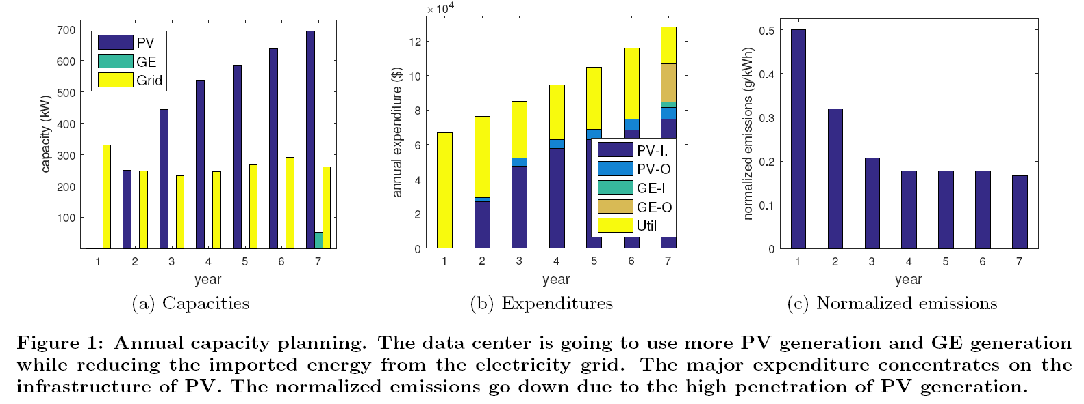

Slide 35
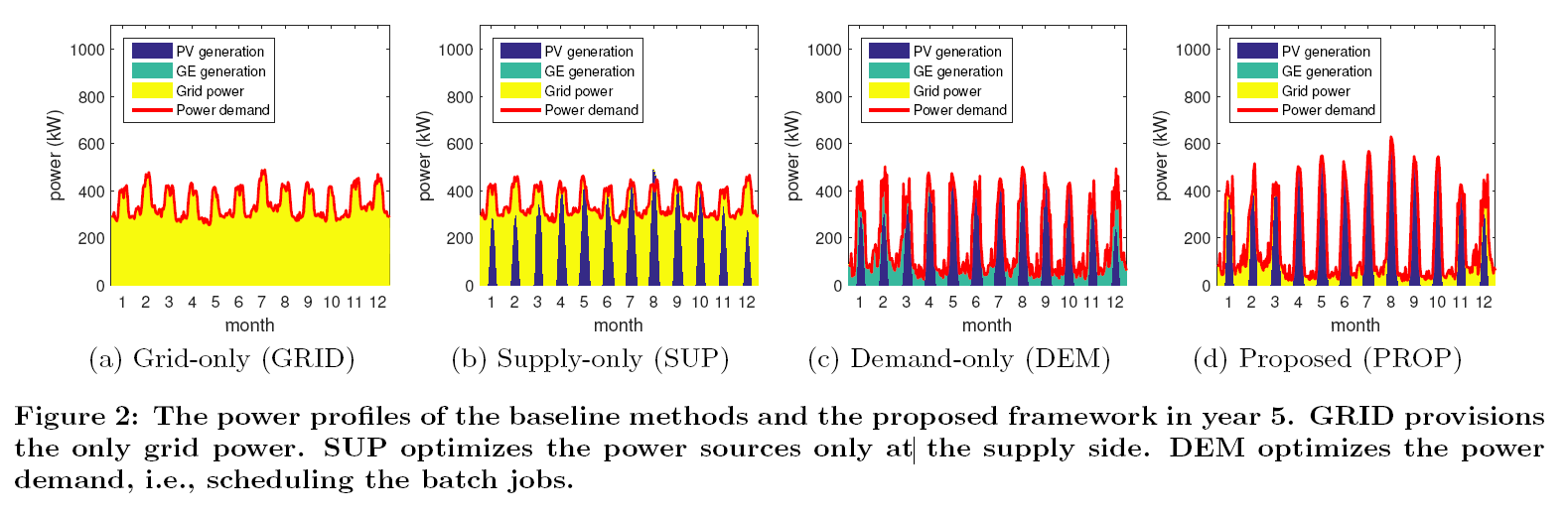

Slide 36
Impacts on
Net-zero energy data centers
Notes:
Total local supply >= total demand in long-run

Slide 37
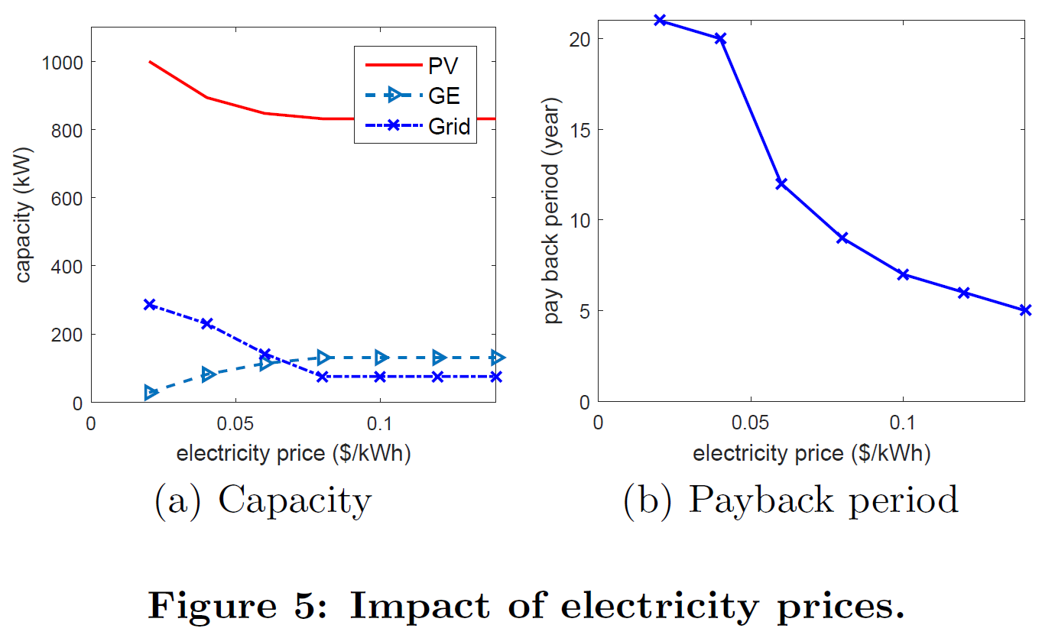
Notes:
the data center starts to use more GE to provide power during night and given the increased GE capacity, more GE generation is used during day time to replace PV.

Slide 38
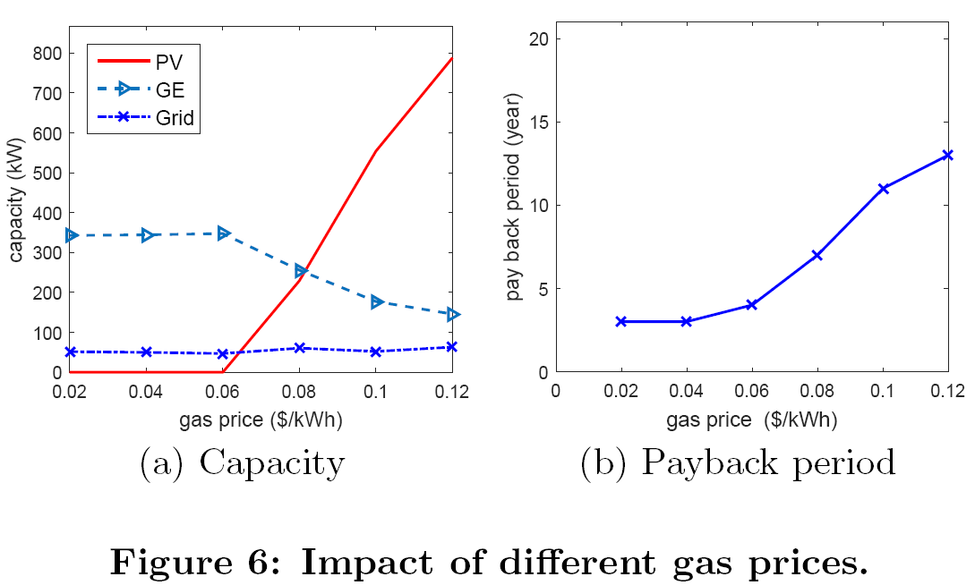
Notes:
Especially, there is the sharp increase of PV capacity when the gas price is more than $0.06$.
Due to the non-dispatchability of solar energy, the data center needs the large capacity of PV generation to compensate the reduction of GE generation.

Slide 39
