Slide 1



Joint Capacity Planning and Operational Management for Sustainable Data Centers and Demand Response
Session 2: Energy-efficient Datacenters
June 22, 2016
Tan N. Le and Zhenhua Liu
Yuan Chen and Cullen Bash
tan.le@stonybrook.edu
Notes:
Introduce my self
I am Tan Le, a Phd Student from Stony Brook University, NY.
This joint work with my advisor Dr. Zhenhua Liu, and 2 co-authors from HP labs Yuan Chen and Cullen Bash

Slide 2
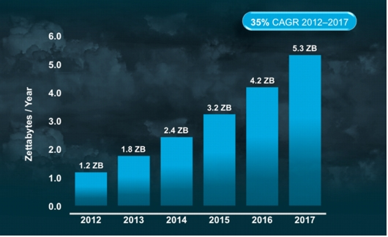
Total global cloud traffic growth
www.cisco.com
Notes:
the global cloud traffic data keep growing at 35%
From 2012 -> 2017, the traffic can increase 4 times in 5 years
What are the consequences of this?

Slide 3
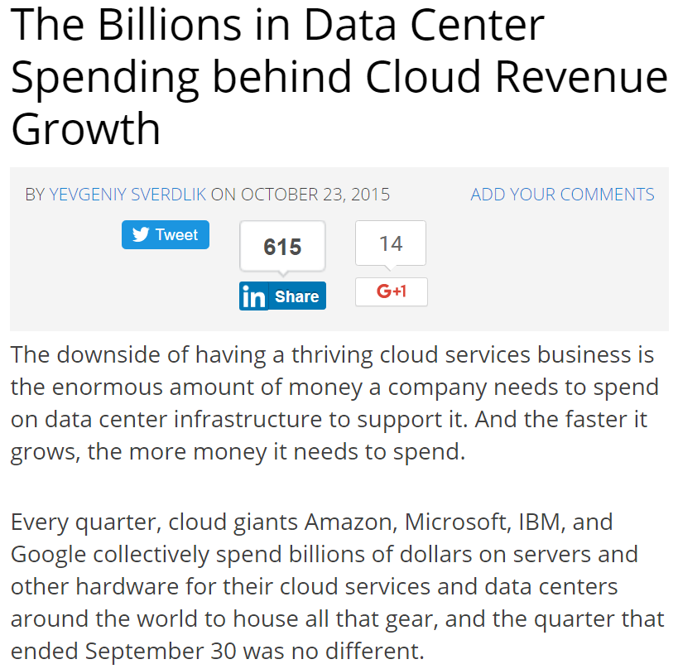
http://www.datacenterknowledge.com/
Notes:
The increase of cloud traffic need more data centers or larger data ceters.
Global cloud providers like Amazon, Microsoft, IBM, and Google
First, the growth of cloud service demand results in more investment in data centers

Slide 4
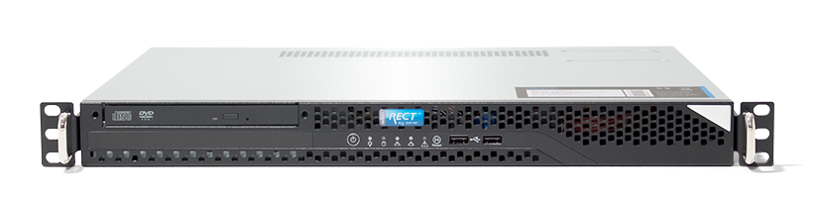

Environmental threat from data centers
Emissions in 2013
450W
5.2 tons carbon a year
=
Carbon footprints of servers can vary by 10x, www.vertatique.com
E. Facts. Greenhouse gas emissions from a typical passenger vehicle, 2005.
www.nrdc.org & wikipedia.org
Notes:
In addition, data centers are not CLEAN.
The emissions from a single server in a data center can be equivalent to a car.
Lets look at this graph, it shows the amount of emissions from US data centers are even more than some countries in Europe like Denmark and Romania.
And, it is growing~

Slide 5

Goal: Reduce costs and emissions for data centers with renewables
Approach: Joint Optimization of CP and OM
Capacity Planning (CP)
Operational
Management
(OM)
Modeling
Evaluation

Slide 6






Power sources
fuel
servers
cooling
electricity bills
maintenance
Capacity Planning (CP)
Operational Management (OM)
Traditionally, they are separate
This results in significant inefficiencies
Ex: CP is based on peak demand, but peak can be shaped in OM
Notes:
Emphasize that Capacity Planning and Operational Management are separate
What is the drawback?

Slide 7
Proposed Joint Optimization Framework
Capacity Planning (CP)
Capacities of renewables,
Non-renewables, IT power demand
Batch job schedule
Non-renewable generation
Grid power usage
Sellback power
Operational
Management
(OM)
Notes:
Proposed Framework

Slide 8


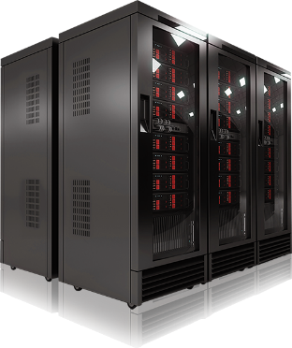
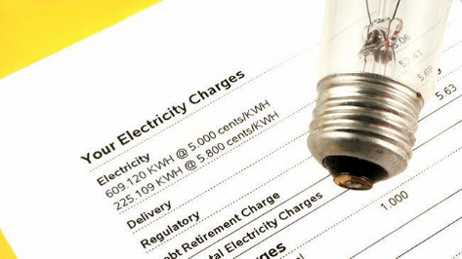
Joint Optimization Framework
minimize
UtilBill
+ RGEx
+ NGEx
+ ITEx
Utility bills (UtilBill)
Renewable Generation Expense (RGEx)
Non-renewable Generation Expense (NGEx)
IT expense (ITEx)
CP cost | N/A | Infra. Cost | Infra. Cost | Infra. cost
OM cost | Purchase – Sell back | O&M costs | O&M costs | O&M costs
The optimization problem is convex
Notes:
Utility bills

Slide 9
How the framework operates?
Capacities
Renewable generation
non-renewable generation
IT power demand
Joint Optimization Framework
Inputs (forecasted)
Workload traces
Electricity prices
Infrastructure costs
O&M costs
Capacity Planning (CP)
Operational
Management
(OM)
Operational outputs
non-renewable generation
Grid power usage
Sell-back power
Power allocated to batch jobs
Solve optimization problem
Notes:
DONE with modeling!!

Slide 10
Goal: Reduce costs and emissions for data centers with renewables
Approach: Joint Optimization of CP & OM
Capacity Planning (CP)
Operational
Management
(OM)
Modeling
Evaluation
Notes:
Lets see how the proposed framework benefit the data centers!!!

Slide 11
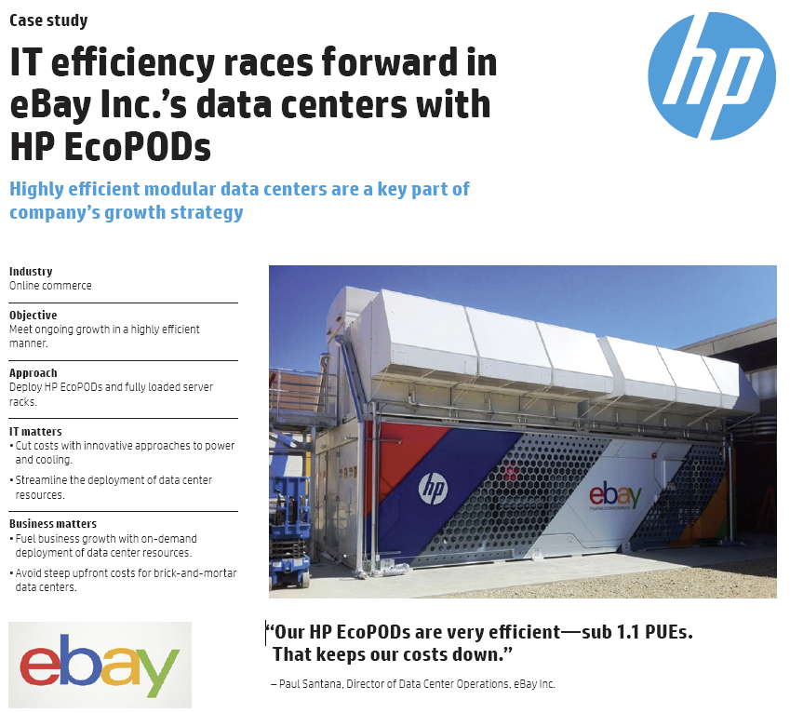
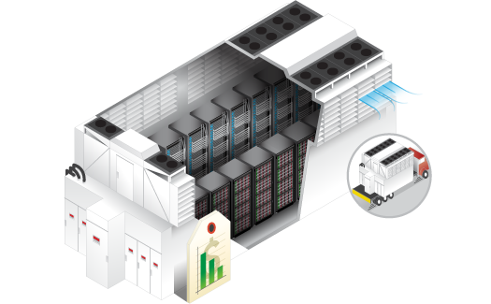
Simulation based on 1MW HP EcoPod Data Center
HP EcoPODs 240a
www.hp.com

Slide 12
Demand Side
Peak-to-Mean ratio: 3
PUE: 1.2
Annual increase rate: 9% a year
[www.zdnet.com]
CPU power usage trace
Interactive workload: 50%
Utilization of server: 40%
Batch jobs: 50%
Flexibility 24 hours
Maximum utilization is 90%
We do not include capacity planning for IT equipment
Notes:
We do not include capacity planning for IT equipment

Slide 13


Supply Side
PV generation
General Electric (GE)
Natural Gas generation
Electricity grid
Capacity factor: ~18%
[Houston traces]
[Texas]
Infra. cost: $2.15/W a year > Infra. cost: $1/W a year > Infra. cost: $0/W a year
12% a year
[cleantechnica]
Operational cost: $0/kWh < Operational cost: $0.06/kWh > Price: $0.056/kWh
1% a year
[www.eia.com]
5% a year
[Texas]
Maintenance cost: $0.005/kWh = Maintenance cost: $0.005/kWh > Maintenance cost: $0/kWh
Emission rate: 0.034g/kWh < Emission rate: 0.443g/kWh > Emission rate: 0.5g/kWh
Notes:
Todo: add the trend for PV, GE, and Electricity prices
12%

Slide 14
Comparisons with baseline methods
Grid Only (GRID) in traditional data centers provisions power only from the electricity grid
Supply-only Optimization (SUP) optimizes power sources based on given demand
Demand-only Optimization (DEM) optimizes power demand based on given the capacity planning
Proposed framework (PROP) Joint Capacity Planning & Operational Management
Notes:
Explain GRID
Explain SUP
Explain

Slide 15




Question: How much can we improve?
I: Infrastructure
O: Operational
Util: Utility bill
Cost: PROP = 50 % GRID
Emissions: PROP = 25 % GRID
GRID: Grid only
DEM: Demand-only optimization
SUP: Supply-only optimization
PROP: Proposed framework
Notes:
Explain the bread down cost:
For Grid-only method, cost comes from the utility bills.
SUP has more PV-I

Slide 16
Costs and emissions under prediction errors
58%
49%
Expenditures vs. prediction errors
Emissions vs. prediction errors
PROP significantly outperforms GRID under large prediction errors
Notes:
Mean value = 1, RMSE is 0->0.7
Prediction errors are applied to all predicted value.
Predictions are independent among the sources
Explain the normalized errors: RMSE errors = 50% of mean value

Slide 17


Joint Capacity Planning and Operational Management
Cost saving 50%
Emission reduction 75%
Notes:
Here we know that our proposed can significantly benefit the data centers

Slide 18

Goal: Reduce data center costs with Demand Response
Approach: Joint Optimization of CP & OM
Capacity Planning (CP)
Operational
Management
(OM)
Modeling
Evaluation

Slide 19
Extending Joint Optimization Framework for DCDR
minimize
UtilBill
+ RGEx
+ NGEx
+ ITEx
Utility bills (UtilBill)
Renewable Generation Expense (RGEx)
Non-renewable Generation Expense (NGEx)
IT expense (ITEx)
CP cost | N/A | Infra. cost | Infra. Cost | Infra. cost
OM cost | Purchase – Sell back | O&M costs | O&M costs | O&M costs
- DR reward + DR penalty
Notes:
Utility bills

Slide 20
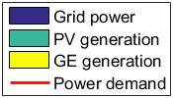
Operation of Framework in DR programs
SR hour
peak is shifted
night
off-peak
peak
Load reduction
Without DR programs
Time of Use (ToU)
Spinning Reserve (SR)
Base price: $0.056/kWh
$0.05 (night), $0.219 (peak), $0.06 (off) /kWh
SR rate: $0.02/kWh
Data center additionally provisions PV & GE to adapt to DR programs
Notes:
Without DR programs

Slide 21
Question: How DR impacts on data centers?
PV & GE are used
Low emissions due to PV
Costs & capacities vary in different DR programs
Some DR programs result in low emissions
IBR: Inclining Block Rates
CPP: Critical Coincident Peak Pricing
WS: Wholesale market
$0.2 (>50kW), $0.5 (>100kW)
CPP rate: $11.2/kWh
$0.05/kWh
Notes:
IBR: Inclining Block Rates

Slide 22
Joint Capacity Planning and Operational Management
Cost saving 50%
Emission reduction 75%
Well adapting to
Thank you
Notes:
This is the end of presentation.
Traditionally, capacity planning and operational management are separate
We proposed ….
It can achieve up to 50% cost
75 % emission reduction
Make the the data center well adapt to the DR programs
Thank you

Slide 24
Backup slides

Slide 26
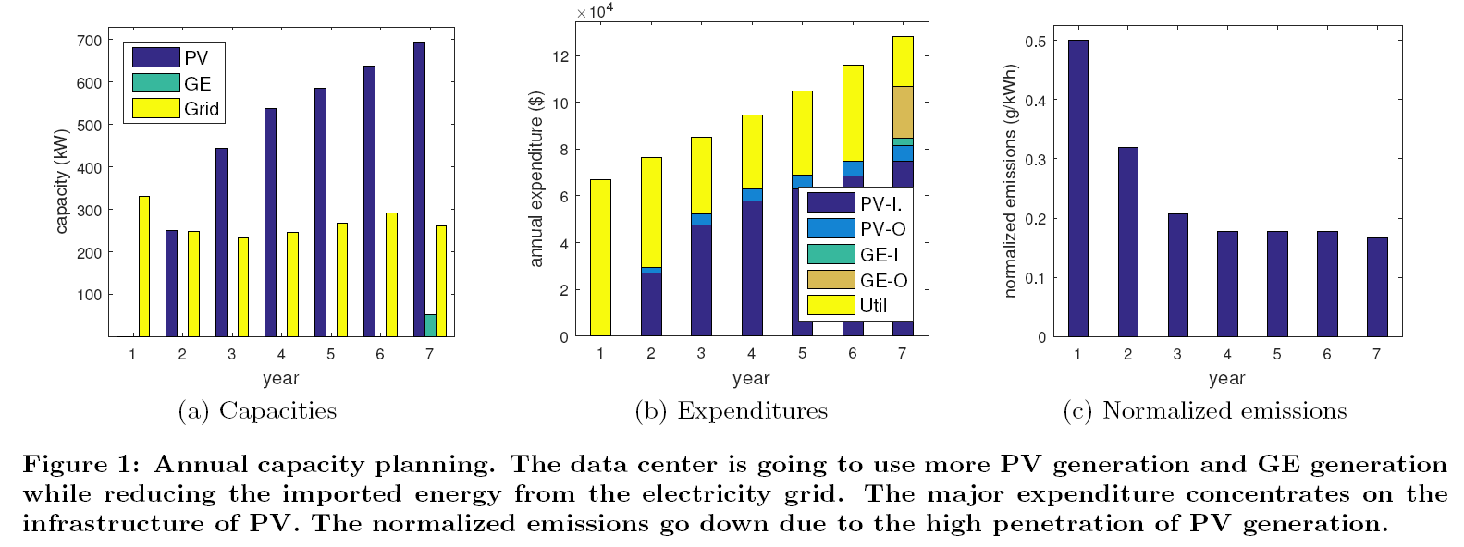

Slide 27
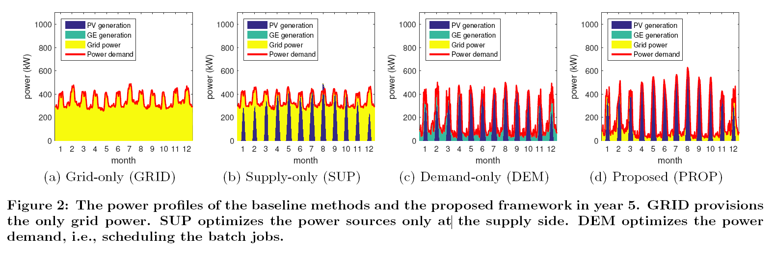

Slide 28


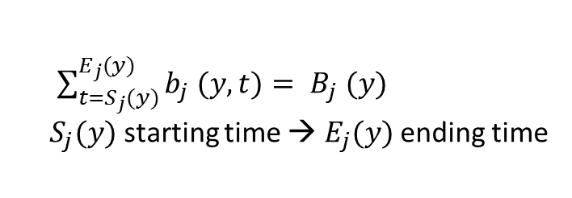



Modeling power demand at time $t$ year $y$
IT power: $P_{IT} \left(y,t\right)=\sum_{i=1}^{N}{a_{i} (y,t)}+\sum_{j=1}^{J}{b_{j} (y,t)}+P_{idle} \left(y,t\right)$
$N$ interactive workloads
$J$ batch jobs
idle power
$a_{i} (y,t)$: power for workload $i$
$B_{j} (y)$: power for job $j$
$\sum_{t=S_{j}(y)}^{E_{j}(y)}{b_{j} (y,t)}= B_{j} (y)$
$S_{j}(y)$ starting time → $E_{j}(y)$ ending time
used to schedule batch jobs
power demand: $P \left(y,t\right)=PUE(y,t)∗P_{IT} \left(y,t\right)$

Slide 29
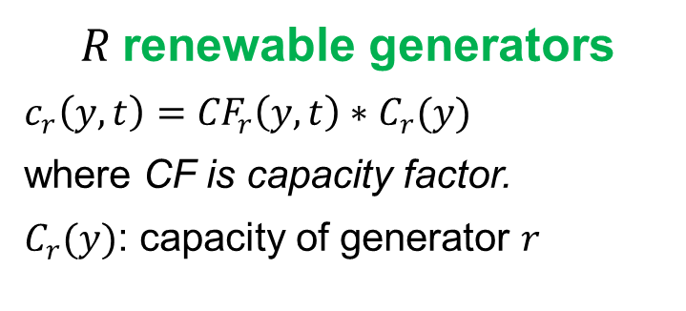


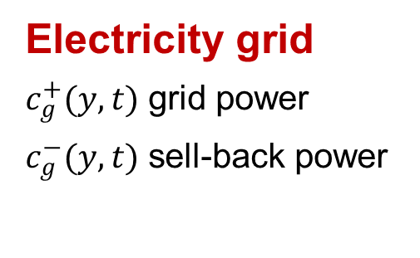
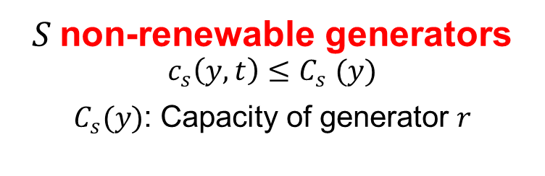
Modeling power supply at time $t$ year $y$
power supply: $\sum_{r=1}^{R}{c_{r}\left(y,t\right)}+\sum_{s=1}^{S}{c_{r}\left(y,t\right)}+c_{g}^{+}\left(y,t\right)−c_{g}^{−}(y,t)$
$R$renewable generators
$c_{r}\left(y,t\right)={CF}_{r}\left(y,t\right)∗C_{r}(y)$
where CF is capacity factor.
$C_{r}(y)$: capacity of generator $r$
$S$non-renewable generators
$$c_{s}\left(y,t\right){≤C}_{s}(y)$$
$C_{s}(y)$: Capacity of generator $r$
Electricity grid
$c_{g}^{+}(y,t)$ grid power
$c_{g}^{−}(y,t)$ sell-back power
power supply $≥$ power demand

Slide 30
Impacts on
Net-zero energy data centers
Notes:
Total local supply >= total demand in long-run

Slide 31
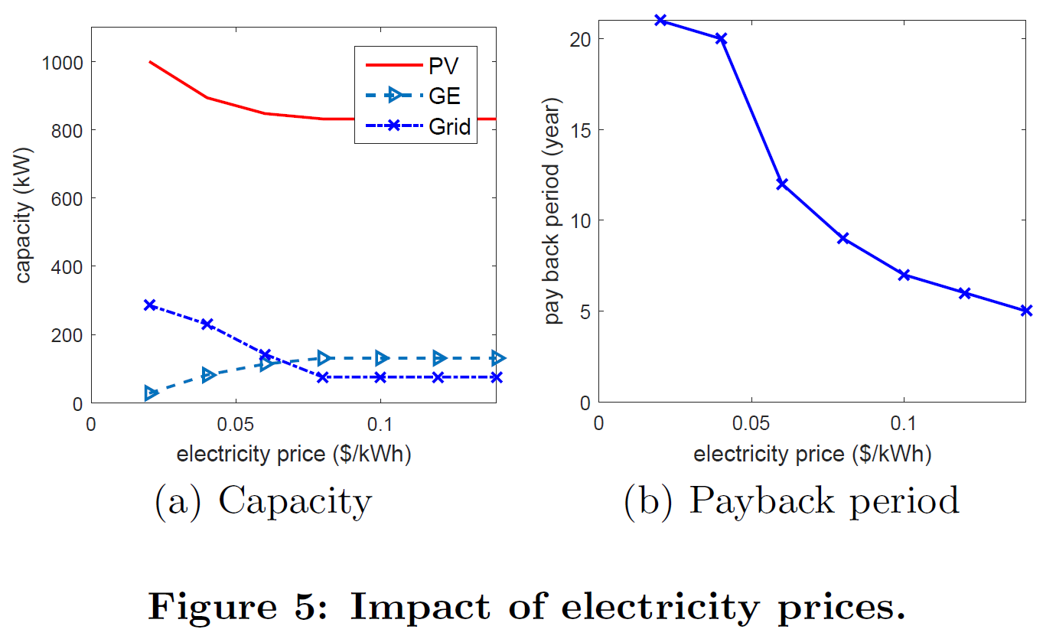
Notes:
the data center starts to use more GE to provide power during night and given the increased GE capacity, more GE generation is used during day time to replace PV.

Slide 32
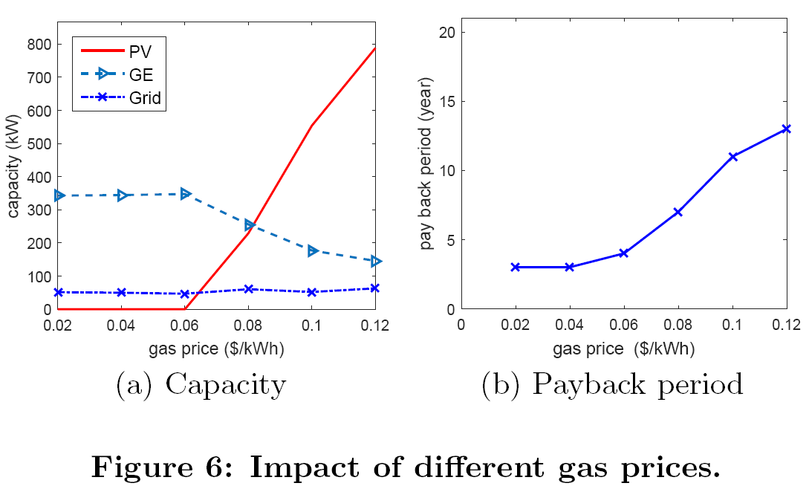
Notes:
Especially, there is the sharp increase of PV capacity when the gas price is more than $0.06$.
Due to the non-dispatchability of solar energy, the data center needs the large capacity of PV generation to compensate the reduction of GE generation.

Slide 33
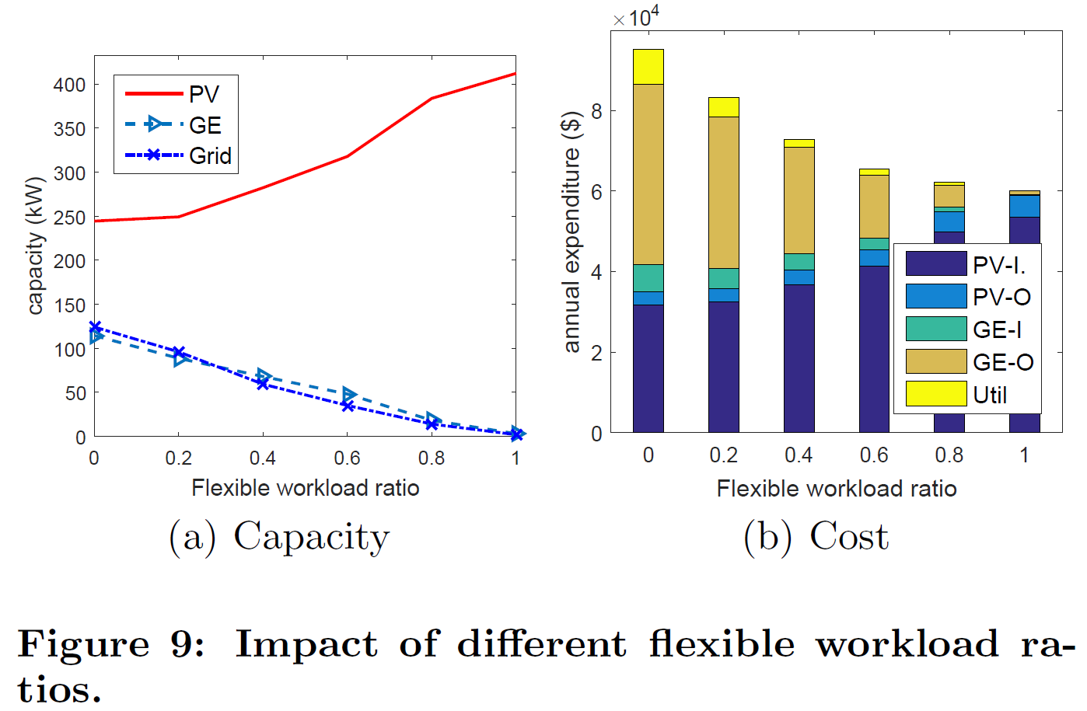

Slide 34
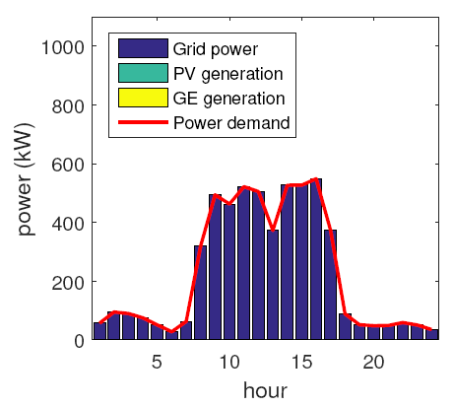
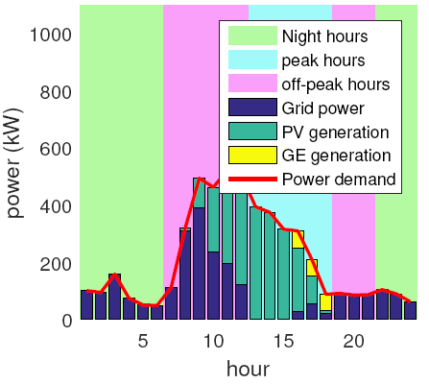
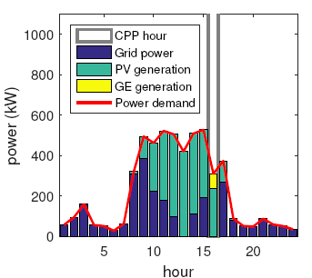
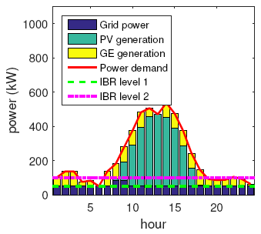
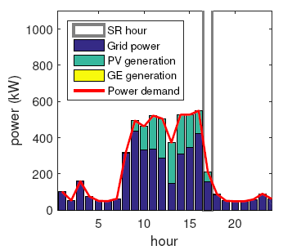
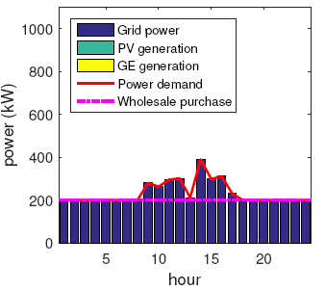
Without DR programs
Time of Use (ToU)
Critical Peak Pricing (CPP)
Base price: $0.056/kWh
$0.05 (night), $0.219 (peak), $0.06 (off) /kWh
CPP rate: $11.2/kWh
IBR
Spinning Reserve (SR)
Wholesale (WS) market
$0.2 (<50kW), $0.5 (<100kW)
SR rate: $0.02/kWh
$0.05/kWh
Notes:
Without DR programs

