Slide 1
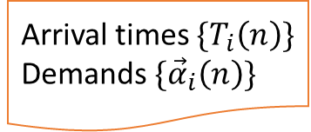
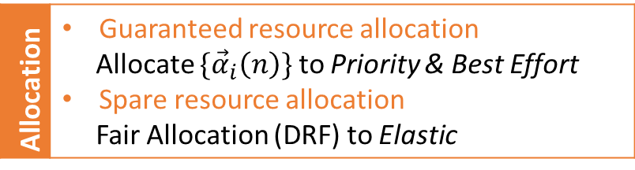
User Input
…
…
LQ_{j}
Arrival times ${\{T}_{i}\left(n\right)\}$
Demands $\{{\vec{α}}_{i}\left(n\right)\}$
New queues
Resource Manager
Admission
Long-term
Y
N
Y
Short-term
N
Elastic
Priority
Best Effort
Allocation | Guaranteed resource allocation Allocate $\{{\vec{α}}_{i}\left(n\right)\}$ to Priority & Best Effort Spare resource allocation Fair Allocation (DRF) to Elastic
Allocations
Available resources
…
…
Node Manager

Slide 2
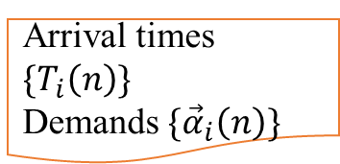

User Input
…
…
LQ_{j}
Arrival times ${\{T}_{i}\left(n\right)\}$
Demands $\{{\vec{α}}_{i}\left(n\right)\}$
New queues
Resource Manager
Admission Control
Resource guarantee
Y
N
Y
N
Elastic
Priority
Best Effort
Fairness
Allocation | Guaranteed resource allocation Allocate $\{{\vec{α}}_{i}\left(n\right)\}$ to Priority & Best Effort Spare resource allocation Fair Allocation (DRF) to Elastic
Allocations
Available resources
…
…
Node Manager_{k}

Slide 3
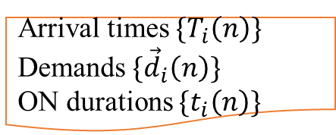
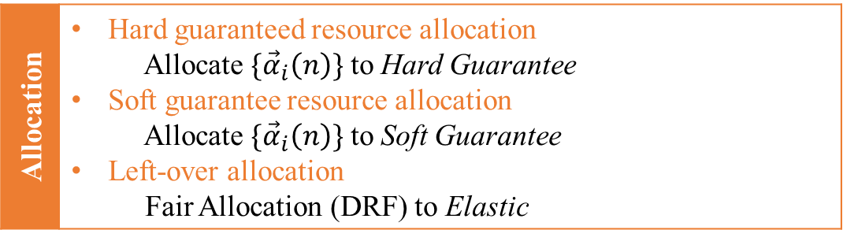
User Input
LQ_{j}
TQ_{k}
Arrival times ${\{T}_{i}\left(n\right)\}$
Demands $\{{\vec{d}}_{i}\left(n\right)\}$
ON durations ${\{t}_{i}\left(n\right)\}$
…
Arrival time
…
Resource Manager
New Queue
Y
Admission Control
N
Safety
is LQ?
Reject
Y
N
Y
Resource
Fairness
Y
N
N
Hard Guarantee
Soft Guarantee
Elastic
Allocation | Hard guaranteed resource allocation Allocate $\{{\vec{α}}_{i}\left(n\right)\}$ to Hard Guarantee Soft guarantee resource allocation Allocate $\{{\vec{α}}_{i}\left(n\right)\}$ to Soft Guarantee Left-over allocation Fair Allocation (DRF) to Elastic
Allocations
Available resources
…
…
Node Manager_{m}

Slide 4
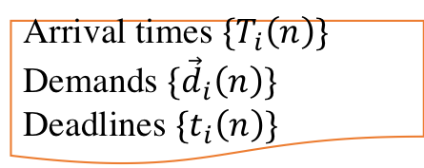

User Input
LQ_{j}
TQ_{k}
Arrival times ${\{T}_{i}\left(n\right)\}$
Demands $\{{\vec{d}}_{i}\left(n\right)\}$
Deadlines ${\{t}_{i}\left(n\right)\}$
…
Arrival time
…
Resource Manager
New queue
Admission | Admit the queue into one of the following classes
Hard Guarantee
Soft Guarantee
Elastic
Allocation | Hard guaranteed resource allocation Allocate $\{{\vec{α}}_{i}\left(n\right)\}$ to Hard Guarantee Soft guarantee resource allocation Allocate $\{{\vec{α}}_{i}\left(n\right)\}$ to Soft Guarantee Left-over allocation Fair Allocation (DRF) to Elastic
Allocations
Available resources
…
…
Node Manager_{m}

