Slide 1

Java Persistence API
Lecture: Nguyễn Mai Huy
PRJ301 : Java Web Application

Slide 2

Objectives
ORM frameworks
Java Persistence API
Annotation to describe the entity
Managing Entities
Apply JPA to Java web application

Slide 3
ORM frameworks
https://hibernate.org/orm/what-is-an-orm/

Slide 4
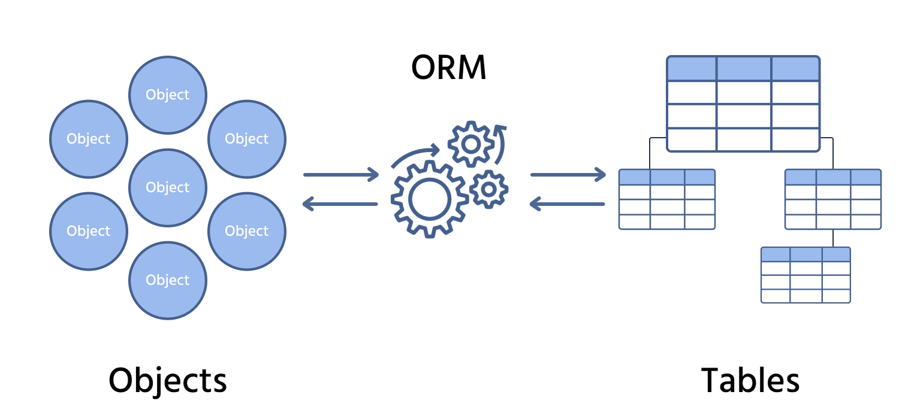
What is ORM ?
ORM (Object-Relational Mapping) is a programming technique that allows developers to map and manage data between object-oriented programming languages (like Java) and relational databases (like MySQL, PostgreSQL)
It abstracts the database interactions by representing tables as Java classes, rows as objects, and columns as fields.
Developers can interact with the database using object-oriented code instead of writing raw SQL queries.

Slide 5
General Reasons
Bridges object-relational mismatch: Object-oriented apps use classes/objects, while databases use tables/rows.
Increases productivity: Reduces boilerplate JDBC/SQL code.
Improves maintainability: Changes to the model layer are easier to manage.
Provides portability: Code can work across different databases with minimal change.
Manages relationships: Supports 1-1, 1-many, many-many relationships as object references
Java is an object-oriented language, and ORM is essential to translate between Java objects and relational data.
Java ORM frameworks (like Hibernate) also integrate with JPA (Java Persistence API) – a standard for ORM in Java EE

Slide 6
Advantages of using ORM
Advantage | Description
Productivity | Faster development with less SQL writing
Maintainability | Centralized and consistent data model
Portability | Works across multiple databases
Lazy/Eager Loading | Controls when data is fetched
Relationship Management | Automatically maps entity relationships
Caching | Improves performance by reducing redundant DB access

Slide 7
Disadvantages of using ORM
Disadvantage | Description
Performance Overhead | ORM can be slower for complex queries
Learning Curve | Requires learning ORM concepts (sessions, lazy loading, etc.)
Debugging Issues | Errors might be abstracted and harder to trace
Less SQL Control | Some advanced queries are harder or inefficient via ORM
Overhead for Small Projects | May be overkill if the project has very simple data access needs

Slide 8
Frameworks that support ORM in Java
Framework | Description
Hibernate | Most popular ORM for Java. Implements JPA and adds advanced features.
EclipseLink | Official reference implementation of JPA. Lightweight and extensible.
Spring Data JPA | Part of the Spring ecosystem. Simplifies JPA access with repository abstraction.
TopLink | Oracle’s original ORM (now evolved into EclipseLink).
Apache OpenJPA | Another open-source ORM implementation of JPA.
MyBatis | Not full ORM, but maps SQL results to objects (semi-ORM).

Slide 9
Java Persistence API
https://docs.oracle.com/javaee/6/tutorial/doc/bnbpz.html

Slide 10
What is JPA ?
JPA (Java Persistence API) is a Java specification (not a framework) that defines how to map Java objects (entities) to relational database tables.
It is part of the Java EE / Jakarta EE platform.
JPA provides a set of annotations and interfaces to manage relational data using object-oriented Java code.
It works with ORM implementations like Hibernate, EclipseLink, or OpenJPA.
Think of JPA as the standard interface, while Hibernate or EclipseLink are the actual tools/libraries that implement it.

Slide 11
Benefit
Benefit | Description
Boilerplate reduction | Avoid writing repetitive JDBC code
Standardization | Same code works across different ORM tools (like Hibernate or EclipseLink)
Productivity | Developers can focus on business logic, not SQL
Entity management | Easy CRUD operations on Java objects
Integration | Easily works with Java EE, Spring, and other frameworks
Maintainability | Changes in database structure can be easily mapped in code

Slide 12
When we need to use
Situation | Reason
You have a relational database | JPA simplifies DB operations for Java apps
You need object-to-database mapping | JPA maps classes ↔ tables, fields ↔ columns
You want to avoid raw SQL | JPA supports JPQL (Java Persistence Query Language)
You build enterprise or Spring web apps | JPA is the standard for persistence
You use Hibernate or EclipseLink | These are JPA-compliant tools

Slide 13
How to use JPA ?
Step 1: Add JPA + ORM Dependencies
Step 2: Create persistence.xml
Step 3: Create Entity Class
Step 4: Use EntityManager to interact with DB

Slide 14
Describe the Entity
https://docs.oracle.com/javaee/6/tutorial/doc/bnbqa.html

Slide 15
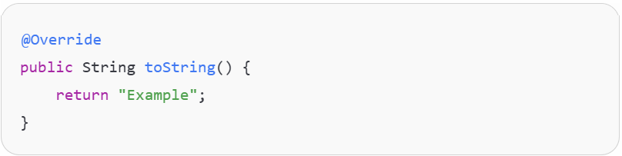
What is Annotation in Java?
In Java, annotations are a form of metadata—they provide data about a program but are not part of the program itself. An annotation is a special kind of interface preceded by @, and can be added to Java elements such as:
Classes
Methods
Variables
Parameters
Packages

Slide 16
Why are Annotations needed in Programming?
Code Clarity and Error Prevention They help the compiler detect mistakes. For example, @Override will cause an error if the method does not actually override anything.
Providing Instructions to the Compiler Some annotations (like @SuppressWarnings) give the compiler special instructions.
Runtime Processing Some annotations are retained at runtime and are used by reflection to change program behavior dynamically. Example: Frameworks like Spring or JUnit use annotations heavily to configure components, inject dependencies, or mark test methods.
Code Generation and Tools Tools like Lombok, or libraries that use annotation processors, can generate boilerplate code using annotations like @Getter, @Setter, etc.
Framework and API Integration Modern frameworks rely on annotations for configuration and behavior rather than XML or config files.

Slide 17
Annotation in JPA
In Java Persistence API (JPA), annotations are used to map Java objects (entities) to database tables. JPA annotations fall into several categories based on their purpose.
Entity and Table Mapping
Primary Key and Identity
Column Mapping
Relationship Mapping (Associations)
Lifecycle Callback Annotations
Embeddables and Inheritance

Slide 18
Entity and Table Mapping
Annotation | Giải thích
@Entity | Đánh dấu class là một entity (thực thể) trong JPA.
@Table(name = "...") | Xác định bảng trong CSDL tương ứng với entity.
@MappedSuperclass | Cho phép class cha chia sẻ mapping cho các class con, nhưng không được ánh xạ thành bảng.
@Embeddable | Đánh dấu một class có thể được nhúng vào entity khác như một field phức tạp.
@Embedded | Sử dụng một object có @Embeddable trong entity hiện tại.

Slide 19
Column, Key and Identity
Annotation | Giải thích
@Id | Khóa chính.
@GeneratedValue(strategy = ...) | Tự động tạo giá trị cho khóa chính (auto increment, sequence,...).
@Column(name = "...") | Ánh xạ một trường Java đến cột trong bảng SQL.
@Basic | Ánh xạ mặc định cho một trường (nếu không dùng @Column).
@Transient | Trường này không được ánh xạ vào database.
@Temporal(...) | Dùng với java.util.Date, chọn kiểu DATE / TIME / TIMESTAMP.
@Enumerated(...) | Dùng cho enum, xác định kiểu lưu: STRING hoặc ORDINAL.

Slide 20
Relationship Mapping
Annotation | Giải thích
@OneToOne | Quan hệ 1-1 giữa 2 entity.
@OneToMany | Quan hệ 1-N: một entity chứa danh sách các entity khác.
@ManyToOne | Quan hệ N-1: nhiều entity liên kết đến một entity cha.
@ManyToMany | Quan hệ N-N: ánh xạ bảng phụ giữa hai bảng.
@JoinColumn | Xác định cột khóa ngoại ở phía quan hệ N-1 hoặc 1-1.
@JoinTable | Dùng cho @ManyToMany, định nghĩa bảng phụ và các cột liên kết.
@MappedBy | Dùng ở phía bị điều khiển trong quan hệ hai chiều (bi-directional).
@OrderBy | Xác định thứ tự của danh sách (trong @OneToMany, v.v).
@Cascade (Hibernate only) | Định nghĩa các thao tác cascade (persist, merge, remove,...) – dùng trong Hibernate chứ không có sẵn trong JPA.

Slide 21
Query mapping
Annotation | Giải thích
@NamedQuery | Định nghĩa truy vấn JPQL tĩnh, đặt tên và sử dụng lại.
@NamedQueries | Nhóm nhiều @NamedQuery trong một class.
@NamedNativeQuery | Truy vấn SQL gốc (native SQL).
@SqlResultSetMapping | Dùng để ánh xạ kết quả từ SQL gốc về entity hoặc DTO.

Slide 22
EntityManager
Annotation | Giải thích
@PersistenceContext | Inject EntityManager trong môi trường container (Spring/Jakarta EE).
@PersistenceUnit | Inject EntityManagerFactory.
@ExcludeDefaultListeners, @ExcludeSuperclassListeners | Kiểm soát listener trong vòng đời entity.

Slide 23
Managing Entities
https://docs.oracle.com/javaee/6/tutorial/doc/bnbqw.html

Slide 24
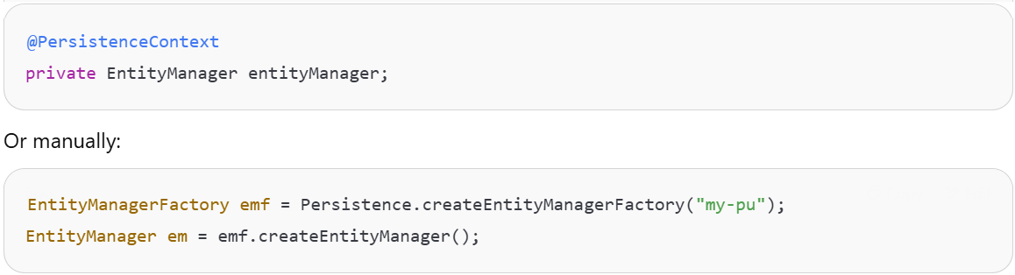
What is EntityManager ?
The EntityManager is the central interface in JPA used to interact with the persistence context. It acts as a bridge between your Java objects and the database. It manages the lifecycle of entity instances and provides APIs for CRUD operations, queries, transactions, etc.
In simple terms, it’s like a session that allows you to persist, retrieve, update, and delete objects from the database.

Slide 25
How the EntityManager work ?
Manages database transaction
EntityTransaction
Opens the database
EntityManagerFactory
EntityManager
Query

Slide 26
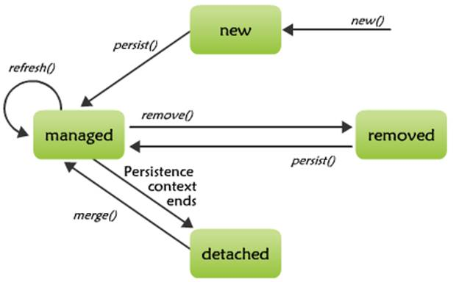
Entity life cycle

Slide 27
Common Responsibilities of EntityManager
Create and remove persistent entity instances
Find entities by their primary key
Run JPQL or native SQL queries
Manage transactions (when not using a container)
Synchronize entities with the database

Slide 28
Common methods
Method | Description
persist(Object entity) | Inserts a new entity into the database
find(Class<T> entityClass, Object primaryKey) | Retrieves an entity by its primary key
merge(T entity) | Updates (merges) an entity with the current persistence context
remove(Object entity) | Deletes an entity from the database
clear() | Clears the persistence context (detaches all entities)
createQuery(String jpql) | Creates a JPQL query
createNativeQuery(String sql) | Creates a native SQL query
getTransaction() | Returns the transaction object (for manual transaction control)

Slide 29
Apply JPA to Java web application
https://docs.oracle.com/javaee/6/tutorial/doc/bnbqa.html

Slide 30
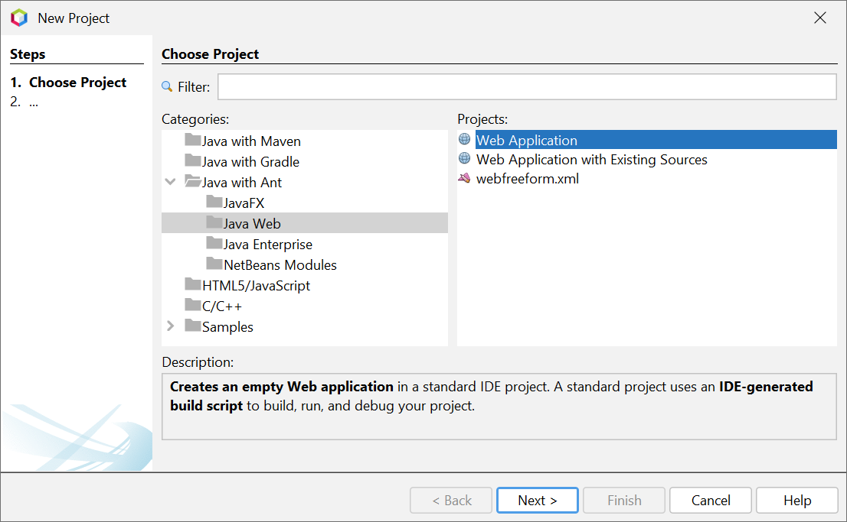
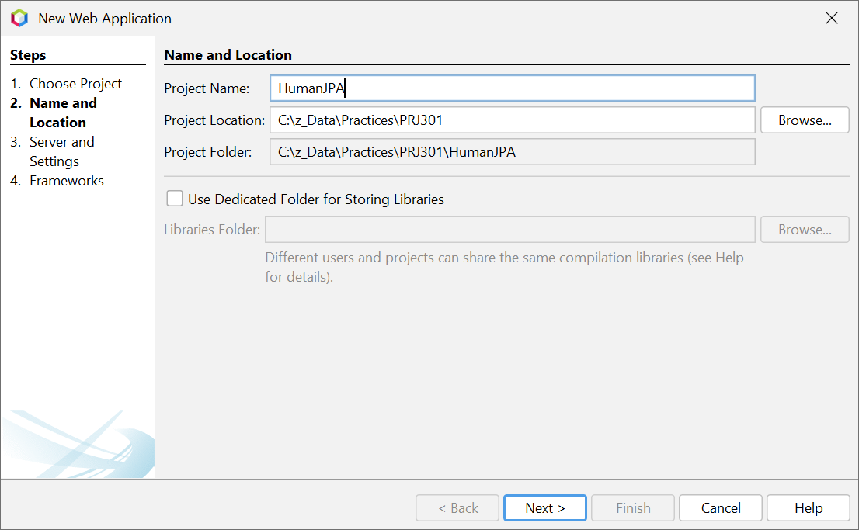
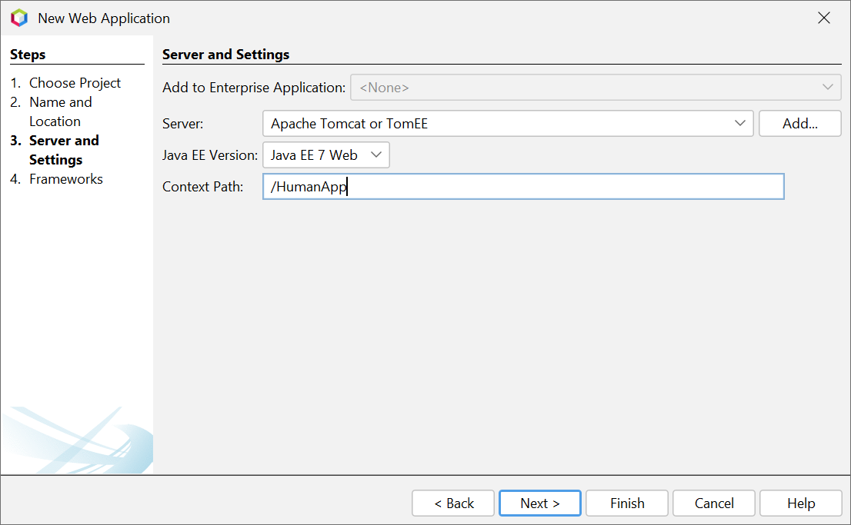
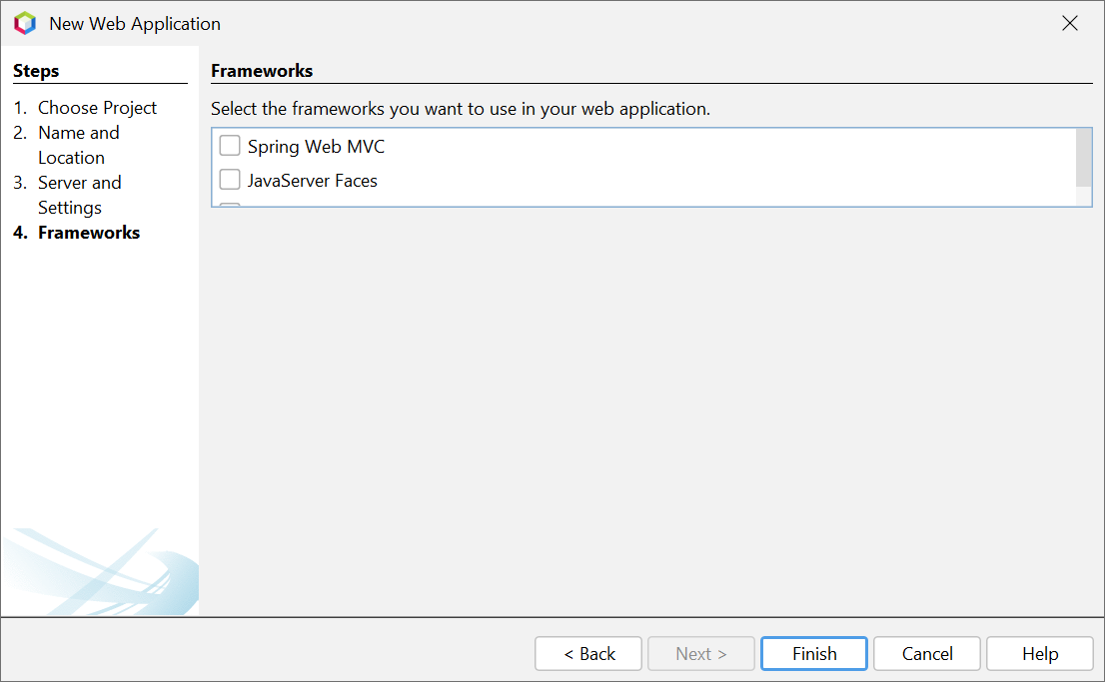
Create Java with Ant Web Project
1
2
3
4

Slide 31
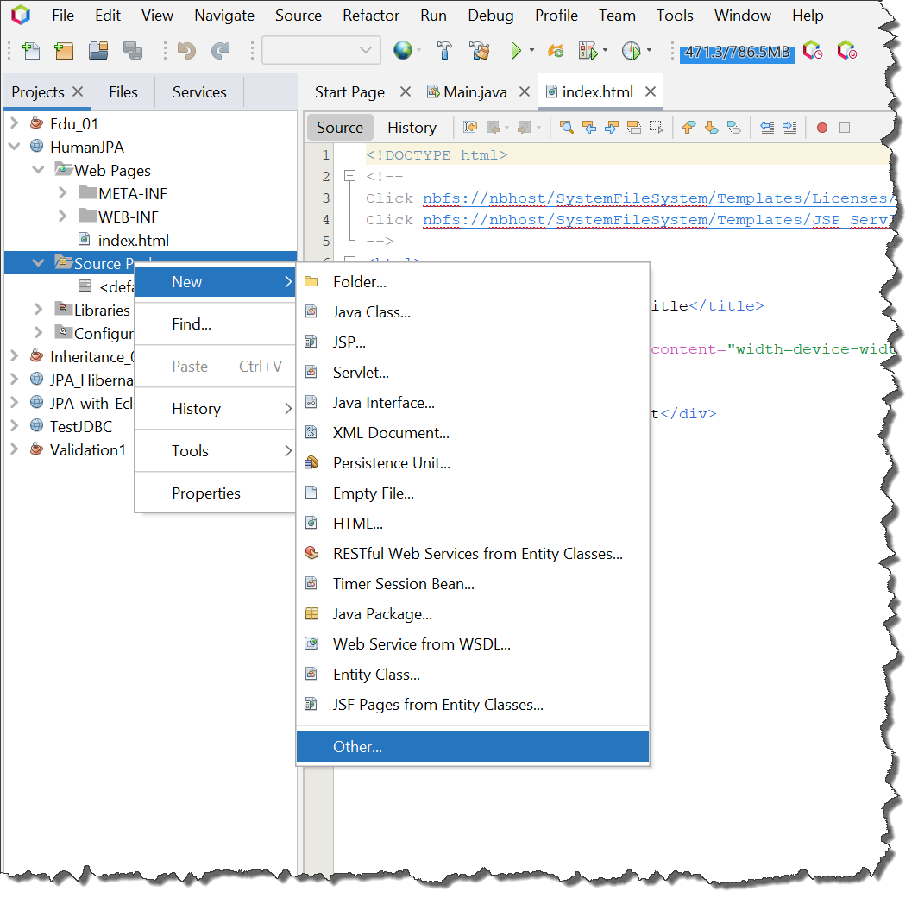
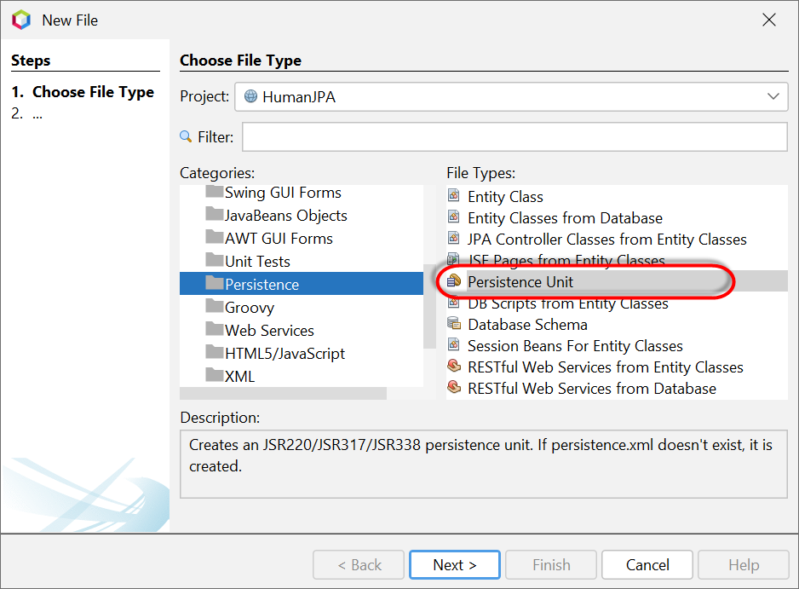
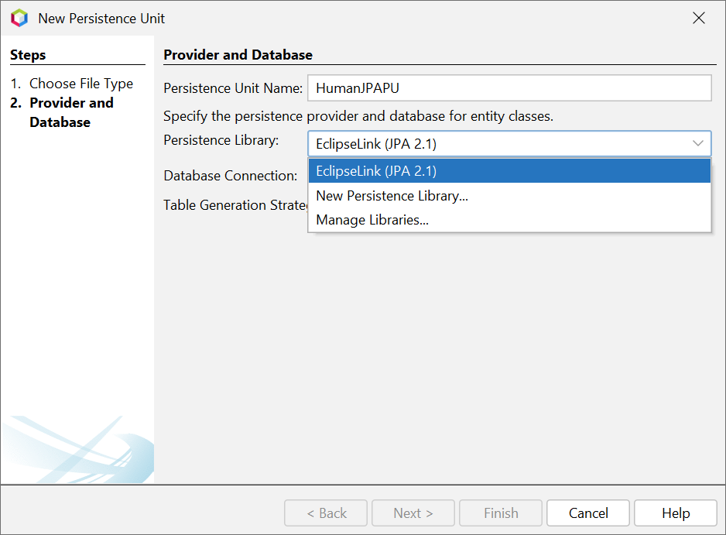
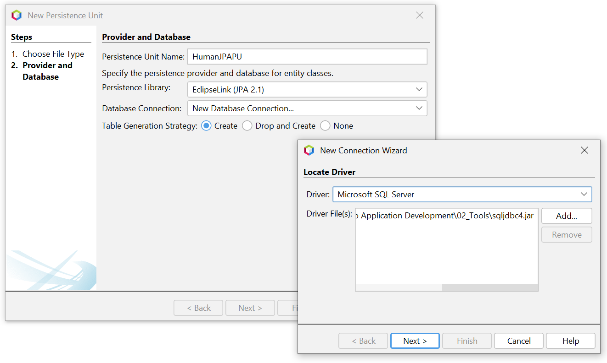
Create Persistence Unit (4 steps)
2
3
1
4

Slide 32
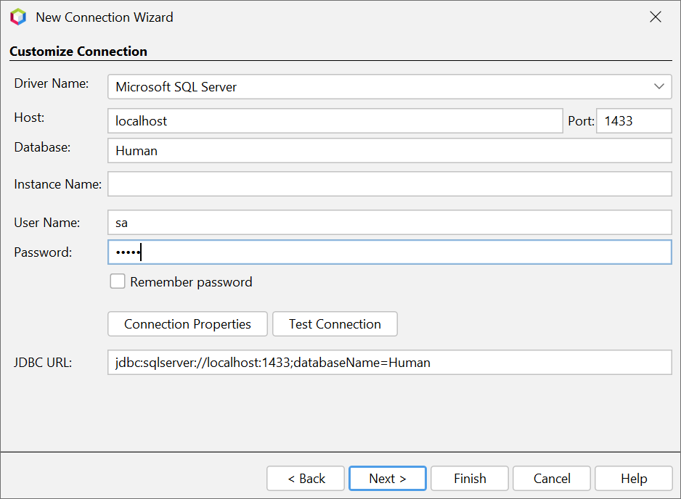
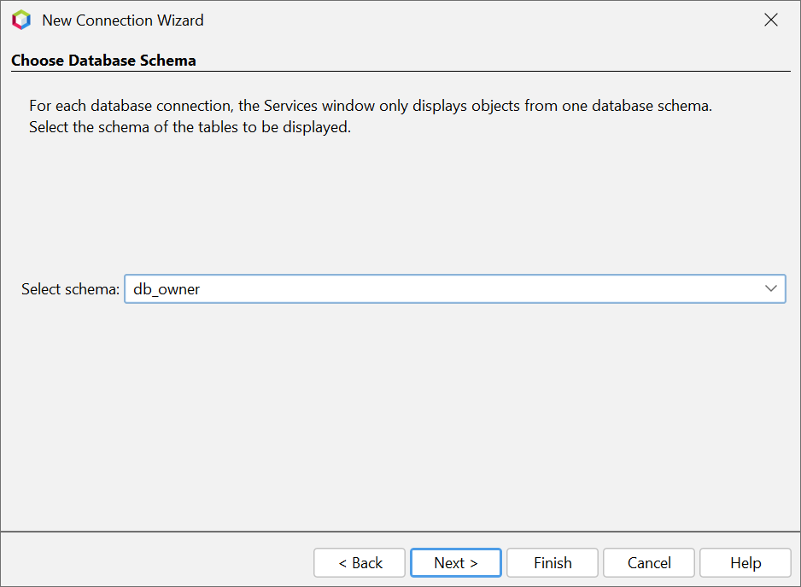
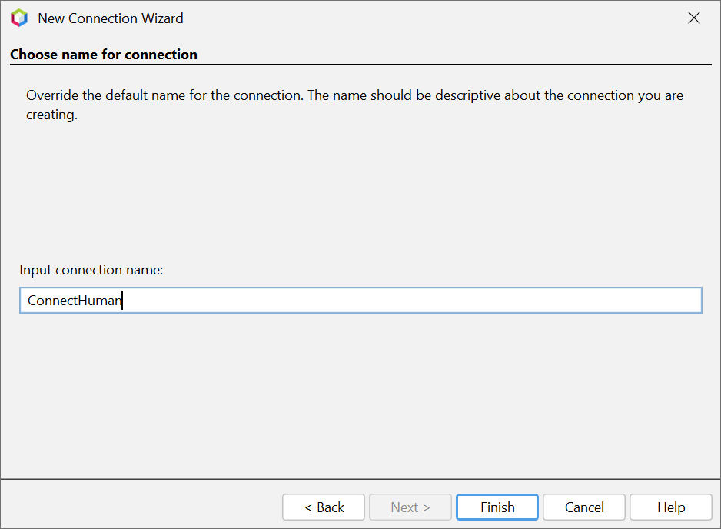
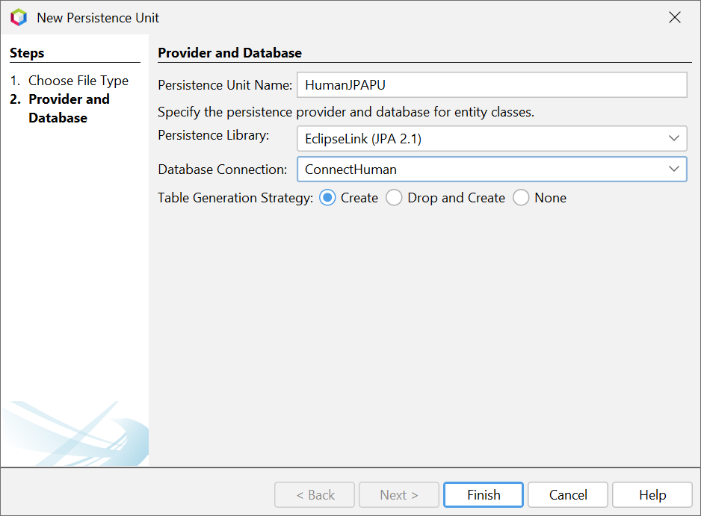
Create Persistence Unit (New connection)
4

Slide 33
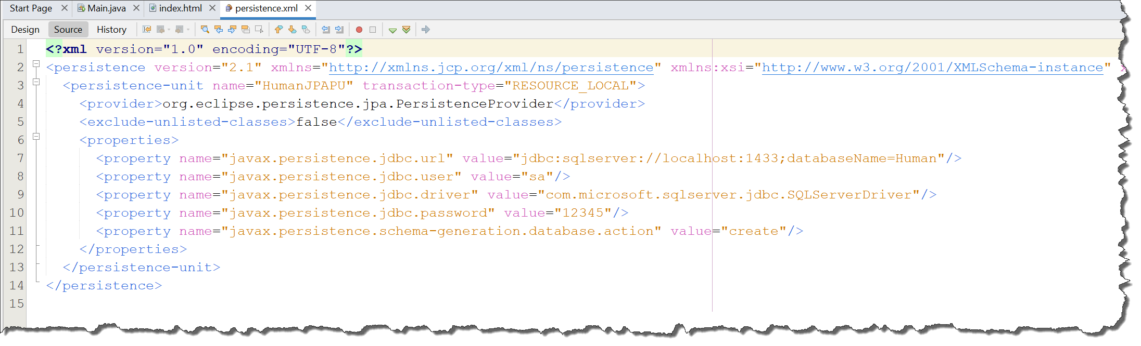
Persistence.xml

Slide 34
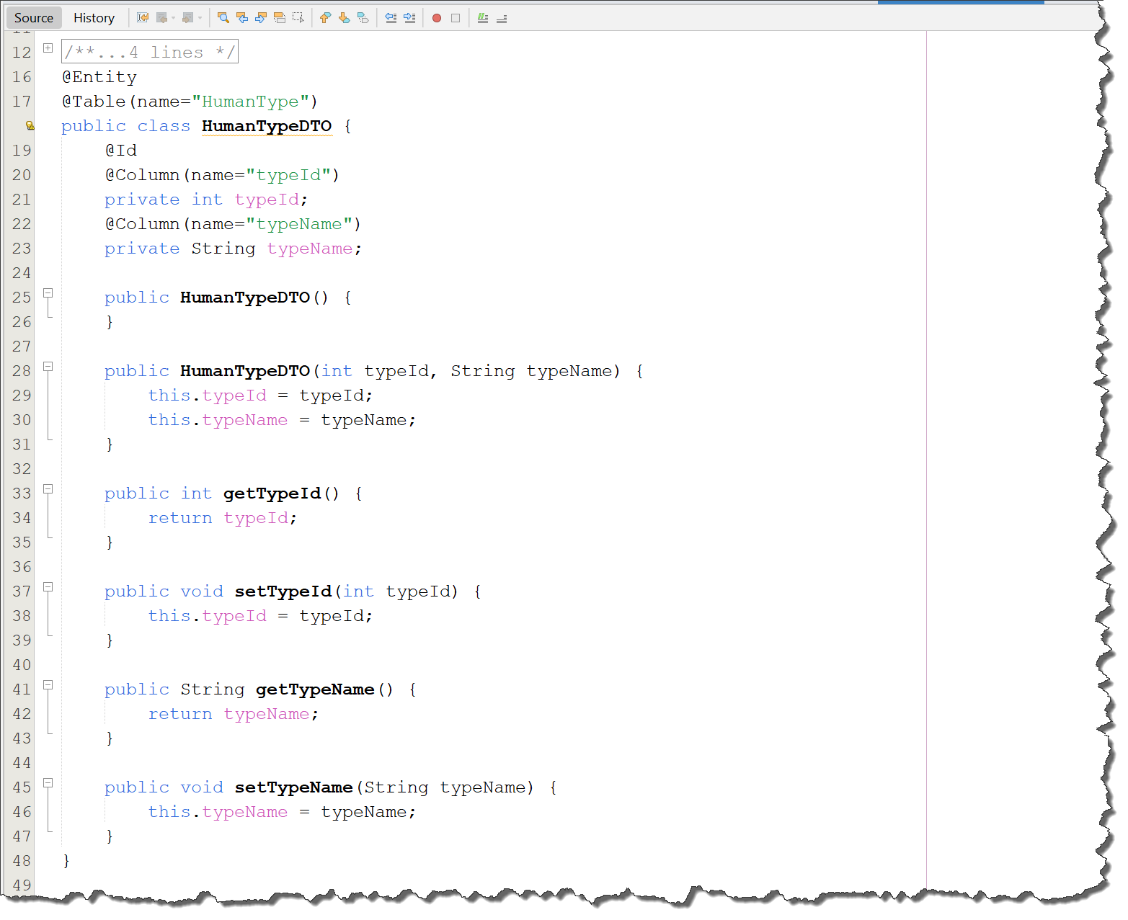
HumanTypeDTO
1/- Use annotations to describe the Table, Fields and Constraint in DTO class
- @Table
- @Column
- @Id
(Package: javax.persistence)
2/- Generate Constructors, Getters, Setters

Slide 35
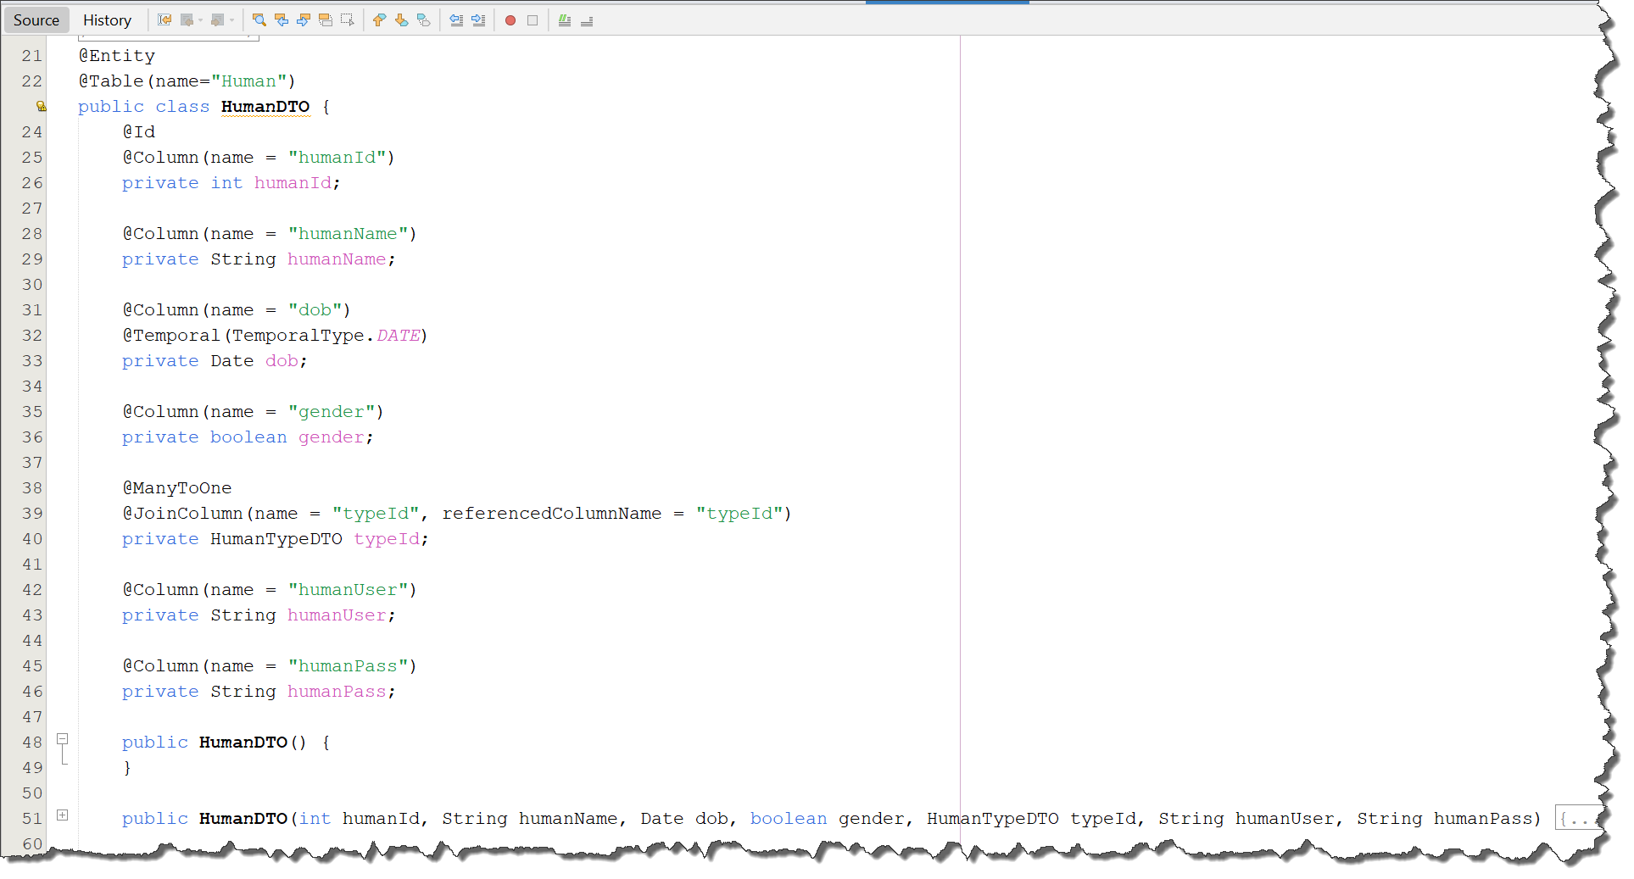
HumanDTO
1/- Use annotations to describe the Table, Fields and Constraint in DTO class
- @Table
- @Column
- @Id
- @ManyToOne
- @JoinColumn
- @Temporal
(Package: javax.persistence)
2/- Generate Constructors, Getters, Setters

Slide 36
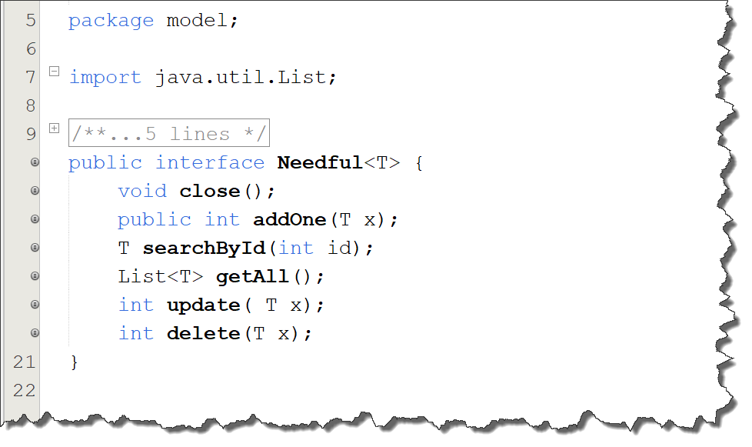
Interface to describe needed methods
1/- Use generic types to define an interface for entities that share the same methods.

Slide 37
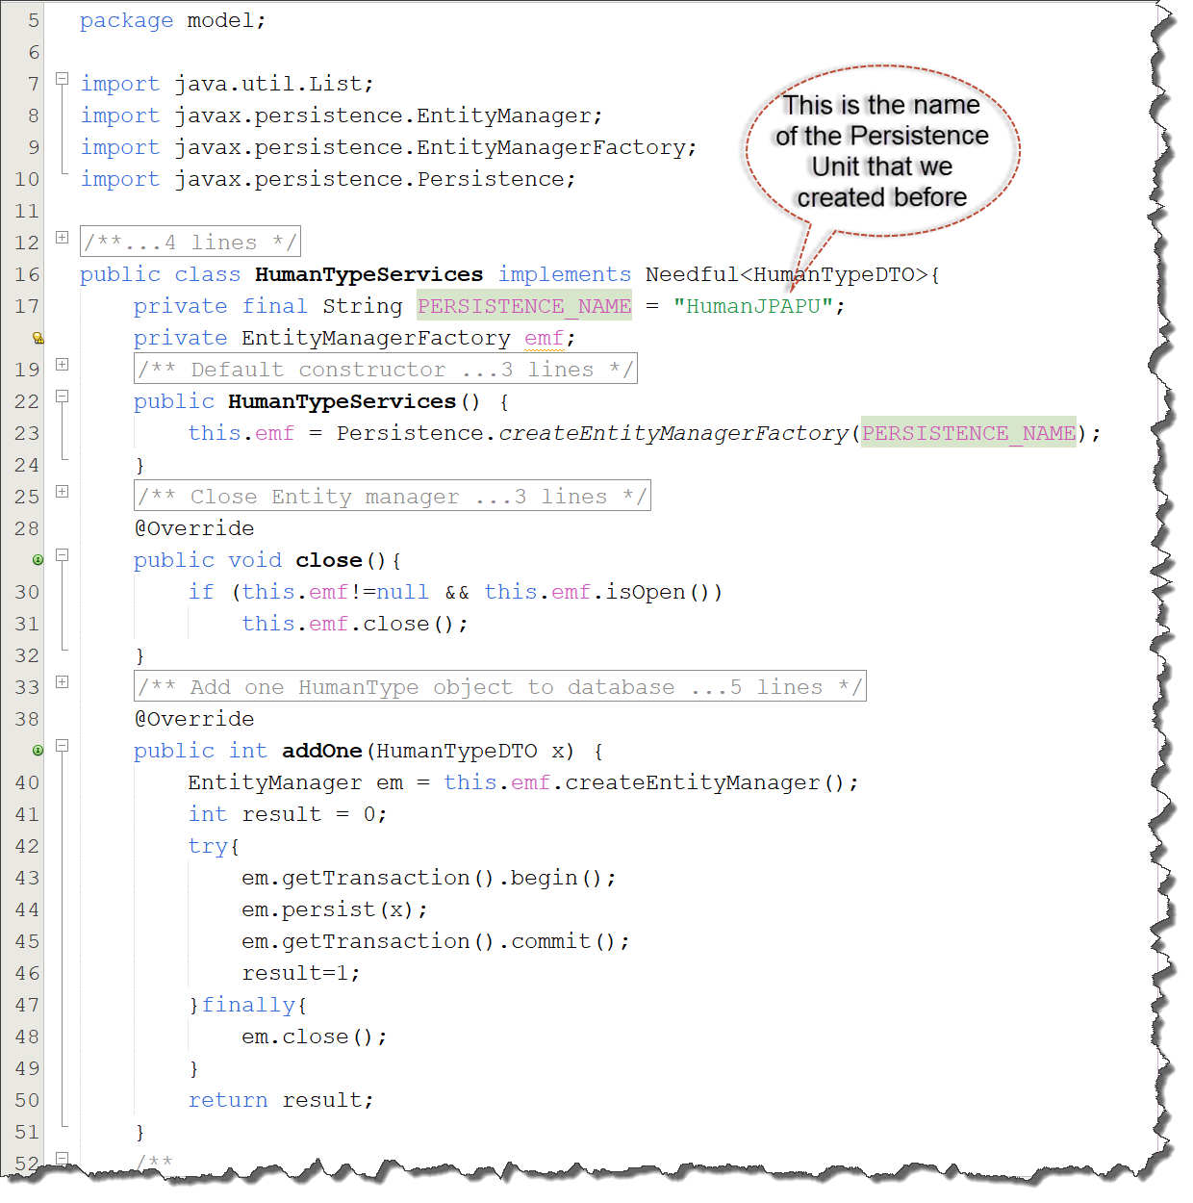
Services class to managing entity
1/- Define a service class that implements the Needful interface and provides implementations for all abstract methods.
2/- Utilize the EntityManager to handle persistence operations on JPA entities.
3/- Some methods to using
- getTransaction().begin();
- getTransaction().commit();
- isOpen()
- close()
- persist()
- merge()
- find()

Slide 38
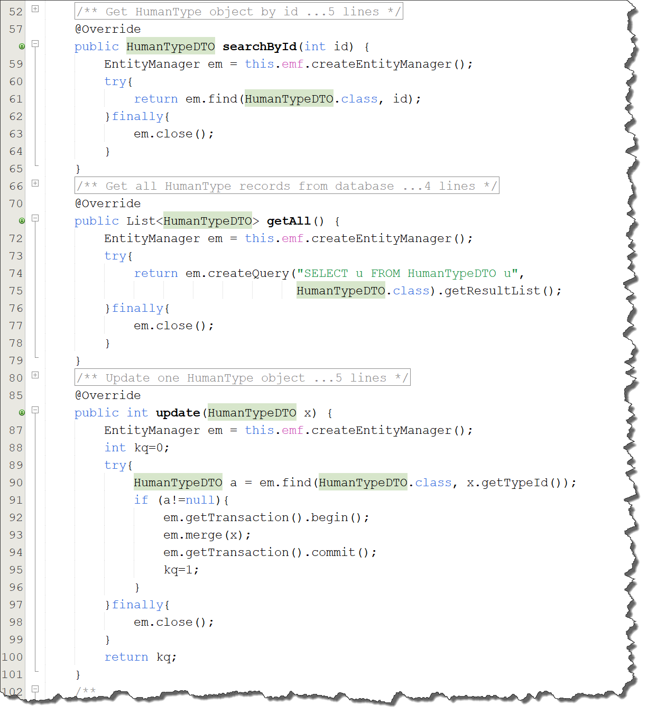
Services class to managing entity
1/- Define a service class that implements the Needful interface and provides implementations for all abstract methods.
2/- Utilize the EntityManager to handle persistence operations on JPA entities.
3/- Some methods to using
- getTransaction().begin();
- getTransaction().commit();
- isOpen()
- close()
- persist()
- merge()
- remove()
- find()
- createQuery()

Slide 39
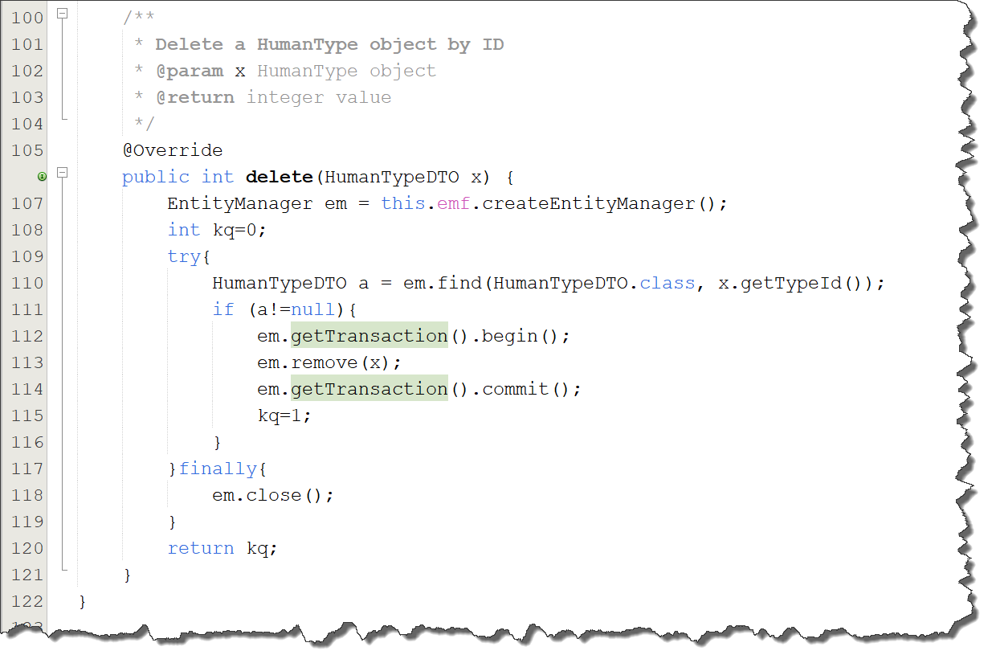
Services class to managing entity
1/- Define a service class that implements the Needful interface and provides implementations for all abstract methods.
2/- Utilize the EntityManager to handle persistence operations on JPA entities.
3/- Some methods to using
- getTransaction().begin();
- getTransaction().commit();
- isOpen()
- close()
- persist()
- merge()
- remove()
- find()
- createQuery()

Slide 40
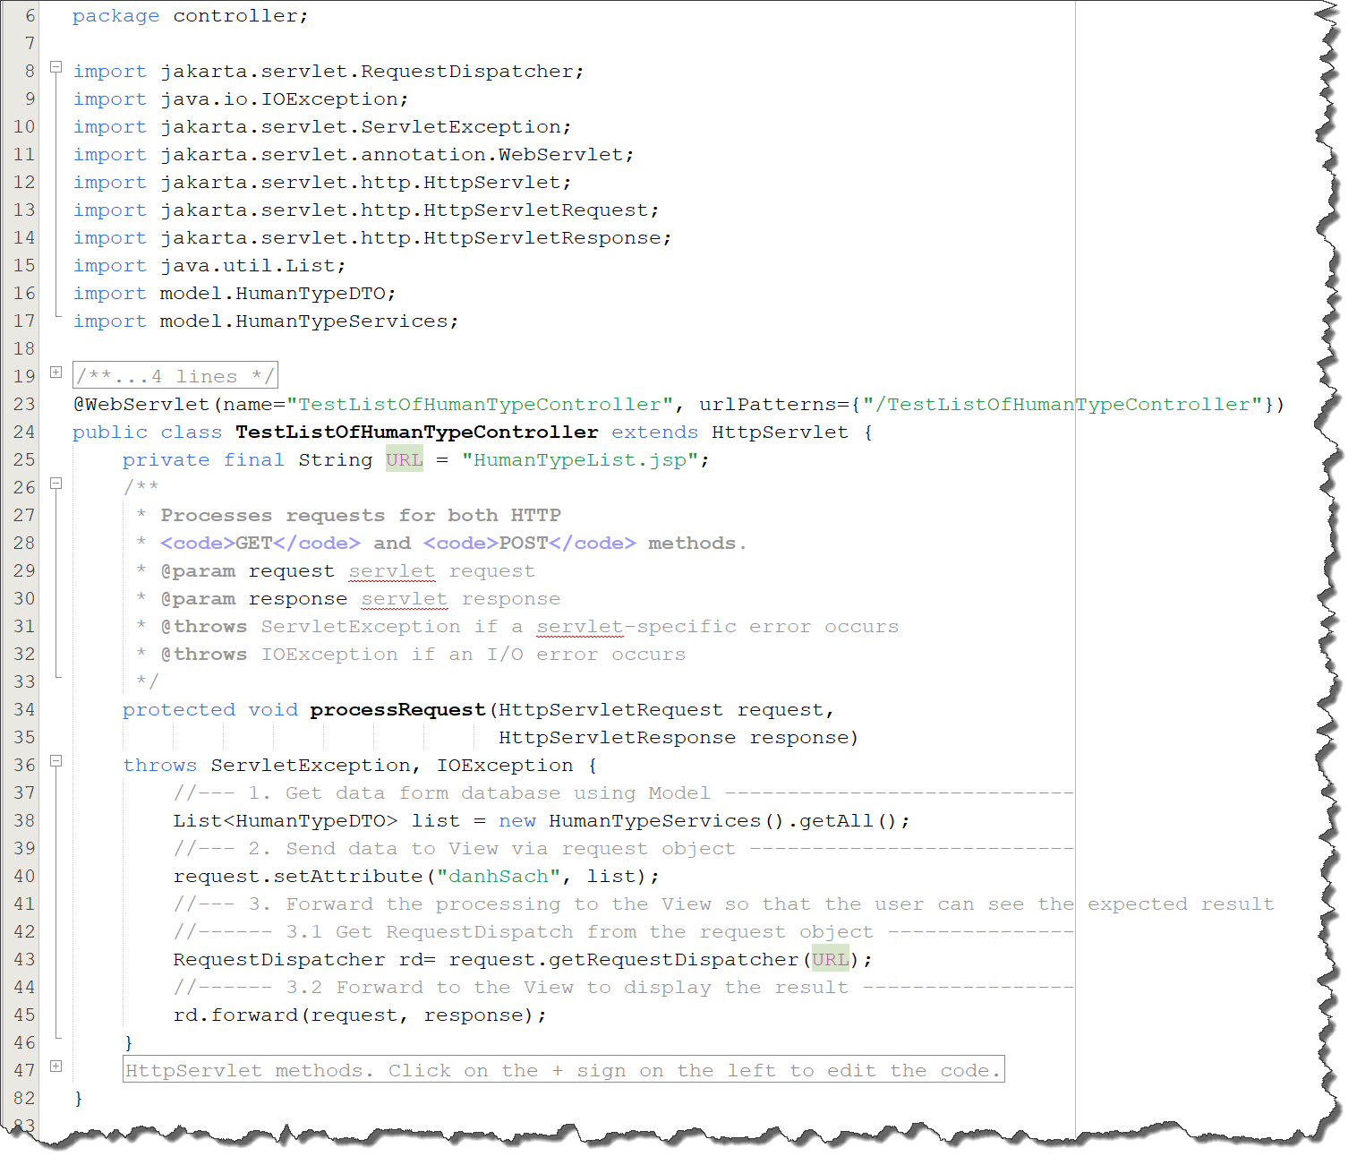
Create Controller to test
Three steps in controller
1/- Get data from the database using the Model.
2/- Send the data to the View via the request object.
3/- Forward the processing to the View so that the user can see the expected result.

Slide 41
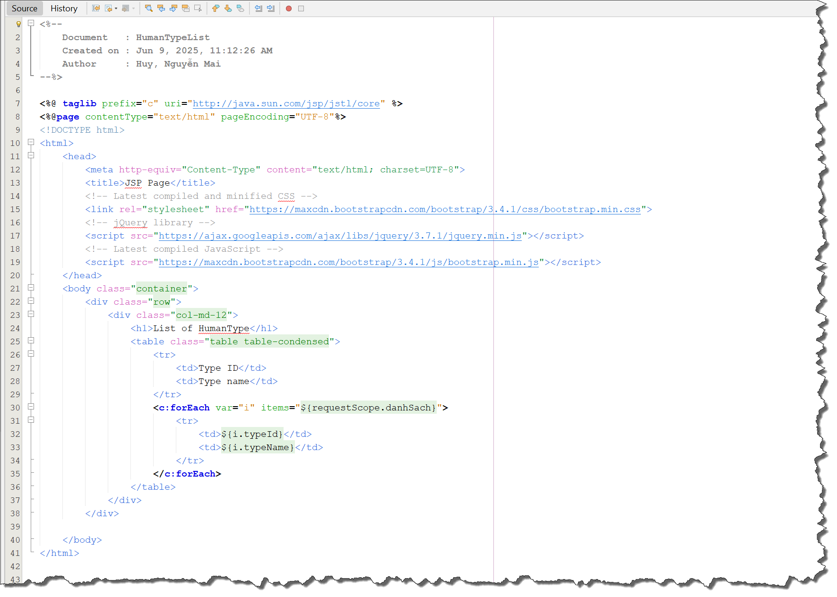
Create JSP to test
Use Expression Language (EL) and JSTL to generate HTML output.

Slide 42
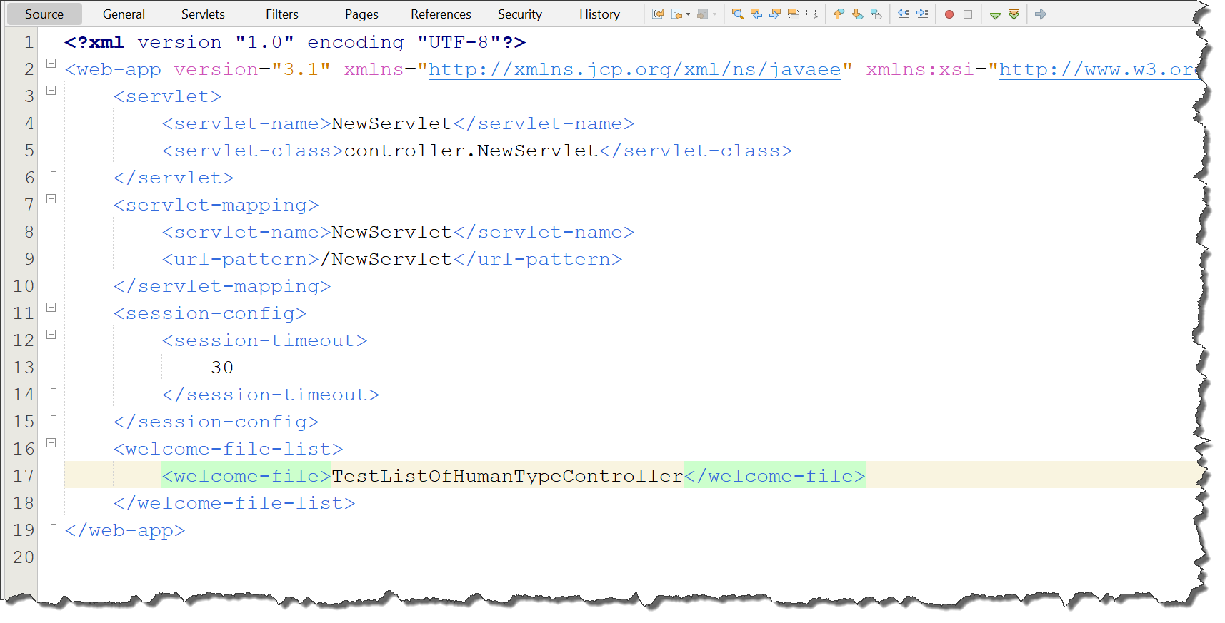
Deployment descriptor (web.xml)

Slide 43
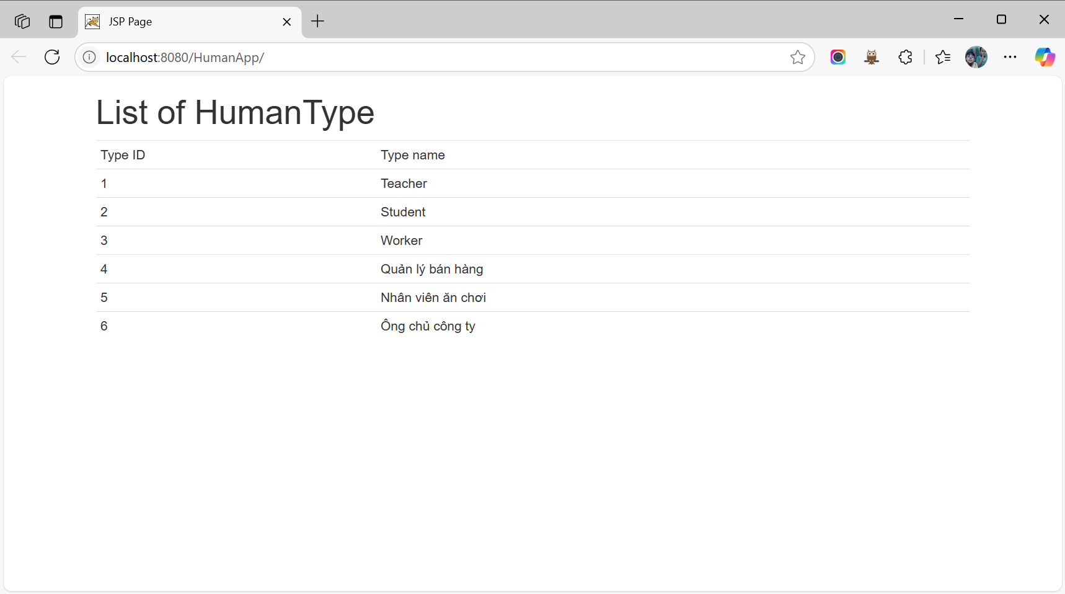
Result:: HumanType list

Slide 44
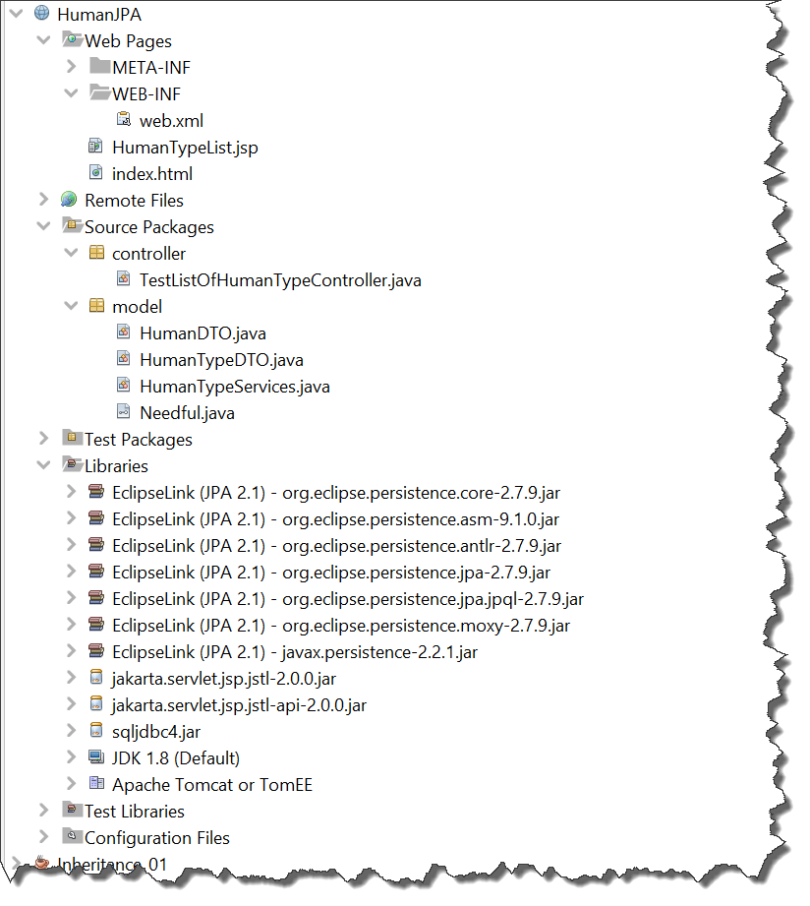
HumanJPA - Project structure

Slide 45
Conclusion

Slide 46
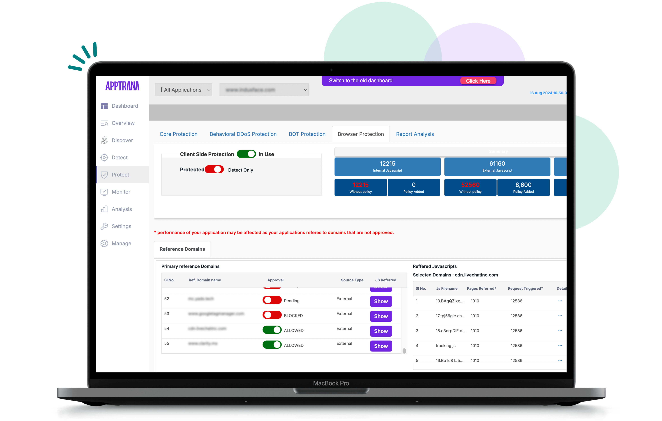
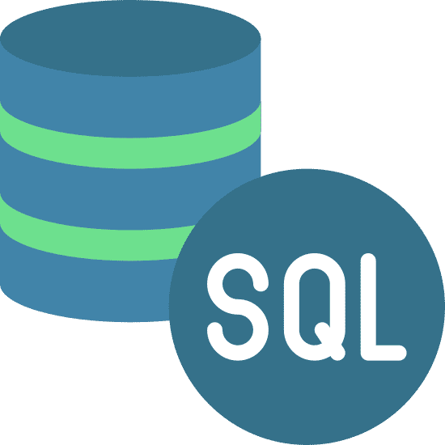
MVC with DAO + DTO
Replace with Entity
View (Render Html)
Servlet container
6.Response
5.Forward/Redirect
DAO
2.Call model
C
3.Query data
URL string
DTO
1.Send request
4.Store data to…
7.Display result
Reference: KhanhKT

Slide 47
MVC with Entity
View (Render Html)
Servlet container
BLO
6.Response
5.Forward/Redirect
2.Call model
3. Call
C
Persistence context
URL string
1.Send request
Entity
4. Query / Sync
7.Display result
Reference: KhanhKT
4. Retrieve
Entity Manager

Slide 48
Advantages of using JPA in Java Web Application
Simplified Database Interaction
JPA abstracts away the boilerplate JDBC code (like Connection, Statement, ResultSet, etc.).
Developers can work with Java objects (entities) instead of writing SQL queries directly.
Object-Relational Mapping (ORM)
JPA maps Java classes to database tables automatically.
Relationships like @OneToMany, @ManyToOne, etc., make it easy to handle complex object relationships.
Portability
JPA is part of the Java EE standard (also used in Spring).
Applications using JPA can switch between different JPA providers (e.g., Hibernate, EclipseLink) with minimal changes.
Reduced Boilerplate Code
With annotations like @Entity, @Id, and @Column, configuration is simplified.
JPA handles SQL generation for common operations like CRUD (Create, Read, Update, Delete).
Query Language Support
JPA provides JPQL (Java Persistence Query Language) which is object-oriented and safer than raw SQL.
Supports dynamic queries using Criteria API, which is type-safe and useful for complex searches.
Caching Support
JPA supports first-level (per-session) and second-level (shared) caching to boost performance.

Slide 49
Advantages of using JPA in Java Web Application
Technical Perspective: Separation of Business Logic and Data Access Logic
By using annotations and entities, the business logic can operate independently from the persistence logic.
This makes the code easier to maintain and extend.
Transaction Management
Integrates well with Java EE/Spring transaction management.
Supports ACID transactions and rollback in case of failure.
Lifecycle Management
JPA automatically manages the lifecycle of entities (new, managed, detached, removed) which reduces manual handling.
Tooling and Ecosystem
Excellent support in IDEs (e.g., IntelliJ, Eclipse) for code completion, validation, and debugging.
Seamless integration with frameworks like Spring Boot, making development even faster.
Maintainability and Scalability
Cleaner codebase and separation of concerns (entity classes, repositories, services).
Easier to maintain and extend as the application grows.

Slide 50

Summary
Learn about ORM frameworks
Java Persistence API
How to apply to your web project

