Slide 1
Server-side
Web Programming
Lecture 5:
Java Servlets and the
Control-View Architecture

Slide 2
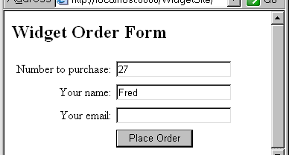
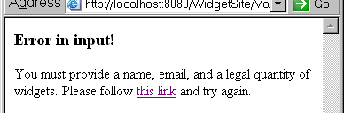
The Control-View Architecture
Different user input might require different response pages
  Different types of request
  Errors/missing field values, etc.
    Example: missing fields in Widget order

Slide 3
The Control-View Architecture
Bad solution: single JSP with lots of conditions
<% if (fields are valid) { %>
entire web page for normal response
<% } else { %>
entire web page for error message(s)
<% } %>

Slide 4
Java Servlets
Class containing methods executed by Tomcat
  Not a web page (like a JSP)
  Methods invoked by a request for the servlet
  Usually redirects to a JSP
Tomcat
Request for servlet
Servlet methods called
Servlet
JSP converted to html
Redirect to appropriate response page
Response
html
JSP

Slide 5
The Control-View Architecture
Servlets usually act as controls
  Categorize request based on the parameters and possibly other factors (database info, etc.).
  Decide which JSP should be sent back as response.
  Forward control (and request data) to that JSP.
request
Control servlet
JSP
JSPs act as views
JSP
response
JSP

Slide 6
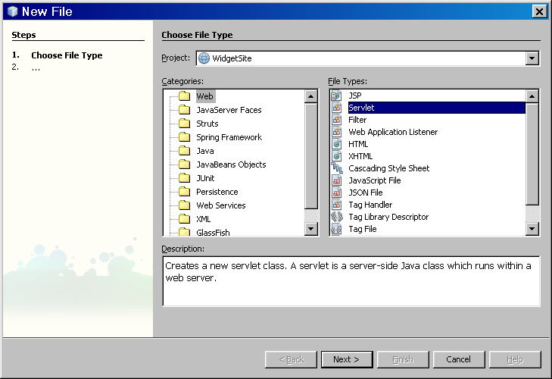
Adding a Servlet
Choose Servlet type
File → New File

Slide 7
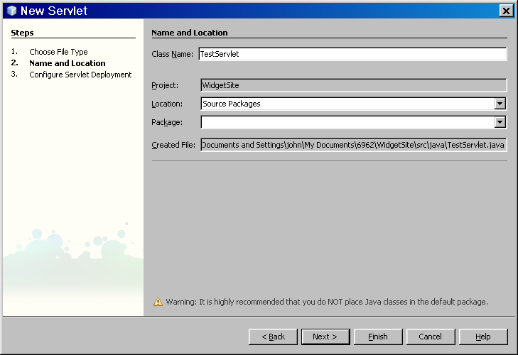
Adding a Servlet
Give it a name

Slide 8
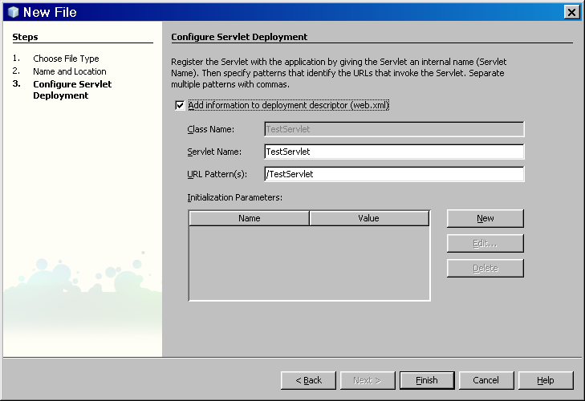
Adding a Servlet
Adds servlet information to web.xml descriptor file.
This allows other servlets and JSPs to refer to it using its name.

Slide 9
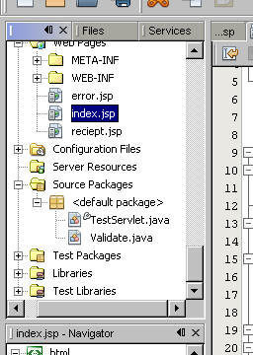
Adding a Servlet
Servlet added to source packages of site
When deployed, must be in WEB-INF/classes subdirectory of site
webapps→
application directory →
your html files and Java Server pages
WEB-INF →
web.xml
classes →
yourservlet.class
  Note that the yourservlet.java file must be compiled to create yourservlet.class

Slide 10
Basic Servlet Structure
Key methods:
void doGet(HttpServletRequest request,
HttpServletResponse response)
Called if servlet invoked using get method
void doPost(HttpServletRequest request,
HttpServletResponse response)
Called if servlet invoked using post method
Have access to request object
  Can call getParameter, etc.

Slide 11
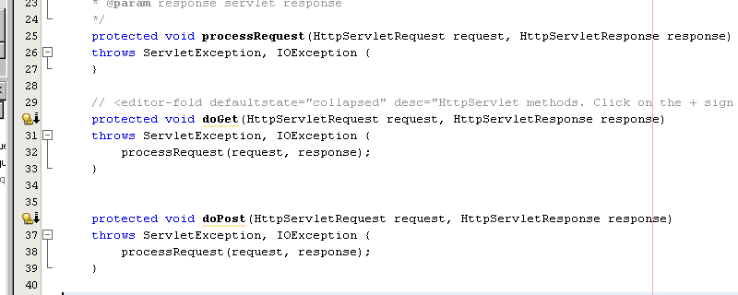
Basic Servlet Structure
Note that 99.9% both doGet and doPost do same thing
NetBeans generates code in both that just calls single processRequest method.
  doGet and doPost hidden by editor

Slide 12
Importing Servlet Libraries
Servlets libraries generally imported:
  import java.io.*;
  import javax.servlet.*;
  import javax.servlet.http.*;
  This is where request, response, etc. defined
Note that NetBeans does not automatically import these (just specific classes)
  Should change code to include all of these

Slide 13
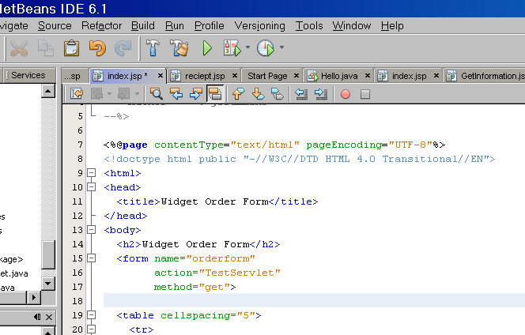
Invoking a Servlet from a JSP
Use its name in the ACTION attribute of FORM

Slide 14
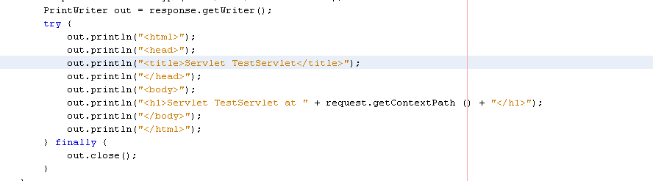
Servlet Background
Preceded development of JSP model
  Modeled after CGI-BIN model
Can generate own response page by writing a string of html to response object
  Very rarely done!
  Usually just redirect to JSP to create response

Slide 15
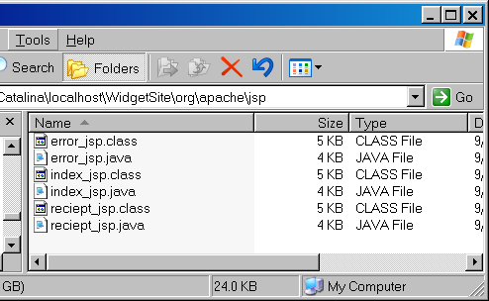
Servlet Background
JSP model built on servlets
  When JSP called for first time
    JSP converted to equivalent servlet and compiled
    Stored in WORK directory
    Run to generate html for response
Only this done in subsequent requests
Much more efficient than running JSP again each request

Slide 16
Servlet Redirection
Basic syntax (step 1):
RequestDispatcher dispatcherObject = getServletContext().
getRequestDispatcher("/MyJSP");
Forward control to this JSP on the same site
The / tells Tomcat to look in the application root directory
dispatcherObject
is a new object that holds information about the redirection
Get the location of the site (so can do a relative url forward)

Slide 17
Servlet Redirection
Basic syntax (step 2):
dispatcherObject.forward(request, response);
Transfer control using the dispatcherObject
Both the request and response must be passed so the JSP has access to parameters, etc.

Slide 18
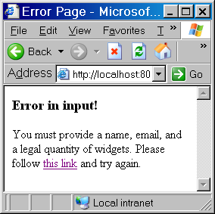
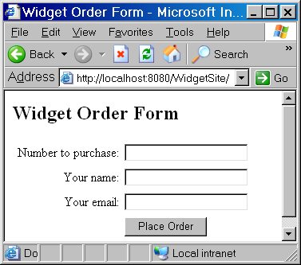
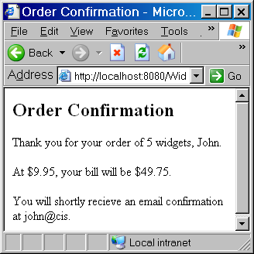
Redirection Example
index.jsp prompts for quantity, name, email
Upon submit, invokes Validate.java servlet
If all information present, forward to receipt page
Otherwise forward to error page
Validate.java
servlet

Slide 19
Redirection Example
public class Validate extends HttpServlet {
protected void processRequest(HttpServletRequest request,
HttpServletResponse response)
throws ServletException, IOException {
String url = ""; // url to forward to
// Get the parameter values from the request
String name = request.getParameter("customerName");
String email = request.getParameter("customerEmail");
String quantity = request.getParameter("quantity");
// If any are empty, set the url to forward to to the error page.
// Otherwise, forward to the normal reciept
if (name.equals("") || email.equals("") || quantity.equals("")) {
url = "/error.jsp";
}
else {url = "/reciept.jsp";}
// Create the dispatcher from the url and perform the forward
RequestDispatcher dispatcher =
getServletContext().getRequestDispatcher(url);
dispatcher.forward(request, response);
}

Slide 20
Passing Information to the JSP
Information can be passed from a servlet to the JSP it forwards to
Added to request object as an attribute
  Like a parameter, has name and a value
  Value can be any Java object (not just a string)
Request
parameter=value
parameter=value
…
servlet
Request
parameter=value
parameter=value
attribute=value
…
JSP

Slide 21
Passing Information to the JSP
Adding attribute in servlet:
request.setAttribute(“name”, some object);
Retrieving attribute in JSP:
variable = (type)request.getAttribute(“name”);
Since attribute can be any type, must use casting to tell Java original type

Slide 22
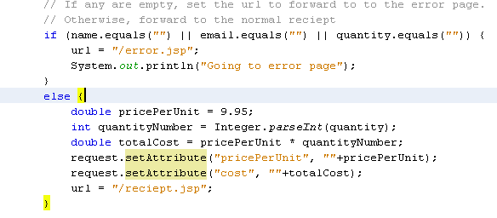
Passing Information to the JSP
Code in servlet to pass price per unit and total cost as strings

Slide 23
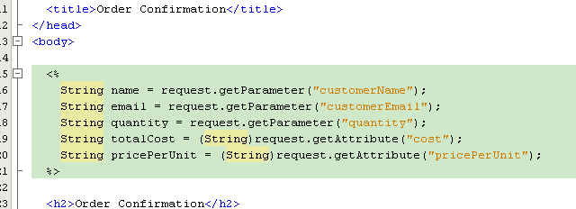
Passing Information to the JSP
Code in JSP to retrieve price per unit and total cost as strings

Slide 24
Servlet Details
Important note: Forward does not terminate servlet!
  Will run to end of processRequest even after forward
Bad code:
if (somevalue == null) {
forward to error page
}
code that will crash if somevalue is null
Better code:
if (somevalue == null) {
forward to error page
}
else {
code that will crash if somevalue is null
}

Slide 25
Servlet Details
Invoking one servlet from another:
  getRequestDispatcher(“/sitename/servletname“);
  Note: may not need sitename in NetBeans, but may not work when deployed otherwise
  Often done for modular multistage redirection
WidgetSite
Validate
JSP for standard configuration
request
Error JSP
Validation servlet
Servlet to choose computer type
JSP for custom configuration
response

Slide 26
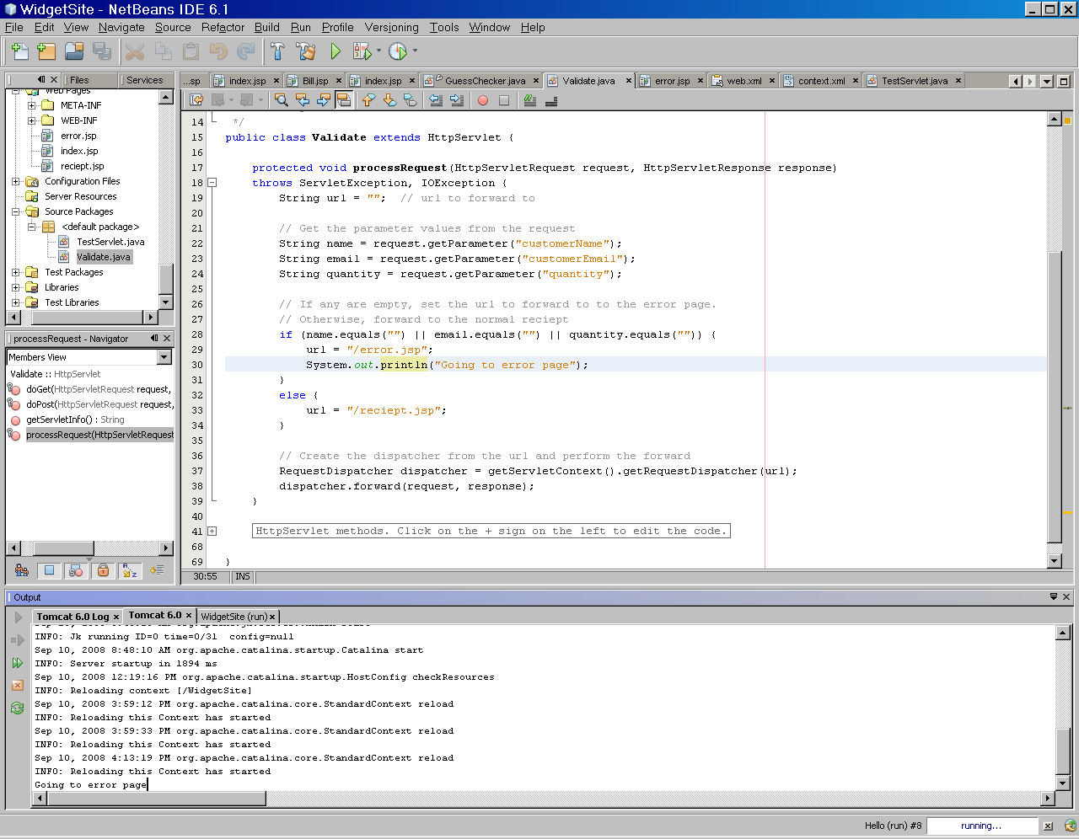
Servlet Details
Debugging servlets
  Can write diagnostic messages to control screen
  System.out.println(“message”);

