Slide 1
Why, and with what consequences did industrialization result in popular protest and political change?
2.4

Slide 2
Reactions to mechanization and economic change
Pre-Industrialization the rural areas of England were rather static (little change occurred)
Industrialization caused major changes and unrest
Causes of protests in rural areas:
Rapid population growth, led to a reduced demand for workers, factories decreased home-created demand
Food prices rose (BREAD)
Enclosure farming began effecting more and more areas, leading to loss of common land (pasture and gardens/fields)
Landowners needed less full time workers
Parliament passed laws with heavy penalties against poaching
Limited welfare system couldn't handle the demand

Slide 3
Reactions to mechanization and economic change
Scattered food riots between 1790-1810, but generally only when bread prices were incredibly high (generally small and not frequent)
Rioters were punished and riots were suppressed—very unorganized, most people were illiterate
Enclosure riots were similar
Growing demand for labor in towns/cities helped offset the lack of job demands in rural areas
1792-1815 England was at war which allowed many men to have a job
Post-1815 a rise in protests in England increases
Agriculture prices collapsed, led to lower prices but also lower wages
1820s-burning of haystacks, local food riots, and attacks of livestock
Increase in radical newspapers-aimed at middle-class readers and focused on issues that effected them
Others aimed at working class (generally read aloud at inns) attacked the taxes that had to be paid to support the rich

Slide 4
The Captain swing Riots
1830-31 ended protests
Mythical figure allegedly organizing the movement, the name appeared on various threats to landowners (letters mainly)
Called 'riots' by the government
Protests were considered illegal, violent, and destructive by the elite
Protests highlighted several issues
Lack of regular employment
Low wages, bad housing and working conditions
Lack of welfare support
Having to pay taxes to support the Church of England
Arrival of threshing machines (helped harvest), reduced the demand for labor
Hunger
Main areas of protests were in Southern England where there was little employment options
Troops were sent in to keep order, normal judicial processes were suspended (some were executed, transported to Australia, or imprisoned)
Protests achieved very little-delayed threshing machine for a few years, trade unions were unsuccessful (leaders sent to Australia), helped lead to the reforms of 1832 (didn't do much though)

Slide 5
The Luddite Riots
Very few protests and riots against the factory system
Occasional attacks on new machines (pre-1830) but few after
2 significant attempts to prevent the establishment of new machines
(1)-1770 Lancashire, arrival of machinery which improved output and quality of finished woolen cloth. Men and women found themselves jobless, led to smashing of new machines, but it was confined to the small areas
(2) Luddite movement 1811-1816. Main machine breaking occurred between 1811-1812. Throughout northern England and midlands, mobs broke into factories and smashed new machines. A lot of damage was done, one mill owner was killed. Many who were involved were people whose job was threatened or taken by new machines

Slide 6
The Luddite Riots
Why did the Luddite revolt occur?
England was at war (Europe and America)-led to a decrease in raw materials available
Led to high unemployment
Wage cuts and high bread prices
Miners were also involved (not affected by new machines) showing bigger problems at play
Eventually repressed by troops and offenders imprisoned
Some magistrates appeared to be sympathetic (lack of investigation and prosecution)
Seen as the beginning of the class struggle by the 'lower orders' against the excesses of capitalism also seen as just hungry men faced with the loss of jobs and livelihood

Slide 7
The political and constitutional consequences
Early on, industrialization had limited political impacts
George III had limited power, but was sympathetic to its economic impacts
Parliament was sympathetic to social and economic changes
There were few obstacles to industrialization:
Enclosure acts were passed easily
Inventors could easily get patents
Canal and railroads had permission to build
Oversea trade was protected by the navy
Tariffs were assisting exports
Taxation was low, laissez-faire was popular
Ruling classes were making money, so they protected their interests

Slide 8
The political and constitutional consequences
1790s beginning of demands for political change
3 factors: (1) movement began by a group of liberal MPs in early 1780s aimed to reduce the amount of control the king and aristocracy had over parliament, and create fairer representation; (2) people were taking notice of the French Revolution with its radical political ideas; and (3) The Rights of Man (1791) by Thomas Paine demanding votes for all men, democratic society, equality for all, and a welfare state
'Corresponding Societies' began forming (literate skilled workers)-sympathetic to Paine's ideas, but little interest in those facing the worst of Industrialization
Had little impact on any changes occurring
1815 problems (linked working and lower classes and radicals)
300,000 soldiers were no longer needed and flooded job market
40 million pounds became available
Bad harvest, 1815
Corn Laws, 1815-prevented the importation of cheap corn and designed to help landowners increase profits
Working class hunger and unemployment grew
Ideas of the 1790s Corresponding Societies re-emerged
Protests achieved little
Early 1820s bread prices fell again
Lack of unity between protestors

Slide 9
The political and constitutional consequences
Peaceful protests often were dealt with harshly
1819-60,000+ people attended a public meeting at St. Peter's Field near Manchester to hear the radical political speaker Henry Hunt. The local magistrates aided by local yeomanry had an armed calvary charge the crowd killing 11 (became known as Peterloo after the famous Waterloo defeat of France)
Yeomanry: force made up of local volunteers, usually middle class. Been created to support the regular army during the Napoleonic Wars, but now was used to prevent domestic order
1829-1830
Bad harvest led to increased bread prices
Trade decreased, unemployment increased in urban areas
Growing dissatisfaction with Conservative government (more concerned with aristocracy than the common man)
Felt system of parliament was corrupt and out of date, having little change since the 1500s
Dominated by aristocracy with agricultural interests, ignoring industry
Towns lost their population leading to declining MP representation and the rise of 'rotten boroughs' (purchasing of MP position)
1830-King died, bringing in new liberal government under Early Grey
1830-1832
Alliance between middle class and working class to reform politics
National Union of Working Classes (1831) established, along with other groups
Demands for all male suffrage

Slide 10
The Great Reform Act, 1832
Aristocratic control was reduced
Industrial towns were able to send MPs to parliament, rising the proportion of middle-class men from manufacturing, commerce, banking, and industry (not huge, but it did increase)
Middle-class gained with the expansion of the right to vote
Working-class didn't gain a lot
Only men who owned property could vote
Membership of parliament still looked similar
Led to the Chartist movement
Mass protests of skilled and unskilled (rural and urban) and serious rioting, made the gov't take them seriously
1832 reforms empowered and rewarded the middle class, but harmed the working-class

Slide 11
The New Poor Law, 1834
Need to change Old Poor Law from the 1500s
1790s-modified into the Speenhamland System (named after the village where it was first developed) and mainly used in Southern England
Paid for by local landowners and led to their contributions increasing (poor rate)
Depended on the size of the recipients family (larger the family, the more received)
Varied with the price of bread (bread price higher; families got more)
System was widely disliked, it was expensive and didn’t encourage the unemployed to find jobs
System was unable to cope with the mass unemployment
Royal commission in 1832 to investigate and recommend action about poverty in Britain
Commission was made up of Middle-class men who ensured their findings supported their ideas, and exaggerated the failings of the old system (no one understood the report, 1834)

Slide 12
The New Poor Law, 1834
Middle-class men who ensured their findings supported their ideas, and exaggerated the failings of the old system (no one understood the report, 1834)
1834, Poor Law Amendment Act-intention of creating a welfare system designed to deal with the new industrial society
Speenhamland System was abolished
Those who needed help would only get it in a workhouse
Men and women would be separated (workhouse for each sex)
Idea that it would prevent people from having too many kids
Monitored by the government in London, but managed by locals
Ended up having very little spend on support
Poverty became a crime essentially
Bastilles-sentence in the workhouse, called this off the Bastille in France
Segregation by age and sex didn't actually happen and everyone was treated poorly
New system still wasn't adept at dealing with the mass unemployed

Slide 13
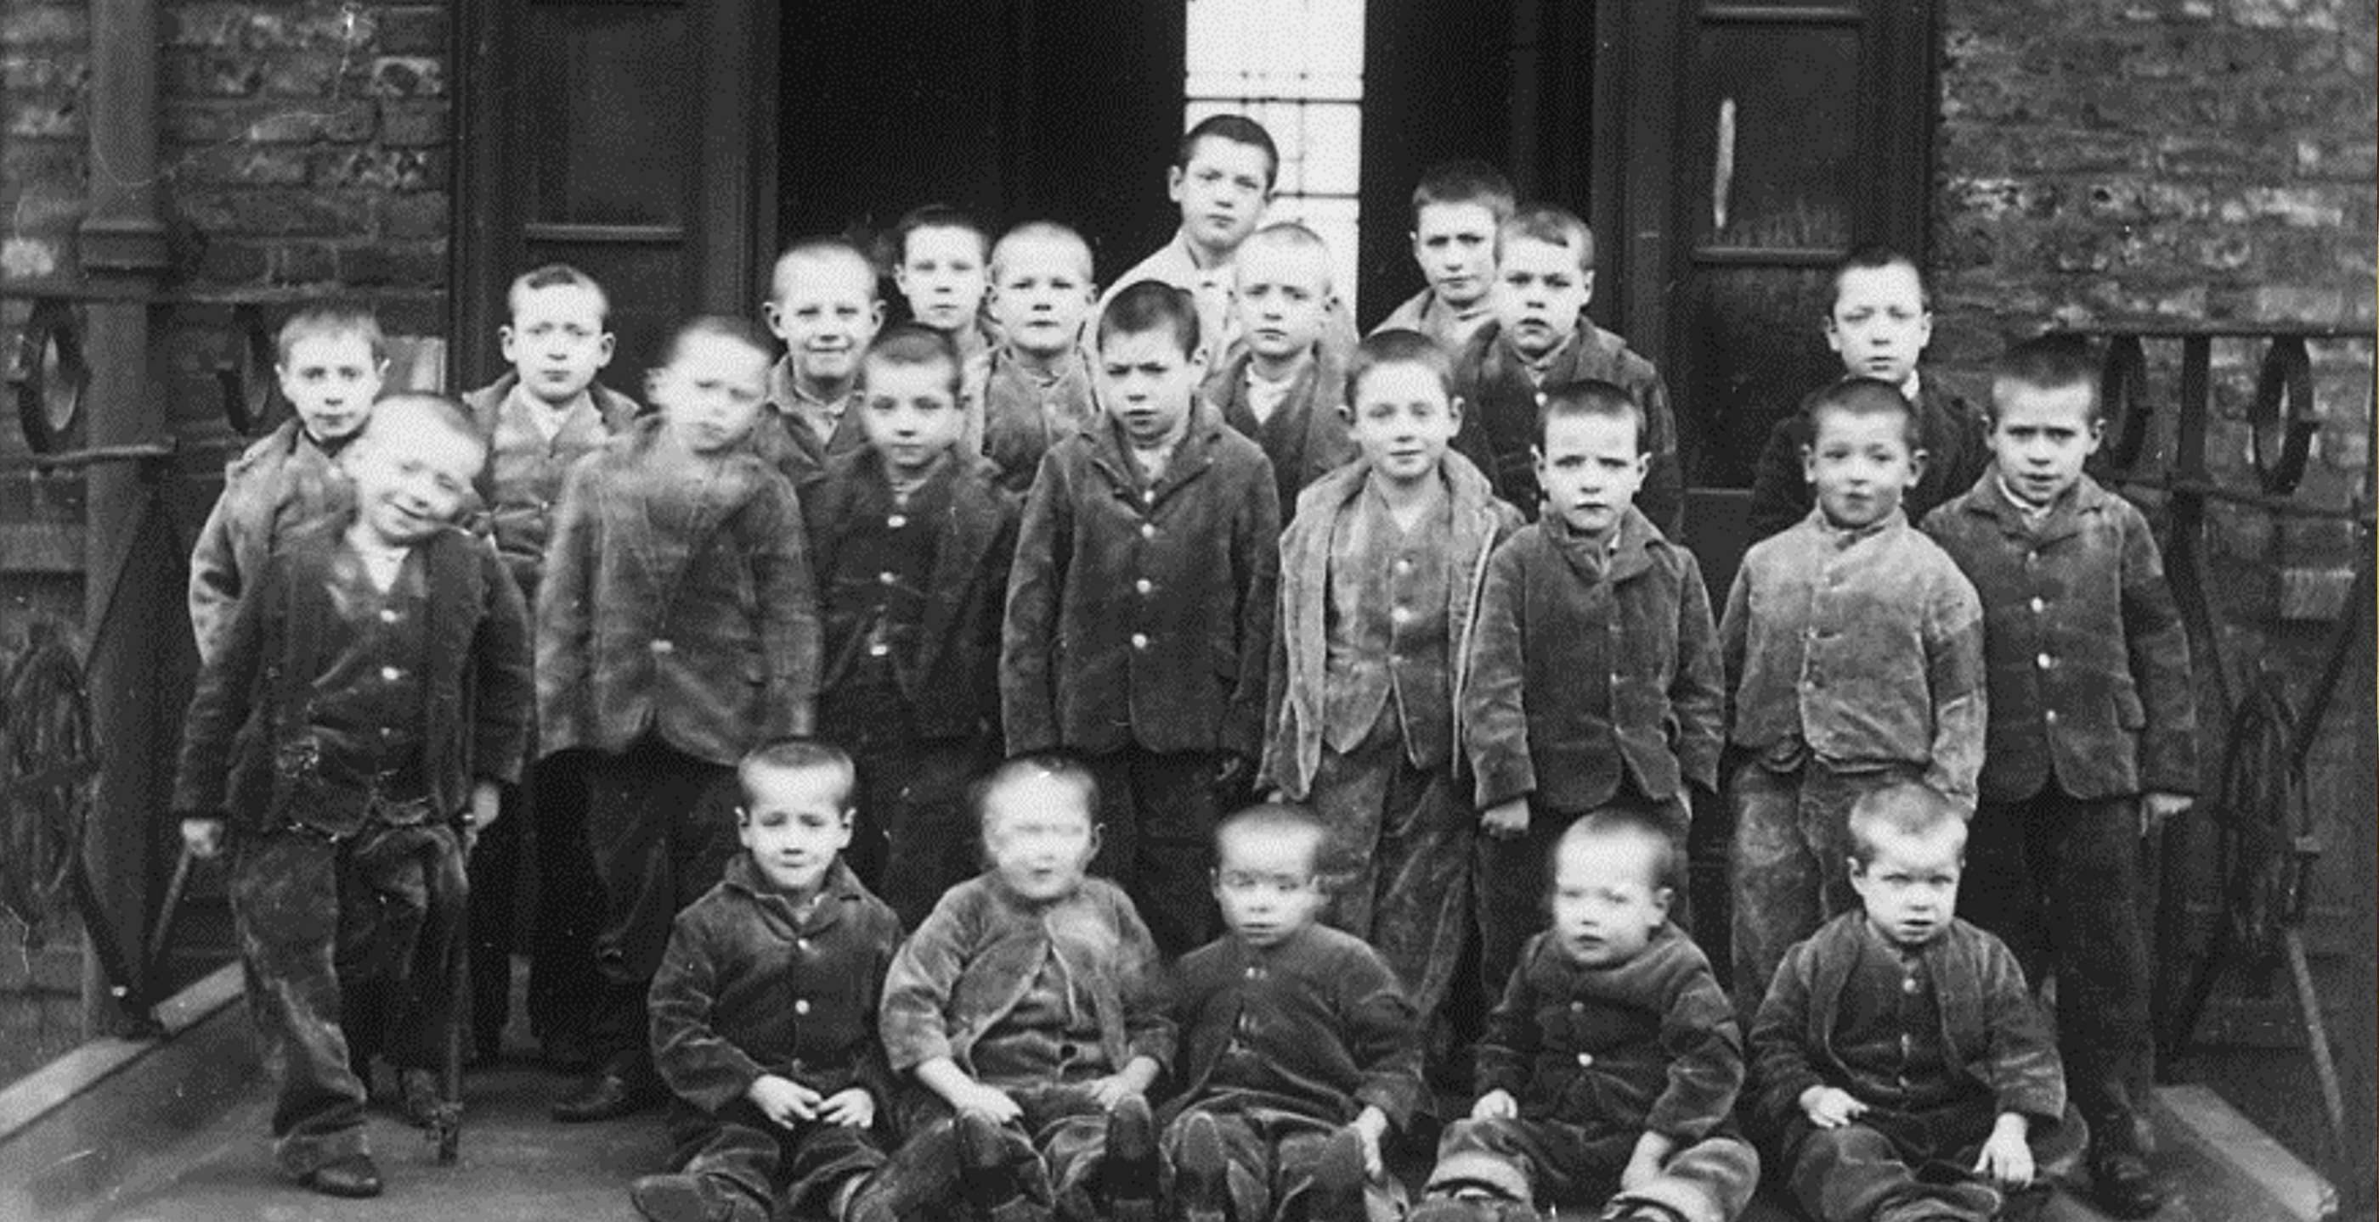

Slide 14
Demands for Political reform, including Chartists
New movement emerged in the 1830s after the Reform acts failed to making any changes (Chartism)
Bad harvests, high food prices, and high unemployment between 1837-1848 led to an inevitable Chartist activity and protests
New Poor Law was greatly hated, trade-union movement had failed to improve wages or working conditions
Slavery was abolished in 1833 with millions given in compensation to slave holders, but nothing to the slaves themselves or the poor in rural England
Growing literacy and cheap radical press began encouraging action

Slide 15
Chartists
1838-group of skilled working class men (led by Francis Place and William Lovett) met in London and created a document that they hoped would unite the working classes across Britain
People's Charter had 6 simple points:
Universal manhood suffrage
No property qualification required before someone could stand for election to Parliament
Annual parliaments would be held (annual election)
Equal representation-each area that sent an MP had to contain the same number of voters
Payment for MPs
Ballot/secret voting (voting in 1830s was done in public)
3 main periods of Chartist Activity: 1838-39, 42, and 48-49 (all periods of high food prices or high unemployment)
Petitions were sent each time to Parliament containing millions of signatures requesting the implementation of the Charter, parliament met none of the demands
Chartist riots could often be violent-many were arrested, killed, or sent to Australia
1848-Charitsts planned a large riot in London, few showed up and little happened. The Chartist petition was presented to Parliament, and nothing changed, this ended Chartism

Slide 16
Why did Chartism fail to achieve its objective?
Divided and fueled by hunger and unemployment
When conditions improved, support for the movement declined
Government didn’t respond with unnecessary or harsh reactions
General Napier (general in charge of troops keeping order) was sympathetic to the cause
Divisions faced by movement: use of force or peaceful protest, revolution or moderate change, support for or opposition to industrialization, collaborate with middle class or remain separate, religious or not, focus on education and banning alcohol or not banning alcohol, focus on self-improvement or more action by the gov't, hate for O'Connor or support, whether Chartists were socialists or not
Movement achieved very little
Failed in the short term, but all demands were met in the long-term

Slide 17
Trade Unions-Origins of Organized labor
Trade Union: a group of workers who joined together to defend their work-related interests and put concerns to their managers (usual aims were improve pay and working conditions)
Had limited impact at this time
Illegal throughout the 18th century, but they did exist
Upper class didn't like working class coming together to attempt to make improvements
'Combinations'-groups of men organized together, usually in towns. Generally skilled workers in specific trades
Reasons tended to be: provide insurance benefits for members, give themselves more bargaining power against employers, restrict entry to professions (long training periods)
Wanted to preserve the interests of their members and not in wider social or economic or political issues

Slide 18
Trade Unions-Origins of Organized labor
1799-1800-Combination Laws (reaction to French Rev.)-Gov't made membership of a union punishable by imprisonment
Intense fear of conspiracy, and combinations were seen as dangerous
Most local governments were fairly tolerant towards them
During war years, membership boomed as people successfully gained better pay and conditions for shipbuilders and cotton spinners
Economic depression and gov't repression reduced activity (1815), and by 1818 it failed totally
1824-Combination Laws were repealed allowing trade unions to be legal
Sudden outbreaks of strikes, leading to the law being modified in 1825-unions were still legal but could only negotiate hours and wages, with NO right to strike
Union leaders could still be prosecuted under various laws (secret oaths, master and servant laws, etc.)
Trade unions achieved little throughout the 1820s and 30s
Large divisions between political aspirations and those who simply wanted better working conditions

Slide 19
Cooperative societies
1844-28 working-class people set up shop in Lancashire, mainly skilled workmen in regular employment (inspired by Chartism and socialist ideas) set up a Cooperative movement
Sold food, clothes and other goods
Prices were reasonable
Run by members
Not designed to be profitable, but surplus income was paid back to it by members
Anyone could become a member and run democratically (women could be members and vote!)
Neutral towards religion and political affiliation
Later formed a significant role in the formation of the Labour Party, which was set up to get working-class men into the House of Commons

Slide 20
Government reaction to demands for change
Some governments ignored it, some opposed them, and some agreed with them
Government rarely took a positive role with the working-class and industrialization
Always worked to maintain order (Luddism and Chartism)
1832-gov't was faced with real pressure (threat of Revolution) and made changes-limited concessions were made (1832 Great Reform Act)
Corn Laws remained enacted until 1846 despite the negative effect on food prices

