Slide 1

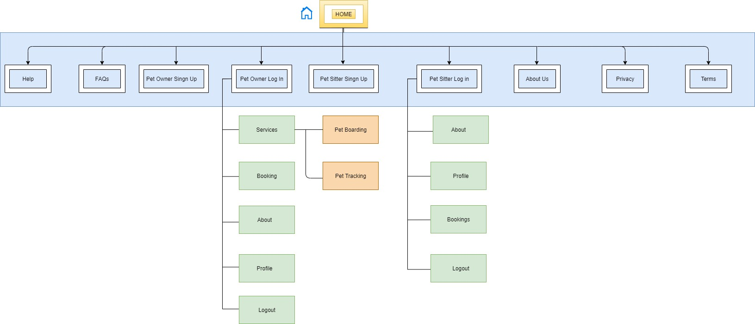
PETSITTER
MOHAMED ASHRAF ALI – 20BCE1630 SANJIL KC – 20BCE1855 LENIN VASAN – 20BCE1892
Dr. Sweetlin Hemalatha
SCOPE
TARP Project
INTRODUCTION
Industry estimates show there are around 19 million pets in India (around 80 percent of these are dogs), and on average, 6,00,000 pets are adopted every year. Pets become a part of the family the moment they step into our house. Pets become very used to human company, unlike stray animals who usually live on their own. There are many people who are excellent pet caretakers but cannot own a pet due to their work lives. But such people are willing to take care of others' pets during weekends or during their free time. Connecting such people with pet owners and creating and expanding this community is the main goal of this solution.
The key motivation to develop Pet Sitter was to help pet owners enjoy a peaceful vacation and the pet lovers who cannot own a pet for any reason to be able to own a pet just for a few days. The Pet Sitter application connects the pet owners to pet lovers or carers near them by using geolocation through a booking system. The nearest pet lovers are displayed to the pet owner based on both their geo locations.
Objectives
Pet Sitter is a platform that connects pet lovers and pet owners where the pet owner will be able to choose a pet lover nearby his place who is willing to take care of his pet on his behalf.
SCOPE of the project
The scope of our project is to relieve pet owners from the guilt associated when traveling without their pet or leaving them in a boarding kennel. On our platform, the pet lover has to make an account and set up their profile mentioning where they stay, their experience with the types of pets, their cost to keep different kinds of pets and whether or not they will provide food during the stay.
methodology
Requirements Description: This include determining the user requirements, functional and non-functional requirements, and hardware and software requirements. A thorough report will contain the requirements.
System Design: The requirements specification will be used to develop the system. The overall system architecture, data flow diagrams, ER diagrams, use case diagrams, and other design papers are all included in the system design. The project team will analyze the design documentation and take any necessary modifications into account.
System implementation: The front-end and back-end of the system will be created by the development team. The system will be built, and the database will be integrated. Functionality, performance, and security checks will be performed on the system.
Findings and Discussion: The system's efficacy and efficiency will be assessed. Any problems or worries will be dealt with, and suggestions for improvement will be given.
Architecture
Results and discussion
The Pet Sitter application successfully connects the pet owner and pet lover. Pet owners can book pet lovers by going to the services section in the application Top pet carers near them will be displayed to the pet owner. The pet owners and pet lovers can edit their profile at any time. Availability option present in the pet carer profile gives control to the pet carer as to when he would like to take bookings. The tracker system built with the gsm gps module successfully sends and receives messages to the owner of the pet. The pet owner has to just send a “Hi” and he/she will receive the reply message. The reply message contains the coordinates and a google map link of the tracker at that given time. This ensures safety of the pet and assurity to the pet owner that their pet is at the location he was dropped off to the pet lover.
Conclusion
The Pet Sitter application is a complete system which can connect pet lovers and owners. The owner can track their pet through their phone by just sending a “Hi” message. Owners can enjoy their vacation while pet lovers can take care of these pets in their free time. The pet owners can review the pet carers making the system reliable.
References
X. Ge, R. Gu, Y. Lang and Y. Ding, "Design of handheld positioning tracker based on GPS/GSM," 2017 IEEE 3rd Information Technology and Mechatronics Engineering Conference (ITOEC), 2017, pp. 868-871, doi: 10.1109/ITOEC.2017.8122477.
Ganchev, Z. Ji and M. O’Droma, "Designing a Low-Cost Location Tracker for Use in IoT Applications," 2020 XXXIIIrd General Assembly and Scientific Symposium of the International Union of Radio Science, 2020, pp. 1-2, doi: 10.23919/URSIGASS49373.2020.9232023.

