Slide 1
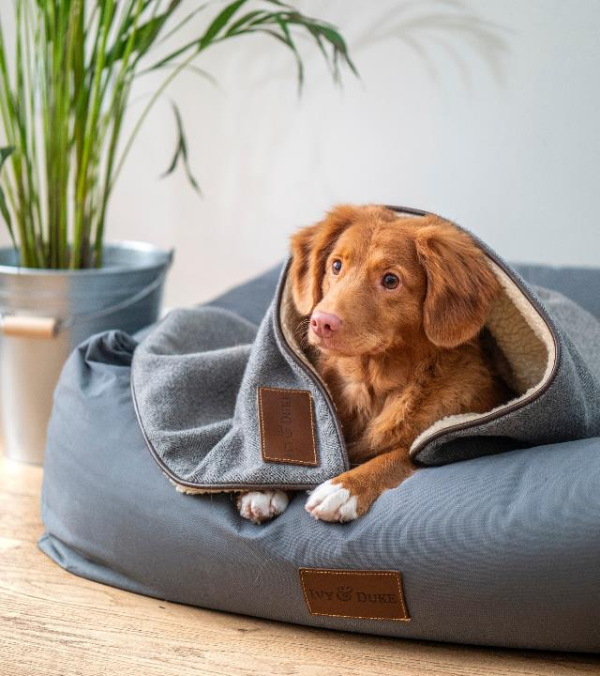
Pet Sitter
Mohamed Ashraf Ali - 20BCE1630
Sanjil K C - 20BCE1855
Lenin Vasan - 20BCE1892

Slide 2
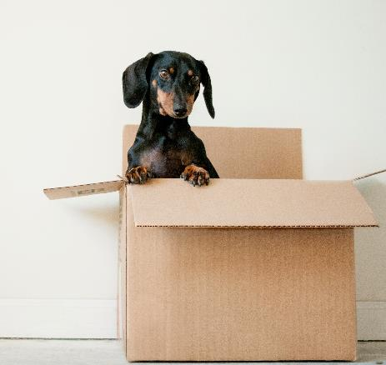
Problem Identified
Industry estimates show there are around 19 million pets in India (around 80 percent of these are dogs), and on average, 6,00,000 pets are adopted every year. Pets become a part of the family the moment they step into our house. Pets become very used to human company, unlike stray animals who usually live on their own. It’s a sad fact for pet owners that vacation planning can be such a hassle. So, we came up with the idea of a pet care system to fill in the void between pet owners, pet lovers, and the pet. There are many people who are excellent pet caretakers but cannot own a pet due to their work lives. But such people are willing to take care of others' pets during weekends or during their free time. Connecting such people with pet owners and creating and expanding this community is the main goal of this solution.

Slide 3
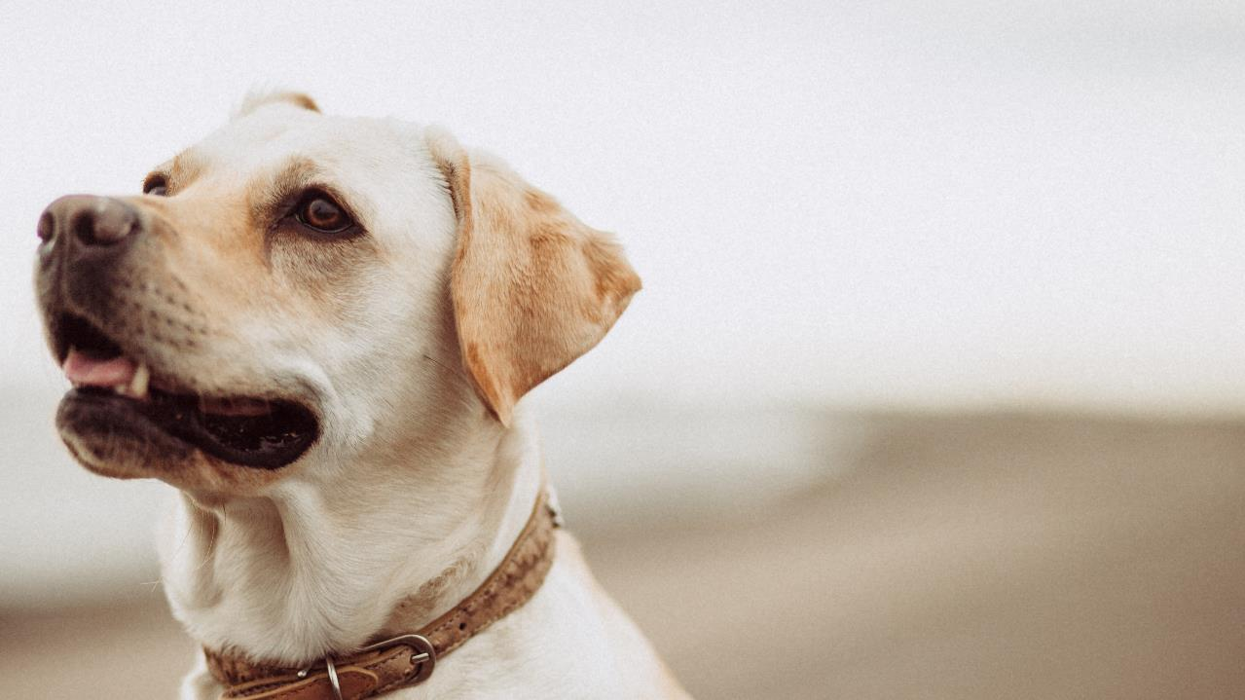
Motivation
The key motivation to develop Pet sitter was to help pet owners enjoy a peaceful vacation and the pet lovers who cannot own a pet for any reason to be able to own a pet just for a few days. The Pet sitter application connects the pet owners to pet lovers or carers near them by using geolocation through a booking system. The nearest pet lovers are displayed to the pet owner based on both their geo locations. The amount is charged by the pet lover on a per day basis. One unique feature of Pet sitter is the tracker. The pet owners can track their pet through their phone to ensure that their pet is safe.

Slide 4
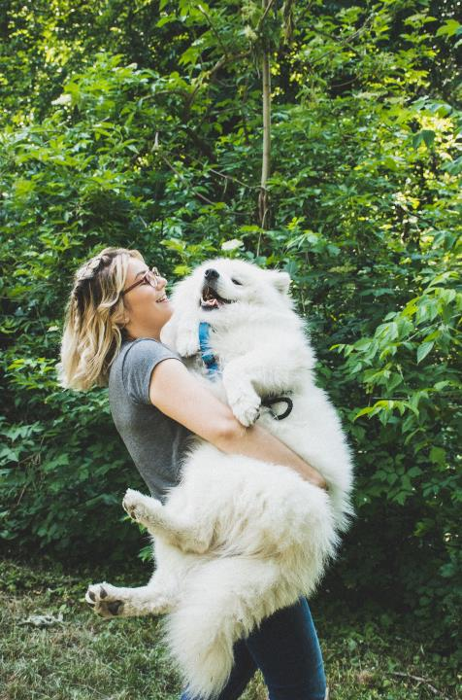
Plan For Collecting Data
We are planning to collect the data from internet , through survey and through Field Visit

Slide 5
Process Involved
The Main process is developing the Pet Sitter application, The tracker is a unique feature of the Pet Sitter application, but it came with certain challenges.
Notes:
Photo by Erda Estremera on Unsplash

Slide 6
Expected Outcome
The Pet owners can move freely without worrying about their pets without sorrow. They even plan for long trip or vacation.
Pet owners can book pet lovers by going to the services section in the application Top pet carers near them will be displayed to the pet owner. The pet owners and pet lovers can edit their profile at any time.

Slide 7
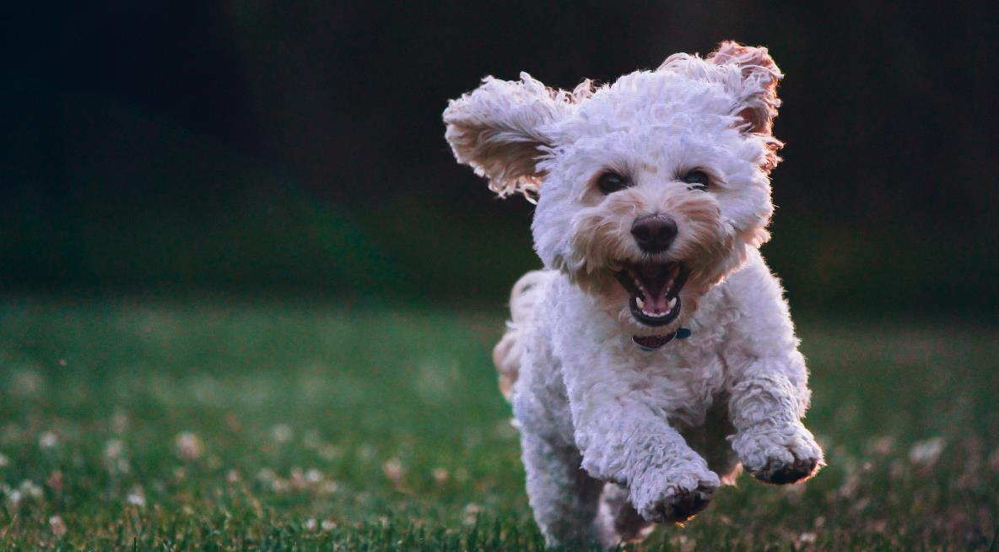
Thank You

