Slide 1

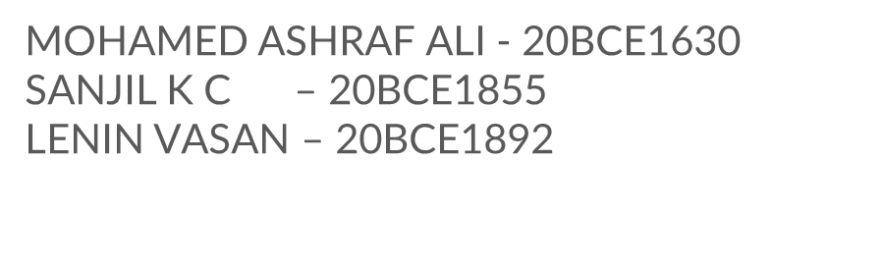
PET
SITTER

Slide 2
TABLE OF CONTENTS
01
02
03
UML DIAGRAMS
ARCHITECTURE DIAGRAMS
METHODOLOGY
04
05
ALGORITHM
FLOWCHART

Slide 3
UML DIAGRAMS
01

Slide 4
CLASS DIAGRAM
01
This basic UML diagram represents the bifurcation of a system into individual classes. We use these UML diagram types to provide the static representation of the program. A class has three major elements – its name, attributes, and behavior.

Slide 5
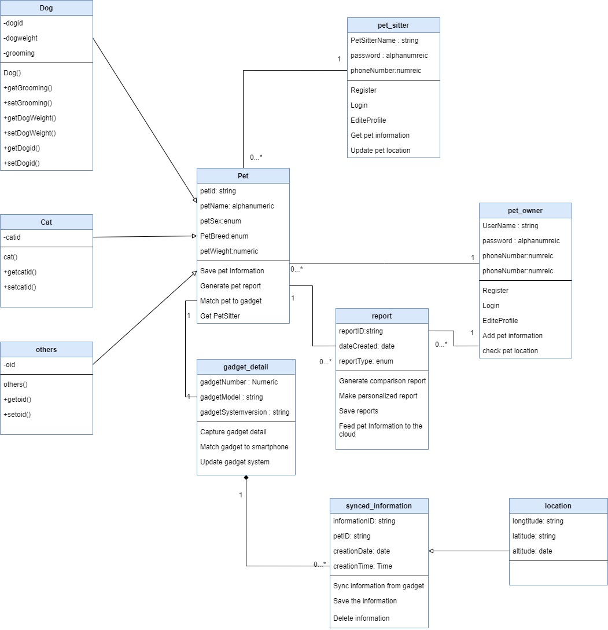

Slide 6
COMPONENT DIAGRAM
02
Component diagrams are mostly created when a system is complex and consists of too many classes. Therefore, we break down the entire system into different components and show how they are dependent on each other. These types of UML diagrams only consist of two things, components and dependencies.

Slide 7
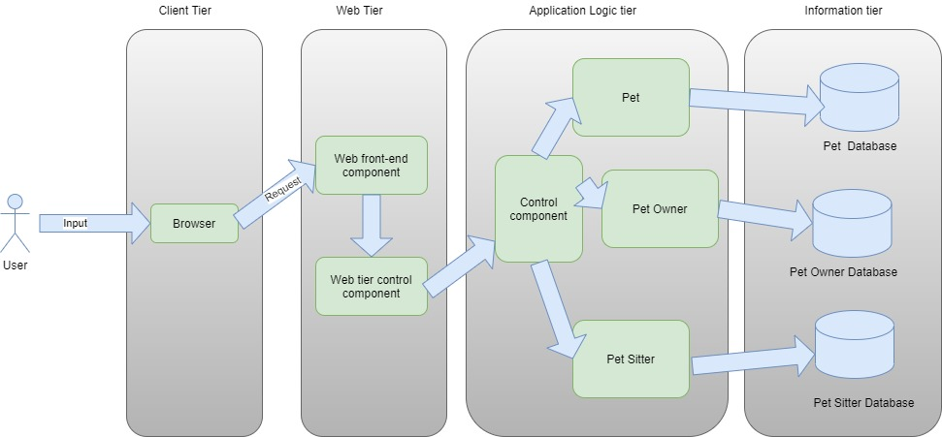

Slide 8
USECASE DIAGRAM
03
This is one of the most popular types of UML diagrams that represent how the end user would interact with the system. It features different key actors (users) and their interaction with dedicated components of the system. Apart from software development, it plays a vital role in its deployment as well.

Slide 9
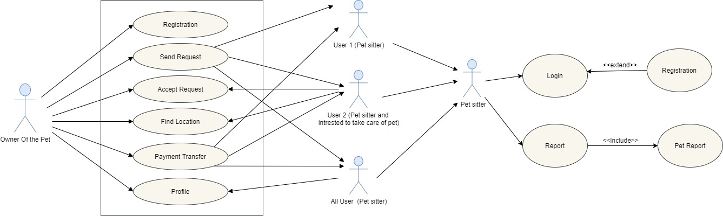

Slide 10
DEPLOYMENT DIAGRAM
04
This provides the actual software representation of the system (with the inclusion of Hardware component in it). This UML diagram follows a more real-world approach on how the system would be deployed. It consists of two major units – nodes and artifacts. Nodes represent the database server or hardware unit while artifacts represent clients or schemas.

Slide 11
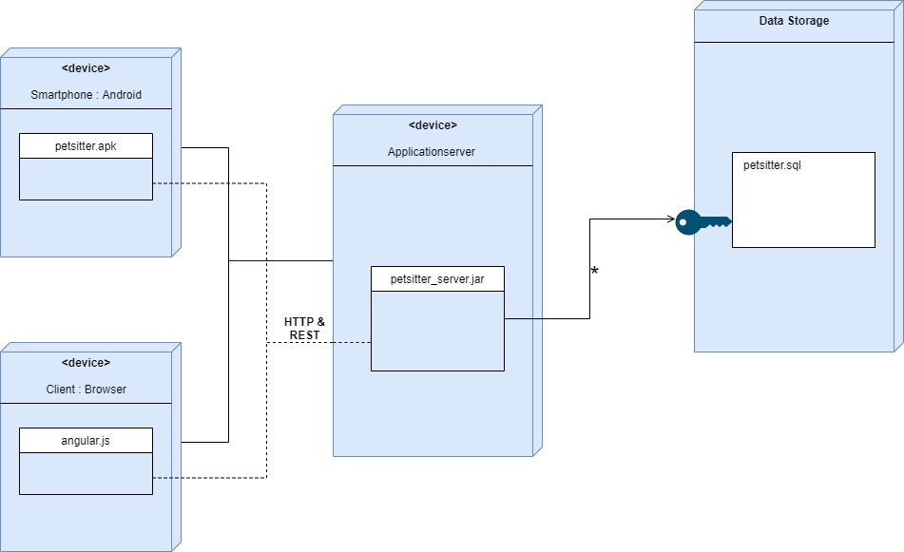

Slide 12
PROFILE DIAGRAM
05
This a brand new type of UML diagram that was introduced in UML 2. While these types of UML diagrams are not that popular, they can be used to depict the meta-structure of the system. That is, what are the major profiles, meta classes, and so on. There can be connections within a profile’s elements and among different profiles.

Slide 13
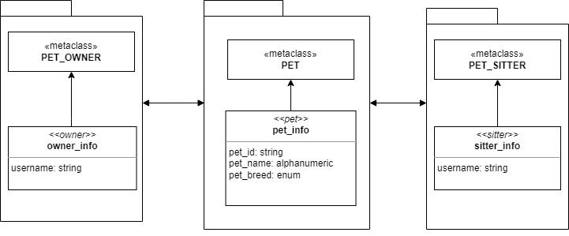

Slide 14
OBJECT DIAGRAM
06
Consider this as a breakdown of a class diagram (since a class is a collection of different objects). Though, these UML diagram types are mostly based on real-world entities. It features different objects and their links. Each entity has an object name and its set of attributes.

Slide 15
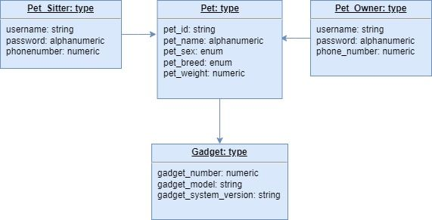

Slide 16
COMPOSITE DIAGRAM
07
These UML diagram types are used to represent the internal structure of a class. They let us know how different entities in a class relate to each other and how the class itself is associated with the outside entity/system. Every element has a “role” assigned here.

Slide 17
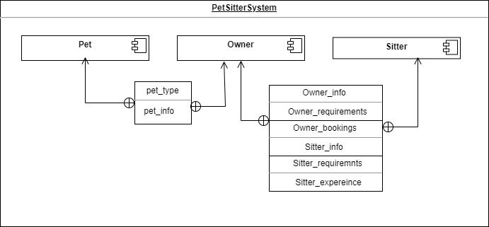

Slide 18
ACTIVITY DIAGRAM
08
These types of UML diagrams are extensively used as they represent the overall flow in the system with respect to numerous activities. It takes an instance of the system and covers how it would flow. These diagrams are more focused on the real-world implementation of the system rather than its structure.

Slide 19
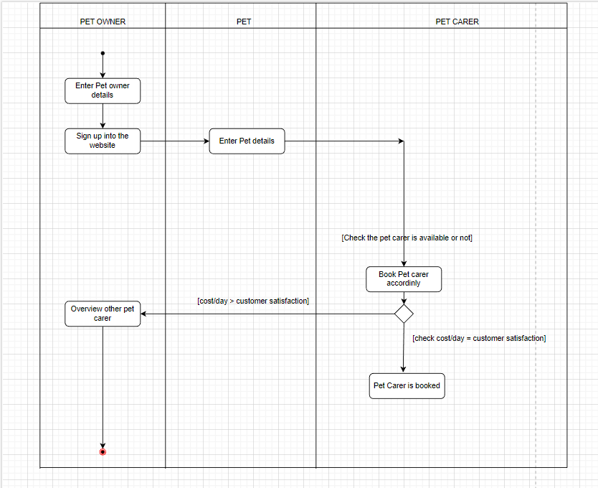

Slide 20
SEQUENCE DIAGRAM
09
As the name suggests, this describes the flow of a process among various components in a sequential manner. This is mostly used in architecture development and real-world implementation of the system. It features different components and describes how the flow is switched from one component to another.

Slide 21
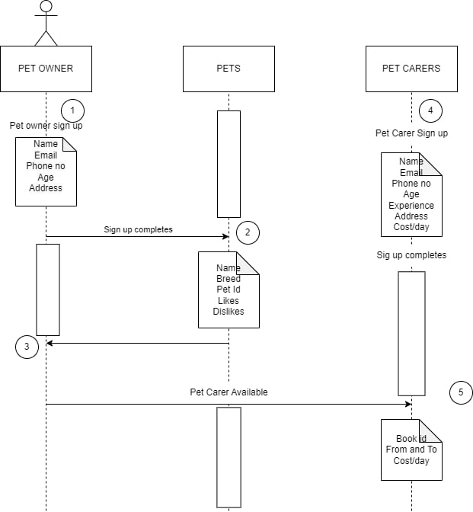

Slide 22
STATE MACHINE DIAGRAM
10
This is a dynamic diagram which describes the different states of the system. It features all sorts of actions and how a class would respond to it. Accordingly, a flow is established that is focused on the state of the core entities.

Slide 23
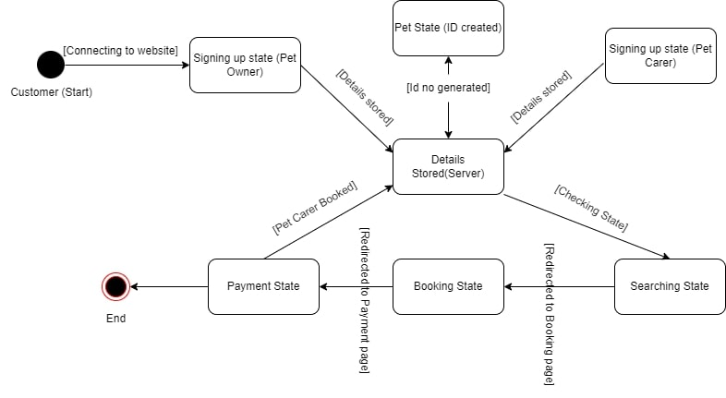

Slide 24
ARCHITECTURE DIAGRAMS
02

Slide 25
SYSTEM DIAGRAM
01
A system architecture diagram (SAD) is a diagram that shows the relationship between software modules. The term often denotes the arrangement of system components, such as hardware, software, networks, storage, and people, efficiently to meet organizational requirements.

Slide 26
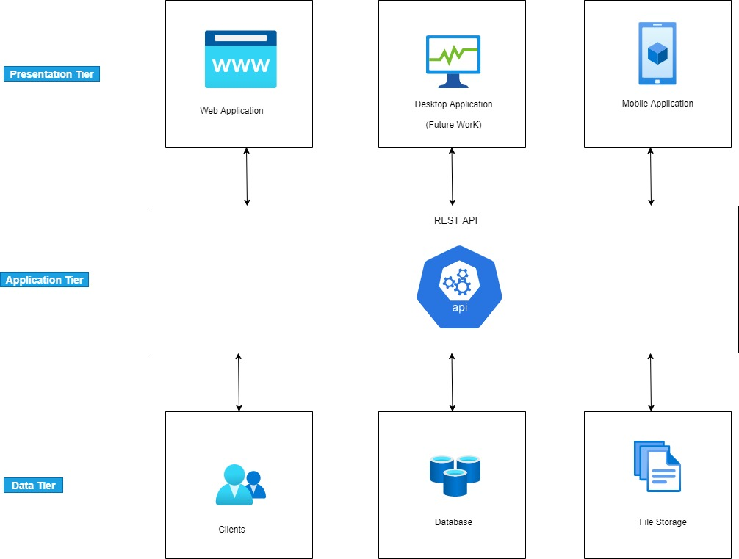

Slide 27
WEBSITE DIAGRAM
02
This diagram helps in website planning and design, including artistic, technological, and practical considerations. It uses a hierarchy structure to show website content management and website directory structure.

Slide 28
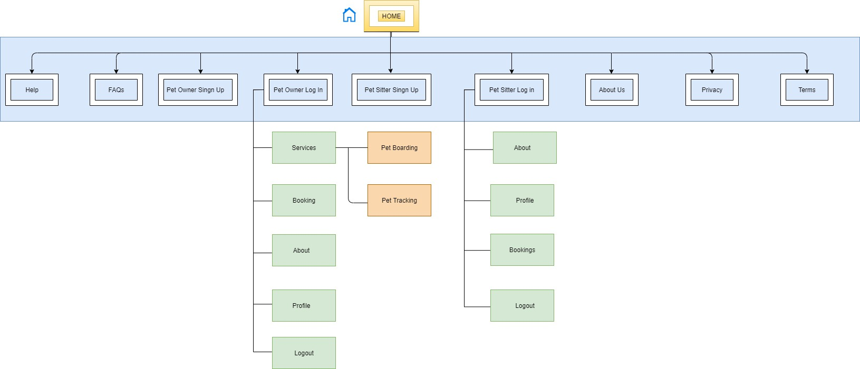

Slide 29
APPLICATION DIAGRAM
03
This kind of diagram involves a plan, system, and processes. It has a functional application as the framework for system procedures.

Slide 30
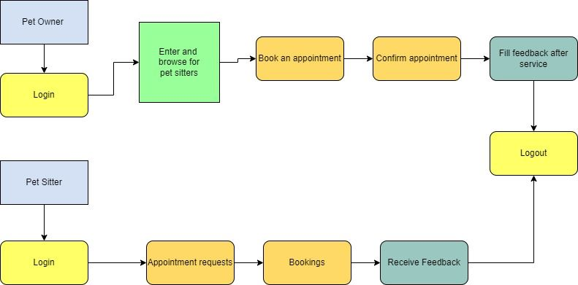

Slide 31
SOFTWARE DIAGRAM
04
The physical view is about cartography. It draws the map for physical hardware and system software.
The system components are bound to a group of computable physical nodes.
The physical view helps a software architecture diagram and includes the service layer, business layer, and data layer. It establishes relations amongst both internal and external systems, users, and services.

Slide 32
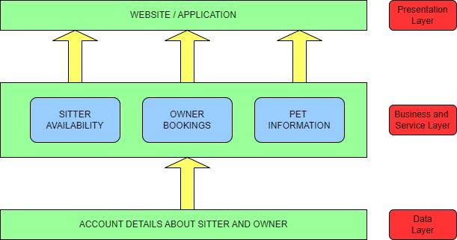

Slide 33
ENTERPRISE DIAGRAM
05
The Enterprise architecture diagram help manage the business and organizational model of a project. The diagram shows security policies, management tools, business plans, teams, roles, interaction, and workflow.

Slide 34
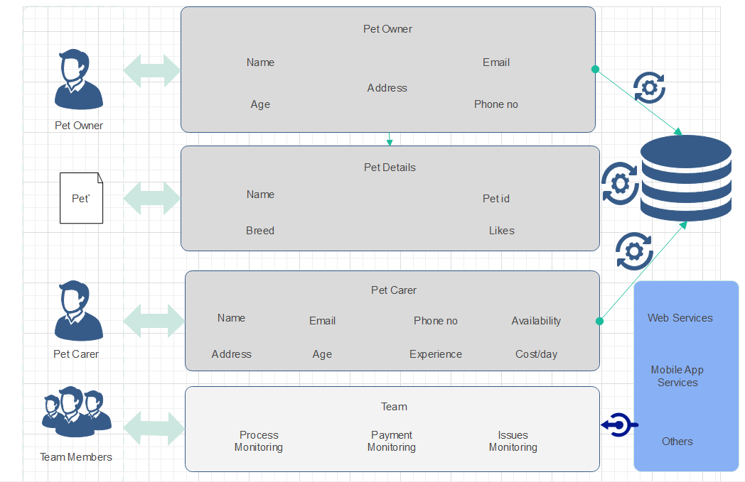

Slide 35
METHODOLOGY
03

Slide 36
Requirements Description: The needs for the pet-care system will be determined and described. This include determining the user requirements, functional and non-functional requirements, and hardware and software requirements. A thorough report will contain the requirements.
System Design: The requirements specification will be used to develop the system. The overall system architecture, data flow diagrams, ER diagrams, use case diagrams, and other design papers are all included in the system design. The project team will analyze the design documentation and take any necessary modifications into account.
System implementation: The system will be put into use with the right programming languages and software tools. The front-end and back-end of the system will be created by the development team. The system will be built, and the database will be integrated. Functionality, performance, and security checks will be performed on the system.
Findings and Discussion: The system's efficacy and efficiency will be assessed. The evaluation's findings will be examined and debated. Any problems or worries will be dealt with, and suggestions for improvement will be given.
Conclusion and Future Work: The conclusion will include a summary of the project's findings and a discussion of the system's implications for pet care. It will be suggested more research and development in the future work section.

Slide 37
ALGORITHMS
04

Slide 38
Algorithm for building a pet care website and mobile application:
Define the target audience and determine the main features of the website and mobile application.
Create a wireframe and design the user interface (UI) and user experience (UX) for both the website and mobile application.
Develop the backend of the website and mobile application, including the database and server-side scripting.
Integrate the UI and UX designs with the backend to create a fully functional website and mobile application.
Implement a payment gateway for online payments.
Ensure that the website and mobile application are secure by implementing SSL certificates, firewalls, and other security measures.

Slide 39
7. Integrate the GPS tracking technology into the mobile application and website application to allow users to track their pets' movements in real-time.
8. Test the website and mobile application on different devices and operating systems to ensure compatibility.
Optimize the website and mobile application for search engines (SEO) and improve the loading speed.
Launch the website and mobile application, and ensure that it is properly marketed.
Provide ongoing maintenance and support, including bug fixes, updates, and new feature additions.
Continuously analyse user behaviour and feedback to make improvements and updates to the website and mobile application.

Slide 40
FLOWCHART
05

Slide 41
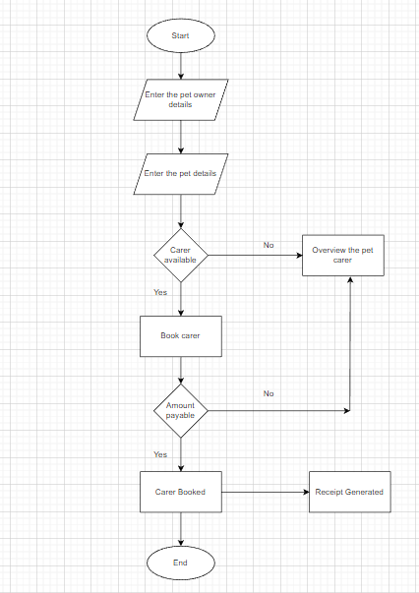

Slide 42

THANK
YOU

