Slide 1


Grounded CAD: Natural-Language Editing of STEP Models
Team: Night_Owls
Reiki Tanaya Karuka
Department of Mechanical engineering
rkaruka@mtu.edu
Lenin Goud
Department of Computer Science
Lathikam@mtu.edu
IDETC 2026 - Problem Statement 3

Slide 2

Motivation:
CAD edits are slow when engineers must manually find features, rebuild geometry, and validate every change.
Grounded CAD edits existing STEP files from natural-language instructions.
Benchmark success depends on changing the intended feature, not just producing a valid CAD file.

Slide 3
Grounded CAD: Harness Architecture
Grounder - extracts a compact B-Rep census: faces, rims, holes, bounding boxes, and edit sites.
Classifier - routes the instruction into typed edit slots.
Planner - selects deterministic tools or GPT-written local CadQuery.
Executor - runs edits in an isolated watchdog process.
Verifier/Critic - rejects bad outputs and turns failure buckets into retry feedback.
Parquet File
.Step
Grounder
Classifier
Planner
Executor
Verifier
No
Critic
Yes
Output

Slide 4
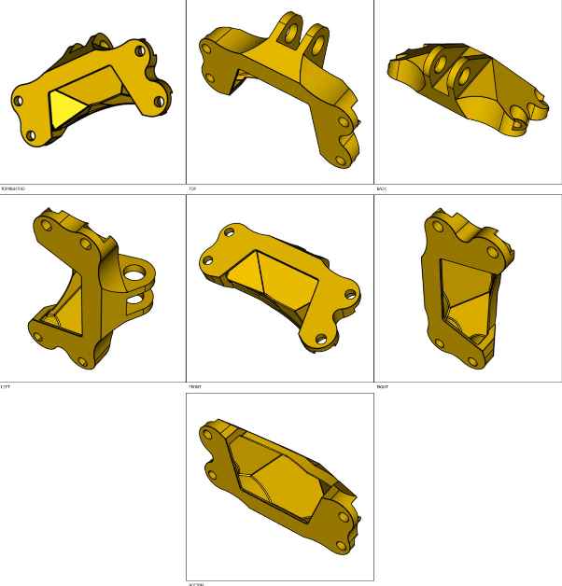
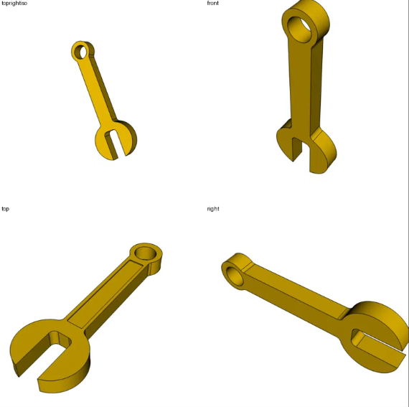
Grounded CAD: What changed during development
The final harness moved away from direct STEP text edits and image-only prompting. It uses STEP-derived geometry facts, true orthographic CAD views, isolated CadQuery execution, and per-row scoring.
Key fixes included provenance-safe fresh runs, watchdog handling, identity-output rejection, true axis-aligned view rendering, candidate enumeration for local edits, and detailed failure buckets for targeted debugging.

Slide 5
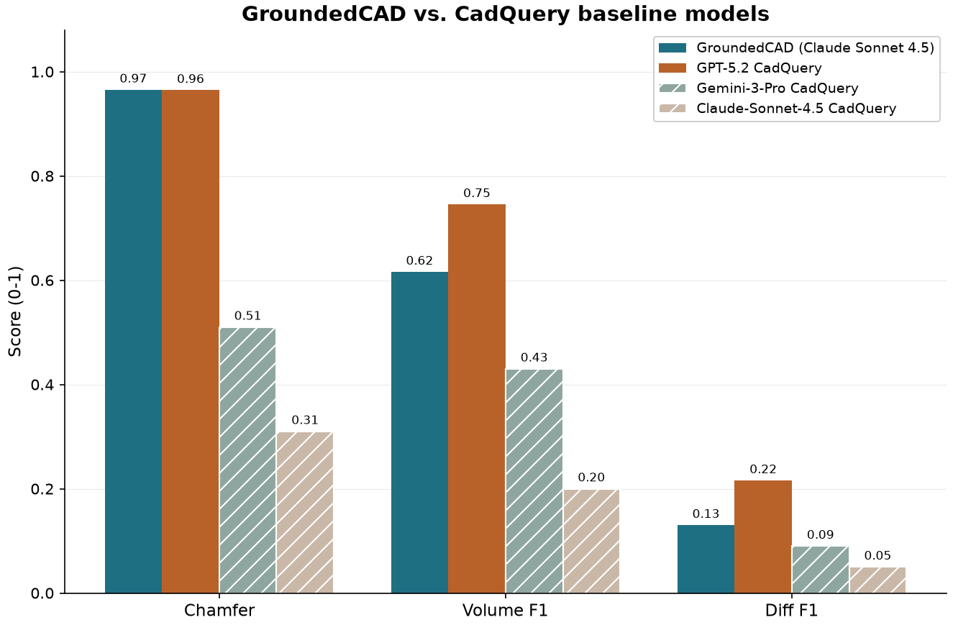
Grounded CAD: Results
Current interpretation: Chamfer and Volume F1 stay relatively high when outputs are valid, but Diff F1 drops when the edit lands on the wrong feature. The next improvement target is therefore feature grounding, not whole-part reconstruction.

Slide 6
Grounded CAD: Cost Efficiency & Scalability
Token efficiency
Scalability safeguards
The harness avoids sending full STEP text to the model.
Instead, it sends compact geometry summaries, orthographic view sheets, parsed dimensions, and targeted retry feedback.
Deterministic candidates handle cheap local edits before spending GPT calls.
Each row runs in a child process with a watchdog.
Large assemblies skip expensive source rendering when it risks freezing the benchmark.
Timeouts are no longer scored as ordinary valid predictions.

Slide 7
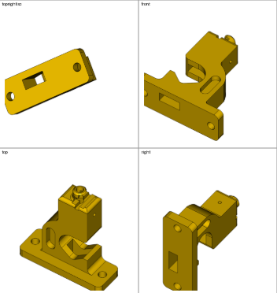
Grounded CAD: Visual evidence and examples
Initial Model | Grounded CAD
Example rows compare the original STEP-derived views with the edited output. The table is intentionally visual: it helps diagnose whether a low D score is caused by no-op output, wrong target selection, or a real but incomplete edit.

Slide 8
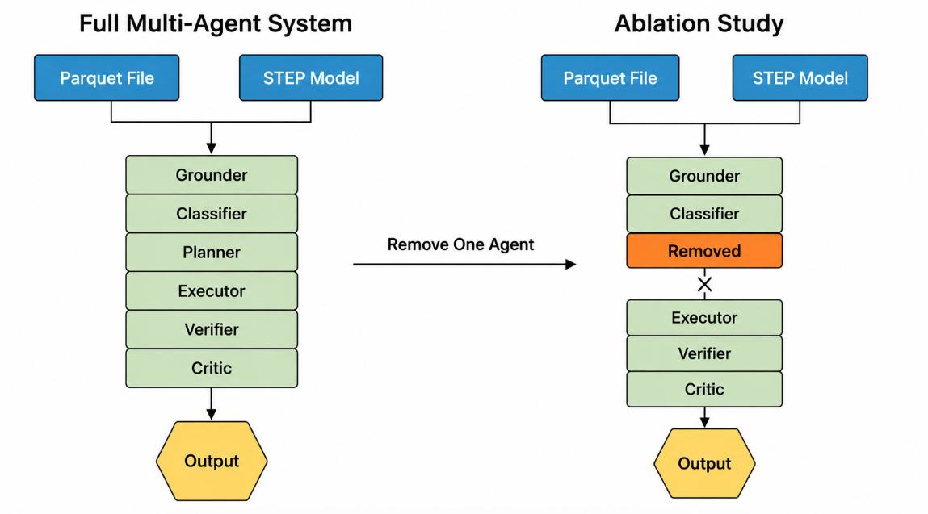
Ablation Study: What Actually Improved Diff F1
We did not use a multi-agent architecture. The strongest improvements came from better grounding, safer execution, and failure-aware retries.
Agent | Success Rate
Grounder
Classifier
Planner
Executor
Verifier
Critic
Component Tested
Observed Effect
Orthographic sheet
Helped after true axis-aligned views were fixed
Baseline Harness
-> Add One Technique
-> Fresh 48-Row Score
-> Keep / Remove
Generic highlighting
Reduced score by confusing target selection
STEP / ISO RAG
Added tokens with limited gain over geometry census
Candidate enumeration
Avoided no-ops but can choose wrong scope
Failure buckets
Useful retry signals for identity and wrong scope
Watchdog isolation
Stopped frozen rows from scoring as valid edits

Slide 9
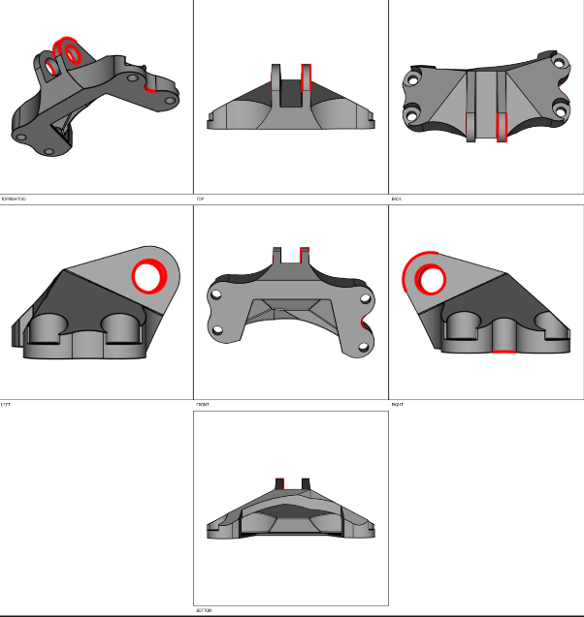
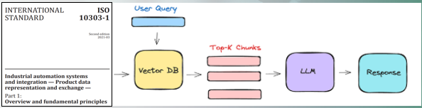
Limitations, Observations, and Next Steps
Main limitation: The system can create valid geometry but still lose Diff F1 when it chooses the wrong edge, hole, face, or side of the part.
Observation: Direct STEP line edits are not reliable because STEP topology is interlinked. CadQuery/B-Rep operations are safer for producing valid edited solids.
Next step: Use failure buckets as control signals. When a row is tagged wrong_edge_or_scope, force re-grounding to alternate candidate features before accepting the edit.
Future scope: stronger B-Rep target matching, operation-specific validators, and a final fresh 48-row evaluation before claiming benchmark improvement.

Slide 11
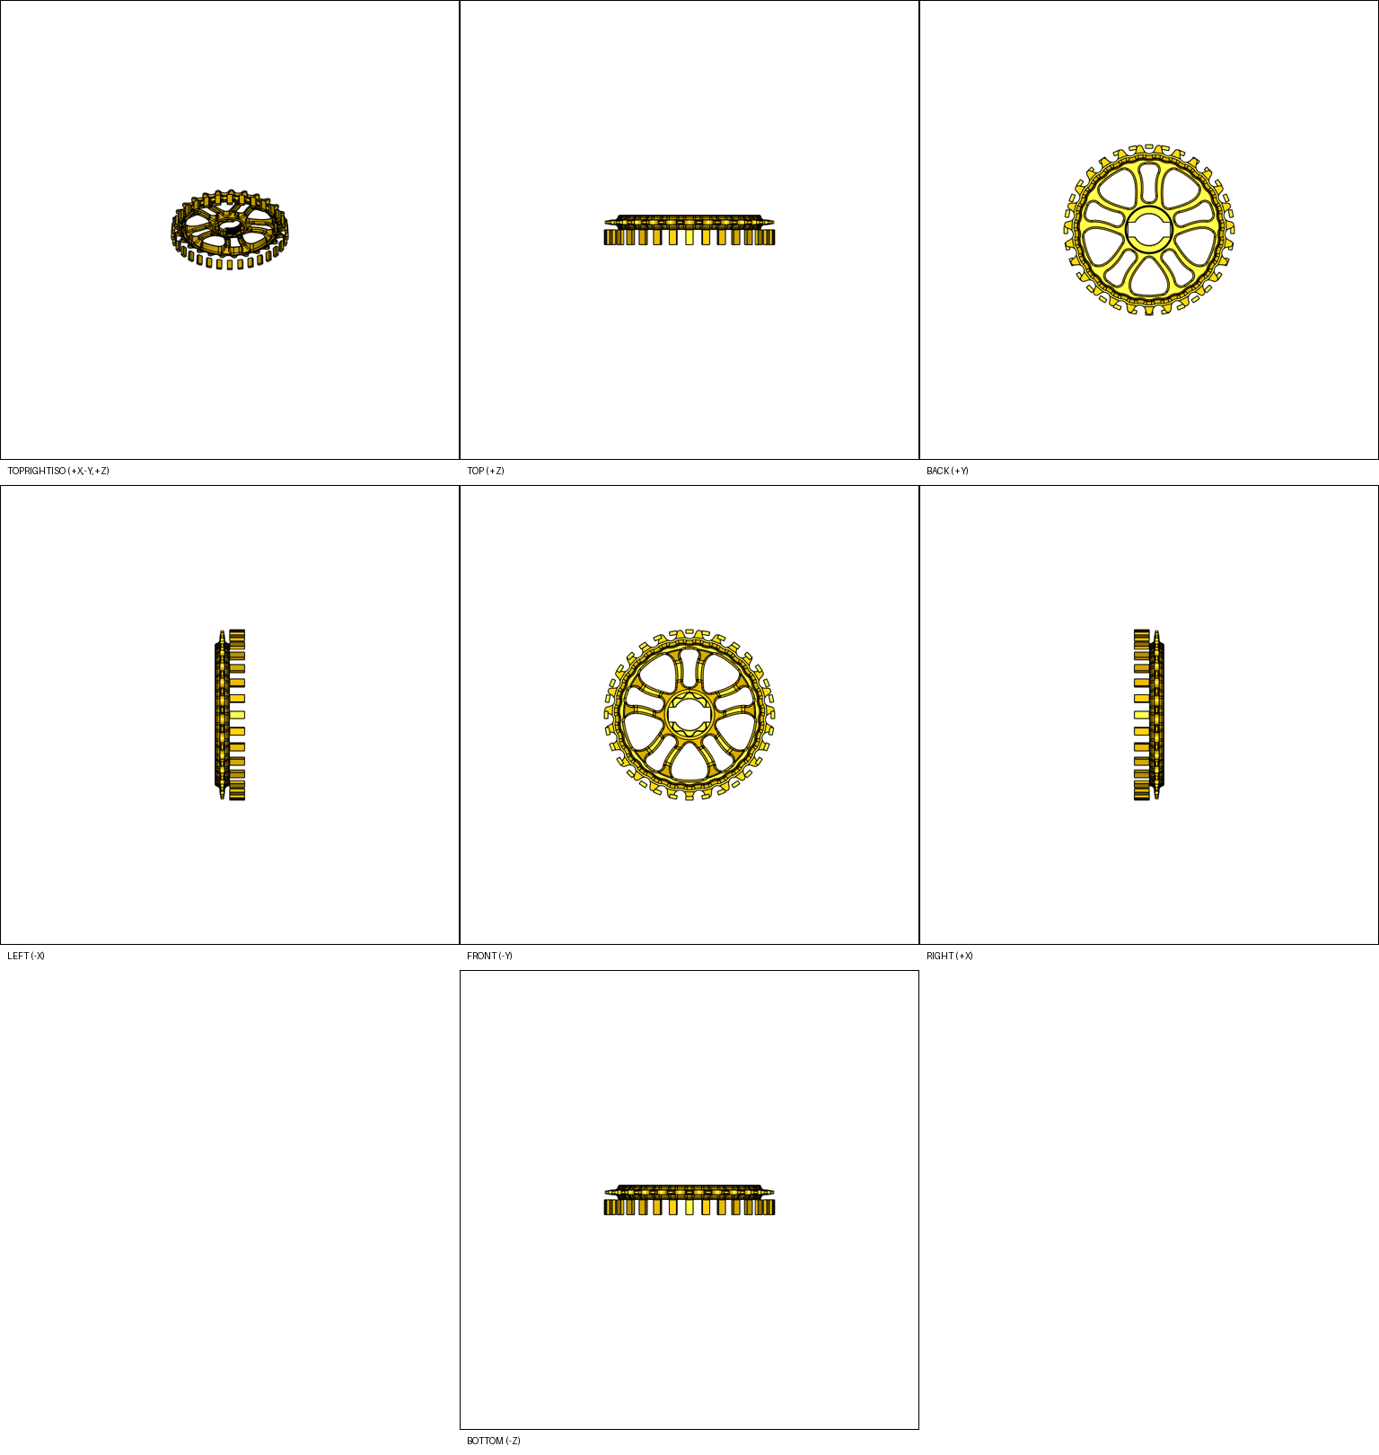
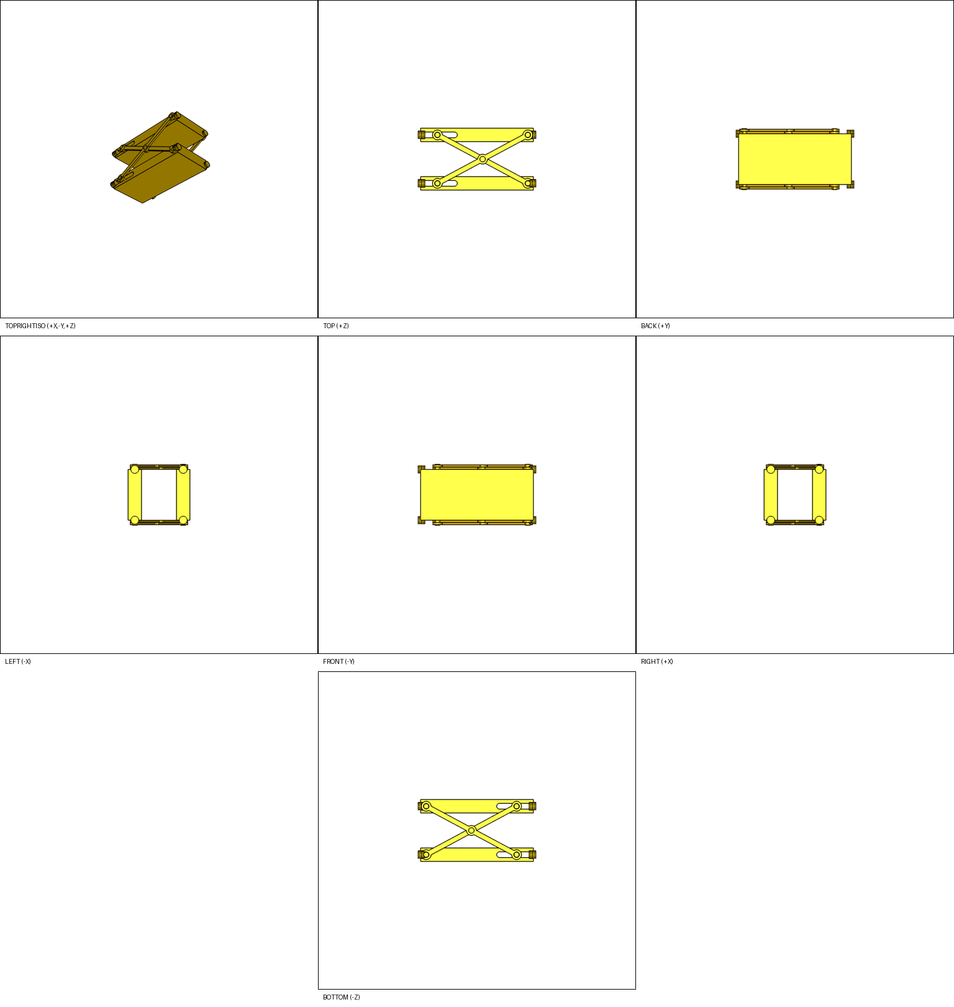
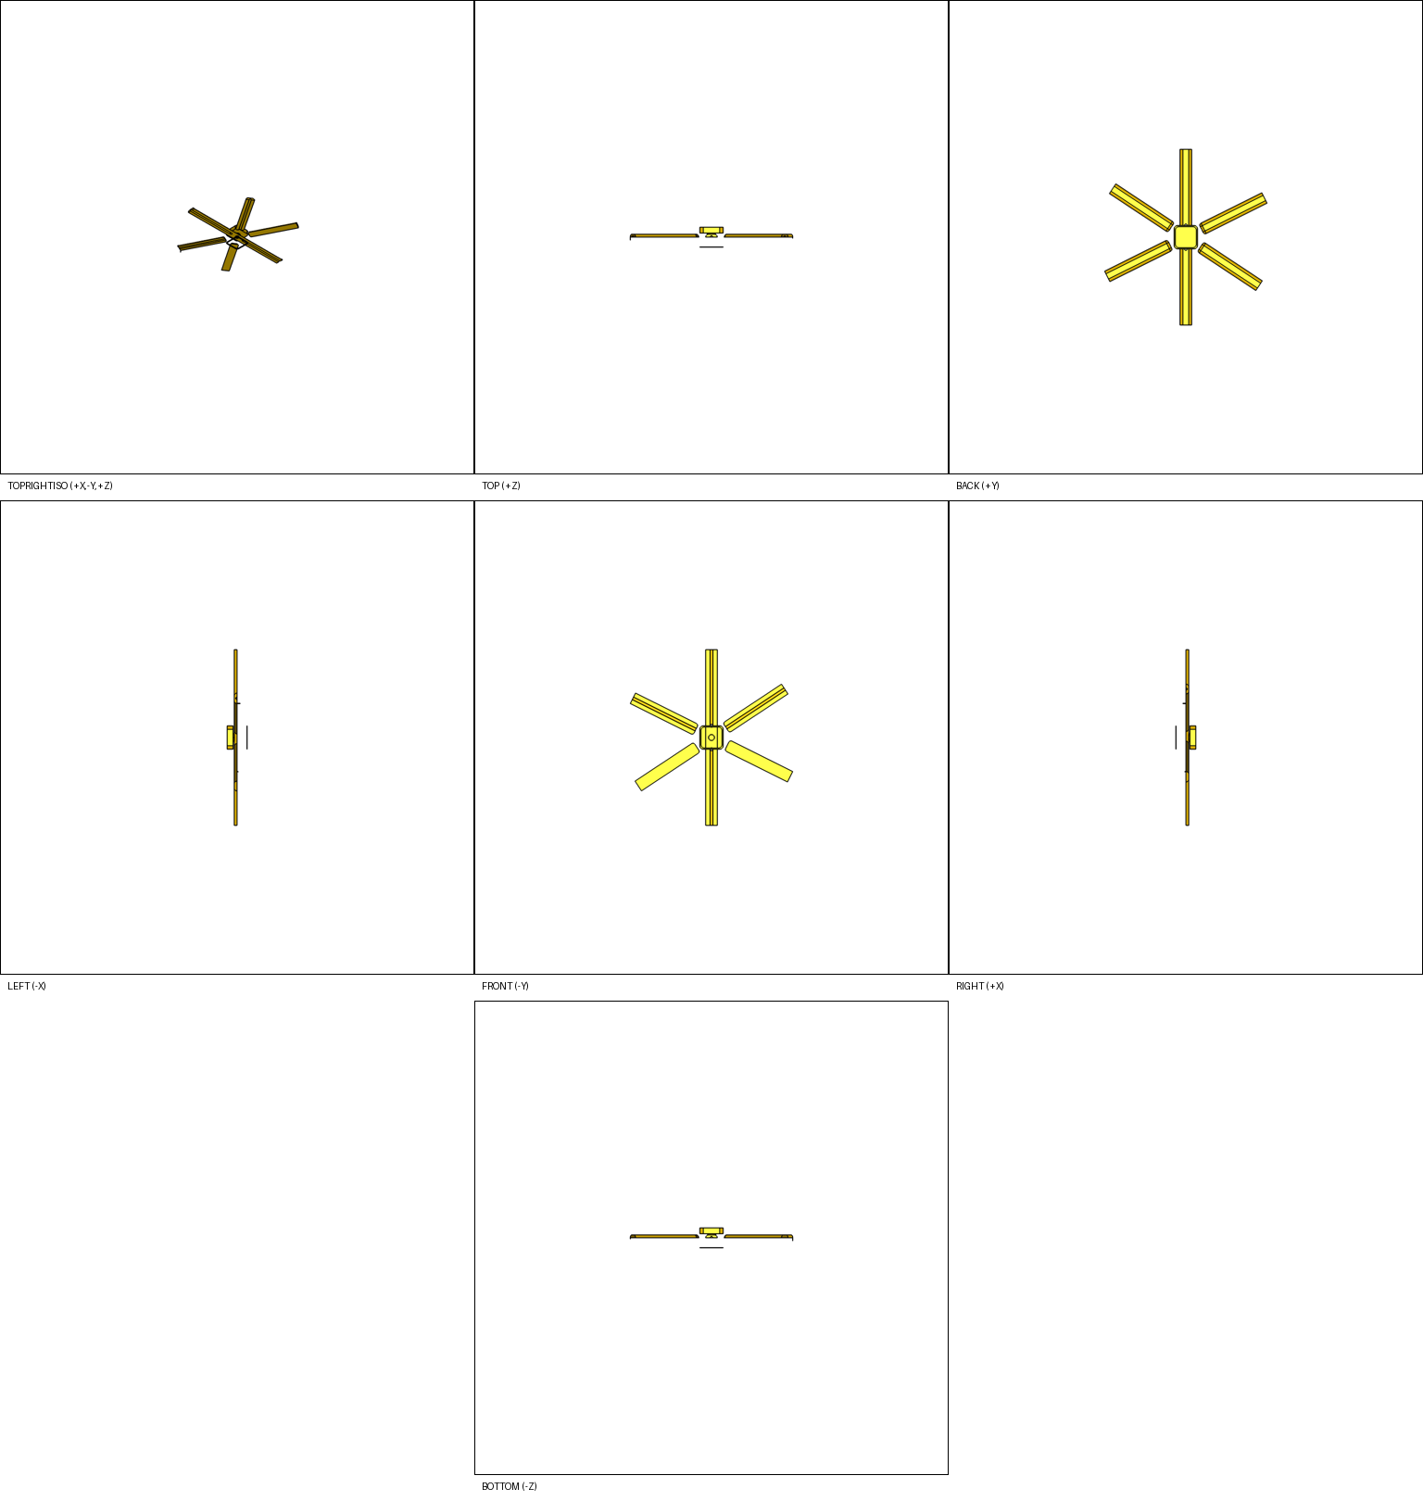
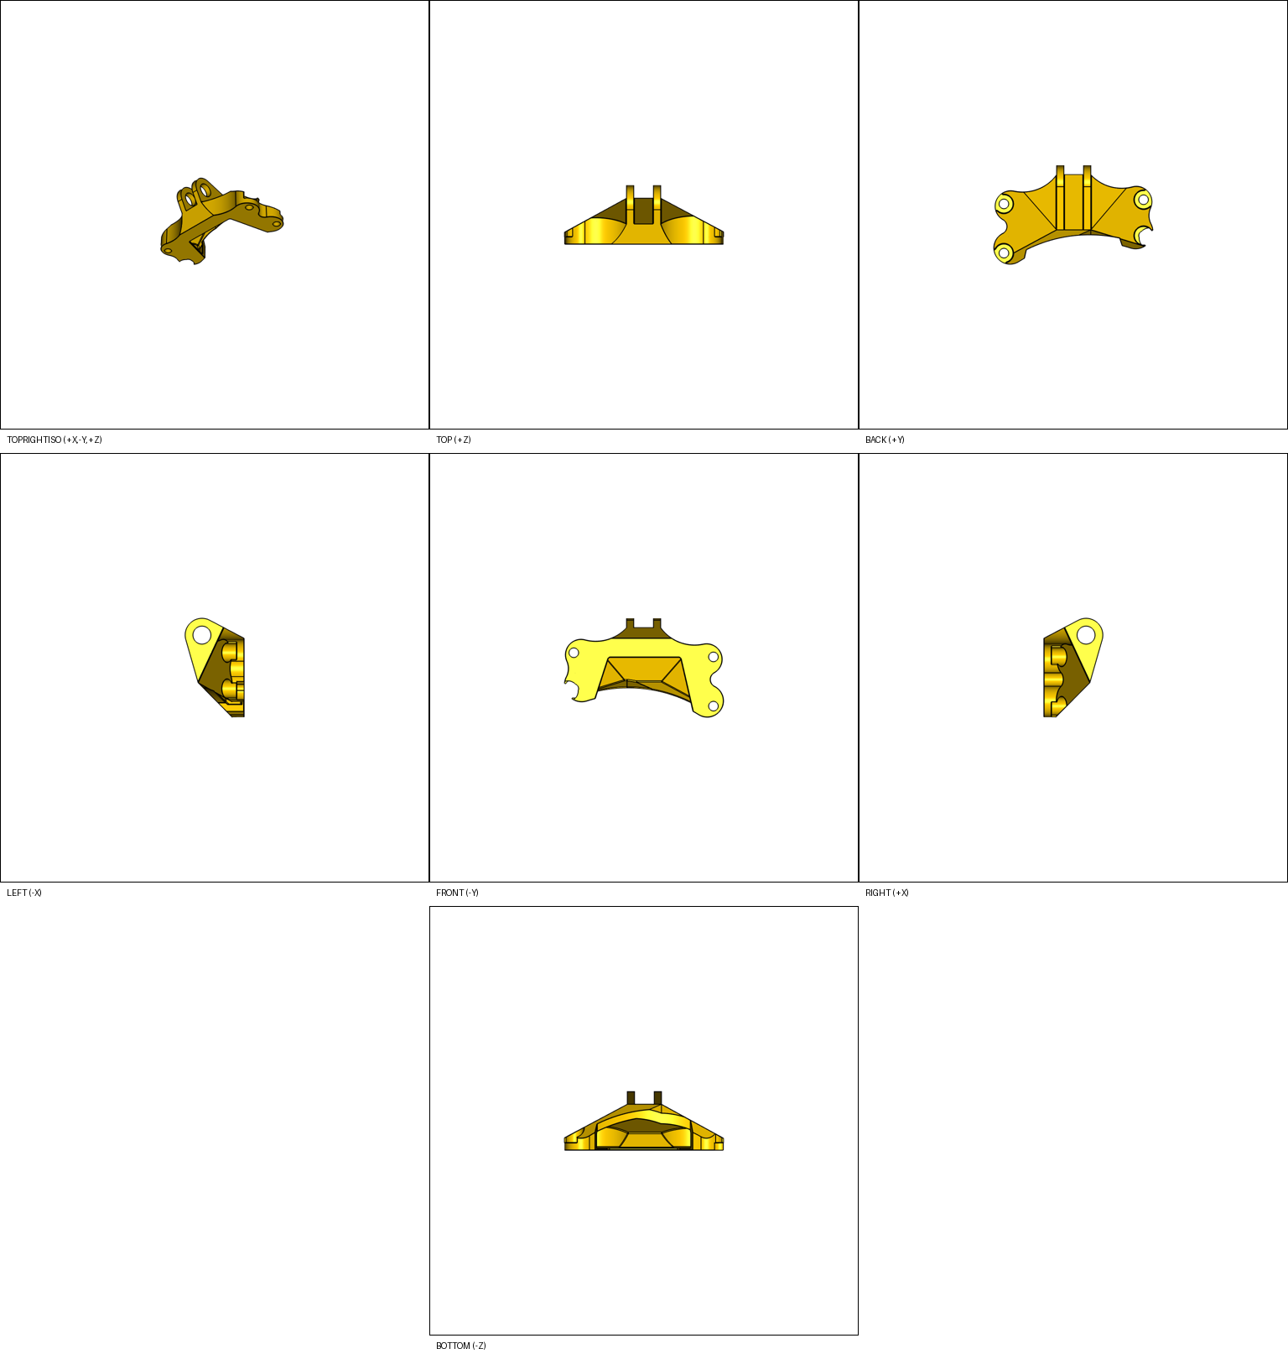
Official qualitative examples show where Diff F1 is won or lost
Five required request IDs from the official submission instructions; metrics are from the fresh GPT-5.2 48-row run.
SUJ2…9987 | boolean_modification
3YH2…3335 | feature_addition
B7A2…4133 | feature_translation
F332…7142 | pattern
ZK22…4422 | hole_edit
Render unavailable
CAD output + score exist
Round gear edges -> straight spur teeth
Add cylindrical heads on long pins
Prolong black lever to front by 5 cm
Add third rotor blade to assembly
Add 1.7 mm connecting hole + grooves
Diff F1 0.143
Vol F1 0.912 | Chamfer 0.973
Diff F1 0.023
Vol F1 0.361 | Chamfer 0.975
Diff F1 0.245
Vol F1 0.638 | Chamfer 0.978
Diff F1 0.108
Vol F1 0.347 | Chamfer 0.985
Diff F1 0.082
Vol F1 0.779 | Chamfer 0.982
Failure bucket: wrong_edge_or_scope
Failure bucket: misclassify
Failure bucket: misclassify
Failure bucket: occ_fail
Failure bucket: wrong_edge_or_scope
Interpretation: these examples are valid outputs, but low Diff F1 usually comes from scope/operation mismatch rather than invalid STEP export.

