Slide 1
CAPSTONE PROJECT
Final Project
Personal Development and Goal Tracking App
Presented By
LENIN S
711721244030
III BTech CSBS
KGISL Institute of Technology
3/21/2024 Annual Rev iew

Slide 2
PROJECT TITLE
Personal Development and Goal Tracking App AI using Autoencoder.
3/21/2024 Annual Rev iew

Slide 3


AGENDA
Problem Statement
Project Overview
End Users
Solution and Value Proposition
The Wow Factor in Your Solution
Modelling
Results
3/21/2024 Annual Rev iew

Slide 4

PROBLEM STATEMENT
Personal Development and Goal Tracking App AI using Autoencoder.
Many people struggle with setting and achieving personal development goals due to lack of organization, motivation, and accountability

Slide 5

PROJECT OVERVIEW
The goal of this project is to develop a personal development and goal tracking app that utilizes AI, specifically autoencoder technology, to provide personalized insights and recommendations to users
By leveraging autoencoders, the app will efficiently process and analyze user-generated content, such as progress updates and reflections, to offer tailored guidance and support.

Slide 6

WHO ARE THE END USERS?
The target audience for this app includes individuals who are committed to personal growth and development.
This may include professionals seeking career advancement, students striving for academic success, or individuals pursuing health and wellness goals
3/21/2024 Annual Rev iew
6

Slide 7

YOUR SOLUTION AND ITS VALUE PROPOSITION
Goal Setting and Tracking: Users can set specific goals, define milestones, and track their progress over time.
AI-Powered Insights: The app will leverage autoencoder technology to analyze user-generated content and provide personalized insights, recommendations, and strategies for goal achievement.
Progress Visualization: Users will have access to visualizations of their progress, including charts, graphs, and timelines, to help them stay motivated and focused.

Slide 8

THE WOW IN YOUR SOLUTION
By analyzing user-generated content in a highly efficient manner, the app can offer tailored guidance and support that adapts to each user's unique goals and preferences
Additionally, the community aspect of the app provides a sense of camaraderie and support, enhancing the overall user experience

Slide 9
MODELLING
The core of the app's AI functionality lies in its use of autoencoder models. Autoencoders are employed to compress and decompress user-generated content, such as progress updates, reflections, and feedback
This compressed representation is then used to extract meaningful insights and patterns, enabling the app to deliver personalized recommendations and strategies for goal achievement

Slide 10
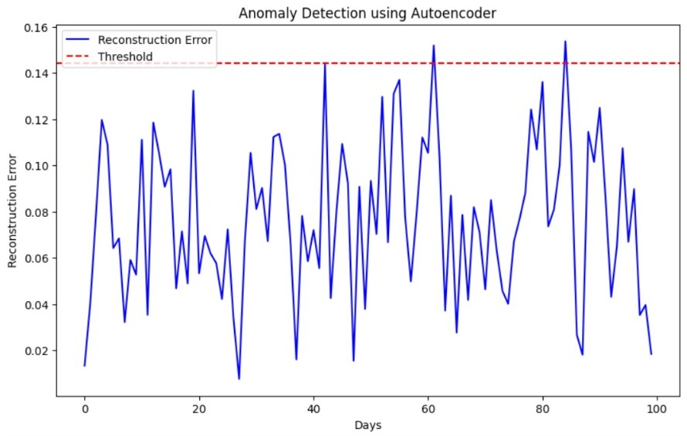
RESULTS
https://drive.google.com/drive/folders/1eLB5yLldi7RJYlOgl-55OYo9vIsTgjYH?usp=drive_link

