Slide 1

CAS Applied Data Science - Module 1
Data Acquisition and Management
PD Dr. Sigve Haug
Bern, 2021-08-26

Slide 2
Module 1
Overview
First day
About data and working with data
Infrastructures for data
Data sources and acquisition
Second day
Visualisation of data
Collecting data from www
Third day
Data bases
Project clarifications
Project
Conceptional Design Report for a Data Science Project

Slide 3
Module 1
Second day
09:00 Discussion session
09:30 Visualisation
Lecture
Notebook tutorial
10:30 Break
11:00 Notebook tutorial
12:30 Lunch
13:30 Webscraping and APIs
17:00 End

Slide 4
Questions from yesterday
...
...

Slide 5
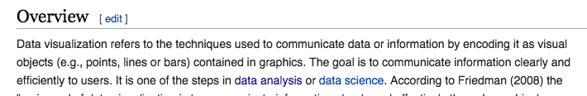
Visualisation of data
Notes:
Descriptive Statistics = Plotting

Slide 6
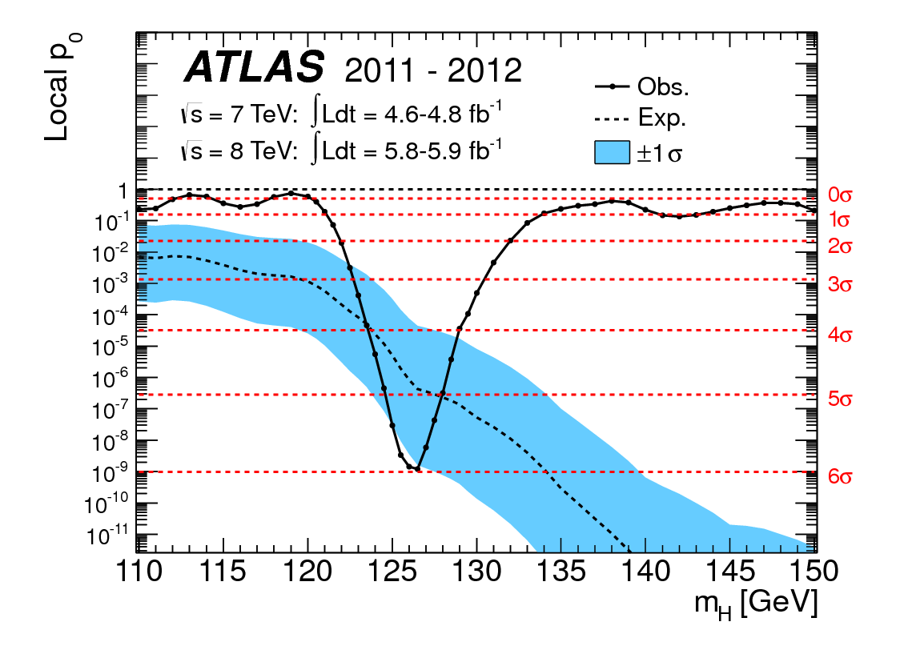
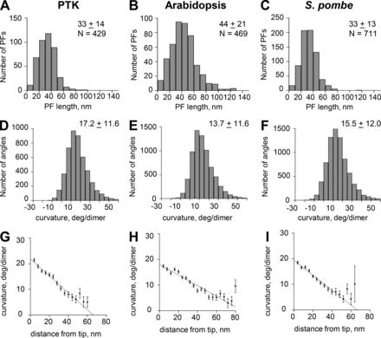
Visualisation examples
R, Python etc
Programmable plotting
Highly customisable and automisable
With effort almost everything can be done (scripted/programmed)

Slide 7
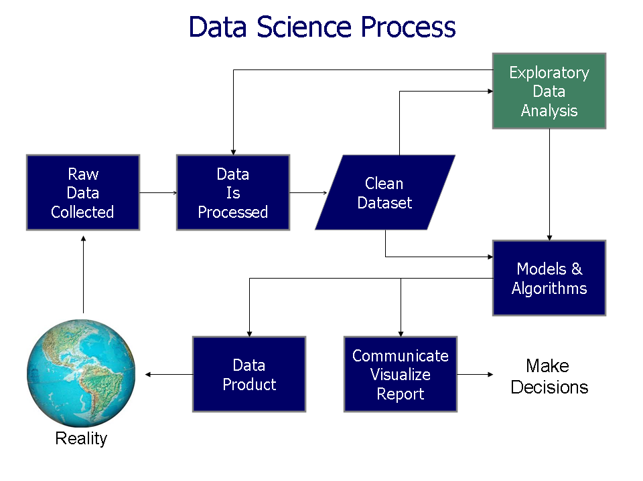
Example of visualisation in the data science process (actually it is all over)

Slide 8
Visualisation of data - a division
Descriptive
Describes the data
Helps understand the data
Do as many as possible at every stage
Do different spaces/representations
Look for patterns, similarities differences, significant features, correlations ..
Inferential
Communicates information and knowledge inferred from the data
Can be complex / compact
Normally your “goal” - whole data science process is about improving the final inferential graph

Slide 9
How do you read a publication (paper, book, report)?
Typically
Quickly read the abstract
Scan introduction and conclusion (for important numbers)
Study figures and graphs
Study tables
Check if there are known references
Dig into the text
So visualisation is important
People with power don’t have time
Normally your space and time for communication are limited
Need to pass your message in an elevator (20 seconds)
Good visualisation communicates trust, results and interpretations
Also helps you understand your data

Slide 10
Visualisation of data - general considerations
Communication
Sender - Message - Receiver
The sender should have a clear motivation and be trustworthy
Choose the right medium for message
The message should be clear and decodable and interpretable for the receiver
Human cognition
Most graphics (still) target humans
Should therefore take
Cognition
Pre-attentive attributes
into account

Slide 11
Visualisation of data - general guidelines
Graphs should reveal data
Show the data
Make the viewer think about the message/data
Avoid distorting from the message/data
Present many number in a small space
Encourage comparison of different pieces of data
Show several levels of detail (from overview to fine structures)
Serve a clear purpose
Be closely integrated with other description of the the data (text, tables etc)
Edward Tufte, The Visual Display of Quantitative Information, 1983

Slide 12
Visualisation of data - concrete guidelines
Important points for graphs
Axes labeling with units
Sufficient but not redundant information for understanding
Readability and visibility
In publications figure legend and reference in text
In science very often uncertainties should be included
Dataframes
Have 50-100 methods
i/o, sorting, selecting, adding ...
Descriptive statistics
Visualisation (plotting)

Slide 13
Visualisation of data
8 message types and graphs
Time series
Ranking
Part to whole
Deviation
Frequency distributions
Correlation
Nominal comparison
Geospatial and geographic
Stephen Few-Perceptual Edge-Selecting the Right Graph for Your Message-2004
For sure there are more ...

Slide 14
Visualisation tools
Spreadsheets
Easy plotting by mouse clicking
Limited customisation possibilities
In (hard) sciences often below standard
R, Python etc
Programmable plotting
Highly customisable and automisable
With effort almost everything can be done (scripted/programmed)
We don’t cover drawings, diagrams, sketches etc (see for example gimp)

Slide 15
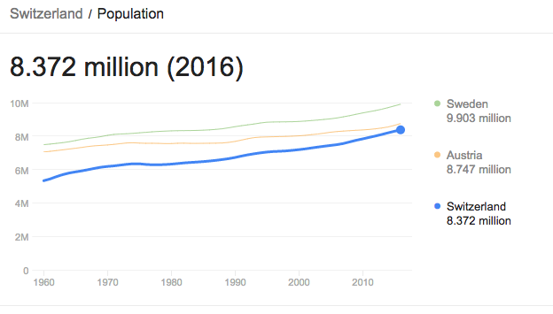
Visualisation of data - graphs
Line charts
Time series
How a variable varies with time
Example - CH population

Slide 16
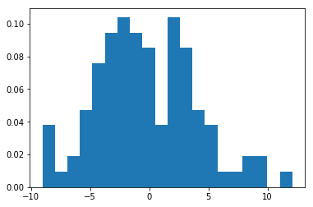
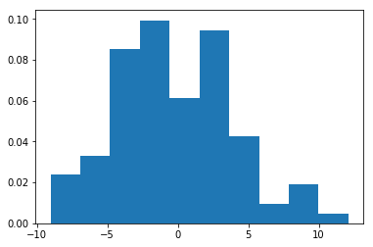
Graphs - histograms
Frequency distribution
Samples the data into bins
Shows the amount of data in each bin
Many bins increase the visual fluctuation
Few bins may hide structures

Slide 17
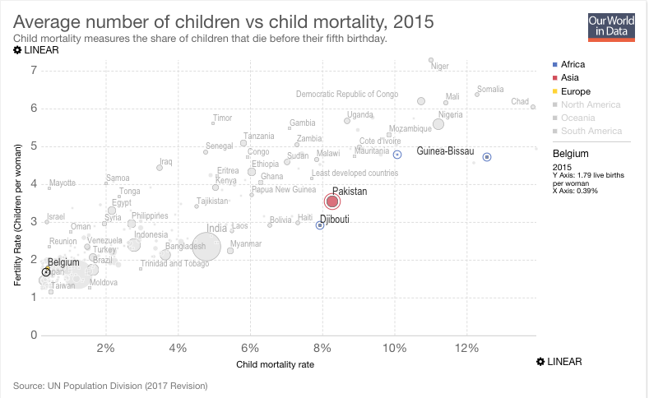
Graphs - scatter plots
Shows correlations
Comparison between observations represented by two variables (X,Y) to determine if they tend to move in the same or opposite directions
Example - human fertility versus child mortality
Scatter plots are often used
Can be 2 or 3 dimensional
Box plots may indicate frequency too

Slide 18
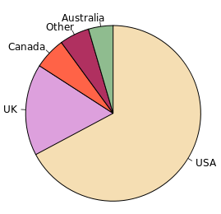
Graphs - pie charts
Parts-to-whole
Categorical subdivisions are measured as a ratio to the whole (i.e., a percentage out of 100%)
Example - countries with their parts of the total english speaking world population
Pie charts can be used

Slide 19
CAS Applied Data Science - Module 1
Data Acquisition and Management

