Slide 1


Statistical Inference for Data Science
CAS Applied Data Science – Module 2 – Day 1
Dr. Anja Mühlemann
29. August 2023

Slide 2
Welcome to Data Science!
Data Science uses
Mathematics and Statistics
Computer Science
Domain expertise
on data to build information and extract knowledge.
Computer Science
Machine Learning
Data Processing
Data Science
Mathematics & Statistics
Domain Expertise
Research

Slide 3
Module 2
Day 1 | Descriptive Statistics and Probability
Day 2 | Parameter estimation
Day 3 | Hypothesis testing
Day 4 | Putting it all together
Project | Presentation session (date to be fixed!)

Slide 4

This module aims to give a brief overview on basic statistics.
That means in a short amout of time we’ll see lot.
While this may be repetition for some,
For others there may be a lot of new things.
I’ll try my best to accomodate everyones needs.
Caution

Slide 5
Introductionary lectures
In-depth self-study of the content with notebooks
Discussion sessions based on your questions Please ask questions ☺
I am open to modifications if wished for!
Teaching

Slide 6

Formal
Group of 2-3 people
15min presentation, 15min discussion
Half-day presence on presentation session
Content
Choose your own data set
answer research questions using statistics
Project

Slide 7
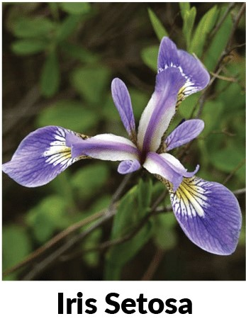
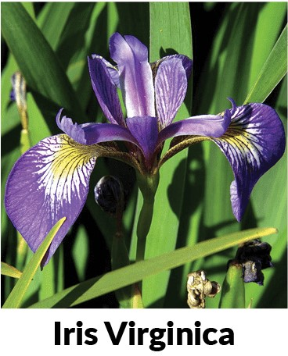
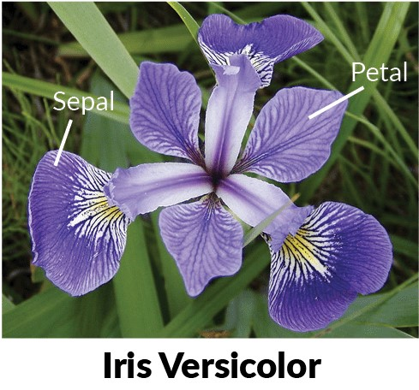
Due to time restrictions we use a single data set in this module
3 classes: versicolor, setosa, virginica
4 characteristics
petal: length, width
sepal: length, width
Iris data set

Slide 8

Any questions so far?

Slide 9
Data Collection & Preprocessing
Descriptive Statistics
Classification, Clustering,…
Inferential Statistics
Planning
General Procedure
Notes:
Planning: What is it I want to know from the data? What do I need to prove to answer my question? What factors do I need to control to be able to really say the difference stems from the variable under study?

Slide 10
Descriptive Statisics
Why?
Get an overview of the data
Identify Patterns
Identify possible problems eg. outliers
Get a feeling for the quality of the data
good description is the basis for good inference

Slide 11
Descriptive Statisics
The two main tasks of descriptive statistics are
the quantitative description and summary, and
the graphical representation of data
What tools are suitable depends on the type of the variable we want to describe.

Slide 12
Categorical Variables (quantitative)
Absolute frequency (eg. number of female participants)
Relative frequency (eq. number of female participants divided by the sample size)

Slide 13
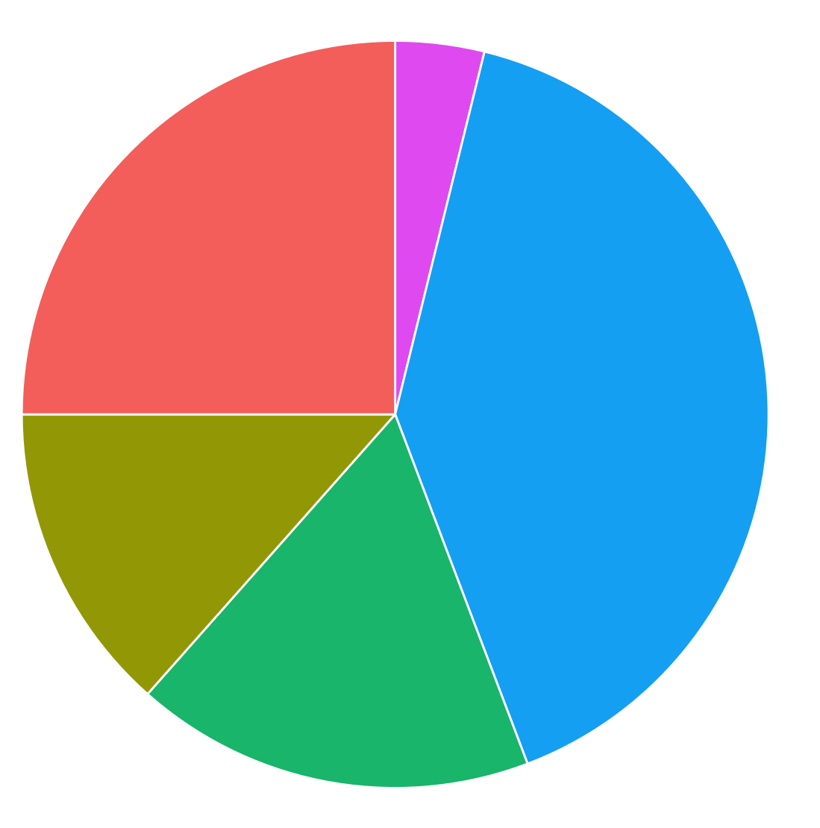
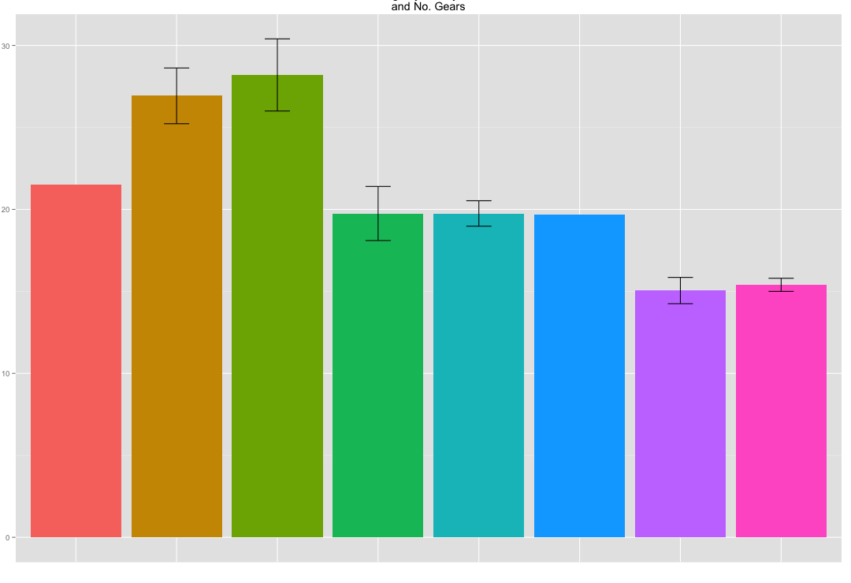
Categorical Variables (graphical)
(Either absolute or relative frequencies can be displayed)

Slide 14
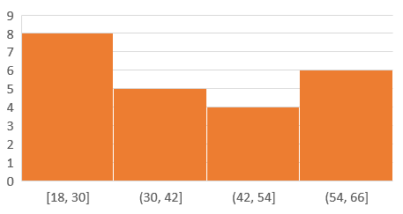
Numerical Variables (categorization)
Summary tables
Age | Nr. of People
18-30 | 8
30-42 | 5
42-54 | 4
54-66 | 6
Histograms

Slide 15
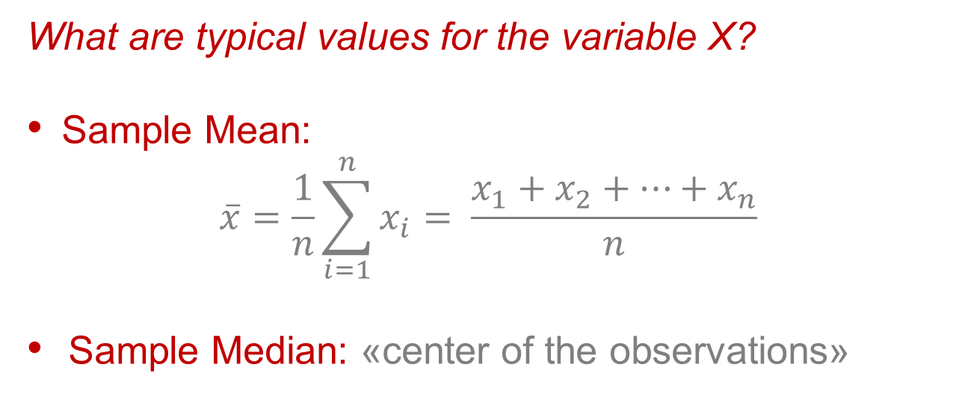


Location
What are typical values for the variable X?
Sample Mean:
$$\overline{x}=\frac{1}{n}\sum_{i=1}^{n}{x_{i}}= \frac{x_{1}+x_{2}+…+x_{n}}{n}$$
Sample Median: «center of the observations»
(Numerical Variables)
odd
$$q_{0.5}$$
even
$$q_{0.5}$$
median ist more robust than the mean
Notes:
For even: Any point inbetween the 2 values that are around the middle are correct. By convention you choose the middle value (average of the two values around the median). The median can also be a set.
Location because it ‚specifies‘ where on the X-axis our value is located.

Slide 16
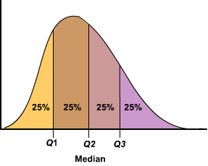
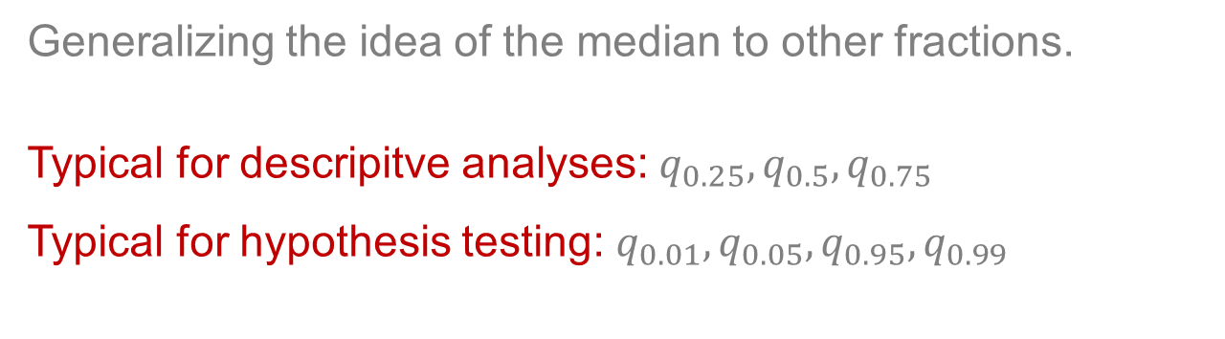



Quantiles
Generalizing the idea of the median to other fractions.
Typical for descripitve analyses: $q_{0.25},q_{0.5},q_{0.75}$
Typical for hypothesis testing: $q_{0.01},q_{0.05},q_{0.95},q_{0.99}$
(Numerical Variables)
$$q_{0.25}$$
$$q_{0.5}$$
$$q_{0.75}$$
Notes:
Quartile = Quantile in one of the quarters (0.25, 0.5, 0.75)

Slide 17
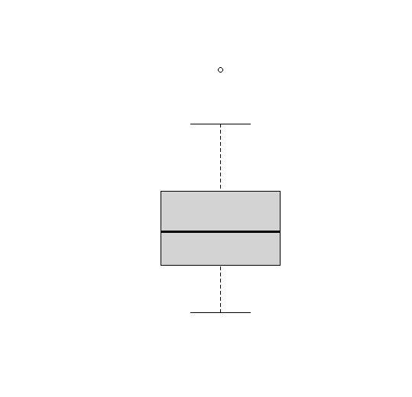










Boxplots
Graphical display of the quantiles
$$max$$
Largest observation less than $q_{0.75}+1.5 ∙(q_{0.75}−q_{0.25})$
$$25\%$$
$$q_{0.75}$$
(Numerical Variables)
$$25\%$$
$$q_{0.5}$$
$$25\%$$
$$q_{0.25}$$
$$25\%$$
$$min$$
Notes:
Box Whiskers Plot shows Outliers
Often when people want to look at Outliers they‘ll use 2* SD → while this works very well for symmetrical distributions, it doesn‘t work quite as well for skewed distributions
Upper end of the whisker is ‚largest not extreme value‘

Slide 18

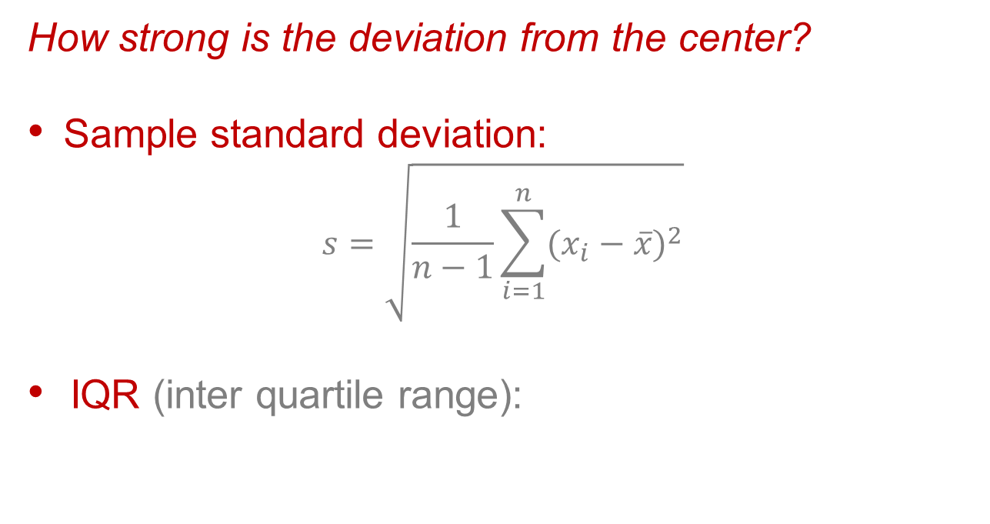


Spread
How strong is the deviation from the center?
Sample standard deviation:
$$s=\sqrt{\frac{1}{n−1}\sum_{i=1}^{n}{{(x_{i}−\overline{x})}^{2}}}$$
IQR (inter quartile range):
(Numerical Variables)
$${IQR=q_{0.75}−q}_{0.25}$$
$$S=1.16, IQR=1.34$$
$$S=4.05, IQR=5.93$$
Notes:
Spread (we square, so large distances have a bigger impact on the spread than small ones).
We divide by n-1 (and not n as in mean) because otherwise we overestimate otherwise.

Slide 19
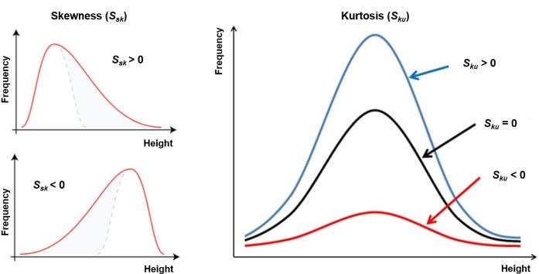
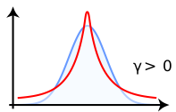
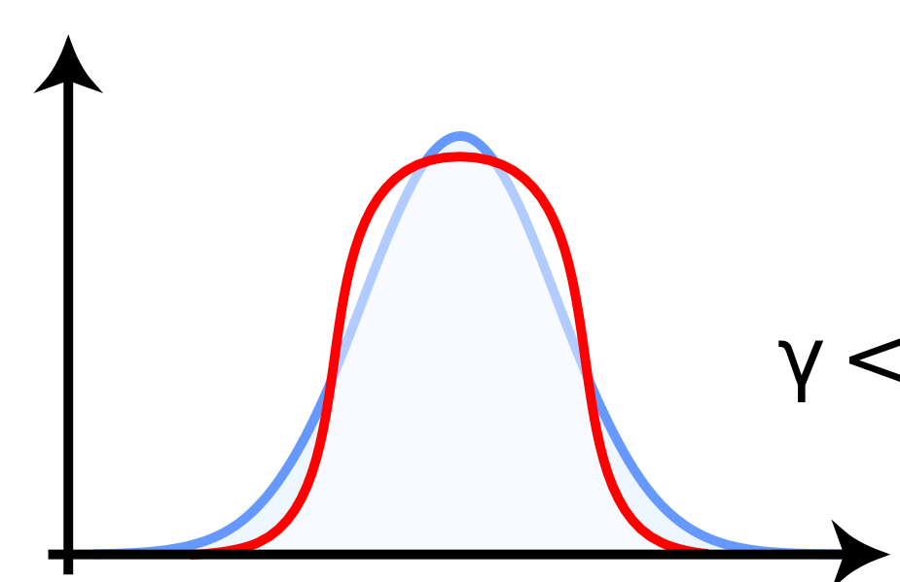
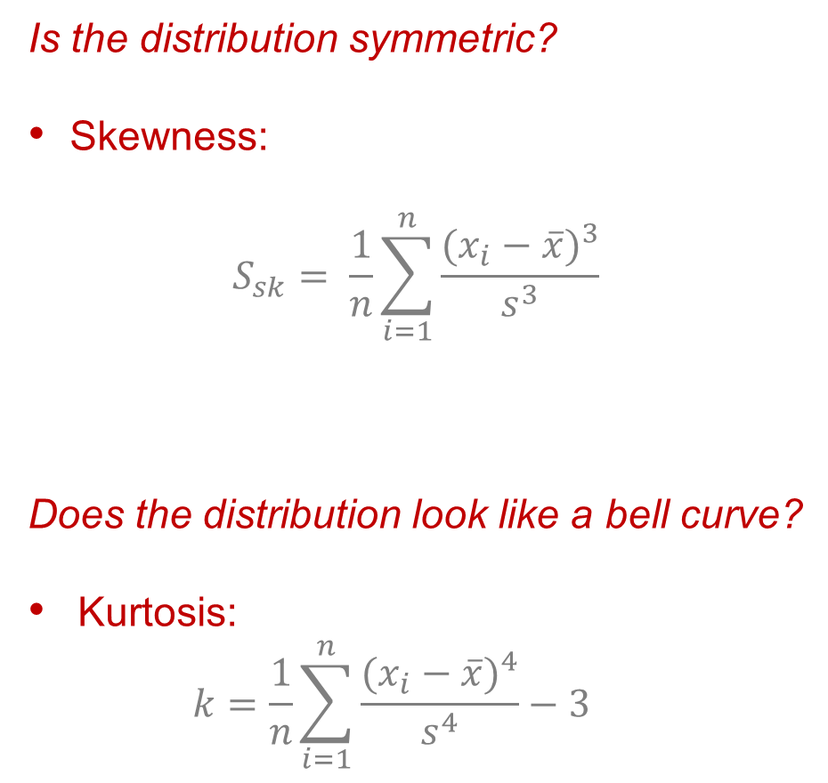
Shape
Is the distribution symmetric?
Skewness:
$$S_{sk}= \frac{1}{n}\sum_{i=1}^{n}{\frac{{(x_{i}−\overline{x})}^{3}}{s^{3}}}$$
Does the distribution look like a bell curve?
Kurtosis: $k=\frac{1}{n}\sum_{i=1}^{n}{\frac{{(x_{i}−\overline{x})}^{4}}{s^{4}}}−3$
(Numerical Variables)
k>0
k<0
Notes:
Kurtosis: Looks if our data is similar to a Bell Curve. K>0 if our data is narrower than the bell curve. K<0 our data is wider than the normal distribution.

Slide 20
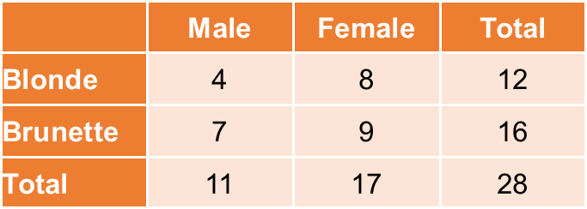
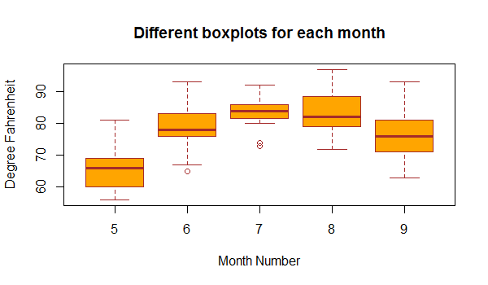
Simultaneous description (of two features)
Contigency table (2 categorical features)
Boxplots (1 categorical and 1 numerical feature)

Slide 21
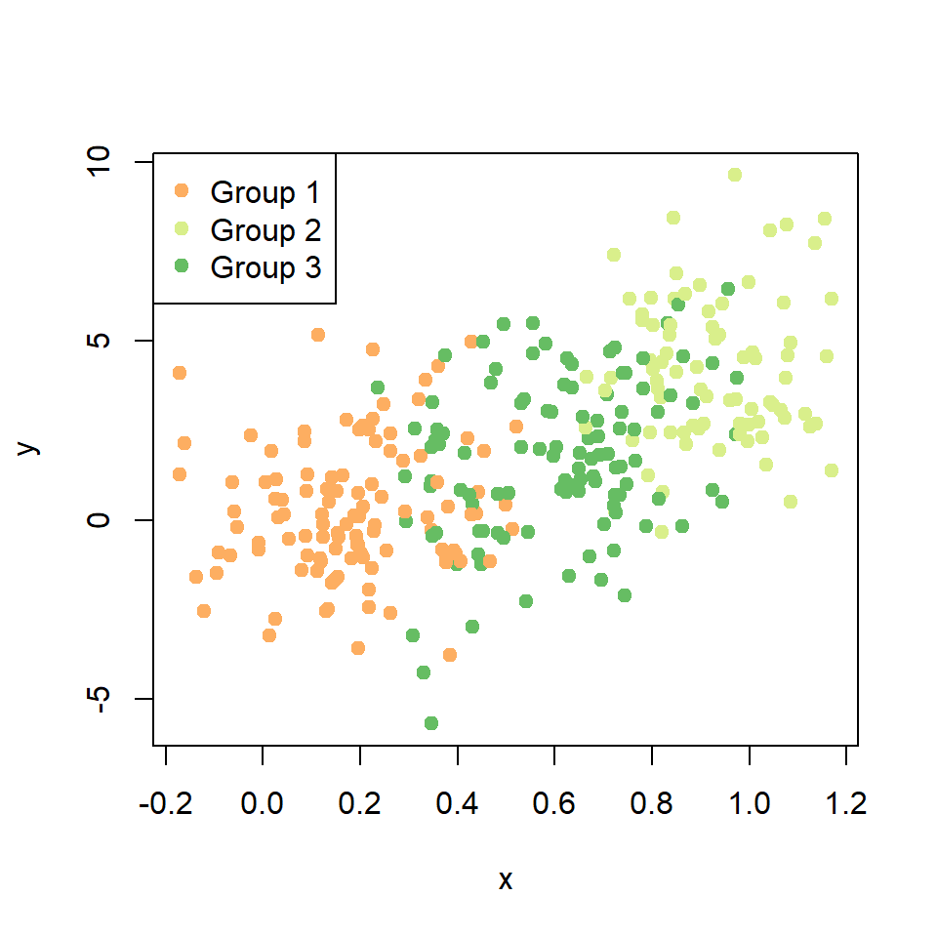
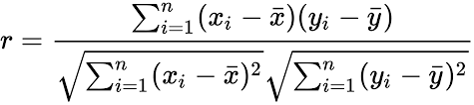
Simultaneous description (of two features)
Scatterplot (2 numerical features)
person i’s y-value
person i’s x-value
Pearson Correlation (2 numerical features)

Slide 22
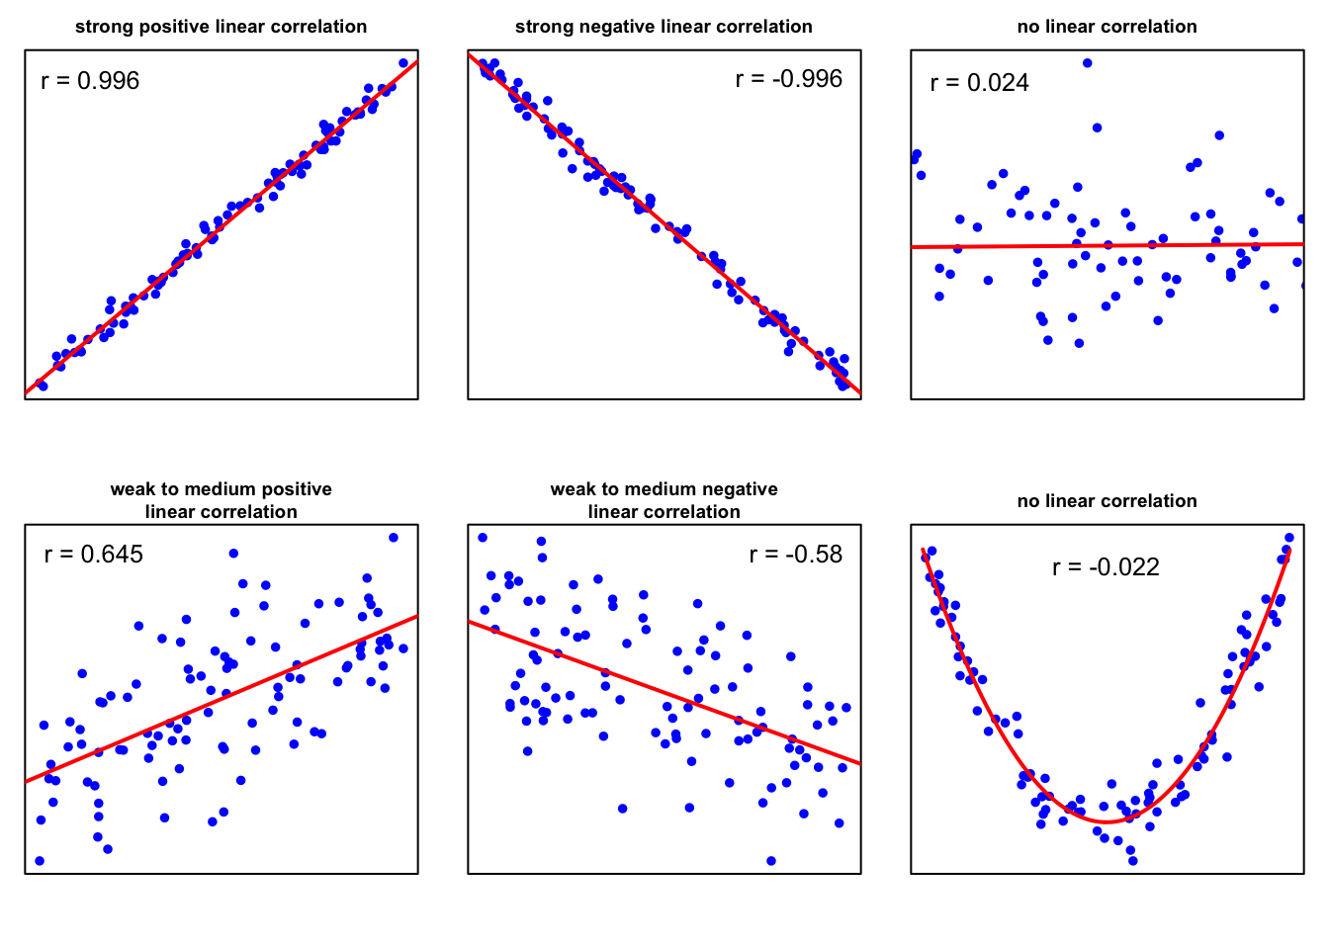
Simultaneous description (of two features)
Pearson Correlation (2 numerical features)
Notes:
Correlation Coefficient is close to 1 or -1 when the points are very close to the straight line aka the distance to the optimal fit is the smallest.
Pearson Correlation Coefficient is not good when we have a non-linear shape/distribution. Pearson-Correlation is only for linear lines!!

Slide 23
Probability
Descriptive statistic is an important first step but does not provide us with the means we aim for eventually.
In general, we want confirm a hypothesis on a population based on sample of said population.
To this end, we need a mathematical framework for dealing this uncertainty.
To quantify the uncertainty one often works with probability distributions.

Slide 24
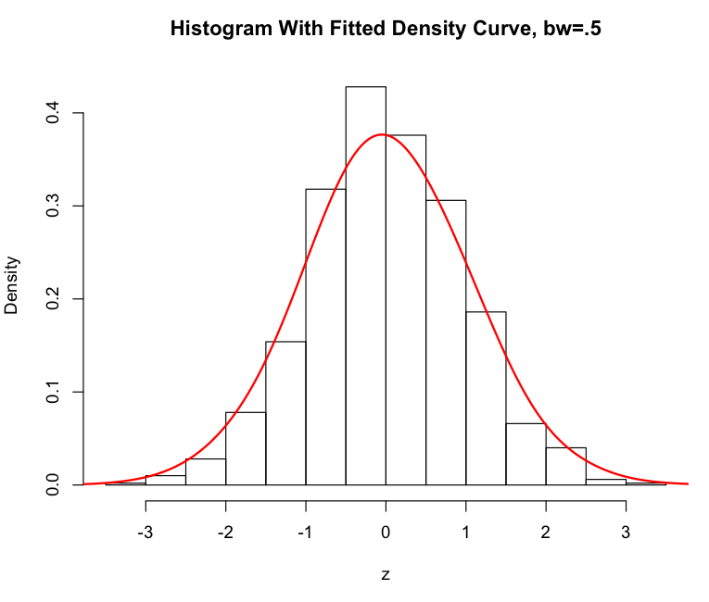
Probability
Probability density function (pdf)

Slide 25
Probability
Probability density function (pdf)

Slide 26
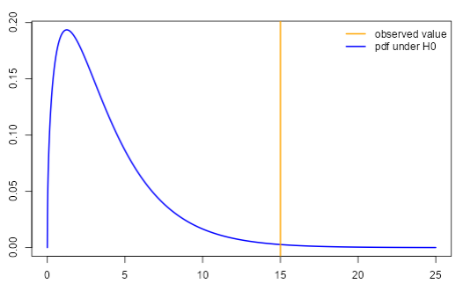
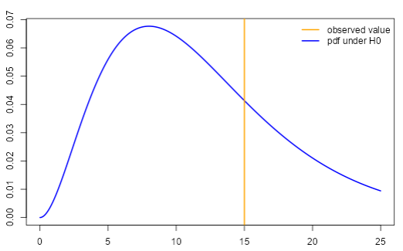
Sketch of idea

