Slide 1
DSC530-T301 Data Exploration & Analysis Term Project
Presented by
Lenin Kamma

Slide 2
Question
Do most of the fatal accidents happen on Monday?

Slide 3
Variables
Accident_Severity – Integer – The severity of accident. 1-fatal, 2-serious, 3–slight
Day_of_week – Numeric – Indicates the day of the week. Sunday -1, Monday-2 etc..
Speed_limit – Numeric – Speed limit. Values from 30 to 70
Road_Surface_Conditons – String- Indicates the road condition Dry, Wet, Frost, Flood, Snow
Road_Type – String- Type of road. One-way, Roundabout, Single way, double way

Slide 4
Variables - Transformation
Road_Surface_Conditons Dry 1
Wet/Damp 2
Frost/Ice 3
Snow 4
Flood 5
Road_Type Single carriageway converted 1
Dual carriageway – 2
One way street – 3
Roundabout – 4
Slip road – 5

Slide 5
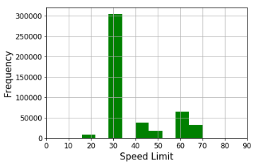
Histogram – Speed limit

Slide 6
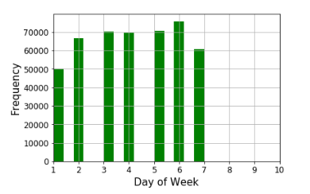
Histogram – Day_of_Week

Slide 7
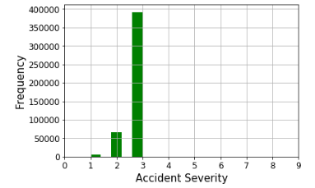
Histogram – Accidents Severity

Slide 8
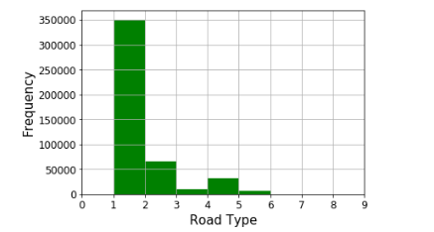
Histogram – Road_Type

Slide 9
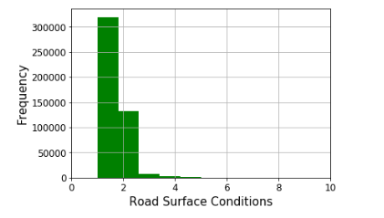
Histogram – Road_Surface_Conditions

Slide 10
Mean. Mode, Variance and Standard Deviation of Accident_Severity
Mean = 2.8333994335498836
Mode = 3
Variance = 0.16168853888219728
Standard Deviation = 0.4021051341156903
Mean is almost close to a value of 3, which indicates that slight accidents are
More frequent than fatal or serious accidents.
The tails are low as the probability of dropping from mode is low

Slide 11
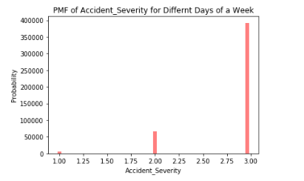
Probability Mass Function (PMF)

Slide 12
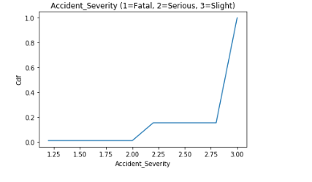
Cumulative Density Function (CDF)

Slide 13
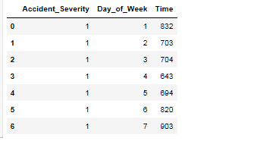
New DataFrame with Day_of_Week and Total Fatal Accidents

Slide 14
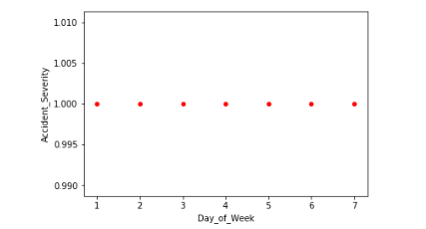
Scatter Plot-1

Slide 15
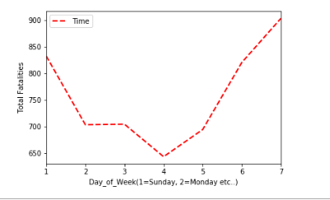
Scatter Plot-2

Slide 16
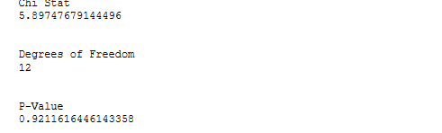
Chi-stat, Degrees of Freedom and p-value Pearson Correlation Coefficient, Covariance and Multiple Regression Statistics
Pearson’s correlation: 0.357
Covariance 7.28333333e+01
Multiple regression:
Intercept: 2.887265567557953 Coefficients: [ 0.02644138 -0.00240911]

