Slide 1
Data Science for Geographers 25/26
Cross validation
Why
How
Types
The caveats
Today

Slide 2
Why
Inference vs Prediction
Why and how?
What are the parameters?
How good is our model in estimating these parameters?
What or whether?
How well can I predict new data?
How good is our model in prediction?
VS
Understand the model fit,
understand the residuals
Cross-validation

Slide 3
Why
Inference vs Prediction
Understand the model fit,
understand the residuals
Cross-validation
In-sample
VS
Out-of-sample
How good is my model in replicating the data it has seen
How good is my model in replicating the data it has not seen

Slide 4

How
Get data
Leave out some of the data
Train the model on the data that you kept
Assess the fit on the left-out data
Train-test split
Model on train
Predict for test
> How close was the prediction to the actual data?
$$Y_{test} −{\hat{Y}}_{test}$$

Slide 5
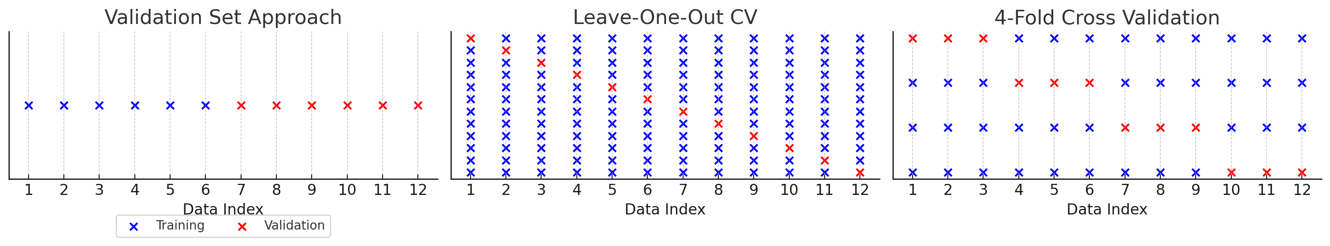
Types
The validation set approach
Split the data into a train set and a test set at random
Model with train and predict for test
Understand the MSE of the prediction
Repeat
Assess the MSE of the multiple runs
Train–test split
50/50
60/40
70/30
80/20

Slide 6
Types
Leave One Out Cross Validation (LOOCV)
Split the data into a train set of all observations except one and into a test set of one observation
Use a trained model to predict for the test observation.
Assess the MSE of all the predictions

Slide 7
Types
K-fold
Split the data into k-folds (k-equal parts)
Train the model on k-1 folds to predict on the k^{th} fold.
Assess MSE of the predictions

Slide 8
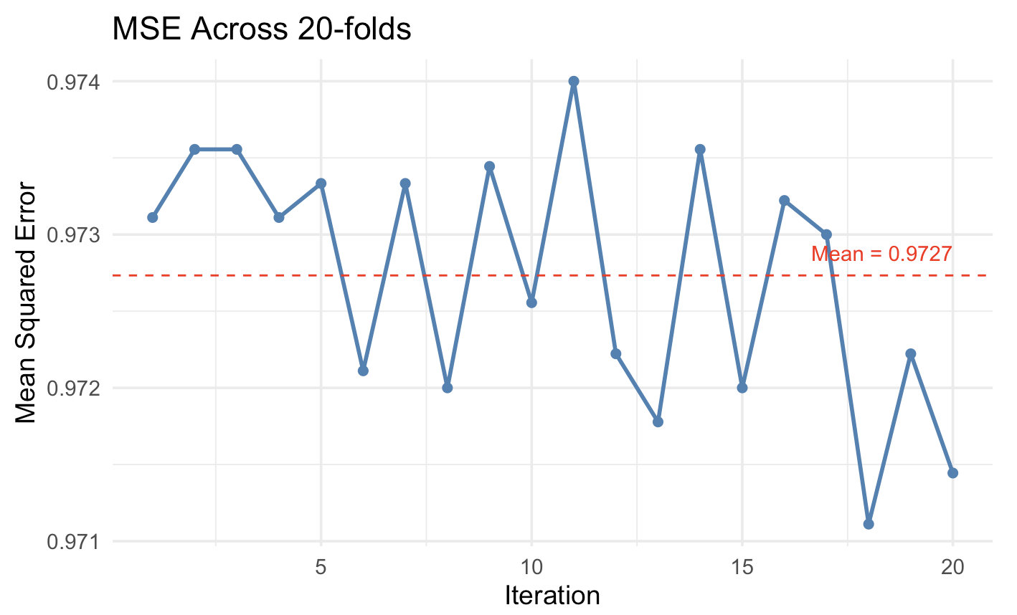

Slide 9
The caveats
Temporal data
Back testing
One-step prediction
Time

Slide 10
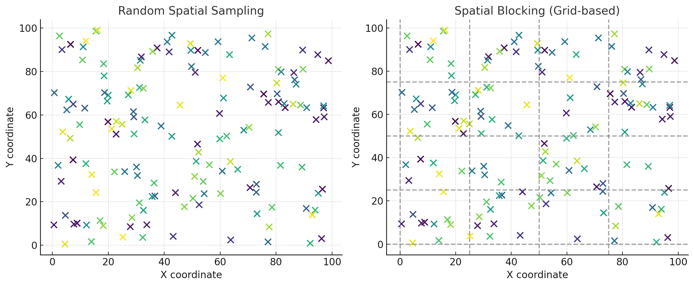
The caveats
Spatial data

Slide 11

The caveats
Using CV as an Inference method
$$β$$
$$β$$
$$β$$
$$β$$
$$β$$
$$β$$
$$β$$
$$β$$
Identifying “influential” observations/groups

